Slide 1
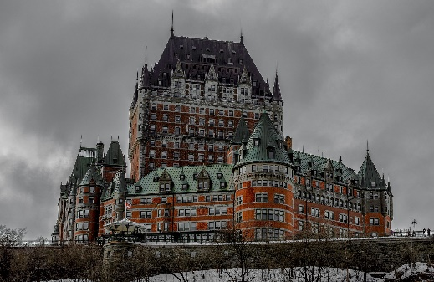
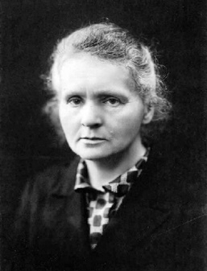
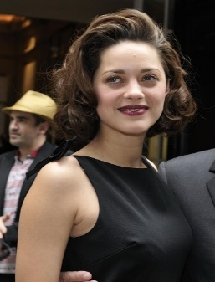
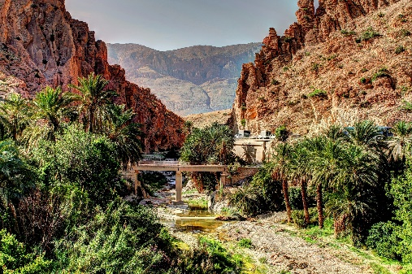
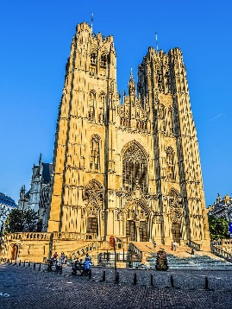




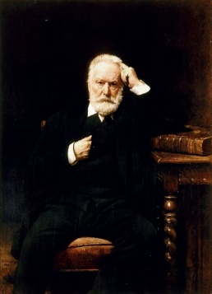
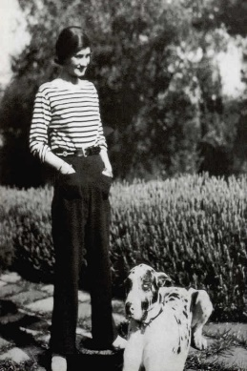

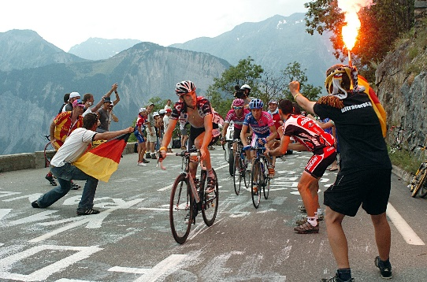
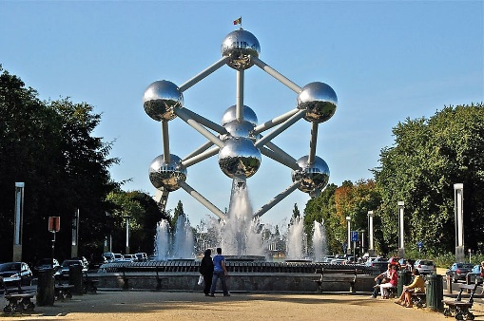



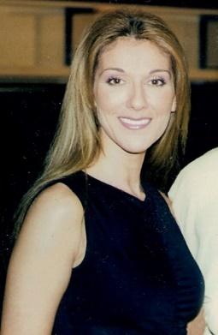
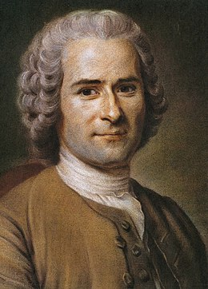
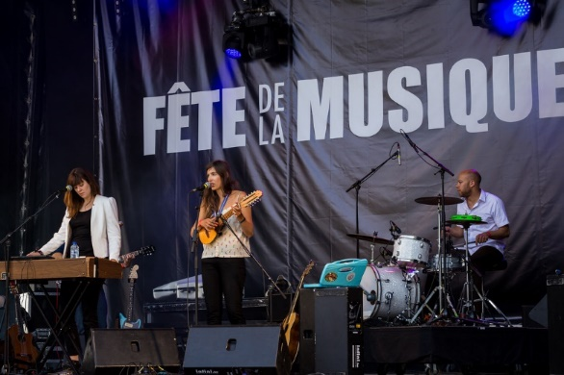
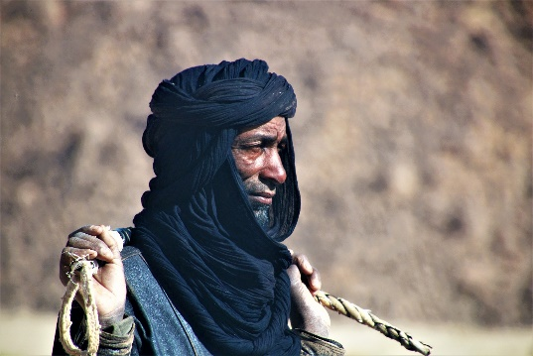
Français
Year 8 Language Guide
Nom: …………………………………………..
Professeur/Professeure: ……………………
Last updated: 21/05/2021

Slide 2
Themes overview | 2 | Pronouns vous (fml) and on (we) Formal and informal situations: Talking to people you do and don't know | 45
Sounds of the language | 3-10
Articles, possessives, gender, il y a Asking about new words in French | 11-12 | Verbs like choisir (sing) Talking about what you/others do at school | 46
Être + profession, est-ce que questions Distinguishing between being/having [1] | 13-14 | Verbs like choisir (pl), present tense with future meaning Talking about this week vs. every week | 47-48
Noun forms & adjective agreement (sing) Distinguishing between being and having | 15 | Noun forms & adjective agreement (pl) Describing more than one thing [1] | 49
Question word + est-ce que, numbers 13-31 Talking about jobs | 16-17 | Adjective position; plusieurs, même(s), autre(s), Describing more than one thing [2] | 50-51
Dates, pronoun ‘on’ Talking about how people celebrate [1] | 18 | Modals, aller + infinitive, two-verb structures What you can, must, will and want to do | 52-53
Possessive adjectives Talking about how people celebrate [2] | 19-20 | Adjectives (comparison, agreement) Comparing things | 54-55
-ER verbs, questions, negation What happens / doesn’t happen | 21-22 | Adverbs (comparison) Comparing how people do things | 56
Perfect tense: je, past participle formation Talking about what you are doing today vs what you did yesterday | 23-24 | Verbs like prendre (pl) Talking about how groups of people do things | 57
Perfect tense: tu, information questions; ce(t), cette, ces Sharing past experiences | 25-26 | Verbs like entendre (sing.) Communicating in other languages | 58-59
Perfect tense: il/elle; il y avait People and places in the past | 27-28 | tout (adj.), verbs like lire and écrire (sing.) Communicating in other languages [1] | 60-61
Perfect tense: negation, yes/no questions Asking about what happened in the past | 29 | Verbs like entendre (pl.) Communicating in other languages [2] | 62
Extended reading: journalistic text Au réveillon de Noël sur l’ISS | 30 | Verbs like lire and écrire (pl.) Communicating in other languages [3] | 63-64
verbs/prepositions with à/de; de + le/la/les Talking about free time (what and where) | 31-32 | Summer test revision Talking about the environment | 65-66
Partitive articles, quels/quelles Talking about parts and wholes | 33-34 | Perfect tense: plurals, inversion questions Talking about what groups of people did | 67-68
Boire [sing.], countability, quantities Talking about nouns you can't count | 35-36 | Perfect tense: adverbs, unspecified times Talking about what you did and have done | 69
Verbs like partir, sortir and comprendre; adverbs, adjectives What is it like? | 37-39 | Past participles, perfect tense questions Asking about the past | 70-71
Spring test revision Saying what you do or did in a typical day | 40-42 | Extended reading: poetry Déjeuner du matin | 72
Verbs like sortir and venir (pl); sans + inf Talking about what groups of people do | 43-44 | Spelling Bee | 73-74
Notes:
Version A

Slide 3
Overview | Theme / Topic
Autumn Term 1 | Asking how to say and write new words in French Distinguishing between being and having Talking about jobs Talking about what, when, where and why you celebrate Talking about how people celebrate What happens and doesn't happen
Autumn Term 2 | Talking about what you are doing today vs what you did yesterday Sharing past experiences People and places in the past Asking about what happened in the past Extended reading: journalistic text Talking about what you do in your free time and where you do it Talking about parts and wholes
Spring Term 1 | Talking about nouns you can't count What is it like? Saying what you do or did in a typical day Talking about what groups of people do Formal and informal situations: Talking to people you do and don't know
Spring Term 2 | Talking about what you and others do at school Talking about what you are doing this week and what you do every week What is it like? Describing more than one thing Talking about what you can, must, will and want to do
Summer Term 1 | What is it like? Comparing things Talking about how groups of people do things Comparing how people do things Communicating in other languages
Summer Term 2 | Communicating in other languages Talking about the environment Talking about what groups of people did Talking about what you did and have done Asking about what you did and have done Extended reading: poetry

Slide 4

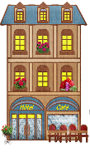


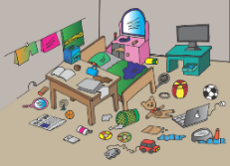

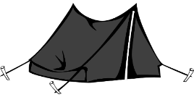





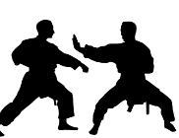
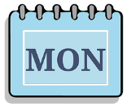
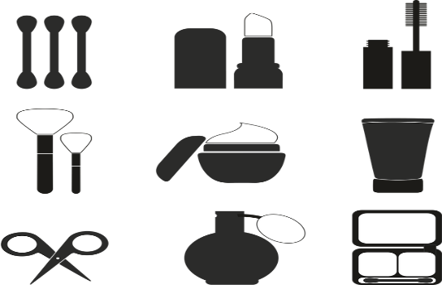
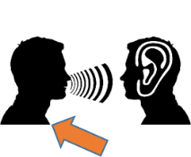


Sounds of the language
The Year 8 ‘Sounds of the language’ cycle revisits existing knowledge of SSC (Sound-spelling correspondences) and liaison patterns taught in Year 7, adding to this stress syllabification exercises to draw attention to cross-linguistic differences in stress patterns, and fifteen new SSC.
Learning these SSC will help you to pronounce written French more confidently and to recognise and spell words you hear.
h
[history,
story]
8
heure
hôtel
hôpital
histoire
hiver
huit
em/am
[together]
[to look like]
[spring]
[time]
camp
ensemble
ressembler (à)
printemps
chambre
temps
aim/im
[simple]
[important]
[impossible]
faim
grimper
simple
important
impossible
imprimer
om
[to
understand]
[account]
[to fall]
Nathalie
Lefèvre
ombre
compte
tomber
combat
nom
comprendre
um/un
1
[none]
[each]
[common]
un
lundi
aucun
chacun
commun
parfum
r
[brother]
[modern]
[to be]
frère
moderne
être
parler
triste
rue
3
Notes:
The cluster words have been chosen for their high-frequency, from a range of word classes, with the SSC (where possible) positioned within a variety of syllables within the words(e.g. initial, 2nd, final etc.., although not, of course with SFC!). Additionally, we have tried to use words that build cumulatively on previously taught SSCs (see the Phonics Teaching Sequence document) and do not include new SSCs. Where new SSCs are used, they are often consonants which have a similar symbol-sound correspondence in English.
Source: Londsale, D., & Le Bras, Y. (2009). A Frequency Dictionary of French: Core vocabulary for learners London: Routledge.
Word frequency rankings (1 is the most common word in French):
histoire [263]; huit [877]; hôpital [1308]; hôtel [1774]; hiver [1586]; heure [99].
camp [1084]; chambre [633] ensemble [124]; printemps [1288]; temps [65]; ressembler [1398].
faim [1986]; simple [212]; important [215]; grimper [2646]; imprimer [3092]; impossible [3092].
nom [171]; comprendre [95]; compte [254]; tomber [547]; combat [1062]; ombre [2001].
un [3]; aucun [63] chacun [323]; commun [780]; lundi [1091]; parfum [4477].
rue [598]; frère [1043], triste [1843], moderne [1239], être [5], parler [106]

Slide 5




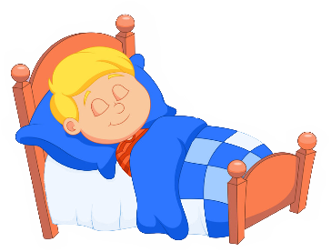





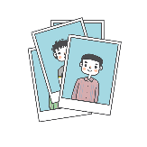
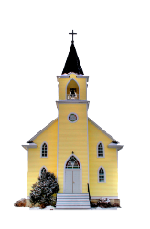


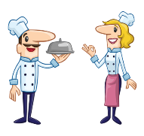









These words have been especially chosen for their high-frequency. This means words that are used a lot when you speak French, and therefore they are very useful words for you to know!
9
open eu/œu
[young]
[mistake]
[sister]
cœur
acteur
jeune
erreur
sœur
neuf
open o
[person]
porte
école
d’accord
personne
dormir
poste
closed o/ô
[thing]
[word]
photo
contrôle
drôle
chose
mot
hôpital
-s-
[sorry]
[thing]
maison
magasin
désolé
chose
cuisine
église
-gn-
[to not
know]
ligne
gagner
espagnol
ignorer
Allemagne
montagne
th
[nice]
[method]
thé
théatre
sympathique
méthode
maths
bibliothèque
4
Notes:
acteur [1552]; cœur [568]; jeune [152]; erreur [612]; neuf [787]; sœur [1558].
porte [696]; d’accord [736]; personne [84]; dormir [39]; école [477]; poste [489].
photo [1412], mot [220], hôpital [1310], chose [125], contrôle [662], drôle [2166]
maison [325]; chose [125]; magasin [1736]; église [1782]; désolé [2081]; cuisine [2618].
ligne [342]; gagner [258]; ignorer [639]; espagnol [1666]; montagne [1734]; Allemagne [N/A].
thé [3517]; méthode [1149]; théâtre [1701]; bibliothèque [2511]; maths [3438]; sympathique [4164].

Slide 6



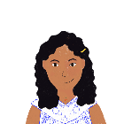






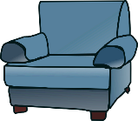
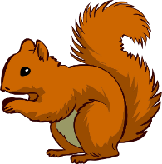

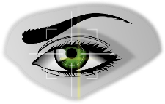
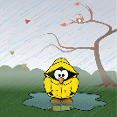



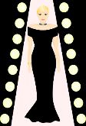







You will sometimes learn these SSC in pairs.
This helps you to distinguish between two very similar sounds.
-ill-/-ille
[to dress]
[family]
fille
brillant
habiller
famille
pavillon
juillet
-aill-/-ail
[to work]
[elsewhere]
[detail]
taille
ail
travailler
ailleurs
détail
medaille
-eill-/-eil
[marvellous]
[device]
[best]
oreille
soleil
merveilleux
appareil
bouteille
meilleur
-euill-/-euil
[to collect]
[welcome]
feuille
fauteuil
accueil
œil
écureuil
recueillir
-ouill-/-ouil
[to rummage]
[to scramble]
[to disentangle]
[wet]
brouillard
fouiller
mouillé
brouiller
débrouiller
grenouille
y
[to analyse]
y
système
style
physique
analyser
rythme
oy
[employee]
[average]
[journey]
envoyer
nettoyer
royal
employé
moyen
voyage
5
Notes:
brillant [2569]; juillet [1326]; habiller [3576]; famille [172]; pavillon [3412].
taille [1500]; ail [>5000]; détail[318]; médaille [3361] travailler [290]; ailleurs [360].
oreille [1844], meilleur [194], soleil [1713], bouteille [2979], merveilleux [2209], appareil [1420]
fauteuil [2743]; feuille [2440] recueillir [1230]; accueil [2541], écureuil [>5000], oeil [474]
fouiller [3431]; brouiller [4682] débrouiller [3618]; grenouille [>5000], mouillé [>5000]
système [289]; style [1999] physique [1146]; analyser [1209]; rythme [1662]
envoyer [526]; royal [2290]; nettoyer [3887]; employé [1485]; voyage [904]; moyen [186]

Slide 7

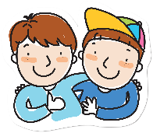


Liaison
If a word normally ends with a Silent Final Consonant, the final consonant is pronounced before a word beginning with [h] or a vowel. This is called liaison.
Here are some examples:
C’est amusant It’s funny.
Because the -t is followed by a vowel, it is pronounced.
Je parle avec mon ami. I speak with my friend.
Because the -n is followed by a vowel, it is pronounced.
Voici trois hôtels. Here are three ideas.
Because the -s is followed by an h-, it is pronounced.
Il y a deux équipes. There are two teams.
Because the -x is followed by a vowel, it is pronounced like a -z.
Syllables and Stress
French does not have the same system of stressed and unstressed syllables as English.
All syllables are sounded fairly equally, with a bit of extra emphasis on the last spoken syllable of each word.
Vowels are not ‘reduced’ – they are sounded in full.
6

Slide 8


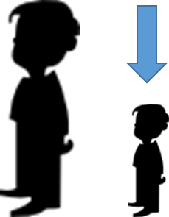
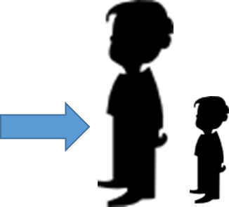


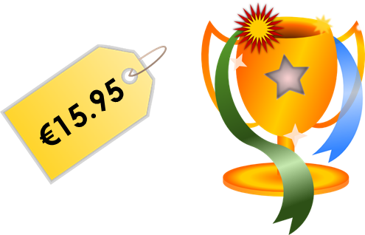


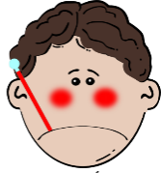





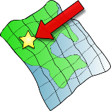
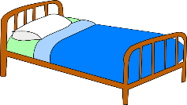
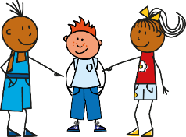




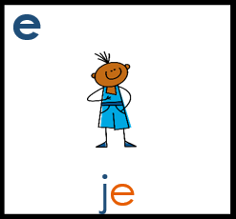
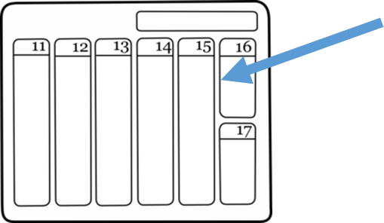
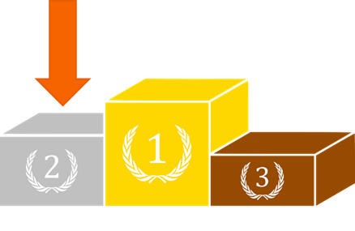
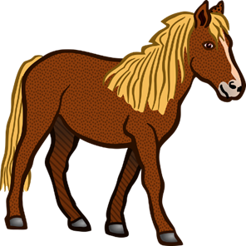





Year 7 phonics
In Year 8, we also revisit the following SSC (Sound-spelling correspondences) taught in Year 7. Learning these will help you to pronounce written French more confidently and to recognise and spell words you hear.
Silent final consonant [SFC)
Something that makes French sound different from English is that some consonants at the ends of words are silent. This means you don’t pronounce them at all!
petit
grand
mot
mais
prix
table
malade
mal
sac
ça va ?
petit
ici
lit
il
qui?
[a little]
[place]
feu
jeu
jeudi
un peu
lieu
[that]
[to have to]
samedi
second
cela
cheval
devoir
[also]
faux
beau
aussi
bateau
7
eau
Notes:
The cluster words have been chosen for their high-frequency, from a range of word classes, with the SSC (where possible) positioned within a variety of syllables within the words(e.g. initial, 2nd, final etc.., although not, of course with SFC!). Additionally, we have tried to use words that build cumulatively on previously taught SSCs (see the Phonics Teaching Sequence document) and do not include new SSCs. Where new SSCs are used, they are often consonants which have a similar symbol-sound correspondence in English.
Source: Londsale, D., & Le Bras, Y. (2009). A Frequency Dictionary of French: Core vocabulary for learners London: Routledge.
Word frequency rankings (1 is the most common word in French):
dans [11]; petit [138] prix [310]; mot [220]; mais [30]; grand [59]
ça va?[54 (cela), 53 (aller)]; malade [1066] mal [277]; table [1019]; sac [2343]; animal [1002]
petit [138]; lit [1837] ici [167]; il[13]; qui [14]; midi [2483]
jeudi[1112]; lieu [117] feu [786]; un peu [138/91]; jeu [291]; deux [41]
samedi [1355]; cela [54] second [379]; devoir [39]; cheval [2220]; je [22]
gauche [607]; aussi [44]; faux[555] photo [1412]; beau [393]; eau [475]

Slide 9





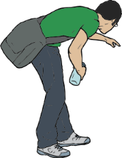










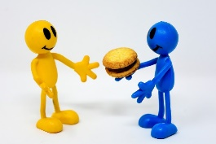



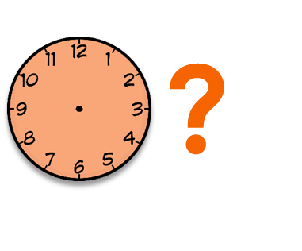
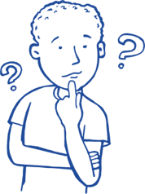

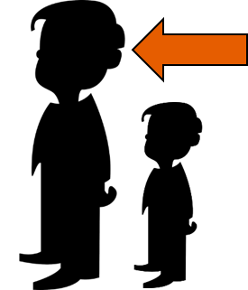


You will sometimes practise the SSC in pairs.
This helps you to distinguish between two very similar sounds.
[on]
[to use]
Salut!
vue
amusant
sur
utiliser
[always;
still]
trouver
jouer
Bonjour!
toujours
douze
[life]
monde
moderne
centre
vie
douze
bébé
aller
donner
nez
parler
[to take]
grand
quand
penser
prendre
encore
[to show]
[at the
back]
[to continue]
onze
continuer
monde
montrer
au fond
8
Notes:
tu [112]; salut ! [2205] vue [191]; sur [16]; amusant [4695]; utiliser [345]
nous [31]; trouver [83] jouer [219]; bonjour [1972]; toujours [103]; douze [1664]
timide [3835]; monde [77]; moderne [1239] centre [491]; vie [132]; douze [1664]
écrire [382]; bébé [>5000]; aller [55] donner [46]; et [6]; parler [106]
enfant [126]; grand [59]; quand [119] penser [116]; prendre[43]; encore [51];
non [72]; onze [2447]; continuer [113] monde [77]; montrer [108]; au fond [553];

Slide 10






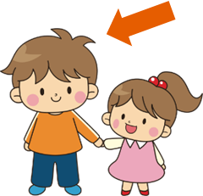


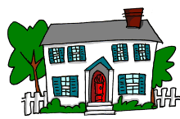







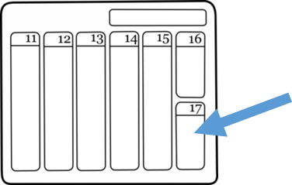






These words have been especially chosen for their high-frequency. This means words that are used a lot when you speak French, and therefore they are very useful words for you to know!
[end]
[now]
fin
matin
vingt
maintenant
main
[problem]
[to be]
fête
frère
collège
problème
être
[reason]
[bad]
[to do]
[week]
maison
raison
mauvais
faire
semaine
[to have]
[why?]
droite
avoir
au revoir
pourquoi ?
trois
[field]
dimanche
chanter
bouche
champ
chat
[to decide]
français
garçon
cinéma
décider
cinq
9
Notes:
train [232]; fin [111]; matin [442] vingt[1273]; maintenant [192]; main [418]
tête [343]; fête [1490]; frère [1043] collège [2116]; problème [188]; être[5]
vrai [292]; maison [325]; raison [72] mauvais [274]; faire [25]; semaine [245]
voir [69]; droite [1293]; avoir [8] au revoir [n/a]; pourquoi[193]; trois[115]
chercher [336]; dimanche [1235]; chanter [1820] bouche [1838]; champ [847]; chat [3138]
ici [167]; français [251]; garçon [1599]; cinéma [1623]; décider [165]; cinq [288]

Slide 11














[to explain]
[to miss;
be missing]
[unique;
only]
quatre
musique
expliquer
manquer
unique
[I have]
[subject]
[already]
[never]
j’ai
génial
sujet
déja
jamais
population
action
situation
international
solution
[nothing]
[soon]
chien
rien
bientôt
ancien
combien ?
Des virelangues pour pratiquer. (Some tongue twisters to practise).
1 Trois gros rats gris dans trois gros trous très creux.
1 Three big grey rats in three big, very deep holes.
2 Ce ver vert va vers le verre vert.
2 This green worm goes towards the green glass.
3 Fruits frais, fruits frits, fruits cuits, fruits crus.
3 Fresh fruits, fried fruits, cooked fruits, raw fruits.
10
Notes:
question[144]; quatre[283]; musique [1139] expliquer [252]; manquer [583]; unique [402]
jour [78]; j’ai [8 - avoir]; génial [3872] sujet [353]; déjà [58]; jamais [179];
attention [482]; population [509]; action [355] situation [223]; international [282]; solution [608];
bien [47]; chien [1744]; rien [168] bientôt [1208]; ancien [392]; combien? [800];
un [3]; quelqu’un [772]; lundi [1091]
Fruit image: Wolfgang Eckert en Pixabay

Slide 12




T1.1 Semaine 1
Prononciation
La liaison
The plural articles ‘les’ and ‘des’ end with a Silent Final Consonant:
However, before a noun beginning with a vowel or ‘h’, the final ‘-s’ is pronounced like the English ‘z’. This is called liaison:
The same thing happens with the numbers ‘deux’ and ‘trois’:
les vacances des parents
les affaires des hommes
deux ordinateurs trois idées
Gender, number and articles
Grammaire
French nouns are either masculine or feminine. Each gender has a different word for ‘the’ and ‘a’. Nouns can also be singular or plural. The number also influences the word for ‘the’ and ‘a’.
masculine
le vélo
(the bike)
un vélo
(a bike)
feminine
la télé
(the TV)
une télé
(a TV)
before a vowel/h-
l’ami(e)
(the friend m/f)
un(e) ami(e)
(a friend m/f)
plural
les vélos
(the bikes)
des vélos
(some bikes)
/
Using ‘il y a’ and ‘il n’y a pas de’
To say what there is, use il y a + indefinite article:
Il y a un vélo Il y a une télé Il y a des vélos
To say what there isn’t, use il n’y a pas + article ‘de’ for all genders:
Il n’y a pas de vélo Il n’y a pas de télé Il n’y a pas de vélos
11
Notes:
Revisit Y7 vocabulary (1/7)
écrire [382], lire [278], affaires [170], anglais2 [784], cadeau [2298], chemise [3892], chien [1744], courses [1289], devoirs [39], femme [154], français2 [251], fruit [896], homme [136], livre [358], mot [220], ordinateur [2201], parents [546], phrase [2074], portable [4002], porte [696], règle [488], télé [2746], vacances [1726], vélo [4594], vêtements [2383], voiture [881], et [6], ou [33], un2 [3], une2 [3], des [3], le [1], la [1], les [1], ce [12], ça [54 (cela)], il2 [13], elle2 [38], voici [1103], cinq [288], deux [41], dix [372], douze [1664], huit [877], neuf [787], onze (2447), quatre [253], sept [905], six [450], trois [115], au revoir [4/1/1274], bonjour [1972], quoi [297], comment ça s’écrit ? [234/54/17/382], il y a [13/36/8]

Slide 13




Asking how to say and write new words in French
Possessive adjectives
We have seen that French has different words for ‘the’ and ‘a’ depending on the gender and number of the noun.
This is also true of the words for ‘my’ and ‘your’:
masculine
mon vélo
(my bike)
ton vélo
(your bike)
feminine
ma voiture mon amie
(my car) (my friend)
ta voiture ton amie
(your car) (your friend)
plural
mes voitures
(my cars)
tes voitures
(your cars)
ta → ton before a vowel / h-
ma → mon before a vowel / h-
Saying ‘it’ and ‘they’
When we are referring to things, il/elle means ‘it’ and ils/elles means ‘they’. The word for it or they matches the gender:
Le livre est bon. Il est bon. → It (m) is good.
Les livres sont bons. Ils sont bons. They (m) are good.
La règle est petite. Elle est petite. → It (f) is short.
Les règles sont petites. Elles sont petites. → They (f) are short.
Vocabulaire
Comment ça s’écrit ?
Revisit
1/6 Y7 vocab
Comment dit-on ça ?
12
Notes:
Revisit Y7 vocabulary (1/7)
écrire [382], lire [278], affaires [170], anglais2 [784], cadeau [2298], chemise [3892], chien [1744], courses [1289], devoirs [39], femme [154], français2 [251], fruit [896], homme [136], livre [358], mot [220], ordinateur [2201], parents [546], phrase [2074], portable [4002], porte [696], règle [488], télé [2746], vacances [1726], vélo [4594], vêtements [2383], voiture [881], et [6], ou [33], un2 [3], une2 [3], des [3], le [1], la [1], les [1], ce [12], ça [54 (cela)], il2 [13], elle2 [38], voici [1103], cinq [288], deux [41], dix [372], douze [1664], huit [877], neuf [787], onze (2447), quatre [253], sept [905], six [450], trois [115], au revoir [4/1/1274], bonjour [1972], quoi [297], comment ça s’écrit ? [234/54/17/382], il y a [13/36/8]

Slide 14

T1.1 Semaine 2
Grammaire
Yes/no questions
There is a space before the question mark in French!
You know two ways to form yes/no questions:
1. swapping the verb/subject and adding a hyphen (inversion):
2. raising your pitch at the end of the sentence (rising intonation):
To emphasise that a question is being asked, we can add ‘Est-ce que’ (‘Is it that...?’) to the beginning of an intonation question:
Inversion questions are used in more formal situations, especially in writing. In casual conversation, est-ce que questions and intonation questions are more usual.
Statement
Tu es malade.
Question
Es-tu malade ?
Statement
Tu es malade.
Question
Tu es malade ?
Statement
Tu es malade.
Question
Est-ce que tu es malade ?
Talking about professions
Je suis avocate. I am a lawyer (f.).
Il veut être secrétaire. He wants to be a secretary.
Je suis une avocate ambitieuse. I am an ambitious lawyer.
C’est un secrétaire de l'école. He’s a secretary at the school.
There is no indefinite article after être + profession:
We do need articles with more general statements, like when we use adjectives to give information about the job.
13

Slide 15




Distinguishing between being and having: talking about jobs
Vocabulaire
nm
nf
nm
nm
nf
nm
nm
nf
nm
nf
adj
un avocat | lawyer (m)
une avocate | lawyer (f)
le bureau | desk, office
le directeur | headteacher (m)
la directrice | headteacher (f)
l’emploi (m) | job
le facteur | postman (m)
la factrice | postwoman f)
le secrétaire | secretary (m)
la secrétaire | secretary (f)
ambitieux | ambitious (m)
adj
adj
adj
adj
adv
ambitieuse | ambitious (f)
prudent(e) | careful (m/f)
travailleur | hard-working (m)
travailleuse | hard-working (f)
assez | quite
Revisit vocab 7.3.1.4 & 7.3.2.5
14
Notes:
avocat [1188], bureau² [273], directeur¹ [640], emploi¹ [517], facteur [1264], secrétaire [920], ambitieux [2905], prudent [1529], travailleur, travailleuse [1341], assez [321]

Slide 16



T1.1 Semaine 3
Grammaire
Feminine noun formation -eur ➜ -rice
We know two rules for making masculine nouns feminine:
1. add -e: un avocat une avocate
2. change the article only: un médecin une médecin
3. change -eur to -rice: un acteur une actrice
Here is another ways:
Adjective agreement (-x to -se)
We know three ways to make masculine adjectives feminine:
1. add -e: grand (m) grande (f)
2. no change if ends in –e: calme (m) calme (f)
3. irregular forms: beau (m) belle (f)
vieux (m) vieille (f)
3. change -x to -se heureux (m) heureuse (f)
ambitieux (m) ambitieuse (f)
exception: travailleur (m) travailleuse (f)
Here is another rule:
Revisit vocab 7.3.1.4 & 7.3.2.5
15

Slide 17



T1.1 Semaine 4
Grammaire
Construction rule for numbers 13-31
Numbers 13-16 are as follows :
treize thirteen quatorze fourteen quinze fifteen seize sixteen
Numbers 17-31 are made up of a combination of other numbers:
dix-sept seventeen dix-huit eighteen
dix-neuf nineteen
vingt twenty trente thirty
vingt-deux twenty-two trente-et-un thirty-one
Join the numbers with a hyphen.
Add et before ‘un’.
Using est-ce que with a question word
We know we can add est-ce que to yes/no intonation questions to emphasise that something is being asked :
Est-ce que tu manges des fruits ?
Do you eat fruit?
Est-ce que tu demandes un cadeau ?
Are you asking for a present?
Combien de fruits est-ce que tu manges ?
How much fruit do you eat?
Qu’est-ce que tu demandes ?
What are you asking for?
?
To turn these into information questions, add a question word before est-ce que :
que → qu’ before a vowel
Remember - the subject and verb stay in the same order with est-ce que, unlike in questions with subject-verb inversion.
16
Notes:
avocat [1188], bureau2 [273], directeur1 [640], directrice2 [640], emploi1 [517], serveur [4377], serveuse [4377], secrétaire [920], ambitieux [2905], ambitieuse [2905], prudent [1529], travailleur1 [1341], travailleuse1 [1341], assez [321]

Slide 18

Talking about what, when, where and why you celebrate
Vocabulaire
vb
vb
pron
célébrer | to celebrate, celebrating
préférer | to prefer, preferring
on | everyone, you, one
la date | date
l’évènement (m) | event
février (m) | February
janvier (m) | January
juin (m) | June
nf
nm
nm
nm
nm
nm
nm
nf
adj
adj
mars (m) | March
mai (m) | May
la tradition | tradition
premier | first (m)
première | first (f)
quatorze | fourteen
quinze | fifteen
seize | sixteen
trente | thirty
treize | thirteen
vingt | twenty
Revisit vocab 7.3.2.6 & 7.3.1.5
17
Notes:
célébrer [2170], préférer [597], on¹ [29], avril [1022], date [660], événement [573], février [1136], janvier [939], juin [931], mai [943], mars [868], tradition [1371], premier, première [56], quatorze [3359], quinze [1472], seize [3285], trente [1646], treize [3245], vingt [1273]

Slide 19
T1.1 Semaine 5
Grammaire
Dates
In English, we change the form of numbers to make dates:
The fourteenth of February 14th February
In French, we simply add le before a number to make it a date:
Le quatorze février 14 février
The only exception is the first day of the month:
Le premier janvier 1er janvier
We don’t need a word for ‘of’.
Subject pronoun on
Subject pronouns (like ‘I’ and ‘they’) tell us who is doing something.
The subject pronoun on is used to talk about what people in general do. We can translate it as ‘people’, ‘you’ or ‘one’.
On célèbre le carnaval en février.
People celebrate carnival in Febuary.
On doit porter un uniforme au collège.
You have to wear a uniform at school.
On uses the same verb endings as il / elle:
‘One’ sounds very formal in English and is rarely used in conversation. However, ‘on’ is commonly used in everyday French.
‘You’ doesn’t refer to a specific person here - it’s impersonal.
Revisit vocab 7.3.2.6 & 7.3.1.5
18

Slide 20







T1.1 Semaine 6
Grammaire
Saying ‘his’ and ‘her’
To say ‘his’ or ‘her’, we use son, sa, or ses, depending on the gender and number of the thing that is possessed:
masculine
son père
his/her father
feminine
sa mère
his/her mother
plural
ses enfants
his/her children
/
/
/
The words for ‘his’ and ‘her’ are the same - we don’t know the gender of the possessor (the person the thing belongs to).
Son/sa/ses can also mean ‘your’ or ‘their’ when talking about belonging to people in general (after words like on and chacun).
Saying ‘our’
To say ‘our’, we use notre with singular nouns, and nos with plural nouns. Notre and nos are used with the pronoun nous.
masculine
notre fils
our son
feminine
notre fille
our girl
plural
nos enfants
our children
/
/
/
19

Slide 21




Talking about how people celebrate [2]
Vocabulaire
vb
pron
nf
nm
nm
nm
nm
nm
nm
adj
adj
adv
organiser | to organise, organising
chacun | each person
l’anniversaire (m) | birthday
août (m) | August
décembre (m) | December
juillet (m) | July
septembre (m) | September
octobre (m) | October
novembre (m) | November
général(e) | general (m/f)
national(e) | national (m/f)
partout | everywhere
Revisit vocab 7.3.2.7 & 7.3.1.6
20
Notes:
organiser [701], chacun [323], anniversaire [2043], août [1445], décembre [891], juillet [1326], septembre [944], octobre [826], novembre [982], général [147], national [227], partout [581]

Slide 22

T1.1 Semaine 7
Grammaire
-ER verbs in the present tense
The majority of French verbs end in -ER (manger, parler, visiter). The form of the verb with an -ER ending is called the infinitive. This is the form you will find when you look up a verb in the dictionary.
To use -ER verbs, you need to remove -ER and add an ending to match the subject. The endings for -ER verbs are as follows:
jouer (to play,playing)
je joue (I play/am playing) | nous jouons (we play/are playing)
tu joues (you play/are playing) | vous jouez (you (pl/fml) play/are playing)
il/elle joue (he/she plays/is playing) | ils/elles jouent (they (m/f) play/are playing)
Verbs with prepositions
Some verbs need to be followed by a preposition in English, but not in French:
I listen to the radio. J’écoute la radio. (no à)
I am looking at the train. Je regarde le train. (no au)
I am looking/asking for a book. Je cherche/demande un livre. (no pour)
Other verbs need a preposition in French too, often a form of à:
I am talking to the teacher. Je parle au professeur.
I am giving a present to the girl. Je donne un cadeau à la fille.
au (à + le) à la (à + la) à l’ (à + l’ + vowel) aux (à + les)
21

Slide 23





What happens and doesn’t happen
Question formation
Grammaire
You know two ways to form a French question.
1. Raised intonation
Statement
Tu chantes.
You sing.
Yes/no question
Tu chantes ?
Do you sing?
Information question
Tu chantes quand ?
When do you sing?
With this type of question, the question word goes at the end.
You can also add est-ce que before the pronoun for emphasis: ‘Est-ce-que tu chantes?’ ‘Quand est-ce que tu chantes?’
2. Inversion
Statement
Tu chantes.
You sing.
Yes/no question
Chantes-tu ?
Do you sing?
Information question
Quand chantes-tu ?
When do you sing?
With this type of question, the question word goes at the start.
Negation
To say something isn’t happening, add ne…pas around the verb.
I speak.
I do not speak.
Je parle.
Je ne parle pas.
Vocabulaire
Revisit 2/6 Y7 vocab
22
Notes:
avocat [1188], bureau2 [273], directeur1 [640], directrice2 [640], emploi1 [517], serveur [4377], serveuse [4377], secrétaire [920], ambitieux [2905], ambitieuse [2905], prudent [1529], travailleur1 [1341], travailleuse1 [1341], assez [321]

Slide 24

T1.2 Semaine 1
Grammaire
Present vs perfect tense (je)
We use the perfect tense to say what we did in the past.
Look at the differences between the present and perfect (past) tense forms of these verbs:
Present Perfect (past)
je dis → j’ai dit
(I say) (I said)
je fais → j’ai fait
(I do/make) (I did/made)
The past tense forms of the verbs (dit - said; fait - made) are called past participles.
In the perfect tense we use j’ai rather than je (‘I’).
The -s and -t at the end of the verbs are Silent Final Consonants (SFCs). The only difference we hear between present and past tense forms is the j’ai.
Past participle formation: -ER verbs
All verbs change to show that we are talking about the past. The form of the verb that comes after j’ai is called the past participle.
All -ER verbs make their past participles by changing the -ER ending to -É:
Irregular verbs have special forms, e.g.:
j’ai fait - I did/made j’ai dit - I said
Present Perfect (past)
j’apporte → j’ai apporté
(I’m bringing) (I brought)
j’envoie → j’ai envoyé
(I’m sending) (I sent)
The -er on the infinitive is replaced with -é. This sounds the same as the infinitive!
23

Slide 25




Talking about what you are doing today vs what you did yesterday
Vocabulaire
vb
vb
vb
vb
vb
adv
adv
nm
nf
nm
nm
apporter | to bring, bringing
dit | said (pp.)
fait | did, made (pp.)
envoyer | to send, sending
utiliser | to use, using
maintenant | now
hier | yesterday
l’appartement (m) | apartment, flat
la banque | bank
le marché | market
le passé | past
Revisit vocab 7.3.2.3 & 8.1.1.2
24
Notes:
apporter [339], dit [dire 37], fait [faire 25], envoyer [526], utiliser [345], maintenant [192], hier [872], appartement [2323], banque [774], marché [280], passé [501]

Slide 26
T1.2 Semaine 2
Grammaire
Present vs perfect tense (tu)
Present Perfect (past)
je travaille → j’ai travaillé
(I work) (I worked)
Present Perfect (past)
tu travailles → tu as travaillé
(you work) (you worked)
tu joues → tu as joué
(you play) (you played)
-ER verbs make their perfect tense with je as follows:
Remember: in the perfect tense we use j’ai rather than je (‘I’).
What do you think the tu form looks like?
The past participle does not change. Only the form of avoir changes to match the subject.
Intonation questions in the perfect tense
Remember - you can ask questions in French by raising the pitch of your voice:
Statement
Tu chantes.
You sing.
Remember to leave a space before the question mark in French!
Question
Tu chantes ?
Do you sing?
You can do the same in the perfect tense:
Statement
Tu as chanté.
You sang / have sung.
Question
(Est-ce que) tu as chanté ?
Did you sing?
Add a question word to the end for more information:
Question
Tu as chanté quand ?
When did you sing?
25

Slide 27



Sharing past experiences
Ce, cet, cette and ces
Grammaire
You have met the word ce, meaning ‘this’:
c’est (this is); en ce moment (at this moment)
Ce is a demonstrative adjective. These are used to identify which noun someone is talking about. Ce has different forms which match the noun to which it refers.
masculin féminin plural
ce marché cette femme ces hommes
cet homme ces femmes
Ce changes to cet before a masculine noun beginning with a vowel or ‘h-’.
Ce becomes ces before a plural noun - regardless of gender.
Vocabulaire
nm
nm
nm
nm
nm
nf
nf
adj
adj
adj
adv
nf
n
l’automne | autumn
l’été (m) | summer
l’hiver (m) | winter
le musée | museum
le printemps | spring
la place | (town) square
la saison | season
belge | Belgian (m/f)
dernier | last (m)
dernière | last (f)
pendant | during
la Belgique | Belgium
Bruxelles | Brussels
Revisit vocab 7.3.2.4 & 8.1.1.4
26
Notes:
automne [1503], été [623], hiver [1586], musée [2216], printemps [1288], place [129], saison [1667], belge [2795], dernier [87], dernière [87], pendant [89], Belgique [n/a], Bruxelles [n/a]

Slide 28





T1.2 Semaine 3
Grammaire
Present vs perfect tense (il/elle)
Present Perfect (past)
tu travailles → tu as travaillé
(you work) (you worked)
Present Perfect (past)
il travaille → il a travaillé
(he works) (he worked)
elle joue elle a joué
(she plays) (she played)
-ER verbs make their perfect tense with je as follows:
Remember: in the perfect tense we use tu as rather than tu (you).
What do you think the il/elle form looks like?
The past participle does not change. Only the form of avoir changes to match the subject.
Il y a vs il y avait
As you know, the expression il y a means ‘there is’ / ‘there are’:
Present:
Il y a une erreur dans la phrase.
There is a mistake in the sentence.
Il y a des voitures dehors.
There are (some) cars outside.
Past:
Il y avait une erreur dans la phrase.
There was a mistake in the sentence.
Il y avait des voitures dehors.
There were (some) cars outside.
To say ‘there was’ / ‘there were’, we use il y avait:
Remember: il y avait means both ‘there was’ (sing.) and ‘there were’ (pl.).
27

Slide 29




People and places in the past; Asking about what happened in the past
Vocabulaire
vb
vb
vb
vb
nf
nf
nf
nf
adj
nf
emporter | to take with, taking with
proposer | to suggest (doing), suggesting (doing)
voyager | to travel, travelling
traverser | to cross, crossing
la frontière | border
la forêt | forest
la montagne | mountain
la vue | view
suisse | Swiss (m/f)
la Suisse | Switzerland
Genève | Geneva
il y avait | there was | there were
Revisit vocab 8.1.1.6 & 7.3.2.5
28
Notes:
emporter [1128], proposer [338], voyager [2194], traverser [1040], frontière [1182], forêt [1724], montagne [1732], vue [191], suisse [2241], Suisse [n/a], Genève [n/a], il y avait [13/36/8]

Slide 30

T1.2 Semaine 4
Grammaire
Negation in the perfect tense
As you know, we make a sentence negative by adding ne… pas around the verb:
Present:
Je ne visite pas la ville. I’m not visiting the town.
Elle n’organise pas de voyages. She isn’t organising any trips.
In two verb structures, ne…pas surrounds the first verb (which agrees with the subject).
So, in the perfect tense, ne…pas surrounds the form of avoir:
Perfect (past):
Je n’ai pas visité la ville. I didn’t visit the town.
Elle n’a pas organisé de voyages. She didn’t organise any trips.
un/une/des → de after ne…pas
There is no one-word equivalent for ‘didn’t’ in French. Didn’t = ne … pas + perfect tense
Yes/no questions in the perfect tense
Remember: you can ask a yes/no question by simply raising the pitch of your voice (intonation) at the end of a sentence:
Statement: Il a visité la ville. He visited the city.
Question: Il a visité la ville ? Did he visit the city?
Another way is to add est-ce que to the
beginning of the sentence:
Statement: Elle a organisé un voyage.
She organised a trip.
Question: Est-ce qu’elle a organisé un voyage ?
Did she organise a trip?
There is no French equivalent word for ‘did’ in a question.
Revisit vocab 8.1.1.6 & 7.3.2.5
29

Slide 31





T1.2 Semaine 5
Vocabulaire
Au réveillon de Noël sur l’ISS
vb
nm
nm
nf
nm
nf
nm
adv
adv
pron
adv
nm
nm
gérer | to manage / managing something or someone
l’espace (m) | space
le goût | taste
la langue | language, tongue
le plat | dish
la recette | recipe
le repas | meal
d’abord | first of all
puis | then
par | by
puisque | as, because
Noël | Christmas
le réveillon | Christmas Eve, New Year’s Eve
Revisit vocab 7.3.2.6 & 8.1.2.1
30
Notes:
gérer, gère [1354], espace [870], goût [1829], langue², [712], plat [2167], recette [1709], repas [2948] d'abord [326], puis [230], par [21], puisque [528], Noël [>5000], réveillon [>5000]

Slide 32
T1.2 Semaine 6
Grammaire
Using the preposition ‘de’
We know that à has different forms when before le, la and les:
Je vais .. au collège (m) à la caisse (f)
I’m going ... to (the) school to the checkout
à l’aéroport (vowel/h-) aux magasins (pl)
to the airport to the shops
Preposition de also has different forms before le, la and les:
C’est près .. du collège (m) de la caisse (f)
It’s near ... the school the checkout
de l’aéroport (vowel/h-) des magasins (pl)
the airport the shops
The preposition de has different translations in English.
L’aéroport est loin de la ville. The airport is far from the town.
Le parc est à droite du pont. The park is to the right of the bridge.
Sometimes it has no translation:
Le magasin est près du collège. The shop is near the school.
Prepositions with ‘jouer’
Vocabulaire
We know some verbs that can be followed by the preposition à:
Je parle à la fille. Je pense à l’été.
I’m speaking to the girl. I think about summer.
With jouer à / de, the prepositions are not translated.
The verb jouer can be followed by the preposition à or the preposition de. We use à for playing a sport or game, and de for an instrument.
Je joue au foot. Je joue du piano.
I play football. I play the piano.
31

Slide 33




Talking about what you do in your free time and where you do it
nf
adv
prep
nm
nf
nm
nf
nm
adj
adj
adv
prep
adv
prep
prep
prep
la carte | card
à côté | nearby
à coté de | next to
le foot, le football | football
la guitare | guitar
l’instrument (m) | instrument
la pétanque | boules (a game from the south of France)
le piano | piano
droit | right
gauche | left
loin | far
loin de | far from
près | nearby
près de | close to, near
à droite | on the right
à gauche | on the left
Revisit vocab 7.3.2.7 & 8.1.2.2
32
Notes:
carte¹ [955], (à) côté (de) [123], foot(ball) [2602], guitare [>5000], instrument [1650], pétanque [>5000] piano [4967], (à) droit [1293], (à) gauche [607], loin [341], près (de) [225]

Slide 34


T1.2 Semaine 7
Grammaire
The partitive article
The words for ‘the’ and ‘a’ are types of articles:
definite article: le poisson (m) la glace (f) the fish the ice cream
les poissons (pl) l’eau (before a vowel/h-)
the fish(es) the water
indefinite article: un poisson (m) une glace (f) a fish an ice cream
des poissons (pl)
fish(es)
To say ‘some’ (an unspecified amount or ‘part’), we use the partitive article. This type of article doesn’t exist in English!
The partitive article forms are the same as de + definite article.
We often use the partitive article to talk about food and drink:
du poisson (m) de la glace (f)
some fish some ice cream
de l’eau (vowel/h-) des vêtements (pl)
some water some clothes
We also use the partitive article with faire to talk about activities:
du sport (m) de la cuisine (f) (some) sport (some) cooking
de l’exercice (vowel/h-) des promenades (pl)
(some) exercise (some) walks
J’achète …
I’m buying ...
Je fais …
I do ...
33

Slide 35






Distinguishing between parts and wholes
Saying ‘which’
As you know, the word for ‘which’ in French changes depending on the gender of the noun:
(m) noun: (f) noun:
Quel livre aimes-tu ? Quelle voiture aimes-tu ?
Which book do you like? Which car do you like?
(m pl) noun: (f pl) noun:
Quels livres aimes-tu ? Quelles voitures aimes-tu ?
Which books do you like? Which cars do you like?
The word for ‘which’ also changes depending on whether the noun is singular or plural:
Quels is also used if the noun refers to a mixed group of males and females, or masculine and feminine nouns.
Vocabulaire
vb
vb
vb
vb
vb
vb
nf
nm
nm
acheter | to buy, buying
coûter | to cost, costing
peser | to weigh, weighing
je pèse | I weigh, am weighing
il/elle pèse | he/she weighs, is weighing
payer | to pay (for), paying (for)
l’eau (f) | water
l’euro (m) | euro
l’exercice (m) | written exercise, physical exercise
Revisit vocab 8.1.2.3 & 8.1.1.2
nm
nf
nm
nm
nm
nm
le fromage | cheese
la natation | swimming
le pain | bread
le poisson | fish
le sport | sport
le travail | work
34
Notes:
acheter [636], coûter [984], peser, pèse [1584], eau [475], euro [1753], exercice² [1290], fromage [4475], glace [2580], pain [2802], natation [>5000], poisson [1616], sport [2011], travail [153]

Slide 36






T2.1 Semaine 1
Grammaire
Using the verb ‘boire’
The endings for the singular forms of ‘boire’ are as follows:
je bois I drink / I am drinking
tu bois you drink / you are drinking
il boit he drinks / he is drinking
elle boit she drinks / she is drinking
You have seen this pattern of -s, -s, -t, -t endings before: dire, sortir, partir, dormir and venir also follow this pattern.
These verb forms all sound the same! The -s and the -t are silent final consonants (SFC).
Uncountable nouns
We use un/une (indefinite article) to talk about whole things, and du/de la/de l’ (partitive article) to talk about parts of things:
J’achète… un poisson du poisson
I’m buying… a fish some fish
These nouns are countable - you can put ‘a’ or a number in front of them (one fish, seven loaves of bread). But what about nouns you can’t count? We don’t say ‘a flour’ or ‘two rice,’ we only say ‘some’. These uncountable nouns take the partitive article only.
J’achète… du riz de la farine
I’m buying… some rice some flour
Negating partitive articles
The indefinite article becomes de in negative sentences:
Il y a un café ici. Il n’y a pas de café ici.
There’s a café here. There isn’t a café here.
The partitive article also becomes de in negative sentences:
Il y a du lait dans le thé. Il n’y a pas de lait dans le thé.
There’s (some) milk in the tea. There isn’t any milk in the tea.
35

Slide 37



Talking about nouns you can't count
Specified quantities
Uncountable nouns cannot be counted, but they can be measured. We do this using expressions of quantity, eg.:
beaucoup a lot un kilo a kilo un litre a litre
un peu a little un gramme a gram un verre a glass
The partitive article changes to de after an expression of quantity:
un peu de lait un kilo de viande un verre d’eau
a little milk a kilo of meat a glass of water
Unspecified quantities
de → d’ before a vowel / h.
We use the definite article to make general statements and give our opinions about things. We don’t always say ‘the’ in English:
Tu aimes le fromage ? - Do you like the cheese? (a specific cheese) OR Do you like cheese? (cheese in general)
Similarly, the partitive article is not always translated as ‘some’:
Tu as acheté du fromage ? - Did you buy some cheese? OR Did you buy cheese?
It is not possible to drop the article in French.
Vocabulaire
vb
vb
vb
vb
vb
nm
nf
nm
boire | to drink, drinking
je bois | I drink, am drinking
tu bois | you drink, are drinking
il/elle boit | s/he drinks, is drinking
gagner | to win, to earn
l’argent (m) | money
la chance | luck
le café | café, coffee
nm
nm
nf
nm
adv
adv
le lait | milk
le thé | tea
la viande | meat
le verre | glass
beaucoup | a lot
un peu | a little (bit)
Revisit vocab 8.1.2.5 & 8.1.1.4
36
Notes:
boire [1879], boit [1879], gagner² [258], argent [472], chance [438], lait [2507], café² [1886], thé [3517], viande [2625], verre [2174], peu [91], beaucoup [150]

Slide 38
T2.1 Semaine 2
Grammaire
Verbs like partir
The verbs sortir, dormir and partir share these endings:
je/tu sors/dors/pars I/you go out/sleep/leave
il/elle sort/dort/part S/he goes out/sleeps/leaves
Venir, devenir and revenir share these endings (with stem change):
je/tu viens/reviens/ deviens I/you come/come back/become
il/elle vient/revient/devient S/he comes/comes back/becomes
The forms sound the same: -s and -t are Silent Final Consonants.
Verbs like venir
Adverb placement
Adverbs and adverbial phrases give information about how, how often, when and where something happens.
Adverbs that tell you how and how often come after the verb they describe:
Il mange souvent à la cantine. Je dors bien à la maison.
He often eats at the canteen. I sleep well at home.
Adverbs that tell you when and where normally come at the beginning or the end.
Hier, j’ai visité le musée. J’ai visité le musée hier.
I visited the museum yesterday.
Some exceptions: Aussi (also) sometimes comes at the end. Normalement (normally) usually comes at the beginning.
J’ai visité la Tour Eiffel aussi. I also visited the Eiffel Tower.
Normalement, je pars tôt. I normally leave early.
37

Slide 39

The verb dire
Grammaire
The irregular -RE verb dire uses the same endings as the irregular
-IR verbs sortir, dormir, partir and venir.
je/tu dis I/you say, tell
il/elle dit s/he says, tells
The endings for prendre, apprendre and comprendre are different:
je/tu prends I/you take je/tu apprends I/you learn
il/elle prend s/he takes il/elle apprend s/he learns
je/tu comprends I/you understand
il/elle comprend s/he understand
The je, tu, il and elle forms all sound the same: the -s and -t are Silent Final Consonants.
Verbs like prendre
Adjective placement
Adjectives give more information about a noun. French adjectives usually come after the noun, but there are a few exceptions!
You know these adjectives which come before the noun:
Before a noun
beau/belle
jeune, vieux/vieille, nouveau/nouvelle
bon(ne), mauvais(e)
grand(e), petit(e), haut(e)
BAGS
BEAUTY
AGE
GOODNESS
SIZE
38

Slide 40









What is it like?
Adjective agreement
French adjectives agree with the gender and number of the noun they describe. Regular adjectives add -e to make the feminine form, and -s to make the plural form:
Il est intéressant. Elle est intéressante.
Ils sont intéressants. Elles sont intéressantes.
Adjectives ending in -e don’t change in the feminine:
Il est malade. Elle est malade.
Some adjectives follow different patterns in the feminine form:
Le garçon est heureux. La fille est heureuse.
Le film est bon. La musique est bonne.
Le goût est naturel La couleur est naturelle.
Le portable est cher. La télé est chère.
L’appartement est nouveau. La maison est nouvelle.
Some irregular adjectives have completely different forms:
L’homme est beau. La femme est belle.
Le bâtiment est vieux. L’université est vieille.
Le vélo est blanc. La voiture est blanche.
Vocabulaire
Revisit
3/6 Y7 vocab
39
Notes:
Revisit Y7 vocabulary (3/7)
apprendre [327], comprendre [95], devenir [162], dire [37], dis [37], dit [37], dormir [1836], dors [1836], dort [1836], partir [163], pars [163], part [163], prendre [43], prend [43], prends [43], revenir [184], sortir [309], sors [309], sort [309], venir [88], viens [88], vient [88], année [102], jour [78], mois [178], moment [148], semaine [245], anglais1 [784], beau [393], belle [393], blanc [708], blanche [708], bleu [1216], bon [94], bonne [94], chaque [151], cher [803], chère [803], français1 [784], grand1 [59], grand2 [59], heureux [764], heureuse [764], intelligent [2509], intéressant [1244], jaune [2585], jeune [152], naturel [760], naturelle [760], noir [572], nouveau [67], nouvelle [67], petit1 [138], petit2 [138], rouge [987], sympa(thique) [4146], vert [1060], vieille [671], vieux [671], absolument [1009], aujourd’hui [233], bien [47], dehors [1217], en retard [7/1278], encore [51], ensemble [124], ici [167], normalement [2018], parfois [410], peut-être [190], rarement [2535], souvent [287], tôt [513], très [66]

Slide 41




T2.1 Semaine 3
Grammaire
Demonstrative adjectives: Ce, cet, cette and ces
These are used to identify which noun you are talking about.
masculine | masculine (before vowel or h) | feminine | plural
ce marché | cet homme | cette femme | ces vélos
The perfect tense: -ER verbs
-ER verbs make their perfect tense as follows:
  Present Perfect (past)
  je travaille → j’ai travaillé
  (I work) (I worked)
  tu travailles → tu as travaillé
  (you work) (you worked)
  il/elle travaille → il/elle a travaillé
  (s(he) works) (s(he) worked)
The past participle does not change. Only the form of avoir changes to match the subject.
Negation in the perfect tense
In the perfect tense, ne… pas surrounds the form of avoir:
Je n’ai pas visité la ville. I didn’t visit the town.
Prepositions with ‘faire’ and ‘jouer’
faire + de + activity | Je fais du sport | I play (some) sport
jouer + à + sport/game | Je joue au foot. | I play football.
jouer + de + instrument | Je joue du piano. | I play the piano.
Pronoun ‘on’
On can mean people in general or ‘we’ in informal situations.
On parle anglais en Écosse.
a) People speak English in Scotland.
b) We speak/are speaking English in Scotland.
40

Slide 42
Saying ‘which’
Grammaire
masc. sing. | masc. pl. | fem. sing. | fem. pl.
quel livre | quels livres | quelle voiture | quelles voitures
Est-ce que
To emphasise that a question is being asked, we can add ‘Est-ce que’ (‘Is it that...?’) to the beginning of an intonation question:
Statement
Tu es malade.
Question
Est-ce que tu es malade ?
Talking about professions
To make masculine nouns feminine:
1. add -e: un avocat une avocate
2. change the article only: un médecin une médecin
3. change -eur to -rice: un acteur une actrice
There is no indefinite article with être + profession:
Je suis avocate. I am a lawyer.
When using adjectives or giving information about a job, we need the article:
Je suis une avocate ambitieuse. I am an ambitious lawyer.
Possessive adjectives
 | masculine | feminine | plural
my | mon vélo | ma voiture | mes voitures
your | ton vélo | ta voiture | tes voitures
his/her | son vélo | sa voiture | ses voitures
our | notre vélo | notre voiture | nos voitures
41

Slide 43







Saying what you do or did in a typical day
The partitive article
Grammaire
Uncountable nouns take the partitive article:
J’achète … du riz de la farine
I’m buying … some rice some flour
The partitive article changes to de after an expression of quantity:
un peu de lait un kilo de viande
a little milk a kilo of meat
The partitive article also changes to de in negative sentences:
Il n’y a pas de lait dans le thé.
There isn’t any milk in the tea.
When referring to an unspecified amount of something, we use the partitive article:
Tu as acheté du fromage? Did you buy some cheese?
OR Did you buy cheese?
We sometimes drop the article in English.
It is not possible to drop the article in French.
Quantities
Vocabulaire
Revisit
4/6 Y7 vocab
42

Slide 44

T2.1 Semaine 5
Grammaire
Verbs like sortir in the plural
To say ‘we’ + verbs like sortir (e.g., dormir and partir), remove the -IR from the infinitive and add ‘-ons’.
nous sortons we go out, are going out
To say ‘you (plural)’ + verbs like sortir (e.g., dormir and partir), remove the -IR from the infinitive and add ‘-ez’.
vous sortez you (plural) go out, are going out
To say ‘they’ + verbs like sortir (e.g., dormir and partir), remove the -IR from the infinitive and add ‘-ent’.
ils/elles sortent they go out, are going out
Verbs like venir in the plural
To say ‘we’ + verbs like venir (e.g., devenir and revenir), remove the -IR from the infinitive and add ‘-ons’.
nous venons we come, are coming
To say ‘you (plural)’ + verbs like venir (e.g., devenir and revenir), remove the -IR from the infinitive and add ‘-ez’.
vous venez you (plural) come, are coming
To say ‘they (masculine or feminine)’ + verbs like venir (e.g., devenir and revenir), change the stem to ‘vien-’, double the ‘n’ and add ‘-ent’.
ils/elles viennent they come, are coming
Saying ‘without’: sans
Sans means ‘without’. You can use it before a verb in the infinitive (long form) to say what someone isn’t doing.
Elle part sans dire un mot. She leaves without saying a word.
43

Slide 45


Talking about what groups of people do; Formal and informal situations: Talking to people you do and don't know
Vocabulaire
vb
pron
nf
n
adj
adj
prep
sortir | to go out, to take out
vous | you (plural / formal)
la maman | mum, mummy
le papa | dad, daddy
possible | possible
seul(e) | alone (m/f)
sans | without
salut | hi, bye
s’il te plaît | please (informal)
s’il vous plaît | please (formal)
Revisit vocab 8.1.2.6 & 8.1.1.6
44
Notes:
sortir² [309], sortons [309], sortez [309], sortent [309], venons [88], venez [88], viennent [88] vous² [50], maman [2168], papa [2458], possible [175], seul [101], sans [71], salut^{1, 2} [2205], s’il te plaît [34/13/112/804], s'il vous plaît [34/13/50/804]

Slide 46







T2.1 Semaine 6
Revisit vocab 8.1.2.6 & 8.1.1.6
Grammaire
Vous as formal ‘you’
We know that the pronoun vous is used when talking to more than one person.
It is also used to talk to one person in a formal situation.
Vous sortez ce week-end ?
Without context, this can mean …
a) Are you (more than one person) going out this weekend?
b) Are you (adult you don’t know well) going out this weekend?
Verb endings are the same for both uses of vous. Use context to work out if it is plural or formal.
We use tu in informal situations, such as when talking to friends, family and children.
‘On’ meaning ‘we’
We know that the pronoun on is used when talking about people in general.
It also means ‘we’ in informal situations, such as talking to friends.
On parle anglais en Écosse.
Without context, this can mean …
a) People speak English in Scotland.
b) We speak/are speaking English in Scotland.
Verb endings are the same for both uses of on. Use context to work out if means ‘people’ or ‘we’.
Nous is used in formal situations, especially in writing.
Nous parlons anglais en Écosse.
We speak/are speaking English in Scotland.
However, not all written language is formal - would you write the same way in an essay as in a text message?
45

Slide 47







T2.2 Semaine 1
Grammaire
Verbs like choisir
To say ‘I’ or ‘you (singular)’ + verbs like choisir, remove the -IR from the infinitive and add ‘-is’:
je choisis I choose
tu choisis you choose
To say ‘he’ or ‘she’ + verbs like choisir, remove the -IR from the infinitive and add ‘-it’:
il choisit he chooses
elle choisit she chooses
The forms sound the same: -s and -t are Silent Final Consonants.
Talking about what you and others do at school
Vocabulaire
vb
vb
vb
vb
n
n
n
n
n
adv
choisir | to choose, choosing
définir | to define, defining
remplir | to fill, filling
réussir | to pass (an exam), passing (an exam)
le blanc | gap, blank
l’examen (m) | exam
le lycée | high school
la note | mark
le cahier | exercise book
alors | so, well
Revisit vocab 8.1.2.7 & 8.1.2.1
46
Notes:
choisir [226], définir [916], remplir [751], réussir [279], blanc² [708], cahier [4001], examen [1448], lycée [2816], note [1161], alors [81]

Slide 48




T2.2 Semaine 2
Grammaire
Verbs like choisir in the plural
To say ‘we’ + verbs like choisir, remove the -IR from the infinitive and add ‘-issons’.
nous choisissons we choose, are choosing
To say ‘you (polite/plural)’ + verbs like choisir, remove the -IR from the infinitive and add ‘-issez’.
vous choisissez you (polite/plural) choose
To say ‘they (masculine or feminine)’ + verbs like choisir, remove the -IR from the infinitive and add ‘-issent’.
ils/elles choisissent they choose, are choosing
Present tense with future meaning
Mardi without an article means ‘on Tuesday’ or ‘this Tuesday’.
We can use this with the present tense to talk about what is happening on a specific day in the future.
Mardi je travaille en ville.
I am working in town on Tuesday.
Le mardi means ‘on Tuesdays’ or ‘every Tuesday’. We can use this to talk about what happens on the same day every week.
Le mardi je travaille en ville.
I work in town on Tuesdays.
Adverbs referring to specific days or times can go at the start OR end of the sentence. In English, these are normally at the end.
Note: ce mardi is another way of saying ‘this Tuesday’.
47

Slide 49



Talking about what you are doing this week and what you do every week
Vocabulaire
vb | finir | to finish, finishing
vb | nourrir | to feed, feeding
n | le chat | cat
n | le dimanche | Sunday
n | l’heure (f) | hour
n | le jeudi | Thursday
n | le lundi | Monday
n | le mardi | Tuesday
n | le mercredi | Wednesday
n | la minute | minute
n | le vendredi | Friday
Revisit vocab 8.2.1.1 & 8.1.2.2
48
Notes:
finir [583], nourrir [1251], chat [3138], dimanche [1235], heure [99], jeudi [1112], lundi [1091], mardi [1044], mercredi [1168], minute [375], vendredi [1086]

Slide 50

T2.2 Semaine 3
Grammaire
Plural marker on masculine nouns (-s, -x, -aux)
Some masculine nouns make their plurals with ‘-x’ instead of ‘-s’:
1. Masculine nouns which end in -eu or -(e)au:
feu → feux réseau → réseaux
2. Masculine nouns which end in -al or -ail.
journal → journaux travail → travaux
The singular and plural forms sound different.
Plural marker on masculine adjectives (-s, -eux, -aux)
Masculine adjectives which end in -eux don’t add an -s in plural:
Masculine singular Masculine plural
heureux heureux
Feminine singular Feminine plural
heureuse heureuses
Masculine singular Masculine plural
local locaux
Feminine singular Feminine plural
locale locales
Masculine adjectives which end in -al follow a different pattern:
Revisit vocab 8.2.1.5 & 8.1.2.3
What is it like? [2] Describing things
adj | autre | other
adj | même | same
adj | idéal(e) | ideal (m/f)
adj | international(e) | international (m/f)
adj | local(e) | local (m/f)
adj | plusieurs | several
adj | social(e) | social (m/f)
n | le jeu (m) | game
n | le feu (m) | fire
n | l’hôpital (m) | hospital
n | le journal (m) | newspaper
n | l’oiseau (m) | bird
n | le réseau (m) | network
49
Notes:
feu [786], hôpital [1308], jeu [291], journal [520], oiseau [2435], réseau [721], autre [28], même [42], idéal [1429], international [282], local [622], plusieurs [213], social [301]

Slide 51
T2.2 Semaine 4
Grammaire
Adjectives that go before the noun
As you have already learned, some adjectives go BEFORE the noun. These adjectives refer to:
Before a noun
beau/belle
jeune, vieux/vieille, nouveau/nouvelle
bon(ne), mauvais(e)
grand(e), petit(e), haut(e)
BAGS
BEAUTY
AGE
GOODNESS
SIZE
Three of the new adjectives you have learned this week also go before the noun:
MASCULINE FEMININE ENGLISH
plusieurs plusieurs several
autre autre other
même même same
NUMBER
OTHER
SAME
Autre and même are the same in masculine and feminine:
l’autre bateau (the other boat)
le même bateau (the same boat)
An –s is added in the plural:
les autres bateaux (the other boats)
les mêmes bateaux (the same boats)
Plusieurs is always plural and doesn’t change in the feminine form.
plusieurs bateaux (several boats)
une autre maison (another house)
la même maison (the same house)
des changes to d’ before autre
d’autres maisons (some other houses)
les mêmes maisons (the same houses)
50
plusieurs maisons (several houses)

Slide 52


Using more than one adjective
Grammaire
Sometimes, we use more than one adjective to describe things.
If both adjectives go after the noun, they are separated using ‘et’:
une personne intelligente et drôle a funny, interesting person
If both adjectives go before the noun, the ‘et’ is often left out. Adjectives describing size (grand, petit, etc.) come second:
un beau petit bâtiment a beautiful little building
If the adjectives go in different positions (i.e. one comes before the noun and one after it), they surround the noun like this:
un nouveau film intéressant a new, interesting film
Revisit vocab 8.2.1.5 & 8.1.2.3
51

Slide 53


T2.2 Semaine 5
Grammaire
The verb aller
The verb aller means ‘to go, going’:
je vais = I go, am going nous allons = we go, are going
tu vas = you go, are going vous allez = you (pl.) go, are going
il/elle va = s/he goes, is going ils/elles vont = they go, are going
We use the verb aller with an infinitive to talk about future plans:
Je vais aller à l’étranger. I am going to go abroad.
Saying ‘going to’
en ‘to’ with feminine countries
aux ‘to the’ with plural nouns.
à ‘to’ with cities.
à la ‘to the’ with feminine nouns.
au ‘to the’ with masculine nouns.
à l’ ‘to the’ before nouns beginning with h- or a vowel.
chez ‘to’ or ‘to the’ with people’s homes or workplaces.
Word order in sentences with two verbs
Je vais aller → Je ne vais pas aller
To make a sentence with two (or more) verbs negative, add ‘ne…pas’ around the first verb in the short form.
In two-verb structures, the adverb often comes before the infinitive.
Je dois seulement sortir le soir avec Léa.
I must only go out with Léa in the evenings.
52

Slide 54


Using modal verbs
Grammaire
Modal verbs give more information about a second verb in a sentence.
Il doit visiter Londres. He must / has to visit London.
Il veut visiter Londres. He wants to visit London.
In sentences with modal verbs, the modal verb appears first, in the short form. The second verb is in the long form (infinitive).
Devoir and vouloir
je dois | I must, have to | je veux | I want (to)
tu dois | you must, have to | tu veux | you want (to)
il doit | he must, has to | elle veut | she wants (to)
Pouvoir and savoir
There are two ways to say ‘can’ in French:
je peux | I can, am able to | je sais | I can, know how to
tu peux | you can, are able to | tu sais | you can, know how to
il peut | he can, is able to | elle sait | she can, knows how to
When the second verb describes an activity which does not require specific skills or knowledge, use pouvoir (can/be able to).
Elle peut sortir. She can / is able to go out.
Elle sait parler français. She can / knows how to speak French.
When the second verb describes an activity which requires specific skills or knowledge, use savoir (can / know how to).
Revisit 5/6 Y7 vocab
53

Slide 55



T3.1 Semaine 1
Grammaire
Regular adjective agreement (-e, -euse, -nne, -lle, -sse)
You know various ways to make a masculine adjective feminine:
add -e: sûr sûre
no change: mince mince
irregular forms: beau belle
change -x to -se: heureux heureuse
With some short masculine adjectives ending in -n, -l or -s, we double the last letter before adding -e:
italien italienne
gentil gentille
Comparing adjectives
To compare two people or things in French, we say one is more or less ‘something’ than another:
Ce cahier est plus grand. This exercise book is bigger. Ce cahier est moins grand. This exercise book is less big.
Bon and mauvais have special forms:
Ma note est bonne / meilleure. My mark is good / better.
Ma note est mauvaise / pire. My mark is bad / worse.
We compare one person or thing with another using que (than):
La ville est plus / moins grande que le village.
The town is bigger / less big than the village.
Le village est aussi grand que la ville.
The village is as big as the town.
plus / moins … que more / less … than
aussi … que as … as
54

Slide 56






What is it like? [4]
Comparing things
Vocabulaire
nm | l’italien (m) | Italian language
adj | plus | more
adj | moins | less
adv | aussi | also, as
conj/pron | que | that, what?, than
adj | dangereux | dangerous (m)
adj | dangereuse | dangerous (f)
adj | gentil(le) | kind (m/f)
adj | gros(se) | fat (m/f)
adj | italien(ne) | Italian nationality (m/f)
adj | meilleur(e) | better (m/f)
adj | mince | thin
adj | pire | worse
adj | sûr(e) | safe (m/f)
nf | l’Italie (f) | Italy
Revisit vocab 8.2.2.1 & 8.1.2.5
55
Notes:
italien² [1477], plus [19], moins [62], aussi² [44], que³ [9], dangereux [713], gentil [2832], gros [419], italien¹ [1477], meilleur [194], mince [3570], pire [743], sûr [270], Italie [n/a]

Slide 57

T3.1 Semaine 2
Grammaire
Comparing adverbs
We can compare adverbs the same way we compare adjectives:
Léa travaille plus vite qu’Amir.
Léa works quicker [more quickly] than Amir.
Amir travaille moins vite que Léa.
Amir works less quickly than Léa.
Léa travaille aussi vite que Noura.
Léa works as quickly as Noura.
The comparative form of bien (well) is mieux (better).
Mal (badly) does not have a special comparative form.
Saying ‘better’
As you know, adjectives describe nouns (what something is like):
Ce livre est bon. Ce livre est meilleur.
This book is good. This book is better.
Bien and mieux are the adverbial forms of bon and meilleur.
Adverbs describe verbs (how something is done/happens):
Je joue bien aux cartes. Tu joues mieux aux cartes.
I play cards well. You play cards better.
The English word ‘better’ can be an adjective or an adverb - it does not tell you whether a noun or verb is being described. The French translation ‘mieux’ or ‘meilleur’ gives us this information.
Tu chantes mieux. You sing better. (adverb)
Ce fromage est meilleur. This cheese is better. (adjective)
Exception: General opinions with ‘c’est’ are normally followed by bien/mieux:
Le jazz, c'est bien, mais le classique, c'est mieux. Jazz is good, but classical is better.
56
Notes:
décision [370], soin [1109], dur [1029], facilement [1194], lentement [2637], mal¹ [277], mieux [217], vite [711]

Slide 58




T3.1 Semaine 3
Grammaire
Verbs like prendre in the present tense
The plural forms of verbs like prendre (e.g., apprendre and comprendre) are:
nous prenons we take / we are taking
vous prenez you take / you are taking (plural/formal)
ils/elles prennent they take / they are taking
Comparing how people do things
n | la décision | decision
n | le soin | care
adv/adj | dur(e) | hard
adv | facilement | easily
adv | lentement | slowly
adv | mal | badly
adv | mieux | better
adv | vite | quickly
Vocabulaire
!!!
Revisit vocab 8.2.2.2 & 8.1.2.6
57

Slide 59
T3.1 Semaine 4
Grammaire
Verbs like entendre
To say ‘I’ or ‘you (singular)’ + verbs like entendre, remove the -RE from the infinitive and add ‘-s’:
j’entends I hear
tu entends you hear
To say ‘he’ or ‘she’ + verbs like entendre, remove the -RE from the infinitive:
il dépend he depends
elle répond she responds
The forms sound the same: -s is a Silent Final Consonant.
Verbs with à and de
Some French verbs are always followed by a certain preposition (normally à or de). These prepositions are often different from those used in English.
dépendre de = to depend on someone or something.
Ça dépend du temps. It depends on the weather.
Amir dépend d’Océane. Amir is depending on Océane.
répondre à = to answer, to reply to
Je réponds à la question. I’m answering the question.
Léa répond à Sophie. Léa is replying to Sophie.
Notice: the verb ‘to answer’ is not followed by a preposition in English. It still needs one in French!
58

Slide 60



Communicating in other languages [1]
Adjective or nationality?
Without an article, espagnol is an adjective describing someone or something that comes from Spain.
Pep est espagnol et il a une voiture espagnole.
Pep is Spanish and he has a Spanish car.
With a capital letter, un Espagnol is a noun (a person from Spain).
Il y a deux Espagnols ici. There are two Spanish people here.
Vocabulaire
vb | dépendre (de) | to depend, depending
vb | entendre | to hear, hearing
vb | répondre (à) | to reply, to answer
n | l’annonce (f) | announcement
n | la conversation | conversation
n | l’espagnol (m) | Spanish
n | le message | message
n | le soleil | sun
n | le temps | weather
adj | espagnol(e) | Spanish nationality (m/f)
n | l’Espagne (f) | Spain
Revisit vocab 8.2.2.3 & 8.1.2.7
59
Notes:
dépendre (de) [313], entendre [159], répondre (à) [200], annonce [1887], conversation [1747], espagnol² [1666], message [792], soleil [1713], temps² [65], espagnol¹ [1666], Espagne [n/a]

Slide 61



T3.1 Semaine 5
Grammaire
Adjective tout
The adjective tout means ‘the whole’ or ‘all’ depends on whether the noun is singular or plural.
Tout agrees in number and gender with the noun it describes.
It is used with a definite article and comes before the noun.
Tout le programme The whole schedule
Toute la communauté The whole community
Tous les produits All the products
Toutes les cultures All the cultures
Tous is irregular
Je veux manger tout le gâteau
Verbs like lire
Verbs like lire (e.g., traduire, dire) make their singular forms by removing -RE and add -s (je, tu) or -t (il/elle):
je dis | I say, am saying
tu lis | you read, are reading
il/elle traduit | (s)he translates, is translating
Verbs like écrire
With verbs like écrire (e.g., décrire) also make their singular forms by removing -RE and add -s (je, tu) or -t (il/elle):
j'écris | I write, am writing
tu décris | you describe, are describing
il/elle écrit | (s)he writes, is writing
Note: The singular forms of verbs like lire and écrire are spelled differently, but sound the same due to the SFC.
60

Slide 62





Communicating in other languages [2]
Vocabulaire
vb | décrire | to describe, describing
vb | traduire | to translate, translating
vb | il/elle lit | he/she reads, is reading
n | la communauté | community
n | la culture | culture
n | l’expérience (f) | experience
n | l’information (f) | information
n | le produit | product
n | le programme | schedule
adj | tout(e) | all, the whole (m/f)
adj | tous | all, the whole (mpl)
Revisit vocab 8.3.1.1 & 8.2.1.1
61
Notes:
décrire [1176], traduire [1125], communauté [558], culture [913], expérience [679], information [317], produit [373], programme [340], tout¹, tous¹ [24]

Slide 63




T3.1 Semaine 6
Grammaire
Verbs like entendre in the plural
You already know the je, tu and il/elle forms of verbs like entendre:
je réponds à = I answer, am answering
tu réponds à = you answer, are answering
il/elle répond à = he/she answers, is answering
Verbs like entendre in the ‘nous’, ‘vous’ and ‘ils/elles’ forms have the same ending as –ER verbs.
Remove –RE and add –ONS (nous), –EZ (vous), –ENT (ils/elles)
nous répondons à = we answer, are answering
vous répondez à = you answer, are answering (plural/formal)
ils/elles répondent à = they answer, are answering
The ‘d’ in the stem is pronounced in the plural forms.
Communicating in other languages [3]
vb | attendre | to wait, waiting
vb | descendre | to go down, going down
n | le bas | bottom
adv | en bas | at the bottom
n | l’histoire (f) | history, story
n | la règle | ruler, rule
n | la piste | ski slope
n | le roman | novel
n | le texte | text
Revisit vocab 8.3.1.2 & 8.2.1.5
62
Notes:
attendre [155], descendre [1705], (en) bas [7/468], histoire² [263], règle² [488], piste [1902], roman [1262], texte [631]

Slide 64



T3.2 Semaine 1
Grammaire
Using froid and chaud to talk about the weather
To say it’s hot/warm or cold weather, we say ‘il fait’ + ‘chaud’ / ’froid’:
Il fait chaud en Espagne. It’s hot/warm in Spain.
Il fait froid en Angleterre. It’s cold in England.
Verbs like lire in the plural
Verbs like lire add an –s- to the stem in the plural forms:
lire – to read, reading dire – to say, saying
je lis je dis
tu lis tu dis
il/elle lit il/elle dit
nous lisons nous disons
vous lisez vous dites
ils/elles lisent ils/elles disent
Unlike in the singular form, the
-s- is pronounced.
! Exception
traduire, conduire, interdire and dire also follow this pattern (EXCEPT: vous dites).
Verbs like écrire in the plural
Verbs like écrire add a -v- to the stem in the plural forms:
écrire – to write, writing
j’écris
tu écris
il/elle écrit
nous écrivons
vous écrivez
ils/elles écrivent
décrire and inscrire also follow this pattern.
63

Slide 65






Communicating in other languages [4]
Vocabulaire
vb | conduire | to drive, driving
vb | vous dites | you (pl/fml) say, are saying
vb | interdire | to ban, banning
vb | inscrire | to write down, writing down
n | le lieu | place
n | l’arbre (m) | tree
n | l’autobus (m) | bus
adj | chaud | hot, warm
adj | froid | cold
n | la neige | snow
adj | scolaire | school (adj)
Revisit vocab 8.3.1.4 & 8.2.2.1
64
Notes:
conduire [487], dites [37], interdire [533], inscrire [1004], lieu [117], arbre [2111], autobus [4216], neige [1824], chaud [1852], froid [1307], scolaire [1993]

Slide 66
T3.2 Semaine 2
Grammaire
Adjectives: agreement
You know these patterns which describe how adjectives change to agree with the noun they describe.
masculine singular | feminine singular | masculine plural | feminine plural
intelligent | intelligente | intelligents | intelligentes
heureux | heureuse | heureux | heureuses
gentil | gentille | gentils | gentilles
local | locale | locaux | locales
triste | triste | tristes | tristes
Some adjectives have irregular feminine forms.
The following types of adjectives go BEFORE the noun:
BEAUTY une belle maison
AGE un vieux piano
GOODNESS un bon café
SIZE un petit chien
NUMBER plusieurs années
OTHER l’autre bateau
SAME la même personne
Adjectives: position
More than one adjective
Adjectives after the noun are separated using et:
Le garçon intelligent et amusant.
Adjectives before the noun don’t need et:
La belle nouvelle guitare.
If the adjectives go in different positions, they surround the noun.
Le petit oiseau bleu The small blue bird
65

Slide 67

Talking about the environment
Verbs like lire
Grammaire
je lis | tu lis | il/elle/on lit
nous lisons | vous lisez | ils/elles lisent
Verbs like écrire
j’écris | tu écris | il/elle/on écrit
nous écrivons | vous écrivez | ils/elles écrivent
Verbs like entendre
j’entends | tu entends | il/elle/on entend
nous entendons | vous entendez | ils/elles entendent
Verbs like prendre
je prends | tu prends | il/elle/on prend
nous prenons | vous prenez | ils/elles prennent
Verbs like sortir
je sors | tu sors | il/elle/on sort
nous sortons | vous sortez | ils/elles sortent
Verbs like venir
je viens | tu viens | il/elle/on vient
nous venons | vous venez | ils/elles viennent
Verbs like choisir
je choisis | tu choisis | il/elle/on choisit
nous choisissons | vous choisissez | ils/elles choisissent
Comparative structures
To make comparisons between adjectives and adverbs:
plus + grand + que ‘more big than’ (bigger than)
moins + vite + que ‘less fast than’ (slower than)
aussi + triste + que ‘as sad as’
Some comparative forms are irregular:
bon (good) → meilleur (better) bien (well) → mieux (better)
mauvais (bad) → pire (worse) mal (badly) → pire (worse)
Revisit 8.3.1.5 & 8.2.2.2 vocab
Vocabulaire
66

Slide 68


T3.2 Semaine 4
Grammaire
The perfect tense with plural verbs
Remember: the singular forms of -ER verbs in the perfect tense are as follows:
j’ai commencé (I started)
tu as commencé (you started)
il/elle a commencé (he/she started)
The plural forms of –ER verbs in the perfect tense follow a similar pattern:
nous avons commencé (we started)
vous avez commencé (you started)
ils/elles ont commencé (they started)
present tense of avoir + past participle
Commencez and commencé sound the same. The presence of ‘avoir’ tells us if the vous form is in the present or the past.
The past participle does not change. Only the form of avoir changes to match the subject.
Inversion questions in the perfect tense
To ask inversion questions in the perfect tense, swap the position of the subject pronoun and the short form of avoir.
Statement: Tu as mangé.
You ate.
Question: As-tu mangé ?
Did you eat?
Remember: There is no French equivalent word for ‘did’ in a question.
67

Slide 69



Talking about what groups of people did; Talking about what you did and have done
Vocabulaire
vb | commencer | to start, starting
vb | expliquer | to explain, explaining
vb | emprunter | to borrow, borrowing
vb | quitter | to leave (somewhere), leaving (somewhere)
n | le cours | lesson
n | la tâche | task, chore
n | la bibliothèque | library
n | la fois | time
adv | déjà | already
adv | enfin | finally
adv | toujours | always
Revisit vocab 8.3.1.5 & 8.2.2.2
68
Notes:
commencer [139], expliquer [252], emprunter [1123], quitter [507], bibliothèque [2511], cours [169], fois [49], tâche [887], déjà¹ [58], enfin [349], toujours [103]

Slide 70
T3.2 Semaine 5
Grammaire
Present perfect vs simple past
The French perfect tense has two equivalent tenses in English:
J’ai fait la tâche. I did the task (simple past)
I have done the task (present perfect)
We use the simple past when we know the specific time at which something happened (day, month, year):
J’ai fait la tâche hier. I did the task yesterday.
When we don’t know the specific time, we can use either the present perfect or the simple past.
Il a fait la tâche ici. He did the task here. (simple past)
He’s done the task here. (present perfect)
In French, we use the same tense for both situations.
Adverb placement
As you know, adverbs that tell us when or where something happens normally come at the beginning or end of sentences:
J’ai commencé la tâche hier. I started the task yesterday.
Adverbs that tell us how or how often something happens normally come after the verb in short form.
This means they split up the form of avoir and the past participle in the perfect tense.
Il a vite quitté la salle. He quickly left the room.
He has quickly left the room.
69

Slide 71


T3.2 Semaine 6
Grammaire
Irregular past participles
You already know two irregular past participles that do not follow the ‘remove –ER, add +É’ pattern.
je fais (I do/make) → j’ai fait (I did, have done)
elle dit (she says/is saying) → elle a dit (she said, has said)
Here are two more:
je bois (I drink/am drinking) → j’ai bu (I dran, have drunk)
elle a (she has) → elle a eu (she had, has had)
Questions: Present perfect vs simple past
We use the simple past when we are asking about something which happened at a specific time (day, month, year):
Est-ce que tu as bu de l’eau hier ?
Did you drink some water yesterday?
If we are asking about something in general, we can use either the present perfect or the simple past.
Est-ce que tu as bu de l’eau ? Have you drunk some water?
Did you drink some water?
Remember: There is no French equivalent word for ‘did’ in a question.
‘Tu as bu ?’ means both ‘did you drink?’ and ‘have you drunk?’.
70

Slide 72



Asking about what you did and have done
Verbs like prendre in the past
Grammaire
The past participle of prendre is pris:
je prends (I take, am taking) j’ai pris (I took, have taken)
With other verbs like ‘prendre’, the past participle ends in ‘-pris’:
tu apprends tu as appris
(you learn, are learning) (you learnt, have learnt)
il comprend il a compris
(he understands, is understanding) (he understood,
has understood)
vb | bu | drank, drunk (pp)
vb | eu | had (pp)
vb | pris | took, taken (pp)
n | l’accident (m) | accident
n | le bras | arm
n | la jambe | leg
n | le mal | ache
n | la maladie | illness
n | le petit-déjeuner | breakfast
n | la photo | photo
adv | déjà | already, yet
adv | pas encore | not yet
adv | ensuite | next
other | avoir mal | to hurt, be sore
Revisit vocab 8.3.1.6 & 8.2.2.3
71
Notes:
bu [boire - 1879], eu [avoir - 8], pris [prendre - 43], accident [1227], bras [1253], jambe [2472], mal² [277], maladie [793], petit-déjeuner [>5000], photo [1412], déjà² [58], pas encore [18/51], ensuite [265]

Slide 73






T3.2 Semaine 7
Vocabulaire
Extented reading: poetry
Déjeuner du matin
vb | lever | to raise, raising
vb | je lève | I raise, am raising
vb | il/elle lève | s(he) raises, is raising
vb | reposer | to put down, putting down
n | le chapeau | hat
n | la cuisine | cooking, kitchen
n | la main | hand
n | le manteau | coat
n | le matin | morning
n | la pluie | rain
n | la tête | head
Revisit vocab 8.3.2.1 & 8.3.1.1
72
Notes:
lever, lève [837], reposer [776], chapeau [2908], cuisine² [2618], main [418], manteau [3764], matin [442], pluie [2217], tête [343]

Slide 74
The Foreign Language Translation Bee - Word list
You have one minute to translate as many sentences (made up of words from this list) into English, as possible.You must say pass in French → je passe. Pronunciation is important!
 | Word list | Y7 | Y8 | Frequency
1 | voyager |  | Y | 1958
2 | manger | Y |  | 1338
3 | boire |  | Y | 1879
4 | apprendre | Y |  | 372
5 | jouer | Y |  | 219
6 | aller | Y |  | 53
7 | habiter | Y |  | 1186
8 | acheter |  | Y | 636
9 | l’Espagne |  | Y | n/a
10 | la France | Y |  | n/a
11 | l’Allemagne | Y |  | n/a
12 | l’Italie |  | Y | n/a
13 | l’Autriche |  |  | n/a
14 | la pizza |  |  | >5000
15 | les frites |  |  | >5000
16 | le fruit | Y |  | 896
17 | la salade |  |  | >5000
18 | le riz |  |  | >5000
19 | le jus d’orange |  |  | >5000/2/3912
20 | l’eau |  | Y | >425
21 | la limonade |  |  | >5000
22 | le thé |  | Y | 3517
23 | le café | Y |  | 1886
24 | l’allemand | Y |  | 544
25 | le français | Y |  | 251
26 | l’espagnol |  | Y | 1666
 | Word list | Y7 | Y8 | Frequency
27 | l’anglais | Y |  | 784
28 | les maths | Y |  | mathématique3438
29 | les sciences | Y |  | science 1114
30 | le théâtre |  |  | 1701
31 | le dessin |  |  | 2624
32 | la géographie |  |  | >5000
33 | l’histoire | Y |  | 263
34 | le foot |  | Y | 2602
35 | le basket |  |  | >5000
36 | le tennis |  |  | 3867
37 | le golf |  |  | 4936
38 | le hockey |  |  | >5000
39 | le rugby |  |  | >5000
40 | les cartes |  | Y | carte 955
41 | le ping-pong |  |  | >5000
42 | le badminton |  |  | >5000
43 | le volley |  |  | >5000
44 | le cinéma | Y |  | 1623
45 | le restaurant |  |  | 2336
46 | le collège | Y |  | 2116
47 | la maison | Y |  | 325
48 | le village |  |  | 1295
49 | la ville | Y |  | 260
73

Slide 75
The Foreign Language Translation Bee - Cont’d
Stage 1: Present tense
Stage 2: Present and future
Stage 3: Present, future and past (perfect)
 | Word list | Y7 | Y8 | Frequency
50 | la campagne |  | Y | 666
51 | le bord de mer |  |  | 991/2/921
52 | la montagne |  | Y | 1732
53 | le tee-shirt |  |  | >5000
54 | la chemise | Y |  | 3892
55 | le pantalon |  |  | 4670
56 | la robe |  |  | 2864
57 | la jupe |  |  | >5000
58 | le pull |  |  | >5000
59 | la veste |  |  | >5000
60 | les chaussures |  |  | 3638
61 | les chaussettes |  |  | >5000
62 | les baskets |  |  | >5000
63 | l’autobus |  |  | 4216
64 | le train | Y |  | 121
65 | la voiture | Y |  | 881
66 | le bateau | Y |  | 1287
67 | le métro |  |  | 3227
74

