Slide 1
Talking about the location of things
Singular definite article (el/la)
SSC [ge], [gi] ('soft G')
Y7 Spanish
Term 1.2 - Week 5 - Lesson 23
Nick Avery / Rachel Hawkes Artwork: Mark Davies
Date updated: 05/08/22
Notes:
Learning outcomes (lesson 1):
Introduction of SSC [ge], [gi]
Introduction of singular definite article
Consolidation of ‘está’ for location
Word frequency (1 is the most frequent word in Spanish):
7.1.2.5 (introduce) museo [1114]; banco [728]; teatro [605]; centro [316]; mercado [487]; tienda [1515]; plaza [806]; iglesia [437]; escuela [424]; ciudad [178]; entre [63]; el, la [1]; lejos [833]; cerca [1042]; respuesta [488]
7.1.2.2 (revisit) uno [425]; dos [64]; tres [134]; cuatro [241]; cinco [284]; seis [438]; siete [603]; ocho [641]; nueve [991]; diez [449]; once [1700]; doce [1138]; color [358]; plan [625]; flor [739]; autor/a [513]; profesor/a [501]; director/a [592]; número [324]
7.1.1.4 (revisit) tener [19]; tengo; tiene; tienes; moneda [1577]; cama [609]; casa [106]; cámara [903]; bicicleta [3684]; libro [230]; barco [1384]; bolígrafo [>5000]; gato [1728]; ¿qué? [50]; nuevo [94]; un/a [6]; lee [leer-209]; frase [1036]; letra [977]; papel [393]
Source: Davies, M. & Davies, K. (2018). A frequency dictionary of Spanish: Core vocabulary for learners (2nd ed.). Routledge: London

Slide 2
ge
gente
Nick Avery
Notes:
Introduce and elicit the pronunciation of the individual SSC ‘ge’ and then present and practise the pronunciation of the source word ‘gente’.
A possible gesture for this source word would be to point to all the people surrounding you in a single, semi-circular motion, palm upwards.

Slide 3
ge
gente
Nick Avery
Notes:
Repeat the sound and elicit the source word.

Slide 4
ge
gente
Nick Avery
Notes:
Repeat the sound and elicit the source word.

Slide 5
ge
imagen
recoger
gesto
gente
argentino
generalmente
[generally]
Nick Avery
Notes:
Timing: 2 minutes
Aim: To introduce/consolidate SSC [ge]
Procedure:
Introduce and elicit the pronunciation of the individual SSC [ge] and then the source word again ‘gente’ (with gesture, if using).
Then present and elicit the pronunciation of the five cluster words.
The cluster words have been chosen for their high-frequency, from a range of word classes, with the SSC (where possible) positioned within a variety of syllables within the words (e.g. initial, 2nd, final etc.). Additionally, we have tried to use words that build cumulatively on previously taught SSCs (see the Phonics Teaching Sequence document) and do not include new SSCs. Where new SSCs are used, they are often consonants which have a similar symbol-sound correspondence in English.
Word frequency (1 is the most frequent word in Spanish): gente [137]; imagen [384]; gesto [928]; generalmente [1387]; recoger [828]; argentino [1032]
Source: Davies, M. & Davies, K. (2018). A frequency dictionary of Spanish: Core vocabulary for learners (2nd ed.). Routledge: London

Slide 6
ge
imagen
recoger
gesto
gente
argentino
generalmente
Nick Avery
Notes:
Without the images, students focus this time again closely on the SSC and the cluster words.

Slide 7
ge
imagen
recoger
gesto
gente
argentino
generalmente
Nick Avery
Notes:
Without the images or sound, students have to pronounce the words themselves.

Slide 8
gi
imaginar
Nick Avery
Notes:
Introduce and elicit the pronunciation of the individual SSC ‘gi’ and then present and practise the pronunciation of the source word ‘imaginar’.
A possible gesture for this source word would be to start with your palm closed and touching your head. Then, gradually remove the palm away from your head and open it (as if the thought were about to disappear into the air)

Slide 9
gi
imaginar
Nick Avery
Notes:
Repeat the sound and elicit the source word.

Slide 10
gi
imaginar
Nick Avery
Notes:
Repeat the sound and elicit the source word.

Slide 11
gi
elegir
original
Versión original
P57
religión
imaginar
colegio
página
48
47
Nick Avery
Notes:
Timing: 2 minutes
Aim: To introduce/consolidate SSC [gi]
Procedure:
Introduce and elicit the pronunciation of the individual SSC [gi] and then the source word again ‘imaginar’ (with gesture, if using).
Then present and elicit the pronunciation of the five cluster words.
The cluster words have been chosen for their high-frequency, from a range of word classes, with the SSC (where possible) positioned within a variety of syllables within the words (e.g. initial, 2nd, final etc.). Additionally, we have tried to use words that build cumulatively on previously taught SSCs (see the Phonics Teaching Sequence document) and do not include new SSCs. Where new SSCs are used, they are often consonants which have a similar symbol-sound correspondence in English.
Word frequency (1 is the most frequent word in Spanish): imaginar [500]; elegir [561]; religión [1338]; página [598]; original [1122]; colegio [628]
Source: Davies, M. & Davies, K. (2018). A frequency dictionary of Spanish: Core vocabulary for learners (2nd ed.). Routledge: London

Slide 12
gi
elegir
original
P57
religión
imaginar
colegio
página
Nick Avery
Notes:
Without the images, students focus this time again closely on the SSC and the cluster words.

Slide 13
gi
elegir
original
religión
imaginar
colegio
página
Nick Avery
Notes:
Without the images or sound, students have to pronounce the words themselves.

Slide 14
Fonética
leer / hablar
gente
60
elegir
imagen
página
Segundos
gesto
religión
imaginar
0
recoger
INICIO
Notes:
Alphabetical read aloud
Timing: 1 minute
Aim: to practise using SSCs [ge] and [gi] in oral production
Procedure:
1. Individually (but all at once) pupils read out the words but in alphabetical order. They keep going for one minute.
Transcript:
Word frequency (1 is the most frequent word in Spanish): gente [137]; imagen [384]; gesto [982]; recoger [828]; imaginar [500]; elegir [561]; religión [1338]; página [598]
Source: Davies, M. & Davies, K. (2018). A frequency dictionary of Spanish: Core vocabulary for learners (2nd ed.). Routledge: London

Slide 15
Vocabulario
leer
l
españo__
c
__aminar
u
est__diar
i
g
opc__ón
__uapo
u
m__cho
a
e
l
__legre
a__to
__s
d
__ónde
r
n
a
pe__o
__o
__rte
a
e
b__jo
__res
s
d
__oy
verda__
l
u
g
a
r
e
s
e
n
l
a
c
i
u
d
a
d
Notes:
Starter
Timing: 2 minutes
Aim: to work out which letters are missing and put them in order into the spaces; to share the learning context for the week
Procedure:
1. Students write the missing letter for each word.
2. Each vertical column of words will create a single word in Spanish. Together, these create ‘lugares en la ciudad’ (the context for this week’s lessons).
3. Teachers check that students understand ‘ciudad’. The word is included in this week’s vocabulary set.
3. Elicit the English translation of these words from students to ensure that they are all clear about their meaning.
Word frequency (1 is the most frequent word in Spanish): no [11]; caminar [514]; estudiar [281]; español¹ [262]; arte [208]; mucho (as adverb only) [41]; pero [30]; ser [7]; soy; eres; es; alegre [2081]; guapo [4192]; alto¹ [231]; bajo¹ [236]; opción [1175]; verdad [176]; dónde [161]
Source: Davies, M. & Davies, K. (2018). A frequency dictionary of Spanish: Core vocabulary for learners (2nd ed.). Routledge: London

Slide 16
hablar
 | Español | Inglés
1 | el | the (masculine, singular)
2 | la | the (feminine, singular)
3 | el museo | museum
4 | el banco | bank
5 | el teatro | theatre
6 | el centro | centre
7 | el mercado | market
8 | la tienda | shop
9 | la plaza | square
10 | la iglesia | church
11 | la escuela | school
12 | entre | between
13 | lejos | far
14 | cerca | near
60
Segundos
0
INICIO
Notes:
Vocabulario
Timing: 1-4 minutes Aim: To reactivate and strengthen vocabulary knowledge. Procedure: Round 1: Look at the Spanish, recall the English meanings, saying them aloud. [1 minute] Round 2: Look at the English, recall the Spanish meanings, saying them aloud. [1 minute] Repeat for two further minutes, to speed up recall.
Note: as ‘el’ and ‘la’ are introduced this week, all words are introduced with their definite article. From now on, all new nouns will be introduced in this way.
Word frequency (1 is the most frequent word in Spanish): museo [1114]; banco [728]; teatro [605]; centro [316]; mercado [487]; tienda [1515]; plaza [806]; iglesia [437]; escuela [424]; entre [63]; el [1]; la [1]; cerca [1042]; lejos [833]
Source: Davies, M. & Davies, K. (2018). A frequency dictionary of Spanish: Core vocabulary for learners (2nd ed.). Routledge: London

Slide 17
Talking about the location of things Using the definite articles ‘el’ and ‘la’
All nouns have a gender in Spanish.
masculine
feminine
Spanish has two genders: ____________ and ___________.
To say ‘the’ before a noun, use ‘el’ or ‘la’.
Masculine nouns
Feminine nouns
el
banco
the bank
la
iglesia
the church
el
teatro
the theatre
la
tienda
the shop
el
mercado
la
the square
the market
plaza
Notes:
Grammar explanation slide
Note: Bear in mind that students following the SoW have seen the singular definite article in various target language instructions such as ‘escribe la letra correcta’, ‘lee el texto’ and ‘marca la opción correcta’ (even though this was an incidental encounter).

Slide 18
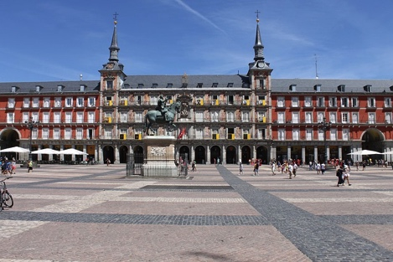
plaza
el
la
La Plaza del Sol es una plaza en el
centro de Madrid.
Notes:
Vocabulary introduction
Aim: to introduce new nouns and their gender
Timing: 4 minutes (slides 12-20)
Procedure:
Bring up noun and picture
Elicit the gender from students (all nouns have regular gender marking)
Photo made freely availble by Hiram Abiff downloaded from Pixabay.com (https://pixabay.com/es/photos/espa%C3%B1a-plaza-madrid-arquitectura-5314946/)

Slide 19
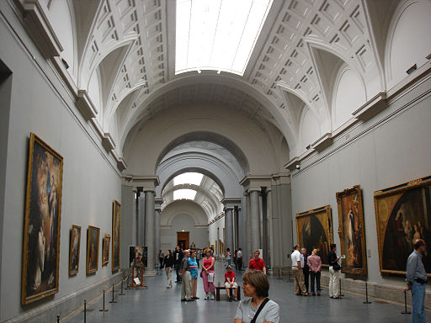
museo
el
la
El Museo del Prado es un museo de arte en Madrid.
Notes:
Photo by losmininos from https://commons.wikimedia.org/wiki/File:Museo_del_Prado_(Madrid)_15.jpg
This file is made freely available and licensed under the Creative Commons Attribution-Share Alike 2.0 Generic License

Slide 20
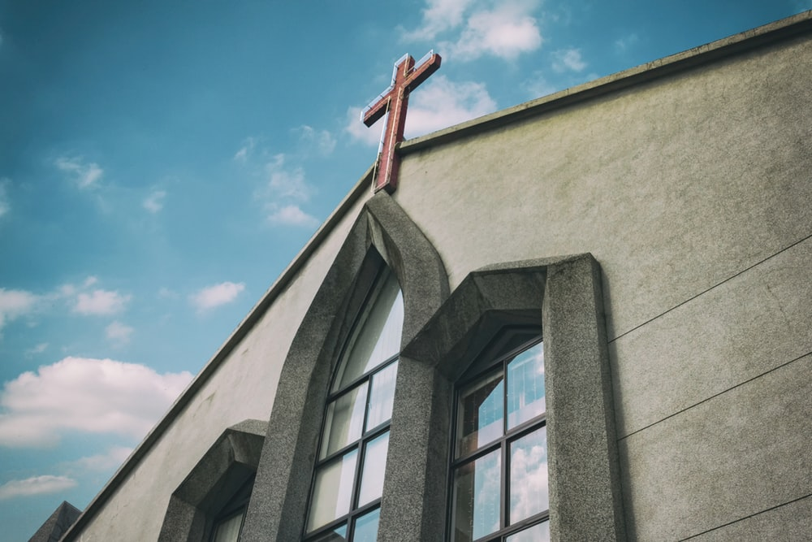
iglesia
el
la
Notes:
Photo by Daniel Tseng on Unsplash (freely usable images)

Slide 21
tienda
el
la
Notes:
Photo by Mike Petrucci on Unsplash

Slide 22
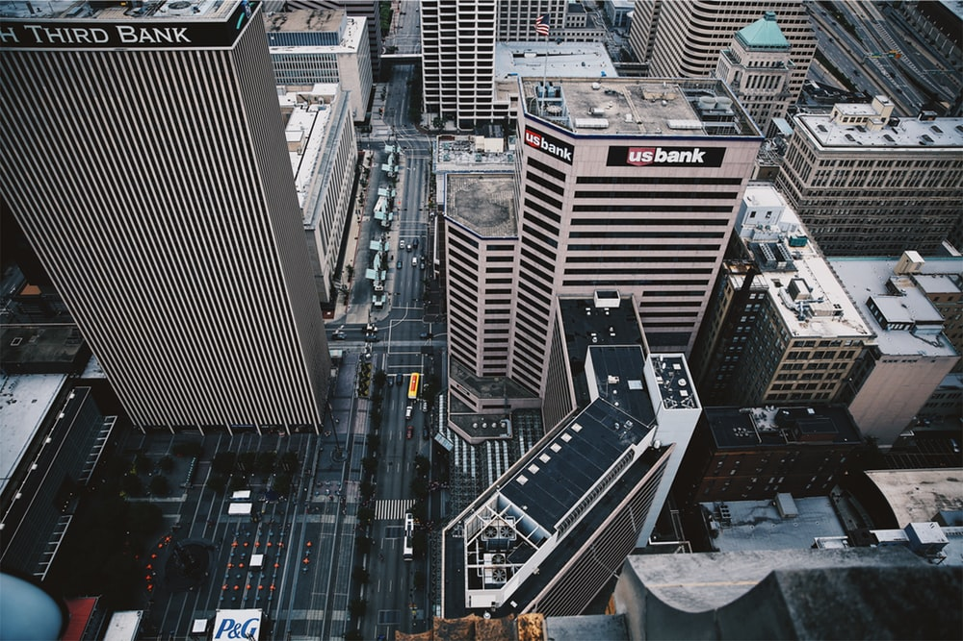
banco
el
la
Notes:
Photo by Jordan on Unsplash

Slide 23
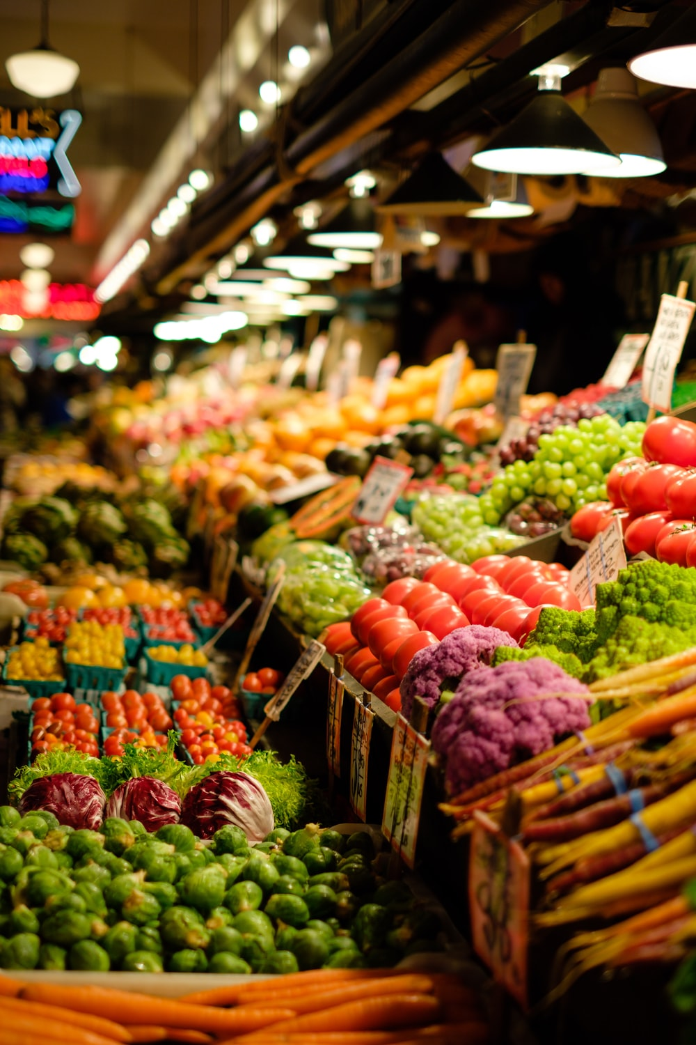
mercado
el
la
Notes:
Photo by Thomas Le on Unsplash

Slide 24
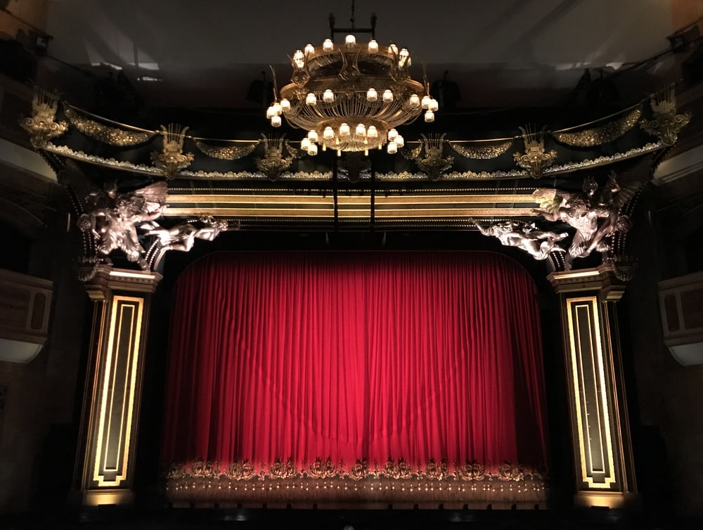
teatro
el
la
Notes:
Photo by Gwen Ong on Unsplash

Slide 25
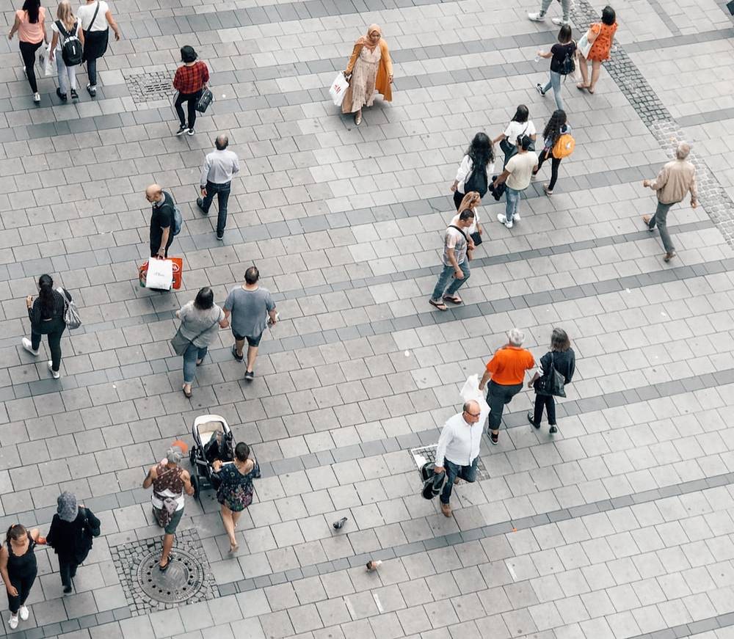
centro
el
la
centre
Notes:
Photo by Jan Kolar / VUI Designer on Unsplash

Slide 26
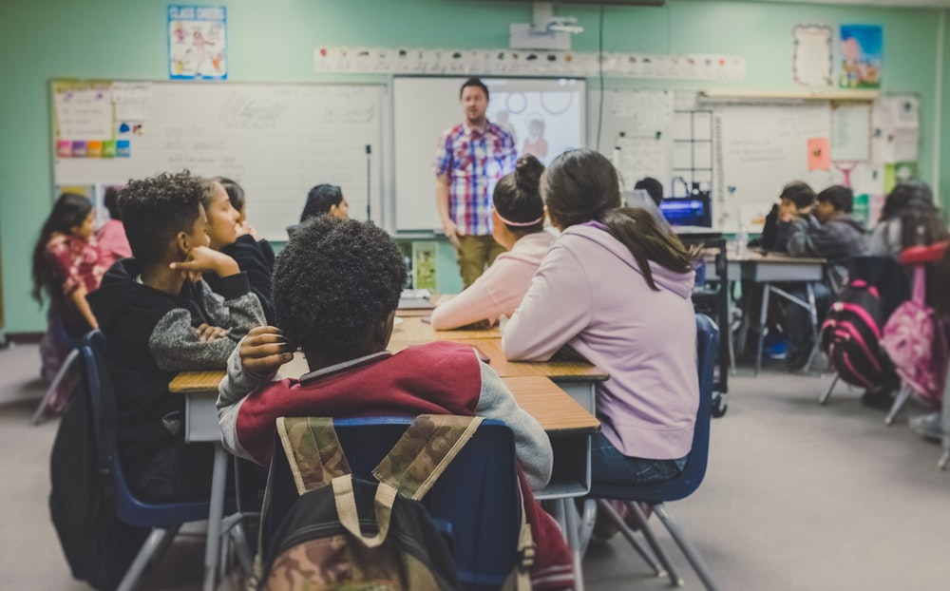
escuela
el
la
Notes:
Photo by NeONBRAND on Unsplash
Note on ‘escuela’ and ‘colegio’. Both words appear in Y7 resources (‘colegio’ as a cluster word for the SSC [gi]).
RAE defines these two words in a very similar way, and both words can be used indistinctively. However, there are some differences in terms of connotations. In some Spanish speaking countries, the differences will be connected to whether the education provided is public (escuela) or private (colegio), although this is not a clear-cut distinction and it will depend on the social context, region, etc.
In Spain, the word 'colegio' is a much more frequent word to refer to 'primary school‘ (whether public or private). This word used to describe the official type of educational institution; the acronym for any primary school in Spain is CEIP (Colegio de Educiación Infantil y Primaria), and it's also the word that people commonly use to talk about 'school'.
The word 'escuela' is mainly used for extra-curricular education. It's the official name used for music schools, language schools, etc. ('Escuela Oficial de Música', 'Escuela Oficial de Idiomas', etc.). 'Escuela' is also used for small primary schools, for example rural schools (‘escuela rural').

Slide 27
leer
Lucía describe unos lugares en una ciudad.
Marca la opción correcta.
1 | El | iglesia |  | está en el centro.
 |  | museo
 |  | could be either
2 | La | tienda de arte |  | es cara.
 |  | mercado
 |  | could be either
3 | El | banco |  | está cerca.
 |  | monumento
 |  | could be either
4 | El | mercado |  | es bonito y barato.
 |  | escuela
 |  | could be either
5 | El | teatro |  | está lejos.
 |  | centro
 |  | could be either
6 | El | barco |  | es famoso.
 |  | iglesia
 |  | could be either
7 | La | ciudad |  | es pequeña.
 |  | plaza
 |  | could be either
8 | La | tienda de música |  | está entre una casa y un bar.
 |  | centro de cultura
 |  | could be either
Notes:
Reading activity
Timing: 6 minutes
Aim: to practise connecting regular gender marking on nouns with the corresponding definite article (i.e. –o = el, –a = la)
Procedure:
1. Students write 1-8.
2. For each item they write the correct answer.
3. In checking feedback, teacher can ask ‘¿Quién tiene la respuesta? ‘Respuesta’ [488] is introduced this week.
Word frequency (1 is the most frequent word in Spanish): museo [1114]; banco [728]; teatro [605]; centro [316]; mercado [487]; tienda [1515]; plaza [806]; iglesia [437]; escuela [424]; ciudad [178]; barco [1384]; monumento [3149]
Source: Davies, M. & Davies, K. (2018). A frequency dictionary of Spanish: Core vocabulary for learners (2nd ed.). Routledge: London

Slide 28
¿Cómo se dice en inglés?
1. The theatre is far (away).
El teatro está lejos.
2. The art shop is expensive.
La tienda de arte es cara.
3. The market is pretty and cheap.
El mercado es bonito y barato.
4. The city is small.
La ciudad es pequeña.
5. The music shop is between a house and a bar.
La tienda de música está entre una casa y un bar.
Notes:
OPTIONAL EXTENSION SLIDE
Note that students can opt to produce the sentences in any order. The shapes are triggered to reveal the English translation when the shape itself is clicked.
This is an opportunity to use the new target language word ‘respuesta’ [488]. For example, when an answer is volunteered, other students can be asked ‘¿La respuesta es correcta?’

Slide 29
escuchar
Amanda describe unos lugares y a unas personas.
 | el | la
la palabra correcta |  | información extra (en inglés)
plaza | mercado
teatro | iglesia
museo | tienda de arte
escuela | centro
banco | tienda de música
ciudad | monumento
chico | chica
directora | director
autora | autor
profesora | profesor
1
cheap
2
far
3
expensive
4
ugly
5
good
6
pretty
7
nice
8
short
9
near
10
good-looking
Notes:
Listening activity
Timing: 8 minutes
Aim: to practise connecting definite articles to nouns that have regular gender marking; to consolidate understanding of adjectives
Procedure:
1. Teacher plays the audio. The first time, students will just tick the definite article that they hear.
2. Students then have 1 minute to look through the words in the next column and decide what the answer will be, based on the definite article. They then write this.
3. Play the audio one more time – this time, students note down the ‘extra information’ in English. These adjectives have all been previously taught.
Notes: The adjectives ‘simpatico’, ‘bajo’ and ‘guapo’ are from T1.1 Week 3, the week just revisited as part of quizlet homework.
Transcript:
El [mercado] es barato.
La [iglesia] está lejos.
El [museo] es caro.
La [escuela] es fea.
La [tienda de música] es buena.
La [ciudad] es bonita.
La [chica] es simpática.
El [director] es bajo.
La [autora] está cerca.
El [profesor] es guapo.
Word frequency (1 is the most frequent word in Spanish): museo [1114]; banco [728]; teatro [605]; centro [316]; mercado [487]; tienda [1515]; plaza [806]; iglesia [437]; escuela [424]; ciudad [178]; barco [1384]; monumento [3149]; autor/a [513]; profesor/a [501]; director/a [592]; chico [727]; chica [1129]
Source: Davies, M. & Davies, K. (2018). A frequency dictionary of Spanish: Core vocabulary for learners (2nd ed.). Routledge: London

Slide 30
Gramática
hablar
En parejas
Persona A:
Read the sentence on your prompt card.
Say it in Spanish, but do not say the word that is crossed out.
Persona B:
Listen to your partner. Their sentence will be missing a noun.
Look at the picture card and decide which noun must be missing.
Write the sentence, including the missing noun.
Notes:
Paired listening/speaking
Timing:
Aim: to practise producing and understanding the definite article in the oral modality
Procedure:
1. Teacher checks understanding of ‘en parejas’.
2. Teacher uses this slide and slide 25 to explain instructions and model activity.
3. During the activity, the pictures on slide 27 will be displayed for all to see in class. The person speaking will use their prompt cards (slide 26), which only they should be able to see (these will be printed).
4. The person listening will be writing down the sentences they hear in Spanish, including the missing noun that is represented by picture A or B, for each item.
Note:
1. To say sentences accurately, students will need to be use adjectival gender agreement (e.g. la plaza es famosa). While this should be encouraged, the main focus of the activity is on comprehension and production of the definite article el/la with a noun of the same gender.

Slide 31
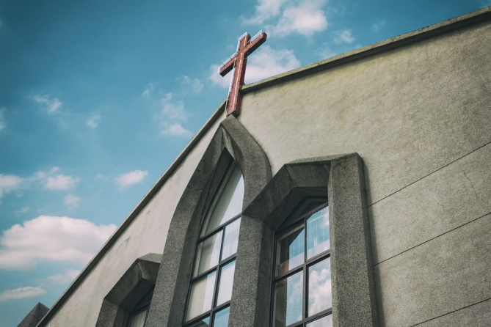
Un ejemplo
Persona A (habla):
El ............ es barato.
The [market] is cheap.
¿Mercado o iglesia?
‘el mercado’
Persona B (escribe):
El mercado es barato
_____________________.
Notes:
Pairs of pictures are contrasted for masculine/feminine gender, so only one option can match the definite article.

Slide 32
Persona A
hablar
The [square] is ugly.
The [market] is cheap.
The [church] is famous.
The [theatre] is good.
The [shop] is expensive.
The [boy] is good-looking.
Persona B
The [museum] is cheap.
The [market] is good.
The [church] is ugly.
The [city] is expensive.
The [bank] is famous.
The [girl] is good-looking.
Notes:
Prompt cards
DO NOT DISPLAY IN CLASS

Slide 33
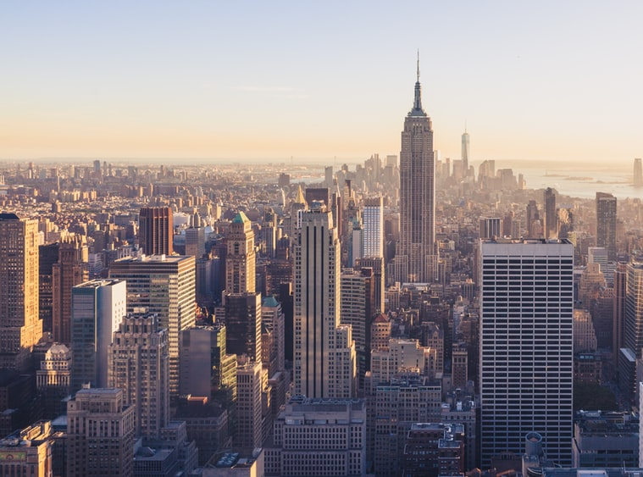
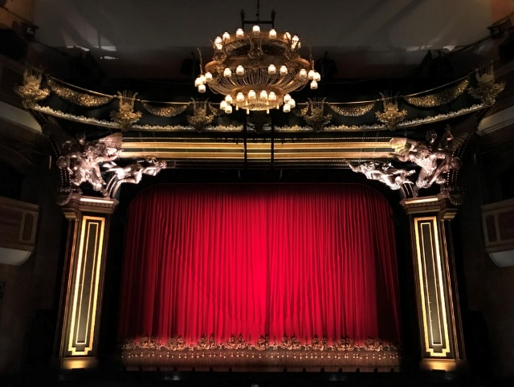
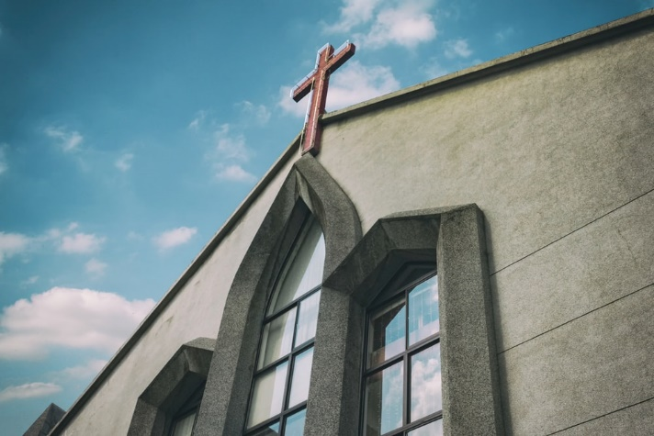
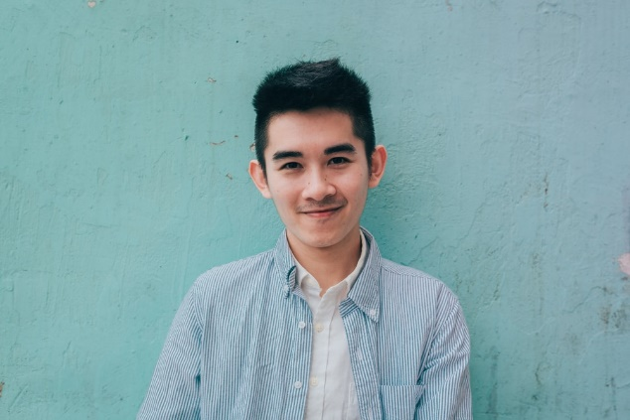
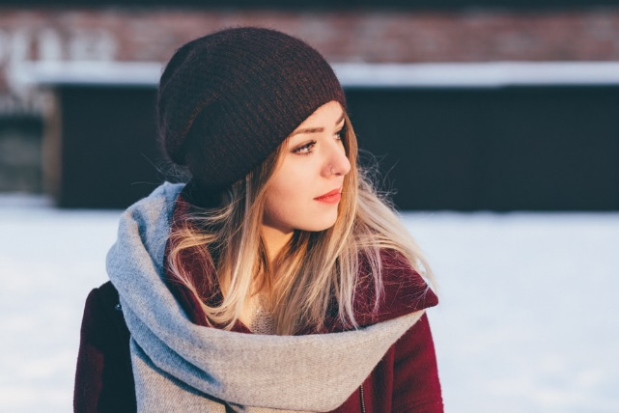
1.
B
4.
A
city
B
A
A
B
A
B
2.
5.
A
B
3.
6.
A
B
centre
Notes:
To display for all students during activity. This avoids having to print/create cards for this activity.
Photo 6a by JD Chow on Unsplash
Photo 6b freestocks.org on Unsplash
Credits given to other images in earlier slides.

Slide 34
Persona B
Escucha. Escribe las 6 frases.
escuchar / escribir
La plaza es fea
1) __________________.
El mercado es barato
2) ________________________.
La iglesia es famosa
3) _______________________.
El teatro es bueno
4) ______________________.
La tienda es cara
5) _____________________.
El chico es guapo
6) ______________________.
Notes:
Person B answers

Slide 35
Persona A
Escucha. Escribe las 6 frases.
escuchar / escribir
El museo es barato
1) ________________________.
El mercado es bueno
2) ________________________.
La iglesia es fea
3) ____________________.
La ciudad es cara
4) ______________________.
El banco es famoso.
5) _____________________.
La chica es guapa.
6) ______________________.
Notes:
Person A answers

Slide 36
Talking about the location of things [2]
Singular definite article (el/la)
‘Está’ for location [revisited]
SSCs [ge], [gi]
Y7 Spanish
Term 1.2 - Week 5 - Lesson 24
Nick Avery / Rachel Hawkes Artwork: Mark Davies
Date updated: 30/06/21
Notes:
Learning outcomes (lesson 2):
Consolidation of SSCs [ge], [gi] Consolidation of singular definite article
Consolidation of está for location
Word frequency (1 is the most frequent word in Spanish):
7.1.2.5 (introduce) museo [1114]; banco [728]; teatro [605]; centro [316]; mercado [487]; tienda [1515]; plaza [806]; iglesia [437]; escuela [424]; ciudad [178]; entre [63]; el, la [1]; lejos [833]; cerca [1042]; respuesta [488]
7.1.2.2 (revisit) uno [425]; dos [64]; tres [134]; cuatro [241]; cinco [284]; seis [438]; siete [603]; ocho [641]; nueve [991]; diez [449]; once [1700]; doce [1138]; color [358]; plan [625]; flor [739]; autor/a [513]; profesor/a [501]; director/a [592]; número [324]
7.1.1.4 (revisit) tener [19]; tengo; tiene; tienes; moneda [1577]; cama [609]; casa [106]; cámara [903]; bicicleta [3684]; libro [230]; barco [1384]; bolígrafo [>5000]; gato [1728]; ¿qué? [50]; nuevo [94]; un/a [6]; lee [leer-209]; frase [1036]; letra [977]; papel [393]
Source: Davies, M. & Davies, K. (2018). A frequency dictionary of Spanish: Core vocabulary for learners (2nd ed.). Routledge: London

Slide 37
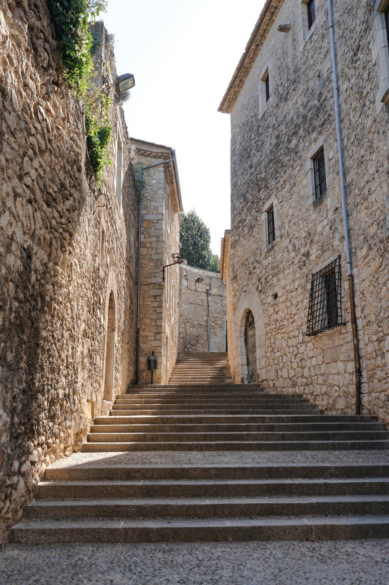
escuchar / escribir
Una conversación entre amigos
¿Dónde está Tomás?
Está en ___rona. Estudia allí.
¿___rona?
Sí, es una ciudad en España. Tengo una ima___n – ¡aquí!
Ah, ¡es una ciudad antigua!
Muy antigua. Tiene tres iglesias y una plaza en el centro.
Y la ___nte, ¿cómo es?
Es inteli____nte. Lee libros y estudia mucho.
¿Qué estudia?
Estudia de todo - ciencias, inglés, español, arte, y reli___ón.
Girona
Notes:
Phonics activity
Timing: 6 minutes
Aim: to practise mapping sound to spelling in a longer text; to revisit previously taught vocabulary
Procedure:
Students listen and complete the dialogue with the target SSCs ‘GI’ and ‘GE’
See next slide for completed version (with all the missing SSCs)
Notes:
This dialogue can also be used for a dictation or for a read aloud in pairs.
The fully readable text (i.e., a text that includes 100% or near to 100% previously taught language) could be used for a dictation. All words except ‘de todo’ have previously been encountered as vocabulary items or phonics practice words.
To help students understand ‘de’ todo’, use slightly exaggerated intonation here and when listing the subjects that follow. This should be sufficient to elicit the meaning from students.
Photo by Fikri Rasyid on Unsplash
Transcript:
¿Dónde está Tomás? Está en Girona. Estudia allí. ¿Girona? Sí, es una ciudad en España. Tengo una imagen – ¡aquí! Ah, ¡es una ciudad antigua! Muy antigua. Tiene tres iglesias y una plaza en el centro. Y la gente, ¿cómo es? Es inteligente. Lee libros y estudia mucho. ¿Qué estudia? Estudia de todo - ciencias, inglés, español, arte, y religión.
Word frequency (1 is the most frequent word in Spanish): centro [316]; plaza [806]; iglesia [437]; ciudad [178]; gente [137]; imagen [384]; estudiar [281]; español¹ [262]; inglés¹ [583]; arte [208]; ciencia(s) [738]; religión [1338]
Source: Davies, M. & Davies, K. (2018). A frequency dictionary of Spanish: Core vocabulary for learners (2nd ed.). Routledge: London

Slide 38
Una conversación entre amigos
¿Dónde está Tomás?
Está en Girona. Estudia allí.
¿Girona?
Sí, es una ciudad en España. Tengo una imagen – ¡aquí!
Ah, ¡es una ciudad antigua!
Muy antigua. Tiene tres iglesias y una plaza en el centro.
Y la gente, ¿cómo es?
Es inteligente. Lee libros y estudia mucho.
¿Qué estudia?
Estudia de todo - ciencias, inglés, español, arte, y religión.
Girona
Notes:
Full text of the conversation on the previous slide.
Photo by Fikri Rasyid on Unsplash

Slide 39
escuchar
A. Y la gente, ¿cómo es?
B. Estudia de todo – ciencias, inglés, español, arte, y religión.
1
D
2
J
C. Muy antigua. Tiene tres iglesias y una plaza en el centro.
3
F
D. ¿Dónde está Tomás?
E. Es inteligente. Lee libros y estudia mucho.
4
H
5
G
F. ¿Girona?
G. Ah, ¡es una ciudad antigua!
6
C
7
A
H. Sí, es una ciudad en España. Tengo una imagen – ¡aquí!
8
E
I. ¿Qué estudia?
9
I
10
B
J. Está en Girona. Estudia allí.
Notes:
OPTIONAL
Procedure:
Students listen again and put the sentences in order
Teacher brings up answers
Note: This could also be used as a reading-only task to challenge higher achieving students.
Word frequency (1 is the most frequent word in Spanish): centro [316]; plaza [806]; iglesia [437]; ciudad [178]; gente [137]; imagen [384]; estudiar [281]; español¹ [262]; inglés¹ [583]; arte [208]; ciencia(s) [738]; religión [1338]
Source: Davies, M. & Davies, K. (2018). A frequency dictionary of Spanish: Core vocabulary for learners (2nd ed.). Routledge: London

Slide 40
leer
la i _ _ _ _ _ _
la iglesia
el m_ _ _ _ _ _
c_ _ _ _
el c_ _ _ _ _
la t_ _ _ _ _
el t_ _ _ _ _
e_ _ _ _
el b_ _ _ _
la e _ _ _ _ _ _
l_
el m_ _ _ _
l _ _ _ _
e_
la p _ _ _ _
Notes:
Vocabulary revision
Timing: 6 minutes (slides 34-48)
Aim: to recall the words introduced in lesson 1
Procedure:
1. Students look at image.
2. Teacher clicks on the picture in the centre to reveal the answer
Word frequency (1 is the most frequent word in Spanish): museo [1114]; banco [728]; teatro [605]; centro [316]; mercado [487]; tienda [1515]; plaza [806]; iglesia [437]; escuela [424]; entre [63]; el, la [1]; lejos [833]; cerca [1042]
Source: Davies, M. & Davies, K. (2018). A frequency dictionary of Spanish: Core vocabulary for learners (2nd ed.). Routledge: London

Slide 41
centre
la i _ _ _ _ _ _
el m_ _ _ _ _ _
c_ _ _ _
el c_ _ _ _ _
el centro
la t_ _ _ _ _
el t_ _ _ _ _
e_ _ _ _
el b_ _ _ _
la e _ _ _ _ _ _
l_
el m_ _ _ _
l _ _ _ _
e_
la p _ _ _ _
Notes:
Vocabulary revision
Click on the picture to reveal the answer

Slide 42
far
la i _ _ _ _ _ _
el m_ _ _ _ _ _
c_ _ _ _
el c_ _ _ _ _
la t_ _ _ _ _
el t_ _ _ _ _
e_ _ _ _
el b_ _ _ _
la e _ _ _ _ _ _
l_
el m_ _ _ _
l _ _ _ _
lejos
e_
la p _ _ _ _
Notes:
Vocabulary revision
Click on the picture to reveal the answer

Slide 43
el c_ _ _ _ _
la i _ _ _ _ _ _
el m_ _ _ _ _ _
c_ _ _ _
la t_ _ _ _ _
el t_ _ _ _ _
e_ _ _ _
la e _ _ _ _ _ _
el b_ _ _ _
la escuela
l_
el m_ _ _ _
l _ _ _ _
e_
la p _ _ _ _
Notes:
Vocabulary revision
Click on the picture to reveal the answer

Slide 44
el c_ _ _ _ _
la i _ _ _ _ _ _
el m_ _ _ _ _ _
c_ _ _ _
la t_ _ _ _ _
la tienda
el t_ _ _ _ _
e_ _ _ _
el b_ _ _ _
la e _ _ _ _ _ _
l_
el m_ _ _ _
l _ _ _ _
e_
la p _ _ _ _
Notes:
Vocabulary revision
Click on the picture to reveal the answer

Slide 45
the (masculine, singular)
la i _ _ _ _ _ _
el m_ _ _ _ _ _
c_ _ _ _
el c_ _ _ _ _
la t_ _ _ _ _
el t_ _ _ _ _
e_ _ _ _
el b_ _ _ _
la e _ _ _ _ _ _
l_
el m_ _ _ _
l _ _ _ _
e_
el
la p _ _ _ _
Notes:
Vocabulary revision
Click on the picture to reveal the answer

Slide 46
el c_ _ _ _ _
la i _ _ _ _ _ _
el m_ _ _ _ _ _
c_ _ _ _
la t_ _ _ _ _
el t_ _ _ _ _
e_ _ _ _
el b_ _ _ _
la e _ _ _ _ _ _
l_
el m_ _ _ _
l _ _ _ _
e_
la p _ _ _ _
la plaza
Notes:
Vocabulary revision
Click on the picture to reveal the answer

Slide 47
between
la i _ _ _ _ _ _
el m_ _ _ _ _ _
c_ _ _ _
el c_ _ _ _ _
la t_ _ _ _ _
el t_ _ _ _ _
e_ _ _ _
entre
el b_ _ _ _
la e _ _ _ _ _ _
l_
el m_ _ _ _
l _ _ _ _
e_
la p _ _ _ _
Notes:
Vocabulary revision
Click on the picture to reveal the answer

Slide 48
el c_ _ _ _ _
la i _ _ _ _ _ _
el m_ _ _ _ _ _
el mercado
c_ _ _ _
la t_ _ _ _ _
el t_ _ _ _ _
e_ _ _ _
el b_ _ _ _
la e _ _ _ _ _ _
l_
el m_ _ _ _
l _ _ _ _
e_
la p _ _ _ _
Notes:
Vocabulary revision
Click on the picture to reveal the answer

Slide 49
the (feminine, singular)
la i _ _ _ _ _ _
el m_ _ _ _ _ _
c_ _ _ _
el c_ _ _ _ _
la t_ _ _ _ _
el t_ _ _ _ _
e_ _ _ _
el b_ _ _ _
la e _ _ _ _ _ _
l_
el m_ _ _ _
la
l _ _ _ _
e_
la p _ _ _ _
Notes:
Vocabulary revision
Click on the picture to reveal the answer

Slide 50
el c_ _ _ _ _
la i _ _ _ _ _ _
el m_ _ _ _ _ _
c_ _ _ _
la t_ _ _ _ _
el t_ _ _ _ _
e_ _ _ _
el b_ _ _ _
la e _ _ _ _ _ _
el m_ _ _ _
l_
el museo
l _ _ _ _
e_
la p _ _ _ _
Notes:
Vocabulary revision
Click on the picture to reveal the answer

Slide 51
el c_ _ _ _ _
la i _ _ _ _ _ _
el m_ _ _ _ _ _
c_ _ _ _
cerca
la t_ _ _ _ _
el t_ _ _ _ _
e_ _ _ _
near
el b_ _ _ _
la e _ _ _ _ _ _
l_
el m_ _ _ _
l _ _ _ _
e_
la p _ _ _ _
Notes:
Vocabulary revision
Click on the picture to reveal the answer

Slide 52
el c_ _ _ _ _
la i _ _ _ _ _ _
el m_ _ _ _ _ _
c_ _ _ _
la t_ _ _ _ _
el t_ _ _ _ _
e_ _ _ _
el b_ _ _ _
la e _ _ _ _ _ _
el banco
l_
el m_ _ _ _
l _ _ _ _
e_
la p _ _ _ _
Notes:
Vocabulary revision
Click on the picture to reveal the answer

Slide 53
el c_ _ _ _ _
la i _ _ _ _ _ _
el m_ _ _ _ _ _
c_ _ _ _
la t_ _ _ _ _
el teatro
el t_ _ _ _ _
e_ _ _ _
el b_ _ _ _
la e _ _ _ _ _ _
l_
el m_ _ _ _
l _ _ _ _
e_
la p _ _ _ _
Notes:
Vocabulary revision
Click on the picture to reveal the answer

Slide 54
Talking about the location of things Using the definite articles ‘el’ and ‘la’
The words ‘un’ and ‘una’ (a, an) often appear with ‘el’ and ‘la’ (the).
You can use ‘un’ and ‘una’ to introduce a noun.
You can use ‘el’ and ‘la’ (or a verb) to refer to it again.
For example:
En Girona, hay un mercado y una iglesia. El mercado es barato y la iglesia es antigua.
Hay is always followed by ‘un’ or ‘una’(not ‘el’ or ‘la’).
Notes:
Grammar explanation slide
In this lesson, we’ll be looking at the use of the definite vs indefinite article and how this relates to the use of ‘hay’.

Slide 55
Gramática
leer
Lee.
Marca la opción correcta.
Ejemplo:
Martín está en Valencia. Hay un / el teatro y la /una iglesia. Son feas.
1. Juan está en Girona. Hay un museo y una tienda de arte. El / un museo es barato, pero una / la tienda de arte es cara.
2. Maria Fernanda está en León. Hay el / un banco y una / la iglesia. Son antiguos.
3. Cristina está en Pamplona. Hay un / el mercado y la / una escuela. Son pequeños.
Notes:
Reading activity [1/2]
Timing: 7 minutes
Aim: to consolidate understanding of the use of indefinite and definite articles
Procedure:
1. Students write 1-6 (the activity goes over two slides).
2. For each sentence, they decide which article is right. This requires two separate choices per sentence.
Word frequency (1 is the most frequent word in Spanish): museo [1114]; banco [728]; teatro [605]; centro [316]; mercado [487]; tienda [1515]; iglesia [437]; escuela [424]; el, la [1]
Source: Davies, M. & Davies, K. (2018). A frequency dictionary of Spanish: Core vocabulary for learners (2nd ed.). Routledge: London

Slide 56
Gramática
leer
Lee.
Marca la opción correcta.
4. Diego está en Bilbao. Hay un monumento y una tienda de música. Una / la tienda de música está cerca y el / un monumento está lejos.
5. Sara está en Marbella. Hay un / el centro de cultura y el / un bar. Son muy famosos.
6. Jorge está en Madrid. Hay una plaza y un restaurante. Una / la plaza es bonita y un / el restaurante es bueno.
Notes:
Reading activity [2/2]
Activity as outlined on previous slide
Word frequency (1 is the most frequent word in Spanish): centro [316]; tienda [1515]; plaza [806]; el, la [1]; lejos [833]; cerca [1042]; monumento [3149]; bar [1938]; restaurante [2636]
Source: Davies, M. & Davies, K. (2018). A frequency dictionary of Spanish: Core vocabulary for learners (2nd ed.). Routledge: London

Slide 57
escuchar
Tienes amigos en diferentes ciudades de España.
Escucha.
Which word is missing?
Escucha otra vez.
Write the word that ‘la’ or ‘una’ refers to.
 |  |  | la palabra
la
una
1
tienda de música
2
iglesia
3
plaza
4
chica
5
escuela
Notes:
Listening activity [1/2]
NB There might not be time to cover all of the input practice activities in lesson 2 this week. There are three practice tasks before the speaking/listening task, so you may wish to decide which to prioritise to complete this lesson’s learning. The others could still be used as additional tasks in later revisiting.
Timing: 8 minutes
Aim: to practise understanding the use of definite vs indefinite articles in the oral modality
Procedure:
Students listen out for whether the noun has already been said with the indefinite or not. This will be a cue for knowing whether the answer is ‘la’ or ‘una’.
As before, the choice of article gender is held constant, so students only need to focus on which article to use.
Notes:
1. Some students may find this task challenging. They may need to go through several (or all) of the items on this slide with the teacher. Repetitions are to be expected. Students shouldn’t think of this as a test!
Transcript:
Martin está en Bilbao. Hay un monumento y una tienda de música. [beep] tienda de música está cerca.
Sofía está en Granada. Hay [beep] iglesia y un banco. El banco es pequeño.
Maria está en Málaga. Hay un mercado y [beep] plaza. El mercado está en el centro.
Daniel está en Pamplona. Hay un chico y una chica. [beep] chica es simpática.
José está en Santander. Hay [beep] escuela y un museo. La escuela está en el norte.
Word frequency (1 is the most frequent word in Spanish): tienda [1515]; iglesia [437]; escuela [424]; plaza [806]; chica [1129]; la [1]
Source: Davies, M. & Davies, K. (2018). A frequency dictionary of Spanish: Core vocabulary for learners (2nd ed.). Routledge: London

Slide 58
escuchar
Tienes amigos en diferentes ciudades de España.
Escucha.
Which word is missing?
Escucha otra vez.
Write the word that ‘el’ or ‘un’ refers to.
 |  |  | la palabra
el
un
6
profesor
7
periódico
8
teatro
9
señor
10
autor
Notes:
Listening activity [2/2]
Activity continues as outlined on previous slide. This time, ‘el’ and ‘un’ are used.
Transcript:
Pablo está en clase. Hay un profesor y una profesora. [beep] profesor es guapo.
Amanda está en casa. Hay [beep] periódico y una revista. La revista es en inglés.
Pepe está en Barcelona. Hay [beep] teatro y un bar. El teatro es muy bueno.
Paula está en un café de San Sebastián. Hay un señor y una señora. [beep] señor es muy bajo.
Alejandro está en una tienda de libros. Hay [beep] autor y una autora. El autor es simpático.
Word frequency (1 is the most frequent word in Spanish): teatro [605]; el [1]; autor [513]; profesor [501]; señor² [201]; periódico [1026]
Source: Davies, M. & Davies, K. (2018). A frequency dictionary of Spanish: Core vocabulary for learners (2nd ed.). Routledge: London

Slide 59
escribir
Some of the sentences you heard have been translated into English.
Lee el inglés.
Escribe en español.
1 | There’s a house and a shop. The shop is near.
2 | There’s a church and a bank. The bank is small.
3 | There’s a school and a square. The school is in the north.
4 | There’s a theatre and a market. The market is very good.
5
Hay una casa y una tienda. La tienda está cerca.
Hay una iglesia y un banco. El banco es pequeño.
Hay una escuela y una plaza. La escuela está en el norte.
Hay un teatro y un mercado. El mercado es muy bueno.
There’s a museum and a bar. The museum is between two shops
Hay un museo y un bar. El museo está entre dos tiendas.
Notes:
Writing activity
Timing: 8 minutes
Aim: to use the new feature (el, la) in written production, alongside previously taught features (indefinite article, es/está, adjectival gender agreement)
Procedure:
1. Students read the sentences and write the Spanish for each.
2. They may wish to refer to books to check anything they are unsure of.
Notes: These sentences aren’t in the same order as students just heard in the listening.
Word frequency (1 is the most frequent word in Spanish): museo [1114]; banco [728]; teatro [605]; mercado [487]; tienda [1515]; plaza [806]; iglesia [437]; escuela [424]; entre [63]; el, la [1]; cerca [1042]; casa [106]; bar [1938]
Source: Davies, M. & Davies, K. (2018). A frequency dictionary of Spanish: Core vocabulary for learners (2nd ed.). Routledge: London

Slide 60
Gramática
hablar
En parejas
Persona A: Estás en una ciudad en España.
Describe la ciudad.
¡Importante! Usa el artículo correcto (‘un’, ‘una’, ‘el’ y ‘la’).
Persona B: Pregúntale a persona A: “¿Dónde estás?” y “¿Qué hay?”
Completa la tabla.
Notes:
Paired speaking/listening
Timing: 10-12 minutes
Aim: to practise using and understanding the definite/indefinite article and other previously taught features in the oral modality
Procedure:
Teachers use this and the next slide to introduce and model the activity
Ask students to copy the blank answer grid into books before they start (see next slide)
Students should also be reminded that on the speaking cards there will be male and female teachers (one set of cards with male, one set with female, to avoid overload). They should be encouraged to use the correct adjective, depending on their gender of the noun, though this isn’t the main focus of the activity.

Slide 61
Un ejemplo
Persona A (pregunta):
¿Dónde estás?
Estoy en Granada.
Persona B (contesta):
Persona A (pregunta):
¿Qué hay?
Hay una tienda y una iglesia. La iglesia está en el centro.
Persona B (contesta):
Persona A (escribe)

Slide 62
Persona A
There is shop and a market.
The market is expensive
There is a bank and a theatre.
The theatre is small.
There is a museum and a church.
The church is near.
Granada
Bilbao
Madrid
There is a boy and a girl.
The girl is nice.
There is a square and a school. The school is in the square.
Valencia
Málaga
Notes:
Do not display during activity
These are available to print in a separate Word doc.

Slide 63
Persona B
There is a bar and a museum.
The bar is between two houses.
There is an art centre and a theatre.
The theatre is expensive.
There is a market and a shop. The shop is cheap.
San Sebastián
Oviedo
Segovia
There is a school and a church. The school is very good.
There is a bank and a museum. The museum is in the centre.
Barcelona
Salamanca
Notes:
Do not display during activity
These are available to print in a separate Word doc.

Slide 64
Persona A
RESPUESTAS
 | ¿Qué hay? | Información extra
San Sebastián
Oviedo
Segovia
Barcelona
Salamanca
Un bar, un museo
El museo está entre dos casas.
Un centro de arte, un teatro
El teatro es caro.
Un mercado, una tienda
La tienda es barata
Una escuela, una iglesia
La escuela es muy buena.
Un banco, un museo
El museo está en el centro.
Persona B
 | ¿Qué hay? | Información extra
Granada
Bilbao
Madrid
Valencia
Málaga
Una tienda, un mercado
El mercado es caro.
Un banco, un teatro
El teatro es pequeño.
Un museo, una iglesia
La iglesia está cerca.
Un chico, una chica
La chica es simpática.
Una plaza, una escuela
La escuela está en la plaza.
Notes:
ANSWER SLIDE
Suggestion for teachers: draw students’ attention to ‘respuesta’ [488] here and check understanding of its meaning. The word is introduced this week.

Slide 65
Gaming Grammar
Gaming Grammar
Gaming Grammar mini-game Definite articles: Gender in the ‘Article agreement’ menu practices aspects of this week’s lessons.
Notes:
This slide links to Gaming Grammar login screen. The appropriate mission can then be selected from the menu page.
Students will progress through the game at their own rate; teachers should use the teacher interface to check progress. This will help to inform future lesson planning.

Slide 66
Deberes
Vocabulary Learning Homework (Y7, Term 1.2, Week 6)
Audio file
Audio file QR code:
Student worksheet
Quizlet link
In addition, revisit: Term 1.2 Week 3
Term 1.1 Week 5

