Slide 1
Saying how many there are
il y a (with numbers plus nouns)
regular plural marking on nouns (-s) [revisited]
SSC [eu] [revisited]
Y7 French
Term 2.1 - Week 1 - Lesson 29
Stephen Owen / Emma Marsden / Catherine Morris Artwork by: Chloé Motard
Date updated 25/07/2022
Notes:
Artwork by Chloé Motard. All additional pictures selected are available under a Creative Commons license, no attribution required.
Learning outcomes (lesson 1):
Consolidation of SSC [eu]
Introduction of il y a (with numbers plus nouns)
Introduction of des (plural indefinite article)
Consolidation of regular plural marking on nouns (-s)
Word frequency (1 is the most frequent word in French):
7.2.1.1 (introduce) cinq [288], deux [41], dix [372], douze (1664), huit [877], neuf [787], onze (2447), quatre [253], sept [905], six [450], trois [115], un² [3], une² [3], des [2 - de], il y a [13/36/8]
7.1.2.5 (revisit) marcher [1532], manger [1338], préparer [368], regarder¹ [425], travailler [290], nous¹ [31], déjeuner [2724], film [848], maison [325], partenaire [1077], télé [2746], dehors [1217], préféré [préférer 597]
7.1.1.7 (revisit) faire [25], fais [25], fait [25], ça [54], activité [452], courses [1289], cuisine [2618], devoirs [39], lit [1837], ménage [2326], modèle [958], quoi [297]
Source: Londsale, D., & Le Bras, Y. (2009). A Frequency Dictionary of French: Core vocabulary for learners London: Routledge.
The frequency rankings for words that occur in this PowerPoint which have been previously introduced in NCELP resources are given in the NCELP SOW and in the resources that first introduced and formally re-visited those words.
For any other words that occur incidentally in this PowerPoint, frequency rankings will be provided in the notes field wherever possible.

Slide 2
eu
deux
Notes:
Timing: 1 minute
Aim: To consolidate SSC [eu]
Procedure: 1. Present the letter(s) and say the [eu] sound first, on its own. Students repeat it with you. 2. Bring up the word ”deux” on its own, say it, students repeat it, so that they have the opportunity to focus all of their attention on the connection between the written word and its sound.
3. A possible gesture for this would be to hold up two fingers (N.B. palm of the hand facing the class!). 4. Roll back the animations and work through 1-3 again, but this time, dropping your voice completely to listen carefully to the students saying the [eu] sound, pronouncing ”deux” and, if using, doing the gesture.
Word frequency (1 is the most frequent word in French):
deux [41].
Source: Londsale, D., & Le Bras, Y. (2009). A Frequency Dictionary of French: Core vocabulary for learners London: Routledge.

Slide 3
eu
deux
Notes:
With sound and no pictures to focus all attention on the sound-symbol correspondence.

Slide 4
eu
deux
Notes:
Without sound to elicit pronunciation (without first hearing the teacher).
Teacher to elicit pronunciation by asking “Comment dit-on …"

Slide 5
eu
jeudi
lieu
[place]
deux
feu
jeu
un peu
[a little]
Notes:
Timing: 2 minutes
Aim: To consolidate SSC [eu]
Procedure:
1. Introduce and elicit the pronunciation of the individual SSC [eu] and then the source word again ‘deux’ (with gesture, if using). 2. Then present and elicit the pronunciation of the five cluster words.
The cluster words have been chosen for their high-frequency, from a range of word classes, with the SSC (where possible) positioned within a variety of syllables within the words (e.g. initial, 2nd, final etc.). Additionally, we have tried to use words that build cumulatively on previously taught SSCs (see the Phonics Teaching Sequence document) and do not include new SSCs. Where new SSCs are used, they are often consonants which have a similar symbol-sound correspondence in English.
Word frequency (1 is the most frequent word in French): deux {41]; jeudi[1112]; lieu [117] feu [786]; un peu [138/91]; jeu [291]. Source: Londsale, D., & Le Bras, Y. (2009). A Frequency Dictionary of French: Core vocabulary for learners London: Routledge.

Slide 6
eu
jeudi
lieu
deux
feu
jeu
un peu
Notes:
With sound and no pictures to focus all attention on the sound-symbol correspondence.

Slide 7
eu
jeudi
lieu
deux
feu
jeu
un peu
Notes:
Without sound to elicit pronunciation (without first hearing the teacher).
Teacher to elicit pronunciation by asking “Comment dit-on …"

Slide 8
Phonétique
écouter
 | nerveux
 | certain
 | peureux
 | rigoureux
 | surprise
 | urgent
 | malheureux
 | merveilleux
 | respectueux
 | heureux
a
nervous
f
urgent
b
certain
g
unhappy
c
fearful
h
marvellous
d
thorough, strict
i
respectful
e
surprise
j
happy
Notes:
Timing: 5 minutes
Aim: Aural recognition of SSC [eu] from a pool of words containing carefully-chosen distractor vowels.
Procedure:
1. Click on a letter to play a word.
2. Students tally how many times they hear SSC [eu].
3. Answers revealed on clicks (first tally then corresponding word).
Transcript and word frequency (1 is the most frequent word in French): nerveux [3735], certain [110], peureux [>5000], rigoureux [2682], surprise [1815], urgent [2179], malheureux [2372], merveilleux [2209], respectueux [2296], heureux [764]
Source: Londsale, D., & Le Bras, Y. (2009). A Frequency Dictionary of French: Core vocabulary for learners London: Routledge.

Slide 9
Phonétique
lire / parler
euro
vieux
30
[Euro]
affreux
[old]
fameux
[awful]
[famous]
pneu
secondes
sérieux
mieux
[tyre]
[serious]
[better]
Europe
feutre
0
[felt tip]
DÉBUT
[Europe]
Notes:
Timing: 1 minute
Aim: Oral production of SSC [eu].
Procedure:
1. Students say the words alternately out loud with a partner, building up speed, over 1 minute’s intensive practice.
2. They call in any order they like but cannot repeat a word.
3. Click on début to start a thirty second timer on the screen.
4. Teacher can circulate to listen into their SSC knowledge.
5. Click on a word to hear it said by a native speaker.
Word frequency (1 is the most frequent word in French): affreux [4369], sérieux [412], vieux [671], euro [1753], fameux [2060], pneu [4514], mieux [217], Europe [n/a], feutre [>5000]
Source: Londsale, D., & Le Bras, Y. (2009). A Frequency Dictionary of French: Core vocabulary for learners London: Routledge.

Slide 10
Phonétique
lire / parler
euro
vieux
30
[Euro]
affreux
[old]
fameux
[awful]
[famous]
pneu
secondes
sérieux
mieux
[tyre]
[serious]
[better]
Europe
feutre
0
DÉBUT
Notes:
Timing: 1 minute
Aim: Oral production of SSC [eu]. Automisation of SSC production through repetition.
Procedure:
1. Students read out the words but in alphabetical order (working either individually or in pairs).
2. They keep going for thirty seconds.
3. Teacher can circulate to listen into their SSC knowledge.
Word frequency (1 is the most frequent word in French): affreux [4369], sérieux [412], vieux [671], euro [1753], fameux [2060], pneu [4514], mieux [217], Europe [n/a], feutre [>5000]
Source: Londsale, D., & Le Bras, Y. (2009). A Frequency Dictionary of French: Core vocabulary for learners London: Routledge.

Slide 11
Vocabulaire
C'est quoi en anglais ?
lire
seven
four
eight
five
two
six
des
some
nine
ten
eleven
twelve
three
Notes:
Timing: 10 minutes for twenty-five slides
Aim: Written recognition of this weeks’ new vocabulary.
NB: Students should have pre-learned this week’s vocabulary using Quizlet. This sequence of slides plays twice.
Procedure:
1. On the first run-through, the teacher should pronounce the French word first, eliciting the SSC from the students, or drawing their attention to it, as appropriate. Irregular pronunciations will be pointed out as we go along.
2. On the second run-through, students should be asked to say the French word, before giving the English equivalent, in order to help embed the SSC patterns.
3. Students have to identify which word on the slide corresponds in meaning to the word in the centre.
4. The correct answer is then highlighted upon clicking the mouse.
5. Try to elicit the word using the target language: “C'est quoi en anglais ?” – “oui” – “non” – “bien!”, etc.

Slide 12
Vocabulaire
C'est quoi en anglais ?
lire
seven
five
four
eight
two
six
deux
some
nine
ten
eleven
twelve
three
Notes:
Further vocabulary practice - French to English.

Slide 13
Vocabulaire
C'est quoi en anglais ?
lire
seven
five
four
eight
two
six
trois
some
nine
ten
eleven
twelve
three
Notes:
Further vocabulary practice - French to English.

Slide 14
Vocabulaire
lire
You will now see a few exceptions to the SFC rule!!! See if you can spot the exceptions.

Slide 15
Vocabulaire
C'est quoi en anglais ?
lire
seven
five
four
eight
two
six
dix
some
nine
ten
eleven
twelve
three
Notes:
Further vocabulary practice - French to English.

Slide 16
Vocabulaire
C'est quoi en anglais ?
lire
seven
five
four
eight
two
six
huit
some
nine
ten
eleven
twelve
three
Notes:
Further vocabulary practice - French to English.

Slide 17
Vocabulaire
C'est quoi en anglais ?
lire
seven
four
eight
five
two
six
cinq
some
nine
ten
eleven
twelve
three
Notes:
Further vocabulary practice - French to English.

Slide 18
Vocabulaire
C'est quoi en anglais ?
lire
five
four
eight
seven
two
six
sept
some
nine
ten
eleven
twelve
three
Notes:
Further vocabulary practice - French to English.

Slide 19
Vocabulaire
C'est quoi en anglais ?
lire
seven
five
four
eight
two
six
neuf
some
nine
ten
eleven
twelve
three
Notes:
Further vocabulary practice - French to English.

Slide 20
Vocabulaire
C'est quoi en anglais ?
lire
seven
five
four
eight
two
six
six
some
nine
ten
eleven
twelve
three
Notes:
Further vocabulary practice - French to English.

Slide 21
Vocabulaire
C'est quoi en anglais ?
lire
seven
five
four
eight
two
six
douze
some
nine
ten
eleven
twelve
three
Notes:
Further vocabulary practice - French to English.

Slide 22
Vocabulaire
C'est quoi en anglais ?
lire
seven
five
four
eight
two
six
quatre
some
nine
ten
eleven
twelve
three
Notes:
Further vocabulary practice - French to English.

Slide 23
Vocabulaire
C'est quoi en anglais ?
lire
seven
five
four
eight
two
six
onze
some
nine
ten
eleven
twelve
three
Notes:
Further vocabulary practice - French to English.

Slide 24
Vocabulaire
C'est quoi en anglais ?
lire
seven
four
eight
five
two
six
des
some
nine
ten
eleven
twelve
three
Notes:
N.B. This is now the second run-through. Students should be asked to say the French word, before giving the English equivalent, in order to help embed the SSC patterns.

Slide 25
Vocabulaire
C'est quoi en anglais ?
lire
seven
five
four
eight
two
six
deux
some
nine
ten
eleven
twelve
three
Notes:
Further vocabulary practice - French to English.

Slide 26
Vocabulaire
C'est quoi en anglais ?
lire
seven
five
four
eight
two
six
trois
some
nine
ten
eleven
twelve
three
Notes:
Further vocabulary practice - French to English.

Slide 27
Vocabulaire
C'est quoi en anglais ?
lire
seven
five
four
eight
two
six
dix
some
nine
ten
eleven
twelve
three
Notes:
Further vocabulary practice - French to English.

Slide 28
Vocabulaire
C'est quoi en anglais ?
lire
seven
five
four
eight
two
six
huit
some
nine
ten
eleven
twelve
three
Notes:
Further vocabulary practice - French to English.

Slide 29
Vocabulaire
C'est quoi en anglais ?
lire
seven
four
eight
five
two
six
cinq
some
nine
ten
eleven
twelve
three
Notes:
Further vocabulary practice - French to English.

Slide 30
Vocabulaire
C'est quoi en anglais ?
lire
five
four
eight
seven
two
six
sept
some
nine
ten
eleven
twelve
three
Notes:
Further vocabulary practice - French to English.

Slide 31
Vocabulaire
C'est quoi en anglais ?
lire
seven
five
four
eight
two
six
neuf
some
nine
ten
eleven
twelve
three
Notes:
Further vocabulary practice - French to English.

Slide 32
Vocabulaire
C'est quoi en anglais ?
lire
seven
five
four
eight
two
six
six
some
nine
ten
eleven
twelve
three
Notes:
Further vocabulary practice - French to English.

Slide 33
Vocabulaire
C'est quoi en anglais ?
lire
seven
five
four
eight
two
six
douze
some
nine
ten
eleven
twelve
three
Notes:
Further vocabulary practice - French to English.

Slide 34
Vocabulaire
C'est quoi en anglais ?
lire
seven
five
four
eight
two
six
quatre
some
nine
ten
eleven
twelve
three
Notes:
Further vocabulary practice - French to English.

Slide 35
Vocabulaire
C'est quoi en anglais ?
lire
seven
five
four
eight
two
six
onze
some
nine
ten
eleven
twelve
three
Notes:
Further vocabulary practice - French to English.

Slide 36
Vocabulaire
C'est quoi en français ?
lire / parler
des
douze
deux
quatre
trois
neuf
five
sept
huit
onze
cinq
six
dix
Notes:
Further vocabulary practice – now switch to English to French, altering the target language question accordingly: “C'est quoi en français ?”

Slide 37
Vocabulaire
C'est quoi en français ?
lire / parler
des
douze
deux
quatre
trois
neuf
three
sept
huit
onze
cinq
six
dix
Notes:
Further vocabulary practice - English to French.

Slide 38
Vocabulaire
C'est quoi en français ?
lire / parler
des
douze
deux
quatre
trois
neuf
seven
sept
huit
onze
cinq
six
Notes:
Further vocabulary practice - English to French.

Slide 39
Vocabulaire
C'est quoi en français ?
lire / parler
douze
deux
quatre
des
trois
neuf
some
sept
huit
onze
cinq
six
dix
Notes:
Further vocabulary practice - English to French.

Slide 40
Vocabulaire
C'est quoi en français ?
lire / parler
des
douze
deux
quatre
trois
neuf
ten
sept
huit
onze
cinq
six
dix
Notes:
Further vocabulary practice - English to French.

Slide 41
Vocabulaire
C'est quoi en français ?
lire / parler
des
deux
quatre
douze
trois
neuf
twelve
sept
huit
onze
cinq
six
dix
Notes:
Further vocabulary practice - English to French.

Slide 42
Vocabulaire
C'est quoi en français ?
lire / parler
des
douze
deux
quatre
trois
neuf
eleven
sept
huit
onze
cinq
six
dix
Notes:
Further vocabulary practice - English to French.

Slide 43
Vocabulaire
C'est quoi en français ?
lire / parler
des
douze
deux
quatre
trois
neuf
nine
sept
huit
onze
cinq
six
dix
Notes:
Further vocabulary practice - English to French.

Slide 44
Vocabulaire
C'est quoi en français ?
lire / parler
des
douze
deux
quatre
trois
neuf
eight
sept
huit
onze
cinq
six
dix
Notes:
Further vocabulary practice - English to French.

Slide 45
Vocabulaire
C'est quoi en français ?
lire / parler
des
douze
deux
quatre
trois
neuf
six
sept
huit
onze
cinq
six
dix
Notes:
Further vocabulary practice - English to French.

Slide 46
Vocabulaire
C'est quoi en français ?
lire / parler
des
douze
deux
quatre
trois
neuf
two
sept
huit
onze
cinq
six
dix
Notes:
Further vocabulary practice - English to French.

Slide 47
Vocabulaire
C'est quoi en français ?
lire / parler
des
douze
deux
quatre
trois
neuf
four
sept
huit
onze
cinq
six
dix
Notes:
Further vocabulary practice - English to French.

Slide 48
To say what there is
grammaire
To say “there is”, use il y a:
These three words each have their own separate meanings, but when they are used together, they mean “there is..."
Remember: un / une can also mean the number ‘one’, so this could be translated as ‘there is one book’!
il
y
a
il y a un livre
there is a book
il y a une maison
there is a house
Notes:
Timing: 3 minutes
Aim: This slide presents the key grammar construction ‘il y a’. ‘Un and ‘une’ were originally presented as forms of the indefinite article (but with the meaning ‘one’ also introduced) in Term 1.1, Week 3.
Procedure:
1. Point out that this is an impersonal expression, i.e. the subject is always ‘il’, and consists of three words: il – y –a (practise saying these independently, as per the animation, and together).

Slide 49
How many?
grammaire
Notice that il y a means both ‘there is’ and ‘there are’:
il y a un ordinateur
there is a computer
il y a quatre ordinateurs
there are four computers
As in English, we can add an –s to the end of most French words to make them plural. However, the –s is silent in French! (SFC)
You cannot tell by listening to a French noun whether it is singular or plural.
Notes:
Timing: 2 minutes
Aim: This slide points out that the same expression – ‘il y a’ – means both ‘there is’ and ‘there are’.

Slide 50
How many?
écouter
Il y a quoi? Écris en anglais!
La chose | How many?
1
bedroom
1
2
books
3
3
mobile phones
4
4
teachers
11
5
dogs
10
6
boy
1
7
people
12
8
ideas
2
Notes:
Timing: 5 minutes
Aim: To hear the ‘il y a’ grammar function with singular and plural nouns and aural recognition of numbers.
Procedure:
1. Students listen and determine how many of each thing mentioned is/are being talked about.
2. These words have been introduced and practised several times already, so here the idea is to get them to recognise these words via this revision activity.
3. Remind them that the indefinite article (‘un’ or ‘une’) can mean both ‘a’/’an’ and ‘one’.
4. Also remind them that the –s on the written form of a plural French noun is not pronounced (i.e. is a silent final consonant)!
5. The answers are provided upon successive mouse clicks.
Transcript:
Il y a une chambre.
Il y a trois livres.
Il y a quatre portables.
Il y a onze professeurs.
Il y a dix chiens.
Il y a un garçon.
Il y a douze personnes.
Il y a deux idées.

Slide 51
Vocabulaire
parler
Il y a quoi? Parle en français. Écris en anglais!
Exemple:
Partenaire A
Say there are these things il y a ... | Write here what your partner says there is
1) | 1)
Partner A écrit…
a computer
a boy
Il y a un ordinateur.
Partenaire B
Say there are these things il y a ... | Write here what your partner says there is
1) | 1)
Partner B écrit…
a boy
a computer
Il y a un garçon.
Notes:
Timing: 10 minutes
Aim: This example shows how the speaking task is intended to work. The stages are animated to support the teacher in modelling the task.
Procedure:
1. The students alternate in saying what is on their prompt sheets and writing what their partner has just said.
2. The role-cards and full task (with answers animated) are on the following three slides.

Slide 52
Role-cards
parler
Partenaire A
Partenaire B
Say there are these things il y a ... | Write here what your partner says there is
1) a computer | 1)
2) a house | 2)
3) twelve cars | 3)
4) five boys | 4)
5) three shops | 5)
6) ten men | 6)
7) two people | 7)
8) four girls | 8)
Say there are these things il y a ... | Write here what your partner says there is
1) a boy | 1)
2) four cars | 2)
3) two girls | 3)
4) seven computers | 4)
5) nine people | 5)
6) five shops | 6)
7) a window | 7)
8) two houses | 8)
Notes:
Role-cards for printing

Slide 53
Réponses - Partenaire A
parler
Il y a quoi? Parle en français. Écris en anglais!
Say there are these things il y a ... | Write here what your partner says there is
1) | 1)
2) | 2)
3) | 3)
4) | 4)
5) | 5)
6) | 6)
7) | 7)
8) | 8)
what Partner B said
a computer
a boy
un garçon
a house
four cars
quatre voitures
twelve cars
two girls
deux filles
five boys
seven computers
sept ordinateurs
three shops
nine people
neuf personnes
ten men
five shops
cinq magasins
two people
a window
une fenêtre
four girls
two houses
deux maisons
Notes:
ANSWERS for Partner A N.B. This slide should not be displayed during the activity!
Aim: This is to keep all students involved, and to provide additional whole class practice.
Procedure:
1. Answers are animated. English appears first, then the French.
2. Teacher elicits English from Partners A, and French from Partners B, either chorally or individually, as preferred.
Note: the left-hand column is greyed out to help students focus on the correct part of their sheet.

Slide 54
Réponses - Partenaire B
parler
Il y a quoi? Parle en français. Écris en anglais!
Say there are these things il y a ... | Write here what your partner says there is
1) | 1)
2) | 2)
3) | 3)
4) | 4)
5) | 5)
6) | 6)
7) | 7)
8) | 8)
what Partner A said
a boy
a computer
un ordinateur
four cars
a house
une maison
two girls
twelve cars
douze voitures
seven computers
five boys
cinq garçons
nine people
three shops
trois magasins
five shops
ten men
dix hommes
a window
two people
deux personnes
two houses
four girls
quatre filles

Slide 55
Liaison
écouter
Deux maisons Two houses
The final -x in deux is a Silent Final Consonant.
But …
Deux enfants Two children
This time, the final consonant in deux is not an SFC!
Because the -x is followed by a vowel, it is pronounced.
This also happens when -x is followed by a h-.
Deux hommes Two men
This pronunciation change is known as liaison.
Notes:
Timing: 2 minutes
Aim: Introduction to the -x liaison.
Procedure:
Click on image to hear audio

Slide 56
Liaison
écouter
six
six
Notes:
Timing: 4.5 minutes for 9 slides
Aim: To introduce the concept of x-liaison before a vowel with numbers.
Procedure:
1. Listen and repeat.

Slide 57
Liaison
écouter
six semaines
six weeks
Notes:
Procedure:
Listen and repeat.
Ask students to translate the sentence.
Reveal picture on a click, ask students to check their translations.
Reveal English translation on click.

Slide 58
Liaison
écouter
six écoles
six schools
Notes:
Procedure:
Listen and repeat.
Ask students to translate the sentence.
Reveal picture on a click, ask students to check their translations.
Reveal English translation on click.

Slide 59
Liaison
écouter
dix
ten
Notes:
Timing: 1.5 minutes for 3 slides
Aim: To introduce the concept of x-liaison before a vowel with numbers.
Procedure:
1. Listen and repeat.

Slide 60
Liaison
écouter
dix magasins
ten shops
Notes:
Procedure:
Listen and repeat.
Ask students to translate the sentence.
Reveal picture on a click, ask students to check their translations.
Reveal English translation on click.

Slide 61
Liaison
écouter
dix activités
ten activities
Notes:
Procedure:
Listen and repeat.
Ask students to translate the sentence.
Reveal picture on a click, ask students to check their translations.
Reveal English translation on click.

Slide 62
Liaison
écouter
deux
two
Notes:
Timing: 1.5 minutes for 3 slides
Aim: To introduce the concept of x-liaison before a vowel with numbers.
Procedure:
1. Listen and repeat.

Slide 63
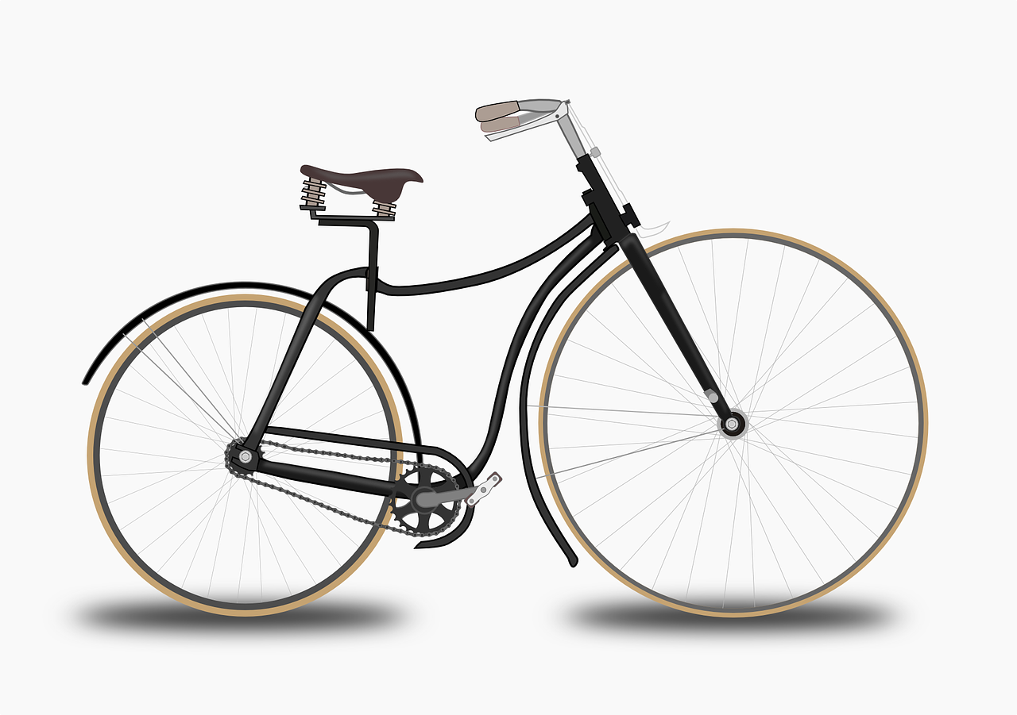
Liaison
écouter
deux vélos
two bikes
Notes:
Procedure:
Listen and repeat.
Ask students to translate the sentence.
Reveal picture on a click, ask students to check their translations.
Reveal English translation on click.

Slide 64
Liaison
écouter
deux ordinateurs
two computers
Notes:
Procedure:
Listen and repeat.
Ask students to translate the sentence.
Reveal picture on a click, ask students to check their translations.
Reveal English translation on click.

Slide 65
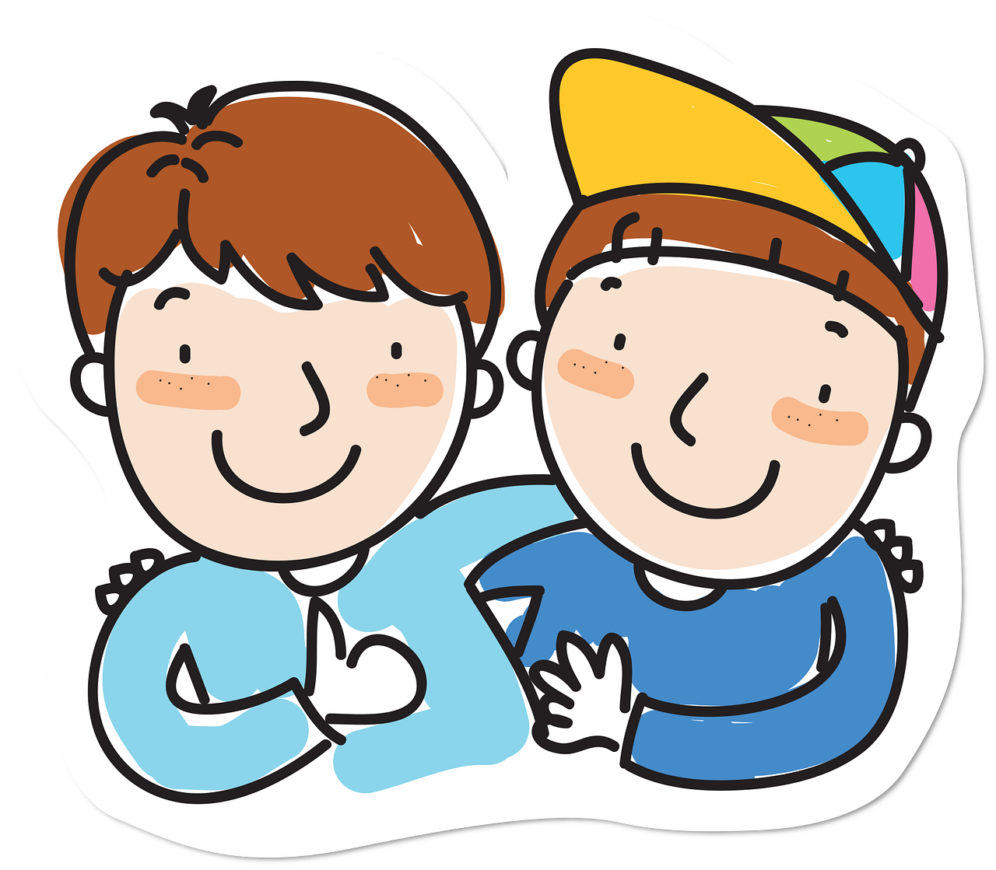
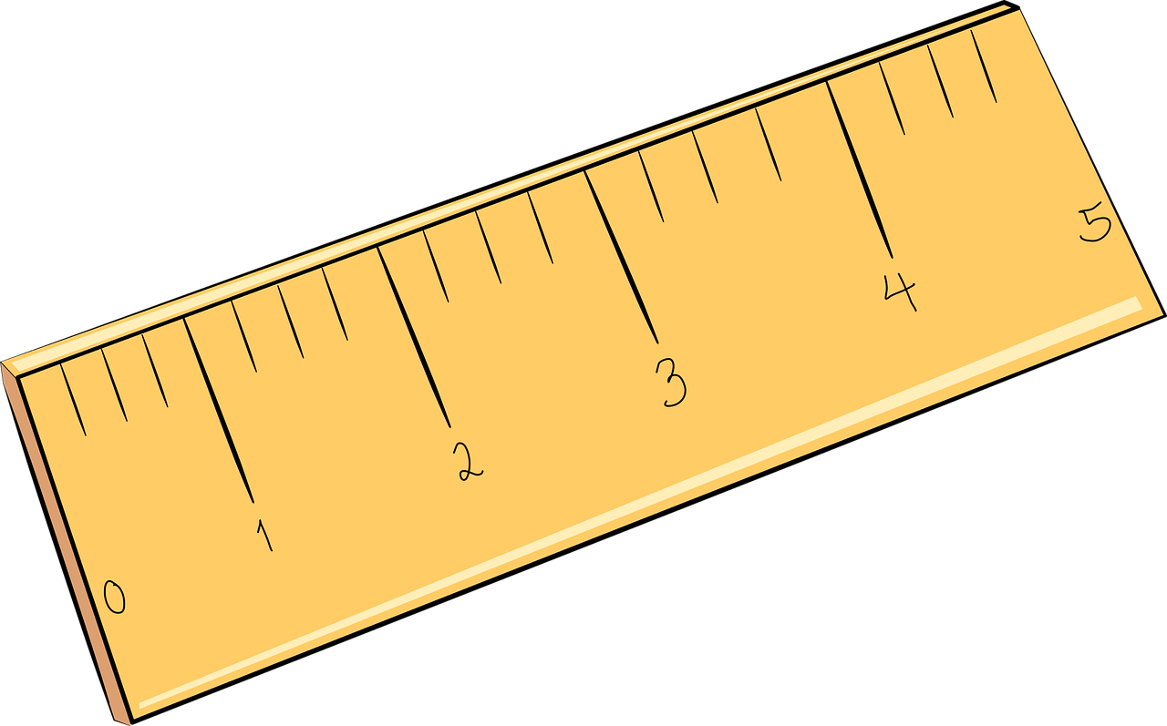
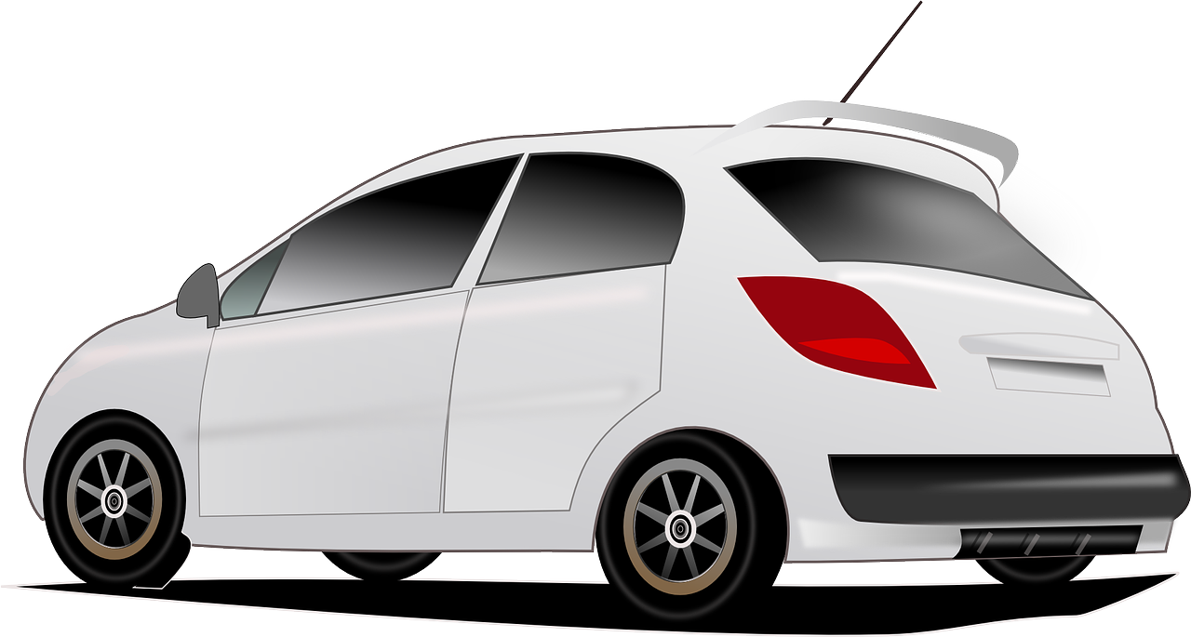
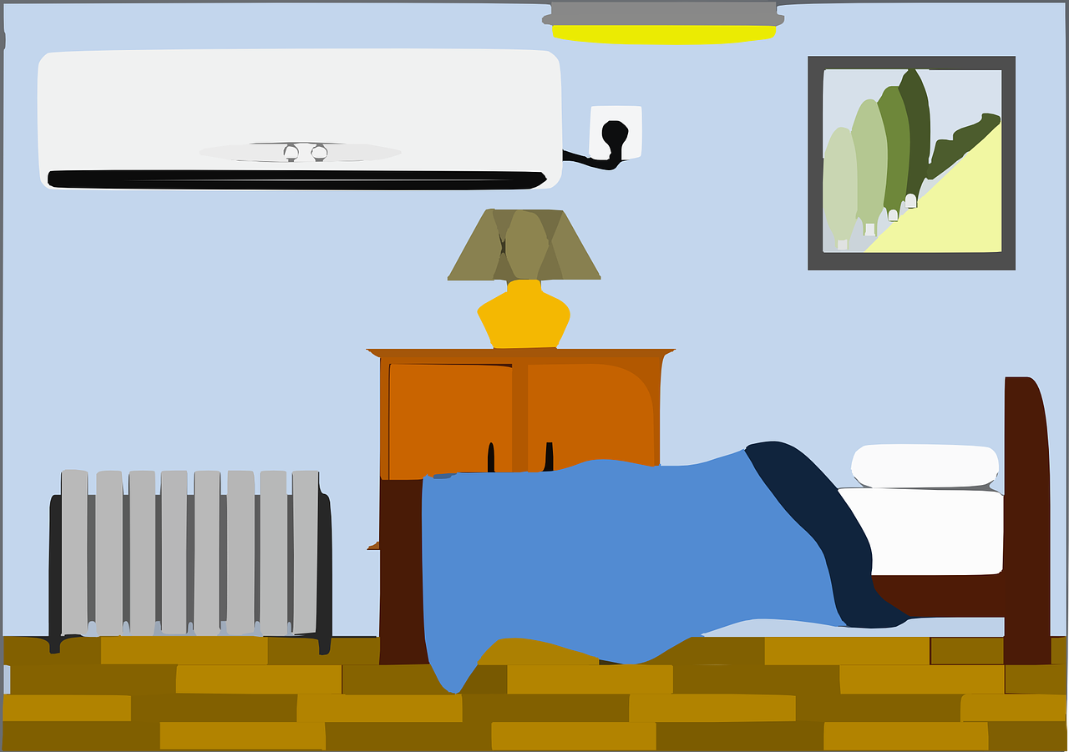
Liaison
écouter
Il y a quoi ? Écoute !
 | Il y a deux chiens / uniformes.
 | Il y a six portables / idées.
 | Il y a dix règles / ordinateurs.
 | Il y a deux chambres / amis.
 | Il y a six livres / acteurs.
 | Il y a dix vélos / activités.
 | Il y a deux voitures / écoles.
 | Il y a six chanteurs / exemples.
1
2
3
4
5
6
7
8
Notes:
Timing: 5 minutes
Aim: Aural recognition of the presence or absence of an x-liaison with numbers, and connect this with meaning.
Procedure:
1. Students write 1-8.
2. Click on a button to hear ‘il y a + number’, followed by a beep.
3. Based on the presence or absence of liaison, students decide which noun must comes next (the noun starting with a vowel, or that starting with a consonant. Remind them it is the presence or absence of a pronounced -x that will give them this information.
4. Click to reveal the answer and hear full audio.
5. Reset the task and ask students to read both versions of each sentence aloud, paying special attention to the –x and whether it enters into a liaison pattern or not.
Transcript
1. Il y a deux [chiens].
2. Il y a six [portables].
3. Il y a dix [ordinateurs].
4. Il y a deux [chambres].
5. Il y a six [acteurs].
6. Il y a dix [vélos].
7. Il y a deux [écoles].
8. Il y a six [exemples].

Slide 66
Saying how many there are
des (plural indefinite article)[cont.]
SSC [eu] [revisited]
Y7 French
Term 2.1 - Week 1 - Lesson 30
Stephen Owen / Emma Marsden / Catherine Morris Artwork by: Chloé Motard
Date updated: 22/07/2022
Notes:
Artwork by Chloé Motard. All additional pictures selected are available under a Creative Commons license, no attribution required.
Learning outcomes (lesson 2):
Consolidation of SSC [eu]
Consolidation of il y a (with numbers plus nouns)
Consolidation of des (plural indefinite article)
Consolidation of regular plural marking on nouns (-s)
Word frequency (1 is the most frequent word in French):
7.2.1.1 (introduce) cinq [288], deux [41], dix [372], douze (1664), huit [877], neuf [787], onze (2447), quatre [253], sept [905], six [450], trois [115], un² [3], une² [3], des [2 - de], il y a [13/36/8]
7.1.2.5 (revisit) marcher [1532], manger [1338], préparer [368], regarder¹ [425], travailler [290], nous¹ [31], déjeuner [2724], film [848], maison [325], partenaire [1077], télé [2746], dehors [1217], préféré [préférer 597]
7.1.1.7 (revisit) faire [25], fais [25], fait [25], ça [54], activité [452], courses [1289], cuisine [2618], devoirs [39], lit [1837], ménage [2326], modèle [958], quoi [297]
Source: Londsale, D., & Le Bras, Y. (2009). A Frequency Dictionary of French: Core vocabulary for learners London: Routledge.
The frequency rankings for words that occur in this PowerPoint which have been previously introduced in NCELP resources are given in the NCELP SOW and in the resources that first introduced and formally re-visited those words.
For any other words that occur incidentally in this PowerPoint, frequency rankings will be provided in the notes field wherever possible.

Slide 67
Phonétique
écouter
Words containing
[eu] | [u] | [è/ê] | [au]
a. neutre (neutral) | b. chute (a fall) | e. mère (mother) | c. chaud (hot)
d. eux (them) | g. mur (wall) | i. suprême (supreme) | f. daube (stew)
j. ceux (those) | k. zut ! (darn !) | l. scène (stage) | h. pause (pause)
a
b
c
d
e
f
g
h
i
j
k
l
Notes:
Timing: 5 minutes
Aim: Distinguish aurally between similar-sounding SSCs in monosyllabic words.
Procedure:
Students sketch the grid.
Click on a letter to play a word.
Students decide which vowel sound they hear and write the letter in the relevant column in their exercise books.
Answers and translations revealed on clicks in order of audio.
Transcript:
neutre
chute
chaud
eux
mère
daube
mur
pause
suprême
ceux
zut
scène
Word frequency (1 is the most frequent word in French): neutre [2785], chute [1761], chaud [1852], eux [161], mère [645], daube [>5000], mur [1335], pause [2647], suprême [2022], ceux [45], zut [>5000], scène [794]
Source: Londsale, D., & Le Bras, Y. (2009). A Frequency Dictionary of French: Core vocabulary for learners London: Routledge.

Slide 68
Phonétique
Lisez en français !
parler
3
peux
2
4
euh !
mieux
1
bleu
9
courageux
nombreux
8
eux
5
dangereux
yeux
7
6
Notes:
Timing: 4 minutes
Aim: Oral production of SSC [eu].
NB: Pupils have learnt the SSC [SFC] (silent final consonant) – here they get a reminder of the silent –X at the end of words.
Procedure:
1. The teacher should read out the title, so that students both hear and read the word ‘lisez’.
2. Explain (or elicit) that ‘lisez’ means ‘you - plural - read’ from the verb ‘lire – to read’.
3. Ask them to notice the ending of the verb – it’s the ‘-ez’ ending. Why might that be? (They have practised ‘ez’ verb inflections already so this is a recap).
4. Partner A reads out words 1-5 in French and Partner B says the English back. Partner A agrees or disagrees.
5. Swap roles - partner B reads words 6-9.
6. Students should then choose any of the words at random to read out, their partner saying the number of the word and then giving the English - this should be out of order, so they cannot just rely on the order here.
7. They should do six words each, alternating: A says French, B gives the number and then the English. B says French, A gives the number and then the English.
8. No timer this time. Some of these will be unfamiliar words and pupils will need to slow down to decode them more carefully.
9. Click on the words to hear their pronunciation.
Word frequency (1 is the most frequent word in French): bleu [1216]; euh [889]; peux [pouvoir - 20] mieux [217]; eux [161]; yeux [œil-474]; dangereux [713]; nombreux [366]; courageux [2198]
Source: Londsale, D., & Le Bras, Y. (2009). A Frequency Dictionary of French: Core vocabulary for learners London: Routledge.

Slide 69
Comment dit-on en français? How do you say … in French?
parler
two
six
twelve
eight
three
deux
six
douze
huit
trois
seven
four
nine
eleven
ten
onze
sept
quatre
neuf
dix
five
some
cinq
des
Notes:
Timing: 3 minutes
Aim: Oral production of this week’s vocabulary.
Procedure:
1. Elicit choral response from students.
2. Click for next word.

Slide 70
Vocabulaire
écrire
 | français | anglais
1
2
3
4
5
6
7
8
9
10
11
12
des
some (plural)
deux
two
trois
three
quatre
four
cinq
five
six
six
sept
seven
huit
eight
neuf
nine
dix
ten
onze
eleven
douze
twelve
Notes:
Timing: 5 minutes
Aim: Written production of this week’s new vocabulary.
N.B. owing to the fact that this week’s vocabulary set consists almost entirely of the numbers 2-12 (‘un’ having been presented previously as both number and indefinite article), the sequential nature of these numbers makes it very much easier than usual to determine the English meanings when they are presented in order, as here – yet there is a value in learning them in sequence for the French. For this reason, however, only the French meanings are removed in this exercise to challenge recall (the vocabulary was practised French – English in the previous lesson).
Procedure:
1. Pupils either work by themselves or in pairs, reading out the words practised last lesson and recapping their English meaning (1 minute).
2. Then the French meanings are removed and students try to write them, looking at the English (3 minutes).
3. Further rounds of learning can be facilitated by one pupil turning away from the board, and his/her partner asking him/her the meanings.

Slide 71
Il y a …?
parler
Say how many items there are, e.g., Il y a deux chiens.
DEUX
[uniform]
[rulers]
[friends]
[mobile]
SIX
[bikes]
[actors]
[cars]
[ideas]
DIX
[men]
[books]
[computers]
[dogs]
Notes:
Timing: 5 minutes
Aim: Spoken production of sentences with il y a + number, to practise liaison patterns with -x. Recall of known vocabulary.
Procedure.
1. Students work in pairs and take turns to say what they see. Student A says the nouns in blue (columns on the left); Student B says the nouns in orange (columns on the right).
2. Tell students to use the il y a plus one of the numbers on the left hand side.
3. Remind students that they will need to decide based on the first letter of the noun whether they must pronounce the –x or not.

Slide 72
There are … au pluriel
grammaire
The –s on the end of the noun is usually not pronounced in French - it is a silent final consonant (SFC).
To say “some” (plural), we use des:
s
il y a des livre
there are some book
s
s
il y a des maison
there are house
s
We add –s to the end of the noun to make it plural, as in English.
The word ‘some is often missed out in English, but we need ‘des’ in French!
des is the plural form of the indefinite article (=some)
un and une are the singular forms of the indefinite article (=one, a, an)
Notes:
Timing: 3 minutes
Aim: This slide presents the plural form of the indefinite article: ‘des’ (‘some’). The singular forms ‘un’ and ‘une’ were originally presented and practised in Term 1.1, Week 3 (with their alternative meaning as ‘one’).
Procedure:
1. The teacher should read out the title and explain or elicit the meaning of 'au pluriel‘.
2. We don't have very good intuition about whether students are aware of cognates and understand them - changing a couple of letters can floor some students if they are not analytic or abstract thinkers about language. It can help to read cognates out, but not always - their sounds can be very different.
3. Point out that the word ‘some’ is often omitted in English, whereas the plural indefinite article cannot be omitted in French, e.g. ‘il y a des maisons’ can be translated as ‘there are some houses’ or simply ‘there are houses’ (depending upon the meaning) in English.
4. Also remind them that the –s on the written form of a plural French noun is not pronounced (i.e. is a silent final consonant)!

Slide 73
How many?
grammaire
To say how many of something there are,
use ‘il y a’ + number (or the plural article ‘des’ = some):
s
il y a deux livre
there are two book
s
s
s
il y a trois maison
there are three house
s
s
there are (some) car
il y a des voiture
Notes:
Timing: 2 minutes
Aim: This slide presents the key grammar construction ‘il y a’. ‘Un and ‘une’ were originally presented as forms of the indefinite article (but with the meaning ‘one’ also introduced) in Term 1.1, Week 3.
Procedure:
1. Point out that this is an impersonal expression, i.e. the subject is always ‘il’.
2. Also make sure that students understand that this expression means both ‘there is’ and ‘there are’, i.e. no verb change is required for the plural (because it is impersonal).
3. Also point out to students that the –s on the written form of a plural French noun is not pronounced (i.e. is a silent final consonant)!

Slide 74
How many?
écouter
Il y a quoi? Écris en anglais!
one thing (‘a’/’an’) – UN / UNE | more than one (‘some’) - DES
1
computer
2
houses
3
car
4
boy
5
shops
6
machines
7
person
8
girls
Notes:
Timing: 5 minutes
Aim: To practice listening out for the indefinite article.
Procedure:
1. Students listen and determine from the indefinite article alone whether one thing is being talked about, or more than one.
2. Remind them that the article is the only way to tell – the –s on the written form of a plural French noun is not pronounced (i.e. is a silent final consonant)!
3. They then write the English for the noun mentioned in the French.
4. The answers are provided upon successive mouse clicks.
Transcript:
Il y a un ordinateur.
Il y a des maisons.
Il y a une voiture.
Il y a un garçon.
Il y a des magasins.
Il y a des machines.
Il y a une personne.
Il y a des filles.
Word frequency (1 is the most frequent word in French): un² [3], une² [3], des [2 - de], il y a [13/36/8]
Source: Londsale, D., & Le Bras, Y. (2009). A Frequency Dictionary of French: Core vocabulary for learners London: Routledge.

Slide 75
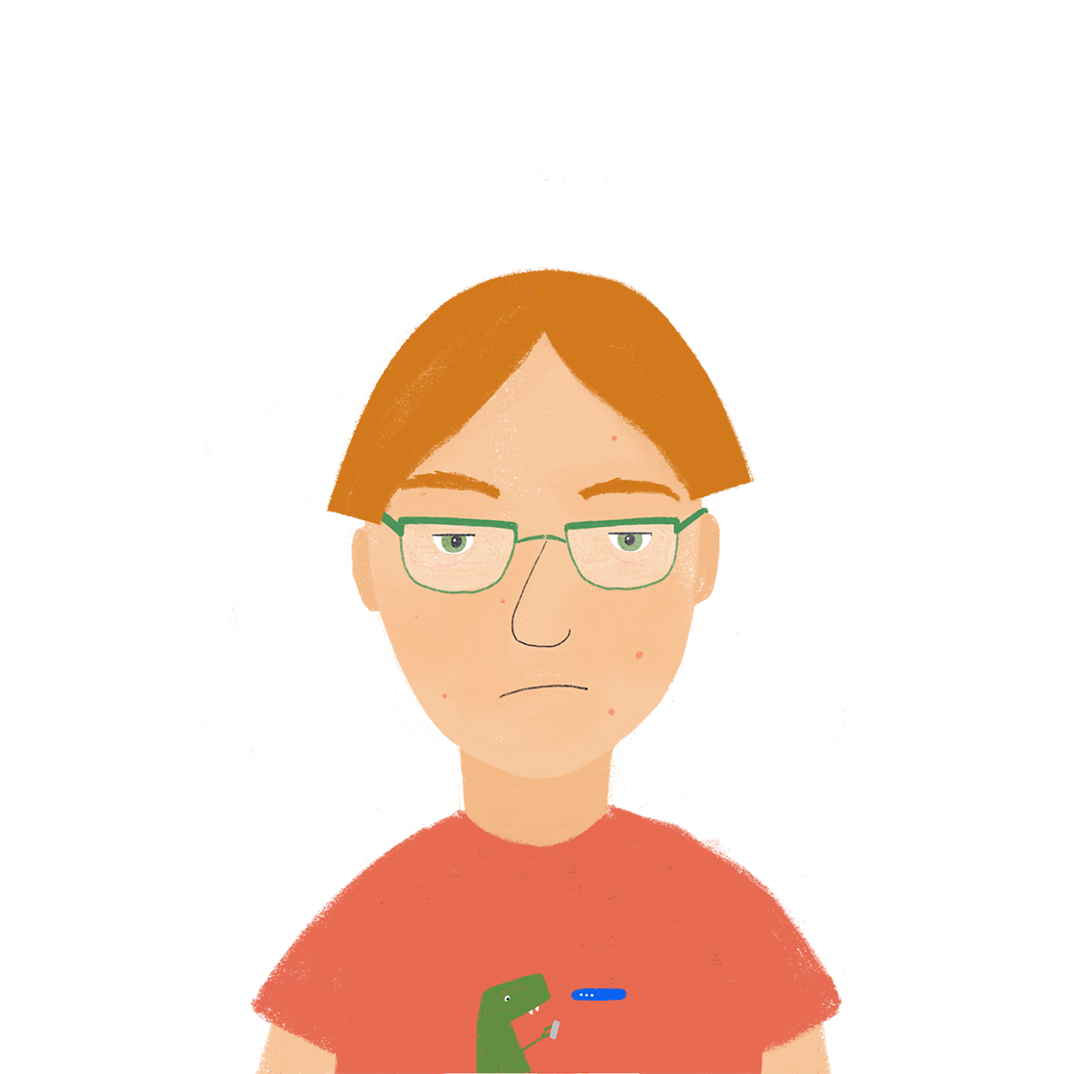
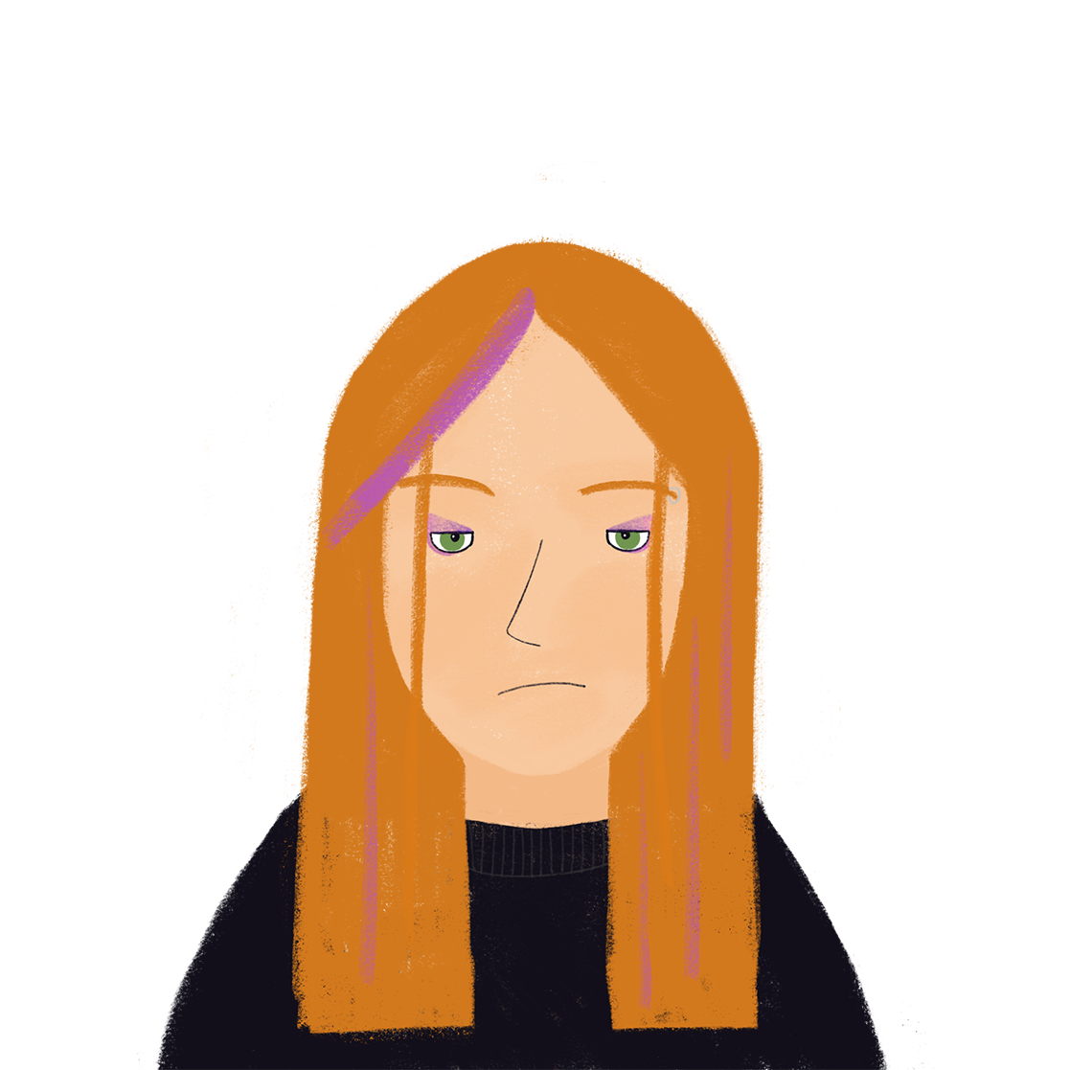
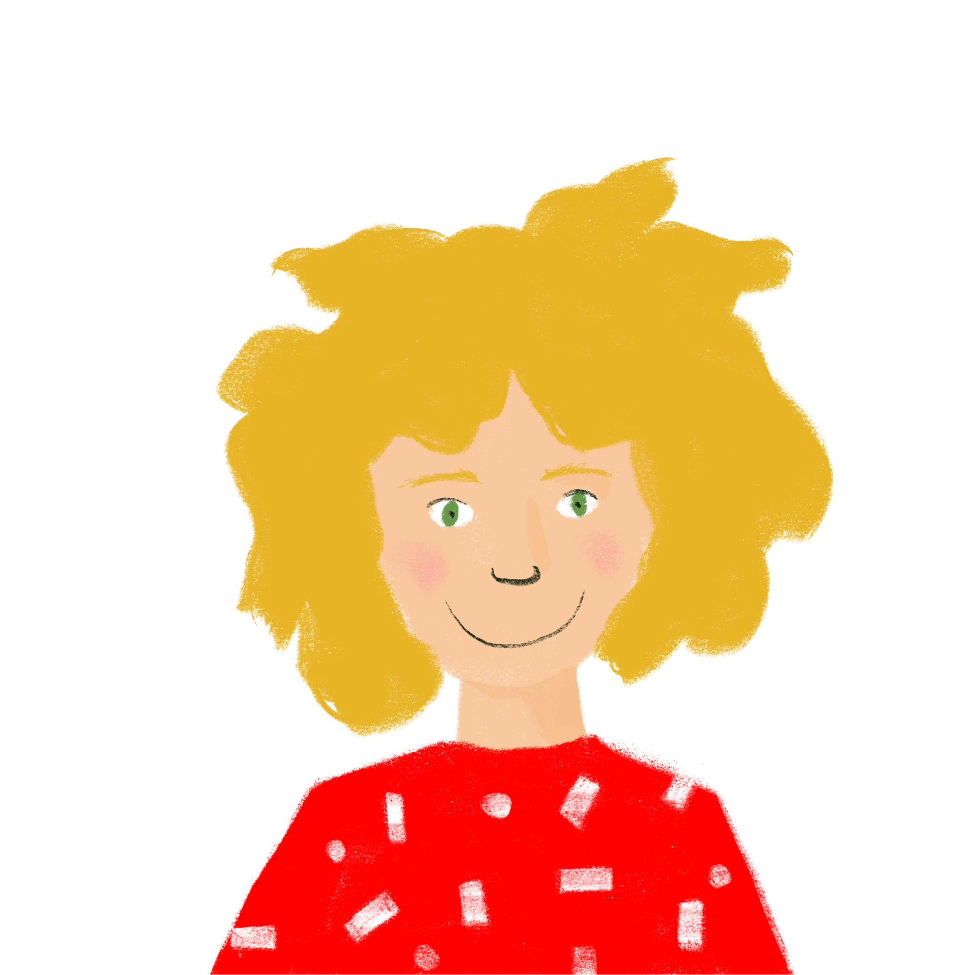
La famille de Léa
lire
Léa is writing about her brother (Antoine) and sister (Élodie).
Lisez le texte - il y a des questions! Complétez la table...
Bonjour, c’est Léa ! Voici Antoine et Élodie. Nous avons une maison en France. Il y a quatre chambres dans la maison. La maison est rouge et nous avons deux voitures. Antoine est grand et intelligent. Il aime faire la cuisine. Il a trois ordinateurs et un portable. Élodie est petite et calme. Elle aime écouter la radio et lire. Elle lis douze livres en ce moment ! J’aime regarder la télé. Nous regardons des films chaque semaine. Antoine fait le ménage en ce moment. Normalement, je suis à l’école. Je porte un uniforme. J’étudie l’anglais et je travaille bien !
Notes:
Timing: 8 minutes
Aim: This reading activity asks students to engage with a slightly longer text, created entirely using vocabulary and grammar already introduced in the scheme of work. The questions on the following slide require them to work out who is being talked about for each thing mentioned in English.
NB: The text should be printed out for students to refer to during the activities that follow, or displayed on a second screen if available.
Procedure:
1. Notice the target language instructions bring in the structure they have been learning: il y a. Check they understand the meaning of lisez le texte and il y a des questions.
2. Before they begin to read: Ask students to see if they can spot anything in the text that surprises them, or seems a bit odd: e.g. her sister is reading twelve books, her brother is doing the housework at the moment, she is not at school, etc.!!
3. Answer the reading questions on the slide that follows.
4. If time permits, students try to translate the text. A suggested answer is given on slides 65.
N.B. famille has not yet been introduced, but as a semi-cognate it should be easily understood, at least in the *written* form. The teacher should read out the title and elicit the English meaning from students. Cognates are more difficult to recognise in the oral form, so ensure that they hear it too to make the connection between the written and oral forms. Regular plural marking on adjectives is presented next week in the scheme, so the adjectives used here are only in the singular forms (masculine and feminine).
Word frequency (1 is the most frequent word in French): famille [172]
Source: Londsale, D., & Le Bras, Y. (2009). A Frequency Dictionary of French: Core vocabulary for learners London: Routledge.

Slide 76
La famille de Léa
lire
De qui parle Jean?
 | Qui? | Léa | Antoine | Élodie | everyone
1
2
3
4
5
6
7
8
has three computers
studies English
is little
likes cooking
watches films each week
is reading twelve books
works well
is doing the housework
Notes:
This is the table for students to note their answers to the reading task. They may copy into their books to complete; alternatively it could be printed out for them. The text should be printed out for students to refer to during this activity. The question word ‘qui ?’ has been introduced incidentally previously (1.1.1), and is dealt with formally in 2.2.4.
The answers are provided on successive clicks of the mouse. Remember to ask students if they feel anything is unusual (promotes affective engagement with the text).

Slide 77
La famille de Léa
lire
Une solution
Hello, it’s Léa! Here are Antoine and Élodie. We have a house in France. There are four rooms in the house. The house is red and we have four cars. Antoine is tall and intelligent. He likes cooking. He has three computers and a mobile phone. Élodie is short and quiet/calm. She likes listening to the radio and reading. She is reading twelve books at the moment ! I like watching TV. We watch films every week. Antoine is cleaning at the moment. I’m normally at school. I wear a uniform. I study English and I work hard/well!
Notes:
Suggested translation for the text on slide 74.

Slide 78
La famille de Léa
lire / parler
Adaptez les phrases. Écrivez en français.
 | (adapted) English | français
1 | There are three bedrooms in the house.
2 | We have one car.
3 | He has six shirts.
4 | She is reading ten books.
5 | We watch four films each week.
6 | I wear two uniforms.
Il y a trois chambres dans la maison.
Nous avons une voiture.
Il a six chemises.
Elle lit dix livres.
Nous regardons quatre films chaque
semaine.
Je porte deux uniformes.
Notes:
Timing: 5 minutes
NB: this is an easier writing task than the one which follows, for substitution at the teacher’s discretion.
Aim: Written adaptation of sentences in a text.
Procedure:
1. Students are challenged to re-write selected sentences of the text in this activity, in order to express the details featured in the table above. The changes required only deal with the number or indefinite article, plus the plural marking if applicable on the associated noun.
2. Sample answers are provided on successive clicks of the mouse.
The students already have a print-out of the text to refer to.

Slide 79
La famille de Léa
lire / parler
Écrivez en français. C’est ‘normal’ ou ‘bizarre’?
 |  | français | Normal | Bizarre
1 | Élodie has seven books.
2 | She studies history.
3 | Antoine is tall and intelligent.
4 | He likes going shopping.
5 | Antoine watches TV.
6 | He is funny.
7 | Antoine has nine shirts.
8 | We like listening to the radio.
Élodie a sept livres.
Elle étudie l’histoire.
Antoine est grand et intelligent.
Il aime faire les courses.
Antoine regarde la télé.
Il est drôle.
Antoine a neuf chemises.
Nous aimons écouter la radio.
Notes:
This is the more challenging version of the writing task outlined on the previous slide.
This text brings in a lot of words and structures studented have been met already. If you have some students who have mastered these structures and words, then you could invite them to write five sentences of their own - they could make up the content about a crazy family or tell the truth about their own.
It would also be worth reminding students that English has two ways of saying the present tense (‘watches’ and ‘is watching’; ‘listens’ and ‘is listening’) but in French there is just one way of talking about the present.

Slide 80
Trouve le trésor !
0
écrire
+5
+10
+15
+ 25
 | 1 | 2 | 3 | 4 | 5
A
B
C
D
to do the cooking
working
outside
I do the housework
faire la cuisine
travailler
to watch television
dehors
regarder la télé
je fais le ménage
I eat lunch
activity
what?
favourite film
je mange le déjeuner
l’activité (f)
quoi ?
film préféré
homework
les devoirs
house
making the bed
we
that
partner (m)
la maison
faire le lit
nous
ça
le partenaire
il fait les courses
to walk, walking
I do the cooking
he does the food shopping
making a model
je fais la cuisine
faire le modèle
she is preparing lunch
marcher
elle prépare le déjeuner
Notes:
Timing: 5 minutes Aim: This ‘treasure hunt’ activity revisits key vocabulary to consolidate knowledge (in the written modality). As well as meaning, the focus is on form and spelling. Procedure:
1. Work individually, in pairs or in small groups. Each row (A-E) represents one round. 2. Write 1-6 in exercise books or mini whiteboards, and write the French for each number. 3. Click the blue box to reveal and check answers. 4. Click the yellow box to reveal the points for each correct answer (these are randomly allocated for an element of chance) – tally the total.

Slide 81
Gaming Grammar
Gaming Grammar
Relevant mini game(s):
Indefinite articles: Gender (Article agreement)
Articles: Number (Article agreement)
Notes:
This slide links to Gaming Grammar login screen. The appropriate mission can then be selected from the menu page.
Students will progress through the game at their own rate; teachers should use the teacher interface to check progress. This will help to inform future lesson planning.

Slide 82
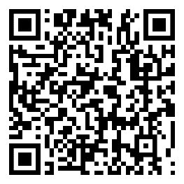
Devoirs
Vocabulary Learning Homework (Y7, Term 2.1, Week 2)
Audio file
Audio file QR code:
Student worksheet
Quizlet link
In addition, revisit: Term 1.2 Week 6
Term 1.2 Week 1

