Slide 1
Vowels
German vowels can be short or long.
Vowels are short when followed by more than one consonant, e.g., Mann, Gast.
Vowels are long when:
there is a double vowel, e.g. Paar,
or when followed by the letter ‘h’, e.g., fahren,
or by a single consonant, e.g., sagen.
NB: German final ‘e’is not silent, but very short, e.g. danke, Klasse.
Notes:
Note: It is important to give this explanation, but in the same way as with explicit grammar explanation, it is the practice that counts most. The idea here is not to write out the explanation, but to put it into practice with the phonics source words, and then relate the long and short ‘a’ sounds to two new nouns, ‘die Tafel’ and ‘die Flasche’.

Slide 2
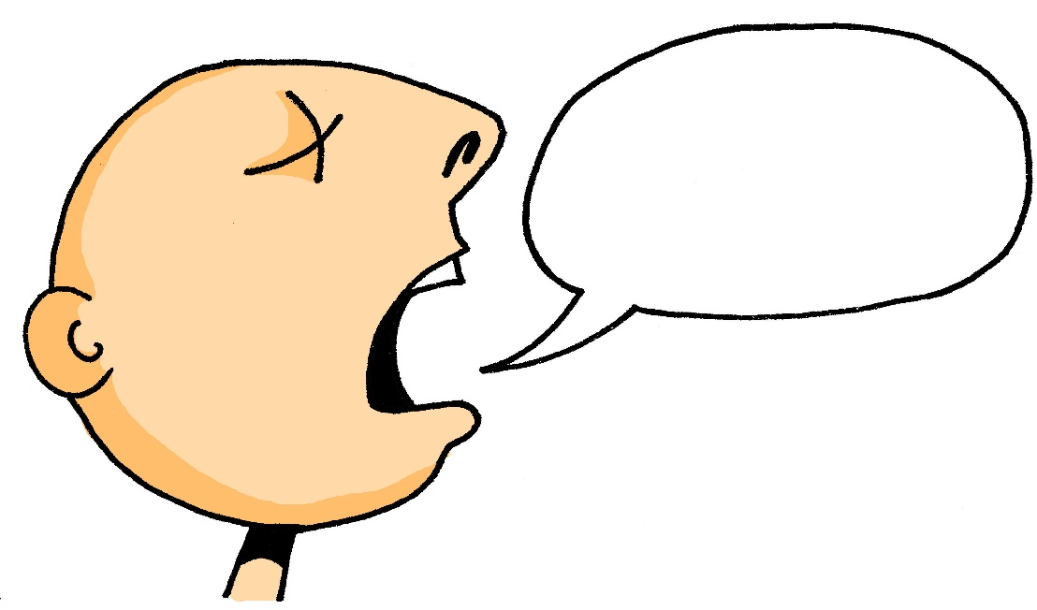
a
[a:]
sagen
Steve Clarke / Rachel Hawkes
Notes:
Source word: sagen [46]
1. Present the letter and say the long ‘a’ sound first, on its own. Students repeat it with you. 2. Bring up the word ‘sagen’ on its own, say it, students repeat it, so that they have the opportunity to focus all of their attention on the connection between the written word and its sound.
3. Bring up the picture, and if using gestures, a possible gesture for this would be to mime speech coming out of your mouth, opening your mouth and drawing your hand away quickly away from you. Establish the meaning of the word in English, clearly, i.e., ‘to say, tell’. It is also worth asking them (this probably in English!) what type of word it is, to see if they can identify it as a verb. 4. Roll back the animations and work through 1-3 again, but this time, dropping your voice completely to listen carefully to the students saying the ‘a’ sound, pronouncing ‘sagen’ and, if using, doing the gesture.
Note: Whilst these two words are not in the vocabulary set for this week’s learning, the idea is that elaborating the first encounter with these high-frequency phonics words will prime students for learning them later. The verb ‘sagen’ for example will soon be met again in the communication strategy language ‘Wie sagt man… (auf Deutsch/Englisch)?

Slide 3
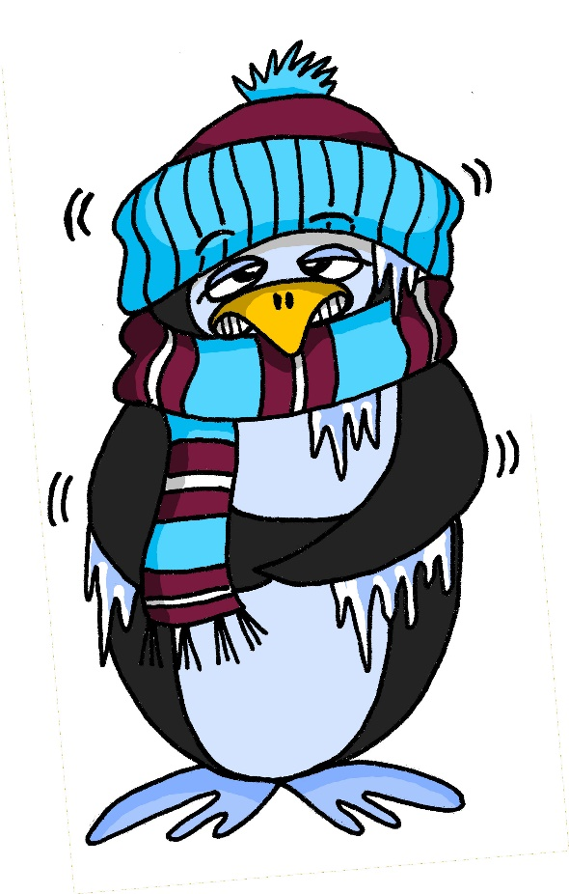
a
[a]
kalt
Steve Clarke / Rachel Hawkes
Notes:
Source word: kalt [875]
1. Present the letter and say the short ‘a’ sound first, on its own. Students repeat it with you. 2. Bring up the word ‘kalt’ on its own, say it, students repeat it, so that they have the opportunity to focus all of their attention on the connection between the written word and its sound.
3. Bring up the picture, and if using gestures, a possible gesture for this would be to mime a shiver, crossing your arms in front of your body. Establish the meaning of the word in English, clearly, i.e., ‘to say, tell’. It is also worth asking them what type of word it is, to see if they can identify it as an adjective. 4. Roll back the animations and work through 1-3 again, but this time, dropping your voice completely to listen carefully to the students saying the ‘a’ sound, pronouncing ‘kalt’ and, if using, doing the gesture.

Slide 4
a
sagen
[a:]
Notes:
Repeat the first two stages from Slide 9; i.e., elicit ‘a’ and then ‘sagen’ from students. They should produce these now, chorally, without first hearing the teacher.
(A possible gesture for this would be to mime speech coming out of your mouth, opening your mouth and drawing your hand away quickly away from you).
Elicitation can be accomplished by pointing. Some teachers may use a very straightforward prompt like ‘Was ist das?’. Students already know ‘Wo ist das?’ Was ist das primes for the next question word students will know. Word order is straightforward here (1:1 equivalent with English in this question structure) and words are cognate-like – was/what – ist/is – das/that. Check that they remember the meaning of the verb.

Slide 5
a
[a]
kalt
Notes:
Repeat the first two stages from Slide 10; i.e., elicit short ‘a’ and then ‘kalt’ from students. They should produce these now, chorally, without first hearing the teacher.
(A possible gesture for this would be to mime a shiver, crossing your arms in front of your body.). Check that they remember the meaning of the adjective.

Slide 6
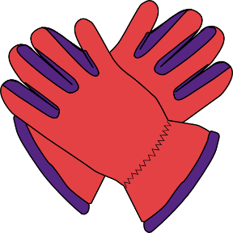
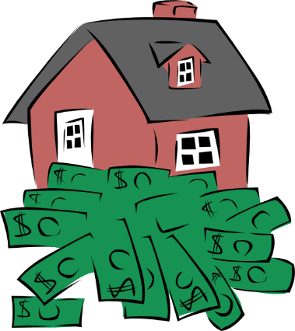
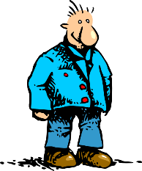
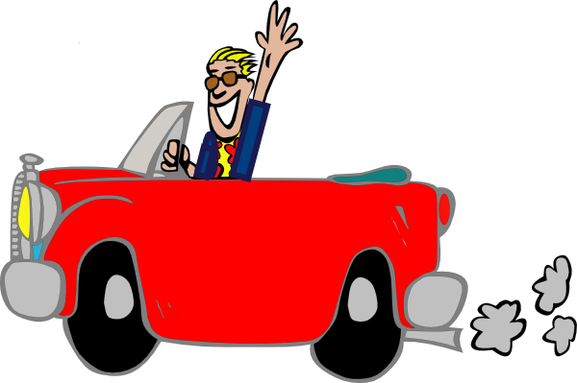
a
Paar
haben
sagen
fahren
Tag
klar
Rachel Hawkes
Notes:
Introduce and elicit the pronunciation of the individual SSC ‘a’ and then the source word again (with gesture, if using). Then present and elicit the pronunciation of the five cluster words. The cluster words have been chosen for their high-frequency, from a range of word classes, with the SSC (where possible) positioned within a variety of syllables within the words(e.g. initial, 2nd, final etc..) and additionally, we have tried to use words that build cumulatively on previously taught SSCs (see the Phonics Teaching Sequence document) and do not include new SSCs. Where new SSCs are used, they are often consonants which have a similar symbol-sound correspondence in English.
Word frequency rankings (1 is the most common word in German): sagen [46]; Paar [284] haben [7]; fahren [169]; klar [255]; Tag [108]. Source: Jones, R.L. & Tschirner, E. (2006). A frequency dictionary of German: core vocabulary for learners. Routledge

Slide 7
a
Paar
haben
sagen
fahren
Tag
klar
Rachel Hawkes
Notes:
With sound and no pictures to focus all attention on the sound-symbol correspondence.
Word frequency rankings (1 is the most common word in German): sagen [46]; Paar [284] haben [7]; fahren [169]; klar [255]; Tag [108]. Source: Jones, R.L. & Tschirner, E. (2006). A frequency dictionary of German: core vocabulary for learners. Routledge

Slide 8
a
Paar
haben
sagen
fahren
Tag
klar
Rachel Hawkes
Notes:
Without sound to elicit production from students.
Word frequency rankings (1 is the most common word in German): sagen [46]; Paar [284] haben [7]; fahren [169]; klar [255]; Tag [108]. Source: Jones, R.L. & Tschirner, E. (2006). A frequency dictionary of German: core vocabulary for learners. Routledge

Slide 9
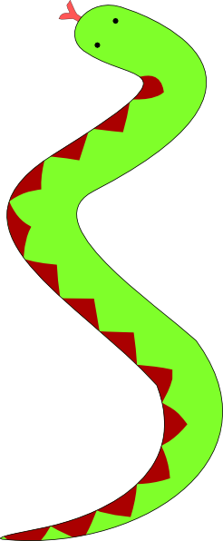
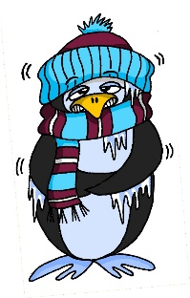
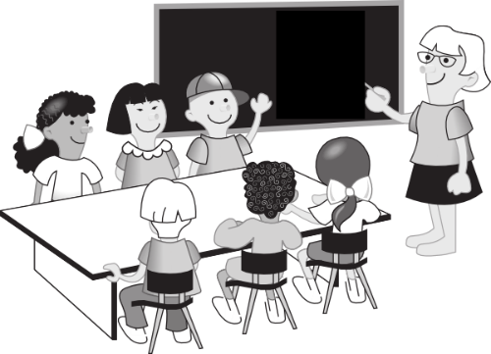
a
lang
Mann
6 Meter
kalt
Klasse
danke
Gast
[guest]
Rachel Hawkes
Notes:
Introduce and elicit the pronunciation of the individual SSC ‘a’ and then the source word again (with gesture, if using). Then present and elicit the pronunciation of the five cluster words. The cluster words have been chosen for their high-frequency, from a range of word classes, with the SSC (where possible) positioned within a variety of syllables within the words(e.g. initial, 2nd, final etc..) and additionally, we have tried to use words that build cumulatively on previously taught SSCs (see the Phonics Teaching Sequence document) and do not include new SSCs. Where new SSCs are used, they are often consonants which have a similar symbol-sound correspondence in English.
Word frequency rankings (1 is the most common word in German): kalt [875]; lang [95] Mann [131]; Klasse [619]; Gast [675]; danke [778]. Source: Jones, R.L. & Tschirner, E. (2006). A frequency dictionary of German: core vocabulary for learners. Routledge

Slide 10
a
lang
Mann
6 Meter
kalt
Klasse
danke
Gast
[guest]
Rachel Hawkes
Notes:
With sound and no pictures to focus all attention on the sound-symbol correspondence.
Word frequency rankings (1 is the most common word in German): kalt [875]; lang [95] Mann [131]; Klasse [619]; Gast [675]; danke [778]. Source: Jones, R.L. & Tschirner, E. (2006). A frequency dictionary of German: core vocabulary for learners. Routledge

Slide 11
a
lang
Mann
kalt
Klasse
danke
Gast
Rachel Hawkes
Notes:
Without pictures to focus all attention on the SSC.
Word frequency rankings (1 is the most common word in German): kalt [875]; lang [95] Mann [131]; Klasse [619]; Gast [675]; danke [778]. Source: Jones, R.L. & Tschirner, E. (2006). A frequency dictionary of German: core vocabulary for learners. Routledge

Slide 12
Lang oder kurz?
 | sagen | kalt
1
2
3
4
5
Notes:
Hör zu. Ist es ‘aaaa’ wie ‘sagen’ oder ‘a’ wie kalt?
Mann
Paar
fahren
Klasse
danke

Slide 13
Antworten
 | sagen | kalt
1
2
3
4
5
Mann
Paar
fahren
Klasse
danke
Notes:
Antworten
Mann
Paar
fahren
Klasse
danke

