Slide 1
Vocabulary
Common irregular adjectives
Y7 French
Term 3.1 - Week 6 - Lesson 59
Jane Wood / Stephen Owen
Date updated: 5/06/2020
Notes:
Learning outcomes
Revisiting SSC [ç] and soft [c]
Frequency rankings of vocabulary introduced this week (1 is the most common word in French):
3.1.6 – bon [54], bonne [54], belle [393 haut [264], nouveau [52], nouvelle [52], vieille [671], vieux [671], bâtiment [1952], église [1782], jardin [2284], pont [1889]
Frequency rankings of vocabulary revisited this week (1 is the most common word in French):
3.1.3 - langue¹ [712], matière¹ [562], quel [146], combien [800], que² [9]
2.2.3 - frapper [745], ressembler [1398], cœur [568], temps [65], noir [572], blanc [708], pourquoi [193], si¹ [34]
Source: Londsale, D., & Le Bras, Y. (2009). A Frequency Dictionary of French: Core vocabulary for learners London: Routledge.

Slide 2
Vocabulaire
lire
10) bon 11) bonne 12) le jardin
8) belle 9) nouveau
6) haut 7) vieille
5) une église
3) le pont 4) nouvelle
1) le bâtiment 2) vieux
Notes:
Vocabulary: French → English - SLOW VERSION
There are three versions of this slide (this and the next two slides), getting progressively faster. Students are challenged to note the English for the twelve vocabulary items, taken from those introduced this week, before the blocks cover the French words. If students don’t immediately know the English, they should write down the French word, as the meaning may come to them later during the activity. Before viewing the answers on the slide following this set of three, students could engage in a one-minute ‘pair-share’ with a partner, to compare answers.
Frequency rankings of vocabulary introduced this week (1 is the most common word in French):
3.1.6 – bon [54], bonne [54], belle [393 haut [264], nouveau [52], nouvelle [52], vieille [671], vieux [671], bâtiment [1952], église [1782], jardin [2284], pont [1889]
Source: Londsale, D., & Le Bras, Y. (2009). A Frequency Dictionary of French: Core vocabulary for learners London: Routledge.
Timing (total for vocabulary activities on Slides 10-16): 10 minutes

Slide 3
Vocabulaire
lire
10) bon 11) bonne 12) le jardin
8) belle 9) nouveau
6) haut 7) vieille
5) une église
3) le pont 4) nouvelle
1) le bâtiment 2) vieux
Notes:
Vocabulary: French → English - MEDIUM VERSION
Students are challenged to note the English for the vocabulary items introduced this week, before the blocks cover the French words.
Frequency rankings of vocabulary introduced this week (1 is the most common word in French):
3.1.6 – bon [54], bonne [54], belle [393 haut [264], nouveau [52], nouvelle [52], vieille [671], vieux [671], bâtiment [1952], église [1782], jardin [2284], pont [1889]
Source: Londsale, D., & Le Bras, Y. (2009). A Frequency Dictionary of French: Core vocabulary for learners London: Routledge.

Slide 4
Vocabulaire
lire
10) bon 11) bonne 12) le jardin
8) belle 9) nouveau
6) haut 7) vieille
5) une église
3) le pont 4) nouvelle
1) le bâtiment 2) vieux
Notes:
Vocabulary: French → English - FAST VERSION
Students are challenged to note the English for the vocabulary items introduced this week, before the blocks cover the French words.
Frequency rankings of vocabulary introduced this week (1 is the most common word in French):
3.1.6 – bon [54], bonne [54], belle [393 haut [264], nouveau [52], nouvelle [52], vieille [671], vieux [671], bâtiment [1952], église [1782], jardin [2284], pont [1889]
Source: Londsale, D., & Le Bras, Y. (2009). A Frequency Dictionary of French: Core vocabulary for learners London: Routledge.

Slide 5
Vocabulaire - réponses
lire
1) the building
2) old (m)
3) the bridge
4) new (f)
5) a church
6) high/tall
7) old (f)
8) beautiful (f)
9) new (m)
10) good (m)
11) good (f)
12) the garden
Notes:
ANSWERS
This slide provides the answers to the French-English task.

Slide 6
Vocabulaire
lire
10) good (m) 11) good (f) 12) the garden
8) beautiful (f) 9) new (m)
6) high/tall 7) old (f)
5) a church
3) the bridge 4) new (f)
1) the building 2) old (m)
Notes:
Vocabulary: English → French – SPEAKING – VERY SLOW VERSION
Students are challenged to say the French from the English for the vocabulary items introduced this week, before the blocks cover the French words.
Frequency rankings of vocabulary introduced this week (1 is the most common word in French):
3.1.6 – bon [54], bonne [54], belle [393 haut [264], nouveau [52], nouvelle [52], vieille [671], vieux [671], bâtiment [1952], église [1782], jardin [2284], pont [1889]
Source: Londsale, D., & Le Bras, Y. (2009). A Frequency Dictionary of French: Core vocabulary for learners London: Routledge.

Slide 7
Vocabulaire
lire
10) good (m) 11) good (f) 12) the garden
8) beautiful (f) 9) new (m)
6) high/tall 7) old (f)
5) a church
3) the bridge 4) new (f)
1) the building 2) old (m)
Notes:
Vocabulary: English → French – WRITING – ULTRA-SLOW VERSION
Students are challenged to write the French from the English for the vocabulary items introduced this week, before the blocks cover the French words.
Frequency rankings of vocabulary introduced this week (1 is the most common word in French):
3.1.6 – bon [54], bonne [54], belle [393 haut [264], nouveau [52], nouvelle [52], vieille [671], vieux [671], bâtiment [1952], église [1782], jardin [2284], pont [1889]
Source: Londsale, D., & Le Bras, Y. (2009). A Frequency Dictionary of French: Core vocabulary for learners London: Routledge.

Slide 8
Vocabulaire - réponses
lire
1) le bâtiment
2) vieux
3) le pont
4) nouvelle
5) une église
6) haut
7) vieille
8) belle
9) nouveau
10) bon
11) bonne
12) le jardin
Notes:
ANSWERS
This slide provides the answers to the speaking/writing tasks.
Frequency rankings of vocabulary introduced this week (1 is the most common word in French):
3.1.6 – bon [54], bonne [54], belle [393 haut [264], nouveau [52], nouvelle [52], vieille [671], vieux [671], bâtiment [1952], église [1782], jardin [2284], pont [1889]
Source: Londsale, D., & Le Bras, Y. (2009). A Frequency Dictionary of French: Core vocabulary for learners London: Routledge.
.

Slide 9
Comment est Nice?
écouter
EITHER
OR
1
plage
bâtiment
2
maison
pont
3
magasin
école
4
bâtiment
poste
5
université
parc
6
poste
magasin
7
bâtiment
église
8
église
bâtiment
Notes:
This listening exercise further practises adjective agreement (including irregular forms). It continues the storyline with our characters.
Students have to decide which noun follows the adjective heard, based upon the adjective gender agreement (pre-nominal adjectives). The article also gives gender information of course, but we felt it would be confusing to have this beeped out immediately prior to the gap which students have to fill.
Transcript
1) À Nice, il y a une belle [plage].
2) Il y a un vieux [pont] aussi.
3) Devant le pont, il y a une bonne [école].
4) C’est un beau [bâtiment]!
5) Il y a une nouvelle [université].
6) Il y a aussi un nouveau [magasin].
7) Il y a une haute [église].
8) Et il y a un haut [bâtiment].
Word frequency rankings:
beau [393], belle [393], haut [264], nouveau [52], nouvelle [52], vieille [671], vieux [671], bâtiment [1952], église [1782], école [477], pont [1889], université [1398], plage [2693]
Source: Londsale, D., & Le Bras, Y. (2009). A Frequency Dictionary of French: Core vocabulary for learners London: Routledge.

Slide 10
Comment est Nice?
écouter
EITHER
OR
1
plage
bâtiment
2
maison
pont
3
magasin
école
4
bâtiment
poste
5
université
parc
6
poste
magasin
7
bâtiment
église
8
église
bâtiment
Notes:
The answers to the listening exercise are on this slide.
Word frequency rankings:
beau [393], belle [393], haut [264], nouveau [52], nouvelle [52], vieille [671], vieux [671], bâtiment [1952], église [1782], école [477], pont [1889], université [1398], plage [2693]
Source: Londsale, D., & Le Bras, Y. (2009). A Frequency Dictionary of French: Core vocabulary for learners London: Routledge.

Slide 11
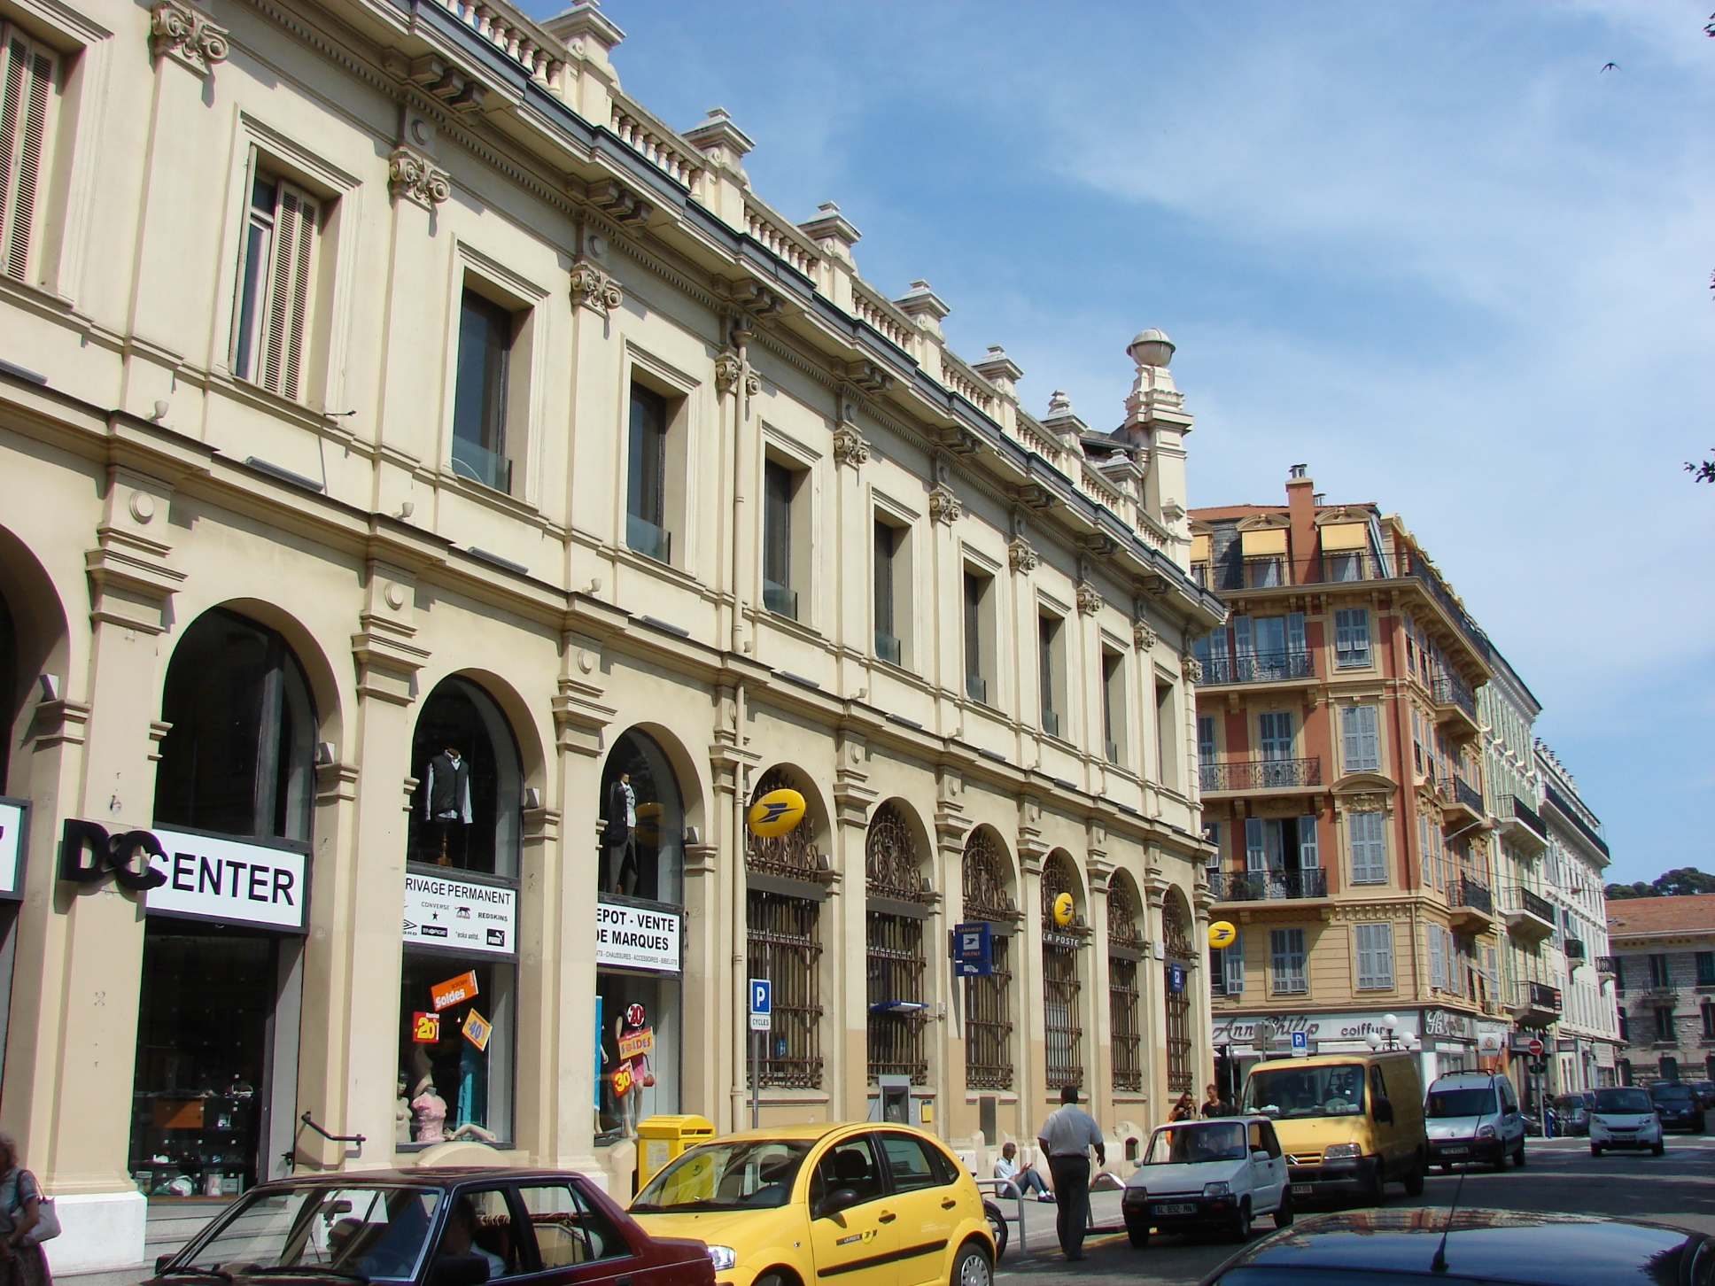
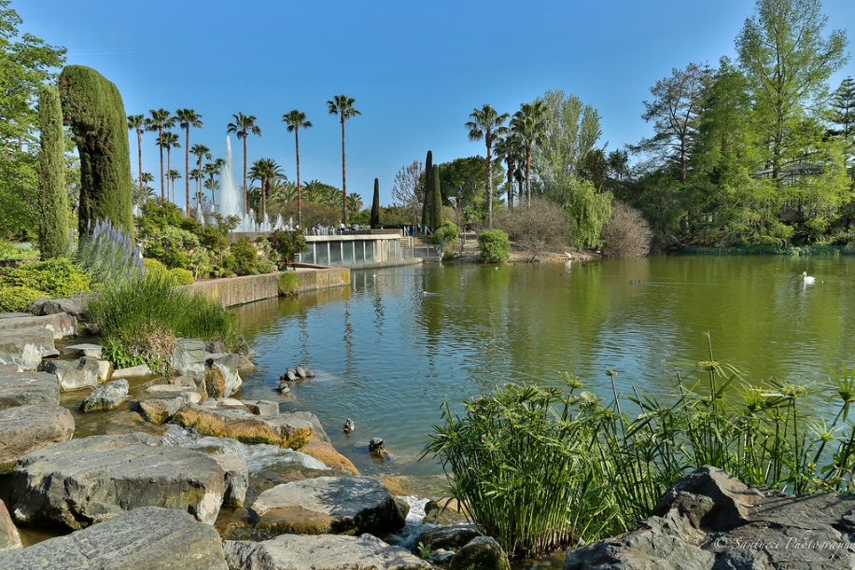
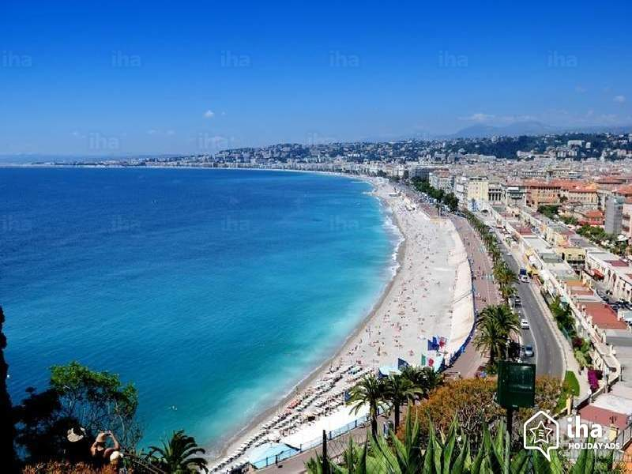
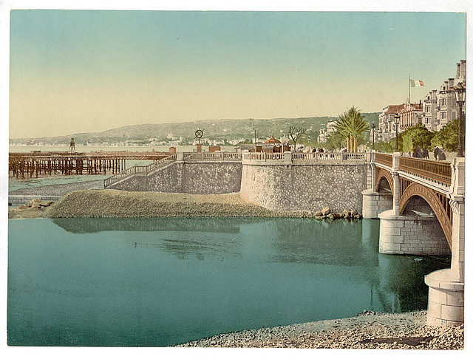
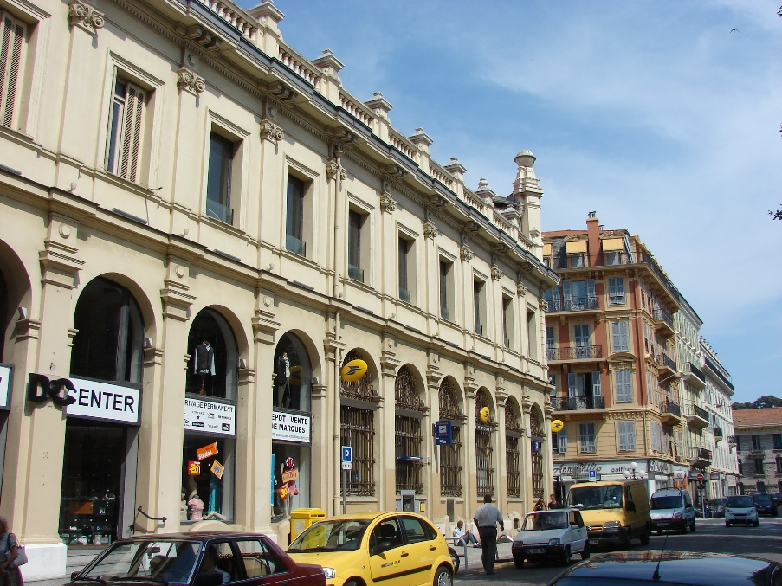
Nice [A]
parler / écrire
À Nice, il y a une belle...
parc
plage
Il y a un vieux ...
pont
poste
Notes:
DO NOT DISPLAY. There is a student worksheet for this activity, which can be downloaded from the NCELP Resource Portal and printed out.
Some new adjectives from this week’s vocabulary set are now presented in their masculine and feminine forms. Those featured here are irregular.
Students work in pairs, one reading the start of each sentence on their card, the other selecting the appropriate noun to complete it, based upon the gender of the adjective.
These slides should not be displayed during the exercise, but are animated to reveal the correct answers.
Frequency rankings of vocabulary introduced this week (1 is the most common word in French):
3.1.6 – bon [54], bonne [54], belle [393 haut [264], nouveau [52], nouvelle [52], vieille [671], vieux [671], bâtiment [1952], église [1782], jardin [2284], pont [1889]
Source: Londsale, D., & Le Bras, Y. (2009). A Frequency Dictionary of French: Core vocabulary for learners London: Routledge.
Timing (total for speaking activities on Slides 28-31): 10 minutes

Slide 12
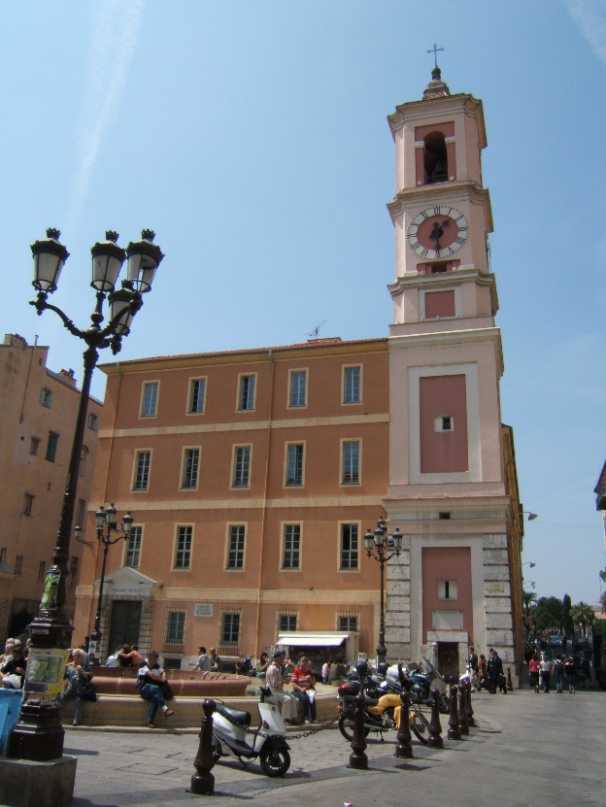
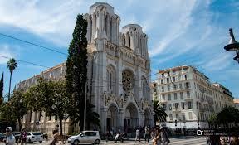
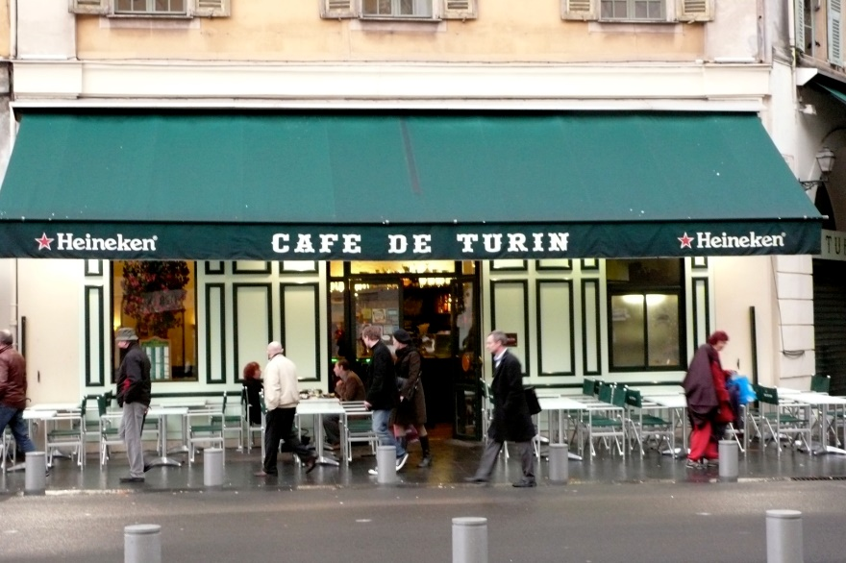
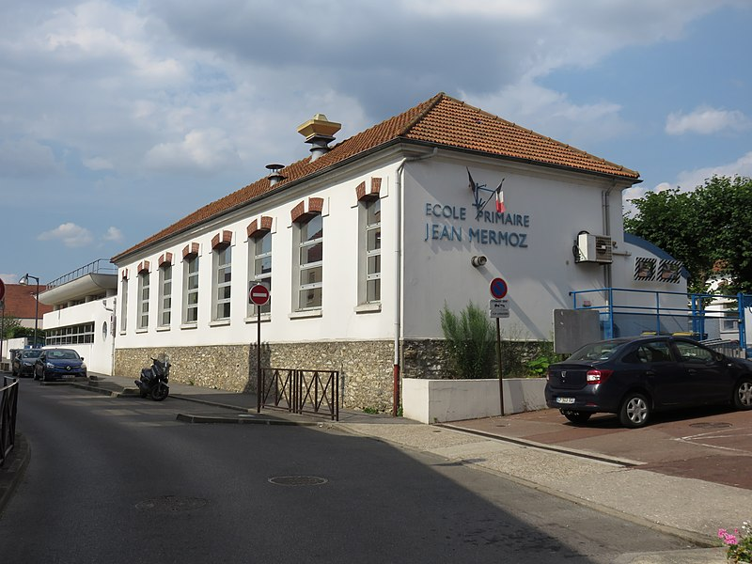
Nice [B]
parler / écrire
Il y a une vieille...
église
bâtiment
Il y a aussi un bon ...
café
école
Notes:
DO NOT DISPLAY. There is a student worksheet for this activity, which can be downloaded from the NCELP Resource Portal and printed out.
Frequency rankings of vocabulary introduced this week (1 is the most common word in French):
3.1.6 – bon [54], bonne [54], belle [393 haut [264], nouveau [52], nouvelle [52], vieille [671], vieux [671], bâtiment [1952], église [1782], jardin [2284], pont [1889]
Source: Londsale, D., & Le Bras, Y. (2009). A Frequency Dictionary of French: Core vocabulary for learners London: Routledge.

Slide 13
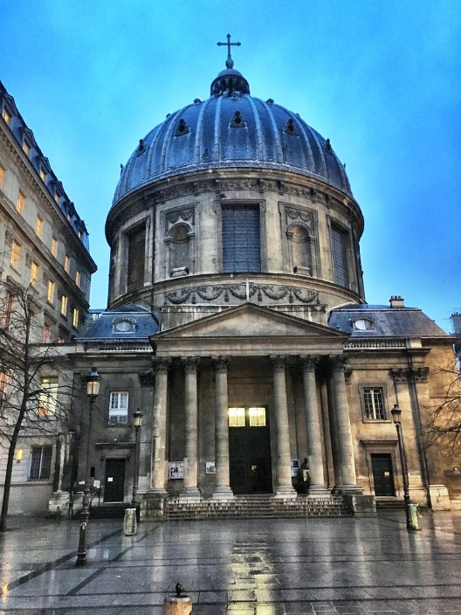
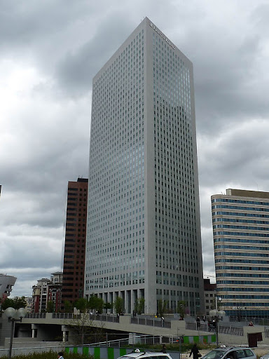
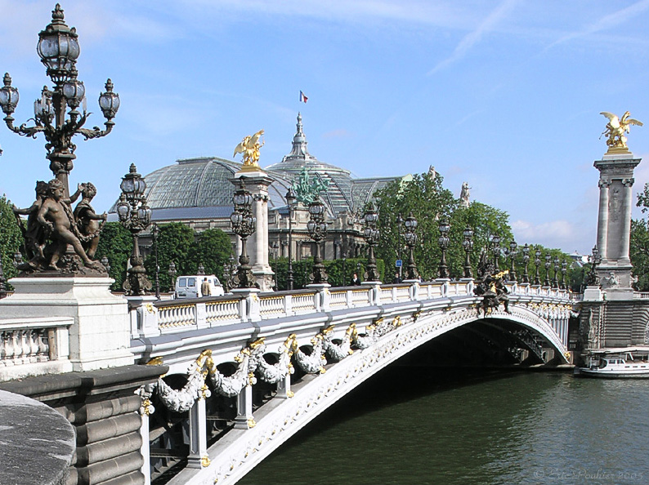
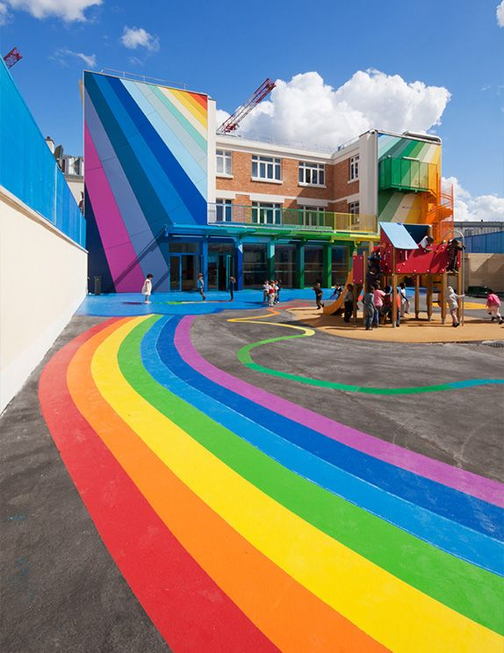
Paris [A]
parler / écrire
À Paris, il y a un haut...
église
bâtiment
Il y a une nouvelle ...
pont
école
Notes:
DO NOT DISPLAY. There is a student worksheet for this activity, which can be downloaded from the NCELP Resource Portal and printed out.
Frequency rankings of vocabulary introduced this week (1 is the most common word in French):
3.1.6 – bon [54], bonne [54], belle [393 haut [264], nouveau [52], nouvelle [52], vieille [671], vieux [671], bâtiment [1952], église [1782], jardin [2284], pont [1889]
Source: Londsale, D., & Le Bras, Y. (2009). A Frequency Dictionary of French: Core vocabulary for learners London: Routledge.

Slide 14
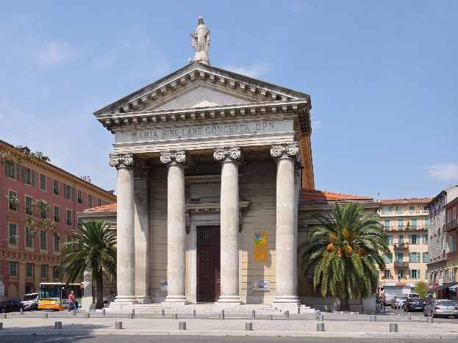
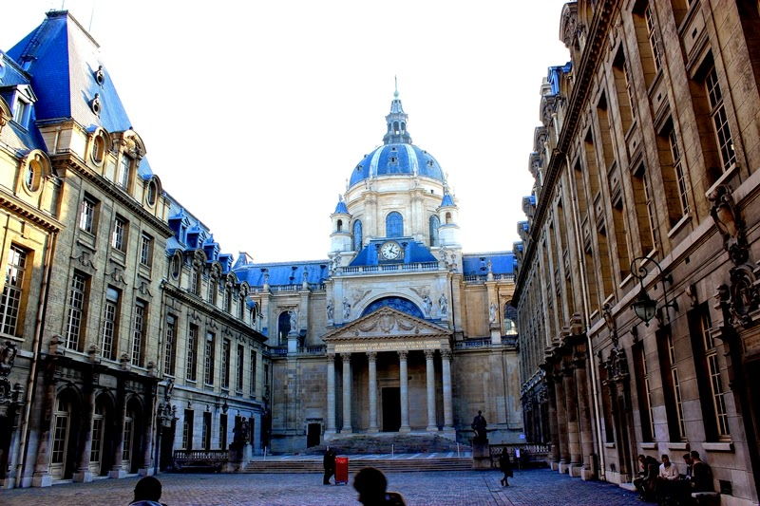
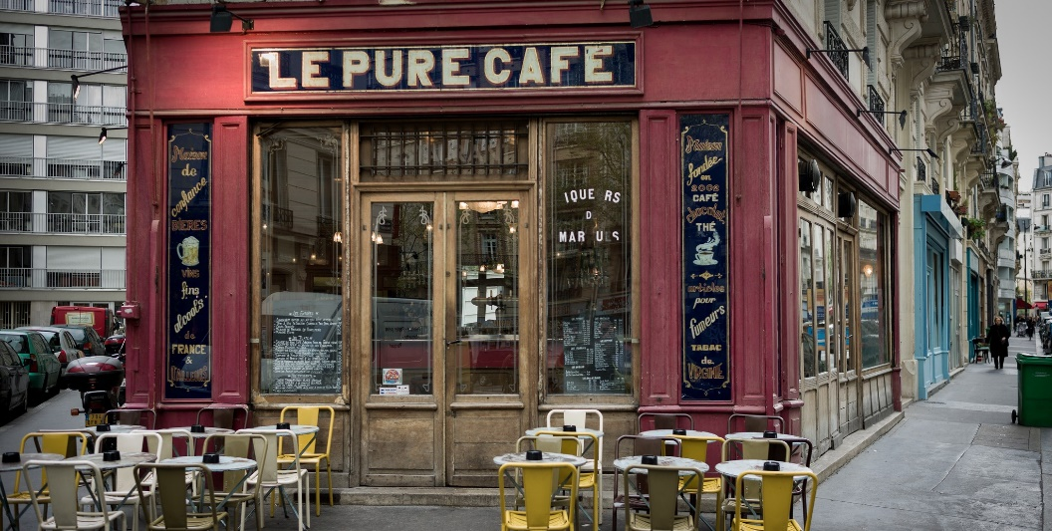
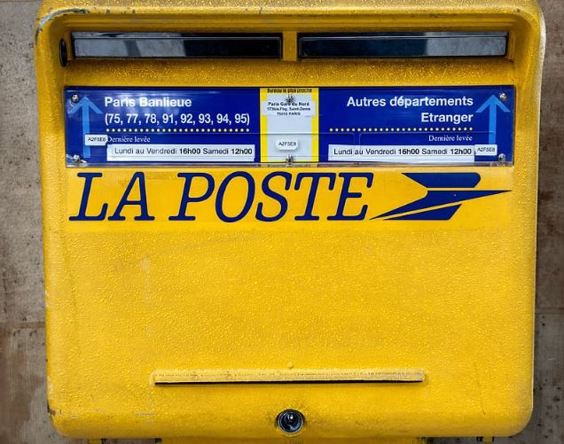
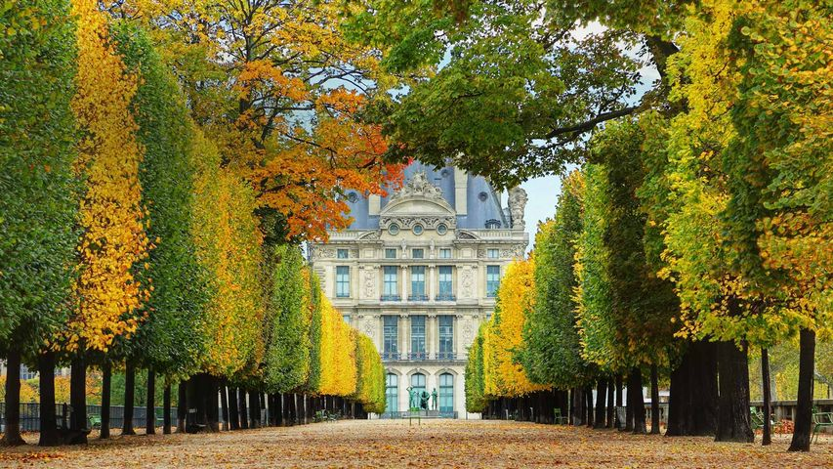
Paris [B]
parler / écrire
Il y a une vieille...
université
café
Il y a aussi un beau ...
poste
jardin
Notes:
DO NOT DISPLAY. There is a student worksheet for this activity, which can be downloaded from the NCELP Resource Portal and printed out.
Frequency rankings of vocabulary introduced this week (1 is the most common word in French):
3.1.6 – bon [54], bonne [54], belle [393 haut [264], nouveau [52], nouvelle [52], vieille [671], vieux [671], bâtiment [1952], église [1782], jardin [2284], pont [1889]
Source: Londsale, D., & Le Bras, Y. (2009). A Frequency Dictionary of French: Core vocabulary for learners London: Routledge.

Slide 15
Vocabulaire
i
4) mat _ ère
l
2) _ angue
e
3) qu _ l
v
l
1) _ é _ o
i
6) comb _ en
e
5) q u _
_ _ _ _ _ _ _
v
i
e
i
l
l
e
Notes:
This slide revises the remaining vocabulary set prescribed for this week – 3.1.3.
3.1.3 - langue1 [712], matière¹ [562], quel [146], combien [800], que² [9]
Timing (total for vocabulary activities on Slides 34-35): 5 minutes

Slide 16
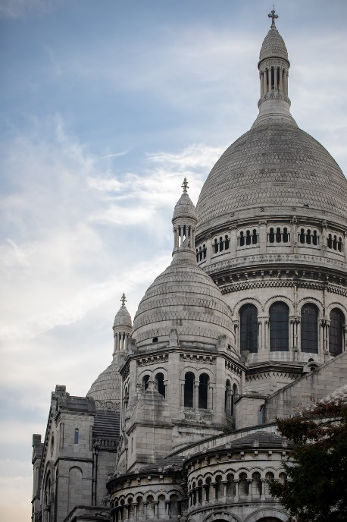
Vocabulaire
lire
C’est quel mot ?
On va visiter le Sacré-______?
- Je ne sais pas __ nous avons le _______ . __________ ?
C’est comment ?
- C’est un grand bâtiment ______ . C’est une église qui __________ à une cathédrale.
- Ah oui ? Qui _______ à la porte ?
Cœur
Pourquoi
si
temps
blanc
ressemble
frappe
Cœur
si
blanc
temps
ressemble
frappe
Pourquoi
Notes:
This slide revises all but one of the words (noir) in one of the other two vocabulary sets prescribed for this week – 2.2.3.
Students complete the dialogue on the theme of visiting a monument in Paris, inserting the correct word in each blank. This can be done orally and/or in writing. The answers are animated. Click on the text to play audio.
2.2.3 - frapper [745], ressembler [1398], cœur [568], temps [65], blanc [708], pourquoi [193], si¹ [34]
Transcript
On va visiter le Sacré-Cœur ?
- Je ne sais pas si nous avons le temps. Pourquoi ?
C’est comment ?
- C’est un grand bâtiment blanc . C’est une église qui ressemble à une cathédrale.
- Ah oui ? Qui frappe à la porte ?

Slide 17
Parlez en français!
parler / écouter
Décris les images 1-6: “C’est un/une ....”.
Use the correct adjective in French to go with the noun (remember position and agreement!).
E.g., C’est une matière facile.
Écoute ton/ta partenaire. Coche la description correcte ou écris la description en anglais.
[easy subject]
Notes:
These are the instructions for the speaking task, with an example which is different from those on the cards. The cards themselves are available to print out in a separate document on the NCELP Resource Portal, as are the answer grids. The harder version removes the noun and adjective prompts from the answer grid.
Students should take turns, and can describe their pictures in any order.
These following two slides cannot be displayed during the exercise, but may be useful in reviewing it.
Timing (total for speaking activities on Slides 51-55): 5 minutes

Slide 18
Parlez en français!
A
parler
1
2
3
Hahaha
[new building]
[intelligent girl]
[funny teacher]
[good question]
4
5
6
[beautiful idea]
[interesting subject]
Notes:
DO NOT DISPLAY. There is a student worksheet for this activity, which can be downloaded from the NCELP Resource Portal and printed out.
Pupils have to describe what is in each box – their partner has to specify what they say, on one of the response sheets which follow. This is Partner A’s prompt card (the answer grids follow the prompt cards).
These slides cannot be displayed during the exercise.
N.B. in this task it has been impossible to make the grammar, in terms of the position of the adjective, task-essential (i.e. students can put the adjective before or after the noun and meanings will still be successfully conveyed). Teachers should circulate and listen in, offering feedback to prompt students to correct their adjectival placement as necessary.
Home learning – the audio for each complete French sentence is accessible upon clicking the button.
Transcript
1. C’est un nouveau bâtiment.
2. C’est une fille intelligente.
3. C’est un professeur drôle.
4. C’est une belle idée.
5. C’est une matière intéressante.
6. C’est une bonne question.

Slide 19
Parlez en français!
B
parler
1
2
3
[beautiful building]
[new girl]
[interesting teacher]
4
5
[funny question]
6
Hahaha
[intelligent idea]
[good subject]
Notes:
DO NOT DISPLAY. There is a student worksheet for this activity, which can be downloaded from the NCELP Resource Portal and printed out.
Pupils have to describe what is in each box – their partner has to specify what they say, on one of the response sheets which follows. This is Partner B’s card. Two answer grids – an easier and a more difficult one – follow on the next two sides.
These slides cannot be displayed during the exercise.
Home learning – the audio for each complete French sentence is accessible upon clicking the button.
Transcript
1. C’est un beau bâtiment.
2. C’est une nouvelle fille.
3. C’est un professeur intéressant.
4. C’est une idée intelligente.
5. C’est une bonne matière.
6. C’est une question drôle.

Slide 20
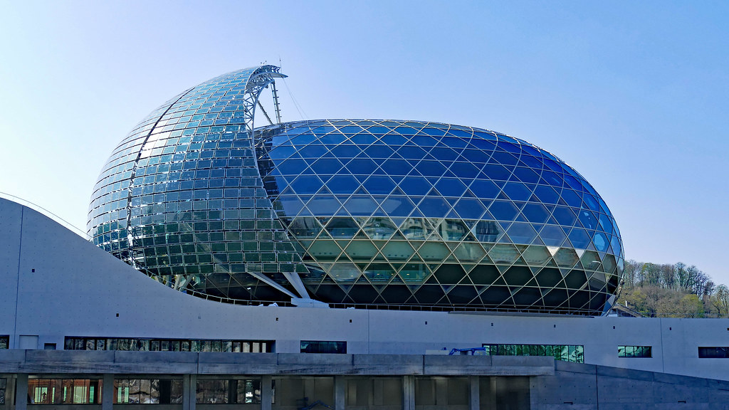
Partenaire A
Utilise les cartes. Écris les 6 phrases.
écrire
Remember!
- position
- agreement
1
C’est un nouveau bâtiment.
2
C’est une fille intelligente.
3
C’est un professeur drôle.
4
C’est une belle idée.
5
C’est une matière intéressante.
La Seine Musicale, Paris.
6
C’est une bonne question.
Notes:
Writing exercise with animated answers – Partner A.
Timing (total for writing activities on Slides 56-58): 15 minutes

Slide 21
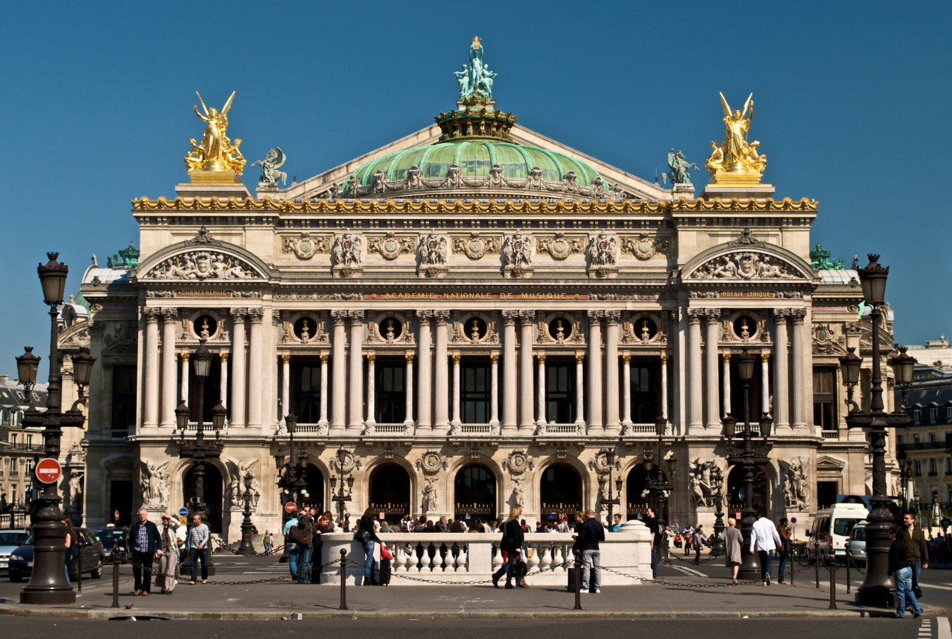
Partenaire B
Utilise les cartes. Écris les 6 phrases.
écrire
Remember!
- position
- agreement
1
C’est un beau bâtiment.
2
C’est une nouvelle fille.
3
C’est un professeur intéressant.
4
C’est une idée intelligente.
5
C’est une bonne matière.
C’est une question drôle.
Palais Garnier, Paris.
6
Notes:
Writing exercise with animated answers – Partner B.

Slide 22
Écris en français !
écrire
Remember to make longer sentences using these conjunctions (linking words):
et and
mais but
ou or
comme like
aussi also
Write some sentences contrasting your town/village with your ideal town/village. You could start as follows:
Dans mon village / ma ville, il y a ...
Dans mon village idéal / ma ville idéale, il y a ...
Use the vocabulary from this sequence, and the dictionary to look up other places to mention.
Notes:
Students are now challenged to write some sentences of their own, contrasting their town/village with their ideal town/village (note that the conditional tense is not introduced at this stage), following the model of the sentences in this resource sequence.

