Slide 1
Saying what people do
Faire with equivalents in English other than 'do/make’
SSC [ch]
Y7 French
Term 1.2 - Week 2 - Lesson 17
Stephen Owen / Emma Marsden / Ciarán Morris
Artwork by: Chloé Motard
Date updated: 28/07/2021
Notes:
Artwork by Chloé Motard. All additional pictures selected are available under a Creative Commons license, no attribution required.
Learning outcomes (lesson 1):
Introduction of SSC [ch]
Introduction of faire with equivalents in English other than 'do/make'
Word frequency (1 is the most frequent word in French):
7.1.2.2 (introduce) bateau [1287], magasin [1736], numéro [766], promenade [>5000], question [144], réponse [456], visite [1072], voyage [904], beau [393], mauvais [274], de¹ [2], en² [7], Paris [n/a], Londres [n/a]
7.1.1.6 (revisit) acteur [1152], actrice [1152], anglais² [784], fille¹ [629], français² [251], garçon [1599], médecin [827], mot [220], personne¹ [84], phrase [2074], le [1], la [1], les [1], en¹ [7]
7.1.1.1 (revisit) être [5], es [5], suis [5], lire [278], écrire [382], écouter [429], parler [429], je [22], tu [112], anglais¹ [784], anglaise¹ [784], français¹ [251], française¹ [251], grand¹ [59], petit¹ [138], grande¹ [59], petite¹ [138], et [6], au revoir [1274], bonjour [1972]
Source: Londsale, D., & Le Bras, Y. (2009). A Frequency Dictionary of French: Core vocabulary for learners London: Routledge.
The frequency rankings for words that occur in this PowerPoint which have been previously introduced in NCELP resources are given in the NCELP SOW and in the resources that first introduced and formally re-visited those words.
For any other words that occur incidentally in this PowerPoint, frequency rankings will be provided in the notes field wherever possible.

Slide 2
ch
chercher
Notes:
Timing: 1 minute
Aim: To introduce SSC [ch]
Procedure: 1. Present the letter(s) and say the [ch] sound first, on its own. Students repeat it with you. 2. Bring up the word ”chercher” on its own, say it, students repeat it, so that they have the opportunity to focus all of their attention on the connection between the written word and its sound.
3. A possible gesture for this would be to mime looking for something everywhere. 4. Roll back the animations and work through 1-3 again, but this time, dropping your voice completely to listen carefully to the students saying the [ch] sound, pronouncing ”chercher” and, if using, doing the gesture.
Word frequency (1 is the most frequent word in French):
chercher [336]. Source: Londsale, D., & Le Bras, Y. (2009). A Frequency Dictionary of French: Core vocabulary for learners London: Routledge.

Slide 3
ch
chercher
Notes:
With sound and no pictures to focus all attention on the sound-symbol correspondence.

Slide 4
ch
chercher
Notes:
Without sound to elicit pronunciation (without first hearing the teacher).
Teacher to elicit pronunciation by asking “Comment dit-on …"

Slide 5
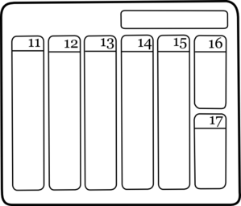
ch
dimanche
chanter
chercher
bouche
chat
champ
[field]
Notes:
Timing: 2 minutes
Aim: To introduce SSC [ch]
Procedure:
1. Introduce and elicit the pronunciation of the individual SSC [ch] and then the source word again ‘chercher’ (with gesture, if using). 2. Then present and elicit the pronunciation of the five cluster words.
The cluster words have been chosen for their high-frequency, from a range of word classes, with the SSC (where possible) positioned within a variety of syllables within the words (e.g. initial, 2nd, final etc.). Additionally, we have tried to use words that build cumulatively on previously taught SSCs (see the Phonics Teaching Sequence document) and do not include new SSCs. Where new SSCs are used, they are often consonants which have a similar symbol-sound correspondence in English.
Word frequency (1 is the most frequent word in French): dimanche [1235]; chanter [1820] bouche [1838]; champ [847]; chat [3138]; chercher [336]. Source: Londsale, D., & Le Bras, Y. (2009). A Frequency Dictionary of French: Core vocabulary for learners London: Routledge.

Slide 6
ch
dimanche
chanter
chercher
bouche
chat
champ
Notes:
With sound and no pictures to focus all attention on the sound-symbol correspondence.

Slide 7
ch
dimanche
chanter
chercher
bouche
chat
champ
Notes:
Without sound to elicit pronunciation (without first hearing the teacher).
Teacher to elicit pronunciation by asking “Comment dit-on …"

Slide 8
Phonétique
écouter / écrire
C’est [ch] ou [s(s)] ?
broche brooch
brosse brush
1
2
3
4
5
6
a
b
a
mâche chews, is chewing
b
masse mass
a
sot silly
b
chaud hot
a
crasse grime
b
crache spits, is spitting
a
sait knows, is knowing
b
chez at
chut hush
su knew
a
b
Notes:
Timing: 5 minutes Aim: To differentiate between pairs of words that differ by one phoneme (one SSC that changes the meaning). These words are called minimal pairs. Procedure: 1. Click on the letter triggers (a then b for numbers 1-6) to play the audio. 2. Students write [ch] or [s(s)] for each pair.
3. Click to see the answers.
Transcript:
1a. broche - b. brosse
2a. mâche - b. masse
3a. sot - b. chaud
4a. crasse - b. crache
5a. sait - b. chez
6a. chut - b. su
Word frequency of unknown vocabulary (1 is the most frequent word in French): broche [>5000], brosse [>5000], mâcher [>5000], masse [1826], sot [>5000], chaud [1852], crasse [>5000], cracher [>5000], savoir [67], chez [206]
Source: Londsale, D., & Le Bras, Y. (2009). A Frequency Dictionary of French: Core vocabulary for learners London: Routledge.

Slide 9
Phonétique
Phonétique
écouter / parler
Le chat et la biche achètent des brioches.
1
The cat and the deer are buying brioche.
Le champion cache son chapeau.
2
The champion is hiding his hat.
La machine à gauche marche.
3
The machine on the left is working.
C’est la moustache du maréchal !
4
It’s the Marshall’s moustache!
Notes:
Timing: 8 minutes
Aim: to recognise and produce SSC [ch] within words at sentence level.
Procedure:
1. Click on the number trigger to play the audio.
2. Students tally the number of times they hear SSC [ch].
3. Click to reveal answers.
4. Students take turns to read the words containing [ch] only aloud (at more advanced levels, students may wish to try reading the whole sentence, paying special attention to the words containing [ch].) The listening partner ensures [ch] is not pronounced the English way. If it is, the speaking student must read it again three times.
5. Click to check pronunciation.
Transcript:
1) Le chat et la biche achètent des brioches.
2) Le champion cache son chapeau.
3) La machine à gauche marche.
4) C’est la moustache du Maréchal !
Word frequency of unknown vocabulary (1 is the most frequent word in French): chat [3138], biche [>5000], acheter [636], brioche [>5000], champion [2443], cacher [914], chapeau [2908], machine [1294], gauche [607], marcher [1532], moustache [>5000], maréchal [>5000]

Slide 10
The verb ‘faire’ – to do/make
Phonétique
grammaire
Reminder: in French we use the verb faire to say to do and to make.
je fais
I do / I make
tu fais
you do / you make
il fait
he does / he makes
elle fait
she does / she makes
Stephen Owen
Notes:
Timing: 2 minutes
Aim: to recap singular persons of the verb ‘faire’.
Procedure:
1.Read through the explanation
2.Highlight the spelling difference in the third person singular form

Slide 11
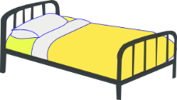
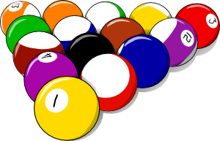
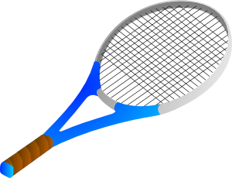
Exercise-faire
The verb ‘faire’ – to do/make
écrire
1
2
faire l_ m_ _ _ _ _
faire un modèle
3
faire l_ l_ _
faire l’a_ _ _ _ _ _ _
faire le lit
faire une activité
5
4
faire l_ c_ _ _ _ _ _
faire la cuisine
faire l_ m_ _ _ _ _
faire le ménage
7
faire l_ _ d_ _ _ _ _ _
faire les devoirs
6
faire l_ _ c_ _ _ _ _ _
faire les courses
Notes:
Timing: 5 minutes
Aim: to revise the previously-presented, prototypical meanings of ‘faire’ (as equivalents of ‘do’ and ‘make’), before introducing some alternative uses.
Procedure:
1. Students complete the words in written modality.
2. Elicit translations into English to clarify the activity and in each instance whether ‘faire’ is translated as ‘do’ or ‘make’

Slide 12
The verb ‘faire’ – other meanings
vocabulaire
However, faire has many other meanings in French:
faire un voyage
faire les courses = to go food shopping (a chore)
faire les magasins = to go shopping (for fun)
to go on a journey
faire une promenade
to go for a walk/ride
faire une visite de
to visit/go on a tour of
faire les magasins
to go shopping
faire beau
to be nice weather
faire mauvais
to be bad weather
Stephen Owen
Notes:
Timing: 3 minutes
Aim: to introduce some alternative meanings of ‘faire’.
Procedure:
1. Click to bring up the French followed by the translation in English.
2. Point out that the verb can variously be rendered as ‘go (on/for)’ and ‘be’ across these examples, the verb ‘faire’ in French covering all of these different meanings in these common collocations.
Note: The weather terms are covered with the infinitive for now, as they can of course be encountered in this form in natural language: e.g., ‘il va faire beau’. The impersonal use of ‘faire’ in these expressions will be discussed later.

Slide 13
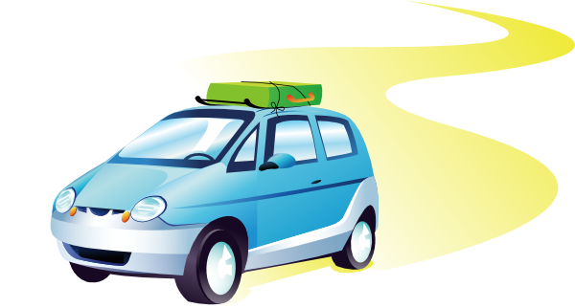
Exercise-faire
The verb ‘faire’ – other meanings
vocabulaire
faire un voyage
faire une promenade
Here, en means ‘by’
(a trip by boat).
As you know, it can also mean ‘in’ (écris en anglais/write in English).
faire beau
faire les magasins
faire une visite de
faire mauvais
faire une promenade en bateau
Notes:
Timing: 3 minutes
Aim: to embed correct pronunciation of the newly learnt expressions with ‘faire’ and promote recall of meanings in English.
Procedure:
1. Present the image and model the pronunciation, asking students to listen and repeat.
2. Click to bring up the French.
3. Elicit meanings in English.

Slide 14
Londres et Paris
écouter
French has its own word for London. Paris has an SFC in French.
To say you went on a tourist visit or tour of a city, use ‘faire une visite de’ (a visit of) + name of city.
Londres
Paris
Je fais une visite de Londres.
Tu fais une visite de Paris.
Notes:
Timing: 3 minutes
Aim: to introduce the French words for ‘London’ and ‘Paris’
Procedure:
Click to see and hear the French names of the cities. [audio missing – recording in progress]
Students repeat.
Students alternate between saying the English and French city names as many times as necessary.
Click to reveal the constructions with ‘de’.
Students repeat.

Slide 15
C’est quoi ?
vocabulaire
faire une visite de
Notes:
Timing: 4 minutes for the next 7 slides
Aim: to promote oral recall of the newly learnt expressions with ‘faire’.
Procedure:
1. Slowly reveal the image of one of the items of vocabulary just introduced one click at a time.
2. Challenge students to guess the item (in French) at the earliest opportunity, gaining more ‘points’, for example, the earlier they do so.
3. Refer to the notes for the vocabulary item sought, e.g. (for this slide):
faire une visite.

Slide 16
C’est quoi ?
vocabulaire
faire un voyage
Notes:
faire un voyage.

Slide 17
C’est quoi ?
vocabulaire
faire une promenade
Notes:
faire une promenade.

Slide 18
C’est quoi ?
vocabulaire
faire beau
Notes:
faire beau.

Slide 19
C’est quoi ?
vocabulaire
faire mauvais
Notes:
faire mauvais.

Slide 20
C’est quoi ?
vocabulaire
faire une promenade en bateau
Notes:
faire une promenade en bateau.

Slide 21
C’est quoi ?
vocabulaire
faire les magasins
Notes:
faire les magasins.

Slide 22
Talking about the weather
Talking about the weather
grammaire
Faire is used with il (meaning ‘it’) with weather expressions:
il fait beau
it is nice weather
il fait mauvais
it is bad weather
Stephen Owen
Notes:
Timing: 1 minute
Aim: to explain the impersonal use of ‘faire’ in weather expressions.
Procedure:
1. Click to bring up the explanation.

Slide 23
Écris le numéro !
écouter
Number the pictures below in the order that you hear them mentioned.
a |  |  | e
b |  |  | f
c |  |  | g
d |  |  | h
1
2
3
4
5
6
7
8
Notes:
Timing: 5 minutes
Aim: to practise recognition of the newly learnt expressions with ‘faire’ in the oral modality.
Procedure:
Click on the number trigger to play the audio.
Students write in the number next to the correct image.
See the next slide for the answers.
Transcript:
Je fais les magasins.
Elle fait le ménage.
Je fais un voyage.
Il fait une promenade.
Il fait mauvais.
Il fait beau.
Elle fait une visite de Londres.
Elle fait une promenade en bateau.

Slide 24
Écris le numéro !
écouter/ parler /écrire
Réponses :
a |  |  | e
b |  |  | f
c |  |  | g
d |  |  | h
6
5
4
3
1
8
7
2
Notes:
Timing: 8 minutes
Aim: to practise written production of the newly learnt expressions with ‘faire’ and singular persons of the verb ‘faire’.
Procedure:
Reveal the answers on a mouse click.
Tell students they are now going to write what they heard.
Play the audio again.
Students reconstruct the sentence as heard in the transcript.
Ask student to then create a similar sentence which could fit the picture. They could do either of these first orally, then in writing (i.e. transcribe or adapt what they hear).

Slide 25
Saying what people do
Faire with equivalents in English other than 'do/make’
SSC [ç/c]
Y7 French
Term 1.2 - Week 2 - Lesson 18
Stephen Owen / Emma Marsden / Ciarán Morris
Artwork by: Chloé Motard
Date updated: 28/07/2021
Notes:
Artwork by Chloé Motard. All additional pictures selected are available under a Creative Commons license, no attribution required.
Learning outcomes (lesson 2):
Introduction of SSC [ç/c]
Consolidation of [faire with equivalents in English other than 'do/make']
Word frequency (1 is the most frequent word in French):
7.1.2.2 (introduce) bateau [1287], magasin [1736], numéro [766], promenade [>5000], question [144], réponse [456], visite [1072], voyage [904], beau [393], mauvais [274], de¹ [2], en² [7], Paris [n/a], Londres [n/a]
7.1.1.6 (revisit) acteur [1152], actrice [1152], anglais² [784], fille¹ [629], français² [251], garçon [1599], médecin [827], mot [220], personne¹ [84], phrase [2074], le [1], la [1], les [1], en¹ [7]
7.1.1.1 (revisit) être [5], es [5], suis [5], lire [278], écrire [382], écouter [429], parler [429], je [22], tu [112], anglais¹ [784], anglaise¹ [784], français¹ [251], française¹ [251], grand¹ [59], petit¹ [138], grande¹ [59], petite¹ [138], et [6], au revoir [1274], bonjour [1972]
Source: Londsale, D., & Le Bras, Y. (2009). A Frequency Dictionary of French: Core vocabulary for learners London: Routledge.

Slide 26
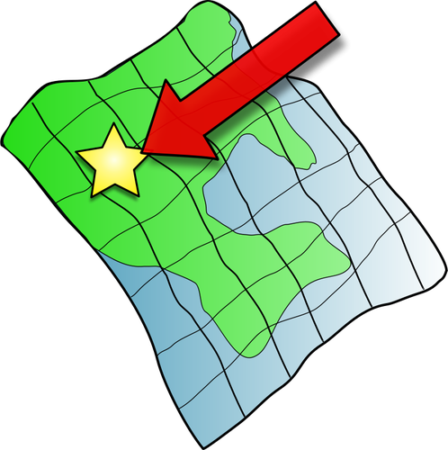
ç/c
ici
Notes:
Timing: 1 minute
Aim: To introduce SSC [ç/c]
Procedure: 1. Present the letter(s) and say the [ç/c] sound first, on its own. Students repeat it with you. 2. Bring up the word ”ici” on its own, say it, students repeat it, so that they have the opportunity to focus all of their attention on the connection between the written word and its sound.
3. A possible gesture for this would be to point to the spot on which one is standing / indicate the room in which the lesson is taking place with a sweeping motion of one’s index finger. 4. Roll back the animations and work through 1-3 again, but this time, dropping your voice completely to listen carefully to the students saying the [ç/c] sound, pronouncing ”ici” and, if using, doing the gesture.
Word frequency (1 is the most frequent word in French):
ici [167]. Source: Londsale, D., & Le Bras, Y. (2009). A Frequency Dictionary of French: Core vocabulary for learners London: Routledge.

Slide 27
ç/c
ici
Notes:
With sound and no pictures to focus all attention on the sound-symbol correspondence.

Slide 28
ç/c
ici
Notes:
Without sound to elicit pronunciation (without first hearing the teacher).
Teacher to elicit pronunciation by asking “Comment dit-on …"

Slide 29
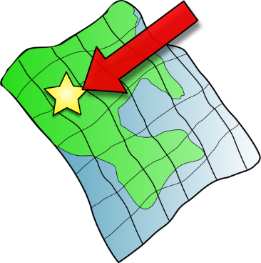
ç/c
français
garçon
ici
cinéma
cinq
décider
[to decide]
Notes:
Timing: 2 minutes
Aim: To introduce SSC [ç/c]
Procedure:
1. Introduce and elicit the pronunciation of the individual SSC [ç/c] and then the source word again ‘ici’ (with gesture, if using). 2. Then present and elicit the pronunciation of the five cluster words.
The cluster words have been chosen for their high-frequency, from a range of word classes, with the SSC (where possible) positioned within a variety of syllables within the words (e.g. initial, 2nd, final etc.). Additionally, we have tried to use words that build cumulatively on previously taught SSCs (see the Phonics Teaching Sequence document) and do not include new SSCs. Where new SSCs are used, they are often consonants which have a similar symbol-sound correspondence in English.
Word frequency (1 is the most frequent word in French): français [251]; garçon [1599]; cinéma [1623]; décider [165]; cinq [288]; ici [167]. Source: Londsale, D., & Le Bras, Y. (2009). A Frequency Dictionary of French: Core vocabulary for learners London: Routledge.

Slide 30
ç/c
français
garçon
ici
cinéma
cinq
décider
Notes:
With sound and no pictures to focus all attention on the sound-symbol correspondence.

Slide 31
ç/c
français
garçon
ici
cinéma
cinq
décider
Notes:
Without sound to elicit pronunciation (without first hearing the teacher).
Teacher to elicit pronunciation by asking “Comment dit-on …"

Slide 32
Phonétique
ici
parler
déçevoir
ceci
45
cinq
cependant
ancien
secondes
façon
commerçant
spécial
insouciant
0
DÉBUT
Notes:
Timing: 5 minutes for three slides.
Aim: automatisation of oral production of SSCs soft [c] and [ç] at word level.
Procedure:
Tell students that they are going to take turns to say all the words within a given time, building up speed. They call in any order they like but are not allowed to repeat the one they said in their last turn.
Click on début to start the timer on the screen.
The listening students checks that the speaking student does not produce a hard [c]. If they do, they must repeat the words correctly three times.
Students swap roles. Restart the timer.
Click to check pronunciation of the words. [audio missing – recording in progress]
Word frequency (1 is the most frequent word in French):
ici [167], décevoir [1302], ceci [732], cinq [288], cependant [352], façon [248], ancien [392], commerçant [4167], spécial [726], insouciant [>5000] Source: Londsale, D., & Le Bras, Y. (2009). A Frequency Dictionary of French: Core vocabulary for learners London: Routledge.
Ask students what they notice about the vowels which follow soft [c] (always ‘i’ or ‘e’). This primes for the explanation on slide 36.

Slide 33
Phonétique
ici
parler
Phonétique
déçevoir
ceci
30
cinq
cependant
ancien
secondes
façon
commerçant
spécial
insouciant
0
DÉBUT
Notes:
As previous, but with 15 fewer seconds on the timer.

Slide 34
Phonétique
ici
parler
Phonétique
déçevoir
ceci
15
cinq
cependant
ancien
secondes
façon
commerçant
spécial
insouciant
0
DÉBUT
Notes:
As previous, but with 15 fewer seconds on the timer still.

Slide 35
Soft or hard [c/ç]?
In French, the letter c is soft (sounds like s) before e or i:
le cinéma c’est
The letter c is hard (sounds like k) before a, o or u:
calme content cuisine
We sometimes soften the c before a, o or u with a cedilla (ç):
le français le garçon le reçu (receipt)
Notes:
Timing: 2 minutes
Aim: to introduce spelling rules governing the pronunciation of [c] and explain when a cedilla is needed.
Procedure:
1. Click to bring up the explanation
2. Ask students to read the words in each category out loud.

Slide 36
Soft or hard [c/ç]?
lire / écouter / parler
 |  | [ç/c] | [hard c]
 | glaçon
 | compter [to count]
 | concombre
j | cible [aim]
 | Franco- [French-]
 | tronçon [section]
h | cabane
 | merci
Complète et dis les mots !
A
Sometimes, you will see the prefix Franco- used instead of français, e.g.:
Il est franco-italien
He is half-French, half-Italien.
B
C
D
E
F
G
H
Notes:
Timing: 5 minutes
Aim: Applying awareness of the spelling rules governing SSC [c/ç]
Procedure
Student read the words and decide based on the spelling of the word (vowel which follows/cedilla) whether the letter in bold is hard or soft.
Click to check.
Students try to say the words out loud.
Click to check.
Word frequency of unknown words and cognates (1 is the most frequent word in French): glaçon [>5000], compter [140], concombre [>5000], cible [2740], Franco- [n/a], tronçon [>5000], cabane [>5000]
Source: Londsale, D., & Le Bras, Y. (2009). A Frequency Dictionary of French: Core vocabulary for learners London: Routledge.

Slide 37
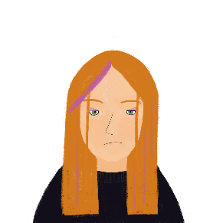
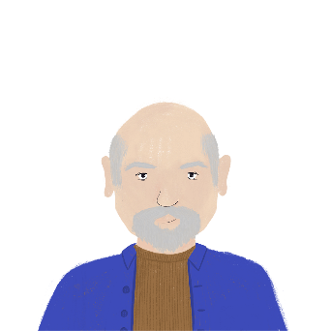
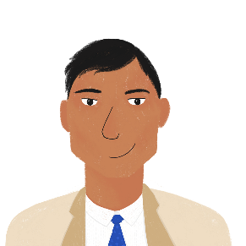
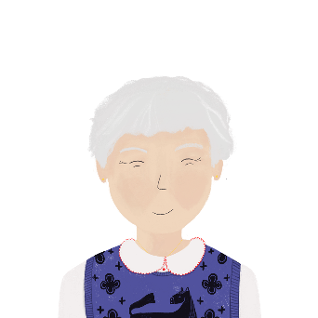
La personne est …
écrire
1. Je suis française.
5. Je suis français.
[French]
[French]
2. Je suis grand.
6. Je suis petit.
[tall]
[short]
3. Je suis anglaise.
7. Je suis grande.
[English]
[tall]
4. Je suis anglais.
8. Je suis petite.
[English]
[short]
Notes:
Timing: 3 minutes
Aim: Written production of some of the words form this week’s revisited set. Revision of adjective agreement.
Procedure
Students read the sentences and decide which form of the French adjective is needed based on the gender of the speaker.
Students write 1-8 and the adjective with the correct ending.
Answers revealed on clicks.

Slide 38
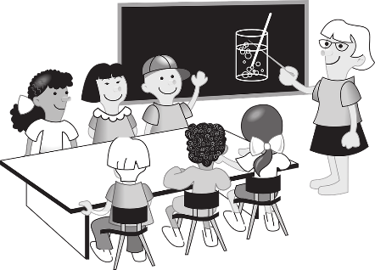
Words with more than one meaning
lire
Many words in English have more than one meaning. What does the word ‘pupil’ mean in these sentences? How do you know?
Your pupils get bigger in the dark. The pupils are working hard.
The other words in the sentence tell you the meaning.
Notes:
Timing: 3 minutes for two slides.
Aim: To introduce the concept of words with multiple meanings, and to explain how these will be taught.

Slide 39
Words with more than one meaning
lire
The same thing happens in French. What does the word ‘en’ mean here?
L’acteur parle en anglais. Je fais un voyage en voiture.
The actor speaks in English. I’m going on a journey by car.
You will learn the meanings of words like this one by one.
When you learn the first meaning of a word, it looks like this on Quizlet:
When you learn another meaning, it appears next to the first meaning:

Slide 40
Saying ‘to’ and ‘in’ in French
Remember!
‘en’ has more than one meaning in French. The other words in the sentence tell us the meaning.
lire
Saying ‘in’ and ‘by’
Lis les phrases. C’est ‘in’ ou ‘by’ ?
Écris les phrases en anglais !
 |  | ‘in’ | ‘by’
1. | Le médecin parle en anglais.
2. | Il fait une promenade en bateau.
3. | Le garçon est actif en classe.
4. | Écris les mots en anglais.
 |  | ‘in’ | ‘by’
5. | L’actrice fait un voyage en bateau.
6. | La fille fait des courses en voiture.
7. | Tu es en France ?
8. | Dis la phrase en français.
Notes:
Timing: 10 minutes
Aim: Practise different translations of preposition en. Written recognition of some of the vocabulary in this week’s revisited set.
Procedure:
Students read the sentences and tick the relevant translation.
Answers revealed on clicks.
Attention should be drawn to the fact that the same preposition can be translated differently depending on the context.
Click to bring up the second task instruction, inviting students to translate the full sentences.
Suggested translations can be found on the next slide.

Slide 41
Saying ‘to’ and ‘in’ in French
Réponses
lire
Saying ‘in’ and ‘by’
Écris les phrases en anglais !
1. | Le médecin parle en anglais. | The doctor speaks in English.
2. | Il fait une promenade en bateau. | He’s taking a trip by boat / a boat trip.
3. | Le garçon est actif en classe. | The boy is active in class.
4. | Écris les mots en anglais. | Write the words in English.
5. | L’actrice fait un voyage en bateau. | The actress is going on a journey by boat.
6. | La fille fait des courses en voiture. | The girl is going food shopping by car.
7. | Tu es en France ? | Are you in France?
8. | Dis la phrase en français. | Say the sentence in French.
Notes:
Suggested translations for the exercise on the previous slide revealed on clicks.

Slide 42
Écris en français
lire
Match the words to the pictures.
1 |  |  | 5
2 |  |  | 6
3 |  |  | 7
4 |  |  | 8
a) elle fait un voyage
d) tu fais les magasins
g) je fais une promenade
b) je fais le ménage
e) elle fait une visite
h) il fait mauvais
c) il fait beau
f) tu fais une promenade en bateau
Notes:
Timing: 5 minutes
Aim: to practise recognition of forms and connecting these with meaning.
Procedure:
Students write 1-8 and a-f.
Answers on next slide.

Slide 43
Écris en français
lire
Réponses :
1 |  |  | 5
2 |  |  | 6
3 |  |  | 7
4 |  |  | 8
c) il fait beau
h) il fait mauvais
g) je fais une promenade
e) elle fait un voyage
f) tu fais une promenade en bateau
d) tu fais les magasins
e) il fait une visite de Paris
b) je fais le ménage
Notes:
Answers to the activity on the previous slide.

Slide 44
Écris en anglais
lire
Now translate the sentences into English.
1 |  |  | 5
2 |  |  | 6
3 |  |  | 7
4 |  |  | 8
il fait beau
il fait mauvais
the weather is nice
the weather is bad
je fais une promenade
elle fait un voyage
I go for a walk
she goes on a journey
tu fais les magasins
tu fais une promenade en bateau
you go shopping
you go on a boat ride
il fait une visite de Paris
je fais le ménage
he goes on a tour of Paris
I do the housework
Notes:
Timing: 5 minutes
Aim: to check understanding of the new vocabulary and of the person of the verb used in each sentence, engaging the students again with the grammar feature.
Procedure:
1. Students translate each sentence into English.
2. Answers are revealed on a mouse click.

Slide 45
Parle en français
parler
1 |  | The weather is nice | 5 |  | The weather is bad
2 |  | I go for a walk | 6 |  | She goes on a journey
3 |  | You go shopping | 7 |  | You go on a boat ride
4 |  | He goes on a tour of Paris | 8 |  | I do the housework
Notes:
Timing: 3 minutes
Aim: to practise oral production of singular persons of the verb ‘faire’ along with this week’s target vocabulary, priming for the oral production task on the following slide.
Procedure:
1. Ask students to convert the sentences back into French orally (either as whole-class choral response or in pairs).
Note:
We need to bear in mind that learners are not at the moment ‘actively’ choosing to use (produce) faire for all these different English meaning. Because this task focusses only on faire, this is a ‘given’ in this series of activities! In a later series of activities in the Scheme of Work, we will provide opportunities for students to actively ‘choose’ to produce ‘faire’ for this set of activities (versus ‘aller’ or ‘être’).

Slide 46
Tu fais quoi ?
parler / écouter
Use the pictures below to describe to your partner in FRENCH what normally happens on a holiday. Your partner will write them down in the order in which you say them. Check afterwards to see if your partner was correct!
Notes:
Timing: 6 minutes
Aim: to practise using the first person singular form of ‘faire’ in response to the pictures, in order to narrate an imaginary day to their partner.
Procedure:
1. Leave this slide displayed during the speaking activity.
2. Student A quickly numbers the activities (or notes them down) in the order that s/he will narrate them.
3. Student B writes down numbers 1-8 (using the next slide as a model).
4. Student A narrates the activities to student B who listens and writes them down in English in the order narrated.
5. Partners then swap roles.
Note: Make it clear to students that they are doing this in the present tense, i.e. saying what they do as it happens, rather than recounting past events.

Slide 47
Écris en anglais
parler / écouter
Write down your partner’s description of the events, in ENGLISH, in the order you hear them.
Order | Description (in ENGLISH)
1
2
3
4
5
6
7
8
Notes:
Optional partner response grid. This can be printed out for students.
(To avoid printing, use this as a model and ask students to write numbers 1-8 in their exercise books noting the activity in English upon listening to their partner.)

Slide 48
Écris en français
écrire
Now use the pictures below to write 8 sentences in FRENCH to describe what normally happens on a holiday.
Notes:
OPTIONAL EXTRA
Timing: 6 minutes
Aim: to practise written production of first person singular of ‘faire’ along with this week’s target vocabulary.
Procedure:
Students write sentences using the first person singular form of ‘faire’ in response to the pictures, in order to narrate an imaginary day on holiday.
For an additional challenge, students could then be asked to do this using the second person singular form – i.e. writing about what ‘you’ do – or the third person singular form – i.e. writing about what s/he does.
Make it clear to students that they are writing in the present tense, i.e. saying what happens normally (Note: we will cover the present continuous in a later week, I am doing, I am playing).
Remind learners that the weather expressions are always used impersonally – i.e. with ‘il’.

Slide 49
Gaming Grammar
Gaming Grammar
Relevant mini game(s):
Verbs (present): 1st person singular/plural (Verb agreement (present))
Verbs (present): 2nd person singular/plural (Verb agreement (present))
Verbs (present): 3rd person singular/plural (Verb agreement (present))
Notes:
This slide links to Gaming Grammar login screen. The appropriate mission can then be selected from the menu page.
Students will progress through the game at their own rate; teachers should use the teacher interface to check progress. This will help to inform future lesson planning.

Slide 50
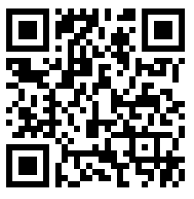
Devoirs
Vocabulary Learning Homework (Term 1.2, Week 3)
Audio file
Audio file QR code:
Student worksheet
Quizlet link
In addition, revisit: Term 1.1 Week 7
Term 1.1 Week 2

