Slide 1
Differentiation within the German SoW
Supporting lower proficiency learners:
by support
by task
by outcome
Activity Selection:
Year 7 German
Term 2.2 - Weeks 3 – 5
30/05/21
Notes:
Welcome to this showcase of differentiation with the German SoW. We will explore teaching activities from Y7 German Term 2.2 weeks 3-5, looking at supporting lower proficiency learners through differentiation by support, task and outcome.

Slide 2
German Y7 Term 2.2 weeks 3-5
High frequency strong verbs in the present tense
Progression:
Week 3 – lesson 1 ‘ich’ & ‘er/sie’; lesson 2 ‘ich’ & ‘er/sie’
Week 4 – lesson 1 ‘ich’ & ‘du’; lesson 2 ‘ich’ ‘du’
Week 5 – lesson 1 ‘er/sie’ & ‘sie’; lesson 2 ‘er/sie’ & ‘sie’(extended text activities)
Notes:
Week 3 begins the first teaching of strong verbs.
The focus is on selected HF strong verbs.
This builds on previous work on weak verbs and irregular verbs, all to ensure that students acquire a good verb lexicon.
This is essential so that they can understand and create interesting sentences and so that they have a solid bank of verbs which can be manipulated, over the coming months and years, for different persons, numbers, tenses, moods, and aspects.

Slide 3
German Y7 Term 2.2 weeks 3-5
Term | Week | Grammar Tracking Overview
2.2 | Wk 1 | Present tense weak verbs: 1st person singular vs 1st person plural (plus HABEN / SEIN)
 | Wk 2 | Modal verb können: ich kann, du kannst, er/sie kann 2-verb rule kein (with plurals) vs nicht
 | Wk 3 | Present tense strong verbs: 1st vs 3rd person singular
 | Wk 4 | Present tense strong verbs: 1st vs 2nd person singular
 | Wk 5 | Present tense weak and strong verbs: 3rd person singular vs 3rd person plural (sie = she, sie = they) WO2
Lesson 1: ‘ich & ‘er/sie’ (input activities)
Lesson 2:
‘ich & ‘er/sie’ (production activities)
Lesson 1:
‘ich’ & ‘du’ (input activities)
Lesson 2: ‘ich’ & ‘du’ (production activities)
Lesson 1: ‘er/sie’ & ‘sie’
Lesson 2:
‘er/sie’ & ‘sie’
(extended text activities)
Notes:
This is the excerpt from the Scheme of Work.
Week 3 contrasts 1st and 3rd person singular forms.
Week 4 develops knowledge and use of strong verbs, this time contrasting 1st and 2nd person singular forms.
This focus lends itself to question and answer tasks.
Lesson 2 focusses in particular on practising in oral modality the strong verb forms.
Week 5 takes the opportunity to contrast the 3rd person singular of both weak and strong verbs with the 3rd person plural form, given that the 3rd person plural of all German verbs is the same form as the infinitive.

Slide 4
Differentiation by: support
Example Y7 T2.2 W3-5
All modes and modalities: reading, listening, speaking and writing
Grammatical focus: present tense strong verbs: 1st vs 3rd person singular
Notes:
Now that we have seen how progression is built in across a series of weeks, let’s now look in closer detail at differentiation to support lower proficiency learners within the resources themselves.

Slide 5
Supporting lower proficiency learners
Term 2.2 Week 3 (p.41)
Term 2.2 Week 4 (p.42)
Term 2.2 Week 5 (p.43)
Notes:
Across the series of lessons on strong verbs, we not only practise the strong verbs from each week’s specific vocab set each time, but also recycle the verbs from the previous lessons as well as gradually bringing in previously learnt weak and irregular verbs. As we have said, this is to ensure that students acquire a good verb lexicon, in particular focussing on highly frequent verbs. To support students’ understanding of the strong verbs used across the activities, where retention is weak, teachers could make use of the Y7 Language Guides in class. If students are not able to readily recall the meanings of the verbs used, they can be directed to pages 41-43. This supports the reading, listening and production activities across the three weeks. Students could be asked to highlight the infinitives in a particular colour.
To promote recall, rather than having the sheet on the desk for constant referral and in order to maintain a degree of challenge, ask students to have this help sheet face down on their desks and that they try to remember vocab before they check the sheet. Once checked, they should turn the sheet back over. Another way to make use of this sheet would be to ask students to read the sheet for 2 minutes ahead of the activity as a quick refresh, either asking students to make no further reference to it, or limiting the number of times the sheet could be referred to (‘lifeline’ style).
These methods could be particularly useful for mixed ability groups where various levels of challenge are required to meet the span of ability across the group.
Where students’ retention is very poor, then allowing the sheet to be referred to throughout may be of benefit.
Remember though that some ‘attempt to recall’ is needed to strengthen memory, so it may be better to reduce the number of items students are required to produce, and instruct them to repeat the task, with less support each time. i.e. whilst others produced 5/6 items, they produce 2 or 3, several times, referring to the sheet initially, then reducing their own reference to it.

Slide 6
Grammatik – strong verbs
Grammatik
Some German verbs change the vowel in the er / sie-form.
We call these strong verbs.
ich spreche
er spricht
You have to learn which verbs are strong, but there are some rules!
Only verbs with an a or an e in their stem can be strong.
ich gebe
Stems with an e change to i or ie:
er gibt
ich lese
sie liest
sie fährt
Stems with an a change to ä:
ich fahre
This includes the a in au!
ich laufe
er läuft
Notes:
This is the first lesson where students are introduced to strong verbs.
Consistent with the principle of avoiding introducing too much too soon, the pair of features focussed on here is first person singular and third person singular.
Original teacher notes
Timing: 2 minutes
Aim: To introduce the concept of strong verbs.
Procedure:
1. Cycle through the information on the slide using the animation sequence.
Rule: must have 'a' or 'e' in the stem to be a potential strong verb.
a → ä (includes au → äu!)
e → i
e → ie
Most verbs do not get a vowel change, but a number of high frequency verbs do!
We will expand the paradigm to include the second person in next week’s sequence.

Slide 7
Grammatik – strong verbs
Grammatik
Supporting lower proficiency learners
Sprechen
to speak
ich spreche
er spricht
sie spricht
I speak
he speaks
she speaks
Only verbs with an a or an e in their stem can be strong.
e → i or ie
ich gebe
er gibt
ich lese
sie liest
a → ä
ich fahre
sie fährt
ich laufe
er läuft
Notes:
Before we move on, some teachers within the network report they find it useful when differentiating for lower proficiency learners to use an even further simplified grammar explanation slide, to minimise written language.

Slide 8
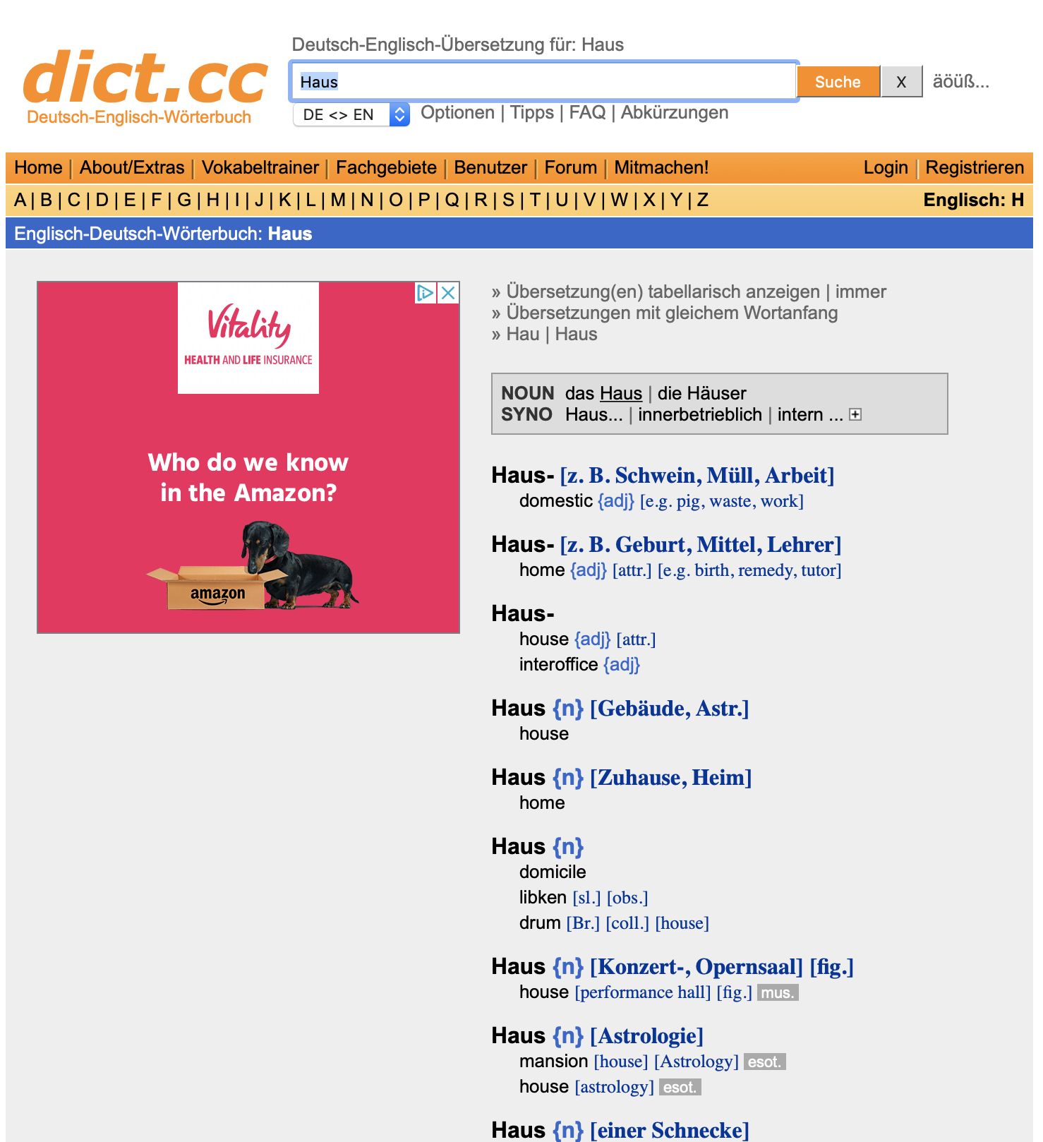
Wie finde ich das?
Verbs
strong or weak?
Nouns
plural?
Notes:
An important support opportunity is given here, to teach students how to use reference material to check if verbs are strong or weak. This is key in helping students towards independence, as part of their journey to acquiring a good verb lexicon.
Original teacher notes
Timing: 2 minutes
Aim: To explain how to find out about stem changes using the dictionary.
Note: This is a brief explanation of how to find out whether a verb has a stem change or not. We will have a more thorough dictionary lesson at another point in the SOW.
Procedure:
1. Cycle through the information on the slide using the animation sequence.
Only verbs with a or an e in the stem can change.
A dictionary entry for a verb will always tell you whether the verb gets a stem change or not.
Similarly, entries for nouns will tell you what the plural form is.

Slide 9
Vokabeln
lesen
laufen
leben
helfen
verstehen
fahren
geben
reisen
bleiben
brauchen
schlafen
vergessen
glauben
Notes:
Let’s take a look at the treatment of the strong vs weak verbs in terms of scaffolding students’ understanding, outside of the input and production activities. This series of four activities across weeks 3-5 offers gradual build up to support students’ learning of this new grammar feature. Here, students begin working with the infinitive only, to embed the meanings and begin recognising strong (new learning) vs weak (previous learning).
2.2.3 lesson 1
Original teacher notes
Timing: 5 minutes
Aim: To revisit some of the verbs that will be used in the reading and listening activities.
Note: The sequence this week will focus on stem changes in the third person singular (contrasted with first person singular). We are using the infinitives here to be able to emphasise the vowel change later.
Procedure: 1. On a click a word will appear.
2. Students write down the word before it disappears. 3. They write the English meaning, too, if remembered. 4. Give feedback item by item. Roll back each animation, elicit the German verb, then the English meaning, and finally click again to see the verb again so learners can double-check their spelling.

Slide 10
Vokabeln
fahren
leben
helfen
verstehen
liegen
geben
bleiben
laufen
reisen
schlafen
brauchen
vergessen
sprechen
glauben
schwimmen
lesen
STRONG
WEAK
Notes:
In lesson 2, a support opportunity is offered for students to practise recalling whether verbs are strong or weak. This consolidation activity is used to help students assimilate their new learning on strong verbs with their previous learning on weak verbs. This also primes students for subsequent activities where determining if verbs are weak or strong and conjugating accordingly will be key to the success of the task. It is a recognition activity using only the infinitive at this stage.
2.2.3 lesson 2
Original teacher notes
Timing: 3 minutes
Aim: To practise recalling whether verbs are strong or weak.
Procedure:
1. Teacher reminds the students that strong means a vowel change and weak means no change.
2. For each verb say whether it is strong or weak.

Slide 11
Vokabeln
lesen / schreiben
A
B
läuft
laufen
schwimmt
schwimmen
C
trägt
tragen
D
E
ist
sein
hilft
helfen
F
isst
essen
G
H
schläft
schlafen
trinkt
trinken
I
M
hört
hören
liest
lesen
J
L
wünscht
wünschen
sitzt
sitzen
K
gibt
geben
Notes:
We can see how support is further built in and progresses across week 4. Here, both strong and weak verbs are practised as a recognition activity this time in 3rd person singular whereby students supply the infinitive.
2.2.4 lesson 1
Original teacher notes
Timing: 5 minutes
Aim: To revisit some verbs.
Note: We include some verbs that are not strong verbs as this is the second week we are doing these. It has been a few lessons since we revisited letters of the alphabet so we use those here to support teacher elicitation of the answers.
Procedure: 1. Show verbs in third person forms and get students to write down the infinitive / dictionary form. 2. Clicking on the letters brings up the infinitive forms to check answers.
3. Students can then be prompted to say both the 3rd person form and the infinitive. E.g. Teacher - A Student - läuft, laufen

Slide 12
Vokabeln - Verben
N
O
laufen
läuft
fahren
fährt
Q
nehmen
nimmt
P
vergessen
vergisst
R
helfen
hilft
S
essen
isst
T
U
schlafen
schläft
halten
hält
V
lassen
lässt
Z
haben
hat
W
Y
gehen
geht
machen
macht
X
gibt
geben
Notes:
Now week 5. We include 10 previously taught strong verbs and three verbs that are not strong verbs (two weak and one irregular (haben), as this is the third week of working with strong verbs. In this progression, students must now conjugate the third person singular, moving on from last week where they provided the infinitive from the 3rd person singular form.
2.2.5 lesson 1
Original teacher notes
Timing: 5 minutes
Aim: To practise recall of the third person singular form of verbs.
Note: This is a reversed version of the verbs task from last week’s sequence, 2.2.4. This time students are presented with infinitives and need to write down the 3rd person form. We use letters of the alphabet again to support teacher elicitation of the answers, but this week the remaining letters N - Z. We include 10 previously taught strong verbs and three verbs that are not strong verbs (two weak and one irregular (haben), as this is the third week of working with strong verbs.
Procedure:
1. Students are presented with infinitives and need to write down the 3rd person form.
2. Students can then be prompted to say both the 3rd person form and the infinitive. E.g. Teacher - N Student - läuft, laufen 3. Teachers can vary the order of the letters, as the answers are triggered to appear by clicking on each letter. 4. Alternatively, students can nominate a letter and give the two verb forms themselves.

Slide 13
Differentiation by: task type
Example Y7 T2.2 W3 lesson 1
Receptive and productive modes, written modality: reading and writing
Grammatical focus: strong verbs, 3rd person singular
Notes:
Now that we have seen ways of differentiating by support, let’s now look at differentiation by task type to support lower proficiency learners.
This is specifically lesson 1 of Y7 Term 2.2 week 3.

Slide 14
Tante Laura schreibt an Mias Mutter!
schreiben
Hallo liebe Schwester. Wie geht’s? Ich schreibe ein paar Infos über Mia. Im Moment [she is reading] ein E-Book. [She is] sehr gut in der Schule, nur manchmal [she forgets] etwas und [she doesn’t understand that]! Zu Hause [she often helps] im Garten. Wann kommst du nach Hause? Bis bald, deine Schwester Laura xx
Copy out the email, putting the words in brackets into German. Pay attention to word order!
Notes:
This reading and writing activity offers differentiation by task type to set up various levels whilst still using this main slide.
Here is the original activity for reference. Let’s take a look at some options here.
Original teacher notes
Timing: 7 minutes (including answers)
Aim: To provide written production practice in using some regular, irregular and strong verbs already encountered, in the third person singular form.
Procedure:
Students copy the email, putting the words in brackets into German (remind them to pay attention to the word order implications of the sentence structure).
The answers are displayed on the next slide.

Slide 15
Tante Laura schreibt an Mias Mutter!
schreiben
Hallo liebe Schwester. Wie geht’s? Ich schreibe ein paar Infos über Mia. Im Moment [she is reading] ein E-Book. [She is] sehr gut in der Schule, nur manchmal [she forgets] etwas und [she doesn’t understand that]! Zu Hause [she often helps] im Garten. Wann kommst du nach Hause? Bis bald, deine Schwester Laura xx
Copy out the email, putting the words in brackets into German. Pay attention to word order!
Supporting lower proficiency learners
Students concentrate on the underlined parts of the text only.
Notes:
To support lower proficiency learners here, give the choice or direct them to complete this either at full sentence level or just verb phrase. If choosing sentence level, students write out the underlined part. This compels them to focus on verb form AND word order at the same time. If choosing just verb phrase, students write only the bold part in parenthesis. This reduces the cognitive load as students only have to consider verb forms. This approach could be particularly useful for a mixed ability class where various levels of challenge are required within one task.

Slide 16
Antworten
schreiben
Supporting lower proficiency learners
Hallo liebe Schwester. Wie geht’s? Ich schreibe ein paar Infos über Mia. Im Moment liest sie ein E-Book. Sie ist sehr gut in der Schule, nur manchmal vergisst sie etwas und sie versteht das nicht! Zu Hause hilft sie oft im Garten. Wann kommst du nach Hause? Bis bald, deine Schwester Laura xx
Notes:
Answer slide.
As part of the feedback, those who had completed the text at paragraph level could be targeted to offer translations of the non-underlined parts, thus offering an opportunity for those who had only completed the underlined parts to gain an understanding of the text as a whole.
Again, this approach could be most useful with a mixed ability class.

Slide 17
Tante Laura schreibt an Mias Mutter!
schreiben
Supporting lower proficiency learners
Hallo liebe Schwester. Wie geht’s? Ich schreibe ein paar Infos über Mia.
Im Moment [she is reading] ein E-Book.
2) Manchmal [she forgets] etwas!
3) [She runs] zweimal die Woche.
4) Zu Hause [she often helps] im Garten.
Wann kommst du nach Hause? Bis bald, deine Schwester Laura xx
liest sie
Read the email. Complete the sentences by putting the words in brackets into German.
Pay attention to word order!
vergisst sie
Sie läuft
hilft sie oft
Notes:
Here the same task has been re-formatted for additional clarity that may benefit a lower proficiency class. Comprehension into English could be elicited orally at sentence level as part of the feedback. This helps maintain pace, removes any literacy barriers, whilst still exploiting all the options this task has to offer.
Students can be asked if they understand the open and close of the email, maybe using a think pair share approach as a way to offer further support.
Note: the sentences could be adapted further as appropriate for the group to remove the focus on word order 2 in sentences 1,2 and 4.

Slide 18
Differentiation by: outcome
Example Y7 T2.2 W4 (lesson 1)
All modes and modalities: reading, writing, speaking and listening
Grammatical focus: extended practice in understanding a range of previously taught strong and weak verbs in 1st, 2nd and 3rd person singular forms
Notes:
Now onto differentiation by outcome.

Slide 19
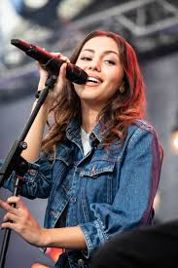
Zwei Deutsche
lesen / hören
Sebastian Vettel
Namika
Notes:
Here teachers use this slide to introduce the activity.
Original teacher notes
Timing: 2 minutes
Aim: To introduce the reading activity.
Procedure:
1. Begin by asking students if they know who these people are. Some students may recognise Sebastian Vettel, at least. 2. Explain that you are going to do a series of activities to find out more about them, bringing together lots of aspects of their learning so far, including the use of question words.
Photos:
Sebastian Vettel
Morio / CC BY-SA (https://creativecommons.org/licenses/by-sa/4.0) Namika Harald Krichel / CC BY-SA (https://creativecommons.org/licenses/by-sa/4.0)

Slide 20
Ein Interview.
Ein Interview. Lesen: Was ist das auf Englisch? Hören: Was sind die Antworten? 1 = ?
lesen / hören
Namika
Ich wohne in Frankfurt-am-Main.
Ich bin Sängerin.
Mein erster Hit heißt ‘Lieblingsmensch’.
Ich singe jeden Tag, früh am Morgen und spät am Abend!
Meine Familie gibt mir Songideen. Mein Opa und meine Oma sind Marokkaner*.
Ich esse oft ein Salamibrot.
Ich sehe kaum Filme.
Mein Lieblingstier ist ein Löwe*.
C
1
H
2
D
3
A
4
E
5
G
6
F
7
Namika
B
8
*Marokkaner - Moroccans / *der Löwe - lion
Notes:
This is the first task of two which gives extended practice in understanding a range of previously taught strong and weak verbs in 1st 2nd and 3rd person singular forms. Ahead of the listening, steps one and two of the procedure in the teacher notes will help secure students’ understanding of the answers A-H, that way, students are not going into the listening ‘cold’. Note that these steps are specifically to support lower proficiency learners. Higher proficiency learners could be challenged to complete the task without one or other of these steps. Step 1: highlight the four compound nouns in the text, made up of previously taught language and/or cognates: Lieblingsmensch / Songideen / Salamibrot / Lieblingstier. Step 2: students read the text and translate it orally in pairs. Teacher can elicit translations orally in whole class feedback, as appropriate. During the feedback after step 2, teachers can annotate the answers A-H with key words in English to act as visual support during the listening as required. Teachers can also talk through strategies to use when listening e.g. key verbs. This will help students match the correct answer to each question. Note: they have also completed a pre-activity on question words as a vocab refresher. All students will be able to attempt this task, given that it is a match-up format, plus the pre-listening tasks also enable maximum success. Differentiation will then be by outcome as students achieve success to a greater or lesser extent.
Original teacher notes
Timing: 10 minutes
Aim: To give extended practice in understanding a range of previously taught strong and weak verbs in 1st 2nd and 3rd person singular forms.
Note: The focus is not on differentiating between the ‘ich’ and the ‘du’ forms, as this is a set of spoken questions with ‘du’ and written answers with ‘ich’. However, students will have to understand the strong verb forms ‘isst’ and ‘siehst’ together with a range of revisited language, brought together in a new context.
Procedure:
1. Highlight the four compound nouns in the text, made up of previously taught and/or cognates: Lieblingsmensch / Songideen / Salamibrot / Lieblingstier
2. Students read the text and translate it orally in pairs. Teacher can elicit translations orally in whole class feedback, as appropriate. 3. Students listen to each question and match it to its correct answer.
4. Answers are animated to allow teachers to conduct feedback after each question, or do all of the questions first.
Transcript: 1. Wie heißt dein erster Hit? 2. Was ist dein Lieblingstier? 3. Wie oft singst du? 4. Wo wohnst du? 5. Woher bekommst du deine Songideen? 6. Wie oft siehst du Filme? 7. Was isst du am Abend? 8. Was ist dein Job?
Note: All of the details are authentic and come from several online sources, including YouTube interviews, podcasts and written interviews. Lieblingsmensch - https://www.youtube.com/watch?v=3ryohiCVq3M Was a big hit in Germany (summer 2015) and followed by Je ne parle pas français (2018) - https://www.youtube.com/watch?v=Cz1rJtlGHVs

Slide 21
lesen / schreiben / hören / sprechen
Ein Interview. Lesen → Schreiben: Was sind die Fragen? Hören: Richtig? p/X Sprechen: Antworten geben
Sebastian Vettel
Ich wohne in Thurgau, in der Schweiz. Ich finde es sehr schön dort.
Ich fahre Formel-Eins.
Ich spreche vier Sprachen: Deutsch, Englisch, ein bisschen Italienisch und ein bisschen Französisch.
Ich fahre einmal pro Jahr in Urlaub.
Ich fahre immer mit meiner Familie zusammen.
Ich habe nie Angst!
1
2
3
4
Sebastian Vettel
5
6
*der Job - job / *pro Jahr - per year
Notes:
Now the follow-on activity where here the focus is on writing the corresponding questions. The listening activity and pre-activity vocab refresher will both set students up for maximum success here. Teachers could set differentiated expectations for task completion. For example, all students attempt 3 questions (for example), most attempt 4 and some attempt all 6.
Original teacher notes
Timing: 15 minutes
Aim: To give extended practice in understanding a range of previously taught strong and weak verbs in 1st 2nd and 3rd person singular forms.
Procedure:
1. Students read the interview answers.
2. They then try to write questions that would give these answers. 3. They then listen to the questions (to check their work) - either listen to the full interview (Q&A) which is activated by clicking on the name Sebastian Vettel, or click the numbered buttons to hear each question separately 4. They then listen to the questions again - teacher clicks each numbered question and students can answer chorally There are several possibilities for answering the questions: i. They turn away from the board and try to answer as Sebastian Vettel ii. They continue facing the board, but instead answer for themselves iii. They turn away from the board, and answer for themselves. Suggested questions / Transcript 1. Wo wohnst du? 2. Was ist dein Job? 3. Wieviele Sprachen sprichst du? 4. Wie oft fährst du in Urlaub? 5. Mit wem fährst du? 6. Wie oft hast du Angst?
Note: Students have previously learnt Angst vor and have revised that for this week.
All of the details are authentic and come from several online sources.
Word frequency (1 is the most frequent word in German):
Formel-Eins [>5009] pro [412]
Source: Jones, R.L & Tschirner, E. (2011). A frequency dictionary of German: Core vocabulary for learners. London: Routle

Slide 22
Differentiation by: support, task and outcome
Example Y7 T2.2 W5 (lesson 2)
Receptive mode, oral and written modalities: listening, reading
Productive mode, written modality: writing
Grammatical focus: extended practice in understanding a range of previously taught strong, weak and irregular verbs in 3rd person singular and 3rd person plural forms.
Notes:
One particular activity in this sequence of learning taken from Term 2.2, from week 5 offers a dictogloss activity to consolidate grammar features learnt across weeks 3 to 5 of this sequence. In order to support lower proficiency learners, differentiation here can be offered by support, task and outcome.

Slide 23
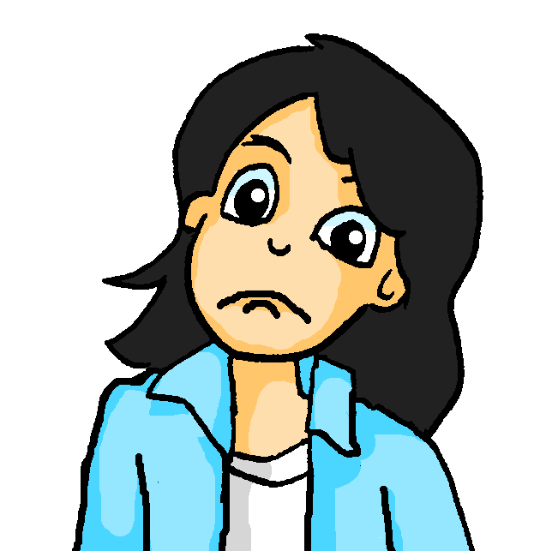
eine Musiktournee
die Musiktournee – concert tour allein – alone, ohne – without plötzlich - suddenly
hören / lesen
1
2
3
4
5
6
7
8
Supporting lower proficiency learners
The audio can be played either as eight sections or as a full text.
Additionally, the audio play button allows for pausing.
Listen to the text and make notes in German. Then try to write what you heard in sentences.
Wolfgang und Mia haben fast zwei Wochen frei und machen zusammen eine Musiktournee. Wolfgang fährt mit Freunden. Er hat kein Geld. Mia nimmt allein den Bus und liest Zeitung.
Wolfgang und Mia spielen beide in einer Band. Wolfgang spielt Gitarre, aber es gibt ein Problem! Wolfgang lässt die Gitarre leider zu Hause. Deshalb kann er das Konzert nicht spielen! Mia findet das schlecht! Sie hat Angst! Was können sie jetzt machen? Sie müssen das Konzert geben. Ohne Gitarre! Eins, zwei, drei, vier...! Es sind viele Leute dort aber sie finden das Konzert nicht gut! Mia und Wolfgang laufen danach zum Hotel. Mia ist sehr müde und hat dann Kopfschmerzen. Sie schläft.
Sie fahren schließlich beide nach Hause. Der Bus hält plötzlich und was sehen sie da? Ach, die Gitarre!
Notes:
There are various options here in terms of the playing of the audio. Teachers can choose to play the audio as eight separate sections by clicking on the individual numbers, or as a full text using the audio play button. If using the audio play button, the teacher can also use the pause facility to give students additional thinking time as necessary and the time to make any necessary notes.
The speed of the audio is also relatively slow, to maximize students’ understanding.
Original teacher notes
Timing: 25 minutes Note: an extended time is allocated to dictogloss tasks, to allow for maximum exploitation of the text.
Aim: To provide a dictogloss activity.
Procedure:
1. Students listen to the text and make notes in German.
2. They then try to reconstruct it in sentences.
3. The first mouse click displays this simple instruction; the second displays the German text, for verification of students’ versions.
4. Students can then read the text whilst listening to the audio recording. This helps to develop their segmentation skills, improving their ability to listen and understand when there is no text to support them. The teacher would use the full audio version for this, pausing it for students to say the next word or the previous word. Teachers could also pause strategically and ask for alternative words from students.
Note: To play the whole recording (for segmentation practice), click on the audio player icon (top right of slide). To play the eight sections of the text separately (for the dictogloss), click on the action buttons 1-8 above the text. 5. Finally, students translate the whole text into English. Transcript:
Wolfgang und Mia haben fast zwei Wochen frei und machen zusammen eine Musiktournee. / Wolfgang fährt mit Freunden. Er hat kein Geld. Mia nimmt allein den Bus und liest Zeitung.
Wolfgang und Mia spielen beide in einer Band. Wolfgang spielt Gitarre, aber es gibt ein Problem! Wolfgang lässt die Gitarre leider zu Hause. / Deshalb kann er das Konzert nicht spielen! Mia findet das schlecht! / Sie hat Angst! Was können sie jetzt machen? Sie müssen das Konzert geben. Ohne Gitarre! / Eins, zwei, drei, vier...! Es sind viele Leute dort aber sie finden das Konzert nicht gut! / Mia und Wolfgang laufen danach zum Hotel. Mia ist sehr müde und hat dann Kopfschmerzen. Sie schläft. /
Sie fahren schließlich beide nach Hause. Der Bus hält plötzlich und was sehen sie da? Ach, die Gitarre!

Slide 24
eine Musiktournee
hören / lesen
 |  | He | She | They | Additional info (in German or English)
to have two weeks free | zwei Wochen frei haben
to do a concert tour | eine Musiktournee machen
to drive/ride with friends | mit Freunden fahren
to take the bus | den Bus nehmen
to read the newspaper | Zeitung lesen
to play in a band | in einer Band spielen
to play guitar | Gitarre spielen
to leave the guitar | die Gitarre lassen
to find that bad | das schlecht finden
to run to the hotel | zum Hotel laufen
to sleep | schlafen
to ride home | nach Hause fahren
Supporting lower proficiency learners
Support grid: for use during the listening or as a standalone vocab sheet.
Stephen Owen
Notes:
Teachers could use this as a scaffold during the listening activity to structure students’ listening. Notice that the verbs listed appear in the order they are heard within the audio.
During the listening, students tick whether it is ‘he’ (Wolfgang), ‘she’ (Mia) or ‘they’ associated with the activity. If they can, students write any additional information that they hear e.g. alone / at home etc. This then helps students with the write up, as a record of which person to put the infinitive into.
Alternatively it could be used as a stand alone vocab list for use during the listening, if the teachers remove the final four columns.
Teachers could add or remove details as appropriate to the level of the group.
Do bear in mind the ways the vocab sheet could be used to support recall as discussed on slide 5 and the importance of providing some attempt to recall, given it is needed to strengthen memory.

Slide 25
eine Musiktournee
die Musiktournee – concert tour allein – alone, ohne – without plötzlich - suddenly
lesen
Supporting lower proficiency learners
Wolfgang und Mia haben fast zwei Wochen frei und machen zusammen eine Musiktournee.
Wolfgang fährt mit Freunden.
Er hat kein Geld.
Mia nimmt allein den Bus und liest Zeitung.
Wolfgang und Mia spielen beide in einer Band.
Wolfgang spielt Gitarre, aber es gibt ein Problem!
Wolfgang lässt die Gitarre leider zu Hause.
Deshalb kann er das Konzert nicht spielen!
Wolfgang and Mia have almost two weeks free and they do a concert tour together.
Wolfgang drives/rides with friends.
He has no money.
Mia takes the bus alone and reads the newspaper.
Wolfgang and Mia both play in a band.
Wolfgang plays guitar, but there is a problem.
Wolfgang unfortunately leaves the guitar at home.
For that reason he cannot play the concert!
Notes:
To bring the activity to a close and ensure students’ comprehension of the text in its entirety, written sentences can be proposed for translation. This step may not be needed if students have managed fairly accurate representations of the text. In that case, teachers could simply take some quick feedback then collect the work in for marking for individualised feedback. If students have only managed a partial understanding of the text through listening, this could be used. Here, in order to gain a full understanding of the text, students have a go at translating the individual sentences, making use of the vocab sheet if necessary. Here differentiation would be by outcome. Teachers would see successful translations of certainly strong verbs in the ‘s/he’ and ‘they’ form, with the extra detail being successfully translated by some students. Conducting whole class feedback once all students had attempted the translations would then bring this activity to its close and ensure understanding for all.

Slide 26
eine Musiktournee
die Musiktournee – concert tour allein – alone, ohne – without plötzlich - suddenly
lesen
Supporting lower proficiency learners
Mia findet das schlecht! Sie hat Angst!
Was können sie jetzt machen?
Sie müssen das Konzert geben.
Ohne Gitarre! Eins, zwei, drei, vier...!
Es sind viele Leute dort aber sie finden das Konzert nicht gut!
Mia und Wolfgang laufen danach zum Hotel.
Mia ist sehr müde und hat dann Kopfschmerzen. Sie schläft.
Sie fahren schließlich beide nach Hause. Der Bus hält plötzlich und was sehen sie da? Ach, die Gitarre!
Mia finds that bad. She is worried.
What can they do now?
They must give the concert.
Without guitar! One, two, three, four…!
There are lots of people there but they find the concert not very good.
Afterwards Mia and Wolfgang run to the hotel.
Mia is very tired and then has a headache. She sleeps.
Finally they both ride home. The bus stops suddenly and what do they see there? Oh, the guitar!

Slide 27
eine Musiktournee
die Musiktournee – concert tour allein – alone, ohne – without plötzlich - suddenly
lesen
Supporting lower proficiency learners
Wolfgang und Mia haben fast zwei Wochen frei und machen zusammen eine Musiktournee.
Wolfgang fährt mit Freunden. Er hat kein Geld.
Mia nimmt allein den Bus und liest Zeitung.
Wolfgang und Mia spielen beide in einer Band.
Wolfgang spielt Gitarre, aber es gibt ein Problem!
Wolfgang lässt die Gitarre leider zu Hause.
Deshalb kann er im Konzert nicht spielen!
Wolfgang and Mia have almost two weeks free and they do a concert tour together.
Wolfgang drives/rides with friends. He has no money
Mia takes the bus alone and reads newspapers.
Wolfgang and Mia both play in a band.
Wolfgang plays guitar, but there is a problem.
Wolfgang unfortunately leaves the guitar at home.
For that reason he cannot play in the concert!
Notes:
This is a suggestion of how the translation task could be adapted to further support lower proficiency learners, should teachers wish to maintain focus on comprehension of the verbs alone, whilst offering support of the sentence in English, to aid students’ understanding of the whole text.
Teachers could obscure other elements of the text to increase the level of challenge as appropriate.

Slide 28
eine Musiktournee
die Musiktournee – concert tour allein – alone, ohne – without plötzlich - suddenly
lesen
Supporting lower proficiency learners
Mia findet das schlecht! Sie hat Angst!
Was können sie jetzt machen?
Sie müssen das Konzert geben.
Ohne Gitarre! Eins, zwei, drei, vier...!
Es sind viele Leute dort aber sie finden das Konzert nicht gut!
Mia und Wolfgang laufen danach zum Hotel.
Mia ist sehr müde und hat dann Kopfschmerzen. Sie schläft.
Sie fahren schließlich beide nach Hause. Der Bus hält plötzlich und was sehen sie da? Ach, die Gitarre!
Mia finds that bad. She is worried.
What can they do now?
They must give the concert.
Without guitar. One, two, three, four…!
There are lots of people there but they find the concert not very good.
Afterwards Mia and Wolfgang run to the hotel.
Mia is very tired and then has a headache. She sleeps.
Finally they both ride home. The bus stops suddenly and what do they see there? Oh, the guitar!

Slide 29
Examples from teachers using the NCELP SoW
Example Y7 T2.2 W3-5
Receptive mode, oral and written modalities: listening, reading
Productive mode, written modality: writing
Grammatical focus: practice using the strong verbs.
Notes:
Here we will see how one school who are using the NCELP German SoW with Year 7 have adapted tasks for lower proficiency. Kind thanks to Mel Yates, ST at Presdales School for providing these examples. Activities are taken from across the suite of three lesson of T2.2 (weeks 3-5).

Slide 30
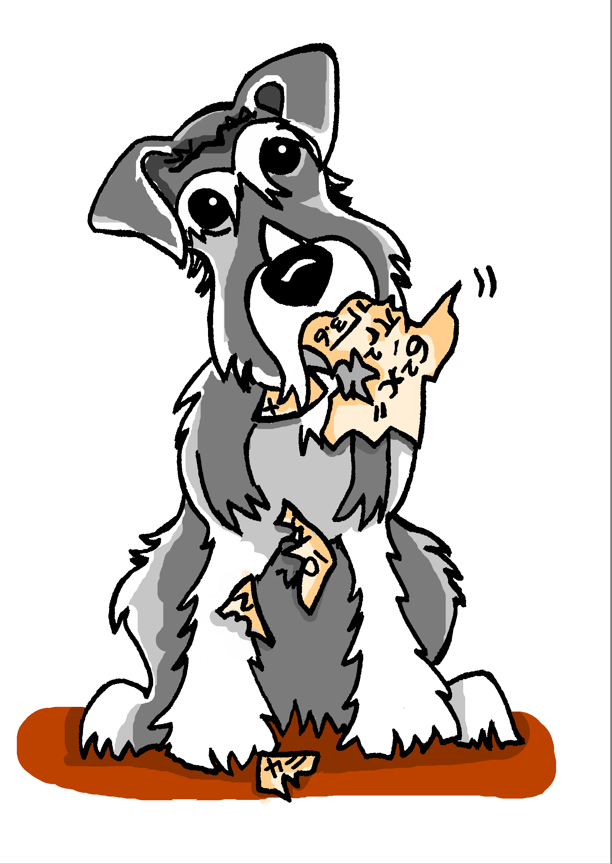
Es ist Montag
Wolfgang redet über Mias Schultag. Was sagt er?
hören / lesen
1
Sie _______ in die Schule.
Sie _______ Matheunterricht aber sie __________ die Hausaufgaben!
Sie _______ nach Hause und _______ die Hausaufgaben!
Sie _______ spät ins Bett und _______.
Mias Hund ______ die Hausaufgaben!
2
3
4
5
essen | schlafen | fahren | haben | laufen | vergessen | machen | gehen
Notes:
From lesson 1 of 2.2 week 5, where students are consolidating their learning on strong verbs, practising using the third person singular in context.
Original teacher notes
Timing: 5 minutes
Aim: To practise using the third person singular form of verbs in context.
Note: This gapped reading exercise challenges students to insert the correct form of the verb into each gap. It is not an input processing task, as students have, in previous lessons, had practice in differentiating between 1st and 3rd singular person strong forms, and 1st and 2nd person singular strong forms. Here, students need to understand the language in the whole sentence, recognise which verb they need, and recall from memory the 3rd person singular forms. Verb prompts are given, in a jumbled order, in the infinitive form.
Procedure:
1. Students read the sentences, select the appropriate verb to fill each gap, and put it into the correct form.
Optional: They can hear the text with the gaps bleeped out on this slide; the following slide displays the answers with the complete audio sentences.
Transcript:
1. Sie [fährt] in die Schule.
2. Sie [hat] Matheunterricht aber sie [vergisst] die Hausaufgaben!
3. Sie [läuft] nach Hause und [macht] die Hausaufgaben!
4. Sie [geht] spät ins Bett und [schläft].
5. Mias Hund [isst] die Hausaufgaben.

Slide 31
Es ist Montag
Wolfgang redet über Mias Schultag. Was sagt er?
hören / lesen
Supporting lower proficiency learners
1
Sie _______ in die Schule.
Sie _______ Matheunterricht aber sie __________ die Hausaufgaben!
Sie _______ nach Hause und _______ die Hausaufgaben!
Sie _______ spät ins Bett und _______.
Mias Hund ______ die Hausaufgaben!
Differentiation by task
2
3
4
5
isst | schläft | fährt | hat | läuft | vergisst | macht | geht
Notes:
In this adapted version of the task, instead of asking students to conjugate the infinitive into 3rd person singular, the verb form has been supplied.
Teachers could run this activity in one of two ways:
Reading, followed by listening to check the answers.
Listening first to support reading.

Slide 32
Vokabeln
lesen / schreiben
A
B
läuft
laufen
schwimmt
schwimmen
C
trägt
tragen
D
E
ist
sein
hilft
helfen
F
isst
essen
G
H
schläft
schlafen
trinkt
trinken
I
M
hört
hören
liest
lesen
J
L
wünscht
wünschen
sitzt
sitzen
K
gibt
geben
Notes:
Earlier we saw how these two activities offer practice in strong verbs vs. weak verbs, bringing in irregulars (next slide).
2.2.4 lesson 1
Original teacher notes
Timing: 5 minutes
Aim: To revisit some verbs.
Note: We include some verbs that are not strong verbs as this is the second week we are doing these. It has been a few lessons since we revisited letters of the alphabet so we use those here to support teacher elicitation of the answers.
Procedure: 1. Show verbs in third person forms and get students to write down the infinitive / dictionary form. 2. Clicking on the letters brings up the infinitive forms to check answers.
3. Students can then be prompted to say both the 3rd person form and the infinitive. E.g. Teacher - A Student - läuft, laufen

Slide 33
Vokabeln - Verben
N
O
laufen
läuft
fahren
fährt
Q
nehmen
nimmt
P
vergessen
vergisst
R
helfen
hilft
S
essen
isst
T
U
schlafen
schläft
halten
hält
V
lassen
lässt
Z
haben
hat
W
Y
gehen
geht
machen
macht
X
gibt
geben
Notes:
We have already spoken of the gradual increase in challenge that this sequence of activities provides.
2.2.5 lesson 1
Original teacher notes
Timing: 5 minutes
Aim: To practise recall of the third person singular form of verbs.
Note: This is a reversed version of the verbs task from last week’s sequence, 2.2.4. This time students are presented with infinitives and need to write down the 3rd person form. We use letters of the alphabet again to support teacher elicitation of the answers, but this week the remaining letters N - Z. We include 10 previously taught strong verbs and three verbs that are not strong verbs (two week and one irregular (haben), as this is the third week of working with strong verbs.
Procedure:
1. Students are presented with infinitives and need to write down the 3rd person form.
2. Students can then be prompted to say both the 3rd person form and the infinitive. E.g. Teacher - N Student - läuft, laufen 3. Teachers can vary the order of the letters, as the answers are triggered to appear by clicking on each letter. 4. Alternatively, students can nominate a letter and give the two verb forms themselves.

Slide 34
Vokabeln - Verben
lesen / schreiben
Differentiation by support
Supporting lower proficiency learners
 |  | Englisch | Infinitiv | Weak/strong | Irregular
a | du heiβt | you are called | heiβen | W
b | du trägst | you are wearing, wear | tragen | S
c | du läufst
d | du gehst
e | du spielst
f | du isst
g | du schwimmst
h | du sprichst
I | du siehst
j | du bist
k
Notes:
In this adapted version of the task, teachers have provided a scaffold to help structure students’ thinking and then act as a written record which can then be used as reference in subsequent tasks.
In this particular example, students are to concentrate on 2nd person singular.
Other combinations could be used as required.

Slide 35
Namika
Supporting lower proficiency learners
Fragen
Antworten
Differentiation by task
1. Wie heißt dein erster Hit? 2. Was ist dein Lieblingstier? 3. Wie oft singst du? 4. Wo wohnst du? 5. Woher bekommst du deine Songideen? 6. Wie oft siehst du Filme? 7. Was isst du am Abend? 8. Was ist dein Job?
A. Ich wohne in Frankfurt-am-Main.
B. Ich bin Sängerin.
C. Mein erster Hit heißt ‘Lieblingsmensch’.
D. Ich singe jeden Tag, früh am Morgen und spät am Abend!
E. Meine Familie gibt mir Songideen. Mein Opa und meine Oma sind Marokkaner*.
F. Ich esse oft ein Salamibrot.
H. Ich sehe kaum Filme.
I. Mein Lieblingstier ist ein Löwe*.
*Marokkaner - Moroccans / *der Löwe - lion
Notes:
These are adapted versions of the activities we saw earlier from 2.2 W4 lesson 1.
Here teachers have provided the questions in written format, rather than listening. This allows students to still engage with the same content but in a way that the teachers feel is more appropriate for their students.

Slide 36
Sebastian Vettel
Supporting lower proficiency learners
Fragen
Antworten
Differentiation by task
1. Wo wohnst du? 2. Was ist dein Job? 3. Wieviele Sprachen sprichst du? 4. Wie oft fährst du in Urlaub? 5. Mit wem fährst du? 6. Wie oft hast du Angst?
A. Ich wohne in Thurgau, in der Schweiz. Ich finde es sehr schön dort.
B. Ich fahre Formel-Eins.
C. Ich spreche vier Sprachen: Deutsch, Englisch, ein bisschen Italienisch und ein bisschen Französisch.
D.Ich fahre einmal pro Jahr in Urlaub.
E. Ich fahre immer mit meiner Familie zusammen.
F. Ich habe nie Angst!
[ ______ ]
[ ____ ]
[ ______ ]
[ ______ ]
[ ______ ]
[ ______ ]
Notes:
Here, teachers have adapted this into a reading and writing activity, rather than asking students to write full versions of the accompanying questions. The productive element focuses entirely on the 2nd person singular verb forms.
There is a mixture of weak, strong and irregular verbs here. Note that to tweak the comprehension challenge upwards the question order could be mixed.
Here, the questions appear in the order of the text.

