Slide 1
Phonics
SSC [S as z], [S as s]
Y7 German
Term 2.1 - Week 4
Leigh McClelland / Rachel Hawkes
Date updated: 18/01/20

Slide 2
s
sollen
Notes:
Introduce and elicit the pronunciation of the individual SSC ‘S as Z’ and then the source word (with gesture, if using). An appropriate gesture might be to ‘wag your finger’ as in the image to show that you are telling someone what they should do.

Slide 3
s
sollen
Notes:
Without picture to focus only on the SSC and source word.

Slide 4
s
sollen
Notes:
Without sound to elicit the pronunciation of the SSC and source word from students.

Slide 5
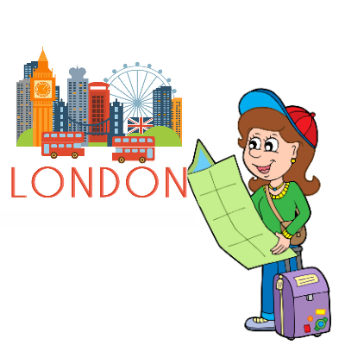
s
Gesetz
Seite
sollen
54
reisen
Satz
Subjekt
Verb
Objekt
langsam
Ich habe Hunger.
Notes:
Introduce and elicit the pronunciation of the individual SSC ‘S’ and then the source word again (with gesture, if using). Then present and elicit the pronunciation of the five cluster words. The cluster words have been chosen for their high-frequency, from a range of word classes, with the SSC (where possible) positioned within a variety of syllables within the words(e.g. initial, 2nd, final etc..) and additionally, we have tried to use words that build cumulatively on previously taught SSCs (see the Phonics Teaching Sequence document) and do not include new SSCs. Where new SSCs are used, they are often consonants which have a similar symbol-sound correspondence in English.
Word frequency rankings (1 is the most common word in German): sollen [63]; Gesetz [552] Seite[217]; reisen [978]; langsam [604]; Satz [582]. Source: Jones, R.L. & Tschirner, E. (2006). A frequency dictionary of German: core vocabulary for learners. Routledge

Slide 6
s
Gesetz
Seite
sollen
reisen
Satz
langsam
Notes:
Without pictures to focus solely on the SSC and cluster words.

Slide 7
s
Gesetz
Seite
sollen
reisen
Satz
langsam
Notes:
Without sound to elicit pronunciation from students.

Slide 8
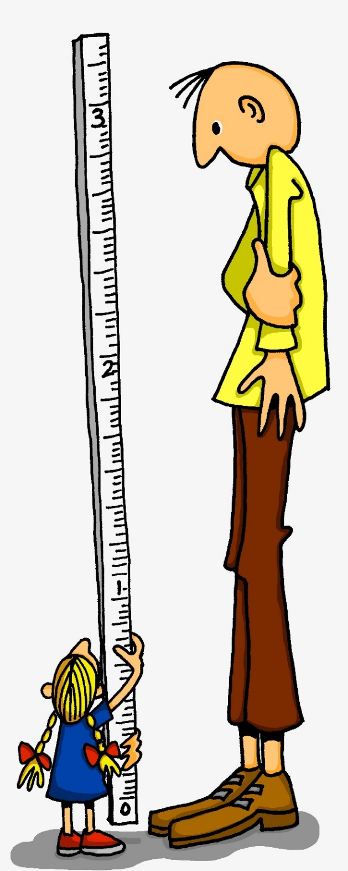
ß
groß
Notes:
Introduce and elicit the pronunciation of the individual SSC ‘S as English S’ and then the source word (with gesture, if using). An appropriate gesture might be to reach up high with your right hand and wide with both hands reaching out, to demonstrate ‘tall and big’.

Slide 9
ß
groß
Notes:
Without picture to focus on SSC and source word alone.

Slide 10
ß
groß
Notes:
Without sound to elicit pronunciation from students.

Slide 11
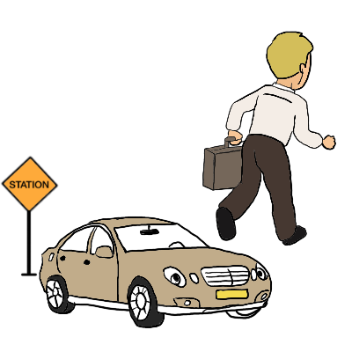
ß
Fußball
ein bisschen
groß
heißen
lassen
Misky
damals
1919
2019
Notes:
Introduce and elicit the pronunciation of the individual SSC ‘ß’ and then the source word again (with gesture, if using). Then present and elicit the pronunciation of the five cluster words. The cluster words have been chosen for their high-frequency, from a range of word classes, with the SSC (where possible) positioned within a variety of syllables within the words(e.g. initial, 2nd, final etc..) and additionally, we have tried to use words that build cumulatively on previously taught SSCs (see the Phonics Teaching Sequence document) and do not include new SSCs. Where new SSCs are used, they are often consonants which have a similar symbol-sound correspondence in English.
Word frequency rankings (1 is the most common word in German): groß [74]; Fußball [1497] ein bisschen [194]; heißen [123]; damals [271]; lassen [82]. Source: Jones, R.L. & Tschirner, E. (2006). A frequency dictionary of German: core vocabulary for learners. Routledge

Slide 12
ß
Fußball
ein bisschen
groß
heißen
lassen
damals
Notes:
Without pictures to focus on SSC and source words alone.

Slide 13
ß
Fußball
ein bisschen
groß
heißen
lassen
Notes:
Without sound to elicit pronunciation from students.

Slide 14
das Essen
gesund
sitzen
zu Hause
hässlich
es
super
interessant
sie
Notes:
Bee pic from pixabay.com
Snake pic from publicdomainvectors.org
Students must decide whether the sounds in the words match to the bee (buzz) or the snake (hiss). Teachers can elicit the sound [zzzz] or [ssss] first from the students, then the full word. Answers are animated one by one to move to the correct image.
Words for this task are taken from the introduced and revisited vocabulary sets for this week, or previously taught words (es, sie) and two cognates (super, interessant) to challenge decoding skills further.

Slide 15
Snap?
Ja
oder
nein?
das Essen
Fußball
reisen
Satz
es
heißen
gesund
sie
lassen
super
sitzen
langsam
interessant
Seite
hässlich
zu Hause
Gesetz
Notes:
Bee pic from pixabay.com
Snake pic from publicdomainvectors.org
Students identify if the sounds highlighted in yellow are a match, ‘snap’ (like the card game) by pronouncing the words aloud and comparing them. Play FOUR times with class and give students a few seconds to pronounce in pairs and decide, before taking the class answer each time. The answers are animated. Then pairs can play against each other – one student choosing and pronouncing two words and the other student deciding whether they make a matching snap pair or not. The words have been chosen from the pre-learn and consolidation and cluster lists as well as the vocabulary students are expected to have learnt in advance of this lesson.

Slide 16
s, ss, ß
When it comes before a vowel, 's' is pronounced like the English ‘z’.
e.g. sagen, sehr, sein, sie, sitzen, sollen, gesund, super, Reise
Elsewhere, the German ‘s’, as well as all instances of ‘ss’ and ‘ß’ are pronounced like an English ‘s’.
e.g. eins, hast, das, dass, groß, lassen, Haus, Wasser, heißen, weiß
'ss’ is used when the preceding vowel in a word is short, but is written 'ß’ after a long vowel e.g. 'Fuß', 'Maß', 'Spaß’
or two vowels together e.g. 'weiß', 'heiß', 'heißt'
Remember: sch-, sp-, st-
are pronounced in their own way at the start of a word!
Notes:
These notes explain how students will know when to pronounce ‘s’ as a ‘z’ and when as an ‘s’. They also explain the use of the ß (called Eszett or scharfes S) instead of ss. There is then an odd one out task to practise applying these SSC.

Slide 17
Was passt nicht in die Reihe?
1.
weiß
groß
Seite
2.
bisschen
Satz
Fußball
3.
langsam
reisen
heißen
4.
lassen
Gesetz
sollen
5.
damals
findest
gesund
Notes:
Odd One Out Students should be encouraged to practise pronouncing these words out loud, individually or in pairs, to decide which is the odd one out in each row (Reihe). Students have met this task type before and the instruction ‘Was passt nicht?’ Teachers can elicit the instruction meaning from students. Answers are animated to shade the odd one out. Words are from the cluster words practised last lesson. There is no need to focus on meaning, though teachers might be interested to see which words may have been retained incidentally.

