Slide 1
Grammar
Revisiting accusative (row 2) nouns
Y7 German
Term 1.2 - Week 7
Author name(s): Inge Alferink / Rachel Hawkes
Date updated: 02/12/2019

Slide 2
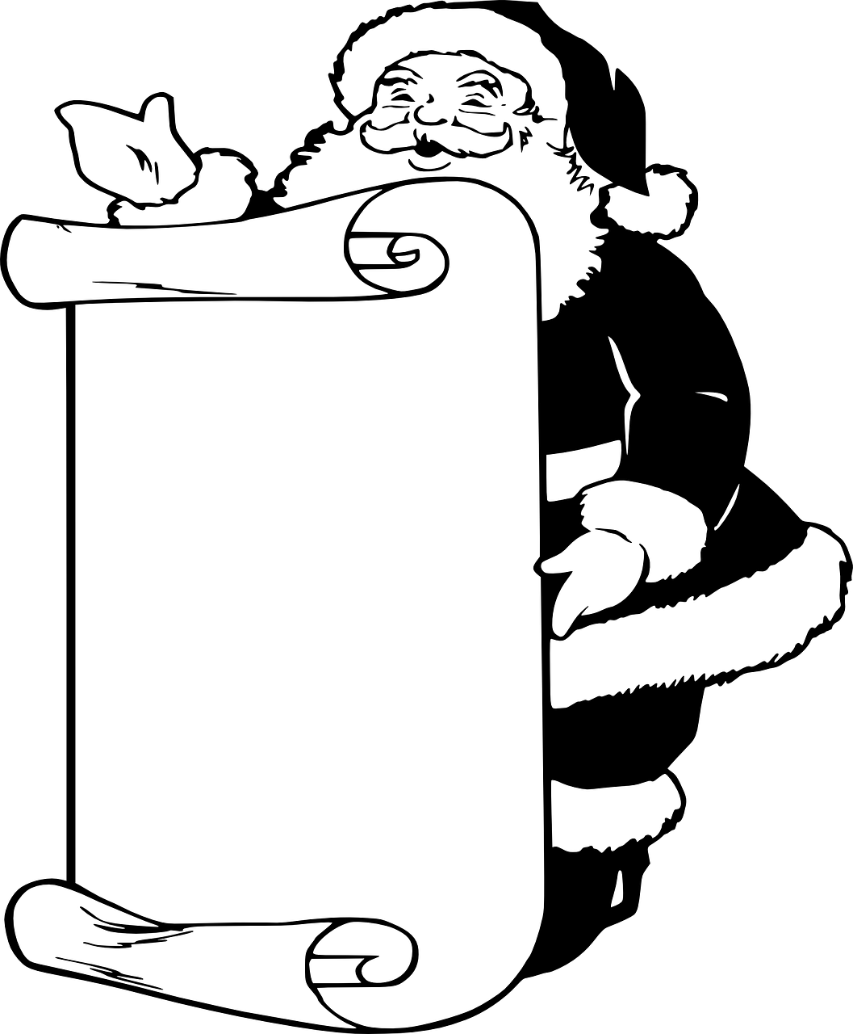
Ich wünsche mir…
… einen Fußball
1. ______________
2. ______________
3. ______________
4. ______________
5. ______________
6. ______________
… ein Haustier
… eine Kerze
Notes:
3] Dictionary work with Weihnachtsliste - Ich wünsche mir + Row 2 nouns indefinite article (revisiting previous grammar with new lexis)
Explain ‘Ich wünsche mir’ (I wish (for myself)). At this point we will not explain the case of mir, but treat it as a chunk.
Go through the examples on the slide to remind the students of the accusative form with indefinite articles. Ask them which indefinite article goes with which gender.
Ask student to look up in the dictionary 6 things in they wish to put on their Weihnachtslist.
Students write the items on their list with the correct indefinite article in the correct form.

