Slide 1
Places and locations
Adverbs of position with ‘del’ and ‘de la’
SSCs [cue], [cui], [cua]
Y7 Spanish
Term 2.2 - Week 4 - Lesson 45
Nick Avery / Rachel Hawkes
Artwork: Mark Davies
Date updated: 15/12/20
Notes:
Artwork by Mark Davies. All additional pictures selected are available under a Creative Commons license, no attribution required.
Learning outcomes (lesson 1):
Consolidation of SSCs [cue], [cua], [cui]
Introduction of ‘del’ and ‘de la’ (after adverbs of position)
Consolidation of ‘estoy’, ‘está’
Word frequency (1 is the most frequent word in Spanish):
7.2.2.4 (introduce) estamos [estar-21]; están [21]; oeste [2416]; este [>5000*]; estación [1404]; coche [1190]; tren [1488]; delante de [delante-1742]; fuera de [fuera-299]; debajo de [1366]; detrás de [2044]
7.2.2.1 (revisit) trabajar [174]; buscar [179]; descansar [1749]; preparar [570]; comida [906]; animal [322]; pasar [68]; tiempo [80]; campo [342]; junto[s] [149]; solo [181]
7.2.1.1 (revisit) balcón [3133]; dama [2062]; torre [2138]; caballero [2056]; saber [44]; pasar [68]; blanco [372]; flor [739]; plaza [806]; llevar [101]
Source: Davies, M. & Davies, K. (2018). A frequency dictionary of Spanish: Core vocabulary for learners (2nd ed.). Routledge: London
The frequency rankings for words that occur in this PowerPoint which have been previously introduced in NCELP resources are given in the NCELP SOW and in the resources that first introduced and formally re-visited those words.
For any other words that occur incidentally in this PowerPoint, frequency rankings will be provided in the notes field wherever possible.

Slide 2
¡A pronunciar!
CUE
CU + vowel
(CUE/CUA/CUI)
cuerpo
escuela
Notes:
[1/3]
Timing: 3 minutes
Introduce and elicit the pronunciation of the individual SSC ‘cue’. Then present and elicit the pronunciation of both cluster words.
The cluster words have been chosen for their high-frequency, from a range of word classes, with the SSC (where possible) positioned within a variety of syllables within the words(e.g. initial, 2nd, final etc..) and additionally, we have tried to use words that build cumulatively on previously taught SSCs (see the Phonics Teaching Sequence document) and do not include new SSCs. Where new SSCs are used, they are often consonants which have a similar symbol-sound correspondence in English.

Slide 3
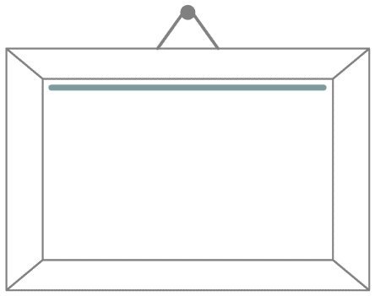
¡A pronunciar!
CUA
CU + vowel
(CUE/CUA/CUI)
cuatro
cuadro
Notes:
[2/3]
Timing: 3 minutes
Introduce and elicit the pronunciation of the individual SSC ‘cua’. Then present and elicit the pronunciation of both cluster words.

Slide 4
¡A pronunciar!
CUI
CU + vowel
(CUE/CUA/CUI)
to look after;
take care of
cuidar
¡cuidado!
Notes:
[3/3]
Timing: 3 minutes
Introduce and elicit the pronunciation of the individual SSC ‘cui’. Then present and elicit the pronunciation of both cluster words.

Slide 5
¿CE, CI, CUE o CUI?
escuchar / escribir
Escucha y escribe las letras.
decir
cuerpo
1
5
escuela
ciencias
2
6
necesario
¡cuidado!
3
7
cuidar
centro
4
8
Notes:
Phonics and vocabulary Timing: 5 minutes.
Aim: To revisit SSCs [ce], [ci], [cue] and [cui].
Procedure:
1. Students listen to each recording and write the word including the missing letters.

Slide 6
¿CE, CI, CUE o CUI?
escuchar / escribir
Escucha y escribe la palabra.
decir
cuerpo
1
5
escuela
ciencias
2
6
necesario
¡cuidado!
3
7
cuidar
centro
4
8
Notes:
OPTIONAL
Differentiation - more challenging version of previous activity: Timing: 5 minutes.
Aim: To revisit SSCs [ce], [ci], [cue] and [cui].
Procedure:
1. Students listen to each recording and write the whole word.

Slide 7
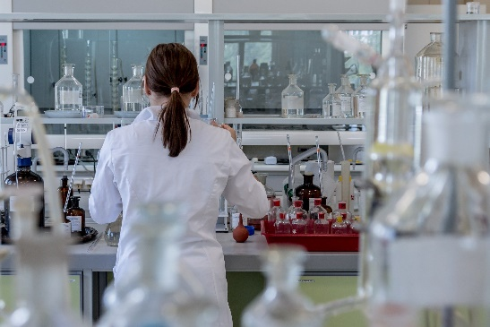
Identifica la imagen/la palabra y escribe la letra correcta.
A
B
C
cuidar | D
decir | I
ciencias | A
cuerpo | C
escuela | F
centro | E
necesario | H
¡cuidado! | B
D
E
F
centre
to look after
H
I
necessary
to say; tell
Notes:
OPTIONAL
Timing: 5 minutes.
Aim: To consolidate SSCs [ce], [ci], [cue] and [cui].
Procedure:
1. Students write the words in their books and write the letter next to the word.
2. Teacher elicits the letter in Spanish to practise letters of the alphabet.
3. Alternatively, the teacher can read out each word and students will say the corresponding letter in Spanish; or teacher says the letters fairly swiftly in jumbled order, and the students pronounce the Spanish word.

Slide 8
Vocabulario
to work, working
to spend (time)
countryside
food
alone
juntos, juntas
el campo
el animal
el tiempo
solo, sola
to look for, looking for
together
pasar
to rest, resting
descansar
time
buscar
animal
trabajar
la comida
Notes:
Timing: 5 minutes
Aim: to revisit this week’s vocabulary (from 2.2.1).
Procedure:
Students read all the words in Spanish and try to recall their meaning.
Teacher click anywhere on the screen; a word in English will come up.
Students search the corresponding words in Spanish on the slide and say the word out loud.
Teachers shows the answer with a further click.

Slide 9
Vocabulario
el n_ _ _ _
el norte
el oeste
el este
el s_ _
el sur
Notes:
[1/4]
Timing: 2 minutes
Aim: to introduce vocabulary.
Procedure:
Teacher clicks on the compass to trigger the appearance of ‘norte’ and ‘sur’, which are revised here.
Teacher says each word out loud, students repeat.
Teacher clicks on the compass again to trigger the appearance of ‘este’ and ‘oeste’.
Teacher shows the vocabulary in the following slides.

Slide 10
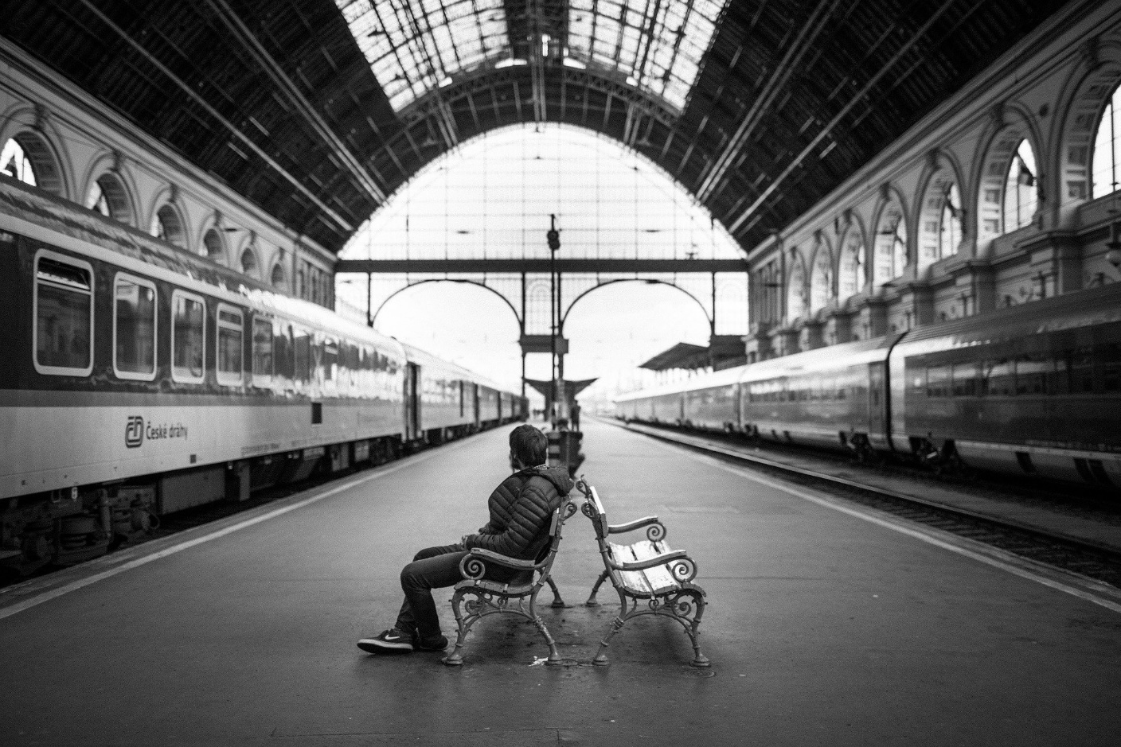
la estación
Notes:
[2/4]

Slide 11
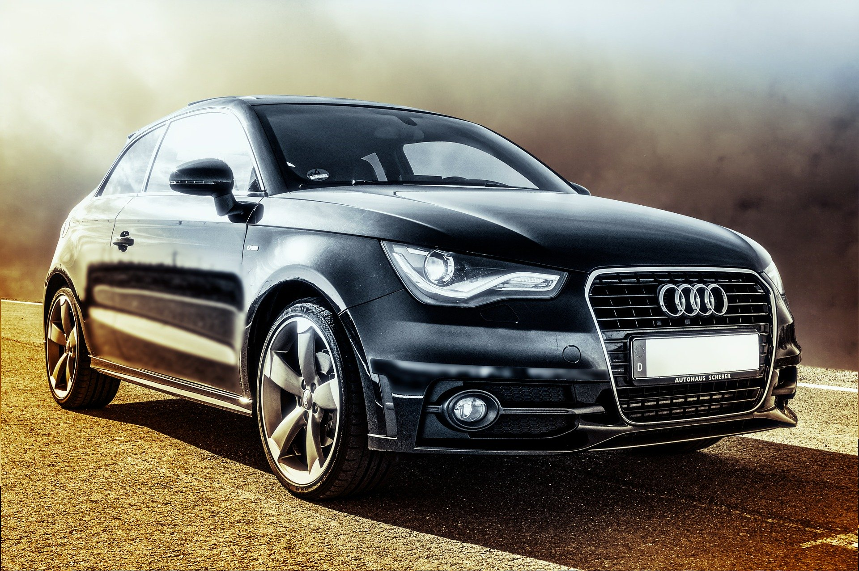
el coche
Notes:
[3/4]

Slide 12
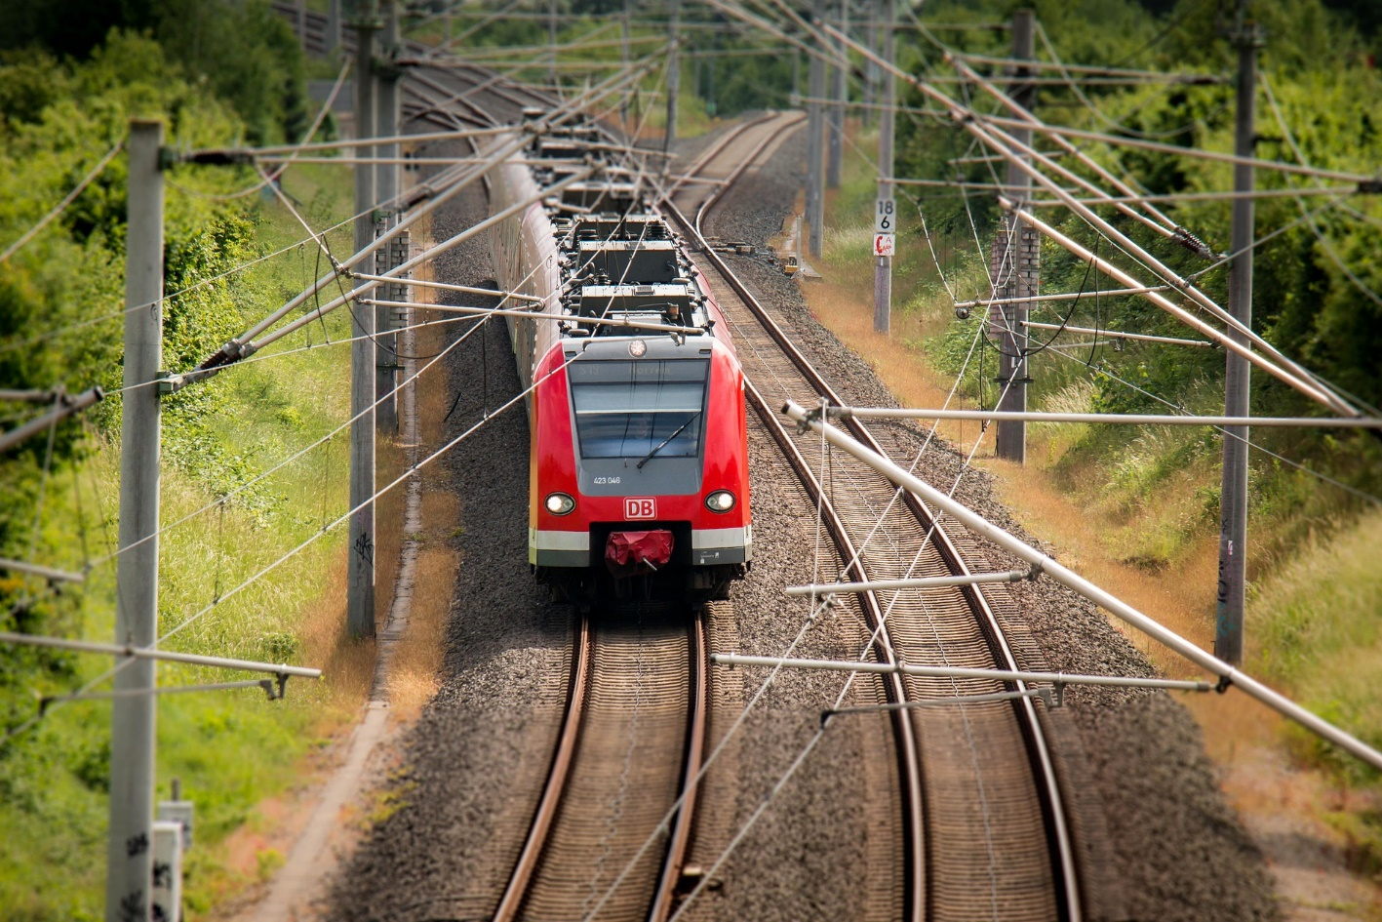
el tren
Notes:
[4/4]

Slide 13
Talking about places and locations Using ‘del’ and ‘de la’ with adjectives
In Spanish, you can give locations using adverbs like ‘cerca’ or ‘lejos’.
You often use ‘de’ after them to refer to a person, place or thing.
Ana is near (to) Madrid.
Ana está cerca de Madrid.
In English we use several words for this: near (to), far (from), in front (of). Or no word: under (-), behind (-), outside (-)
Sara está cerca de Diego.
Sara is near (to) Diego.
To refer to a singular masculine noun (e.g. el museo), change de + el to ‘del’.
Ana está cerca del museo.
Ana is near (to) the museum.
To refer to a singular feminine noun (e.g. la plaza), use ‘de la’.
Ana está cerca de la plaza.
Ana is near (to) the square.
Notes:
Timing: 3 minutes
Aim: to introduce ‘del’ and ‘de la’ (after adverbs of position).
Procedure:
Go through the grammar explanation with students, revealing each new sentence on a mouse click.

Slide 14
¿Es necesario usar ‘del’ or ‘de la’?
cerca (de)
book = libro (m)
door = puerta (f)
c_ _ _ _ de
near (to)
bank = banco (m)
station = estación (f)
shop = tienda (f)
lejos (de)
l_ _ _ _ de
far (from)
lejos de la tienda
lejos ____________
far from the shop
delante (de)
in front (of)
delante____________
in front of the bank
delante del banco
detrás de la puerta
detrás (de)
behind
detrás _____________
behind the door
outside
fuera de la estación
fuera (de)
fuera _____________
outside the station
debajo del libro
debajo (de)
under
debajo____________
under the book
Notes:
Timing: 5 minutes
Aim: to strengthen understanding of the need for ‘del/de la’ and gender agreement.
Procedure:
Students are prompted to recall the Spanish for ‘near’ and ‘far’.
Students translate each phrase on the right hand side into Spanish.
Teacher shows the answers one by one.
Note: it is sometimes thought that positional adverbs are prepositions, but the RAE lists the following as Spanish prepositions : a, ante, bajo, con, contra, de, desde, durante, en, entre, hacia, hasta, mediante, para, por, según, sin, sobre, tras. También son preposiciones, de uso más restringido, pro (asociación pro derechos humanos) y vía (Voló a Miami vía Londres). https://www.rae.es/diccionario-panhispanico-de-dudas/terminos-linguisticos

Slide 15
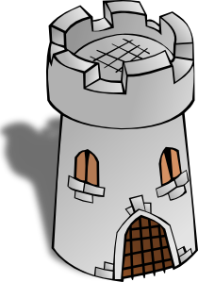
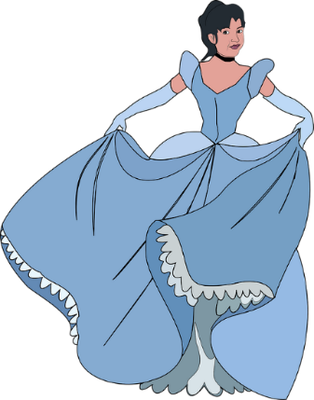
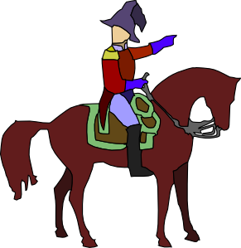
leer
¿Dónde está la persona/el lugar?
Marca la opción correcta.
La t_ _ _ _
la torre
leer
1 | La torre está lejos del | iglesia
 |  | oeste (m)
 |  | could be either
2 | La plaza está debajo del | edificio
 |  | balcón
 |  | could be either
3 | La dama está detrás de la | tienda
 |  | banco
 |  | could be either
4 | El caballero está delante del | casa
 |  | monumento
 |  | could be either
5 | El tren no está fuera de la | estación (f)
 |  | pueblo
 |  | could be either
La p_ _ _ _
la plaza
El b_ _ _ _ _
el balcón
La f_ _ _
la flor
La p_ _ _ _
La d_ _ _
la dama
El c_ _ _ _ _ _ _ _
el caballero
Notes:
Timing: 5 minutes
Aim: to revisit vocabulary (from 2.1.1); to improve understanding of the use of ‘del’ and ‘de la’.
Procedure:
Students are prompted to recall the Spanish word for the images on the right.
Students read each sentence and tick the correct answer depending on the use of ‘del’ (masculine) and ‘de la’ (feminine).
Teacher shows the answers one by one.
Note: the gender of new nouns is given because these don’t have gender marking (-o ending=masc; -a=fem) with which students are familiar.

Slide 16
¿Cómo se dice en inglés?
The tower is far from the west.
1
La torre está lejos del oeste.
The square is below the balcony.
2
La plaza está debajo del balcón.
The lady is behind the shop.
3
La dama está detrás de la tienda.
The gentleman/knight is in front of the monument.
4
El caballero está delante del monumento.
The train is not outside / out of the station.
5
El tren no está fuera de la estación
Notes:
Timing: 6 minutes.
Aim: to consolidate understanding of revisited vocabulary and the use of adverbs.
Procedure:
Students translate each phrase into English.
The teacher reveals each answer by clicking on each dark blue shape.

Slide 17
escuchar
¿Qué escuchas? ¿‘del’ o ‘de la’?
Luego, escucha otra vez. Marca la palabra
correcta y escribe la frase completa en inglés.
escuchar
 | del | de la
la palabra correcta |  | ¿Cómo se dice en inglés?
oeste (m) | ciudad (f)
plaza | este (m)
estación (f) | museo
escuela | banco
tienda | teatro
coche (m) | mesa
iglesia | teatro
edificio | casa
1
The train is far from the city.
2
The white car is near the east.
3
The (male) teacher is in front of the station.
4
The (female) author is outside the bank.
5
The (female) director/headteacher is behind the shop.
6
The (male) classmate is under the table.
7
The station is in front of the theatre.
8
The (male) friend is outside the building.
Notes:
Timing: 7 minutes
Aim: to consolidate the use of ’del’ and ‘de la’; to understand the sentences
Procedure:
Students listen to each recording and tick the correct column.
Students listen again and write the correct word.
Students write the sentence in English. (They may first need to transcribe it in order to think carefully about the language.)
Transcript
1. El tren está lejos de la [ciudad] 2. El coche blanco está cerca del [este] 3. El profesor está delante de la [estación] 4. La autora está fuera del [banco] 5. La directora está detrás de la [tienda de musica] 6. El compañero está debajo de la [mesa] 7. La estación está delante del [teatro] 8. El amigo está fuera del [edificio]
Note: the genders are mostly clear as most words end in –o and –a. However, students could also be told that even when the nouns don’t end in –o and –a, there are other helpful rules to determine the gender. For example, words ending in –dad (ciudad) and –ción (estación) are always feminine.
Previously taught vocabulary is recycled in this task:
1.2.6 – edificio
1.2.5 – ciudad, plaza, museo, escuela, banco, tienda, teatro, iglesia
1.2.3 – mesa
1.1.4 – casa

Slide 18
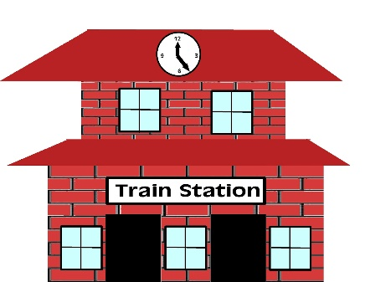
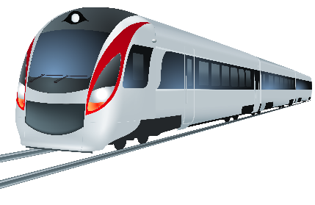
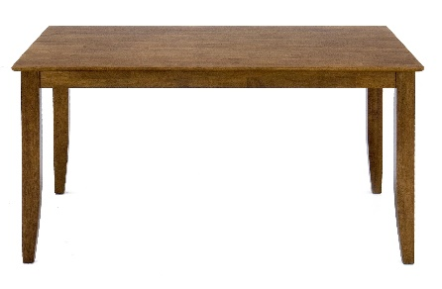
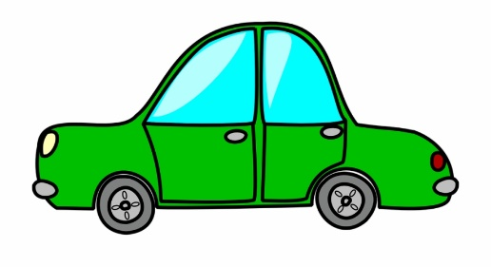
Describe las imágenes. Completa las seis frases en español.
escribir
[behind]
1
2
3
[far from]
1. La persona…
2. El periódico…
3. El chico…
4. La planta…
5. El tren…
6. El coche…
[outside]
[in front of]
4
5
6
[near]
[below]
Notes:
[1/2]
Time: 8 minutes
Aim: to produce sentences including ‘del’ and ‘de la’ and positional adverbs.
Procedure:
Students look at each image/English prompt and complete the sentences in the yellow box with ‘está’, a positional adverb, ‘del’ or ‘de la’ and the referential noun.
Teacher shows the answers on the next slide with further clicks.
Answers:
1) La persona está fuera del banco. 2) El chico está detrás del regalo. 3) El tren está lejos de la estación
4) El periódico está debajo de la mesa.
5) La planta está delante de la ventana.
6) El coche está cerca del oeste.

Slide 19
escribir
Respuestas
escribir
La persona está fuera del banco.
El chico está detrás del regalo.
El tren está lejos de la estación.
El periódico está debajo de la mesa.
La planta está delante de la ventana.
El coche está cerca del oeste.
Notes:
[2/2]
Answers:
1) La persona está fuera del banco. 2) El chico está detrás del regalo. 3) El tren está lejos de la estación
4) El periódico está debajo de la mesa.
5) La planta está delante de la ventana.
6) El coche está cerca del oeste.

Slide 20
Places and locations
Adverbs of position with ‘del’ and ‘de la’
Using ‘estamos’ and ‘están’
Y7 Spanish
Term 2.2 - Week 4 - Lesson 45
Nick Avery / Rachel Hawkes
Artwork: Mark Davies
Date updated: 15/12/20
Notes:
Artwork by Mark Davies. All additional pictures selected are available under a Creative Commons license, no attribution required.
Learning outcomes (lesson 2):
Consolidation of SSCs [cue], [cua], [cui]
Consolidation of ‘del’ and ‘de la’ (after adverbs of position)
Introduction of ‘estamos’, ‘están’
Consolidation of ‘estoy’, ‘está’
Word frequency (1 is the most frequent word in Spanish):
7.2.2.4 (introduce) estamos [estar-21]; están [21]; oeste [2416]; este [>5000*]; estación [1404]; coche [1190]; tren [1488]; delante de [delante-1742]; fuera de [fuera-299]; debajo de [1366]; detrás de [2044]
7.2.2.1 (revisit) trabajar [174]; buscar [179]; descansar [1749]; preparar [570]; comida [906]; animal [322]; pasar [68]; tiempo [80]; campo [342]; junto[s] [149]; solo [181]
7.2.1.1 (revisit) balcón [3133]; dama [2062]; torre [2138]; caballero [2056]; saber [44]; pasar [68]; blanco [372]; flor [739]; plaza [806]; llevar [101]
Source: Davies, M. & Davies, K. (2018). A frequency dictionary of Spanish: Core vocabulary for learners (2nd ed.). Routledge: London
The frequency rankings for words that occur in this PowerPoint which have been previously introduced in NCELP resources are given in the NCELP SOW and in the resources that first introduced and formally re-visited those words.
For any other words that occur incidentally in this PowerPoint, frequency rankings will be provided in the notes field wherever possible.

Slide 21
Escucha y completa las palabras con ‘cua’, ‘cue’, ‘que’, ‘cui’ o ‘qui’.
escuchar / escribir
Luego escribe la frase en inglés.
1. Si no cuidas el cuerpo, los efectos son malos.
1
If you don’t look after the body, the effects are bad.
2. En la imagen hay quince cuadros pequeños.
2
In the image there are fifteen small squares.
3. ¿Quién sabe qué quiere?
3
Who knows what s/he wants?
4. ¡Cuidado con el material de la escuela!
4
Careful with the school material!
5. Hay cuatro personas en el parque.
5
There are four people in the park.
Notes:
Timing: 5 minutes.
Aim: to continue focusing on SSCs [cue], [cua] and [cui], now juxtaposed with two related SSCs: [que] and [qui].
Procedure:
Students listen to each recording and complete the words with the correct missing SSC.
Teacher shows the answers one by one.
Transcription:
Si no cuidas el cuerpo, los efectos son malos.
En la imagen hay quince cuadros pequeños.
¿Quién sabe qué quiere?
¡Cuidado con el material de la escuela!
Hay cuatro personas en el parque.

Slide 22
Identifica la palabra correcta.
puede
pedir
puedo
hablar
1 | 2 | 3
4 | 5 | 6
7 | 8 | 9
to be able to; can | to ask; asking | favour
you are able to; you can | to play; playing | I am able to; I can
to change; changing | to ask for; asking for | Can I go to the toilet?
s/he is able to; s/he can | to participate; participating | to wear; to carry/take
¿Puedo ir a los servicios?
poder
participar
jugar
llevar
10 11 12
el favor
puedes
preguntar
cambiar
Notes:
Timing: 5 minutes
Aim: to revisit words from weeks 2.1.6 and 2.1.1 (revisited in the scheme of work this week) that haven’t already been incorporated into other lesson activities.
Procedure:
Teacher says the number (either in numerical or random order, to challenge students more).
Students have to search the options around the edge of the box to decide which is the corresponding word.
Teacher pauses for several seconds to allow students to search, then elicit the Spanish word from students in chorus.
Answers:
poder
preguntar
el favor
puedes
jugar
puedo
cambiar
pedir
¿Puedo ir a los servicios?
puede
participar
llevar

Slide 23
Daniel habla de la escuela. ¿Cuál es la palabra correcta?
hablar
En la clase es normal 1) [to be able to] 2) [to ask for]
3) [a favour] cuando necesitas ayuda o 4) [to ask]
5) [can I go to the toilet?] si necesitas ir.
El lunes 6) [I can] 7) [to play] con los compañeros y
8) [to take, to carry] material a casa. ¿También
9) [can you]? El profesor 10) [he can] 11) [to change] las actividades para grupos diferentes. 12) ¡[He participates] en muchas clases!
poder
pedir
un favor
preguntar
¿puedo ir a los servicios?
puedo
jugar
llevar
puedes
puede
cambiar
Participa
Notes:
Timing: 6 minutes
Aim: to produce the revisited vocabulary from 2.1.6 and 2.1.1 orally within a short text.
Procedure:
In pairs, students take turns to read the text aloud translating the English prompts into Spanish as they go.
The teacher asks students to read out the full text chorally.
To give feedback, the teacher shows each answer with further clicks.
Notes:
1. Teachers will make a judgement here about students’ readiness for oral productive recall. Ideally, as the target vocabulary here is all revisited (and also seen in the last activity) they would do this without looking at notes. However, if this is too much of a jump, they could write each number and the corresponding word in Spanish before speaking.
2. Students in pairs can divide the text in two: student A reads out the first paragraph and student B reads out the second paragraph.
Unknown words/cognates:
diferente [293]

Slide 24
Talking about places and locations Using verb ‘estamos’ and ‘están’
Use the verb ‘estar’ to talk about locations.
To say ‘we are’ with a place or location, say ‘estamos’.
We are in a café.
Estamos en un café.
To say ‘they are’ with a place or location, say ‘están’.
Están en el centro.
They are in the centre.
Notes:
Timing: 2 minutes
Aim: to introduce ‘estamos’ and ‘están’.
Procedure:
1. Go through the grammar explanation with students, revealing each new sentence on a mouse click.
Note: ‘Estamos’ has the same –amos ending for that was previously taught for regular –ar verbs.

Slide 25
Talking about places and locations
Remember that in Spanish, to talk about locations you use ‘de’ after adverbs like ‘cerca’ o ‘lejos.
El tren está cerca de la ciudad.
The train is near (to) the city.
El profesor está lejos de la plaza.
The teacher is far (from) the square.
When you refer to a singular masculine noun (e.g. el campo), change de + el to ‘del’.
La casa está cerca del campo.
The house is near (to) the countryside.
To refer to a singular feminine noun (e.g. la estación), use ‘de la’.
El perro está cerca de la estación.
The dog is near (to) the station.
Notes:
Timing: 2 minutes
Aim: to recap ‘del’ and ‘de la’ (after adverbs of position), which was introduced last lesson.
Procedure:
Go through the grammar explanation with students, revealing each new sentence on a mouse click.

Slide 26
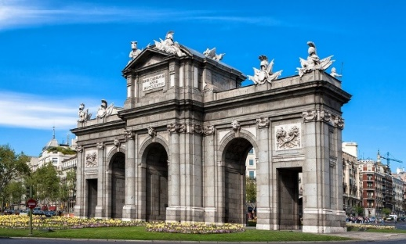
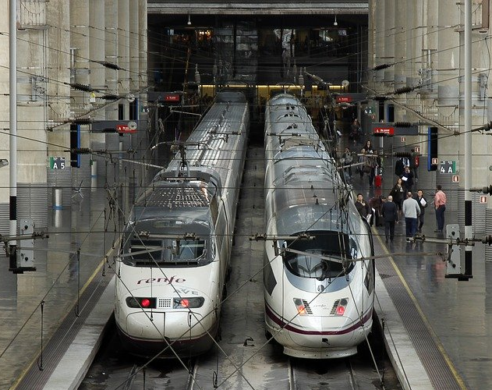
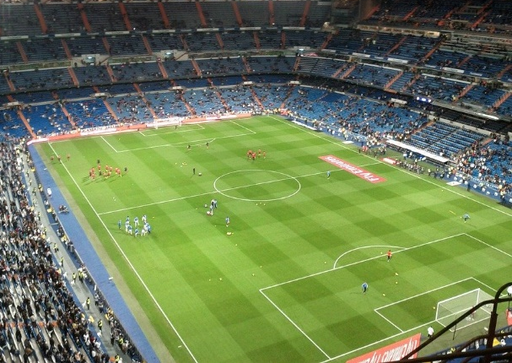
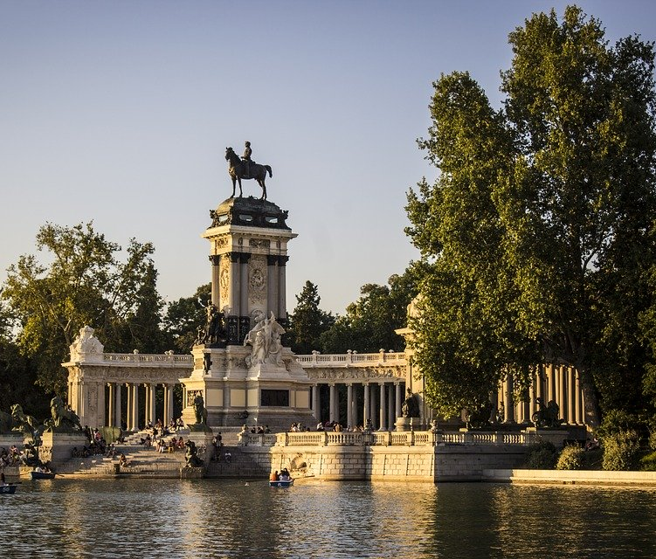
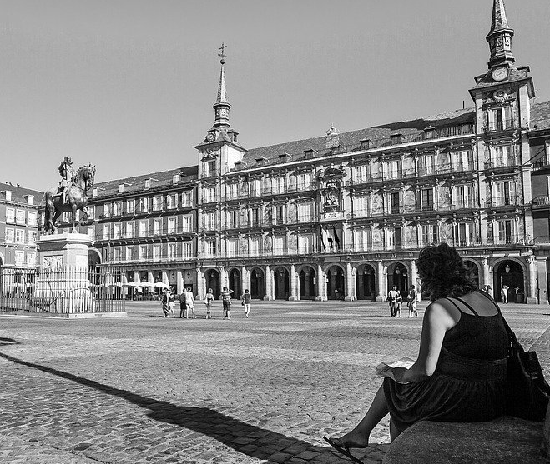
Pep is texting someone. He’s saying where he and his friends are in Madrid. He also says where other friends are.
Puerta de Alcalá (f)
Marca ‘del’ o ‘de la’.
Luego, marca ‘we’ o ‘they’.
Estación Atocha (f)
Estadio Bernabéu (m)
 |  |  | ‘we’ | ‘they’
1. Estamos debajo | de la | Puerta de Alcalá.
 | del
2. Están cerca | del | Parque del Retiro.
 | de la
3. Estamos delante | de la | Estadio Bernabéu.
 | del
4. Están fuera | de la | Estación Atocha.
 | del
5. Estamos detrás | del | Plaza Mayor.
 | de la
Parque del Retiro (m)
Plaza Mayor (f)
Notes:
Timing: 6 minutes
Aim: to consolidate the use of ‘del’ and ‘de la’; to practise linking ‘estamos’ and ‘están’ to the meanings ‘we’ and ‘they’.
Procedure:
Students read each sentence and write ‘del’ or ‘de la’ depending on the gender of the following word.
Students tick the corresponding column, ‘we’ or ‘they’, depending on the verb.
Students translate the sentences to check understanding of the adverbs.
Notes:
The gender of all nouns is given to allow students to focus all their attention on connecting gender with the use of ‘del and ‘de la’. However, teachers could remove the (f) and (m) to increase the challenge for their students, as appropriate.
Teachers might like to prompt students to reflect on the gender of the nouns and to ask them, if needed. E.g., ‘parque, ¿es masculino o femenino?

Slide 27
You’re playing a Spanish version of ‘Where’s Wally?’. A narrator is giving you some hints! Is it Wally (‘he is’) or Wally and his Spanish twin, Waldito (‘they are’)?
‘He is’
‘They are’
¿dónde? (Escribe en inglés)
in front of a door.
1
You can also use indefinite articles (e.g. ‘un’, ‘una’) after ‘de’.
¿Cómo se dice en inglés?
a) Está cerca de un coche.
b) Está cerca del coche.
2
in a river.
near a car.
3
outside a big building.
4
5
behind a tree in a park.
6
with some short people.
7
far from England.
8
between two people.
Notes:
Timing: 7 minutes.
Aim: to consolidate understanding of the difference between está (‘s/he is’) and están (‘they are’); to understand sentences with positional adverb + del/de la + place
Procedure:
Students listen to each recording and tick the corresponding column depending on the verb they hear.
Students listen again and write the information about where he is/they are in English.
Transcript
Está delante de una puerta.
Están en un río
Está cerca de un coche.
Está fuera de un edificio grande.
Están detrás de un árbol en un parque.
Está con unas personas bajas.
Están lejos de Inglaterra.
Están entre dos personas.
Note: Answers are animated to reflect this: 1-8 ticks and then 1-8 English. As always, teachers who want to run this activity differently can change the animation order.
Vocabulary in this task is recycled from
Term 2.1, week 3: río, ábol
Term 1.2, week 6: edificio, grande
Term 1.2, week 5: cerca, lejos, entre
Term 1.2, week 3: puerta, persona
Term 1.2, week 2: dos
Term 1.1, week 3: bajo
Term 1.1, week 1: Inglaterra
‘Parque’ was a previously taught phonics word

Slide 28
hablar / escuchar
Un ejemplo
hablar / escuchar
Estamos cerca del....
Persona A (habla):
We are near the [Parque del Retiro]
Don’t say the crossed out part!
Persona B (completa la tabla):
near
Plaza Mayor (f) Parque del Retiro (m)
Notes:
[1/5]
Timing: 12 minutes
Aim: to practise the use of ‘estoy’ and ‘estamos’ , the use of adverbs and the use of ‘del’ or ‘de la’ in oral production.
Procedure:
1. Students work in pairs. Student A reads the the English prompt and translates into Spanish for student B, without showing the card. However, s/he must not say the crossed out word.
2. Student B will listen and complete the grid. S/he has to
choose between ‘I am’ vs ‘we are’, based on the form of ‘estar’ that they hear. Student A’s correct use of ‘estoy’ and ‘estamos’ is needed in order to complete the task.
write the adverb of location (e.g., near)
choose between place A or B, which juxtapose masculine and feminine nouns. Person A’s correct use of ‘del’ and ‘de la’ is needed in order to complete this part of the task.
Note: It is perfectly fine for student A to repeat the sentence, given that there are several pieces of information for Person B to write down.

Slide 29
hablar / escuchar
Persona A
hablar / escuchar
We are near the..
We are below the…
I am in front of the...
Parque del Retiro (m)
Plaza Mayor (f)
Estadio Bernabéu (m)
We are far from the…
I am behind the...
I am outside…
Puerta de Alcalá (f)
Estación Atocha (f)
Museo del Prado (m)
Notes:
[2/5]
Speaking cards – Person A
Do not display during the activity

Slide 30
hablar / escuchar
Persona B
hablar / escuchar
I am outside…
I am behind the...
We are far from the…
Plaza Mayor (f)
Museo del Prado (m)
Estación Atocha (f)
I am in front of the...
We are near the..
We are below the…
Puerta de Alcalá (f)
Estadio Bernabéu (m)
Museo del Prado (m)
Notes:
[3/5]
Speaking cards – Person B
Do not display during the activity

Slide 31
escuchar
Persona B
Escucha. Completa la tabla.
escuchar
‘I am’ | ‘we are’ | near? far? under? behind? outside? in front of? | ¿Dónde? ¿Es ‘A’ o ‘B’?
A
B
1
near
Plaza Mayor (f) Parque del Retiro (m)
2
below
Museo del Prado (m) Plaza Mayor (f)
3
in front of
Estadio Bernabéu (m) Estación Atocha (f)
4
far from
Parque del Retiro (m) Puerta de Alcalá (f)
5
behind
Estación Atocha (f) Estadio Bernabéu (m)
6
outside
Museo del Prado (m) Puerta de Alcalá (f)
Notes:
[4/5]
Answers – Show during feedback

Slide 32
escuchar
Persona A
Escucha. Completa la tabla.
escuchar
‘I am’ | ‘we are’ | near? far? under? behind? outside? in front of? | ¿Dónde? ¿Es ‘A’ o ‘B’?
A
B
1
outside
Plaza Mayor (f) Parque del Retiro (m)
2
behind
Museo del Prado (m) Plaza Mayor (f)
3
far from
Estadio Bernabéu (m) Estación Atocha (f)
4
in front of
Parque del Retiro (m) Puerta de Alcalá (f)
5
near
Estación Atocha (f) Estadio Bernabéu (m)
6
below
Museo del Prado (m) Puerta de Alcalá (f)
Notes:
[5/5]
Answers – Show during feedback

Slide 33
You and your classmates have got lost on Spanish exchange! Text your exchange partner to say where everyone is. Escribe las seis frases en español.
escribir
escribir
Estamos fuera de la ciudad.
Estoy delante de la estación.
Está detrás del tren.
1. We are outside the city.
2. He is behind the train.
3. I am in front of the station.
Están lejos de la escuela.
Está cerca del este.
Estoy debajo del coche verde.
4. They are far from the school.
5. She is near the east.
6. I am under the green car
Notes:
Timing: 8 minutes.
Aim: to bring together the grammar and vocabulary taught (and revisited) this week in written production.
Procedure:
1. Students translate each sentence into Spanish.
2. The teacher shows the answers one by one.
Note: At this stage, we are expecting students to recall the gender of the noun.

Slide 34
Deberes
Vocabulary Learning Homework (Term 2.2, Week 5)
Audio file
Audio file QR code:
Student worksheet
Quizlet link
In addition, revisit: Term 2.2 Week 2
Term 2.1 Week 2

