Slide 1
An introduction to NCELP pedagogy and resources Friday 11th November
Presenter: Nick Avery

Slide 2
Overview
What is NCELP?
Principles of pedagogy and sample resources
Cultural aspects of resources
Q&A
Notes:
This session introduces NCELP, explaining the project's aims and some of the core principles of our pedagogy. We’ll be talking in particular about three areas of knowledge: phonics, vocabulary and grammar.
For each of these, we’ll also present some sample Spanish resources that were made as we resourced our schemes of work.
We plan to leave about 10 minutes for questions at the end of the session.

Slide 3
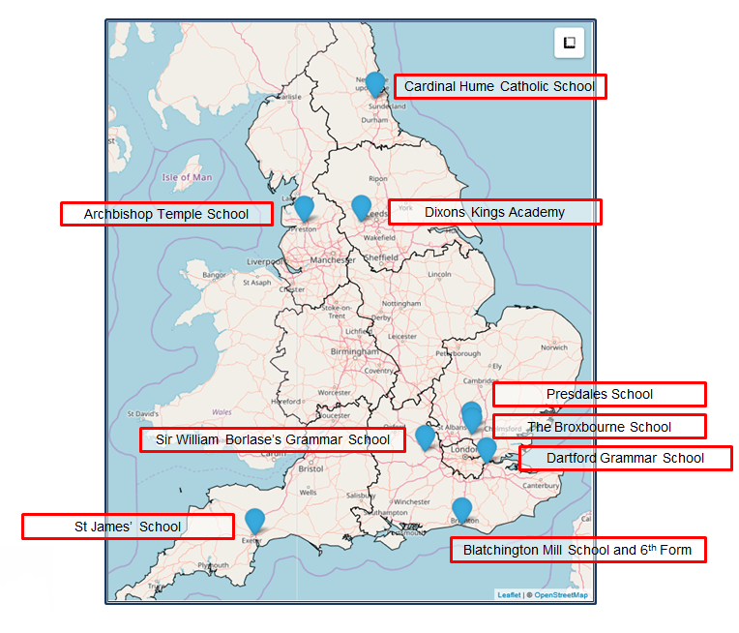
What is NCELP?
Notes:
NCELP (National Centre for Excellence for Language Pedagogy) was established in December 2018, funded by the UK Government’s Department for Education (DfE) to create and deliver research-informed resources and professional development for teaching French, German, and Spanish in collaboration with a network of school teachers. NCELP is housed within the University of York’s Department of Education. NCELP works with 9 Lead Schools shown here. Each lead school has a set of ‘hub’ schools in its area with which it works closely to support implementation of NCELP pedagogy and resources, making a network of around 45 schools.
As our strapline says, our business is to understand, improve, and promote the learning of foreign languages. This involves a wide range of activities such as creating a wide range of resources, developing and delivering CPD, maintaining the resource portal, communicating research findings, monitoring progress, addressing feedback, and providing technical and administrative support.

Slide 4
NCELP aims to…
Connect classroom practice and research
Develop pedagogy, with resources to deliver it
Improve intrinsic motivation and increase GCSE uptake
Notes:
NCELP’s overarching purposes are:
1 to link research and practice more closely than has previously been the case – a longstanding issue due to a lack of time, tight school budgets and issues of access.
2 to develop research-informed pedagogy and a full suite of supporting resources – this means taking account of relevant research and working with teachers to adapt and align their pedagogy with those findings.
3 to improve intrinsic motivation and increase numbers at KS4 – research suggests that pedagogy can improve intrinsic motivation (even though there are other external factors outside of our control)
The bottom line for the DfE (and therefore for NCELP, too) is that more students choose to continue to study languages at KS4. Currently this is the situation (talk through the bullets):
- Fewer than 1/2 Y11 students takes a language at GCSE
- Only 1/3 all Y11 pupils achieves a Grade 4 or better
There is also regional and socio-economic inequality of language learning provision
--------------------------------------------------------------------------------------
Full notes
Let’s take the core purposes one by one. Why has it been and continues to be a challenge to link language learning research and practice? It is not for a lack of interest on the part of teachers (or motivation on the part of researchers). The difficulties are lack of time and money and problems of access – this includes the difficulty of gaining access to high-quality research journals. Once no longer in full-time study, access to these journals is expensive and not supported by school CPD budgets. There are also sometimes issues in a) relating the terminology of research to the pedagogy of the classroom and b) in discerning the applicability of findings from studies in which the contexts differ wildly from our own (e.g. university learners of English in China vs secondary-age learners of FL in the UK).
So, NCELP aims help improve this situation.
2 to develop research-informed pedagogy and a full suite of supporting resources
The difficulties just mentioned explain why research and practice are not generally mutually informing.
NCELP’s work aims to articulate pedagogy that has these features: it does take account of relevant and compelling research findings and then works directly with teachers to adapt and align pedagogy with those findings. It seeks to describe teaching methods that are sound and work for as many pupils as possible for as much of the time as possible, with the aim of making language teaching less reliant on personal charisma and craft knowledge of individual teachers.
It stresses the importance of establishing a body of phonics, vocabulary and grammar knowledge and sets out to define what that could look like.
It brings this knowledge together in practice of various kinds, but above all practice that doesn’t lose the connection with the meaning and the function of language.
In all this, the aspect that is downplayed is the topic, for reasons we will come back to.
3 in order to improve intrinsic motivation and increase numbers at KS4.
Re increasing intrinsic motivation…
Leaving aside factors associated with demotivation that lie outside our control (English is the global lingua franca, Brexit, harsh grading at GCSE and A level, etc…),
NCELP is set on developing pedagogy to improve intrinsic motivation, which is something that research suggests we can influence through changes to pedagogy.
The innovations to pedagogy that NCELP suggests are designed to: 1] make explicit / increase the transparency of certain features of a language that are particularly tricky to notice, and therefore to learn 2] increase the level of understanding in the classroom and take sufficient time and include sufficient practice to enable students to feel that they are achieving and progressing
3] explicitly teach students how to decode the L2 accurately (phonics), as research has shown that a) not to do so means that students don’t learn how to do and b) not to be able to do so is demotivating for students 4] ensure that we focus on teaching a large proportion of high-frequency words (and that we are explicit about this) so that students are learning language that is important for communication outside (as well as inside) the classroom, and that they know they are.
Re increasing uptake…
The bottom line for the DfE (and therefore for NCELP, too) is that more students choose to continue to study languages at KS4. Currently this is the situation (talk through the bullets):
- Fewer than 1/2 Y11 students takes a language at GCSE
- Only 1/3 all Y11 pupils achieves a Grade 4 or better
- In 34.5% state schools the majority of the Y9 cohort no longer learns languages (2-year KS3)
- There is regional and socio-economic inequality of language learning provision (for example, there is regional disparity (62% in London, 40% in the North East, 29% in Middlesborough), but also disparity in provision between schools with low PP / low FSM (Free School Meals) numbers and those with a much higher ratio of students from more challenging socio-economic backgrounds.

Slide 5
Current GCSE review
Nov, 2019: Department for Education convened an independent panel to review the current MFL subject content
March, 2021: Recommendations put to public consultation
Key recommendations:
Particular themes no longer required
Vocabulary selection informed by frequency
Creation of a word list to use for designing assessment
Grammar more clearly defined and amount reduced
-> themes emerge
Notes:
Given that increasing GCSE uptake is a major aim of the project, it is worth noting that a review has recently been undertaken of the existing GCSE subject content for French, German and Spanish.
In November 2019 the DfE announced a 7 member expert panel that would consider potential changes to the existing subject content. One of the motivators of this was to align policy with the recommendations of the 2016 TSC pedagogy review. Earlier this year, the panel’s recommendations were put to public consultation. These include
A GCSE in which set themes and topics are no longer specified. One reason for this is that when topics are taken as a starting point, the vocabulary chosen is very often topic-specific, rather than transferrable across contexts, and therefore limited in usefulness.
It is proposed that vocabulary selection should be informed by frequency of occurrence. It is proposed that this will allow students to talk about a wide range of themes and topics.
It is proposed that exam boards create a set vocabulary list, which will form the basis for vocabulary assessment. To date, there has been a requirement for unknown language to be included, but it is now proposed that students are only tested using words on the list, and that any unknown words (no more than 2% of the total) would be glossed.
To the best of our knowledge, those changes are due to come into effect.

Slide 6
Current GCSE review
The core reasons for learning a language haven’t changed!
Develop ability and ambition to communicate (in speech and writing)
Step beyond familiar cultural boundaries
Develop new ways of seeing the world
Provide a strong foundation for further study
Notes:
Regardless of the nature of the assessment, the core purpose for language learning has not changed: this is the need to understand and communicate about cultures and societies (both their own and in countries where the language is spoken), and to stimulate interest in the language itself.

Slide 7
The NCELP Pillars
Pupils need to gain systematic knowledge of the vocabulary, grammar, and sound and spelling systems (phonics) of their new language, and how these are used by speakers of the language.
They need to reinforce this knowledge with extensive planned practice and use in order to build the skills needed for communication.
+ meaningful practice
Teaching Schools Council (2016), MFL Pedagogy Review.
Notes:
To be able to do this, students need to gain an understanding of the fundamental building blocks of language: the vocabulary, grammar and sound/spelling systems, and how these are used. This then needs to be reinforced with extensive planned practice and use.
Image by Steve Clarke

Slide 8
Phonics
explicit teaching of the key sound-spelling correspondences (SSCs)
helps students to avoid relying on English SSCs when they ‘sound out’ words
positively associated with motivation, autonomy and vocabulary learning
supports errorless learning – accurate understandings from the beginning
gradual roll-out, with systematic revisiting in order to maintain progress
Notes:
The first of the three ‘strands’ is phonics: explicit teaching of the relationships between the letters of written words and their sounds.
In recent years there has been a lot of emphasis on phonics teaching in primary education for learning English, but this is still relatively uncommon in the MFL classroom.
Yet research suggests that without explicit phonics teaching, learners make little progress and that English SSCs remain entrenched. Students know that the words should sound different, but they are unsure how they should sound
There are many benefits associated with explicit phonics teaching. Research has found that this improves students’ phonological decoding ability (their ability to sound out unknown words).
There are also many related benefits in terms of motivation and confidence in oral and written production, autonomy and vocabulary learning.
This also supports errorless learning – avoiding inaccurate representations regarding how the how new language sounds and is spelt.
In the NCELP schemes of work, the SSCs are gradually introduced and are revisited over time – this is key in order to maintain progress.
(Sources: Erler, 2003, 2004; Erler & Macaro, 2012; Porter, 2014, forthcoming; Woore, 2009, 2010, 2011, 2014, 2018).

Slide 9
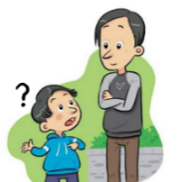
a
e
i
o
u
ll
libro
alto
elefante
idea
yo
universo
llamar
l
ca
co
cu
ce
ci
z
MADRID 1KM
casa
comer
cuerpo
cerca
cierto
zona
ga
go
gu
ge
gi
j
ganar
gol
preguntar
gente
imaginar
ojo
ñ
mano
v
celebrar
rr
pero
h
porque
qui
guerra
gui
español
n
ver
b
perro
r
hablar
que
quiero
gue
guitarra
Notes:
Phonics poster with key Spanish SSCs
This can be used just to give an overview of those that are taught and practised in the NCELP Spanish scheme of work. It is worth re-emphasising here the phased roll-out and focused nature of the practice. In any given week, one SSC or a group of closely related SSCs is introduced. Later on, multiple SSCs can be brought together in revision activities.
Each SSC here as a ‘source word’ (a highly frequent word that contains the target SSC and can be captured in an image and/or gesture).

Slide 10
ce
doce
centro
MADRID 1KM
cerca
necesitar
necesario
[necessary]
[to need]
parecer
[to seem; appear]
Notes:
Introduce and elicit the pronunciation of the individual SSC ‘ce’ and then the source word again (with gesture, if using). Then present and elicit the pronunciation of the five cluster words.
The cluster words have been chosen for their high-frequency, from a range of word classes, with the SSC (where possible) positioned within a variety of syllables within the words (e.g. initial, 2nd, final etc.). Additionally, we have tried to use words that build cumulatively on previously taught SSCs (see the Phonics Teaching Sequence document) and do not include new SSCs. Where new SSCs are used, they are often consonants which have a similar symbol-sound correspondence in English.
Might also be presented after without images + without images or sound

Slide 11
ce
doce
centro
cerca
necesitar
necesario
parecer
Notes:
Without the images, students focus this time again closely on the SSC and the cluster words.

Slide 12
ce
doce
centro
cerca
necesitar
necesario
parecer
Notes:
Without the images or sound, students have to pronounce the words themselves.

Slide 13
ci
cine
diciembre
ciencias
ciudad
cierto
decir
[to say; tell]
Notes:
Introduce and elicit the pronunciation of the individual SSC ‘ci’ and then the source word again (with gesture, if using). Then present and elicit the pronunciation of the five cluster words.
The cluster words have been chosen for their high-frequency, from a range of word classes, with the SSC (where possible) positioned within a variety of syllables within the words (e.g. initial, 2nd, final etc.). Additionally, we have tried to use words that build cumulatively on previously taught SSCs (see the Phonics Teaching Sequence document) and do not include new SSCs. Where new SSCs are used, they are often consonants which have a similar symbol-sound correspondence in English.

Slide 14
ci
cine
diciembre
ciencias
ciudad
cierto
decir
Notes:
Without the images, students focus this time again closely on the SSC and the cluster words.

Slide 15
ci
cine
diciembre
ciencias
ciudad
cierto
decir
Notes:
Without the images or sound, students have to pronounce the words themselves.

Slide 16
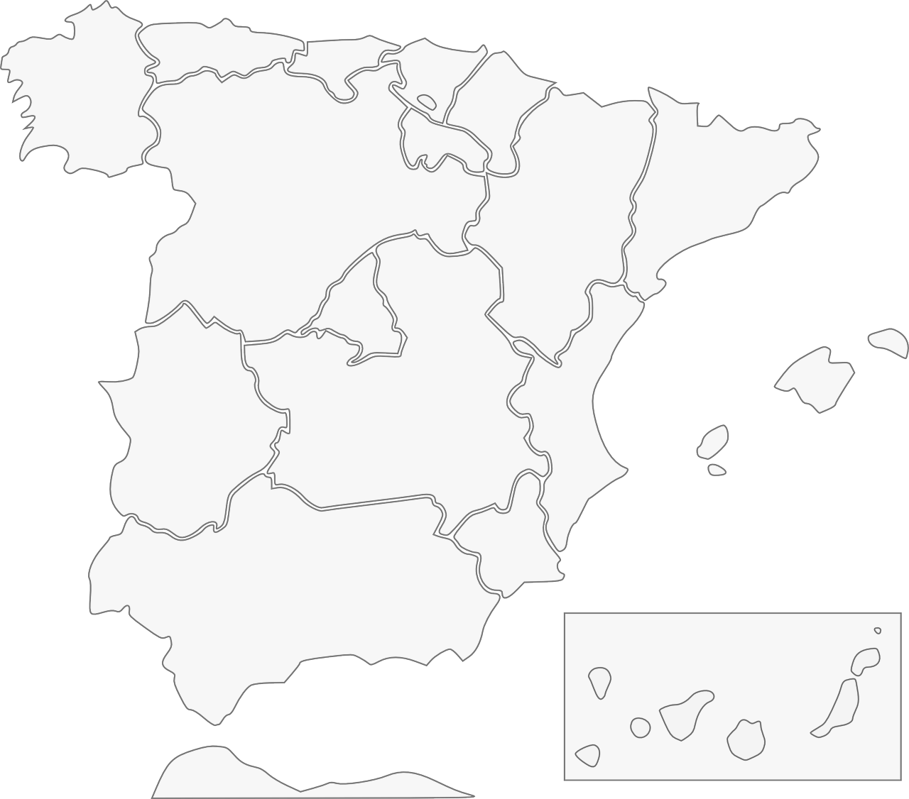
Fonética: [ci] & [ce]
escuchar / escribir
Escucha y escribe en español el nombre correcto del lugar.
1
Galicia
2
Barcelona
3
Cáceres
4
Valencia
Albacete
5
Murcia
Andalucía
7
6
Ceuta
8
Notes:
This is an example activity used to practise transcription of the SSCs [ce] and [ci]. Students listen and complete the place names on the map. If students need extra support, the activity could be adapted so that they simply need to add the missing SSC. The use of the map is also a chance to integrate language learning with cultural knowledge regarding Spanish cities and autonomous communities.
------------
Teacher notes:
Timing: 5 minutes
Aim: to revisit the sound-spelling correspondence for the SSCs [ce] and [ci] with eight names of cities/autonomous communities Spain
Procedure:
Click on the action button to play the audio.
Reveal the place by clicking on the red line. Answers can be given in any order.
Transcript:
1. Galicia
2. Barcelona
3. Valencia
4. Murcia
5. Ceuta
6. Andalucía
7. Albacete
8. Cáceres

Slide 17
SSCs [CE] y [CI]
escuchar
Remember, there are different ways to pronounce CE and CI.
In most of mainland Spain, the ‘c’ before ‘e’ or ‘i’ is pronounced
like _____ in English.
‘th’
In the Canary Islands (part of Spain) and Latin America, this ‘c’ is often pronounced like an ____.
‘s’
Escucha. Es ¿España o Canarias / Latinoamérica?
ciencias
España
1
________________________________
ciencias
Canarias / Latinoamérica
2
________________________________
doce
Canarias / Latinoamérica
3
________________________________
doce
España
4
________________________________
Notes:
Learning can be extended by explaining to students the geographical variation in pronunciation of key SSCs, such as [ce] and [ci]. Here, students recap the key information, and can be given a walk-through with a couple of examples that contrast the two types of pronunciation. This prepares them for the subsequent listening activity.
--------------------------
Teacher notes
Phonics recap slide
Timing: 3 minutes
Aim: to revisit the SSCs [CE] and [CI] and consolidate understanding of the different ways in which they are pronounced in the Spanish-speaking world.
Procedure:
Read the explanation, eliciting the answers from students where prompted by gaps.
Play the audio and ask where the person is from (‘¿La persona es de…?’)
Ask students which other words they can recall from Y7 which have [ce] and [ci]. This will help to prepare them for the next activity.
Anticipate, for [CI], cine, diciembre, decir, cierto, ciudad
Anticipate, for [CE], centro, necesitar, necesario, cerca, doce, parecer.
Notes:
Teachers may also find it useful to consider the information from exam board specifications below:
AQA : “The [listening] test will be studio recorded using native speakers speaking Castilian in clearly articulated, standard speech at near normal speed. Different types of spoken language will be used, using familiar language across a range of contemporary and cultural themes. (p. 82)
EdExcel : “For listening and reading assessments, the majority of contexts are based on the culture and countries where the assessed language is spoken. […] It is, therefore, important that students are exposed to materials relating to Spanish-speaking countries throughout the course.” (p. 7)
WJEC : “This GCSE specification in Spanish for use in Wales is based on a conviction that learners studying a modern foreign language will develop their desire and ability to communicate with and understand speakers of Spanish in a variety of contexts and for a variety of purposes.” (p. 3)

Slide 18
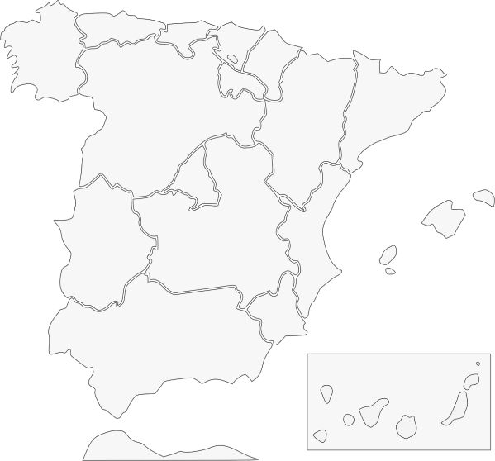
Pilar y Conchi son de lugares diferentes, así que no tienen la misma pronunciación de [ce] y [ci]. Escucha. Quién habla, ¿Conchi o Pilar? Escribe el lugar también.
escuchar
Pilar (Islas Canarias) | Conchi (Alicante)
İHola! ¿Cómo estás? Soy Pilar y soy de Puerto Rico en las Islas Canarias.
1
Ceuta
2
Galicia
3
Valencia
4
Murcia
İBuenos días! Soy Conchi y soy de Alicante en la Comunidad Valenciana.
5
Cáceres
6
Barcelona
7
Andalucía
8
Albacete
Notes:
Phonics practice activity
Timing: 6 minutes
Aim: to raise awareness of the different ways in which the SSCs [ce] and [ci] are pronounced in the Spanish-speaking world.
Procedure:
Go through instructions with students.
Check understanding of instructions by asking students an example. E.g., ciudad (pronounced with seseo): ¿Es Pilar or Conchi? ¿Por qué? Sí, perfecto, porque Pilar es de las Islas Canarias. ¿Y en Alicante, cómo es la pronunciación?
Play the audio and ask students to tick the correct column and write the place with the target SSCs.
Check answers, including spelling, in the feedback.
Note:
Some students may be able to write the entire sentence.
Transcript:
Tengo un amigo de Ceuta.
Mi prima vive en Galicia
¿Tu madre es de Valencia?
Voy a ir de vacaciones a Murcia.
Hay una universidad muy famosa en Cárceres.
Barcelona tiene unos museos geniales.
Andalucía es una zona muy bonita.
Albacete está en el sureste de España.

Slide 19
Phonetik
lesen / sprechen
Sag die Zungenbrecher.
15
1.
[u]
[ü]
Fünf gute Schüler müssen Kunst in der Küche üben.
Five good pupils must practise art in the kitchen.
üben
Sekunden
in der Küche
Kunst
fünf
müssen
gute
Schüler
0
langsamer
LOS!
Notes:
Procedure: 1. Students use the English and German prompts to construct and say aloud the tongue twister within the five seconds.
2. Click the blue text box to hear it pronounced.
3. Follow the same procedure for the next two slides.
Transcript: Fünf gute Schüler müssen Kunst in der Küche üben.
Word frequency of unknown words and cognates (1 is the most frequent word in German): üben [1928] Source: Jones, R.L. & Tschirner, E. (2019). A frequency dictionary of German: core vocabulary for learners. Routledge

Slide 20
Phonetik
lesen / sprechen
Sag die Zungenbrecher.
5
2.
[a]
[ä]
Acht ähnliche Männer machen acht ähnliche Fächer.
Eight similar men do eight similar subjects.
Sekunden
ähnliche
machen
Männer
acht
Fächer
0
langsamer
LOS!
Notes:
Transcript: Acht ähnliche Männer machen acht ähnliche Fächer

Slide 21
Grammar
practising with ‘pairs’ of features
activities that require learners to connect form with meaning
other ‘cues’ for meaning may need to be removed (e.g., time markers)
plenty of initial comprehension practice (reading and listening)
later moving to production (speaking and writing)
(e.g., Marsden, 2006; Kasprowicz & Marsden, 2018; VanPatten & Cadierno, 1993; VanPatten & Oikkenon, 1996)
Notes:
There are of course many factors that affect what can be effectively learnt, and when, but here are some general principles drawn from research in second language learning.
The first is to practise pairs of features together. For example, two verb endings can be ‘paired up’ to juxtapose two meanings (or functions). Practising a whole new set of features together, e.g., a full range of verb endings, is unlikely to lead to be effective, as it is beyond what most learners can pay attention to at any one time.
The practice itself should require attention to form and meaning. A simple example could be to read sentences with two types of verb ending and decide, in each case, when an action occurred.
It may be necessary to remove other ‘cues’ from the sentence, such as time markers, as these otherwise give the answer away, and it is no longer necessary to pay attention to the grammar.
There should be plenty of initial reading and listening practice with the new features before production, and there is evidence that this controlled approach can actually make the production practice more successful.

Slide 22
Word order 2
Grammatik
As you know, the order of words in a simple German sentence is:
Mia spielt jeden Dienstag Klarinette.
Sometimes, we want to start the sentence with the adverb to emphasise it.
When we do this, the adverb and subject swap places.
Jeden Dienstag spielt Mia Klarinette.
The position of the verb does not change. It is always between the subject and the adverb.
Word order
1
SUBJECT
VERB
ADVERB
NOUN
Word order
2
ADVERB
VERB
SUBJECT
NOUN
Notes:
In German, sentences may either begin with a subject or an adverb. The adverb comes first when it is given more emphasis.
-----------------------------
Activity notes
Timing: 2 minutes
Aim: To explain the order of words in a German sentence, and how this is affected by an initial adverb.
Procedure:
1. Cycle through the information on the slide using the animation sequence.

Slide 23
Was schreiben sie?
lesen
Wolfgang und Mehmet finden Mathe langweilig. Sie dürfen aber im Unterrricht nicht reden!
Was schreiben sie?
Am Dienstag
chille ich ein bisschen zu Hause. Und du?
C
-
Hey Mehmet, was machst du heute?
Am Dienstag
ich habe Tanzunterricht. Was machst du am Samstag?
D
-
Heute
ich spiele Gitarre. Und du?
Am Samstag
gehe ich mit Mama ins Theater. Langweilig!.Und du?
A
E
-
-
Heute
spiele ich Schlagzeug!
Und am Dienstag?
Am Samstag
gehe ich shoppen! Mit Heidi :D
B
F
-
-
Notes:
In this reading activity, students need to read the sentences and decide how they must begin: with an adverb (like Heute-today; Am Dienstag – on Tuesday) or without anything. To do this, they have to look carefully at the first word of the sentence. If it begins with a subject (like ich), nothing is missing. If it begins with a verb (like spiele), the sentence must begin with an adverb. It is followed in the same teaching sequence by a listening activity and then a scaffolded written production task, which cues production of the two different word orders.
-----------------------------
Activity notes
Timing: 5 minutes
Aim: In this referential reading activity and the listening exercise that follow, students must decide whether a time phrase is included in the sentence or not.
Procedure:
1. Explain that the word order will tell them whether or not whether a time phrase is included in the sentence.
2. Students select between the time phrase shown in each case, or a blank (indicated by a dash), in order to complete the sectence.
2. Answers revealed on clicks.
Notes:
1. Capital letters have been removed from all sentences so as not to give lexical clues. Teachers to note that Wolfgang und Mehmet should have used capital letters at the beginning of sentences 1 and 4!
2. This week’s SSC ‘TH’ appears in the word ‘Mathe’ - it is worth pointing this out to students. ☺
Word frequency (1 is the most frequent word in German):
chillen [>4034] shoppen [>4034]
Source: Jones, R.L & Tschirner, E. (2019). A frequency dictionary of German: Core vocabulary for learners. London: Routledge.

Slide 24
Der Lehrer ist streng!
hören
Herr Mürrisch, der Mathelehrer, findet die Situation nicht so toll! Er redet mit Oma am Telefon.
Was sagt er?
1
heute | -
5
heute | -
2
jeden Tag | -
6
jetzt | -
3
oft | -
7
am Montag | -
4
immer | -
8
dann| -
Notes:
Timing: 8 minutes
Aim: To use knowledge of word order to decide whether a time phrase is included in the sentence or not.
Procedure:
1. Again, teacher to remind students that word order will tell them whether or not the sentence starts with a time phrase.
2. Students may need reminding that dann and danach, which students met in 2.2.5, also count as time phrases.
3. Audio plays on number clicks (with time phrases blanked out – and ‘decoy’ beeps where there are no time phrases missing, to avoid the beep itself becoming the clue).
Transcript:
Guten Tag. [beep] Wir haben ein Problem.
[beep] sitzt Wolfgang im Klassenzimmer und macht nichts.
[beep] redet er mit Mehmet im Unterricht.
[beep] vergisst er die Hausaufgaben.
[beep] Ich denke, ich habe die Antwort.
[beep] Wolfgang und Mehmet können nicht zusammen sitzen. Das ist klar.
[beep] sitzt Wolfgang allein.
[beep] kann er ja den Kopf benutzen!

Slide 25
Antworten
hören
Herr Mürrisch, der Mathelehrer, findet die Situation nicht so toll! Er redet mit Oma am Telefon.
Was sagt er?
1
heute | -
5
heute | -
2
jeden Tag | -
6
jetzt | -
3
oft | -
7
am Montag | -
4
immer | -
8
dann| -
Notes:
Timing: 2 minutes
Aim: To provide the answers to the activity on the previous slide.
Procedure:
1. Full answers, including time phrases, play on number clicks.
Transcript:
Guten Tag. Wir haben ein Problem.
Jeden Tag sitzt Wolfgang im Klassenzimmer und macht nichts.
Oft redet er mit Mehmet im Unterricht.
Immer vergisst er die Hausaufgaben.
Ich denke, ich habe die Antwort.
Wolfgang und Mehmet können nicht zusammen sitzen. Das ist klar.
Am Montag sitzt Wolfgang allein.
Dann kann er ja den Kopf benutzen!

Slide 26
Meine Woche
schreiben
Dein Freund versteht kein Englisch! Schreib die Sätze auf Deutsch. Word order 1 or 2?
1. I’m cleaning my room on Monday.
2. I’m staying at home on Tuesday.
3. I’m eating ice cream on Wednesday.
4. I’m sleeping on Thursday.
5. I’m playing in the Orchestra on Friday.
6. I’m singing in the choir on Saturday.
7. I’m getting a present on Sunday!
1. Am Montag putze ich mein Zimmer.
2. Ich bleibe am Dienstag zu Hause.
3. Ich esse am Mittwoch Eis.
4. Am Donnerstag schlafe ich.
5. Ich spiele am Freitag im Orchester.
6. Am Samstag singe ich im Chor.
7. Am Sonntag bekomme ich ein Geschenk!
…
Wo
…
…
…
…
…
…
Notes:
This scaffolded writing task is taken from the end of the same lesson. It practises the same features (word order one vs word order two). To compel students to use both word orders, the sentence starter is given. After further practice, students could be asked to produce such sentences more freely, writing their own sentences using the two word orders.
---------------------------
Timing: 3 minutes
Aim: This exercise is a scaffolded task that prepares students for the freer spoken and written exercises in the next lesson. The starts of the German sentences are given so that students must practise both WO1 and WO2.
Procedure:
1. Teacher to note the use of the present continuous in English throughout, and highlight to students. 2. Students translate each sentence into German, following the start indicated.
Note: Students may be inclined to reproduce English word order (i.e. put the days of the week at the end of the sentence). It is worth perhaps doing the first two sentences and then providing whole class feedback, reminding students that the adverb (here it is an adverbial time expression - on Monday etc..) goes straight after the verb in WO1, as they have previously learnt and practised with other adverbs.

Slide 27
Vocabulary
using frequency to inform vocabulary selection
vocabulary sets with mixed word classes
cohesion of vocabulary with grammar practice activities
teaching one new meaning of a word at a time
systematic revisiting of vocabulary in different contexts
Notes:
Earlier I mentioned the concept of vocabulary frequency. Up until now we’ve had to rely on intuition about which words might be useful to learn. However, there is now data available from corpora (large electronic collections of oral and written language) on the frequency with which words occur in the language. As high-frequency words can be used across contexts (rather than for a single topic), they are particularly useful in a time-limited teaching context, where it is difficult to learn large numbers of words.
Other principles for vocabulary teaching include:
combining different word classes in a each vocabulary set. This offers great potential for sentence building and creative language use. Traditionally, it has been quite common to present a list of nouns that simply fill a slot after a verb (e.g., juego al…) but this offers very little scope for students to manipulate language themselves.
choosing words that are closely related to the grammar being practised. If we are practising adjectival gender agreement, it makes sense to introduce a number of adjectives on which those endings are used, rather than treating the grammar and vocabulary practice as separate parts of the lesson.
teaching each meaning of a word separately to avoid confusion and unnecessary difficulty. High-frequency words often have more than one meaning – e.g. rico for rich and tasty.
systematically revisiting previously taught words. This is the crucial factor affecting students’ long term retention and needs to be planned into the curriculum. Encounters with the word – specifically, activities that require students to do something with it – are planned into the SOW as part of several cycles of vocabulary revisiting. This may be facilitated by CALL, e.g., Quizlet. It’s important to find a desirable level of difficulty here (e.g. moving from receptive to productive language use, using language in new contexts, and introducing an element of time pressure to speed up recall).
--------------------------
Notes from another relevant slide
Decisions had to be made about vocabulary teaching
Which vocabulary is carefully selected from the highest frequency words according to a well constructed corpus of millions of words – the words that appear most are the most useful for communication across different situations
We know from research that you need to have a bank of verbs before you can create the sentences you want to create – the meaning of verbs is like the anchor in a sentence. We know that learning mixed sets of words allows you to create a number of sentences very quickly – but if you just know a set of nouns for sports or animals or types of television programmes, it is harder to be creative with what you can understand and say. Also we know that very closely semantically related words (sets of fruits or animals) can be confusing and more difficult to learn than more mixed sets. Research can also tell us what kinds of activities are most efficient for establishing robust knowledge that lasts and can be recalled fast and when under some pressure
And it can tell us about the kinds of activities that can help promote depth of vocabulary knowledge – knowing when to use a word, what its opposites are, which words often occur with it

Slide 28
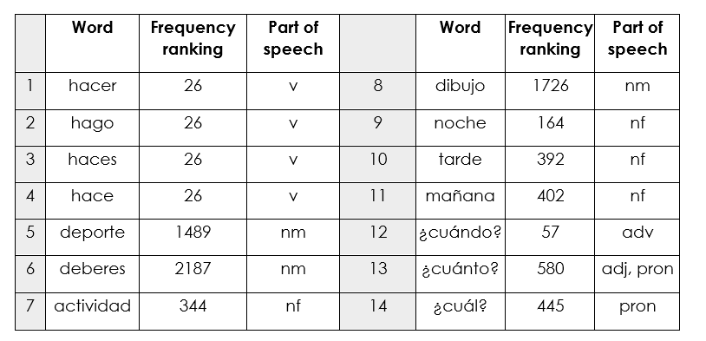
Mixed word class sets
Sample mixed word class set set
Year 7 Spanish Term 2.1 Week 4
Source of frequency data: A Frequency Dictionary of Spanish (2nd ed.) (Davies, M. & Davies, K., 2018), Published by Routledge.
Notes:
This screenshot illustrates the first three points on the last slide (frequency, mixed word classes, cohesion of vocab selection with the grammar being practised).
Here is an example of set of mixed word class words. These words were planned for teaching in Term 2 of our Year 7 SOW. In the first column is the word, in the second is the frequency ranking (1 being the most common word in Spanish).
Three forms of the verb ‘hacer’ are introduced over two lessons, along with nouns that can be used with it and several question words that can be used to ask questions about what people do/make. The inclusion of mañana, tarde and noche allows for question-answer interactions using ‘cuándo’.
--------------------------------------------
Mixed word class sets There is some research evidence that teaching vocabulary in topic-based lists of words with a single word class (e.g. a list of just nouns) is not optimal (Häcker, 2008).
Teaching mixed word class sets provides the means for learners to encounter words in sentences, as well as individually, at present stage, but without running the risk of cognitive overload if too much language (new and previously taught) is presented at once.
Working with words in context is identified by Schmitt as an important strategy for embedding and developing word knowledge.
As mentioned previously, NCELP has been tasked with KS3 pedagogy, but given the very mixed picture of provision nationally, has had to start from a position of ‘ab initio’ learner in its curriculum planning. However, were there to be a KS2 SOW it is likely not only that the same overarching principles would apply, but also that some of the Y7 SOW could be repurposed for earlier years.
Here are some examples of a week’s vocabulary set from each of the three languages, Fr, Gm and Sp, showing the mixed word class composition.

Slide 29
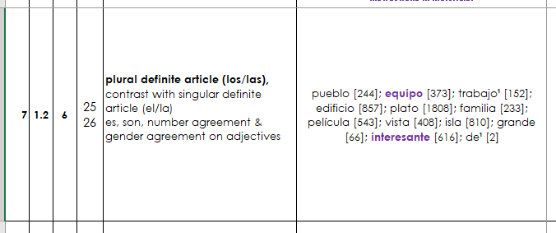
Cohesion of grammar and vocabulary
Context: “Describing a place”
Bold = new grammar
Normal = revisited grammar
Vocabulary to introduce

Slide 30
Multiple senses

Slide 31
Revisiting vocabulary in different grammatical and semantic contexts
Talking about people’s lives
NEW
Asking about future intentions
REVISITED
Talking about the environment
REVISITED
Notes:
The vocabulary is not revisited in the same contexts e.g., aller is seen in a wide range of topics (not just holidays), laver is seen texts that are not just about a personal routine or helping at home.
Here you can see the same vocabulary is practised in three different sets of activities: people’s lives, future intentions, and talking about the environment
And the vocabulary appears with a wide range of grammar too. So, items of vocabulary are not stuck in the same grammatical structures or sentence frames. The words are carefully moved across different grammar features.
So, here you can see the same set of vocabulary is used with er verbs in the 3rd person, with a verb + infinitive structure, and then in a revision lesson which covers a wide range of grammar features.

Slide 32
Slide 32
But what about…
the country/ people / culture?
social communication and interaction?
inferencing skills for when unknown language appears?
Notes:
One question that was persistently raised in the consultation on the new GCSE Subject Content was a misapprehension that defining the linguistic content in clear ways – by listing vocabulary, the details of grammar, and the sounds-symbol correspondences - would mean that language learning was no longer about engendering an interest in the countries and people associated with the language. That clearly defining linguistic content somehow meant that the rationale suddenly became only an academic one. Defining the language content seemed to be interpreted by some as neglecting other rationales such as raising awareness about language (in a way that could be applied to other languages later in the pupils’ lives) or imbuing a sense of curiosity in culture, places, and people.
Here are some texts I will whizz through to illustrate, I hope, that these views resulted from a false dichotomy, a conflation of completely different issues.
I hope to illustrate in a whistle stop tour of some of the 966 classroom resources that NCELP have created, that interesting texts and ideas can be communicated with high frequency words and basic grammar structures, in a curriculum where the vocab and grammar adheres to a schedule to ensure that particular vocab and grammar are revisited at specific times.

Slide 33
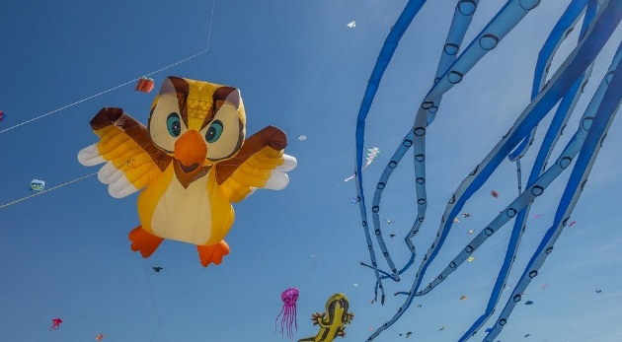
Le festival de Dieppe
lire
*le plus grand =
the biggest
*le cerf-volant = kite
*le son = sound
Comment dit-on les mots orange en anglais ?
What noun does this word look like?
What adjective does this word look like?
Le festival de Dieppe est le plus grand* festival de cerfs-volants* au monde.
On trouve le festival sur la plage.
Les visiteurs viennent de beaucoup de pays pour regarder des cerfs-volants traditionnels, de l'art et des acrobates. Un aspect important du festival est qu’on peut visiter sans acheter de billet. Il est gratuit !
Il y a beaucoup d'activités pour les enfants et le festival encourage l'imagination. Cet événement culturel célèbre les relations internationales. Pendant le dernier week-end du festival, on regarde les cerfs-volants illuminés pendant un show son* et lumière. Je pense à visiter le festival. Tu veut voyager au festival avec ma famille ?
What noun does this word look like?
visitors
What does this sentence tell you about the festival?
acrobats
traditional
The start of this word looks like the English
free
What adjective does this look like?
This word has the same stem as the previous one you worked out. What might it mean?
event
illuminated
light
What words that you already know could you use instead of the words in orange?
Now answer the question at the end.
Notes:
Here is a text about a kite-festival in Dieppe with lots of language awareness activities to help learners understand cognates
Then drawing on their current lexicons – which we know what they are precisely as they have been tracked so carefully - to replace these cognates with words they know
Then giving their reaction to the content of the text by answering a question about whether they would like to go to the festival
----------
Timing: 5 minutes
Aim: Developing inferencing skills by using surrounding context to work out meaning of unknown words; word substitution with known words.
Procedure:
1. Students try to work out the meaning of the highlighted words based on context (text and images) and similarity to English words.
2. If students need some help, click to bring up a clue
3. Click gain to reveal the translations.
4. Click to bring up the extension. Students think of known words that could replace the orange words to make a sensible sentence.
Some suggested answers:
visiteurs -> gens, enfants, personnes … any relevant noun to describe people
traditionnels -> grands, nouveaux… any relevant adjective to describe kites
acrobates -> artistes, chanteurs … any relevant noun to describe performers
événement -> lieu, festival … (note that any relevant masculine noun works here but ‘cet’ would need to change to agree)
illuminés -> verts, bons … any relevant adjective to describe kites
lumière -> musique, film … any relevant noun to describe a show

Slide 34
Hanoucca
*la bougie = candle
**deuxième = second
lire
Lis le texte. Use the words you know to understand the general meaning of the words in bold.
Pour la communauté juive, la fête importante de décembre est Hanoucca. C’est une fête de lumières et on utilise des bougies* pour célébrer. La fête est de huit jours, et on allume une bougie le premier jour, deux bougies la deuxième** jour … Les bougies sont un symbole de la bonté de Dieu. Dans une vieille histoire juive, une petite bouteille d’huile a nourri une lampe pendant huit jours, beaucoup plus de temps que normalement. On mange des beignets comme un symbole de l’huile. Les enfants jouent avec des toupies qui contiennent une phrase religieuse. Hanoucca est plus familial et spirituel que religieux.
bonté : part of body / personality / room / song
huile : a type of wood / plant / liquid / shoe
beignet : a type of drink / chair / cup / food
toupie : a type of toy / book / hat / sweet
goodness
oil
doughnut
spinning top
Notes:
Here is a text about Hanoucca . This activity includes some practice at inferencing the meaning of words by using the words that we know they have already met several times and have been tested on
At this stage of learning, lexical inferencing becomes (more) possible and likely to happen successfully, because we can be more confident that they have a critical mass of vocabulary to start doing this, than if we had used a curriculum where we weren’t very sure about which vocabulary had been covered several times already.
Timing: 5 minutes Aim: to practise lexical inferencing; the written comprehension of known words to arrive at a general understanding of one unknown word in a sentence context. In addition, to revise previously learnt vocabulary in new contexts. Procedure: 1. Ensure that students understand the task (as this is the first time they are doing this type of activity). Students need to know that they are aiming to understand the general meaning, rather than specific meaning (though they may in some cases also arrive at this).
2. Students read each text and decide which of the four options is most likely, depending on their understanding of the surrounding words.
3. Click to reveal answers.
4. Proceed to the next slide for the comprehension part of the activity.
Word frequency of unknown words used (1 is the most frequent word in French):
lumière [1059], allumer [3169], bougie [>5000], deuxième [427], bonté [>5000], huile [2340], beignet [>5000], toupie [>5000]
Word frequency of cognates used (1 is the most frequent word in French): Hanoucca [>5000], bouteille [2979], lampe [4699], normal [833], familial [1622], spirituel [3047]
Source: Lonsdale, D., & Le Bras, Y. (2009). A Frequency Dictionary of French: Core vocabulary for learners London: Routledge.

Slide 35
La Manche
Remplis les blancs avec les formes des verbes correctes.
lire / écrire
La Manche* sépare la France et l’Angleterre. On peut traverser la Manche en bateau ou en train sous l’eau. Quand nous visitons l’Angleterre, nous aimons prendre le train – c’est plus rapide. Ils préfèrent prendre le bateau pour regarder la vue. Comment traversez-vous la Manche ?
Le tunnel sous la Manche constitue le plus long tunnel sous-marin* du monde – on trouve 38 de ses 50 kilomètres sous la mer*.
On utilise le tunnel pour voyager entre l'Angleterre et la France. C'est idéal pour les vacances et les affaires.
[1]
[2]
[3]
[4]
[5]
[6]
[7]
[8]
*la Manche = the English Channel
*sous-marin = underwater
*la mer = sea
séparer (to separate)
visiter
aimer
préférer
traverser
constituer (to form)
trouver
utiliser
Notes:
Here is a text about the channel and how to cross it
This is a standard gap fill including manipulation of verbs
-----------------------
Timing: 4 minutes
Aim: Written production of –ER verbs in all forms; raising cultural awareness (geography).
Procedure:
1. Students read the text about the English Channel and fill the gaps with the appropriate form of the given verbs. For an added challenge at higher levels, remove the numbers from the verbs in the box and mix up the order so that students must also read for semantic meaning and assign the words to the correct gaps.
2. Click to reveal answers.
3. Click to proceed to comprehension questions on next slide.
Word frequency of unknown words used (1 is the most frequent word in French): constituer [495], marin [2101], mer [921]
Source: Londsale, D., & Le Bras, Y. (2009). A Frequency Dictionary of French: Core vocabulary for learners London: Routledge.
Word frequency of cognates (1 is the most frequent word in French): séparer [946], tunnel [3386], long [202], kilomètre [1435]
Source: Londsale, D., & Le Bras, Y. (2009). A Frequency Dictionary of French: Core vocabulary for learners London: Routledge.

Slide 36
Lee este artículo y escribe el título correcto. Debes elegir ‘su’ o ‘sus’.
¿Por qué hacer un viaje a México? Aquí te damos cinco razones.
leer
gente
1. Su / sus________________
Si vienes a México es seguro que puedes hacer amigos. Los mexicanos son muy simpáticos y reciben a los visitantes* con los brazos abiertos.
2. Su / sus ________________
Los paisajes de México son geniales. Puedes visitar sus playas hermosas, sus montañas altas, sus lagos* grandes o sus bosques* llenos de vida.
3. Su / sus ________________
En sus calles vas a encontrar todo tipo de edificios: iglesias antiguas, plazas llenas de gente, mercados, teatros, tiendas con productos locales...
4. Su / sus ________________
México es conocido por sus platos deliciosos. Los mexicanos comen bien y preparan muchas cosas tradicionales: tacos, tamales, mole...
5. Su / sus ________________
Si te interesa la cultura, México es un lugar ideal. Las tradiciones son muy importantes para los mexicanos y sus celebraciones son muy especiales.
Opciones
gente
costumbres
museos
ciudades
música
comida
bebidas
naturaleza
naturaleza
ciudades
comida
*el/la visitante - visitor
costumbres
*el bosque - forest
*el lago - lake
Notes:
Here is an activity that is in a series based introducing the culture and people of Mexico,
but it is also a grammar activity that is based on VanPatten & Cadierno’s processing instruction – forcing attention on the function of the su versus sus possessive pronouns to mean ‘it / its’. This is combined with a task that focuses on the general meaning of the text in order to put the correct subtitle over the text.
So, this activity is an example of all three things: a focus on grammar, a focus on the general meaning of a text, whilst embedded in material about the culture and people.
-------------
Timing: 7 minutes
Aims:
to correctly identify the section headers.
to use the correct form of the possessive adjective (‘su’ or ‘sus’).
Procedure: 1. Students read each section and decide on the correct title from the options available. Note that there are eight options but students will only need to choose five.
2. Show the answers one by one and give feedback. As part of feedback, oral translations could be given in English for each short section.
Frequency of unknown words and cognates:
visitante [2428]; lago [2151]; bosque [1444]; local [734]; ideal [2388]
Image from Pixabay (free to use)

Slide 37
Una tradición mexicana: el Día de Muertos
leer / escuchar
Lee y escucha el texto sobre el Día de Muertos:
1
5
‘Pan de muerto’ es un tipo de pan tradicional en este día.
México tiene muchas tradiciones, pero su tradición del Día de Muertos es especialmente conocida. Es una costumbre única y muy importante para su comunidad porque es una forma de pensar en los muertos. Para los mexicanos, los muertos vienen a la tierra este día.
Nadia es mexicana y celebra el Día de Muertos con su familia. Por la mañana se levanta temprano para ayudar a su abuela: preparan pan* de muerto y un poco de fruta para el altar. Su altar tiene varios* niveles. Los niveles del altar son las diferentes partes del mundo: el primer nivel es la tierra y el segundo nivel es el cielo*. Nadia pone allí fotos de su abuelo y se sienta al lado de su abuela. Se queda unas horas en casa con su familia y se acuerda de su abuelo muerto.
Por la tarde se pone ropa divertida, se pinta de blanco y negro y va a la calle con su hermano. En su barrio hay un festival con música fuerte y luces de colores. ¡Es muy divertido!
2
6
3
7
4
*el pan = bread; *el cielo = sky, heaven; *varios = various
Notes:
Following this was a task focusing on the Day of the Dead in Mexico. This was a bimodal reading and listening task – where learners are asked to follow the text whilst they listen; every so often the audio stops and they have to say the next word or the previous one, or replace the next word with something else
This was informed by evidence that bimodal input helps learners to segment the input into words and helps their comprehension.
Timing: 8 minutes
Aims:
to reinforce understanding of the difference between ‘se’ and ‘su’.
to help students to connect the spoken and written forms of the language more securely.
to consolidate vocabulary and grammar knowledge by eliciting suggested changes to the text.
Procedure:
Students read the text and write ‘se’ or ‘su’ for each space.
Click on the audio button to play the text. Read and listen.
Note: There is a full version of the audio top right with a player. Alternatively, the audio is in 6 sections with a pause just after the words 1-5 below, to facilitate easy stop/start.
To support segmentation, stop the audio and ask students to say: a) the next word b) the previous word
In addition, to develop understanding, vocabulary and grammar knowledge, pause at key points and ask students to suggest an alternative word that could replace the next word. This is a chance to draw on previously taught grammar and vocabulary knowledge.
Es una costumbre única y muy importante para su... (students volunteer other possible nouns – e.g., gente, historia, país).
y celebra el Día de Muertos con su…..(students volunteer other possible nouns – e.g., padre, madre, primo etc.).
de su abuelo y se... (students volunteer verbs in third person singular that fit after ‘se’ – e.g., se acuerda de..., se queda, se prepara (para), etc)
en casa con su familia y se ... (students volunteer other possible verbs that fit after ‘se’ – e.g., se saca (fotos), se mira en el espejo, se presenta a otra gente).
Por la tarde se…… (students are prompted other possible verbs that fit after ‘se’)
va a la calle con su…. (students volunteer other possible nouns)
Notes:
1. The word for ‘bread’ (‘pan’) will be introduced in the next week’s vocabulary set.
Transcript
México tiene muchas tradiciones, pero su tradición del Día de Muertos es especialmente conocida. Es una costumbre única y muy importante para su comunidad porque es una forma de pensar en los muertos. Para los mexicanos, los muertos vienen a la tierra este día.
Nadia es mexicana y celebra el Día de Muertos con su familia. Por la mañana se levanta temprano para ayudar a su abuela: preparan pan* de muerto y un poco de fruta para el altar. Sualtar tiene varios niveles. Los niveles del altar son las diferentes partes del mundo: el primer nivel es la tierra y el segundo nivel es el cielo. Nadia pone allí fotos de su abuelo y se sienta al lado de su abuela. Se queda unas horas en casa con su familia y se acuerda de su abuelo muerto.
Por la tarde se pone ropa divertida, sepinta de blanco y negro y va a la calle con su hermano. En su barrio hay un festival con música fuerte y luces de colores. ¡Es muy divertido!
Frequency of unknown words and cognates:
pan [1342]; cielo [620]; varios [386]
Photos:
Photo of the child by Christian Newman, from Unsplash.
Photo of ‘Pan de muertos’ by Alejandro Ávila Cortez, from Pixabay.

Slide 38
Where to find more resources
NCELP resource portal
https://resources.ncelp.org/
Hundreds of resources (lessons, tests, schemes of work, CPD presentations)
Gaming grammar
Digital game with activities in a ‘spy mission’ context
Reading and listening-based grammar practice
Open Accessible Summaries in Language Studies (OASIS)
Sign up to get monthly alerts to summaries of new research, from OASIS
Multiling profiler
This text profiling tool allows the user to see what proportion of a text is within the 2000 most frequent words or has been previously taught
Notes:
Just before we finish, we wanted to let you know about a few of the free resources available.
The NCELP resource portal has hundreds of resources, including all the lessons from the scheme of work, homework, test, scheme of work documents and CPD presentations.
Gaming Grammar is a digital game partly funded by NCELP that allows for reading and listening-based grammar practice in line with the principles of grammar practice that I mentioned earlier.
OASIS is a database with single-side A4 summaries of relevant research published in international peer-reviewed journals. All summaries are written in non-technical language.

