Slide 1
French Vocabulary Learning Sequence
Descriptions

Slide 2
Stages of vocabulary learning
Topic-based vocabulary lists of one single word class are not optimal.
Introduction (i.e. first encounters with new words, and initial memorisation routines)
Consolidation (i.e. speed of retrieval building, controlled production, e.g. sentence-building)
Developing use (i.e. revisiting across different contexts, modalities, synthesising with previously-learnt language)
Assessment
Stephen Owen

Slide 3
First encounters
Directed, pre-learning (e.g. using Quizlet)
Peer- / Self-introduction in the lesson
Teacher-led presentation and elicitation (e.g. with pictures)
Self-made flashcard routines
Text / mini-story-based introduction
Stephen Owen
Notes:
There are many ways for learners to encounter new language, particularly when we are confident that they can ‘sound out’ new words with relative accuracy. Here is a list of 5 different ways for learners to start the learning process.

Slide 4
Décrire les gens [describing people]
 | Word | Frequency ranking | Part of speech
1 | la fille | 629 | noun
2 | le fils | 735 | noun
3 | les cheveux | 2296 | noun
4 | ans (m.pl.) | 76 | noun
5 | avoir | 8 | verb
6 | être | 5 | verb
7 | long(s) | 202 | adjective
8 | court(s) | 545 | adjective
9 | jeune | 152 | adjective
10 | unique | 402 | adjective
Stephen Owen
Notes:
This is the slide of 10 words pupils are going to learn.
Note the mixed word class selection, and the frequency (all well within the top 2000 more frequently occurring words in French).

Slide 5
1. Quizlet
Complétez la section LEARN
Objectif: maîtriser tous les mots
https://quizlet.com/_6dysp2
Stephen Owen
Notes:
1. Quizlet Pupils are given a 30-minute pre-learning homework. They need some guidance and instruction about how to use Quizlet. 1. For pre-learning spend 30 minutes on LEARN 2. Objective is to get ‘Mastered’ in all of the words 3. Have the audio audible (either headphones or out loud if you are working alone)
4. Vocalise the words as well as looking at them. Don’t just do this silently in your head – get into the habit of saying the words out loud when you learn

Slide 6
2. Peer or self introduction
60
 | Word | English meaning
1 | la fille | girl; daughter
2 | le fils | son
3 | les cheveux | hair
4 | ans | years
5 | avoir | to have; having
6 | être | to be; being
7 | long(s) | long
8 | court(s) | short
9 | jeune | young
10 | unique | only (child)
Secondes
0
DÉBUT
Stephen Owen
Notes:
2. Peer or self-introduction Pupils either work by themselves or in pairs, reading out the words and studying their English meaning (1 minute). Then the English meanings are removed and they try to recall them, looking at the French (1 minute). Then the French meanings are removed and they to recall them, looking at the English (1 minute) NB: It is not expected that they will be able to do them all. However, in a mixed ability class, some pupils will come close to being able to do this, whilst others may just manage one or two. It is important to have open-ended routines for first encounters of new words, where learners are ‘self-serving’, as it prevents the frustration hat can be caused by a mismatched pace of presentation.
Further rounds of learning can be facilitated by one pupil turning away from the board, and his/her partner asking him/her the meanings. This activity can work from L2 → L1 or L1 → L2.

Slide 7
Teacher-led presentation
le fils
Stephen Owen
Notes:
Teacher presentation
Here the teacher is the source of the input, and presents the written form of the word, says the spoken form and displays a picture. As there is no English in this presentation, it’s important to check that pupils are completely clear about the meanings of these new words. If they are unclear about the meaning, this may delay the learning.

Slide 8
fils unique
Stephen Owen

Slide 9
être
[to be | being]
est
[is]
Stephen Owen / Emma Marsden

Slide 10
jeune
Stephen Owen

Slide 11
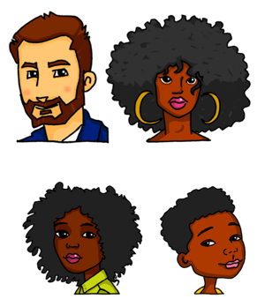
la fille
Stephen Owen

Slide 12
avoir
[to have | having]
a
[has]
Stephen Owen / Emma Marsden

Slide 13
avoir 7 ans
Stephen Owen

Slide 14
les cheveux longs
Stephen Owen

Slide 15
les cheveux courts
Stephen Owen

Slide 16
4. Self-made flashcard routines
Pupils create their own paper flashcards (English on one side, French on the other)
Beginning with French side facing up, pupils read the word aloud and turn it over to see the meaning
Repeat 2-3 times with each word, then move to the next one
After the third word, re-visit the first and second words and try to recall their meaning
Build up until all words have been practised
Stephen Owen
Notes:
4. Self-made flashcard routines
Additional details: Learners can work in pairs to do this routine. There are many uses for these paper flashcards, also in the consolidation phase. 1) in pairs, pelmanism (not guessing of course, but working from English to French – have to say the words correctly to claim the pair) 2) in fours, happy families – Tu as le fils?’ 3) listening tasks – one partner calls out the words in French, the other has to put his/her cards in the correct order (when viewing English side up) 4) sentence-building tasks – take two at random and put them into a sentence (can be written or spoken)

Slide 17
5. Text/Story presentation
Paul est fils unique. Il est jeune. Il a 7 ans. Il a les cheveux courts. La fille de la famille est Sophie. Elle a 10 ans, donc elle est jeune aussi. Elle a les cheveux longs.
Stephen Owen
Notes:
5. Text/Story presentation
Formatting here shows the ‘target words’ to be learned. Routine might be used either as very first encounter or after one of the methods 1,2 or 4: 1) Pupils read aloud (either for themselves or in pairs) as decoding task – teacher circulates to listen in 2) Teacher reads aloud, emphasising meaning through intonation and, where appropriate, gestures to support meaning. 3) Teacher elicits meaning of the key words from pupils (elicits meaning of the verb forms and relates them back to the infinitive – asks why not ETRE) 4) One pupil can read aloud, partner put his/her paper flashcards in order. 5) Pupils read and draw their understanding of the text in a picture.

Slide 18
Consolidation
Individual word level tasks (e.g. L1:L2 table completion, Look-Say-Cover-Write-Check)
Listening tasks
Sentence-completion tasks
Sentence-level production tasks
Stephen Owen

Slide 19
1) Give the meaning of the following words:
e.g. | petit | small | p
1 | la fille |  |  | 6 | être
2 | le fils |  |  | 7 | long(s)
3 | les cheveux |  |  | 8 | court(s)
4 | ans (m.pl.) |  |  | 9 | jeune
5 | avoir |  |  | 10 | unique
Stephen Owen

Slide 20
2) Give the correct French spellings
Give the correct French spellings (with the definite article (le/la/les), if needed,) for the following words:
e.g. | boy | le | garçon | p | p
1 | short
2 | hair
3 | girl
4 | young
5 | to have/having
6 | to be/being
Stephen Owen

Slide 21
2) Listening: Individual words
1
2
3
4
5
6
7
8
9
10
Stephen Owen
Notes:
Pupils are looking away anyway, but if desired, this slide can be hidden, so pupils cannot see which number the teacher is clicking (because s/he will repeat the words several times).
1 individual words recorded
Use these in conjunction with the self-made flashcards, in several ways. First, pupils look at French side facing up, and when they hear the word, they just turn it over to the English side (simple recognition). The turn it back. Second, pupils look at English side facing up and select the correct card in response to what they hear [individual words]. Then turn it back.
Transcript (each said twice):
1)la fille
2) le fils
3) les cheveux
4) ans
5) avoir
6) être
7) longs
8) courts
9) jeune
10) unique

Slide 22
2) Listening: Sentences 1a
1
2
3
4
5
Stephen Owen
Notes:
2 Sentences recorded SET 1a Third, with French side up, pupils hear sentences with 2-3-4 of the items in them and they place them down in order – this might sound easy, but remember they will be seeing the infinitive, but hearing the short form, so there is still some significant processing to do (plus the fact that you will have several items together in an order, so not as easy as it might seem). Fourth, a bingo game. Pupils place 6 of their cards English side up in a 3 x 2 formation and they turn them to French when they hear the word called. Winner is i) a complete row then ii) a full house. Fifth, with English side up, pupils listen to a set of sentences containing 2-4 of the items and have to put them in order. E.g. La fille est jeune (they would need to place ‘daughter/girl’, then ‘to be(description)’ then ‘young’. This is challenging (sentences will be slow and careful). It is worth varying the speed of delivery of the sentences. I normally do this just with my voice.
Transcript (each said twice):
1) Le garçon est fils unique?
2) Il a les cheveux courts.
3) La fille est jeune.
4) Elle a les cheveux longs?
5) Il a 7 ans?

Slide 23
2) Listening: Sentences 1a
Question or statement?
1
2
3
4
5
Stephen Owen
Notes:
2 Sentences recorded – Question or statement SET 1a Pupils listen again and decide whether each is a question of statement. Those who are able can continue to use their cards at the same time. Others may just listen carefully to the intonation.
Transcript (each said twice):
1) Le garçon est fils unique?
2) Il a les cheveux courts.
3) La fille est jeune.
4) Elle a les cheveux longs?
5) Il a 7 ans?

Slide 24
2) Listening: Sentences 1b
ÊTRE ou AVOIR?
1
1 Le garçon ________ fils unique?
2
2 Il ________ les cheveux courts.
3
3 La fille ________ jeune.
4
4 Elle ________ les cheveux longs?
5
5 Il ________ 7 ans?
Stephen Owen
Notes:
2 Sentences recorded – Etre ou Avoir? SET 1b This focuses pupils’ attention on the verbs ‘to be’ and ‘to have’. A sound effect obscures the verb. Pupils need to fill in ‘est’ or ‘a’.
Transcript (each said twice):
1) Le garçon est fils unique?
2) Il a les cheveux courts.
3) La fille est jeune.
4) Elle a les cheveux longs?
5) Il a 7 ans?

Slide 25
3) Use the correct verb and write the correct form of the verb.
 | Sentences
1 | Pierre _____ fils unique.
2 | Il _____ 7 ans.
3 | Sophie _____ les cheveux longs.
4 | Elle _____ jeune.
5 | Pierre _____ les cheveux longs.
Stephen Owen
Notes:
[Could also be done as a listening OR use the audio for a listen and check] TRANSCRIPT

Slide 26
3) Use the correct verb and write the correct form of the verb.
ANSWERS
 | Sentences
1 | Pierre _____ fils unique.
2 | Il _____ 7 ans.
3 | Sophie _____ les cheveux longs.
4 | Elle _____ jeune.
5 | Pierre _____ les cheveux longs.
est
a
a
est
a
Stephen Owen
Notes:
[Could also be done as a listening OR use the audio for a listen and check] TRANSCRIPT

Slide 27
Sentence level production
1
avoir / cheveux courts
2
fils / 7 ans
3
Pierre / fils unique
4
fille / cheveux
5
être / jeune
Stephen Owen

Slide 28
Developing use
Build in new vocabulary (additional nouns, prepositions of place)
Spot the difference
Map task
Stephen Owen

Slide 29
Information gap
Same or different?
A
B
Stephen Owen
Notes:
Task is also on Resources Handout
This pair speaking task focuses on the difference between ‘est’ and ‘a’. Pupils describe the pictures they have, one by one, using the numbers as identifiers. They have to work out if they have the same picture or a different one. The only difference in what they say will be in the verb ‘is’ or ‘has’. Pupils can tick for same, and cross for different.
ANSWERS: 2, 4, 7 are the same, the rest are different.
Sample statements.
1 Numéro un est un chien 2 Numéro deux est un bébé. 3 Numéro trois a une table. 4 Numéro quatre a une photo. 5 Numéro cinq est un cheval. 6 Numéro six a un cinema. 7 Numéro sept est un chat.
1 Numéro un a un chien 2 Numéro deux est un bébé. 3 Numéro trois est une table. 4 Numéro quatre a une photo. 5 Numéro cinq a un cheval. 6 Numéro six est un cinema. 7 Numéro sept est un chat.

Slide 30
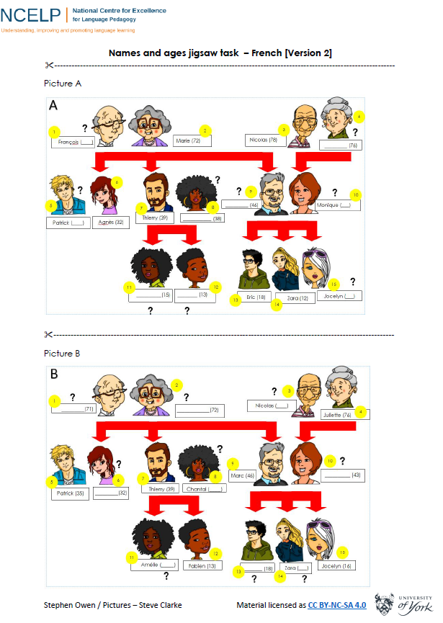
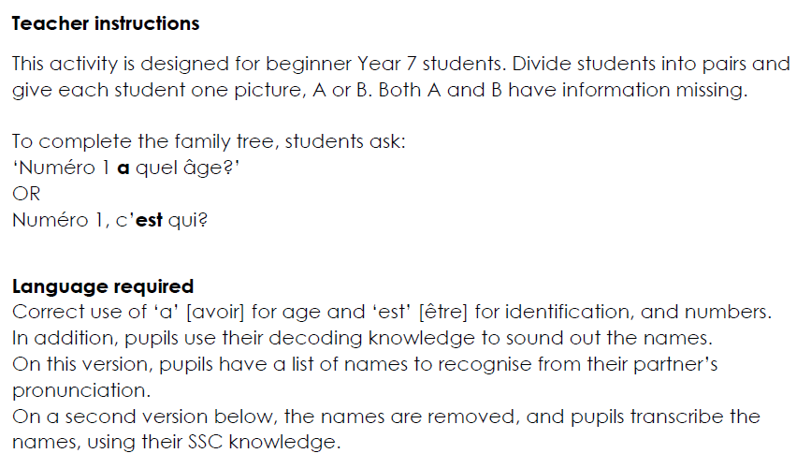
Information gap
Stephen Owen
Notes:
This is within the Resources Handouts

Slide 31
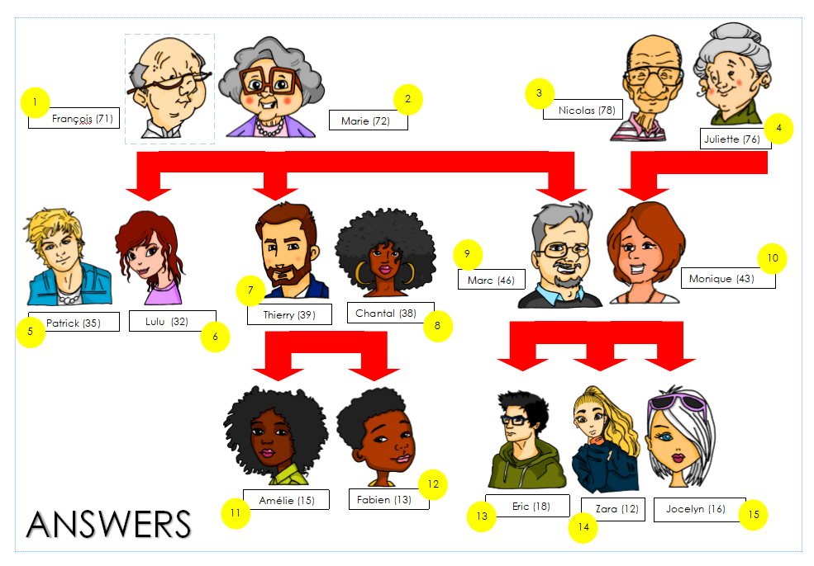
Information gap
Stephen Owen

Slide 32
Assessment
Self-assessment checklist
Sentence-level vocabulary test
Stephen Owen

Slide 33
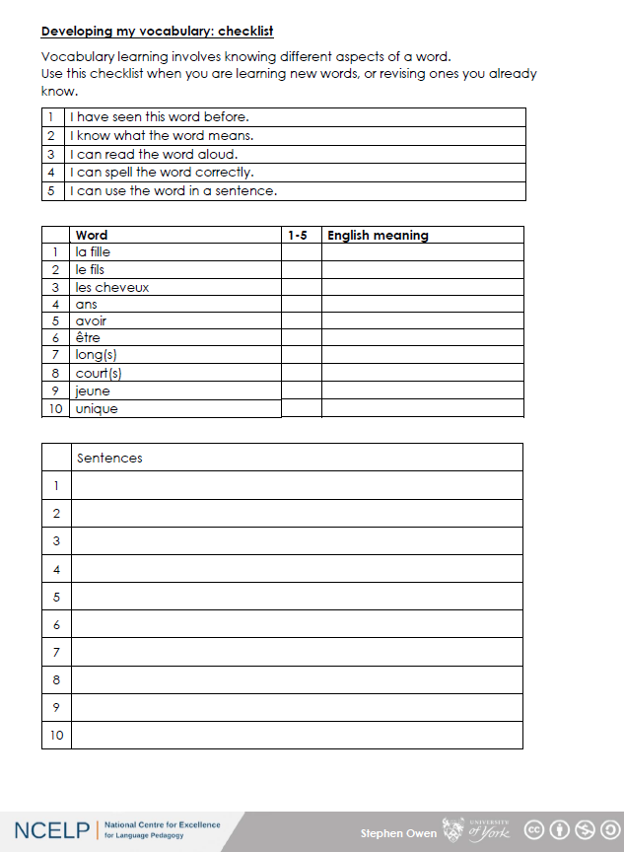
Self-assessment checklist
Stephen Owen

Slide 34
Sentence translation
1
The boy is an only child.
2
He has long hair.
3
The girl is nine years old.
4
She has short hair.
5
She is young.
Stephen Owen

Slide 35
Sentence translation
ANSWERS
1
Le garçon est fils unique.
2
Il a les cheveux longs.
3
La fille a neuf ans.
4
Elle a les cheveux courts.
5
Elle est jeune.
Stephen Owen

