Slide 1
Vocabulary
Y7 German
Term 2.2 - Week 2
Author name(s):
Rachel Hawkes / Ciaran Morris / Catherine Morris
Date updated: 26/04/20

Slide 2
1 | 2 | 3 | 4
5 | 6 | 7 | 8
Notes:
Starter activity - transcription to reactivate verb vocabulary Students have one piece of A4 paper. They fold it (no need for numbers or drawing of lines) horizontally in half, then vertically in half and half again to create 8 rectangular box shapes. If this is the first time students have done this, teacher models carefully from the front.
1] Teacher dictates infinitives (e.g. Eins – tanzen,..zwei, Gitarre spielen) and students write the verb/noun-verb phrase in German within each box 1-8. 2] Then they tear the sheet to create 8 separate boxes and on the other side of each draw a very quick picture (5 seconds only allowed for drawing, count down 5-1) to indicate the meaning. Alternatively, they can write the English word. Note: the notes under Slide 1 list all the verbs taught to date, including those encountered in the SSC. The verbs chosen for this starter include verbs from this week, from the recycled sets and four from previous learning. The next slide shows correct spelling and example pictures (for students to check their spelling and understanding)

Slide 3
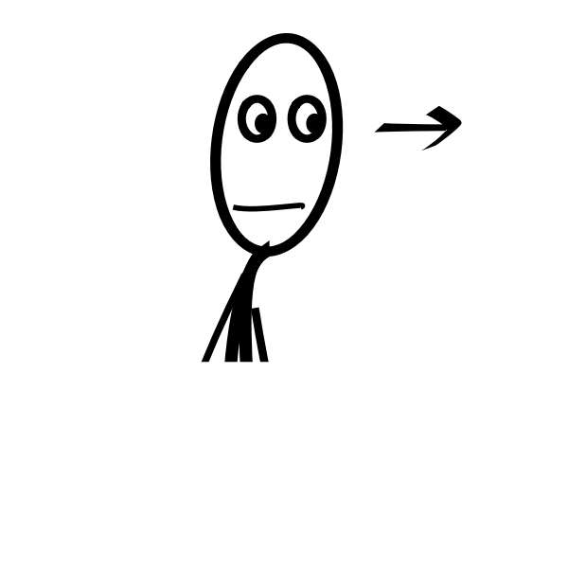
1 | 2 | 3 | 4
5 | 6 | 7 | 8
tanzen
Gitarre spielen
stehen
einen Hut tragen
sehen
liegen
schreiben
denken
Notes:
Starter activity - answers
1. tanzen 2. Gitarre spielen 3. stehen 4. einen Hut tragen 5. sehen 6. liegen 7. schreiben 8. denken
Picture and verb are animated to appear together. Teacher elicits pronunciation from students (preferably chorally to give all students the maximum opportunity for read aloud practice).
Teachers might ask students to tell them why it is ‘einen Hut’ - both the meaning ‘a’ and form ‘einen’ to revisit their previous learning about indefinite articles in Row 2 (accusative).
Note: more verbs can easily be added to the sets in subsequent lessons. Students should retain their verb cards (perhaps in an envelope in the back of their books).
In this or subsequent lessons, further practice using these ‘mini flashcards’ might include:
1 speed listening in pairs 2 Q & A in groups of 4 (i.e. put all the cards together – each learner picks 4) Hast du ‘schreiben’? Ja/Nein– make pairs this way. Always have 4 x cards so have to pick up when you’ve given one away.

Slide 4
können
[to be able | can]
Note: können means physically or situationally able, NOT ‘allowed to’ to do something. We will learn ‘allowed to’ next term.
kann
[is able | can]

Slide 5
können
[to be able | can]
kann
[is able | can]

Slide 6
kann
[is able | can]
Er kann sprechen.
[He can speak.]

Slide 7
kann
[is able | can]
Er _____ sprechen.
kann
[He can speak.]

Slide 8
a/ä
b
d
e
f
g
h
k
l
m
r
s
t
v
w
z
Notes:
Verb brainstorming
The purpose of this final activity of lesson 1 of this sequence is to practise recall of infinitive verbs. It is deliberately open-ended to allow for individual learner differences. In addition, it is a preparatory task to support students in lesson 2, when they anticipate the content of the poem, and when they write their own versions of it.
Note: There are several possible versions of this task, to suit different ability levels and time constraints. Version 1: Display this blank grid to the class and ask them to try to list any verbs they know in German that start with these letters.
All verbs encountered to date in alphabetical order(including in phonics source and cluster words): ändern [479] antworten [804]; arbeiten [200]; ausgehen [483] bekommen [234]; benutzen [872]; bleiben [112] brauchen [201] denken [124]; erklären [250]; essen [655] fahren [169]; finden [110]; geben [57]; gehen [69]; gewinnen [410]; glauben [143]; haben [7]; heißen [123]; helfen [406]; holen [640]; hören [1557]; kochen [1005]; kommen [61]; können [23] lächeln [793]; leben [168]; liegen [118]; lernen [203]; lesen [323]; machen [49]; mögen [151]; reden [356]; reisen [978]; sagen [46]; schreiben [245]; schwimmen [1832]; sehen [81] sein [3]; sitzen [261]; spielen [195] sprechen [157]; stehen [87]
tanzen [2011]; tragen [307]; trinken [608]; träumen [1907]; vergessen [595]; verstehen [222]; wählen [564]; wiederholen [1044]; wissen [79]; wohnen [380]; wollen [65]; wünschen [684]; zählen [680]; zeigen [154]; ziehen [266]; zuhören [1946]; putzen [2851] (omitted this one for space reasons) Alternative version – with German given, to elicit the English meanings is on the next slide.

Slide 9
a/ä
b
d
e
antworten ändern arbeiten ausgehen
bekommen benutzen bleiben brauchen
denken
erklären essen
f
g
h
k
fahren finden
geben
gehen gewinnen glauben
haben heißen
helfen holen
hören
kochen
kommen können
l
m
r
s
lächeln liegen leben lesen lernen
machen mögen
reisen reden
sagen schreiben schwimmen sehen
sein sitzen spielen sprechen stehen
t
v
w
z
tanzen tragen trinken träumen
vergessen verstehen
wählen wollen
wissen wünschen wiederholen
zählen zuhören zeigen ziehen
Notes:
Verb brainstorming
Version 2: Display this German version to the class and ask students to write down the German and English for any of the verbs they know. Note that this version can be simplified, as desired, by removing some of the options. Note that this version of the slide can be used as the answer slide for Version 1 and Version 3.

Slide 10
a/ä
b
d
e
to answer to change to work to go out
to receive/get to use to stay to need
to think
to explain to eat
f
g
h
k
to go/travel to find
to give
to go to win to believe
tp have to fetch to help to listen to be called
to cook to come to be able to/can
l
m
r
s
to smile to be lying down
to live to read to learn
to do/make to like
to talk to travel
to say to be to write to sit to swim to play
to see to speak to stand
t
v
w
z
to dance to wear/carry to drink to dream
to forget to understand
to choose to want to know to wish to repeat
to count to listen to show to pull
Notes:
Verb brainstorming
Version 3:
Display this English version to the class and ask students to write down the German and English for any of the verbs they know, in their books. Note that this version can be simplified, as desired, by removing some of the options.
Note that this version of the slide can be used as the answer slide for Version 2.

