Slide 1
Vocabulary
Y7 German
Term 1.1- Week 1
Author name(s): Inge Alferink / Rachel Hawkes
Date updated: 13/12/ 2019

Slide 2
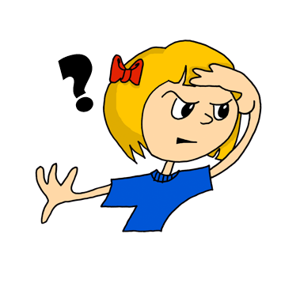
wo?
where?
Rachel Hawkes
Notes:
Introducing question word ‘Wo?’ [frequency ranking: 94]

Slide 3
wo?
where?
Wo ist Niko?
[Where is Niko?]
Rachel Hawkes

Slide 4
wo?
where?
____ ist Niko?
Wo
[Where is Niko?]
Rachel Hawkes
Notes:
Whenever possible, make the questions in the teaching referential! Here it’s logical to ask this question of the class.
If you happen to have a Niko in your class, then the students will say ‘da’! If not, just take the opportunity to ask the questions with a few of the names of students in the class (just for a few seconds revisiting the structure just seen and practised).

Slide 5
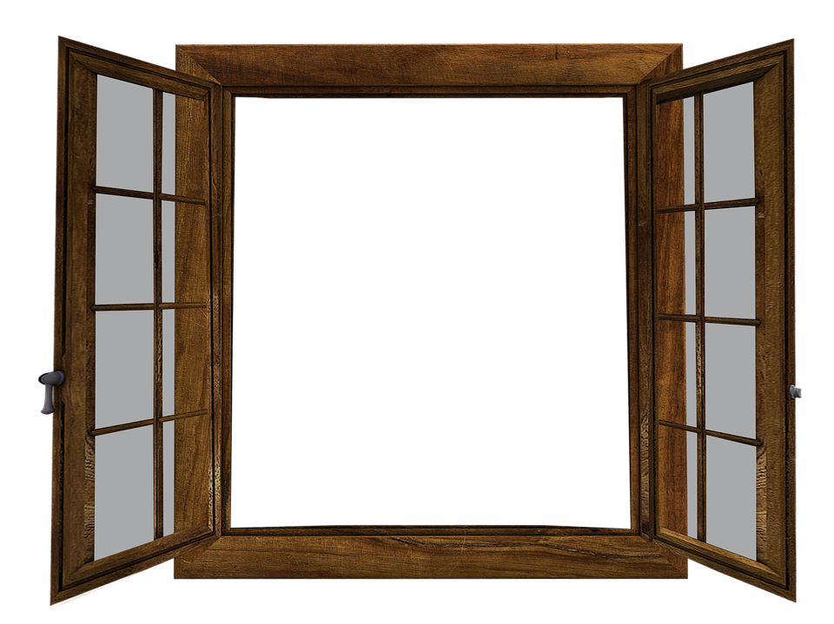
das Fenster
Wo ist ?
Notes:
Presentation: Wo ist das Fenster? Das Fenster ist da. The vocabulary in this first lesson is a set of concrete high-frequency nouns that all teachers will be able to point to, as well as show pictures of. Given the importance of grasping that every noun in German has a grammatical gender, that this is not the same as their previous understanding of gender, that it really does apply to every inanimate object around them, and that it’s best to think of it as simply part of the word, it feels useful for students to learn how to name some things that will always be in sight during their lessons, and therefore easily recycled in the few seconds between tasks in future lessons, etc.. The teacher can use this recycling to monitor students’ recall of gender at regular moments during the first half-term, and then periodically during the rest of the first year.
Although we continue to use the structure Wo ist… ? to elicit responses, our key focus at this moment is on the meaning of the word in front of the noun – i.e. ‘the’. We want therefore to elicit this explicitly from students as we go through. I think we will find it is clear that ‘Fenster’ means window, when we walk over to it and tap on it. The important question for follow is ‘Was ist ‘das’?’ Wo ist das Fenster?’ Stress ‘das’ and elicit its meaning in English.

Slide 6
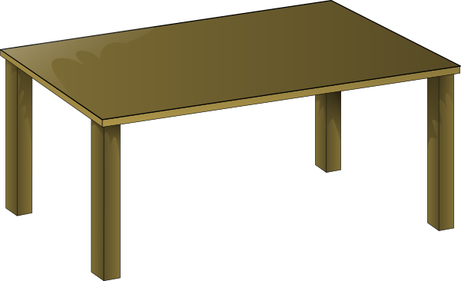
der Tisch
Wo ist ?
Notes:
Presentation: Wo ist der Tisch? Der Tisch ist hier.
Here again the presentation can refer to the actual tables in the classroom. At this point, students should be encouraged to notice the word change. Depending on the class, sometimes this can be achieved simply by pausing, standing back, assuming a slightly puzzled expression, saying ‘mmm’ (all in a matter of seconds!) and inviting someone to say something that way. Alternatively, repeating the question, stressing the ‘der’ and eliciting the meaning will do it. Saying ‘ok – das Fenster – auf Englisch? The window, ja, ok. der Tisch – the table. OK. Very often students will burst out with something like ‘there are two words for ‘the’’ or ‘there are different words for ‘the’. This is NOT a long-winded process, it is all accomplished in conjunction with encountering the word, saying the word, associating the word with its meaning etc..

Slide 7
das Heft
Wo ist ?
Notes:
Presentation: Wo ist das Heft? Das Heft ist hier.
Teachers may have routines in their schools / departments which include issuing exercise books in the first lesson. If that is the case, then this would probably be the most useful time in the lesson to do this, as students can connect lots of listening to the word ‘das Heft’ with receiving one (many Y7 students find it exciting to get new exercise books in the first week, of course). It would be equally possible to model the word by showing an exercise book, and save the book distribution / labelling process for another lesson. This is a matter for individual teachers. One reason that each week’s resources are within one PowerPoint is to build in the flexibility to adapt the timings across the (anticipated) two lessons per week, that the SOW is based on.
Image by <a href="https://pixabay.com/users/OpenClipart-Vectors-30363/?utm_source=link-attribution&amp;utm_medium=referral&amp;utm_campaign=image&amp;utm_content=161701">OpenClipart-Vectors</a> from <a href="https://pixabay.com/?utm_source=link-attribution&amp;utm_medium=referral&amp;utm_campaign=image&amp;utm_content=161701">Pixabay</a>

Slide 8
die Tafel
Wo ist ?
Notes:
Presentation: die Tafel. Wo ist die Tafel? Die Tafel ist hier. This time…
1. Bring up the word and elicit the pronunciation from students (this is an opportunity for them to apply their phonics knowledge and decode the new word) 2. Correct their pronunciation and repeat the word with the class, if/as necessary.
3. Bring up the picture, point in addition at the actual board in the classroom, and elicit the word again.
4. Bring up the question text, elicit both question and answer from students. 5. Elicit a translation for ‘die Tafel’ and stress ‘die’ to prompt them to notice another word for ‘the’. They have now met the three words for ‘the’ for singular nouns. Note: if ‘da’ has already been introduced earlier in the lesson, make this question referential by asking: Ist die Tafel hier oder da? This is obviously a question of perspective and position within the classroom. Modelling this by moving to the back and pointing when saying ‘die Tafel ist da’ and moving close to it when saying ‘die Tafel ist hier’ is useful demonstration, here, and will help to cement the word-meaning mapping. (Needless to say, moving students to different positions in the room, and asking them where the board is, is also useful and fun!)

Slide 9
da
Notes:
Presentation: da
Elicit pronunciation from students. Ensure that they are pronouncing the ‘a’ as long vowel. A pointing action could be used as a gesture
One idea then would be to ask students to shut their eyes and ask them: Wo ist das Fenster? Wo ist das Heft (if they have one already OR if there is a one at the front on the teacher’s desk) Wo ist der Tisch? Wo ist die Tafel? Wo ist David? (plus any other students in the class!) Additional idea: Blindfold yourself, have two volunteer students turn you around about 10 times, and then they ask you: Wo ist das Fenster? Wo ist David? etc… You may actually get some answers wrong (or you might pretend to!) This would be a very useful moment for the words ‘JA’ and ‘NEIN’ as students will be very keen to tell you if you have pointed correctly as you say ‘da’.

Slide 10
die Flasche
Wo ist ?
Notes:
Presentation: die Flasche. Wo ist die Flasche? Die Flasche ist hier.
Elicit pronunciation from students. Ensure that they are pronouncing the ‘a’ as short vowel. It’s helpful if the teacher is one who carries a water bottle to class and it’s sitting on the desk at the front → ‘da’ Most students also have their own water bottles (esp. brand new Y7 students!) so they will be able to use ‘hier’ as well. Note that students have not met the SSC ‘sch’ yet, so listen carefully to the pronunciation and draw attention to it briefly, as necessary.

Slide 11
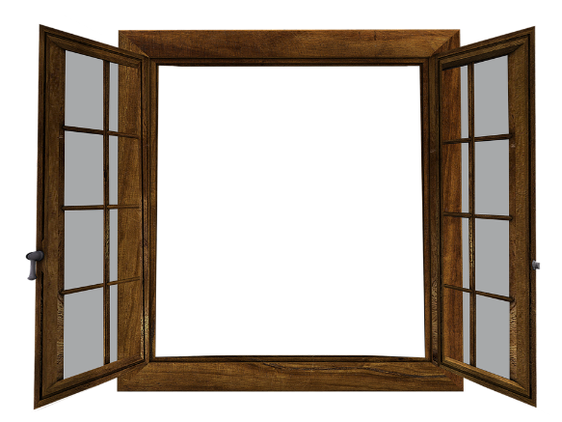
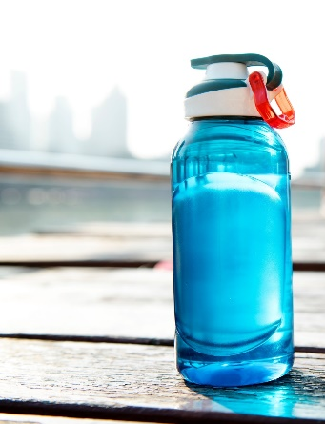
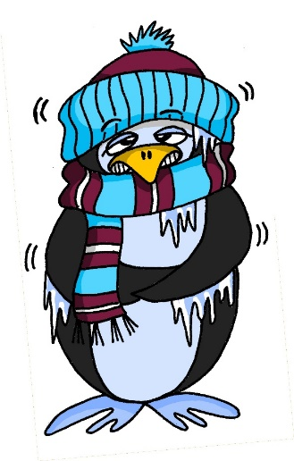
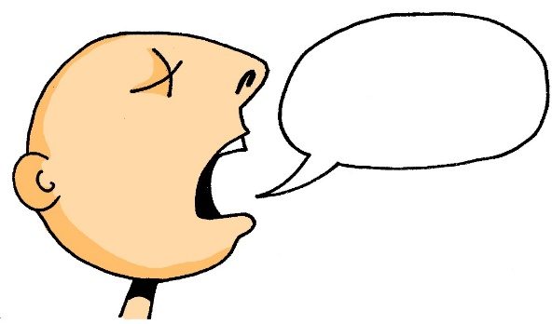
der Tisch
d__ T____h
die Tafel
d__ T___l
d__ F_____e
die Flasche
das Fenster
d__ F_____r
d__ H__t
das Heft
Notes:
Slide to see what students can remember from the lesson. Also an opportunity to ask them which word they like best (in English at this stage, as they don’t know the German ‘Lieblingswort’ although this will soon be taught so that students can do this in the new language). An L2 possibility would be ‘das beste Wort’ as this will be understood. However, if there is time, it would be interesting to hear ‘why’ students like particular words, and this will be best accomplished in English!
1. Bring up all the words but with gaps to elicit both the gender/correct word for ‘the’ and the noun itself. (suggest choral responses – at this stage we are not expecting necessarily that every student will be secure with every word. Note that the words are in a different order from the one in which they were presented in the lesson. 2. Bring up the pictures to elicit the nouns with their articles once more. Bring up the two phonics source words, too, to remind students of our key SSC for this week. Ask students to tell you which is their favourite word, and why. ☺

Slide 12
Notes:
1. Click to bring up both pictures at once. 2. Say the gender of either one and students have to respond by either turning their heads to the left or right or pointing at the correct picture, whichever is clearer. The teacher can frame this as the partially completed question ‘Wo ist die…? OR ‘Wo ist das…? There are three slides like this.

Slide 15
der Mann
Notes:
Presentation of nouns
der Mann [131] der Gast [625] der Tag [108] die Klasse [619] das Paar [284] das Heft [3594] das Fenster [634] der Tisch [492] die Tafel [3656] die Flasche [1758]
1. Teacher introduces the word and picture and says the word. 2. Teacher brings up the word for ‘the’ separately to focus attention on it.
3. Students say the article and the noun together. Rolling back the mouse (I’m assuming a wireless presenter mouse – the most important piece of equipment I own for teaching!) several times allows you to elicit the article again, the article and noun (with the picture only) etc.. Repeat the stages with the remainder of the vocabulary, remembering that some of the words are already known. These are recapped in the middle of this sequence, making the new words appear first and last. Some work has suggested that salience is increased at the start and end of lists/sequences of things to remember.

Slide 16
der Gast
[guest]
Notes:
Image by mohamed Hassan from Pixabay
der Gast

Slide 17
der Tisch
Notes:
der Tisch

Slide 18
das Fenster
Notes:
das Fenster

Slide 19
das Paar
Notes:
die Klasse, das Paar
das Heft [3594] das Fenster [634] der Tisch [492] die Tafel [3656] die Flasche [1758]

Slide 20
das Heft
Notes:
das Heft

Slide 21
die Tafel
Notes:
die Tafel

Slide 22
die Flasche
Notes:
die Flasche

Slide 23
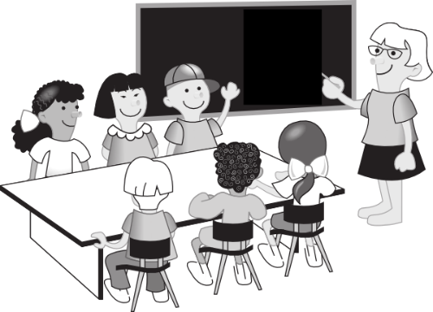
die Klasse
Notes:
die Klasse

Slide 24
der Tag
Notes:
der Tag

