Slide 1
Spanish SSC (symbol-sound correspondences)
Cluster Words
Date updated: 18/08/2021
Notes:
Artwork by Mark Davies. All additional pictures selected are available under a Creative Commons license, no attribution required.
Learning outcomes (lesson 1):
Consolidation of a range of SSCs
Consolidation of possessive adjectives mi/mis and tu/tus
Consolidation of ‘quiere’, ‘debe’ and ‘puede’
Introduction of ‘quieren’, ‘deben’ and ‘pueden’
Note: although the 3rd person plural forms of QUERER, DEBER and PODER are listed as ‘new’ language, they in fact tie in very closely with earlier Y7 grammar teaching. The 3rd person plural –en verb ending was already taught in 3.1.6 and revisited in 3.2.3 with these verbs. Furthermore, students will already be familiar with the verb stems used in the 3rd person plural (i.e. ‘quier-’, ‘pued-’ and ‘deb-’), having learnt the 3rd person singular forms in term 2. The lesson is therefore carefully planned to consolidate and extend learning without overburdening students with new grammatical concepts and forms just before the summer break.
Word frequency (1 is the most frequent word in Spanish):
No new vocabulary introduced. A range of vocabulary to be revisited. Vocabulary to be revisited has been drawn from 1.1.5, 1.1.7, 1.2.5, 2.1.2, 2.2.1, 3.1.1, 3.1.5, 3.1.6.
Source for subsequent slides: Davies, M. & Davies, K. (2018). A frequency dictionary of Spanish: Core vocabulary for learners (2nd ed.). Routledge: London
The frequency rankings for words that occur in this PowerPoint which have been previously introduced in NCELP resources are given in the NCELP SOW and in the resources that first introduced and formally re-visited those words.
For any other words that occur incidentally in this PowerPoint, frequency rankings will be provided in the notes field wherever possible.

Slide 2
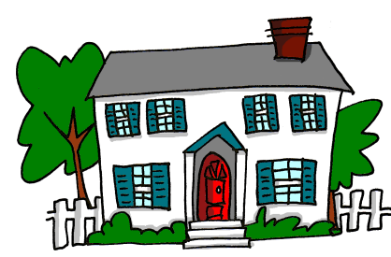
a
nada
amar
∅
casa
alto
agosto
cama
Nick Avery
Notes:
Introduce and elicit the pronunciation of the individual SSC ‘a’ and then the source word again (with gesture, if using). Then present and elicit the pronunciation of the five cluster words.
The cluster words have been chosen for their high-frequency, from a range of word classes, with the SSC (where possible) positioned within a variety of syllables within the words(e.g. initial, 2nd, final etc..) and additionally, we have tried to use words that build cumulatively on previously taught SSCs (see the Phonics Teaching Sequence document) and do not include new SSCs. Where new SSCs are used, they are often consonants which have a similar symbol-sound correspondence in English.
Word frequency rankings: alto [231]; nada [87]; casa [106] cama [609]; amar [700]; agosto [931] Source: Davies, M. & Davies, K. (2018). A Frequency Dictionary of Spanish: Core vocabulary for learners (2nd ed.) London: Routledge.
A note on L1:L2 word translations: these are supported in the research literature on vocabulary learning, and should only be avoided where meanings are transparent. If at any point in teaching, pupils are not clear about a meaning, teachers should not hesitate in giving the English meaning.

Slide 3
a
nada
amar
casa
alto
agosto
cama
Nick Avery
Notes:
Without the images, students focus this time again closely on the SSC and the cluster words.

Slide 4
a
nada
amar
casa
alto
agosto
cama
Nick Avery
Notes:
Without the images or sound, students have to pronounce the words themselves.

Slide 5
e
papel
en
espalda
tener
elefante
[to have]
estar
[to be]
Nick Avery
Notes:
Introduce and elicit the pronunciation of the individual SSC ‘e’ and then the source word again (with gesture, if using). Then present and elicit the pronunciation of the five cluster words.
The cluster words have been chosen for their high-frequency, from a range of word classes, with the SSC (where possible) positioned within a variety of syllables within the words(e.g. initial, 2nd, final etc..) and additionally, we have tried to use words that build cumulatively on previously taught SSCs (see the Phonics Teaching Sequence document) and do not include new SSCs. Where new SSCs are used, they are often consonants which have a similar symbol-sound correspondence in English.
Word frequency rankings: elefante [>5000]; papel [393]; espalda [942]; estar [21]; en [5]; tener [19] Source: Davies, M. & Davies, K. (2018). A Frequency Dictionary of Spanish: Core vocabulary for learners (2nd ed.) London: Routledge.

Slide 6
e
papel
en
espalda
tener
elefante
estar
Nick Avery
Notes:
Introduce and elicit the pronunciation of the individual SSC ‘e’ and then the source word again (with gesture, if using). Then present and elicit the pronunciation of the five cluster words.
The cluster words have been chosen for their high-frequency, from a range of word classes, with the SSC (where possible) positioned within a variety of syllables within the words(e.g. initial, 2nd, final etc..) and additionally, we have tried to use words that build cumulatively on previously taught SSCs (see the Phonics Teaching Sequence document) and do not include new SSCs. Where new SSCs are used, they are often consonants which have a similar symbol-sound correspondence in English.
Word frequency rankings: elefante [>5000]; papel [393]; espalda [942]; estar [21]; en [5]; tener [19] Source: Davies, M. & Davies, K. (2018). A Frequency Dictionary of Spanish: Core vocabulary for learners (2nd ed.) London: Routledge.

Slide 7
e
papel
en
espalda
elefante
tener
estar
Nick Avery
Notes:
Without the images or sound, students have to pronounce the words themselves.

Slide 8
i
lista
ir
idea
interesante
sin
primero
Sin ketchup
Nick Avery
Notes:
Introduce and elicit the pronunciation of the individual SSC ‘i’ and then the source word again (with gesture, if using). Then present and elicit the pronunciation of the five cluster words.
The cluster words have been chosen for their high-frequency, from a range of word classes, with the SSC (where possible) positioned within a variety of syllables within the words(e.g. initial, 2nd, final etc..) and additionally, we have tried to use words that build cumulatively on previously taught SSCs (see the Phonics Teaching Sequence document) and do not include new SSCs. Where new SSCs are used, they are often consonants which have a similar symbol-sound correspondence in English.

Slide 9
i
lista
ir
idea
interesante
sin
primero
Nick Avery
Notes:
Without the images, students focus this time again closely on the SSC and the cluster words.

Slide 10
i
lista
ir
idea
interesante
sin
primero
Nick Avery
Notes:
Without the images or sound, students have to pronounce the words themselves.

Slide 11
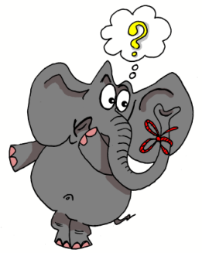
o
olvidar
dos
solo
yo
con
Con ketchup
poco
[little]
Nick Avery
Notes:
Introduce and elicit the pronunciation of the individual SSC ‘o’ and then the source word again (with gesture, if using). Then present and elicit the pronunciation of the five cluster words.
The cluster words have been chosen for their high-frequency, from a range of word classes, with the SSC (where possible) positioned within a variety of syllables within the words(e.g. initial, 2nd, final etc..) and additionally, we have tried to use words that build cumulatively on previously taught SSCs (see the Phonics Teaching Sequence document) and do not include new SSCs. Where new SSCs are used, they are often consonants which have a similar symbol-sound correspondence in English.

Slide 12
o
olvidar
dos
solo
yo
con
poco
Nick Avery
Notes:
Without the images, students focus this time again closely on the SSC and the cluster words.

Slide 13
o
olvidar
dos
solo
yo
con
poco
Nick Avery
Notes:
Without the images or sound, students have to pronounce the words themselves.

Slide 14
u
mundo
mucho
un
lugar
universo
[a; an]
[place]
nunca
[never]
Nick Avery
Notes:
Introduce and elicit the pronunciation of the individual SSC ‘u’ and then the source word again (with gesture, if using). Then present and elicit the pronunciation of the five cluster words.
The cluster words have been chosen for their high-frequency, from a range of word classes, with the SSC (where possible) positioned within a variety of syllables within the words(e.g. initial, 2nd, final etc..) and additionally, we have tried to use words that build cumulatively on previously taught SSCs (see the Phonics Teaching Sequence document) and do not include new SSCs. Where new SSCs are used, they are often consonants which have a similar symbol-sound correspondence in English.

Slide 15
u
mundo
mucho
un
lugar
universo
nunca
Nick Avery
Notes:
Without the images, students focus this time again closely on the SSC and the cluster words.

Slide 16
u
mundo
mucho
un
lugar
universo
nunca
Nick Avery
Notes:
Without the images or sound, students have to pronounce the words themselves.

Slide 17
ll
llegar
llave
© www.englishrescue.com
llamar
llevar
amarillo
ella
Nick Avery
Notes:
Introduce and elicit the pronunciation of the individual SSC ‘LL’ and then the source word again (with gesture, if using). Then present and elicit the pronunciation of the five cluster words.
The cluster words have been chosen for their high-frequency, from a range of word classes, with the SSC (where possible) positioned within a variety of syllables within the words(e.g. initial, 2nd, final etc..) and additionally, we have tried to use words that build cumulatively on previously taught SSCs (see the Phonics Teaching Sequence document) and do not include new SSCs. Where new SSCs are used, they are often consonants which have a similar symbol-sound correspondence in English.

Slide 18
ll
llegar
llave
llamar
llevar
amarillo
ella
Nick Avery
Notes:
Without the images, students focus this time again closely on the SSC and the cluster words.

Slide 19
ll
llegar
llave
llamar
llevar
amarillo
ella
Nick Avery
Notes:
Without the images or sound, students have to pronounce the words themselves.

Slide 20
l
salir
palabra
lista
libro
luz
luego
[later; then]
Nick Avery
Notes:
Introduce and elicit the pronunciation of the individual SSC ‘L’ and then the source word again (with gesture, if using). Then present and elicit the pronunciation of the five cluster words.
The cluster words have been chosen for their high-frequency, from a range of word classes, with the SSC (where possible) positioned within a variety of syllables within the words(e.g. initial, 2nd, final etc..) and additionally, we have tried to use words that build cumulatively on previously taught SSCs (see the Phonics Teaching Sequence document) and do not include new SSCs. Where new SSCs are used, they are often consonants which have a similar symbol-sound correspondence in English.

Slide 21
l
salir
palabra
lista
libro
luz
luego
Nick Avery
Notes:
Without the images, students focus this time again closely on the SSC and the cluster words.

Slide 22
l
salir
palabra
lista
libro
luz
luego
Nick Avery
Notes:
Without the images or sound, students have to pronounce the words themselves.

Slide 23
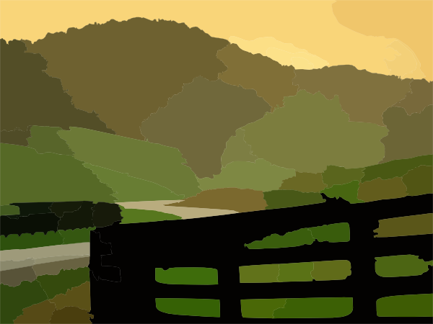
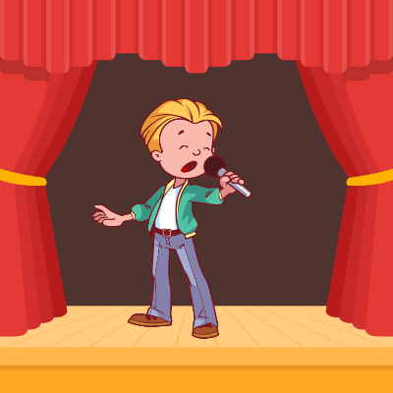
ca
campo
cara
cambiar
casa
cantar
calle
£
$
[street]
Nick Avery
Notes:
Introduce and elicit the pronunciation of the individual SSC ‘ca’ and then the source word again (with gesture, if using). Then present and elicit the pronunciation of the five cluster words.
The cluster words have been chosen for their high-frequency, from a range of word classes, with the SSC (where possible) positioned within a variety of syllables within the words(e.g. initial, 2nd, final etc..) and additionally, we have tried to use words that build cumulatively on previously taught SSCs (see the Phonics Teaching Sequence document) and do not include new SSCs. Where new SSCs are used, they are often consonants which have a similar symbol-sound correspondence in English.

Slide 24
ca
campo
cara
cambiar
casa
cantar
calle
Nick Avery
Notes:
Without the images, students focus this time again closely on the SSC and the cluster words.

Slide 25
ca
campo
cara
cambiar
casa
cantar
calle
Nick Avery
Notes:
Without the images or sound, students have to pronounce the words themselves.

Slide 26
co
costa
coche
blanco
comer
con
Con ketchup
¿cómo?
[how…?]
Nick Avery
Notes:
Introduce and elicit the pronunciation of the individual SSC ‘co’ and then the source word again (with gesture, if using). Then present and elicit the pronunciation of the five cluster words.
The cluster words have been chosen for their high-frequency, from a range of word classes, with the SSC (where possible) positioned within a variety of syllables within the words(e.g. initial, 2nd, final etc..) and additionally, we have tried to use words that build cumulatively on previously taught SSCs (see the Phonics Teaching Sequence document) and do not include new SSCs. Where new SSCs are used, they are often consonants which have a similar symbol-sound correspondence in English.
Teachers whose students have been also been taught French may wish to use the word ‘coche’ to also highlight the difference between the ‘ch’ in Spanish, and the softer ‘ch’ in French (as in ‘chat’)

Slide 27
co
costa
coche
blanco
comer
con
Con ketchup
¿cómo?
Nick Avery
Notes:
Without the images, students focus this time again closely on the SSC and the cluster words.

Slide 28
co
costa
coche
blanco
comer
con
¿cómo?
Nick Avery
Notes:
Without the images or sound, students have to pronounce the words themselves.

Slide 29
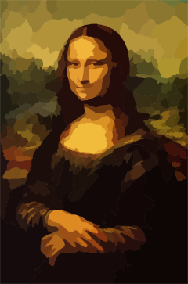
cu
cultura
cuatro
cuerpo
escuchar
cuadro
escuela
Nick Avery
Notes:
Introduce and elicit the pronunciation of the individual SSC ‘cu’ and then the source word again (with gesture, if using). Then present and elicit the pronunciation of the five cluster words.
The cluster words have been chosen for their high-frequency, from a range of word classes, with the SSC (where possible) positioned within a variety of syllables within the words(e.g. initial, 2nd, final etc..) and additionally, we have tried to use words that build cumulatively on previously taught SSCs (see the Phonics Teaching Sequence document) and do not include new SSCs. Where new SSCs are used, they are often consonants which have a similar symbol-sound correspondence in English.

Slide 30
cu
cultura
cuatro
cuerpo
escuchar
cuadro
escuela
Nick Avery
Notes:
Without the images, students focus this time again closely on the SSC and the cluster words.

Slide 31
cu
cultura
cuatro
cuerpo
escuchar
cuadro
escuela
Nick Avery
Notes:
Without the images or sound, students have to pronounce the words themselves.

Slide 32
cue
cue
cuello
cuerpo
[body]
[body]
[neck]
encuentro
cuenta
escuela
recuerdo
[bill]
[memory, keepsake]
[meeting]
Notes:
Introduce and elicit the pronunciation of the individual SSC ‘z’ and then the source word again (with gesture, if using). Then present and elicit the pronunciation of the five cluster words.
The cluster words have been chosen for their high-frequency, from a range of word classes, with the SSC (where possible) positioned within a variety of syllables within the words (e.g. initial, 2nd, final etc.). Additionally, we have tried to use words that build cumulatively on previously taught SSCs (see the Phonics Teaching Sequence document) and do not include new SSCs. Where new SSCs are used, they are often consonants which have a similar symbol-sound correspondence in English.

Slide 33
cue
cue
cuello
cuerpo
encuentro
cuenta
recuerdo
Notes:
Without the images, students focus this time again closely on the SSC and the cluster words.

Slide 34
cue
cuello
cue
cuerpo
encuentro
cuenta
escuela
recuerdo
Notes:
Without the images or sound, students have to pronounce the words themselves.

Slide 35
cue
cua
cuarenta
cuando
40
[when]
¿cuál?
cuarto
cuatro
cuadro
[which]
[room]
Notes:
Introduce and elicit the pronunciation of the individual SSC ‘z’ and then the source word again (with gesture, if using). Then present and elicit the pronunciation of the five cluster words.
The cluster words have been chosen for their high-frequency, from a range of word classes, with the SSC (where possible) positioned within a variety of syllables within the words (e.g. initial, 2nd, final etc.). Additionally, we have tried to use words that build cumulatively on previously taught SSCs (see the Phonics Teaching Sequence document) and do not include new SSCs. Where new SSCs are used, they are often consonants which have a similar symbol-sound correspondence in English.

Slide 36
cue
cua
cuarenta
cuando
¿cuál?
cuarto
cuatro
cuadro
Notes:
Without the images, students focus this time again closely on the SSC and the cluster words.

Slide 37
cue
cua
cuarenta
cuando
¿cuál?
cuarto
cuatro
cuadro
Notes:
Without the images or sound, students have to pronounce the words themselves.

Slide 38
cue
cui
to look after;
take care of
¡cuidado!
cuidar
[careful!]
Notes:
Introduce and elicit the pronunciation of the individual SSC ‘z’ and then the source word again (with gesture, if using). Then present and elicit the pronunciation of the five cluster words.
The cluster words have been chosen for their high-frequency, from a range of word classes, with the SSC (where possible) positioned within a variety of syllables within the words (e.g. initial, 2nd, final etc.). Additionally, we have tried to use words that build cumulatively on previously taught SSCs (see the Phonics Teaching Sequence document) and do not include new SSCs. Where new SSCs are used, they are often consonants which have a similar symbol-sound correspondence in English.

Slide 39
cue
cui
¡cuidado!
cuidar
Notes:
Without the images, students focus this time again closely on the SSC and the cluster words.

Slide 40
cue
cui
¡cuidado!
cuidar
Notes:
Without the images or sound, students have to pronounce the words themselves.

Slide 41
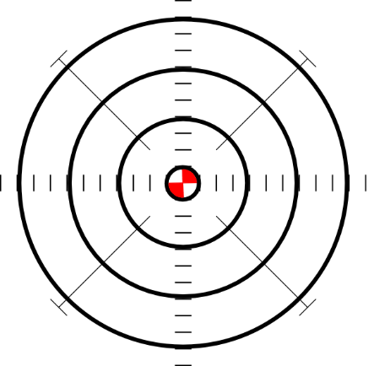
ce
doce
centro
MADRID 1KM
cerca
necesitar
necesario
[necessary]
[to need]
parecer
[to seem; appear]
Nick Avery
Notes:
Introduce and elicit the pronunciation of the individual SSC ‘ce’ and then the source word again (with gesture, if using). Then present and elicit the pronunciation of the five cluster words.
The cluster words have been chosen for their high-frequency, from a range of word classes, with the SSC (where possible) positioned within a variety of syllables within the words (e.g. initial, 2nd, final etc.). Additionally, we have tried to use words that build cumulatively on previously taught SSCs (see the Phonics Teaching Sequence document) and do not include new SSCs. Where new SSCs are used, they are often consonants which have a similar symbol-sound correspondence in English.

Slide 42
ce
doce
centro
cerca
necesitar
necesario
parecer
Nick Avery
Notes:
Without the images, students focus this time again closely on the SSC and the cluster words.

Slide 43
ce
doce
centro
cerca
necesitar
necesario
parecer
Nick Avery
Notes:
Without the images or sound, students have to pronounce the words themselves.

Slide 44
ci
cine
diciembre
ciencias
ciudad
cierto
decir
[to say; tell]
Nick Avery
Notes:
Introduce and elicit the pronunciation of the individual SSC ‘ci’ and then the source word again (with gesture, if using). Then present and elicit the pronunciation of the five cluster words.
The cluster words have been chosen for their high-frequency, from a range of word classes, with the SSC (where possible) positioned within a variety of syllables within the words (e.g. initial, 2nd, final etc.). Additionally, we have tried to use words that build cumulatively on previously taught SSCs (see the Phonics Teaching Sequence document) and do not include new SSCs. Where new SSCs are used, they are often consonants which have a similar symbol-sound correspondence in English.

Slide 45
ci
cine
diciembre
ciencias
ciudad
cierto
decir
Nick Avery
Notes:
Without the images, students focus this time again closely on the SSC and the cluster words.

Slide 46
ci
cine
diciembre
ciencias
ciudad
cierto
decir
Nick Avery
Notes:
Without the images or sound, students have to pronounce the words themselves.

Slide 47
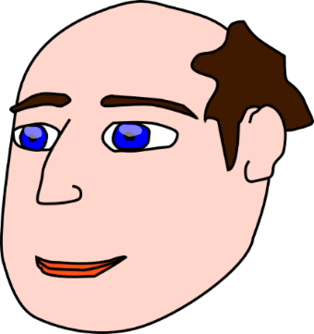
z
voz
diez
cabeza
zapato
zona
empezar
[to start]
Nick Avery
Notes:
Introduce and elicit the pronunciation of the individual SSC ‘z’ and then the source word again (with gesture, if using). Then present and elicit the pronunciation of the five cluster words.
The cluster words have been chosen for their high-frequency, from a range of word classes, with the SSC (where possible) positioned within a variety of syllables within the words (e.g. initial, 2nd, final etc.). Additionally, we have tried to use words that build cumulatively on previously taught SSCs (see the Phonics Teaching Sequence document) and do not include new SSCs. Where new SSCs are used, they are often consonants which have a similar symbol-sound correspondence in English.

Slide 48
z
voz
diez
cabeza
zapato
zona
empezar
Nick Avery
Notes:
Without the images, students focus this time again closely on the SSC and the cluster words.

Slide 49
z
voz
diez
cabeza
zapato
zona
empezar
Nick Avery
Notes:
Without the images or sound, students have to pronounce the words themselves.

Slide 50
que
parque
pequeño
porque
¿qué?
querer
[because]
[to want]
quedar
[to meet up; stay; suit]
Nick Avery
Notes:
Introduce and elicit the pronunciation of the individual SSC ‘que’ and then the source word again (with gesture, if using). Then present and elicit the pronunciation of the five cluster words.
The cluster words have been chosen for their high-frequency, from a range of word classes, with the SSC (where possible) positioned within a variety of syllables within the words (e.g. initial, 2nd, final etc.). Additionally, we have tried to use words that build cumulatively on previously taught SSCs (see the Phonics Teaching Sequence document) and do not include new SSCs. Where new SSCs are used, they are often consonants which have a similar symbol-sound correspondence in English.

Slide 51
que
parque
pequeño
porque
¿qué?
querer
quedar
Nick Avery
Notes:
Without the images, students focus this time again closely on the SSC and the cluster words.

Slide 52
que
parque
pequeño
porque
¿qué?
querer
quedar
Nick Avery
Notes:
Without the images or sound, students have to pronounce the words themselves.

Slide 53
qui
izquierda
tranquilo
quiero
[I want…]
quince
¿quién?
equipo
Nick Avery
Notes:
Introduce and elicit the pronunciation of the individual SSC ‘qui’ and then the source word again (with gesture, if using). Then present and elicit the pronunciation of the five cluster words.
The cluster words have been chosen for their high-frequency, from a range of word classes, with the SSC (where possible) positioned within a variety of syllables within the words (e.g. initial, 2nd, final etc.). Additionally, we have tried to use words that build cumulatively on previously taught SSCs (see the Phonics Teaching Sequence document) and do not include new SSCs. Where new SSCs are used, they are often consonants which have a similar symbol-sound correspondence in English.

Slide 54
qui
izquierda
tranquilo
quiero
quince
¿quién?
equipo
Nick Avery
Notes:
Without the images, students focus this time again closely on the SSC and the cluster words.

Slide 55
qui
izquierda
tranquilo
quiero
quince
¿quién?
equipo
Nick Avery
Notes:
Without the images or sound, students have to pronounce the words themselves.

Slide 56
ga
regalo
jugar
gato
ganar
amiga
lugar
[place]
Nick Avery
Notes:
Introduce and elicit the pronunciation of the individual SSC ‘ga’ and then the source word again (with gesture, if using). Then present and elicit the pronunciation of the five cluster words.
The cluster words have been chosen for their high-frequency, from a range of word classes, with the SSC (where possible) positioned within a variety of syllables within the words (e.g. initial, 2nd, final etc.). Additionally, we have tried to use words that build cumulatively on previously taught SSCs (see the Phonics Teaching Sequence document) and do not include new SSCs. Where new SSCs are used, they are often consonants which have a similar symbol-sound correspondence in English.

Slide 57
ga
regalo
jugar
gato
ganar
amiga
lugar
Nick Avery
Notes:
Without the images, students focus this time again closely on the SSC and the cluster words.

Slide 58
ga
regalo
jugar
gato
ganar
amiga
lugar
Nick Avery
Notes:
Without the images or sound, students have to pronounce the words themselves.

Slide 59
go
domingo
largo
SUNDAY
gol
juego (n)
conmigo
[with me]
algo
[something]
Nick Avery
Notes:
Introduce and elicit the pronunciation of the individual SSC ‘go’ and then the source word again (with gesture, if using). Then present and elicit the pronunciation of the five cluster words.
The cluster words have been chosen for their high-frequency, from a range of word classes, with the SSC (where possible) positioned within a variety of syllables within the words (e.g. initial, 2nd, final etc.). Additionally, we have tried to use words that build cumulatively on previously taught SSCs (see the Phonics Teaching Sequence document) and do not include new SSCs. Where new SSCs are used, they are often consonants which have a similar symbol-sound correspondence in English.

Slide 60
go
domingo
largo
gol
juego (n)
conmigo
algo
Nick Avery
Notes:
Without the images, students focus this time again closely on the SSC and the cluster words.

Slide 61
go
domingo
largo
gol
juego (n)
conmigo
algo
Nick Avery
Notes:
Without the images or sound, students have to pronounce the words themselves.

Slide 62
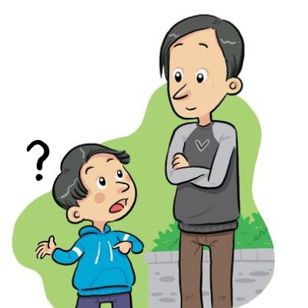
gu
¡mucho gusto!
segundo
preguntar
Nick Avery
Notes:
Introduce and elicit the pronunciation of the individual SSC ‘gu’ and then the source word again (with gesture, if using). Then present and elicit the pronunciation of the five cluster words.
The cluster words have been chosen for their high-frequency, from a range of word classes, with the SSC (where possible) positioned within a variety of syllables within the words (e.g. initial, 2nd, final etc.). Additionally, we have tried to use words that build cumulatively on previously taught SSCs (see the Phonics Teaching Sequence document) and do not include new SSCs. Where new SSCs are used, they are often consonants which have a similar symbol-sound correspondence in English.

Slide 63
gu
¡mucho gusto!
segundo
preguntar
Nick Avery
Notes:
Without the images, students focus this time again closely on the SSC and the cluster words.

Slide 64
gu
¡mucho gusto!
segundo
preguntar
Nick Avery
Notes:
Without the images or sound, students have to pronounce the words themselves.

Slide 65
j
julio
mejor
rojo
ojo
mujer
dejar
[to leave]
Nick Avery
Notes:
Introduce and elicit the pronunciation of the individual SSC ‘j’ and then the source word again (with gesture, if using). Then present and elicit the pronunciation of the five cluster words.
The cluster words have been chosen for their high-frequency, from a range of word classes, with the SSC (where possible) positioned within a variety of syllables within the words (e.g. initial, 2nd, final etc.). Additionally, we have tried to use words that build cumulatively on previously taught SSCs (see the Phonics Teaching Sequence document) and do not include new SSCs. Where new SSCs are used, they are often consonants which have a similar symbol-sound correspondence in English.

Slide 66
j
julio
mejor
rojo
ojo
mujer
dejar
Nick Avery
Notes:
Without the images, students focus this time again closely on the SSC and the cluster words.

Slide 67
j
julio
mejor
rojo
ojo
mujer
dejar
Nick Avery
Notes:
Without the images or sound, students have to pronounce the words themselves.

Slide 68
ge
imagen
recoger
gesto
gente
argentino
generalmente
[generally]
Nick Avery
Notes:
Introduce and elicit the pronunciation of the individual SSC ‘ge’ and then the source word again (with gesture, if using). Then present and elicit the pronunciation of the five cluster words.
The cluster words have been chosen for their high-frequency, from a range of word classes, with the SSC (where possible) positioned within a variety of syllables within the words (e.g. initial, 2nd, final etc.). Additionally, we have tried to use words that build cumulatively on previously taught SSCs (see the Phonics Teaching Sequence document) and do not include new SSCs. Where new SSCs are used, they are often consonants which have a similar symbol-sound correspondence in English.

Slide 69
ge
imagen
recoger
gesto
gente
argentino
generalmente
Nick Avery
Notes:
Without the images, students focus this time again closely on the SSC and the cluster words.

Slide 70
ge
imagen
recoger
gesto
gente
argentino
generalmente
Nick Avery
Notes:
Without the images or sound, students have to pronounce the words themselves.

Slide 71
gi
elegir
original
Versión original
P57
religión
imaginar
colegio
página
48
47
Nick Avery
Notes:
Introduce and elicit the pronunciation of the individual SSC ‘gi’ and then the source word again (with gesture, if using). Then present and elicit the pronunciation of the five cluster words.
The cluster words have been chosen for their high-frequency, from a range of word classes, with the SSC (where possible) positioned within a variety of syllables within the words (e.g. initial, 2nd, final etc.). Additionally, we have tried to use words that build cumulatively on previously taught SSCs (see the Phonics Teaching Sequence document) and do not include new SSCs. Where new SSCs are used, they are often consonants which have a similar symbol-sound correspondence in English.

Slide 72
gi
elegir
original
P57
religión
imaginar
colegio
página
Nick Avery
Notes:
Without the images, students focus this time again closely on the SSC and the cluster words.

Slide 73
gi
elegir
original
religión
imaginar
colegio
página
Nick Avery
Notes:
Without the images or sound, students have to pronounce the words themselves.

Slide 74
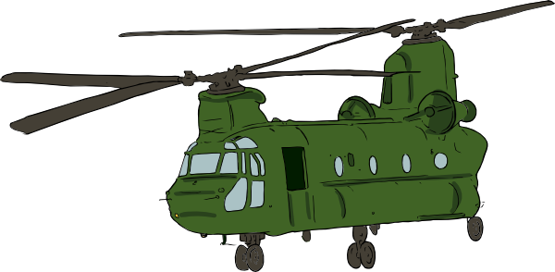
gue
guerra
Nick Avery
Notes:
Introduce and elicit the pronunciation of the individual SSC ‘gue’ and then the source word again (with gesture, if using). Then present and elicit the pronunciation of the five cluster words.
The cluster words have been chosen for their high-frequency, from a range of word classes, with the SSC (where possible) positioned within a variety of syllables within the words (e.g. initial, 2nd, final etc.). Additionally, we have tried to use words that build cumulatively on previously taught SSCs (see the Phonics Teaching Sequence document) and do not include new SSCs. Where new SSCs are used, they are often consonants which have a similar symbol-sound correspondence in English.

Slide 75
gue
guerra
Nick Avery
Notes:
Without the images, students focus this time again closely on the SSC and the cluster words.

Slide 76
gue
guerra
Nick Avery
Notes:
Without the images or sound, students have to pronounce the words themselves.

Slide 77
gui
guitarra
Nick Avery
Notes:
Introduce and elicit the pronunciation of the individual SSC ‘gui’ and then the source word again (with gesture, if using). Then present and elicit the pronunciation of the five cluster words.
The cluster words have been chosen for their high-frequency, from a range of word classes, with the SSC (where possible) positioned within a variety of syllables within the words (e.g. initial, 2nd, final etc.). Additionally, we have tried to use words that build cumulatively on previously taught SSCs (see the Phonics Teaching Sequence document) and do not include new SSCs. Where new SSCs are used, they are often consonants which have a similar symbol-sound correspondence in English.

Slide 78
gui
guitarra
Nick Avery
Notes:
Without the images, students focus this time again closely on the SSC and the cluster words.

Slide 79
gui
guitarra
Nick Avery
Notes:
Without the images or sound, students have to pronounce the words themselves.

Slide 80
ñ
año
montaña
2019
señora
niña
español
mañana
[morning; tomorrow]
Nick Avery
Notes:
Introduce and elicit the pronunciation of the individual SSC ‘ñ’ and then the source word again (with gesture, if using). Then present and elicit the pronunciation of the five cluster words.
The cluster words have been chosen for their high-frequency, from a range of word classes, with the SSC (where possible) positioned within a variety of syllables within the words (e.g. initial, 2nd, final etc.). Additionally, we have tried to use words that build cumulatively on previously taught SSCs (see the Phonics Teaching Sequence document) and do not include new SSCs. Where new SSCs are used, they are often consonants which have a similar symbol-sound correspondence in English.

Slide 81
ñ
año
montaña
señora
niña
español
mañana
Nick Avery
Notes:
Without the images, students focus this time again closely on the SSC and the cluster words.

Slide 82
ñ
año
montaña
señora
niña
español
mañana
Nick Avery
Notes:
Without the images or sound, students have to pronounce the words themselves.

Slide 83
n
noche
poner
mano
nada
nosotros
tener
[to have]
Nick Avery
Notes:
Introduce and elicit the pronunciation of the individual SSC ‘n’ and then the source word again (with gesture, if using). Then present and elicit the pronunciation of the five cluster words.
The cluster words have been chosen for their high-frequency, from a range of word classes, with the SSC (where possible) positioned within a variety of syllables within the words (e.g. initial, 2nd, final etc.). Additionally, we have tried to use words that build cumulatively on previously taught SSCs (see the Phonics Teaching Sequence document) and do not include new SSCs. Where new SSCs are used, they are often consonants which have a similar symbol-sound correspondence in English.

Slide 84
n
noche
poner
mano
nada
nosotros
tener
Nick Avery
Notes:
Without the images, students focus this time again closely on the SSC and the cluster words.

Slide 85
n
noche
poner
mano
nada
nosotros
tener
Nick Avery
Notes:
Without the images or sound, students have to pronounce the words themselves.

Slide 86
v
verdad
verano
verde
joven
ver
vivir
[to live]
Nick Avery
Notes:
Introduce and elicit the pronunciation of the individual SSC ‘gi’ and then the source word again (with gesture, if using). Then present and elicit the pronunciation of the five cluster words.
The cluster words have been chosen for their high-frequency, from a range of word classes, with the SSC (where possible) positioned within a variety of syllables within the words (e.g. initial, 2nd, final etc.). Additionally, we have tried to use words that build cumulatively on previously taught SSCs (see the Phonics Teaching Sequence document) and do not include new SSCs. Where new SSCs are used, they are often consonants which have a similar symbol-sound correspondence in English.

Slide 87
v
verdad
verano
verde
joven
ver
vivir
Nick Avery
Notes:
Without the images, students focus this time again closely on the SSC and the cluster words.

Slide 88
v
verdad
verano
verde
joven
ver
vivir
Nick Avery
Notes:
Without the images or sound, students have to pronounce the words themselves.

Slide 89
b
abuela
bonito
[pretty]
saber
deber
celebrar
[to know]
bastante
[quite]
Nick Avery
Notes:
Introduce and elicit the pronunciation of the individual SSC ‘b’ and then the source word again (with gesture, if using). Then present and elicit the pronunciation of the five cluster words.
The cluster words have been chosen for their high-frequency, from a range of word classes, with the SSC (where possible) positioned within a variety of syllables within the words (e.g. initial, 2nd, final etc.). Additionally, we have tried to use words that build cumulatively on previously taught SSCs (see the Phonics Teaching Sequence document) and do not include new SSCs. Where new SSCs are used, they are often consonants which have a similar symbol-sound correspondence in English.

Slide 90
b
abuela
bonito
saber
deber
celebrar
bastante
Nick Avery
Notes:
Without the images, students focus this time again closely on the SSC and the cluster words.

Slide 91
b
abuela
bonito
saber
deber
celebrar
bastante
Nick Avery
Notes:
Without the images or sound, students have to pronounce the words themselves.

Slide 92
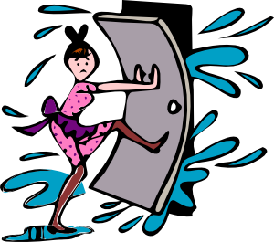
rr
correr
barrio
cerrar
perro
correcto
correo
@
Nick Avery
Notes:
Introduce and elicit the pronunciation of the individual SSC ‘rr’ and then the source word again (with gesture, if using). Then present and elicit the pronunciation of the five cluster words.
The cluster words have been chosen for their high-frequency, from a range of word classes, with the SSC (where possible) positioned within a variety of syllables within the words (e.g. initial, 2nd, final etc.). Additionally, we have tried to use words that build cumulatively on previously taught SSCs (see the Phonics Teaching Sequence document) and do not include new SSCs. Where new SSCs are used, they are often consonants which have a similar symbol-sound correspondence in English.
Word frequency rankings: perro [888]; correr [343]; cerrar [521]; correo [1638]; barrio [940]; correcto [1467] Source: Davies, M. & Davies, K. (2018). A Frequency Dictionary of Spanish: Core vocabulary for learners (2nd ed.) London: Routledge.

Slide 93
rr
correr
barrio
cerrar
perro
correcto
correo
Nick Avery
Notes:
Without the images, students focus this time again closely on the SSC and the cluster words.

Slide 94
rr
correr
barrio
cerrar
perro
correcto
correo
Nick Avery
Notes:
Without the images or sound, students have to pronounce the words themselves.

Slide 95
r
caro
abro
seria
pero
Francia
sobre
[about; on top of]
Nick Avery
Notes:
Introduce and elicit the pronunciation of the individual SSC ‘r’ and then the source word again (with gesture, if using). Then present and elicit the pronunciation of the five cluster words.
The cluster words have been chosen for their high-frequency, from a range of word classes, with the SSC (where possible) positioned within a variety of syllables within the words (e.g. initial, 2nd, final etc.). Additionally, we have tried to use words that build cumulatively on previously taught SSCs (see the Phonics Teaching Sequence document) and do not include new SSCs. Where new SSCs are used, they are often consonants which have a similar symbol-sound correspondence in English.
Word frequency rankings: pero [30]; caro [2179]; Francia [939]; sobre [62]; abrir [246]; rico[398] Source: Davies, M. & Davies, K. (2018). A Frequency Dictionary of Spanish: Core vocabulary for learners (2nd ed.) London: Routledge.

Slide 96
r
caro
abro
seria
pero
Francia
sobre
Nick Avery
Notes:
Without the images, students focus this time again closely on the SSC and the cluster words.

Slide 97
r
caro
abro
seria
pero
Francia
sobre
Nick Avery
Notes:
Without the images or sound, students have to pronounce the words themselves.

Slide 98
h
hijo
helado
hospital
hasta luego
hablar
hacer
[to do]
Nick Avery
Notes:
Introduce and elicit the pronunciation of the individual SSC ‘h’ and then the source word again (with gesture, if using). Then present and elicit the pronunciation of the five cluster words.
The cluster words have been chosen for their high-frequency, from a range of word classes, with the SSC (where possible) positioned within a variety of syllables within the words (e.g. initial, 2nd, final etc.). Additionally, we have tried to use words that build cumulatively on previously taught SSCs (see the Phonics Teaching Sequence document) and do not include new SSCs. Where new SSCs are used, they are often consonants which have a similar symbol-sound correspondence in English.

Slide 99
h
hijo
helado
hospital
hasta luego
hablar
hacer
Nick Avery
Notes:
Without the images, students focus this time again closely on the SSC and the cluster words.

Slide 100
h
hijo
helado
hospital
hasta luego
hablar
hacer
Nick Avery
Notes:
Without the images or sound, students have to pronounce the words themselves.

