Slide 1
Spanish SSC (symbol-sound correspondences)
Cluster Words
Date updated: 09/08/21
Notes:
All pictures selected are available under a Creative Common license, no attribution required. This is the full set of SSC (Symbol-sound correspondence) cluster words. This PPT is to be used in combination with the source words presentation. There is a suggested teaching order document, and there are many supporting resources for the teaching and consolidation of each individual SSC, also on the portal.
NB: Each SFC and cluster word set are presented twice, on two slides. The first is accompanied by visual images, the second without the images. Teachers can elicit meanings or gestures to reinforce the word-meaning connection. Seeing just the SFC and cluster words on the slide also focuses attention closely on the symbol-sound relationship.

Slide 2
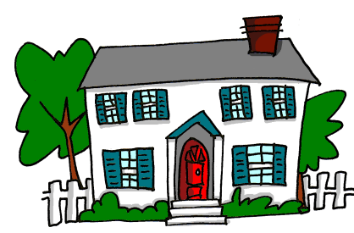
a
nada
amar
∅
casa
alto
agosto
cama
Nick Avery
Notes:
Recap individual SSC ‘A’ and then the source word again (with gesture, if using). Then present and elicit the pronunciation of the five cluster words. The cluster words have been chosen for their high-frequency, from a range of word classes, with the SSC (where possible) positioned within a variety of syllables within the words (e.g. initial, 2nd, final etc.). Additionally, we have tried to use words that build cumulatively on previously taught SSCs (see the Phonics Teaching Sequence document) and do not include new SSCs. Where new SSCs are used, they are often consonants which have a similar symbol-sound correspondence in English.
Word frequency rankings: alto [231]; nada [87]; casa [106] cama [609]; amar [700]; agosto [931] Source: Davies, M. & Davies, K. (2018). A Frequency Dictionary of Spanish: Core vocabulary for learners (2nd ed.) London: Routledge.
A note on L1:L2 word translations: these are supported in the research literature on vocabulary learning, and should only be avoided where meanings are transparent. If at any point in teaching, pupils are not clear about a meaning, teachers should not hesitate in giving the English meaning.

Slide 3
a
nada
amar
casa
alto
agosto
cama
Nick Avery
Notes:
Without the images, students focus this time again closely on the SSC and the cluster words.

Slide 4
e
papel
en
espalda
elefante
tener
estar
[to have]
[to be]
Nick Avery
Notes:
Introduce and elicit the pronunciation of the individual SSC ‘e’ and then the source word again (with gesture, if using). Then present and elicit the pronunciation of the five cluster words.
The cluster words have been chosen for their high-frequency, from a range of word classes, with the SSC (where possible) positioned within a variety of syllables within the words (e.g. initial, 2nd, final etc.). Additionally, we have tried to use words that build cumulatively on previously taught SSCs (see the Phonics Teaching Sequence document) and do not include new SSCs. Where new SSCs are used, they are often consonants which have a similar symbol-sound correspondence in English.

Slide 5
e
papel
en
espalda
elefante
tener
estar
Nick Avery
Notes:
Without the images, students focus this time again closely on the SSC and the cluster words.

Slide 6
i
lista
ir
idea
interesante
sin
primero
Sin ketchup
Nick Avery
Notes:
Introduce and elicit the pronunciation of the individual SSC ‘i’ and then the source word again (with gesture, if using). Then present and elicit the pronunciation of the five cluster words.
The cluster words have been chosen for their high-frequency, from a range of word classes, with the SSC (where possible) positioned within a variety of syllables within the words (e.g. initial, 2nd, final etc.). Additionally, we have tried to use words that build cumulatively on previously taught SSCs (see the Phonics Teaching Sequence document) and do not include new SSCs. Where new SSCs are used, they are often consonants which have a similar symbol-sound correspondence in English.

Slide 7
i
lista
ir
idea
interesante
sin
primero
Nick Avery
Notes:
Without the images, students focus this time again closely on the SSC and the cluster words.

Slide 8
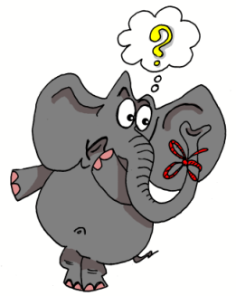
o
olvidar
dos
solo
yo
con
Con ketchup
poco
[little]
Nick Avery
Notes:
Introduce and elicit the pronunciation of the individual SSC ‘o’ and then the source word again (with gesture, if using). Then present and elicit the pronunciation of the five cluster words.
The cluster words have been chosen for their high-frequency, from a range of word classes, with the SSC (where possible) positioned within a variety of syllables within the words (e.g. initial, 2nd, final etc.). Additionally, we have tried to use words that build cumulatively on previously taught SSCs (see the Phonics Teaching Sequence document) and do not include new SSCs. Where new SSCs are used, they are often consonants which have a similar symbol-sound correspondence in English.

Slide 9
o
olvidar
dos
solo
yo
con
poco
Nick Avery
Notes:
Without the images, students focus this time again closely on the SSC and the cluster words.

Slide 10
u
mundo
mucho
un
lugar
universo
[a; an]
[place]
nunca
[never]
Nick Avery
Notes:
Introduce and elicit the pronunciation of the individual SSC ‘u’ and then the source word again (with gesture, if using). Then present and elicit the pronunciation of the five cluster words.
The cluster words have been chosen for their high-frequency, from a range of word classes, with the SSC (where possible) positioned within a variety of syllables within the words (e.g. initial, 2nd, final etc.). Additionally, we have tried to use words that build cumulatively on previously taught SSCs (see the Phonics Teaching Sequence document) and do not include new SSCs. Where new SSCs are used, they are often consonants which have a similar symbol-sound correspondence in English.

Slide 11
u
mundo
mucho
un
lugar
universo
nunca
Nick Avery
Notes:
Without the images, students focus this time again closely on the SSC and the cluster words.

Slide 12
ll
llegar
llave
© www.englishrescue.com
llamar
llevar
amarillo
ella
Nick Avery
Notes:
Introduce and elicit the pronunciation of the individual SSC ‘LL’ and then the source word again (with gesture, if using). Then present and elicit the pronunciation of the five cluster words.
The cluster words have been chosen for their high-frequency, from a range of word classes, with the SSC (where possible) positioned within a variety of syllables within the words (e.g. initial, 2nd, final etc.). Additionally, we have tried to use words that build cumulatively on previously taught SSCs (see the Phonics Teaching Sequence document) and do not include new SSCs. Where new SSCs are used, they are often consonants which have a similar symbol-sound correspondence in English.
Word frequency rankings: llamar [122]; llegar [75]; llevar [101]; ella [72]; llave [1853]; amarillo [1381] Source: Davies, M. & Davies, K. (2018). A Frequency Dictionary of Spanish: Core vocabulary for learners (2nd ed.) London: Routledge.

Slide 13
ll
llegar
llave
llamar
llevar
amarillo
ella
Nick Avery
Notes:
Without the images, students focus this time again closely on the SSC and the cluster words.

Slide 14
l
salir
palabra
lista
libro
luz
luego
[later; then]
Nick Avery
Notes:
Introduce and elicit the pronunciation of the individual SSC ‘L’ and then the source word again (with gesture, if using). Then present and elicit the pronunciation of the five cluster words.
The cluster words have been chosen for their high-frequency, from a range of word classes, with the SSC (where possible) positioned within a variety of syllables within the words (e.g. initial, 2nd, final etc.). Additionally, we have tried to use words that build cumulatively on previously taught SSCs (see the Phonics Teaching Sequence document) and do not include new SSCs. Where new SSCs are used, they are often consonants which have a similar symbol-sound correspondence in English.
Word frequency rankings: libro [230]; salir [114]; lista [1189]; luego [150]; palabra [192]; luz [278] Source: Davies, M. & Davies, K. (2018). A Frequency Dictionary of Spanish: Core vocabulary for learners (2nd ed.) London: Routledge.

Slide 15
l
salir
palabra
lista
libro
luz
luego
Nick Avery
Notes:
Without the images, students focus this time again closely on the SSC and the cluster words.

Slide 16
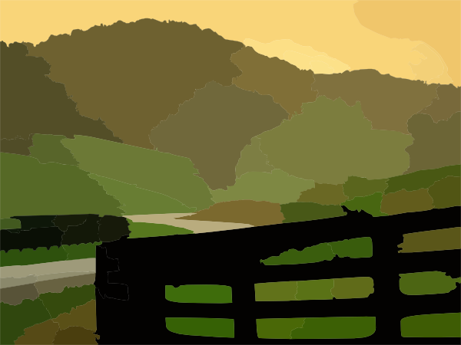
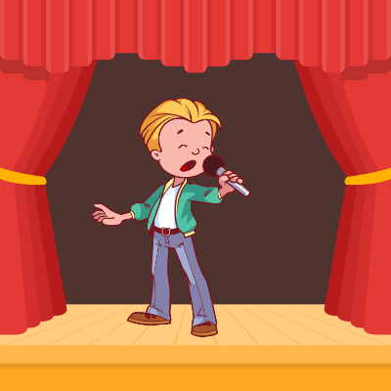
ca
campo
cara
cambiar
casa
cantar
calle
£
$
[street]
Nick Avery
Notes:
Introduce and elicit the pronunciation of the individual SSC ‘ca’ and then the source word again (with gesture, if using). Then present and elicit the pronunciation of the five cluster words.
The cluster words have been chosen for their high-frequency, from a range of word classes, with the SSC (where possible) positioned within a variety of syllables within the words (e.g. initial, 2nd, final etc.). Additionally, we have tried to use words that build cumulatively on previously taught SSCs (see the Phonics Teaching Sequence document) and do not include new SSCs. Where new SSCs are used, they are often consonants which have a similar symbol-sound correspondence in English.

Slide 17
ca
campo
cara
cambiar
casa
cantar
calle
Nick Avery
Notes:
Without the images, students focus this time again closely on the SSC and the cluster words.

Slide 18
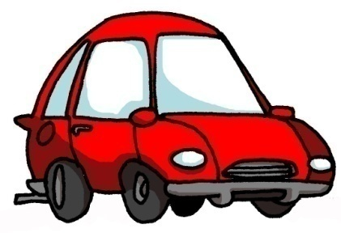
co
costa
coche
blanco
comer
con
Con ketchup
¿cómo?
[how…?]
Nick Avery
Notes:
Introduce and elicit the pronunciation of the individual SSC ‘co’ and then the source word again (with gesture, if using). Then present and elicit the pronunciation of the five cluster words.
The cluster words have been chosen for their high-frequency, from a range of word classes, with the SSC (where possible) positioned within a variety of syllables within the words (e.g. initial, 2nd, final etc.). Additionally, we have tried to use words that build cumulatively on previously taught SSCs (see the Phonics Teaching Sequence document) and do not include new SSCs. Where new SSCs are used, they are often consonants which have a similar symbol-sound correspondence in English.
Teachers whose students have been also been taught French may wish to use the word ‘coche’ to also highlight the difference between the ‘ch’ in Spanish, and the softer ‘ch’ in French (as in ‘chat’)

Slide 19
co
costa
coche
blanco
comer
con
¿cómo?
Nick Avery
Notes:
Without the images, students focus this time again closely on the SSC and the cluster words.

Slide 20
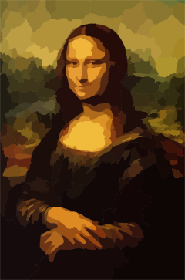
cu
cultura
cuatro
cuerpo
escuchar
cuadro
escuela
Nick Avery
Notes:
Introduce and elicit the pronunciation of the individual SSC ‘cu’ and then the source word again (with gesture, if using). Then present and elicit the pronunciation of the five cluster words.
The cluster words have been chosen for their high-frequency, from a range of word classes, with the SSC (where possible) positioned within a variety of syllables within the words (e.g. initial, 2nd, final etc.). Additionally, we have tried to use words that build cumulatively on previously taught SSCs (see the Phonics Teaching Sequence document) and do not include new SSCs. Where new SSCs are used, they are often consonants which have a similar symbol-sound correspondence in English.

Slide 21
cu
cultura
cuatro
cuerpo
escuchar
cuadro
escuela
Nick Avery
Notes:
Without the images, students focus this time again closely on the SSC and the cluster words.

Slide 22
cue
cue
cuello
cuerpo
[body]
[body]
encuentro
cuenta
escuela
recuerdo
[bill]
[memory, keepsake]
Notes:
Introduce and elicit the pronunciation of the individual SSC ‘z’ and then the source word again (with gesture, if using). Then present and elicit the pronunciation of the five cluster words.
The cluster words have been chosen for their high-frequency, from a range of word classes, with the SSC (where possible) positioned within a variety of syllables within the words (e.g. initial, 2nd, final etc.). Additionally, we have tried to use words that build cumulatively on previously taught SSCs (see the Phonics Teaching Sequence document) and do not include new SSCs. Where new SSCs are used, they are often consonants which have a similar symbol-sound correspondence in English.

Slide 23
cue
cue
cuello
cuerpo
encuentro
cuenta
escuela
recuerdo
Notes:
Without the images, students focus this time again closely on the SSC and the cluster words.

Slide 24
cue
cuello
cue
cuerpo
encuentro
cuenta
escuela
recuerdo
Notes:
Without the images or sound, students have to pronounce the words themselves.

Slide 25
cue
cua
cuarenta
cuando
40
¿cuál?
cuarto
cuatro
cuadro
Notes:
Introduce and elicit the pronunciation of the individual SSC ‘z’ and then the source word again (with gesture, if using). Then present and elicit the pronunciation of the five cluster words.
The cluster words have been chosen for their high-frequency, from a range of word classes, with the SSC (where possible) positioned within a variety of syllables within the words (e.g. initial, 2nd, final etc.). Additionally, we have tried to use words that build cumulatively on previously taught SSCs (see the Phonics Teaching Sequence document) and do not include new SSCs. Where new SSCs are used, they are often consonants which have a similar symbol-sound correspondence in English.

Slide 26
cue
cua
cuarenta
cuando
¿cuál?
cuarto
cuatro
cuadro
Notes:
Without the images, students focus this time again closely on the SSC and the cluster words.

Slide 27
cue
cua
cuarenta
cuando
¿cuál?
cuarto
cuatro
cuadro
Notes:
Without the images or sound, students have to pronounce the words themselves.

Slide 28
cue
cui
to look after;
take care of
¡cuidado!
cuidar
[careful!]
Notes:
Introduce and elicit the pronunciation of the individual SSC ‘z’ and then the source word again (with gesture, if using). Then present and elicit the pronunciation of the five cluster words.
The cluster words have been chosen for their high-frequency, from a range of word classes, with the SSC (where possible) positioned within a variety of syllables within the words (e.g. initial, 2nd, final etc.). Additionally, we have tried to use words that build cumulatively on previously taught SSCs (see the Phonics Teaching Sequence document) and do not include new SSCs. Where new SSCs are used, they are often consonants which have a similar symbol-sound correspondence in English.

Slide 29
cue
cui
¡cuidado!
cuidar
Notes:
Without the images, students focus this time again closely on the SSC and the cluster words.

Slide 30
cue
cui
¡cuidado!
cuidar
Notes:
Without the images or sound, students have to pronounce the words themselves.

Slide 31
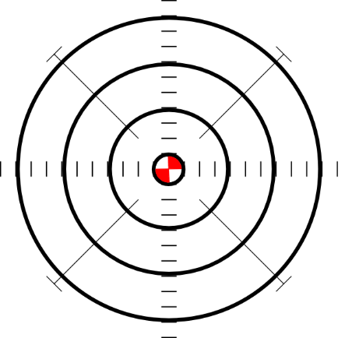
ce
doce
centro
MADRID 1KM
cerca
necesitar
necesario
[necessary]
[to need]
parecer
[to seem; appear]
Nick Avery
Notes:
Introduce and elicit the pronunciation of the individual SSC ‘ce’ and then the source word again (with gesture, if using). Then present and elicit the pronunciation of the five cluster words.
The cluster words have been chosen for their high-frequency, from a range of word classes, with the SSC (where possible) positioned within a variety of syllables within the words (e.g. initial, 2nd, final etc.). Additionally, we have tried to use words that build cumulatively on previously taught SSCs (see the Phonics Teaching Sequence document) and do not include new SSCs. Where new SSCs are used, they are often consonants which have a similar symbol-sound correspondence in English.

Slide 32
ce
doce
centro
cerca
necesitar
necesario
parecer
Nick Avery
Notes:
Without the images, students focus this time again closely on the SSC and the cluster words.

Slide 33
ci
cine
diciembre
ciencias
ciudad
cierto
decir
[to say; tell]
Nick Avery
Notes:
Introduce and elicit the pronunciation of the individual SSC ‘ci’ and then the source word again (with gesture, if using). Then present and elicit the pronunciation of the five cluster words.
The cluster words have been chosen for their high-frequency, from a range of word classes, with the SSC (where possible) positioned within a variety of syllables within the words (e.g. initial, 2nd, final etc.). Additionally, we have tried to use words that build cumulatively on previously taught SSCs (see the Phonics Teaching Sequence document) and do not include new SSCs. Where new SSCs are used, they are often consonants which have a similar symbol-sound correspondence in English.

Slide 34
ci
cine
diciembre
ciencias
ciudad
cierto
decir
Nick Avery
Notes:
Without the images, students focus this time again closely on the SSC and the cluster words.

Slide 35
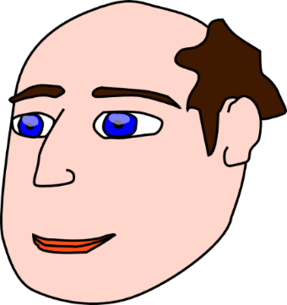
z
voz
diez
cabeza
zapato
zona
empezar
[to start]
Nick Avery
Notes:
Introduce and elicit the pronunciation of the individual SSC ‘z’ and then the source word again (with gesture, if using). Then present and elicit the pronunciation of the five cluster words.
The cluster words have been chosen for their high-frequency, from a range of word classes, with the SSC (where possible) positioned within a variety of syllables within the words (e.g. initial, 2nd, final etc.). Additionally, we have tried to use words that build cumulatively on previously taught SSCs (see the Phonics Teaching Sequence document) and do not include new SSCs. Where new SSCs are used, they are often consonants which have a similar symbol-sound correspondence in English.

Slide 36
z
voz
diez
cabeza
zapato
zona
empezar
Nick Avery
Notes:
Without the images, students focus this time again closely on the SSC and the cluster words.

Slide 37
que
parque
pequeño
porque
¿qué?
querer
[because]
[to want]
quedar
[to meet up; stay; suit]
Nick Avery
Notes:
Introduce and elicit the pronunciation of the individual SSC ‘que’ and then the source word again (with gesture, if using). Then present and elicit the pronunciation of the five cluster words.
The cluster words have been chosen for their high-frequency, from a range of word classes, with the SSC (where possible) positioned within a variety of syllables within the words (e.g. initial, 2nd, final etc.). Additionally, we have tried to use words that build cumulatively on previously taught SSCs (see the Phonics Teaching Sequence document) and do not include new SSCs. Where new SSCs are used, they are often consonants which have a similar symbol-sound correspondence in English.

Slide 38
que
parque
pequeño
porque
¿qué?
querer
quedar
Nick Avery
Notes:
Without the images, students focus this time again closely on the SSC and the cluster words.

Slide 39
qui
izquierda
tranquilo
quiero
[I want…]
quince
¿quién?
equipo
Nick Avery
Notes:
Introduce and elicit the pronunciation of the individual SSC ‘qui’ and then the source word again (with gesture, if using). Then present and elicit the pronunciation of the five cluster words.
The cluster words have been chosen for their high-frequency, from a range of word classes, with the SSC (where possible) positioned within a variety of syllables within the words (e.g. initial, 2nd, final etc.). Additionally, we have tried to use words that build cumulatively on previously taught SSCs (see the Phonics Teaching Sequence document) and do not include new SSCs. Where new SSCs are used, they are often consonants which have a similar symbol-sound correspondence in English.

Slide 40
qui
izquierda
tranquilo
quiero
quince
¿quién?
equipo
Nick Avery
Notes:
Without the images, students focus this time again closely on the SSC and the cluster words.

Slide 41
ga
regalo
jugar
gato
ganar
amiga
lugar
[place]
Nick Avery
Notes:
Introduce and elicit the pronunciation of the individual SSC ‘ga’ and then the source word again (with gesture, if using). Then present and elicit the pronunciation of the five cluster words.
The cluster words have been chosen for their high-frequency, from a range of word classes, with the SSC (where possible) positioned within a variety of syllables within the words (e.g. initial, 2nd, final etc.). Additionally, we have tried to use words that build cumulatively on previously taught SSCs (see the Phonics Teaching Sequence document) and do not include new SSCs. Where new SSCs are used, they are often consonants which have a similar symbol-sound correspondence in English.

Slide 42
ga
regalo
jugar
gato
ganar
amiga
lugar
Nick Avery
Notes:
Without the images, students focus this time again closely on the SSC and the cluster words.

Slide 43
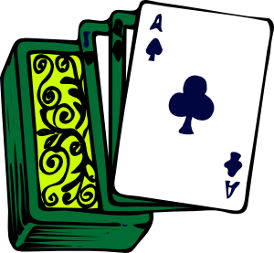
go
domingo
largo
SUNDAY
gol
juego (n)
conmigo
[with me]
algo
[something]
Nick Avery
Notes:
Introduce and elicit the pronunciation of the individual SSC ‘go’ and then the source word again (with gesture, if using). Then present and elicit the pronunciation of the five cluster words.
The cluster words have been chosen for their high-frequency, from a range of word classes, with the SSC (where possible) positioned within a variety of syllables within the words (e.g. initial, 2nd, final etc.). Additionally, we have tried to use words that build cumulatively on previously taught SSCs (see the Phonics Teaching Sequence document) and do not include new SSCs. Where new SSCs are used, they are often consonants which have a similar symbol-sound correspondence in English.

Slide 44
go
domingo
largo
gol
juego (n)
conmigo
algo
Nick Avery
Notes:
Without the images, students focus this time again closely on the SSC and the cluster words.

Slide 45
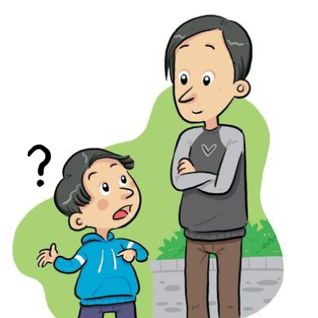
gu
¡mucho gusto!
segundo
preguntar
Nick Avery
Notes:
Introduce and elicit the pronunciation of the individual SSC ‘gu’ and then the source word again (with gesture, if using). Then present and elicit the pronunciation of the five cluster words.
The cluster words have been chosen for their high-frequency, from a range of word classes, with the SSC (where possible) positioned within a variety of syllables within the words (e.g. initial, 2nd, final etc.). Additionally, we have tried to use words that build cumulatively on previously taught SSCs (see the Phonics Teaching Sequence document) and do not include new SSCs. Where new SSCs are used, they are often consonants which have a similar symbol-sound correspondence in English.

Slide 46
gu
¡mucho gusto!
segundo
preguntar
Nick Avery
Notes:
Without the images, students focus this time again closely on the SSC and the cluster words.

Slide 47
j
julio
mejor
rojo
ojo
mujer
dejar
[to leave]
Nick Avery
Notes:
Introduce and elicit the pronunciation of the individual SSC ‘j’ and then the source word again (with gesture, if using). Then present and elicit the pronunciation of the five cluster words.
The cluster words have been chosen for their high-frequency, from a range of word classes, with the SSC (where possible) positioned within a variety of syllables within the words (e.g. initial, 2nd, final etc.). Additionally, we have tried to use words that build cumulatively on previously taught SSCs (see the Phonics Teaching Sequence document) and do not include new SSCs. Where new SSCs are used, they are often consonants which have a similar symbol-sound correspondence in English.

Slide 48
j
julio
mejor
rojo
ojo
mujer
dejar
Nick Avery
Notes:
Without the images, students focus this time again closely on the SSC and the cluster words.

Slide 49
ge
imagen
recoger
gesto
gente
argentino
generalmente
[generally]
Nick Avery
Notes:
Introduce and elicit the pronunciation of the individual SSC ‘ge’ and then the source word again (with gesture, if using). Then present and elicit the pronunciation of the five cluster words.
The cluster words have been chosen for their high-frequency, from a range of word classes, with the SSC (where possible) positioned within a variety of syllables within the words (e.g. initial, 2nd, final etc.). Additionally, we have tried to use words that build cumulatively on previously taught SSCs (see the Phonics Teaching Sequence document) and do not include new SSCs. Where new SSCs are used, they are often consonants which have a similar symbol-sound correspondence in English.

Slide 50
ge
imagen
recoger
gesto
gente
argentino
generalmente
Nick Avery
Notes:
Without the images, students focus this time again closely on the SSC and the cluster words.

Slide 51
gi
elegir
original
Versión original
P57
religión
imaginar
colegio
página
48
47
Nick Avery
Notes:
Introduce and elicit the pronunciation of the individual SSC ‘gi’ and then the source word again (with gesture, if using). Then present and elicit the pronunciation of the five cluster words.
The cluster words have been chosen for their high-frequency, from a range of word classes, with the SSC (where possible) positioned within a variety of syllables within the words (e.g. initial, 2nd, final etc.). Additionally, we have tried to use words that build cumulatively on previously taught SSCs (see the Phonics Teaching Sequence document) and do not include new SSCs. Where new SSCs are used, they are often consonants which have a similar symbol-sound correspondence in English.

Slide 52
gi
elegir
original
religión
imaginar
colegio
página
Nick Avery
Notes:
Without the images, students focus this time again closely on the SSC and the cluster words.

Slide 53
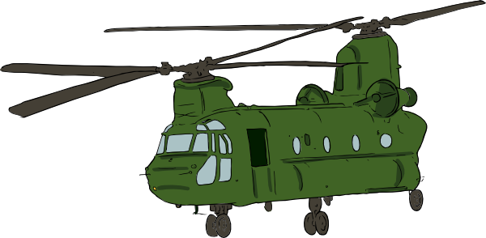
gue
guerra
Nick Avery
Notes:
Introduce and elicit the pronunciation of the individual SSC ‘gue’ and then the source word again (with gesture, if using). Then present and elicit the pronunciation of the five cluster words.
The cluster words have been chosen for their high-frequency, from a range of word classes, with the SSC (where possible) positioned within a variety of syllables within the words (e.g. initial, 2nd, final etc.). Additionally, we have tried to use words that build cumulatively on previously taught SSCs (see the Phonics Teaching Sequence document) and do not include new SSCs. Where new SSCs are used, they are often consonants which have a similar symbol-sound correspondence in English.

Slide 54
gue
guerra
Nick Avery
Notes:
Without the images, students focus this time again closely on the SSC and the cluster words.

Slide 55
gui
guitarra
Nick Avery
Notes:
Introduce and elicit the pronunciation of the individual SSC ‘gui’ and then the source word again (with gesture, if using). Then present and elicit the pronunciation of the five cluster words.
The cluster words have been chosen for their high-frequency, from a range of word classes, with the SSC (where possible) positioned within a variety of syllables within the words (e.g. initial, 2nd, final etc.). Additionally, we have tried to use words that build cumulatively on previously taught SSCs (see the Phonics Teaching Sequence document) and do not include new SSCs. Where new SSCs are used, they are often consonants which have a similar symbol-sound correspondence in English.

Slide 56
gui
guitarra
Nick Avery
Notes:
Without the images, students focus this time again closely on the SSC and the cluster words.

Slide 57
ñ
año
montaña
2019
señora
niña
español
mañana
[morning; tomorrow]
Nick Avery
Notes:
Introduce and elicit the pronunciation of the individual SSC ‘ñ’ and then the source word again (with gesture, if using). Then present and elicit the pronunciation of the five cluster words.
The cluster words have been chosen for their high-frequency, from a range of word classes, with the SSC (where possible) positioned within a variety of syllables within the words (e.g. initial, 2nd, final etc.). Additionally, we have tried to use words that build cumulatively on previously taught SSCs (see the Phonics Teaching Sequence document) and do not include new SSCs. Where new SSCs are used, they are often consonants which have a similar symbol-sound correspondence in English.

Slide 58
ñ
año
montaña
señora
niña
español
mañana
Nick Avery
Notes:
Without the images, students focus this time again closely on the SSC and the cluster words.

Slide 59
n
noche
poner
mano
nada
nosotros
tener
[to have]
Nick Avery
Notes:
Introduce and elicit the pronunciation of the individual SSC ‘n’ and then the source word again (with gesture, if using). Then present and elicit the pronunciation of the five cluster words.
The cluster words have been chosen for their high-frequency, from a range of word classes, with the SSC (where possible) positioned within a variety of syllables within the words (e.g. initial, 2nd, final etc.). Additionally, we have tried to use words that build cumulatively on previously taught SSCs (see the Phonics Teaching Sequence document) and do not include new SSCs. Where new SSCs are used, they are often consonants which have a similar symbol-sound correspondence in English.

Slide 60
n
noche
poner
mano
nada
nosotros
tener
Nick Avery
Notes:
Without the images, students focus this time again closely on the SSC and the cluster words.

Slide 61
v
verdad
verano
verde
joven
ver
vivir
[to live]
Nick Avery
Notes:
Introduce and elicit the pronunciation of the individual SSC ‘gi’ and then the source word again (with gesture, if using). Then present and elicit the pronunciation of the five cluster words.
The cluster words have been chosen for their high-frequency, from a range of word classes, with the SSC (where possible) positioned within a variety of syllables within the words (e.g. initial, 2nd, final etc.). Additionally, we have tried to use words that build cumulatively on previously taught SSCs (see the Phonics Teaching Sequence document) and do not include new SSCs. Where new SSCs are used, they are often consonants which have a similar symbol-sound correspondence in English.

Slide 62
v
verdad
verano
verde
joven
ver
vivir
Nick Avery
Notes:
Without the images, students focus this time again closely on the SSC and the cluster words.

Slide 63
b
abuela
bonito
[pretty]
saber
deber
celebrar
[to know]
bastante
[quite]
Nick Avery
Notes:
Introduce and elicit the pronunciation of the individual SSC ‘b’ and then the source word again (with gesture, if using). Then present and elicit the pronunciation of the five cluster words.
The cluster words have been chosen for their high-frequency, from a range of word classes, with the SSC (where possible) positioned within a variety of syllables within the words (e.g. initial, 2nd, final etc.). Additionally, we have tried to use words that build cumulatively on previously taught SSCs (see the Phonics Teaching Sequence document) and do not include new SSCs. Where new SSCs are used, they are often consonants which have a similar symbol-sound correspondence in English.

Slide 64
b
abuela
bonito
saber
deber
celebrar
bastante
Nick Avery
Notes:
Without the images, students focus this time again closely on the SSC and the cluster words.

Slide 65
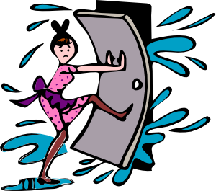
rr
correr
barrio
cerrar
perro
correcto
correo
@
Nick Avery
Notes:
Introduce and elicit the pronunciation of the individual SSC ‘rr’ and then the source word again (with gesture, if using). Then present and elicit the pronunciation of the five cluster words.
The cluster words have been chosen for their high-frequency, from a range of word classes, with the SSC (where possible) positioned within a variety of syllables within the words (e.g. initial, 2nd, final etc.). Additionally, we have tried to use words that build cumulatively on previously taught SSCs (see the Phonics Teaching Sequence document) and do not include new SSCs. Where new SSCs are used, they are often consonants which have a similar symbol-sound correspondence in English.
Word frequency rankings: perro [888]; correr [343]; cerrar [521]; correo [1638]; barrio [940]; correcto [1467] Source: Davies, M. & Davies, K. (2018). A Frequency Dictionary of Spanish: Core vocabulary for learners (2nd ed.) London: Routledge.

Slide 66
rr
correr
barrio
cerrar
perro
correcto
correo
Nick Avery
Notes:
Without the images, students focus this time again closely on the SSC and the cluster words.

Slide 67
r
caro
abro
seria
pero
Francia
sobre
[about; on top of]
Nick Avery
Notes:
Introduce and elicit the pronunciation of the individual SSC ‘r’ and then the source word again (with gesture, if using). Then present and elicit the pronunciation of the five cluster words.
The cluster words have been chosen for their high-frequency, from a range of word classes, with the SSC (where possible) positioned within a variety of syllables within the words (e.g. initial, 2nd, final etc.). Additionally, we have tried to use words that build cumulatively on previously taught SSCs (see the Phonics Teaching Sequence document) and do not include new SSCs. Where new SSCs are used, they are often consonants which have a similar symbol-sound correspondence in English.
Word frequency rankings: pero [30]; dar [42]; seria [856]; sobre [62]; abrir [246]; rico[398] Source: Davies, M. & Davies, K. (2018). A Frequency Dictionary of Spanish: Core vocabulary for learners (2nd ed.) London: Routledge.

Slide 68
r
caro
abro
seria
pero
Francia
sobre
Nick Avery
Notes:
Without the images, students focus this time again closely on the SSC and the cluster words.

Slide 69
h
hijo
helado
hospital
hasta luego
hablar
hacer
[to do]
Nick Avery
Notes:
Introduce and elicit the pronunciation of the individual SSC ‘h’ and then the source word again (with gesture, if using). Then present and elicit the pronunciation of the five cluster words.
The cluster words have been chosen for their high-frequency, from a range of word classes, with the SSC (where possible) positioned within a variety of syllables within the words (e.g. initial, 2nd, final etc.). Additionally, we have tried to use words that build cumulatively on previously taught SSCs (see the Phonics Teaching Sequence document) and do not include new SSCs. Where new SSCs are used, they are often consonants which have a similar symbol-sound correspondence in English.

Slide 70
h
hijo
helado
hospital
hasta luego
hablar
hacer
Nick Avery
Notes:
Without the images, students focus this time again closely on the SSC and the cluster words.

