Slide 1
French Phonics Collection
SSC [é]
Artwork by: Chloé Motard
Date updated: 17/02/21
Notes:
Artwork by Chloé Motard. All additional pictures selected are available under a Creative Commons license, no attribution required.

Slide 2
SSC [é]
phonétique
Introduction

Slide 3
é
[é / -er / -ez]
écrire
Notes:
Timing: 1 minute
Aim: To introduce SSC [é]
Procedure: 1. Present the letter(s) and say the [é] sound first, on its own. Students repeat it with you. 2. Bring up the word ”écrire” on its own, say it, students repeat it, so that they have the opportunity to focus all of their attention on the connection between the written word and its sound.
3. A possible gesture for this would be to mime the act of writing (onto the palm of the other hand perhaps). 4. Roll back the animations and work through 1-3 again, but this time, dropping your voice completely to listen carefully to the students saying the [é] sound, pronouncing ”écrire” and, if using, doing the gesture.
Word frequency (1 is the most frequent word in French):
écrire [382] Source: Londsale, D., & Le Bras, Y. (2009). A Frequency Dictionary of French: Core vocabulary for learners London: Routledge.

Slide 4
é
écrire
[é / -er / -ez]
Notes:
With sound and no pictures to focus all attention on the sound-symbol correspondence.

Slide 5
é
[é / -er / -ez]
écrire
Notes:
Without sound to elicit pronunciation (without first hearing the teacher).
Teacher to elicit pronunciation by asking “Comment dit-on …”/

Slide 6
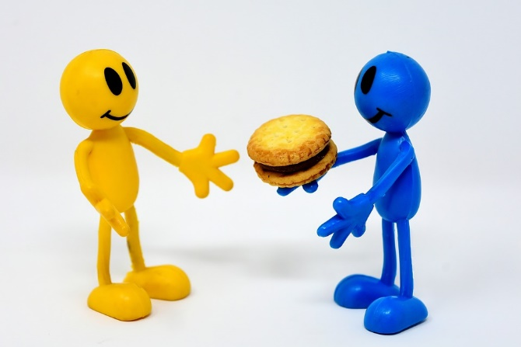
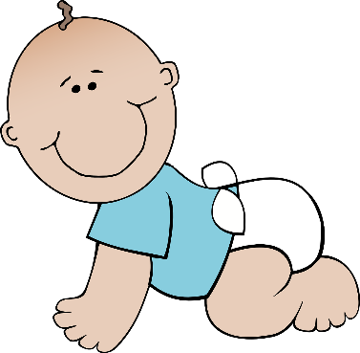
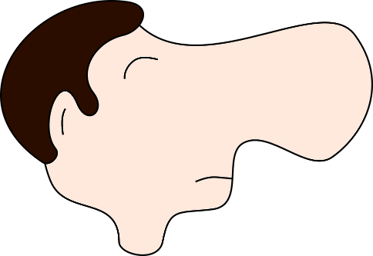
é
bébé
donner
[é / -er / -ez]
nez
parler
écrire
aller
[to go]
Notes:
Timing: 2 minutes
Aim: To introduce/consolidate SSC [é]
Procedure:
1. Introduce and elicit the pronunciation of the individual SSC [é] and then the source word again ‘écrire’ (with gesture, if using). 2. Then present and elicit the pronunciation of the five cluster words.
The cluster words have been chosen for their high-frequency, from a range of word classes, with the SSC (where possible) positioned within a variety of syllables within the words (e.g. initial, 2nd, final etc.). Additionally, we have tried to use words that build cumulatively on previously taught SSCs (see the Phonics Teaching Sequence document) and do not include new SSCs. Where new SSCs are used, they are often consonants which have a similar symbol-sound correspondence in English.
Word frequency (1 is the most frequent word in French): écrire [382]; bébé [>5000]; aller [55] donner [46]; et [6]; parler [106]. Source: Londsale, D., & Le Bras, Y. (2009). A Frequency Dictionary of French: Core vocabulary for learners London: Routledge.

Slide 7
é
donner
bébé
[é / -er / -ez]
nez
parler
écrire
aller
Notes:
With sound and no pictures to focus all attention on the sound-symbol correspondence.

Slide 8
é
donner
bébé
[é / -er / -ez]
nez
parler
écrire
aller
Notes:
Without sound to elicit pronunciation (without first hearing the teacher).
Teacher to elicit pronunciation by asking “Comment dit-on …"

Slide 9
Phonétique
écouter
In which order do you hear the words? Write 1 or 2.
[SFe]
[é / -er / -ez]
__ vole (I fly)
__ volez (you fly)
1
2
a
__ porte (door)
__ porter (to wear)
2
1
b
__ marche (step)
__ marché (market)
2
1
c
__ ferme (farm)
__ fermer (to close)
d
1
2
__ tourne (spins)
__ tournée (tour)
e
1
2
Notes:
Timing: 4 minutes
Aim: aural recognition of SSCs [SFe] and [é / -er / -et]
Procedure:
1. Click the letters to play the audio.
2. Students write ‘1’ beside the first word they hear, and ‘2’ beside the second
3. Click to reveal the answers.

Slide 10
Phonétique
assez
parler
papier
quite
60
voler
réalité
bébé
to fly
Secondes
éviter
médias
to avoid
médical
février
0
DÉBUT
February
Notes:
Timing: 1 minute
Aim: oral production of SSC [é / -er / -ez]
Procedure:
1. Students say the words alternately out loud with a partner, building up speed, over 1 minute’s intensive practice. They call in any order they like, students are not allowed to repeat the one they said in their last turn.
2. Teacher can circulate to listen into their SSC knowledge.
3. Click on début to start a one-minute timer on the screen.
4. Click on the words to hear them said by a native speaker. Students repeat.
Word frequency (1 is the most frequent word in French): assez [321], papier [951], réalité [532], bébé [2271], voler [1610], médical [1566], médias [1585], éviter [396], février [1136]
Source: Londsale, D., & Le Bras, Y. (2009). A Frequency Dictionary of French: Core vocabulary for learners London: Routledge.

Slide 11
Phonétique
assez
parler
papier
quite
60
voler
réalité
bébé
to fly
Secondes
éviter
médias
to avoid
médical
février
0
DÉBUT
February
Notes:
Timing: 1 minute
Aim: oral production of SSC [é / -er / -ez]
Procedure:
1. Individually, students read out the words but in alphabetical order. They keep going for one minute.
2. Teacher can circulate to listen into their SSC knowledge.
Word frequency (1 is the most frequent word in French): assez [321], papier [951], réalité [532], bébé [2271], voler [1610], médical [1566], médias [1585], éviter [396], février [1136]
Source: Londsale, D., & Le Bras, Y. (2009). A Frequency Dictionary of French: Core vocabulary for learners London: Routledge.

Slide 12
SSC [é]
phonétique
Consolidation [1]

Slide 13
é
[é / -er / -ez]
écrire
Notes:
Timing: 1 minute
Aim: To consolidate SSC [é]
Procedure: 1. Present the letter(s) and say the [é] sound first, on its own. Students repeat it with you. 2. Bring up the word ”écrire” on its own, say it, students repeat it, so that they have the opportunity to focus all of their attention on the connection between the written word and its sound.
3. A possible gesture for this would be to mime the act of writing (onto the palm of the other hand perhaps). 4. Roll back the animations and work through 1-3 again, but this time, dropping your voice completely to listen carefully to the students saying the [é] sound, pronouncing ”écrire” and, if using, doing the gesture.
Word frequency (1 is the most frequent word in French):
écrire [382] Source: Londsale, D., & Le Bras, Y. (2009). A Frequency Dictionary of French: Core vocabulary for learners London: Routledge.

Slide 14
é
écrire
[é / -er / -ez]
Notes:
With sound and no pictures to focus all attention on the sound-symbol correspondence.

Slide 15
é
[é / -er / -ez]
écrire
Notes:
Without sound to elicit pronunciation (without first hearing the teacher).
Teacher to elicit pronunciation by asking “Comment dit-on …”/

Slide 16
é
bébé
donner
[é / -er / -ez]
nez
parler
écrire
aller
[to go]
Notes:
Timing: 2 minutes
Aim: To consolidate SSC [é]
Procedure:
1. Introduce and elicit the pronunciation of the individual SSC [é] and then the source word again ‘écrire’ (with gesture, if using). 2. Then present and elicit the pronunciation of the five cluster words.
The cluster words have been chosen for their high-frequency, from a range of word classes, with the SSC (where possible) positioned within a variety of syllables within the words (e.g. initial, 2nd, final etc.). Additionally, we have tried to use words that build cumulatively on previously taught SSCs (see the Phonics Teaching Sequence document) and do not include new SSCs. Where new SSCs are used, they are often consonants which have a similar symbol-sound correspondence in English.
Word frequency (1 is the most frequent word in French): écrire [382]; bébé [>5000]; aller [55] donner [46]; et [6]; parler [106]. Source: Londsale, D., & Le Bras, Y. (2009). A Frequency Dictionary of French: Core vocabulary for learners London: Routledge.

Slide 17
é
donner
bébé
[é / -er / -ez]
nez
parler
écrire
aller
Notes:
With sound and no pictures to focus all attention on the sound-symbol correspondence.

Slide 18
é
donner
bébé
[é / -er / -ez]
nez
parler
écrire
aller
Notes:
Without sound to elicit pronunciation (without first hearing the teacher).
Teacher to elicit pronunciation by asking “Comment dit-on …"

Slide 19
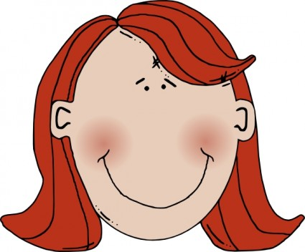
Amies ou ennemies ?
écouter
Elles ont une chose en commun:
1
Elles sont très différentes !
Agnès
é
è
e
et
Chloé
Notes:
Timing: 5 minutes (for 8 slides)
Aim: Aural recognition of SSC [è] in contrast to [é] and [e]. Names are used so that students focus on the SSCs rather than vocabulary knowledge.
Procedure:
1. Students write 1-8 in their workbooks, and for each write down either the SSC that is common to both names, or “[-]”.
2. Click the number to hear the pairs of names. This can be repeated as necessary depending on the level of the class.
3. The answers are animated to show first whether the two names have “something in common” (the SSC [e], [è] or [e]!) or if they are “very different” (no common SSC).
4. On a final click, the names in full including the SSC highlighted in blue.
Transcript:
1. Agnès et Chloé

Slide 20
Amies ou ennemies ?
écouter
Elles ont une chose en commun:
2
Elles sont très différentes !
Léa
é
è
e
et
Zoé
Notes:
Transcript:
2. Léa et Zoé

Slide 21
Amies ou ennemies ?
écouter
Elles ont une chose en commun:
3
Elles sont très différentes !
Madeleine
é
è
e
et
Renée
Notes:
Transcript:
3. Madeleine et Renée

Slide 22
Amies ou ennemies ?
écouter
Elles ont une chose en commun:
4
Elles sont très différentes !
Marylène
é
è
e
et
Émeline
Notes:
Transcript:
4. Marylène et Émeline

Slide 23
Amies ou ennemies ?
écouter
Elles ont une chose en commun:
5
Elles sont très différentes !
Solène
é
è
e
et
Cécile
Notes:
Transcript:
5. Solène et Cécile

Slide 24
Amies ou ennemies ?
écouter
Elles ont une chose en commun:
6
Elles sont très différentes !
Michèle
é
è
e
et
Mylène
Notes:
Transcript:
6. Michèle et Mylène

Slide 25
Amies ou ennemies ?
écouter
Elles ont une chose en commun:
7
Elles sont très différentes !
Ségolène
é
è
e
et
Aurélie
Notes:
Transcript:
7. Ségolène et Aurélie

Slide 26
Amies ou ennemies ?
écouter
Elles ont une chose en commun:
8
Elles sont très différentes !
Adèle
é
è
e
et
Hélène
Notes:
Transcript:
8. Adèle et Hélène

