Slide 1
French Phonics Collection
SSC [y]
Artwork by: Chloé Motard
Date updated: 30/08/2022
Notes:
Artwork by Chloé Motard. All additional pictures selected are available under a Creative Commons license, no attribution required.

Slide 2
SSC [y]
phonétique
Introduction

Slide 3
y
y
Notes:
Timing: 1 minute
Aim: To introduce SSC [y]
Procedure: 1. Present the letter(s) and say the [y] sound first, on its own. Students repeat it with you. 2. Bring up the word ”y” on its own, say it, students repeat it, so that they have the opportunity to focus all of their attention on the connection between the written word and its sound.
3. A possible gesture for this would be [to point over ‘there’]. 4. Roll back the animations and work through 1-3 again, but this time, dropping your voice completely to listen carefully to the students saying the [y] sound, pronouncing ”y” and, if using, doing the gesture.
Word frequency (1 is the most frequent word in French):
y [36]
Source: Londsale, D., & Le Bras, Y. (2009). A Frequency Dictionary of French: Core vocabulary for learners London: Routledge.

Slide 4
y
y
Notes:
With sound and no pictures to focus all attention on the sound-symbol correspondence.

Slide 5
y
y
Notes:
Without sound to elicit pronunciation (without first hearing the teacher).
Teacher to elicit pronunciation by asking “Comment dit-on …”/

Slide 6
y
rythme
système
style
y
analyser
[to analyse]
physique
Notes:
Timing: 2 minutes
Aim: To introduce SSC [y]
Procedure:
1. Introduce and elicit the pronunciation of the individual SSC [y] and then the source word again ‘y’ (with gesture, if using). 2. Then present and elicit the pronunciation of the five cluster words.
The cluster words have been chosen for their high-frequency, from a range of word classes, with the SSC (where possible) positioned within a variety of syllables within the words (e.g. initial, 2nd, final etc.). Additionally, we have tried to use words that build cumulatively on previously taught SSCs (see the Phonics Teaching Sequence document) and do not include new SSCs. Where new SSCs are used, they are often consonants which have a similar symbol-sound correspondence in English.
Word frequency (1 is the most frequent word in French): système [289]; style [1999] physique [1146]; analyser [1209]; rythme [1662] Source: Londsale, D., & Le Bras, Y. (2009). A Frequency Dictionary of French: Core vocabulary for learners London: Routledge.

Slide 7
y
rythme
système
style
y
analyser
physique
Notes:
With sound and no pictures to focus all attention on the sound-symbol correspondence.

Slide 8
y
rythme
système
style
y
analyser
physique
Notes:
Without sound to elicit pronunciation (without first hearing the teacher).
Teacher to elicit pronunciation by asking “Comment dit-on …”

Slide 9
[y] en anglais vs français
écouter / parler
English | French
Syrian | syrien
anonymous | anonyme
system | système
Pythagoras | Pythagore
myth | mythe
cycling | cyclisme
English [y] in the middle of a word sounds like ‘ih’.
French [y] sounds like SSC [i].
A
B
C
D
E
F
Notes:
Timing: 3 minutes
Aim: Oral production of SSC [y]. Raising awareness of pronunciation differences between French and English [y].
Procedure:
1. Students say the English words and French words – focusing on the difference in pronunciation [French y is a more exaggerated sound than English y]
2. Click on letters to hear French pronunciation. Students repeat.
3. Click to bring up pronunciation tip.
Transcript:
a. syrien
b. anonyme
c. système
d. pythagore
e. mythe
f. cyclisme
Word frequency (1 is the most frequent word in French): anonyme[3129], syrien [4453], pythagore [>5000], système [289], cyclisme [>5000]
Source: Londsale, D., & Le Bras, Y. (2009). A Frequency Dictionary of French: Core vocabulary for learners London: Routledge.

Slide 10
y
rythme
système
style
y
analyser
[to analyse]
physique
Notes:
Timing: 1 minute
Aim: To consolidate SSC [y]
Procedure:
1. Introduce and elicit the pronunciation of the individual SSC [y] and then the source word again ‘y’ (with gesture, if using). 2. Then present and elicit the pronunciation of the five cluster words.
The cluster words have been chosen for their high-frequency, from a range of word classes, with the SSC (where possible) positioned within a variety of syllables within the words (e.g. initial, 2nd, final etc.). Additionally, we have tried to use words that build cumulatively on previously taught SSCs (see the Phonics Teaching Sequence document) and do not include new SSCs. Where new SSCs are used, they are often consonants which have a similar symbol-sound correspondence in English.
Word frequency (1 is the most frequent word in French): système [289]; style [1999] physique [1146]; analyser [1209]; rythme [1662] Source: Londsale, D., & Le Bras, Y. (2009). A Frequency Dictionary of French: Core vocabulary for learners London: Routledge.

Slide 11
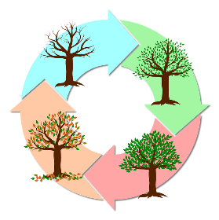
Phonétique
lire / parler
Dis les mots. Make sure to use your knowledge of French SSCs and not your knowledge of English!
60
typhon
analyser
[typhoon]
mystère
[to analyse]
cycle
[mystery]
psychologie
secondes
python
[psychology]
recycler
rythme
dynamique
hypothèse
[vibrant]
[hypothesis]
cynique
typique
0
[cynical]
[typical]
DÉBUT
Notes:
Timing: 5 minutes
Aim: Oral production of unknown words containing SSC [y].
Procedure:
1. Split students into pairs.
2. Click début to start the timer. NB: at higher levels, the timer can be set to a shorter time. To do this, click on ‘animations’ and then the orange timer bar. Adjust the number of seconds in ‘duration’.
3. Speaking student tries to pronounce all words accurately within a minute.
4. Listening student checks pronunciation. If they hear an English pronunciation of [y], they ask their partner to repeat the word correctly three times before proceeding.
5. When timer finishes, swap so other person speaks.
6. The winner is the student who pronounced the most words correctly within a given time.
7. Check pronunciation by clicking on words to hear them said by a native speaker. Students repeat.
Word frequency (1 is the most frequent word in French): cycle [2462], mystère [2777], analyser [1209], cynique [3547], hypothèse [1669], typique [4178], dynamique [2078], psychologie [4836], python [>5000], recycler [>5000], rythme [1662], typhon [>5000]
Source: Londsale, D., & Le Bras, Y. (2009). A Frequency Dictionary of French: Core vocabulary for learners London: Routledge.

Slide 12
SSC [y]
phonétique
Consolidation [1]

Slide 13
y
y
Notes:
Timing: 1 minute
Aim: To consolidate SSC [y]
Procedure: 1. Present the letter(s) and say the [y] sound first, on its own. Students repeat it with you. 2. Bring up the word ”y” on its own, say it, students repeat it, so that they have the opportunity to focus all of their attention on the connection between the written word and its sound.
3. A possible gesture for this would be [to point over ‘there’]. 4. Roll back the animations and work through 1-3 again, but this time, dropping your voice completely to listen carefully to the students saying the [y] sound, pronouncing ”y” and, if using, doing the gesture.
Word frequency (1 is the most frequent word in French):
y [36]
Source: Londsale, D., & Le Bras, Y. (2009). A Frequency Dictionary of French: Core vocabulary for learners London: Routledge.

Slide 14
oy
envoyer
Notes:
Timing: 1 minute
Aim: To consolidate SSC [oy]
Procedure: 1. Present the letter(s) and say the [oy] sound first, on its own. Students repeat it with you. 2. Bring up the word ”envoyer” on its own, say it, students repeat it, so that they have the opportunity to focus all of their attention on the connection between the written word and its sound.
3. A possible gesture for this would be [sending a letter]. 4. Roll back the animations and work through 1-3 again, but this time, dropping your voice completely to listen carefully to the students saying the [oy] sound, pronouncing ”envoyer” and, if using, doing the gesture.
Word frequency (1 is the most frequent word in French):
enyoyer [526]
Source: Londsale, D., & Le Bras, Y. (2009). A Frequency Dictionary of French: Core vocabulary for learners London: Routledge.

Slide 15
Phonétique
écouter / écrire
Écoute. C’est [oy] ou [y] ?
Q | mot | [oy] | [y]
 | joyau [jewel]
 | cycliste [cyclist]
 | symbole [symbol]
 | voyelle [vowel]
 | lycée [sixth form]
 | gymnase [gym]
 | incroyable [incredible]
 | moyen [average]
1
2
3
4
5
6
7
8
Notes:
Timing: 5 minutes
Aim: Aural recognition of SSCs [oy] and [y]
Procedure:
1. Click to play the audio.
2. Students tick whether they hear [oy] or [y].
3. Click to reveal the answers.
4. Click to reveal the words.
Transcript:
joyau
cycliste
symbole
voyelle
lycée
gymnase
incroyable
citoyen
Word frequency of unknown words used (1 is the most frequent word in French):
joyau [>5000], voyelle [>5000], incroyable [2231], citoyen [1081]
Word frequency of near-cognates used (1 is the most frequent word in French): symbole [1427], cycliste [>5000], mystère [2777], gymnase [>5000],
Source: Lonsdale, D., & Le Bras, Y. (2009). A Frequency Dictionary of French: Core vocabulary for learners London: Routledge.

Slide 16
y
rythme
système
style
y
analyser
[to analyse]
physique
Notes:
Timing: 1 minute
Aim: To consolidate SSC [y]
Procedure:
1. Introduce and elicit the pronunciation of the individual SSC [y] and then the source word again ‘y’ (with gesture, if using). 2. Then present and elicit the pronunciation of the five cluster words.
The cluster words have been chosen for their high-frequency, from a range of word classes, with the SSC (where possible) positioned within a variety of syllables within the words (e.g. initial, 2nd, final etc.). Additionally, we have tried to use words that build cumulatively on previously taught SSCs (see the Phonics Teaching Sequence document) and do not include new SSCs. Where new SSCs are used, they are often consonants which have a similar symbol-sound correspondence in English.
Word frequency (1 is the most frequent word in French): système [289]; style [1999] physique [1146]; analyser [1209]; rythme [1662] Source: Londsale, D., & Le Bras, Y. (2009). A Frequency Dictionary of French: Core vocabulary for learners London: Routledge.

Slide 17
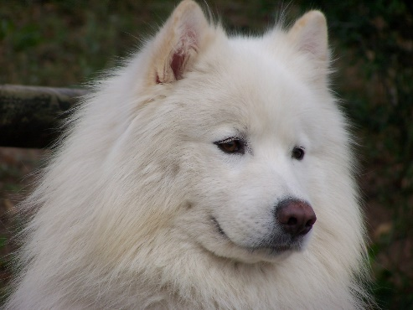
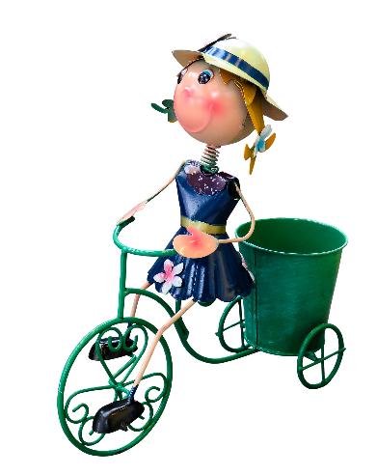
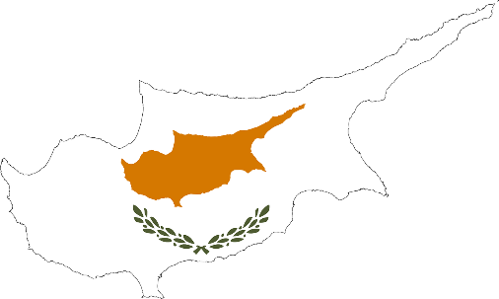
Des virelangues !
écouter / parler
Le samoyède syrien aime aboyer sur le python royal.
[The Syrian Samoyed likes to bark at the royal python.]
Sylvie la cycliste joyeuse voyage à Chypre.
[Sylvie the joyful cyclist travels to Cyprus.]
Notes:
Timing: 4 minutes (slide 1/2)
Aim: practising oral production of SSCs [oy], [y]
Procedure:
Click on play button to hear a tongue twister. Students repeat as many times a necessary.
If students feel confident, they should speed up – compete to see who can pronounce it the fastest
Transcript:
Le samoyède syrien aime aboyer au python royal.
Sylvie la cycliste joyeuse voyage en Chypre.
Word frequency of unknown words used (1 is the most frequent word in French):
samoyède [>5000], aboyer [>5000], Chypre [>5000]
Word frequency of cognates used (1 is the most frequent word in French):
syrien [4453], python [>5000], royal [2290], cycliste [>5000] , joyeux [3987]
Source: Lonsdale, D., & Le Bras, Y. (2009). A Frequency Dictionary of French: Core vocabulary for learners London: Routledge.

Slide 18
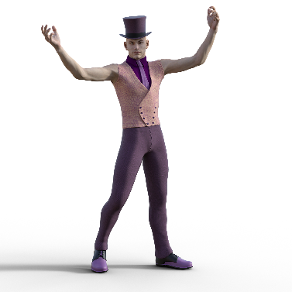
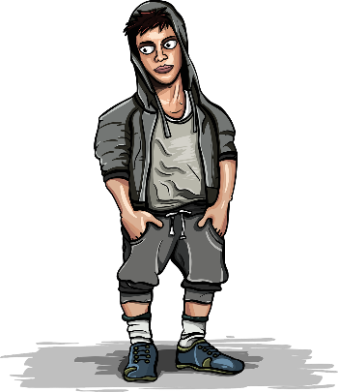
Des virelangues !
écouter / parler
Le lycéen flamboyant aime le rythme de l’hymne calypso.
[The flamboyant sixth-former likes the rhythm of the calypso carol.]
Le voyou moyen doit nettoyer les pylônes du royaume.
[The average hooligan has to clean the pylons of the kingdom.]
Notes:
Slide 2/2
Transcript:
Le lycéen flamboyant aime le rythme de l’hymne calypso.
Le voyou moyen doit nettoyer les pylônes du royaume.
Word frequency of unknown words used (1 is the most frequent word in French):
lycéen [>5000], hymne [4862], voyou [>5000], moyen [186], nettoyer [3887], royaume [2620]
Word frequency of cognates used (1 is the most frequent word in French):
flamboyant [>5000], rythme [1662], calypso [>5000], pylône [>5000]
Source: Lonsdale, D., & Le Bras, Y. (2009). A Frequency Dictionary of French: Core vocabulary for learners London: Routledge.

Slide 19
SSC [y]
phonétique
Consolidation [2]

Slide 20
y
y
Notes:
Timing: 1 minute
Aim: To consolidate SSC [y]
Procedure: 1. Present the letter(s) and say the [y] sound first, on its own. Students repeat it with you. 2. Bring up the word ”y” on its own, say it, students repeat it, so that they have the opportunity to focus all of their attention on the connection between the written word and its sound.
3. A possible gesture for this would be [to point over ‘there’]. 4. Roll back the animations and work through 1-3 again, but this time, dropping your voice completely to listen carefully to the students saying the [y] sound, pronouncing ”y” and, if using, doing the gesture.
Word frequency (1 is the most frequent word in French):
y [36]
Source: Lonsdale, D., & Le Bras, Y. (2009). A Frequency Dictionary of French: Core vocabulary for learners London: Routledge.

Slide 21
y
rythme
système
style
y
analyser
[to analyse]
physique
Notes:
Timing: 1 minute
Aim: To consolidate SSC [y]
Procedure:
1. Introduce and elicit the pronunciation of the individual SSC [y] and then the source word again ‘y’ (with gesture, if using). 2. Then present and elicit the pronunciation of the five cluster words.
The cluster words have been chosen for their high-frequency, from a range of word classes, with the SSC (where possible) positioned within a variety of syllables within the words (e.g. initial, 2nd, final etc.). Additionally, we have tried to use words that build cumulatively on previously taught SSCs (see the Phonics Teaching Sequence document) and do not include new SSCs. Where new SSCs are used, they are often consonants which have a similar symbol-sound correspondence in English.
Word frequency (1 is the most frequent word in French): système [289]; style [1999] physique [1146]; analyser [1209]; rythme [1662] Source: Lonsdale, D., & Le Bras, Y. (2009). A Frequency Dictionary of French: Core vocabulary for learners London: Routledge.

Slide 22
[y] et [i]
écouter
What do you notice about these words?
mite
[moth]
mythe
[myth]
SSC [y] is the same sound as SSC [i], which you already know.
SSC [y] is often found in cognate words (words which look like English or another language).
Notes:
Timing: 1 minute
Aim: Raising awareness of the identical sound in SSCs [y] and [i].
For a reminder of Year 7 SSC [i], see the two slides that follow.
Word frequency of unknown words (1 is the most frequent word in French): mite [>5000]
Source: Lonsdale, D., & Le Bras, Y. (2009). A Frequency Dictionary of French: Core vocabulary for learners London: Routledge.
Word frequency of cognates (1 is the most frequent word in French): mythe [2910]
Source: Lonsdale, D., & Le Bras, Y. (2009). A Frequency Dictionary of French: Core vocabulary for learners London: Routledge.

Slide 23
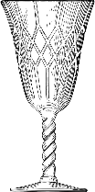
[y] et [i]
parler
Attention ! Some words look like English.
Use your French SSC knowledge to pronounce them correctly.
60
type
cultiver
analyser
cycle
[to grow]
[to analyse]
secondes
fragile
mystère
tisser
[mystery]
bijou
[to weave]
tragique
[jewel]
prime
héritage
[bonus]
[tragic]
hypothèse
cynique
mérite
typique
0
[hypothesis]
[cynical]
[merit]
[typical]
DÉBUT
Notes:
Timing: 3 minutes
Aim: To practise pronunciation of SSCs [y] and [i] in individual words.
Procedure:
1. Split students into pairs.
2. Click début to start the timer
3. Students take it in turns try to pronounce as many words accurately as possible
4. The listening partner checks pronunciation and tallies the total number of words pronounced correctly within 30 seconds. If a student pronounces [i] or [y] the ‘English’ way, they must repeat it three times before scoring the point and continuing.
5. When timer finishes, swap roles.
6. Students tally up the total number of words said correctly. The student who has said the greatest number of words is the winner.
7. Go through all the words together as a class to confirm pronunciation (click on words to hear them pronounced by a native speaker, students repeat.)
Word frequency of unknown words (1 is the most frequent word in French): bijou [4301], tisser [4320], prime [2094]
Source: Lonsdale, D., & Le Bras, Y. (2009). A Frequency Dictionary of French: Core vocabulary for learners London: Routledge.
Word frequency of cognate words (1 is the most frequent word in French): type [440], cycle [2462], mystère [2777], analyser [1209], cynique [3547], hypothèse [1669], typique [4178], mérite [2035], tragique [2042], cultiver [2061], fragile [2107], héritage [2193]
Source: Lonsdsale, D., & Le Bras, Y. (2009). A Frequency Dictionary of French: Core vocabulary for learners London: Routledge.

Slide 24
Des virelangues
lire / parler
Lily lit typiquement un livre
dans son lit.
Lily typically reads a book in bed.
Notes:
Timing: 2 minutes. This is slide 1/2.
Aim: To practise pronunciation of [i] and [y] in full sentences.
Procedure:
1. Students sound out the words in the tongue twister.
2. Click audio button to hear tongue twister read out by a native speaker.
3. Students try to reproduce the tongue twister at a similar speed, then at increasing speeds.
4. Students listen to the audio again. This time, the teacher pauses the audio at different points and asks students to say the last word that they heard.
Transcript:
Lily lit typiquement un livre dans son lit.
Word frequency of unknown words used (1 is the most frequent word in French): typiquement [>5000]
Source: Lonsdale, D., & Le Bras, Y. (2009). A Frequency Dictionary of French: Core vocabulary for learners London: Routledge.

Slide 25
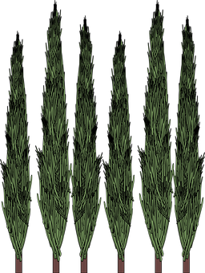
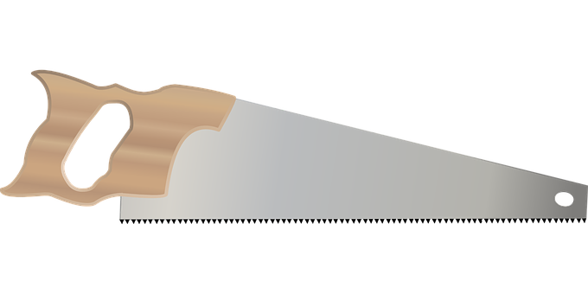
Des virelangues
lire / parler
Si six scies scient six cyprès,
six cents scies scient six cent cyprès.
If six saws saw six cypresses, six hundred saws saw six hundred cypresses
Notes:
This is slide 2/2.
NB: This tongue twister is very challenging! Students need to pay careful attention to the SSCs. They may need reassurance that the first 5 words are all supposed to sound the same!
Transcript:
Si six scies scient six cyprès, six cents six scies scient six cent six cyprès
Word frequency of unknown words used (1 is the most frequent word in French): scie [>5000], scier [>5000], cyprès [>5000], cent [704]
Source: Lonsdale, D., & Le Bras, Y. (2009). A Frequency Dictionary of French: Core vocabulary for learners London: Routledge.

Slide 26
Phonétique
écouter
Écoute. Les mots ont-ils la SSC [oy] ou [y] ?
Q | mot | en anglais | [oy] | [y]
 | joyau | [jewel]
 | c y cliste | [cyclist]
 | r y thme | [rhythm]
 | voyelle | [vowel]
 | l y cée | [sixth form]
 | g y mnase | [gymnasium]
 | incroyable | [incredible]
 | citoyen | [citizen]
1
_
2
_
Notice that all the words containing [y] are cognates (look like English).
3
_
4
_
5
_
6
_
7
_
8
_
Notes:
Timing: 5 minutes
Aim: Aural recognition of SSCs [oy] and [y] in single words; connecting SSC [y] with cognate words
Procedure:
1. Click to play the audio.
2. Students tick whether they hear [oy] or [y].
3. Click to reveal the answers.
4. Note that it is the near-cognates that contain SSC [y].
Transcript:
1. joyau
2. cycliste
3 rythme
4. voyelle
5. lycée
6. gymnase
7. incroyable
8. citoyen
Word frequency of unknown words used (1 is the most frequent word in French):
joyau [>5000], voyelle [>5000], incroyable [2231], citoyen [1081]
Word frequency of near-cognates used (1 is the most frequent word in French): rythme [1662], cycliste [>5000], mystère [2777], gymnase [>5000],
Source: Lonsdale, D., & Le Bras, Y. (2009). A Frequency Dictionary of French: Core vocabulary for learners London: Routledge.

Slide 27
Des virelangues !
écouter / parler
Le samoyède syrien aime aboyer sur le python royal.
[The Syrian Samoyed likes to bark at the royal python.]
Sylvie la cycliste joyeuse voyage à Chypre.
[Sylvie the joyful cyclist travels to Cyprus.]
Notes:
Timing: 4 minutes. This is slide 1/2.
Aim: oral production of SSCs [oy] and [y] in longer contexts; fluency production
Procedure:
1. Click on play button to hear a tongue twister said aloud by a native speaker. Students read along.
2. Students repeat as many times a necessary.
3. If students feel confident, they can try to speed up – compete to see who can say a correct the sentence correctly fastest.
Transcript:
Le samoyède syrien aime aboyer au python royal.
Sylvie la cycliste joyeuse voyage en Chypre.
Word frequency of unknown words used (1 is the most frequent word in French):
samoyède [>5000], aboyer [>5000], Chypre [>5000]
Word frequency of cognates used (1 is the most frequent word in French):
syrien [4453], python [>5000], royal [2290], cycliste [>5000] , joyeux [3987]
Source: Lonsdale, D., & Le Bras, Y. (2009). A Frequency Dictionary of French: Core vocabulary for learners London: Routledge.

Slide 28
Des virelangues !
écouter / parler
Le lycéen flamboyant aime le rythme de l’hymne calypso.
[The flamboyant sixth-former likes the rhythm of the calypso carol.]
Le voyou moyen doit nettoyer les pylônes du royaume.
[The average hooligan has to clean the pylons of the kingdom.]
Notes:
This is slide 2/2.
Transcript:
Le lycéen flamboyant aime le rythme de l’hymne calypso.
Le voyou moyen doit nettoyer les pylônes du royaume.
Word frequency of unknown words used (1 is the most frequent word in French):
lycéen [>5000], hymne [4862], voyou [>5000], moyen [186], nettoyer [3887], royaume [2620]
Word frequency of cognates used (1 is the most frequent word in French):
flamboyant [>5000], rythme [1662], calypso [>5000], pylône [>5000]
Source: Lonsdale, D., & Le Bras, Y. (2009). A Frequency Dictionary of French: Core vocabulary for learners London: Routledge.

