Slide 1
French Phonics Collection
SSC [qu]
Artwork by: Chloé Motard
Date updated: 31/08/22
Notes:
Artwork by Chloé Motard. All additional pictures selected are available under a Creative Commons license, no attribution required.

Slide 2
SSC [qu]
phonétique
Introduction

Slide 3
qu
?
question
Notes:
Timing: 1 minute
Aim: To introduce/consolidate SSC [qu]
Procedure: 1. Present the letter(s) and say the [qu] sound first, on its own. Students repeat it with you. 2. Bring up the word ”question” on its own, say it, students repeat it, so that they have the opportunity to focus all of their attention on the connection between the written word and its sound.
3. A possible gesture for this would be to raise one’s eyebrows and look intently, as if querying something. 4. Roll back the animations and work through 1-3 again, but this time, dropping your voice completely to listen carefully to the students saying the [qu] sound, pronouncing ”question” and, if using, doing the gesture.
Word frequency (1 is the most frequent word in French):
question [144].
Source: Londsale, D., & Le Bras, Y. (2009). A Frequency Dictionary of French: Core vocabulary for learners London: Routledge.

Slide 4
qu
question
Notes:
With sound and no pictures to focus all attention on the sound-symbol correspondence.

Slide 5
qu
?
question
Notes:
Without sound to elicit pronunciation (without first hearing the teacher).
Teacher to elicit pronunciation by asking “Comment dit-on …"

Slide 6
qu
quatre
musique
?
question
expliquer
unique
[to explain]
manquer
[unique; only]
[to miss/be missing]
Notes:
Timing: 2 minutes
Aim: To introduce/consolidate SSC [qu]
Procedure:
1. Introduce and elicit the pronunciation of the individual SSC [qu] and then the source word again ‘question’ (with gesture, if using). 2. Then present and elicit the pronunciation of the five cluster words.
The cluster words have been chosen for their high-frequency, from a range of word classes, with the SSC (where possible) positioned within a variety of syllables within the words (e.g. initial, 2nd, final etc.). Additionally, we have tried to use words that build cumulatively on previously taught SSCs (see the Phonics Teaching Sequence document) and do not include new SSCs. Where new SSCs are used, they are often consonants which have a similar symbol-sound correspondence in English.
Word frequency (1 is the most frequent word in French): quarte [283]; musique [1139] expliquer [252]; manquer [583]; unique [402]; question [144]. Source: Londsale, D., & Le Bras, Y. (2009). A Frequency Dictionary of French: Core vocabulary for learners London: Routledge.

Slide 7
qu
quatre
musique
?
question
expliquer
unique
manquer
Notes:
With sound and no pictures to focus all attention on the sound-symbol correspondence.

Slide 8
qu
quatre
musique
?
question
expliquer
unique
manquer
Notes:
Without sound to elicit pronunciation (without first hearing the teacher).
Teacher to elicit pronunciation by asking “Comment dit-on …"

Slide 9
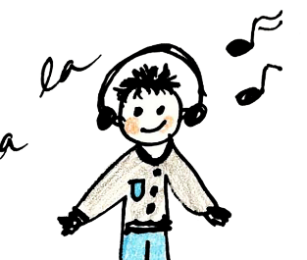
Phonétique
lire / parler
Phonétique
équipe
60
musique
quantité
équipement
[quantity]
Secondes
requête
manquer
[request]
[to miss]
4
expliquer
quatre
0
DÉBUT
Notes:
Timing: 5 minutes for three slides
Aim: automatisation of oral production of SSC [qu] at word level.
Procedure:
Tell students that they are going to take turns to say all the words within a given time, building up speed. They call in any order they like but are not allowed to repeat the one they said in their last turn.
Click on début to start the timer on the screen.
The listening students checks that the speaking student does not pronounce [qu] the English way. If they do, they must repeat the word correctly three times.
Students swap roles. Restart the timer.
Click to check pronunciation of the words.
Word frequency (1 is the most frequent word in French): musique [1139], équipe [814], équipement [1704], quantité [1680], requête [3750], manquer [583], expliquer [252], quatre [253] Source: Londsale, D., & Le Bras, Y. (2009). A Frequency Dictionary of French: Core vocabulary for learners London: Routledge.

Slide 10
Phonétique
Phonétique
lire / parler
Phonétique
Phonétique
équipe
45
musique
quantité
équipement
[quantity]
Secondes
requête
manquer
[request]
[to miss]
4
expliquer
quatre
0
DÉBUT
Notes:
As previous but with 15 fewer seconds on the timer.

Slide 11
Phonétique
Phonétique
lire / parler
Phonétique
Phonétique
équipe
30
musique
quantité
équipement
[quantity]
Secondes
requête
manquer
[request]
[to miss]
4
expliquer
quatre
0
DÉBUT
Notes:
As previous but with 15 fewer seconds on the timer still.

Slide 12
SSC [qu]
phonétique
Consolidation [1]

Slide 13
qu
?
question
Notes:
Timing: 1 minute
Aim: To introduce/consolidate SSC [qu]
Procedure: 1. Present the letter(s) and say the [qu] sound first, on its own. Students repeat it with you. 2. Bring up the word ”question” on its own, say it, students repeat it, so that they have the opportunity to focus all of their attention on the connection between the written word and its sound.
3. A possible gesture for this would be to raise one’s eyebrows and look intently, as if querying something. 4. Roll back the animations and work through 1-3 again, but this time, dropping your voice completely to listen carefully to the students saying the [qu] sound, pronouncing ”question” and, if using, doing the gesture.
Word frequency (1 is the most frequent word in French):
question [144].
Source: Londsale, D., & Le Bras, Y. (2009). A Frequency Dictionary of French: Core vocabulary for learners London: Routledge.

Slide 14
qu
question
Notes:
With sound and no pictures to focus all attention on the sound-symbol correspondence.

Slide 15
qu
?
question
Notes:
Without sound to elicit pronunciation (without first hearing the teacher).
Teacher to elicit pronunciation by asking “Comment dit-on …"

Slide 16
qu
quatre
musique
?
question
expliquer
unique
[to explain]
manquer
[unique; only]
[to miss/be missing]
Notes:
Timing: 2 minutes
Aim: To introduce/consolidate SSC [qu]
Procedure:
1. Introduce and elicit the pronunciation of the individual SSC [qu] and then the source word again ‘question’ (with gesture, if using). 2. Then present and elicit the pronunciation of the five cluster words.
The cluster words have been chosen for their high-frequency, from a range of word classes, with the SSC (where possible) positioned within a variety of syllables within the words (e.g. initial, 2nd, final etc.). Additionally, we have tried to use words that build cumulatively on previously taught SSCs (see the Phonics Teaching Sequence document) and do not include new SSCs. Where new SSCs are used, they are often consonants which have a similar symbol-sound correspondence in English.
Word frequency (1 is the most frequent word in French): quarte [283]; musique [1139] expliquer [252]; manquer [583]; unique [402]; question [144]. Source: Londsale, D., & Le Bras, Y. (2009). A Frequency Dictionary of French: Core vocabulary for learners London: Routledge.

Slide 17
qu
quatre
musique
?
question
expliquer
unique
manquer
Notes:
With sound and no pictures to focus all attention on the sound-symbol correspondence.

Slide 18
qu
quatre
musique
?
question
expliquer
unique
manquer
Notes:
Without sound to elicit pronunciation (without first hearing the teacher).
Teacher to elicit pronunciation by asking “Comment dit-on …"

Slide 19
Dictée – ‘q’ ou ‘c’ ?
Dictée – ‘q’ ou ‘c’ ?
écrire
1
quand
6
parc
2
comprendre
7
chaque
3
cadeau
8
quatre
4
sympathique
9
combien
5
question
10
caisse
Notes:
Timing: 5 minutes
Aim: reinforce students’ awareness of the fact that [qu] has the same pronunciation as hard [c].
Procedure:
The teacher plays the recorded words (all known vocabulary items) one at a time.
Students write them, then click to check.
Transcript:
1. quand
2. comprendre
3. cadeau
4. sympathique
5. question
6. parc
7. chaque
8. quatre
9. combien
10. caisse
Word frequency (1 is the most frequent word in French):
quand [119]; comprendre [95] cadeau [2298]; sympathique [4164]; question[144]; parc [1240], chaque [151], quatre [253], combien [800], caisse [1881]
Source: Londsale, D., & Le Bras, Y. (2009). A Frequency Dictionary of French: Core vocabulary for learners London: Routledge.

Slide 20
Phonétique
Phonétique
parler
Lots of French words containing [qu] come from other languages!
Attention! They are still pronounced the ‘French’ way!
60
conséquence
quitter
qualité
secondes
qualification
liquide
séquence
équivalent
qualifier
tranquille
quantité
0
fréquent
équipement
DÉBUT
Notes:
Timing: 5 minutes
Aim: oral production of a unknown cognate words containing SSC [qu]
Procedure
1. Teacher explains to students that although these words have the same or similar meanings to the English words they recognise, the pronunciation is not the same.
2. Teacher clicks ‘début’.
3. Student A reads the list of words out loud to student B. Student B listens carefully to their partner’s pronunciation, and stops Student A if the [qu] sound is pronounced the English way. They only stop their partner if the [qu] is pronounced incorrectly. If another mispronunciation is noticed, the listening student should note this and correct it at only the end of the round.
4. Students count how many words Student A managed to say correctly.
5. Students swap roles. The student with the most points at the end is the winner.
6. After two rounds, the teacher plays the correct pronunciation by clicking on the audio. Students repeat.
Word frequency (1 is the most frequent word in French):
conséquence [617], qualité [606], quitter [507], qualification [4004], liquid [3520], qualifier [1283], équivalent [2476], sequence [3099], quantité [1680], tranquille [2555], fréquent [2684], équipement [1704]
Source: Londsale, D., & Le Bras, Y. (2009). A Frequency Dictionary of French: Core vocabulary for learners London: Routledge.

Slide 21
SSC [qu]
phonétique
Consolidation [2]

Slide 22
qu
?
question
Notes:
Timing: 1 minute
Aim: To introduce/consolidate SSC [qu]
Procedure: 1. Present the letter(s) and say the [qu] sound first, on its own. Students repeat it with you. 2. Bring up the word ”question” on its own, say it, students repeat it, so that they have the opportunity to focus all of their attention on the connection between the written word and its sound.
3. A possible gesture for this would be to raise one’s eyebrows and look intently, as if querying something. 4. Roll back the animations and work through 1-3 again, but this time, dropping your voice completely to listen carefully to the students saying the [qu] sound, pronouncing ”question” and, if using, doing the gesture.
Word frequency (1 is the most frequent word in French):
question [144].
Source: Londsale, D., & Le Bras, Y. (2009). A Frequency Dictionary of French: Core vocabulary for learners London: Routledge.

Slide 23
qu
quatre
musique
?
question
expliquer
unique
[to explain]
manquer
[unique; only]
[to miss/be missing]
Notes:
Timing: 2 minutes
Aim: To introduce/consolidate SSC [qu]
Procedure:
1. Introduce and elicit the pronunciation of the individual SSC [qu] and then the source word again ‘question’ (with gesture, if using). 2. Then present and elicit the pronunciation of the five cluster words.
The cluster words have been chosen for their high-frequency, from a range of word classes, with the SSC (where possible) positioned within a variety of syllables within the words (e.g. initial, 2nd, final etc.). Additionally, we have tried to use words that build cumulatively on previously taught SSCs (see the Phonics Teaching Sequence document) and do not include new SSCs. Where new SSCs are used, they are often consonants which have a similar symbol-sound correspondence in English.
Word frequency (1 is the most frequent word in French): quarte [283]; musique [1139] expliquer [252]; manquer [583]; unique [402]; question [144]. Source: Londsale, D., & Le Bras, Y. (2009). A Frequency Dictionary of French: Core vocabulary for learners London: Routledge.

Slide 24
Des groupes consonantiques
écouter / écrire
Coche chaque fois que tu entends une des SSCs [th], [ch] ou [qu].
 | th | ch | qu | phrase
 |  |  |  | Mathieu est athlète.
 |  |  |  | Il cherche des marathons au Québec…
 |  |  |  | …parce qu’il est enthousiaste.
 |  |  |  | Son chat, Thibaut, mâche du thon québécois.
 |  |  |  | Son chien, Véronique, est chez Monique.
1
Mathieu is an athlete.
Ma__ieu est a__lète.
He looks for/is looking for marathons in Quebec…
Il __er__e des mara__ons au __ébec…
2
3
…because he is enthusiastic.
…parce __’il est en__ousiaste.
His cat, Thibaut, chews/is chewing tuna from Quebec.
4
Son __at, __ibaut, mâ__e du __on __ébecois.
Son __ien, Véroni__e, est __ez Moni__e.
His dog, Véronique, is at Monique’s place.
5
Notes:
Timing: 8 minutes
Aim: Aural recognition of SSCs [th], [ch], [qu] in longer contexts. Raising awareness of cross-linguistic differences in the pronunciation of these consonant clusters through use of cognate words.
Procedure:
1. Click on the buttons to play the audio.
2. Students listen and tick or transcribe the target SSCs.
3. Click to reveal answers (with more advanced classes, skip this step and move to step 4 to challenge students to translate the sentences through listening alone).
4. Students use the answers to try to translate the sentences into English, noticing the cognate words that they have transcribed.
5. Click to reveal answers.
6. Ask students to identify other SSCs in the sentence that sound identical to [th] and [qu] ([t] and hard [c] in enthousiaste and Québec).
Transcript:
1. Mathieu est athlète.
2. Il cherche des marathons au Québec…
3. …parce qu’il est enthousiaste.
4. Son chat, Thibault, mâche du thon québécois.
5. Son chien, Véronique, est chez Monique.
Word frequency of cognates used (1 is the most frequent word in French):
athlète [4722], marathon [>5000], enthousiaste [4287], groupe [187], consonantique [<5000]
Word frequency of unknown words used (1 is the most frequent word in French):
mâcher [>5000], thon [>5000]
Source: Lonsdale, D., & Le Bras, Y. (2009). A Frequency Dictionary of French: Core vocabulary for learners London: Routledge.

Slide 25
Phonétique
écouter / écrire
Personne A lit la phrase. Personne B coche chaque fois qu’il/elle entend [th, [ch] ou [qu].
Charles va chez Thérèse chaque dimanche.
1
2
3
 | th | ch | qu | en anglais
1 |  |  |  | Charles goes to Thérèse’s place every Sunday.
2
3
4
Notes:
Timing: 8 minutes. This is slide 1/7. [note only 6 slides include SSC [qu]]
Aim: Oral production and aural recognition of SSCs [th], [ch], [qu].
Procedure:
1. Students prepare for the activity by sketching the grid pictured on this slide. Use the sentence on this slide as an example to model steps 2-6 below.
2. Students work in pairs. Student A faces the board. Student B turns away.
3. Student A reads the sentence from the board. Student B has their back to the board and ticks the SSCs they hear.
4. Student B turns back to the board to check the answer, revealed on clicks.
5. Students use their knowledge of cognates to guess the English meaning of the sentence, revealed on a further click. At more advanced levels, the listening student could try to do this as part of step 3.
6. Both students practice saying the sentences at increasing speeds to increase fluency of production. Click on the numbers 1-3 to hear the sentences read aloud at different speeds. Students listen and repeat.
7. Repeat steps 2-7 for the remaining sentences.

Slide 26
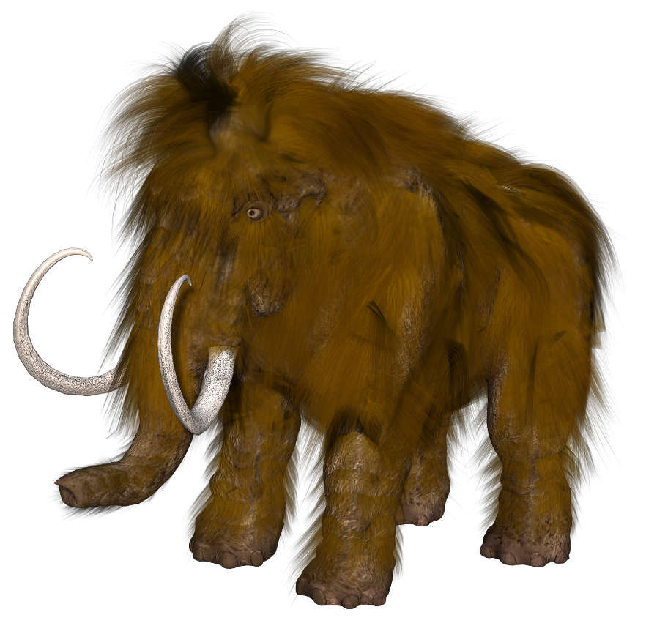
Phonétique
écouter / écrire
Michel le mammouth explique qu’il vient de Belgique.
Michel the mammoth explains that he comes from Belgium.
1
2
3
Notes:
This is slide 2/7
Word frequency of cognates used (1 is the most frequent word in French):
mammouth [<5000]
Source: Lonsdale, D., & Le Bras, Y. (2009). A Frequency Dictionary of French: Core vocabulary for learners London: Routledge.

Slide 27
Phonétique
écouter / écrire
Frédérique choisit la musique catholique.
Frédérique chooses Catholic music.
1
2
3
Notes:
This is slide 3/7
Word frequency of cognates used (1 is the most frequent word in French):
catholique [1578]
Source: Lonsdale, D., & Le Bras, Y. (2009). A Frequency Dictionary of French: Core vocabulary for learners London: Routledge.

Slide 28
Phonétique
écouter / écrire
Les quatre chats sympathiques cherchent quatre chaises chaudes.
The four nice cats are looking for four warm chairs.
1
2
3
Notes:
This is slide 4/7
Word frequency of unknown words used (1 is the most frequent word in French):
chaise [3419]
Source: Lonsdale, D., & Le Bras, Y. (2009). A Frequency Dictionary of French: Core vocabulary for learners London: Routledge.

Slide 29
Phonétique
écouter / écrire
Les dimanches, Agathe va au théâtre, aux champs, et à la bibliothèque.
On Sundays, Agathe goes to the theatre, to the fields, and to the library.
1
2
3
Notes:
This is slide 5/7
Word frequency of cognates used (1 is the most frequent word in French):
théâtre [1701]
Word frequency of unknown words used (1 is the most frequent word in French):
champ [847]
Source: Lonsdale, D., & Le Bras, Y. (2009). A Frequency Dictionary of French: Core vocabulary for learners London: Routledge.

Slide 30
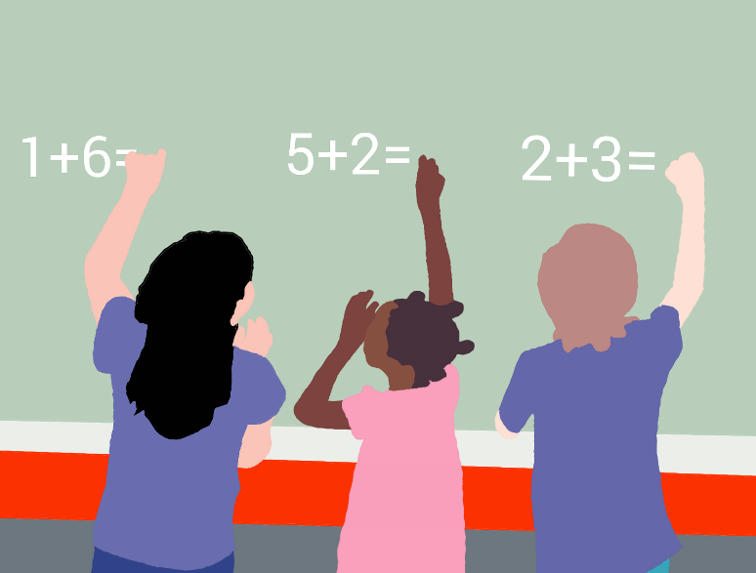
Phonétique
écouter / écrire
Dominique a des questions sur les méthodes chinoises de maths.
Dominique has some questions about Chinese maths methods.
1
2
3
Notes:
This is slide 7/7
Word frequency of cognates used (1 is the most frequent word in French):
méthode [1149], chinois [1914]
Source: Lonsdale, D., & Le Bras, Y. (2009). A Frequency Dictionary of French: Core vocabulary for learners London: Routledge.

Slide 31
SSC [qu]
phonétique
Consolidation [3]

Slide 32
qu
?
question
Notes:
Timing: 1 minute
Aim: To introduce/consolidate SSC [qu]
Procedure: 1. Present the letter(s) and say the [qu] sound first, on its own. Students repeat it with you. 2. Bring up the word ”question” on its own, say it, students repeat it, so that they have the opportunity to focus all of their attention on the connection between the written word and its sound.
3. A possible gesture for this would be to raise one’s eyebrows and look intently, as if querying something. 4. Roll back the animations and work through 1-3 again, but this time, dropping your voice completely to listen carefully to the students saying the [qu] sound, pronouncing ”question” and, if using, doing the gesture.
Word frequency (1 is the most frequent word in French):
question [144].
Source: Londsale, D., & Le Bras, Y. (2009). A Frequency Dictionary of French: Core vocabulary for learners London: Routledge.

Slide 33
qu
quatre
musique
?
question
expliquer
unique
[to explain]
manquer
[unique; only]
[to miss/be missing]
Notes:
Timing: 2 minutes
Aim: To introduce/consolidate SSC [qu]
Procedure:
1. Introduce and elicit the pronunciation of the individual SSC [qu] and then the source word again ‘question’ (with gesture, if using). 2. Then present and elicit the pronunciation of the five cluster words.
The cluster words have been chosen for their high-frequency, from a range of word classes, with the SSC (where possible) positioned within a variety of syllables within the words (e.g. initial, 2nd, final etc.). Additionally, we have tried to use words that build cumulatively on previously taught SSCs (see the Phonics Teaching Sequence document) and do not include new SSCs. Where new SSCs are used, they are often consonants which have a similar symbol-sound correspondence in English.
Word frequency (1 is the most frequent word in French): quarte [283]; musique [1139] expliquer [252]; manquer [583]; unique [402]; question [144]. Source: Londsale, D., & Le Bras, Y. (2009). A Frequency Dictionary of French: Core vocabulary for learners London: Routledge.

Slide 34
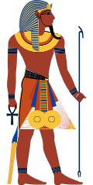
Mots qui finissent par -que
écouter / écrire
This week you are learning two French words ending with -que.
fantastique (fantastic)
historique (historic)
Notice that they are spelled similarly in English and French and have the same meaning. They are cognates.
The only spelling difference is the word ending.
In French it’s -que, in English it’s -c. How are these endings pronounced?
Notes:
Timing: 2 minutes
Aim: To introduce the English ‘-c’ ➜ French ‘-que’ word pattern and connect this with SSC [qu].
Procedure:
1. Click to reveal the explanation.
2. Remind students that SSC [i] sounds different in English and French. Practise pronouncing the endings French ‘-ique’ and English ‘-ic’, focusing on the [i] pronunciation (pronounced differently in French and English) and the [qu] spelling and pronunciation (pronounced the same way in French and English).
3. Click on the French words to hear them said by a native speaker. Students repeat, and then say the English.
Transcript:
fantastique
historique

Slide 35
Mots qui finissent par -que
French words ending in -que often end in -c, -ck or -k in English.
écouter / écrire
C’est quoi en anglais ?
Use your knowledge
of French words ending in -que to predict the English.
 | French | English
 | catholique | catholic
 | risque | risk
 | marque | mark
 | rythmique | rhythmic
 | critique | critic
 | scientifique | scientific
 | attaque | attack
 | plastique | plastic
1
2
3
4
5
6
7
8
Notes:
Timing: 5 minutes
Aim: Oral production of words containing SSC [qu]; application of English-French word patterns.
Procedure:
1. Students translate the French words into English, applying the knowledge of French-English word patterns covered in the last slide.
2. Click on the audio button to hear the words pronounced by a native speaker.
3. Students repeat and then say the English translation aloud, focusing on the pronunciation of –(i)c/-(i)que.
4. Click to bring up the bubble with information about the range of English spelling variations equivalent to the French -que.
Transcript:
catholique
risque
marque
rythmique
critique
scientifique
attaque
plastique
Word frequency of cognates used (1 is the most frequent word in French):
catholique [1578], risque [640], marque [1344], rythmique [>5000], ], critique [909], scientifique [950], attaque [1655], plastique [2191]
Source: Londsale, D., & Le Bras, Y. (2009). A Frequency Dictionary of French: Core vocabulary for learners London: Routledge.

Slide 36
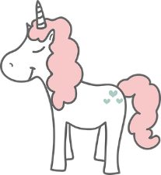
Mots qui finissent par -que
écouter / écrire
As you know, we can translate the French word ending -que with the English word endings -c, -ck and –k.
We can also translate French word ending -ique with the English ending -ical:
magique (magic OR magical)
historique (historic OR historical)
Note: fantastic (great) and fantastiscal (strange, unreal) have different meanings.
fantastique (fantastic OR fantastical)
The only difference in these cognates is the word ending.
In French it’s -ique, but in English it’s -ical. How are these endings pronounced?
Notes:
Timing: 2 minutes
Aim: To revise and expand knowledge of the French word ending –que and its English equivalent equivalents; to introduce the English ‘-ical’ ➜ French ‘-ique’ word pattern and connect these with SSCs [i] and [qu].
1. Click to reveal the explanation.
2. Remind students that SSC [i] sounds different in English and French. Practise pronouncing the endings French ‘-ique’ and English ‘-ical’, focusing on the [i] pronunciation and the [qu] spelling.
3. Click on the French word to hear it said by a native speaker. Students repeat, and then say the English.
Transcript:
fantastique
historique
magique
Word frequency (1 is the most frequent word in French): magique [3530]
Source: Londsale, D., & Le Bras, Y. (2009). A Frequency Dictionary of French: Core vocabulary for learners London: Routledge.

Slide 37
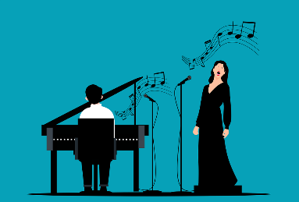
Mots qui finissent par -ique
écrire / parler
C’est quoi en français ?
 | English | French
 | statistical | statistique
 | political | politique
 | physical | physique
 | economical | économique
 | technical | technique
 | logical | logique
 | typical | typique
 | classical music | musique classique
1
2
3
4
5
6
7
8
Notes:
Timing: 5 minutes
Aim: Oral production of words containing SSC [qu]; application of English-French word patterns.
Procedure:
1. Students translate the English words into French, applying the knowledge of French-English word patterns covered on the previous slide.
2. Click to reveal answers.
3. Click on the audio button to hear the words pronounced by a native speaker.
4. Students repeat and then say the English translation aloud, focusing on the pronunciation of –ic(al)/-ique.
Transcript:
statistique
politique
physique
économique
technique
logique
typique
musique classique
Word frequency of cognates used (1 is the most frequent word in French):
statistique [1901], politique [128], physique [1146], économique [261], technique [592], logique [1107], typique [4178], classique [1845],
Source: Londsale, D., & Le Bras, Y. (2009). A Frequency Dictionary of French: Core vocabulary for learners London: Routledge.

