Slide 1
French Phonics Collection
SSC [oy]
Artwork by: Chloé Motard
Date updated: 30/08/2022
Notes:
Artwork by Chloé Motard. All additional pictures selected are available under a Creative Commons license, no attribution required.

Slide 2
SSC [oy]
phonétique
Introduction

Slide 3
oy
envoyer
Notes:
Timing: 1 minute
Aim: To introduce SSC [oy]
Procedure: 1. Present the letter(s) and say the [oy] sound first, on its own. Students repeat it with you. 2. Bring up the word ”envoyer” on its own, say it, students repeat it, so that they have the opportunity to focus all of their attention on the connection between the written word and its sound.
3. A possible gesture for this would be [sending a letter]. 4. Roll back the animations and work through 1-3 again, but this time, dropping your voice completely to listen carefully to the students saying the [oy] sound, pronouncing ”envoyer” and, if using, doing the gesture.
Word frequency (1 is the most frequent word in French):
enyoyer [526]
Source: Londsale, D., & Le Bras, Y. (2009). A Frequency Dictionary of French: Core vocabulary for learners London: Routledge.

Slide 4
oy
envoyer
Notes:
With sound and no pictures to focus all attention on the sound-symbol correspondence.

Slide 5
oy
envoyer
Notes:
Without sound to elicit pronunciation (without first hearing the teacher).
Teacher to elicit pronunciation by asking “Comment dit-on …”

Slide 6
oy
nettoyer
voyage
[journey]
royal
envoyer
moyen
employé
[average]
[employee]
Notes:
Timing: 2 minutes
Aim: To introduce SSC [oy]
Procedure:
1. Introduce and elicit the pronunciation of the individual SSC [oy] and then the source word again ‘envoyer’ (with gesture, if using). 2. Then present and elicit the pronunciation of the five cluster words.
The cluster words have been chosen for their high-frequency, from a range of word classes, with the SSC (where possible) positioned within a variety of syllables within the words (e.g. initial, 2nd, final etc.). Additionally, we have tried to use words that build cumulatively on previously taught SSCs (see the Phonics Teaching Sequence document) and do not include new SSCs. Where new SSCs are used, they are often consonants which have a similar symbol-sound correspondence in English.
Word frequency (1 is the most frequent word in French): envoyer [526]; royal [2290]; nettoyer [3887]; employé [1485]; voyage [904]; moyen [186] Source: Londsale, D., & Le Bras, Y. (2009). A Frequency Dictionary of French: Core vocabulary for learners London: Routledge.

Slide 7
oy
nettoyer
voyage
royal
envoyer
moyen
employé
Notes:
With sound and no pictures to focus all attention on the sound-symbol correspondence.

Slide 8
oy
nettoyer
voyage
royal
envoyer
moyen
employé
Notes:
Without sound to elicit pronunciation (without first hearing the teacher).
Teacher to elicit pronunciation by asking “Comment dit-on …”

Slide 9
[oy] : anglais vs français
écouter / parler
loyal | loyal
royal | royal
joyful | joyeux
royalty | royauté
employer | employeur
SSC [oy]
sounds like a ‘yih’ sound after SSC [oi].
This is similar to the
[-ill-/ille] vs [i] and
[-aill-/-ail] vs [a] patterns.
A
B
C
D
E
Notes:
Timing: 5 minutes
Aim: Practising aural recognition and oral production of SSC [oy]
Procedure:
1. Practice saying the English [oy] and the French [oy] sounds individually.
2. Students say the English words.
3. Click on the letters to hear the French word.
4. Students repeat the French word as many times as they need to.
Transcript:
loyal
royal
joyeux
royauté
employeur
Word frequency of cognates used (1 is the most frequent word in French): loyal [4325], royal [2290], joyeux [3987], royauté [>5000], employeur [2633]
Source: Londsale, D., & Le Bras, Y. (2009). A Frequency Dictionary of French: Core vocabulary for learners London: Routledge.

Slide 10
Phonétique
écouter / écrire
Say these words:
SSC [oy]
sounds like a ‘yih’ sound after SSC [oi].
This is similar to the
[-ill-/ille] vs [i] and
[-aill-/-ail] vs [a] patterns.
fois
[time]
foyer
[home]
Notes:
Timing: 1 minute
Aim: Aural recognition and production of SSCs [oy] and [oi] to prime for the activity on the next slide.
Procedure:
1. Students try to say the words in the pair, foi and foyer.
2. Click to hear the words said by a native speaker. Students repeat.
3. Click to bring up the hint.
Transcript:
fois
foyer
Word frequency (1 is the most frequent word in French): ail [>5000]

Slide 11
Phonétique (1/2)
Hint
SSC [oy]
sounds like a ‘yih’ sound after SSC [oi].
écouter
Écoute ! Quel mot a la SSC [oy] ?
[to drown] | [black]
a) noyer | b) noir
[king] | [kingdom]
a) roi | b) royaume
1
3
__
_
__
__
[law] | [to use]
a) loi | b) employer
[happy] | [joy]
a) joyeux | b) joie
2
4
__
__
__
__
Notes:
Timing: 8 minutes (for two slides)
Aim: aural recognition of SSCs [oy] and [oi] in pairs. Awareness-raising exercise in pronunciation of [oy] (sounds like [oi] + ‘yih’.)
Procedure:
1. Click the numbers to play the audio.
2. Students write 1-8 and complete the word with [oi] or [oy].
3. Click to reveal the answers.
4. Students sound out the pairs of words. Draw attention to the SFC.
5. Move to the next slide and repeat steps 1-4 for four more pairs.
Transcript:
1. a) noyer b) noir
2. a) loi b) employer
3. a) roi b) royaume
4. a) joyeux b) joie
Word frequency of unknown words used (1 is the most frequent word in French): noyer [4060], noir [572], loi [267], employer [724], roi [1364], royaume [2620], joyeux [3987], joie [1984]
Source: Londsale, D., & Le Bras, Y. (2009). A Frequency Dictionary of French: Core vocabulary for learners London: Routledge.

Slide 12
Phonétique (2/2)
Hint
SSC [oy]
sounds like a ‘yih’ sound after SSC [oi].
écouter
Écoute ! Quel mot a le SSC [oy] ?
[believer] | [to believe]
a) croyant | b) croire
[nucleus] | [Chinese]
a) noyau | b) chinois
5
7
__
_
__
_
[citizen] | [roof]
a) citoyen | b) toit
3 | [to grant]
a) trois | b) octroyer
6
8
__
_
_
__
Notes:
This is the second part of the activity described on the previous slide.
Transcript:
5. a) croyant b) croire
6. a) citoyen b) toit
7. a) noyau b) chinois
8. a) trois b) octroyer
Word frequency of unknown words used (1 is the most frequent word in French): croyant [4332], croire [135], citoyen [1081], toit [roof], noyau [3832], chinois [1914], trois [115], octroyer [4232]
Source: Londsale, D., & Le Bras, Y. (2009). A Frequency Dictionary of French: Core vocabulary for learners London: Routledge.

Slide 13
SSC [oy]
phonétique
Consolidation [1]

Slide 14
oy
envoyer
Notes:
Timing: 1 minute
Aim: To consolidate SSC [oy]
Procedure: 1. Present the letter(s) and say the [oy] sound first, on its own. Students repeat it with you. 2. Bring up the word ”envoyer” on its own, say it, students repeat it, so that they have the opportunity to focus all of their attention on the connection between the written word and its sound.
3. A possible gesture for this would be [sending a letter]. 4. Roll back the animations and work through 1-3 again, but this time, dropping your voice completely to listen carefully to the students saying the [oy] sound, pronouncing ”envoyer” and, if using, doing the gesture.
Word frequency (1 is the most frequent word in French):
enyoyer [526]
Source: Londsale, D., & Le Bras, Y. (2009). A Frequency Dictionary of French: Core vocabulary for learners London: Routledge.

Slide 15
oy
nettoyer
voyage
[journey]
royal
envoyer
moyen
employé
[average]
[employee]
Notes:
Timing: 1 minute
Aim: To consolidate SSC [oy]
Procedure:
1. Introduce and elicit the pronunciation of the individual SSC [oy] and then the source word again ‘envoyer’ (with gesture, if using). 2. Then present and elicit the pronunciation of the five cluster words.
The cluster words have been chosen for their high-frequency, from a range of word classes, with the SSC (where possible) positioned within a variety of syllables within the words (e.g. initial, 2nd, final etc.). Additionally, we have tried to use words that build cumulatively on previously taught SSCs (see the Phonics Teaching Sequence document) and do not include new SSCs. Where new SSCs are used, they are often consonants which have a similar symbol-sound correspondence in English.
Word frequency (1 is the most frequent word in French): envoyer [526]; royal [2290]; nettoyer [3887]; employé [1485]; voyage [904]; moyen [186] Source: Londsale, D., & Le Bras, Y. (2009). A Frequency Dictionary of French: Core vocabulary for learners London: Routledge.

Slide 16
Phonétique
écouter / écrire
Écoute. C’est [oy] ou [y] ?
Q | mot | [oy] | [y]
 | joyau [jewel]
 | cycliste [cyclist]
 | symbole [symbol]
 | voyelle [vowel]
 | lycée [sixth form]
 | gymnase [gym]
 | incroyable [incredible]
 | moyen [average]
1
2
3
4
5
6
7
8
Notes:
Timing: 5 minutes
Aim: Aural recognition of SSCs [oy] and [y]
Procedure:
1. Click to play the audio.
2. Students tick whether they hear [oy] or [y].
3. Click to reveal the answers.
4. Click to reveal the words.
Transcript:
joyau
cycliste
symbole
voyelle
lycée
gymnase
incroyable
citoyen
Word frequency of unknown words used (1 is the most frequent word in French):
joyau [>5000], voyelle [>5000], incroyable [2231], citoyen [1081]
Word frequency of near-cognates used (1 is the most frequent word in French): symbole [1427], cycliste [>5000], mystère [2777], gymnase [>5000],
Source: Lonsdale, D., & Le Bras, Y. (2009). A Frequency Dictionary of French: Core vocabulary for learners London: Routledge.

Slide 17
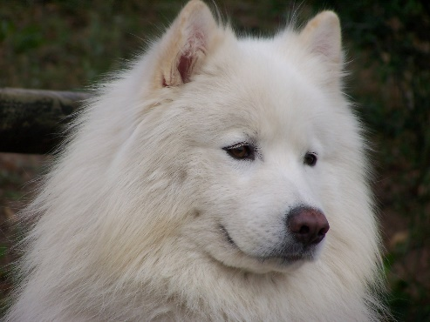
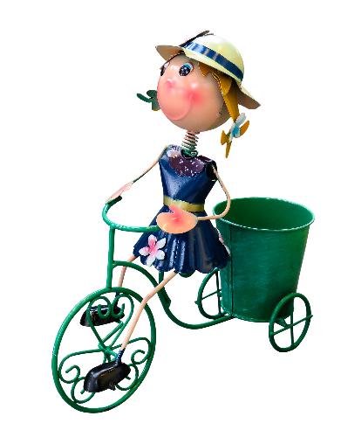
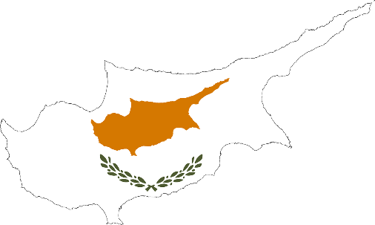
Des virelangues !
écouter / parler
Le samoyède syrien aime aboyer sur le python royal.
[The Syrian Samoyed likes to bark at the royal python.]
Sylvie la cycliste joyeuse voyage à Chypre.
[Sylvie the joyful cyclist travels to Cyprus.]
Notes:
Timing: 4 minutes (slide 1/2)
Aim: practising oral production of SSCs [oy], [y]
Procedure:
Click on play button to hear a tongue twister. Students repeat as many times as necessary.
If students feel confident, they should speed up – compete to see who can pronounce it the fastest
Transcript:
Le samoyède syrien aime aboyer au python royal.
Sylvie la cycliste joyeuse voyage en Chypre.
Word frequency of unknown words used (1 is the most frequent word in French):
samoyède [>5000], aboyer [>5000], Chypre [>5000]
Word frequency of cognates used (1 is the most frequent word in French):
syrien [4453], python [>5000], royal [2290], cycliste [>5000] , joyeux [3987]
Source: Lonsdale, D., & Le Bras, Y. (2009). A Frequency Dictionary of French: Core vocabulary for learners London: Routledge.

Slide 18
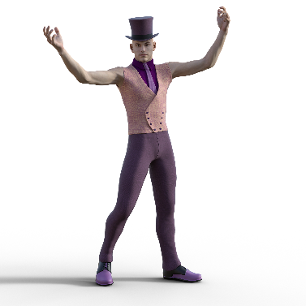
Des virelangues !
écouter / parler
Le lycéen flamboyant aime le rythme de l’hymne calypso.
[The flamboyant sixth-former likes the rhythm of the calypso carol.]
Le voyou moyen doit nettoyer les pylônes du royaume.
[The average hooligan has to clean the pylons of the kingdom.]
Notes:
Slide 2/2
Transcript:
Le lycéen flamboyant aime le rythme de l’hymne calypso.
Le voyou moyen doit nettoyer les pylônes du royaume.
Word frequency of unknown words used (1 is the most frequent word in French):
lycéen [>5000], hymne [4862], voyou [>5000], moyen [186], nettoyer [3887], royaume [2620]
Word frequency of cognates used (1 is the most frequent word in French):
flamboyant [>5000], rythme [1662], calypso [>5000], pylône [>5000]
Source: Lonsdale, D., & Le Bras, Y. (2009). A Frequency Dictionary of French: Core vocabulary for learners London: Routledge.

Slide 19
SSC [oy]
phonétique
Consolidation [2]

Slide 20
oy
nettoyer
voyage
[journey]
royal
envoyer
moyen
employé
[average]
[employee]
Notes:
Timing: 1 minute
Aim: To consolidate SSC [oy]
Procedure:
1. Introduce and elicit the pronunciation of the individual SSC [oy] and then the source word again ‘envoyer’ (with gesture, if using). 2. Then present and elicit the pronunciation of the five cluster words.
The cluster words have been chosen for their high-frequency, from a range of word classes, with the SSC (where possible) positioned within a variety of syllables within the words (e.g. initial, 2nd, final etc.). Additionally, we have tried to use words that build cumulatively on previously taught SSCs (see the Phonics Teaching Sequence document) and do not include new SSCs. Where new SSCs are used, they are often consonants which have a similar symbol-sound correspondence in English.
Word frequency (1 is the most frequent word in French): envoyer [526]; royal [2290]; nettoyer [3887]; employé [1485]; voyage [904]; moyen [186] Source: Lonsdale, D., & Le Bras, Y. (2009). A Frequency Dictionary of French: Core vocabulary for learners London: Routledge.

Slide 21
oy
envoyer
Notes:
Timing: 1 minute
Aim: To consolidate SSC [oy]
Procedure: 1. Present the letter(s) and say the [oy] sound first, on its own. Students repeat it with you. 2. Bring up the word ”envoyer” on its own, say it, students repeat it, so that they have the opportunity to focus all of their attention on the connection between the written word and its sound.
3. A possible gesture for this would be [sending a letter]. 4. Roll back the animations and work through 1-3 again, but this time, dropping your voice completely to listen carefully to the students saying the [oy] sound, pronouncing ”envoyer” and, if using, doing the gesture.
Word frequency (1 is the most frequent word in French):
enyoyer [526]
Source: Lonsdale, D., & Le Bras, Y. (2009). A Frequency Dictionary of French: Core vocabulary for learners London: Routledge.

Slide 22
Phonétique
écouter
Écoute. Les mots ont-ils la SSC [oy] ou [y] ?
Q | mot | en anglais | [oy] | [y]
 | joyau | [jewel]
 | c y cliste | [cyclist]
 | r y thme | [rhythm]
 | voyelle | [vowel]
 | l y cée | [sixth form]
 | g y mnase | [gymnasium]
 | incroyable | [incredible]
 | citoyen | [citizen]
1
_
2
_
Notice that all the words containing [y] are cognates (look like English).
3
_
4
_
5
_
6
_
7
_
8
_
Notes:
Timing: 5 minutes
Aim: Aural recognition of SSCs [oy] and [y] in single words; connecting SSC [y] with cognate words
Procedure:
1. Click to play the audio.
2. Students tick whether they hear [oy] or [y].
3. Click to reveal the answers.
4. Note that it is the near-cognates that contain SSC [y].
Transcript:
1. joyau
2. cycliste
3 rythme
4. voyelle
5. lycée
6. gymnase
7. incroyable
8. citoyen
Word frequency of unknown words used (1 is the most frequent word in French):
joyau [>5000], voyelle [>5000], incroyable [2231], citoyen [1081]
Word frequency of near-cognates used (1 is the most frequent word in French): rythme [1662], cycliste [>5000], mystère [2777], gymnase [>5000],
Source: Lonsdale, D., & Le Bras, Y. (2009). A Frequency Dictionary of French: Core vocabulary for learners London: Routledge.

Slide 23
Des virelangues !
écouter / parler
Le samoyède syrien aime aboyer sur le python royal.
[The Syrian Samoyed likes to bark at the royal python.]
Sylvie la cycliste joyeuse voyage à Chypre.
[Sylvie the joyful cyclist travels to Cyprus.]
Notes:
Timing: 4 minutes. This is slide 1/2.
Aim: oral production of SSCs [oy] and [y] in longer contexts; fluency production
Procedure:
1. Click on play button to hear a tongue twister said aloud by a native speaker. Students read along.
2. Students repeat as many times a necessary.
3. If students feel confident, they can try to speed up – compete to see who can say a correct the sentence correctly fastest.
Transcript:
Le samoyède syrien aime aboyer au python royal.
Sylvie la cycliste joyeuse voyage en Chypre.
Word frequency of unknown words used (1 is the most frequent word in French):
samoyède [>5000], aboyer [>5000], Chypre [>5000]
Word frequency of cognates used (1 is the most frequent word in French):
syrien [4453], python [>5000], royal [2290], cycliste [>5000] , joyeux [3987]
Source: Lonsdale, D., & Le Bras, Y. (2009). A Frequency Dictionary of French: Core vocabulary for learners London: Routledge.

Slide 24
Des virelangues !
écouter / parler
Le lycéen flamboyant aime le rythme de l’hymne calypso.
[The flamboyant sixth-former likes the rhythm of the calypso carol.]
Le voyou moyen doit nettoyer les pylônes du royaume.
[The average hooligan has to clean the pylons of the kingdom.]
Notes:
This is slide 2/2.
Transcript:
Le lycéen flamboyant aime le rythme de l’hymne calypso.
Le voyou moyen doit nettoyer les pylônes du royaume.
Word frequency of unknown words used (1 is the most frequent word in French):
lycéen [>5000], hymne [4862], voyou [>5000], moyen [186], nettoyer [3887], royaume [2620]
Word frequency of cognates used (1 is the most frequent word in French):
flamboyant [>5000], rythme [1662], calypso [>5000], pylône [>5000]
Source: Lonsdale, D., & Le Bras, Y. (2009). A Frequency Dictionary of French: Core vocabulary for learners London: Routledge.

