Slide 1
French Phonics Collection
SSC [open eu/œu]
Artwork by: Chloé Motard
Date updated: 30/08/2022
Notes:
Artwork by Chloé Motard. All additional pictures selected are available under a Creative Commons license, no attribution required.

Slide 2
SSC [open eu/œu]
phonétique
Introduction

Slide 3
open eu/œu
cœur
Notes:
Timing: 1 minute
Aim: To introduce SSC open [eu]/[œu]
Procedure: 1. Present the letter(s) and say the open [eu]/[œu] sound first, on its own. Students repeat it with you. 2. Bring up the word ”cœur” on its own, say it, students repeat it, so that they have the opportunity to focus all of their attention on the connection between the written word and its sound.
3. A possible gesture for this would be to put your hand on your chest over your heart. 4. Roll back the animations and work through 1-3 again, but this time, dropping your voice completely to listen carefully to the students saying the open [eu]/[œu] sound, pronouncing ”cœur” and, if using, doing the gesture.
Word frequency (1 is the most frequent word in French):
cœur [568]
Source: Londsale, D., & Le Bras, Y. (2009). A Frequency Dictionary of French: Core vocabulary for learners London: Routledge.

Slide 4
open eu/œu
cœur
Notes:
With sound and no pictures to focus all attention on the sound-symbol correspondence.

Slide 5
open eu/œu
cœur
Notes:
Without sound to elicit pronunciation (without first hearing the teacher).
Teacher to elicit pronunciation by asking “Comment dit-on …”

Slide 6
open eu/œu
acteur
neuf
9
jeune
cœur
sœur
[young]
[sister]
erreur
[mistake]
Notes:
Timing: 2 minutes
Aim: To introduce SSC open [eu]/[œu]
Procedure:
Introduce and elicit the pronunciation of the individual SSC open [eu]/[œu] and then the source word again ‘œil’ (with gesture, if using). Then present and elicit the pronunciation of the five cluster words. The cluster words have been chosen for their high-frequency, from a range of word classes, with the SSC (where possible) positioned within a variety of syllables within the words (e.g. initial, 2nd, final etc.). Additionally, we have tried to use words that build cumulatively on previously taught SSCs (see the Phonics Teaching Sequence document) and do not include new SSCs. Where new SSCs are used, they are often consonants which have a similar symbol-sound correspondence in English.
Word frequency (1 is the most frequent word in French): acteur [1552]; cœur [568]; jeune [152]; erreur [612]; neuf [787]; sœur [1558]. Source: Londsale, D., & Le Bras, Y. (2009). A Frequency Dictionary of French: Core vocabulary for learners London: Routledge.

Slide 7
open eu/œu
acteur
neuf
jeune
cœur
sœur
erreur
Notes:
With sound and no pictures to focus all attention on the sound-symbol correspondence.

Slide 8
open eu/œu
acteur
neuf
jeune
cœur
sœur
erreur
Notes:
Without sound to elicit pronunciation (without first hearing the teacher).
Teacher to elicit pronunciation by asking “Comment dit-on …”

Slide 9
Closed and open [eu/œu]
écouter
You have already met an [eu] sound in Year 7:
The long vowel sounds like the ‘ur’ in the English ‘hurt.’
[few]
[fear]
peu
peur
This is a closed vowel.
When you say this sound, your tongue is near the top of your mouth.
This is an open vowel.
When you say this sound, your tongue is near the bottom of your mouth.
Notes:
Timing: 2 minutes
Aim: To introduce the concept of open and closed vowel sounds.
Procedure:
1. Click to reveal ‘peu’. Students repeat it
2. Click to relevel the first info bubble. Students hear and say ‘peu’ again several time, noticing the position of the tongue in the mouth.
3. Click to reveal ‘peur’. Repeat steps one and two.
4. Click to play the words in quick succession.
5. Move to the following slides for a reminder of other words containing closed [eu].
Word frequency (1 is the most frequent word in French): peu [92], peur [755]

Slide 10
Closed or open [eu/œu]?
écouter / écrire
 |  | open | closed
 | bleu [blue]
 | deux
 | bœuf
 | ordinateur
 |  | open | closed
 | vœux [wishes]
 | rumeur [rumour]
 | adieu [farewell]
 | meuble [furniture]
1
5
2
6
3
7
4
8
What do you notice about the spelling of the words containing open [eu/œu] compared to those containing closed [eu/œu]?
If the vowel is followed by a pronounced consonant (not an SFC), it is open.
Notes:
Timing: 6 minutes
Aim: aural recognition of open and closed [eu/œu]. Raising awareness of spelling rules governing the pronoun.
Procedure:
1. Click on numbers to hear words. Student decide if [eu/œu] is open or closed.
2. Click to reveal answers.
3. Click again to reveal the question about spelling. Students consider in pairs. They might say things like ‘the words are longer’ or ‘the sound is in the middle of the word’. Encourage students to look at the letters they see after the SSC.
4. Click to reveal the answers and again to reveal the rule.
5. Students try to say the words.
Word frequency (1 is the most frequent word in French): bleu [1216], deux [41], bœuf [3914], ordinateur [2201], déjeuner [2724], vœu [2103], rumeur [2164], peuple [378], adieu [3968], meuble [3876], feu [786],
Source: Londsale, D., & Le Bras, Y. (2009). A Frequency Dictionary of French: Core vocabulary for learners London: Routledge.

Slide 11
SSC [open eu/œu]
phonétique
Consolidation [1]

Slide 12
open eu/œu
cœur
Notes:
Timing: 1 minute
Aim: To consolidate SSC open [eu]/[œu]
Procedure: 1. Present the letter(s) and say the open [eu]/[œu] sound first, on its own. Students repeat it with you. 2. Bring up the word ”cœur” on its own, say it, students repeat it, so that they have the opportunity to focus all of their attention on the connection between the written word and its sound.
3. A possible gesture for this would be to put your hand on your chest over your heart. 4. Roll back the animations and work through 1-3 again, but this time, dropping your voice completely to listen carefully to the students saying the open [eu]/[œu] sound, pronouncing ”cœur” and, if using, doing the gesture.
Word frequency (1 is the most frequent word in French):
cœur [568]
Source: Londsale, D., & Le Bras, Y. (2009). A Frequency Dictionary of French: Core vocabulary for learners London: Routledge.

Slide 13
open eu/œu
acteur
neuf
9
jeune
cœur
sœur
[young]
[sister]
erreur
[mistake]
Notes:
Timing: 2 minutes
Aim: To consolidate SSC open [eu]/[œu]
Procedure:
Introduce and elicit the pronunciation of the individual SSC open [eu]/[œu] and then the source word again ‘œil’ (with gesture, if using). Then present and elicit the pronunciation of the five cluster words. The cluster words have been chosen for their high-frequency, from a range of word classes, with the SSC (where possible) positioned within a variety of syllables within the words (e.g. initial, 2nd, final etc.). Additionally, we have tried to use words that build cumulatively on previously taught SSCs (see the Phonics Teaching Sequence document) and do not include new SSCs. Where new SSCs are used, they are often consonants which have a similar symbol-sound correspondence in English.
Word frequency (1 is the most frequent word in French): acteur [1552]; cœur [568]; jeune [152]; erreur [612]; neuf [787]; sœur [1558]. Source: Londsale, D., & Le Bras, Y. (2009). A Frequency Dictionary of French: Core vocabulary for learners London: Routledge.

Slide 14
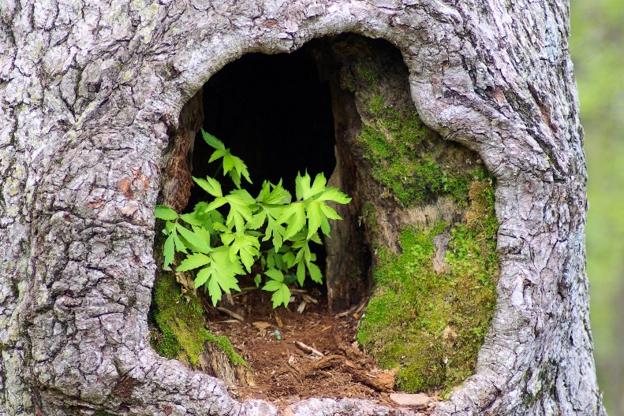
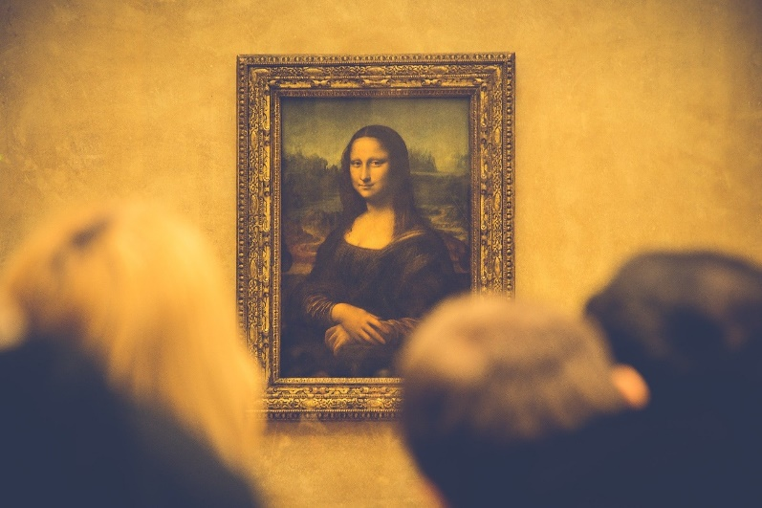
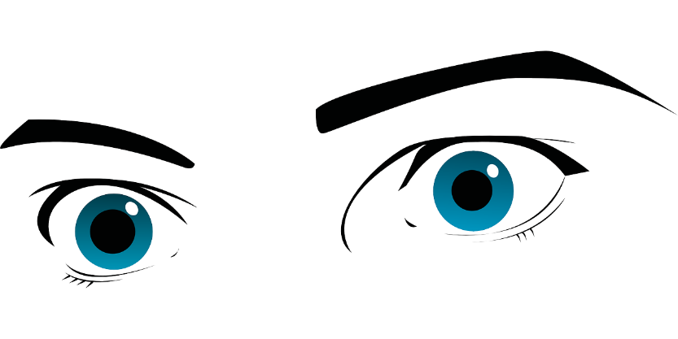
Phonétique
écouter
Écoute les mots et choisis la bonne SSC.
 | en français | en anglais | open [eu/œu] | [eu]
 | la peur | fear
 | adieu | goodbye
 | l’œuvre | work of art
 | le pneu | tyre
 | l’œuf | egg
 | les yeux | eyes
 | creux | hollow
 | la fleur | flower
1
__
2
___
3
___
4
___
5
___
6
__
7
__
8
__
Notes:
Timing: 5 minutes
Aim: Aural recognition of SSCs open [eu]/[œu] and [eu].
Procedure:
1. Click the number to play the audio.
2. Students choose which SSC the word contains.
3. Click to reveal answers.
Transcript:
la peur
adieu
l’œuvre
le pneu
l’œuf
les yeux
creux
la fleur
Word frequency of unknown words used (1 is the most frequent word in French): peur [755]; adieu [3968]; œuvre [331]; pneu [4514]; œuf [2685]; yeux [>5000]; creux [3508]; fleur [2305]
Source: Londsale, D., & Le Bras, Y. (2009). A Frequency Dictionary of French: Core vocabulary for learners London: Routledge.

Slide 15
Phonétique
parler
Partners say alternate sentences while the other counts the SSCs they hear.
 |  | open [eu/œu] | [eu]
 | Léa dit adieu à son vieux grand-père à deux heures. | 1 | 3
 | Antoine choisit une seule fleur bleue à neuf heures. | 4 | 1
 | Le chef travailleur donne un copieux déjeuner à la neuvième personne dans la queue. | 2 | 3
 | Le jeune pêcheur va au fleuve parce qu’il veut prendre plusieurs poissons. | 4 | 1
A
B
A
B
Notes:
Timing: 2 minutes
Aim: Oral production of sentences containing SSCs open [eu]/[œu] and [eu].
Procedure:
1. Student B turns away from the board.
2. Click to reveal partner A’s first sentence.
3. Partner A reads the sentence aloud while student B counts the total number of open [eu]/[œu] and [eu] they hear.
4. Click to reveal answer.
5. Student A then turns away from the board.
6. Repeat steps 2-4.
7. Repeat for the second pair of sentences.
8. The next slide contains English translations of the sentences with the SSC highlighted in different colours.
Word frequency of unknown words used (1 is the most frequent word in French): adieu [3968]; fleur [2305]; neuvième [>5000]; queue [3255]; pêcheur [2759]; fleuve [2893]; poisson [1616]
Source: Londsale, D., & Le Bras, Y. (2009). A Frequency Dictionary of French: Core vocabulary for learners London: Routledge.

Slide 16
Phonétique
parler
 |  | open [eu/œu] | [eu]
 | Léa dit adieu à son vieux grand-père à deux heures. (Léa says goodbye to her old grandad at two o’clock.) | 1 | 3
 | Antoine choisit une seule fleur bleue à neuf heures. (Antoine choses a single blue flower at nine o’clock.) | 4 | 1
 | Le chef travailleur donne un copieux déjeuner à la neuvième personne dans la queue. (The hard-working chef gives a generous lunch to the ninth person in the queue.) | 2 | 3
 | Le jeune pêcheur va au fleuve parce qu’il veut prendre plusieurs poissons. (The young fisherman goes to the river because he wants to take several fish.) | 4 | 1
A
B
A
B
Notes:
Answers to previous slide with translations and SSCs highlighted.

Slide 17
SSC [open eu/œu]
phonétique
Consolidation [2]

Slide 18
open eu/œu
cœur
Notes:
Timing: 1 minute [2 slides]
Aim: To consolidate SSC open [eu]/[œu]
Procedure: 1. Present the letter(s) and say the open [eu]/[œu] sound first, on its own. Students repeat it with you. 2. Bring up the word ”cœur” on its own, say it, students repeat it, so that they have the opportunity to focus all of their attention on the connection between the written word and its sound.
3. A possible gesture for this would be to put your hand on your chest over your heart. 4. Roll back the animations and work through 1-3 again, but this time, dropping your voice completely to listen carefully to the students saying the open [eu]/[œu] sound, pronouncing ”cœur” and, if using, doing the gesture.
Word frequency (1 is the most frequent word in French):
cœur [568]
Source: Londsale, D., & Le Bras, Y. (2009). A Frequency Dictionary of French: Core vocabulary for learners London: Routledge.

Slide 19
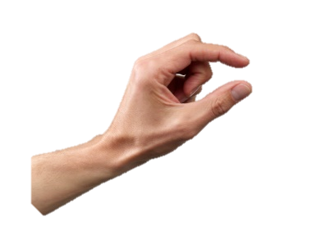
Mots qui finissent par -eur
écouter / écrire
Compare these two words:
The SSC [eu] is closed.
The SSC [eu] is open.
peu (bit)
peur (fear)
How are these words pronounced? Is the SSC [eu] open or closed?
The SSC [eu] is always open before an -r in French.
Notes:
Timing: 1 minute
Aim: To highlight the difference in pronunciation between open and closed SSC [eu].
Procedure:
1. Click to reveal the explanation.
2. Click on the French words to hear them said by a native speaker. Students repeat, and then say the English.
3. Remind students that the SSC [eu] can be open or closed depending on its position within a word (long if before a pronounced consonant, short if not). In preparation for the following slide, tell students that the SSC [eu] is always open before an -r in French.
Transcript:
peu
peur
Word frequency of unknown words used (1 is the most frequent word in French):
peur [755]
Source: Londsale, D., & Le Bras, Y. (2009). A Frequency Dictionary of French: Core vocabulary for learners London: Routledge.

Slide 20
open eu/œu
acteur
neuf
9
jeune
cœur
sœur
[young]
[sister]
erreur
[mistake]
Notes:
1 minute [2 slides]
Aim: To consolidate SSC open [eu]/[œu]
Procedure:
Introduce and elicit the pronunciation of the individual SSC open [eu]/[œu] and then the source word again ‘œil’ (with gesture, if using). Then present and elicit the pronunciation of the five cluster words. The cluster words have been chosen for their high-frequency, from a range of word classes, with the SSC (where possible) positioned within a variety of syllables within the words (e.g. initial, 2nd, final etc.). Additionally, we have tried to use words that build cumulatively on previously taught SSCs (see the Phonics Teaching Sequence document) and do not include new SSCs. Where new SSCs are used, they are often consonants which have a similar symbol-sound correspondence in English.
Word frequency (1 is the most frequent word in French): acteur [1552]; cœur [568]; jeune [152]; erreur [612]; neuf [787]; sœur [1558]. Source: Londsale, D., & Le Bras, Y. (2009). A Frequency Dictionary of French: Core vocabulary for learners London: Routledge.

Slide 21
SSC [open eu/œu]
phonétique
Consolidation [3]

Slide 22
Closed and open [eu/œu]
écouter
Remember [eu/œu] can sound different in different word positions!
The long vowel sounds like the ‘ur’ in the English ‘hurt.’
[a little]
[fear]
un peu
peur
This is a closed vowel.
When you say this sound, your tongue is near the top of your mouth.
This is an open vowel.
When you say this sound, your tongue is near the bottom of your mouth.
If the vowel is followed by a pronounced consonant (not an SFC)at the end of a word, it is open.
Notes:
Timing: 2 minutes
Aim: To consolidate the concept of open and closed vowel sounds.
Procedure:
1. Click to reveal ‘peu’. Students repeat it
2. Click to reveal the first info bubble. Students hear and say ‘peu’ again several time, noticing the position of the tongue in the mouth.
3. Click to reveal ‘peur’. Repeat steps one and two.
4. Click to play the words in quick succession.
5. Move to the following slides for a reminder of other words containing closed [eu].

Slide 23
open eu/œu
cœur
Notes:
Timing: 1 minute
Aim: To consolidate SSC open [eu]/[œu]
Procedure: 1. Present the letter(s) and say the open [eu]/[œu] sound first, on its own. Students repeat it with you. 2. Bring up the word ”cœur” on its own, say it, students repeat it, so that they have the opportunity to focus all of their attention on the connection between the written word and its sound.
3. A possible gesture for this would be to put your hand on your chest over your heart. 4. Roll back the animations and work through 1-3 again, but this time, dropping your voice completely to listen carefully to the students saying the open [eu]/[œu] sound, pronouncing ”cœur” and, if using, doing the gesture.
Word frequency (1 is the most frequent word in French):
cœur [568]
Source: Londsale, D., & Le Bras, Y. (2009). A Frequency Dictionary of French: Core vocabulary for learners London: Routledge.

Slide 24
open eu/œu
acteur
neuf
9
jeune
cœur
sœur
[young]
[sister]
erreur
[mistake]
Notes:
Timing: 2 minutes
Aim: To consolidate SSC open [eu]/[œu]
Procedure:
Consolidate and elicit the pronunciation of the individual SSC open [eu]/[œu] and then the source word again ‘œil’ (with gesture, if using). Then present and elicit the pronunciation of the five cluster words. The cluster words have been chosen for their high-frequency, from a range of word classes, with the SSC (where possible) positioned within a variety of syllables within the words (e.g. initial, 2nd, final etc.). Additionally, we have tried to use words that build cumulatively on previously taught SSCs (see the Phonics Teaching Sequence document) and do not include new SSCs. Where new SSCs are used, they are often consonants which have a similar symbol-sound correspondence in English.
Word frequency (1 is the most frequent word in French): acteur [1552]; cœur [568]; jeune [152]; erreur [612]; neuf [787]; sœur [1558]. Source: Londsale, D., & Le Bras, Y. (2009). A Frequency Dictionary of French: Core vocabulary for learners London: Routledge.

Slide 25
Les équipes de mots
écouter / écrire
Organise les mots en équipes : open eu/œu vs closed eu/œu.
1
2
3
4
5
6
7
8
9
10
1. mieux
2. peuple (people)
4. nombreux (plentiful)
open eu/oeu
5. deuxième
closed eu/oeu
3. heure
9. veuf (widower)
6. dangereux
7. sérieux (serious)
10. beurre (butter)
8. euro
Notes:
Timing: 3 minutes
Aim: Identify and transcribe open and closed SSC eu/oeu from heard words
Procedure:
1. Click numbers to hear audio.
2. Students tick whether SSC heard was open or closed and attempt to transcribe the word in French. [note: some words are unknown so all plausible spellings should be rewarded e.g. deusieme]
3. Click to bring up answers (they will appear on the side of the correct SSC kit)
Transcript:
mieux
peuple
heure
nombreux
deuxième
dangereux
sérieux
euro
veuf
beurre
Word frequency (1 is the most frequent word in French): peuple [378], nombreux [366], sérieux [412], veuf [3455], beurre [4112]
Source: Lonsdale, D., & Le Bras, Y. (2009). A Frequency Dictionary of French: Core vocabulary for learners London: Routledge.

Slide 26
Virelangues 1/3
lire / parler
Il y a de nombreux docteurs dangereux au milieu du lac.
(There are many dangerous doctors in the middle of the lake.)
a
b
c
Notes:
Timing: 3 minutes for 3 slides
Aim: To practise pronunciation of open and closed SSC eu/oeu.
Procedure:
1. Students to say tongue twisters as quickly as possible with accurate pronunciation of SSCs.
2. Click buttons to hear slow, medium and fast pronunciation by native speaker.
Transcript:
1. Il y a de nombreux docteurs dangereux au milieu du lac.
2. Je ne veux pas pleurer, il est mieux d'être heureux que d'être sérieux.
3. L’entrepreneur est courageux, il fais la preuve de sa valeur chaque heure.
Word frequency (1 is the most frequent word in French): nombreux [366], docteur [2176], milieu [479], pleurer [2253], sérieux [412], entrepreneur [2377], courageux [2198], preuve [653], valeur [453]
Source: Lonsdale, D., & Le Bras, Y. (2009). A Frequency Dictionary of French: Core vocabulary for learners London: Routledge.

Slide 27
Virelangues 2/3
lire / parler
Je ne veux pas pleurer, il est mieux d'être heureux que d'être sérieux.
(I don’t want to cry, it is better to be
happy than to be serious.)
a
b
c
Notes:
Slide 2/3

Slide 28
Virelangues 3/3
lire / parler
L’entrepreneur est courageux,
il fait la preuve de sa valeur chaque heure.
(The entrepreneur is brave, he proves his worth every hour.)
a
b
c
Notes:
Slide 3/3

