Slide 1
French Phonics Collection
SSC [on]
Artwork by: Chloé Motard
Date updated: 31/08/2022
Notes:
Artwork by Chloé Motard. All additional pictures selected are available under a Creative Commons license, no attribution required.

Slide 2
SSC [on]
phonétique
Introduction

Slide 3
on
non!
Notes:
Timing: 1 minute
Aim: To introduce/consolidate SSC [on]
Procedure: 1. Present the letter(s) and say the [on] sound first, on its own. Students repeat it with you. 2. Bring up the word ”non” on its own, say it, students repeat it, so that they have the opportunity to focus all of their attention on the connection between the written word and its sound.
3. A possible gesture for this would be to shake ones head whilst waggling one’s index finger, to indicate ‘no!’ 4. Roll back the animations and work through 1-3 again, but this time, dropping your voice completely to listen carefully to the students saying the [on] sound, pronouncing ”non” and, if using, doing the gesture.
Word frequency (1 is the most frequent word in French):
onze [2447]
Source: Londsale, D., & Le Bras, Y. (2009). A Frequency Dictionary of French: Core vocabulary for learners London: Routledge.

Slide 4
on
non!
Notes:
With sound and no pictures to focus all attention on the sound-symbol correspondence.

Slide 5
on
non!
Notes:
Without sound to elicit pronunciation (without first hearing the teacher).
Teacher to elicit pronunciation by asking “Comment dit-on …"

Slide 6
on
onze
continuer
[to continue]
non!
monde
au fond
montrer
[at the back]
[to show]
Notes:
Timing: 2 minutes
Aim: To introduce/consolidate SSC [on]
Procedure:
1. Introduce and elicit the pronunciation of the individual SSC [on] and then the source word again ‘non’ (with gesture, if using). 2. Then present and elicit the pronunciation of the five cluster words.
The cluster words have been chosen for their high-frequency, from a range of word classes, with the SSC (where possible) positioned within a variety of syllables within the words (e.g. initial, 2nd, final etc.). Additionally, we have tried to use words that build cumulatively on previously taught SSCs (see the Phonics Teaching Sequence document) and do not include new SSCs. Where new SSCs are used, they are often consonants which have a similar symbol-sound correspondence in English.
Word frequency (1 is the most frequent word in French): onze [2447]; continuer [113] monde [77]; montrer [108]; au fond [553]; non [72]. Source: Londsale, D., & Le Bras, Y. (2009). A Frequency Dictionary of French: Core vocabulary for learners London: Routledge.

Slide 7
on
onze
continuer
non!
monde
au fond
montrer
Notes:
With sound and no pictures to focus all attention on the sound-symbol correspondence.

Slide 8
on
onze
continuer
non!
monde
au fond
montrer
Notes:
Without sound to elicit pronunciation (without first hearing the teacher).
Teacher to elicit pronunciation by asking “Comment dit-on …"

Slide 9
Phonétique
écouter
In which order do you hear the words? Écris ‘1’ ou ‘2’.
e/an
on
__ cent 100
__ son sound
a
1
2
__ en in/by/to
__ on we/one
b
2
1
__ dans in
__ don gift
c
2
1
__ pan part
__ pont bridge
d
1
2
__ sans without
__ sont (they) are
e
1
2
Notes:
Timing: 3 minutes Aim: To differentiate between pairs of words that differ by one phoneme (one SSC that changes the meaning). These words are called minimal pairs. Procedure: 1. Click to listen. 2. Write 1 2 or 2 1 depending on the order in which the words are spoken. 3. Click to see the answers.
Transcript
cent...son
on...en
don...dans
pan...pont
sans...sont

Slide 10
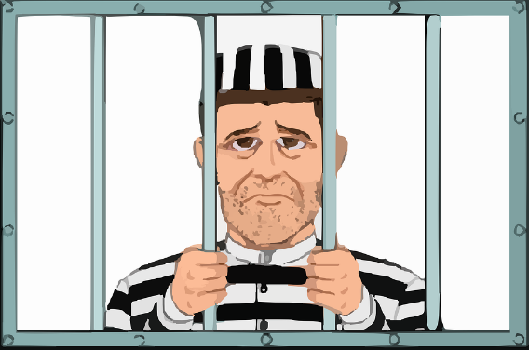
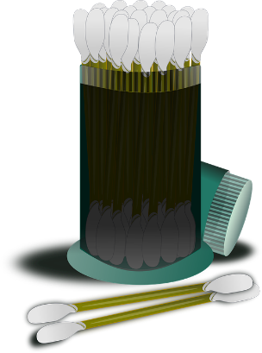
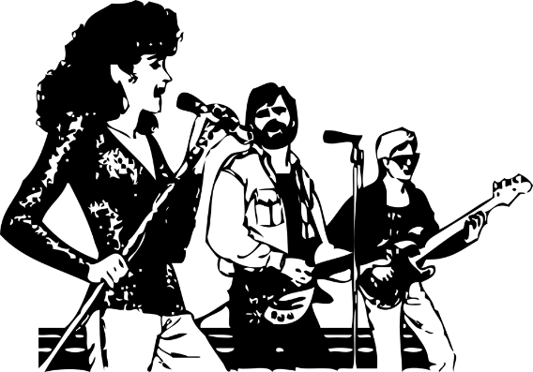
Phonétique
parler
30
These words look like English, but have SSC [on] in French. How do they sound?
prison
blond
contact
opinion
secondes
0
coton
concert
salon
révision
DÉBUT
Notes:
Timing: 3 minutes for 3 slides
Aim: To correctly pronounce cognates and near-cognates containing [on] in decreasing amounts of time, helping automisation of SSC production. Raising awareness of the difference in the English and French pronunciation of this SSC.
Procedure:
Students pair up, and take turns trying to say all the words in 30 seconds (run the timer twice).
Click on the pictures to hear the words pronounced by a native speaker. Students repeat.
Move on to the next slide.
Word frequency (1 is the most frequent word in French): prison [1010], blond [4585], contact [894], opinion [777], coton [4516], concert [1697], salon [2729], revision [2748]
Source: Londsale, D., & Le Bras, Y. (2009). A Frequency Dictionary of French:], Core vocabulary for learners London: Routledge.

Slide 11
Phonétique
parler
20
These words look like English, but have SSC [on] in French. How do they sound?
prison
blond
contact
opinion
secondes
0
coton
concert
salon
révision
DÉBUT
Notes:
As per previous slide, but with ten fewer seconds on the timer.

Slide 12
Phonétique
parler
10
These words look like English, but have SSC [on] in French. How do they sound?
prison
blond
contact
opinion
secondes
0
coton
concert
salon
révision
DÉBUT
Notes:
As per previous slide, but with ten fewer seconds on the timer still.

Slide 13
SSC [on]
phonétique
Consolidation [1]

Slide 14
on
non!
Notes:
Timing: 1 minute
Aim: To introduce/consolidate SSC [on]
Procedure: 1. Present the letter(s) and say the [on] sound first, on its own. Students repeat it with you. 2. Bring up the word ”non” on its own, say it, students repeat it, so that they have the opportunity to focus all of their attention on the connection between the written word and its sound.
3. A possible gesture for this would be to shake ones head whilst waggling one’s index finger, to indicate ‘no!’ 4. Roll back the animations and work through 1-3 again, but this time, dropping your voice completely to listen carefully to the students saying the [on] sound, pronouncing ”non” and, if using, doing the gesture.
Word frequency (1 is the most frequent word in French):
onze [2447]
Source: Londsale, D., & Le Bras, Y. (2009). A Frequency Dictionary of French: Core vocabulary for learners London: Routledge.

Slide 15
on
non!
Notes:
With sound and no pictures to focus all attention on the sound-symbol correspondence.

Slide 16
on
non!
Notes:
Without sound to elicit pronunciation (without first hearing the teacher).
Teacher to elicit pronunciation by asking “Comment dit-on …"

Slide 17
on
onze
continuer
[to continue]
non!
monde
au fond
montrer
[at the back]
[to show]
Notes:
Timing: 2 minutes
Aim: To introduce/consolidate SSC [on]
Procedure:
1. Introduce and elicit the pronunciation of the individual SSC [on] and then the source word again ‘non’ (with gesture, if using). 2. Then present and elicit the pronunciation of the five cluster words.
The cluster words have been chosen for their high-frequency, from a range of word classes, with the SSC (where possible) positioned within a variety of syllables within the words (e.g. initial, 2nd, final etc.). Additionally, we have tried to use words that build cumulatively on previously taught SSCs (see the Phonics Teaching Sequence document) and do not include new SSCs. Where new SSCs are used, they are often consonants which have a similar symbol-sound correspondence in English.
Word frequency (1 is the most frequent word in French): onze [2447]; continuer [113] monde [77]; montrer [108]; au fond [553]; non [72]. Source: Londsale, D., & Le Bras, Y. (2009). A Frequency Dictionary of French: Core vocabulary for learners London: Routledge.

Slide 18
on
onze
continuer
non!
monde
au fond
montrer
Notes:
With sound and no pictures to focus all attention on the sound-symbol correspondence.

Slide 19
on
onze
continuer
non!
monde
au fond
montrer
Notes:
Without sound to elicit pronunciation (without first hearing the teacher).
Teacher to elicit pronunciation by asking “Comment dit-on …"

Slide 20
Le poète en difficulté
Le poète en difficulté
écouter
Le poète fait des erreurs avec les SSC [on] et [au / eau / o].
Écoute le poème. La rime est bonne ou mauvaise ?
Je mange à Dijon
1
Menton
Tu manges à _______
La rime est bonne
La rime est mauvaise
Notes:
Timing: 5 minutes for 8 slides
Aim: oral recognition of this week’s SSC [on] in contrast to the similar-sounding SSC [au / eau / o]
Procedure:
First, check students’ understanding of the L2 instructions. Draw attention to the near-cognates “difficulté” and “erreurs”, which have not been previously encountered. “Poète” / “poème” and “rime” have been introduced previously, but may need some refreshing. The feminine “bonne” and “mauvaise” have not been encountered in this form, so encourage students to decode from the previously learnt “bon” and “mauvais”.
Students write 1-8 in their workbooks.
Click the number button to play the audio – the number of times may vary depending on the needs and level of the class.
Students draw a smiley face if the two lines rhyme (if the second line ends with [o]), or a sad face if they do not (if the second line ends with [au / eau / o] – no need to transcribe the missing word. Place names are used to limit reliance on vocabulary knowledge – the focus is simply on recognising the SSC.
The slides are animated so that the smiley or sad face is highlighted first, then the missing word appears on the next click. Pronunciation can be practised at this stage.
Transcript:
Je mange à Dijon. Tu manges à Menton.
Frequency information for non-SOW (near-)cognates:
difficulté [564], erreur [612], poème [3031], poète [2307], rime [>5000]
Source: Londsale, D., & Le Bras, Y. (2009). A Frequency Dictionary of French: Core vocabulary for learners London: Routledge.

Slide 21
Le poète en difficulté
Le poète en difficulté
écouter
Le poète fait des erreurs avec les SSC [on] et [au / eau / o].
Écoute le poème. La rime est bonne ou mauvaise ?
Je joue à Toulon
2
Bordeaux
Tu joues à _________
La rime est bonne
La rime est mauvaise
Notes:
Transcript:
2. Je joue à Toulon. Tu joues à Bordeaux.

Slide 22
Le poète en difficulté
Le poète en difficulté
écouter
Le poète fait des erreurs avec les SSC [on] et [au / eau / o].
Écoute le poème. La rime est bonne ou mauvaise ?
Je gagne à Soissons
3
Chaumont
Tu gagnes à __________
La rime est bonne
La rime est mauvaise
Notes:
Transcript:
3. Je parle à Soissons. Tu parles à Chaumont.

Slide 23
Le poète en difficulté
Le poète en difficulté
écouter
Le poète fait des erreurs avec les SSC [on] et [au / eau / o].
Écoute le poème. La rime est bonne ou mauvaise ?
Je marche à Mâcon
4
Tu marches à ______
Larrau
La rime est bonne
La rime est mauvaise
Notes:
Transcript:
4. Je marche à Mâcon. Tu marches à Larrau.

Slide 24
Le poète en difficulté
Le poète en difficulté
écouter
Le poète fait des erreurs avec les SSC [on] et [au / eau / o].
Écoute le poème. La rime est bonne ou mauvaise ?
Je reste à Montluçon
5
Tu restes à _________
Monaco
La rime est bonne
La rime est mauvaise
Notes:
Transcript:
5. Je reste à Montluçon. Tu restes à Monaco.

Slide 25
Le poète en difficulté
Le poète en difficulté
écouter
Le poète fait des erreurs avec les SSC [on] et [au / eau / o].
Écoute le poème. La rime est bonne ou mauvaise ?
Je chante à Avignon
6
Tu chantes à ________
Avallon
La rime est bonne
La rime est mauvaise
Notes:
Transcript:
6. Je chante à Avignon. Tu chantes à Avallon.

Slide 26
Le poète en difficulté
Le poète en difficulté
écouter
Le poète fait des erreurs avec les SSC [on] et [au / eau / o].
Écoute le poème. La rime est bonne ou mauvaise ?
Je pense à Briançon
7
Tu penses à __________
Besançon
La rime est bonne
La rime est mauvaise
Notes:
Transcript:
7. Je pense à Briançon. Tu penses à Besançon.

Slide 27
Le poète en difficulté
Le poète en difficulté
écouter
Le poète fait des erreurs avec les SSC [on] et [au / eau / o].
Écoute le poème. La rime est bonne ou mauvaise ?
Je travaille à Quiberon
8
Tu travailles à _____________
Concarneau
La rime est bonne
La rime est mauvaise
Notes:
Transcript:
8. Je travaille à Quiberon. Tu travailles à Concarneau.

Slide 28
Phonétique
parler
Phonétique
concert
prison
moral
euro
local
liaison
front
total
photo
constant
Notes:
Timing: 3 minutes
Aim: Practise production of the target SSC [on] and contrasts SSC [au / eau / o] from lesson 1, using cognates in order to “un-learn” the English pronunciation.
comme² [32]
Students work in pairs, alternately saying one of the words and listening to spot errors in their partner’s pronunciation.
They get one point for each correct French pronunciation of the SSC – no points for the English equivalent!
Word frequency (1 is the most common word in French): concert [1697], euro [1753], front [1729], liaison [1968], local [622], moral [1226], photo [1412], prison [1010], total [658], constant [1762] Source: Londsale, D., & Le Bras, Y. (2009). A Frequency Dictionary of French: Core vocabulary for learners London: Routledge.

Slide 29
SSC [on]
phonétique
Consolidation [2]

Slide 30
on
non!
Notes:
Timing: 1 minute
Aim: To introduce/consolidate SSC [on]
Procedure: 1. Present the letter(s) and say the [on] sound first, on its own. Students repeat it with you. 2. Bring up the word ”non” on its own, say it, students repeat it, so that they have the opportunity to focus all of their attention on the connection between the written word and its sound.
3. A possible gesture for this would be to shake ones head whilst waggling one’s index finger, to indicate ‘no!’ 4. Roll back the animations and work through 1-3 again, but this time, dropping your voice completely to listen carefully to the students saying the [on] sound, pronouncing ”non” and, if using, doing the gesture.
Word frequency (1 is the most frequent word in French):
onze [2447]
Source: Londsale, D., & Le Bras, Y. (2009). A Frequency Dictionary of French: Core vocabulary for learners London: Routledge.

Slide 31
on
onze
continuer
[to continue]
non!
monde
au fond
montrer
[at the back]
[to show]
Notes:
Timing: 2 minutes
Aim: To introduce/consolidate SSC [on]
Procedure:
1. Introduce and elicit the pronunciation of the individual SSC [on] and then the source word again ‘non’ (with gesture, if using). 2. Then present and elicit the pronunciation of the five cluster words.
The cluster words have been chosen for their high-frequency, from a range of word classes, with the SSC (where possible) positioned within a variety of syllables within the words (e.g. initial, 2nd, final etc.). Additionally, we have tried to use words that build cumulatively on previously taught SSCs (see the Phonics Teaching Sequence document) and do not include new SSCs. Where new SSCs are used, they are often consonants which have a similar symbol-sound correspondence in English.
Word frequency (1 is the most frequent word in French): onze [2447]; continuer [113] monde [77]; montrer [108]; au fond [553]; non [72]. Source: Londsale, D., & Le Bras, Y. (2009). A Frequency Dictionary of French: Core vocabulary for learners London: Routledge.

Slide 32
[on] et [om]
écouter
What do you notice about these words?
Even though these words are spelled differently, they sound exactly the same!
Nathalie
non
nom
SSC [on] is the same sound as SSC [om], which you already know.
When this nasal sound appears in front of the letters p or b, it is spelled [om] instead of [on].
monde, montrer BUT tomber [to fall], une ombre [a shadow]
Notes:
Timing: 1 minute
Aim: Raising awareness of the identical sound in SSCs [ain/in], an [aim/im]
For a reminder of Year 7 SSC [ain/in], see the two slides that follow.

Slide 33
om/on
comparaison
Notes:
Timing: 1 minute
Aim: To demonstrate [om] and [on] in the same (highly appropriate!) word.
Word frequency (1 is the most frequent word in French):
comparaison [2244]
Source: Londsale, D., & Le Bras, Y. (2009). A Frequency Dictionary of French: Core vocabulary for learners London: Routledge.

Slide 34
[om] ou [on] ?
lire / écouter
 |  | [on] | [om]
 | tombe
 | trompe
 | concombre
j | confortable [comfortable]
 | pompier
 | bonbon
h | honte [shame]
 | interrompre [to interrupt]
 | combler [to fill]
Comment ça s'écrit ?
Avec [on] ou [om] ?
Complète et dis les mots !
1
_ _
2
_ _
3
_ _
_ _
4
_ _
5
_ _
6
_ _
7
_ _
8
_ _
9
_ _
Notes:
Timing: 5 minutes
Aim: Applying awareness of the spelling rules governing SSCs [on] and [om], and production of all four SSCs.
Procedure
Student read the words and decide based on the presence of absence of a ‘p’ or ‘b’ after the gap when [on] or [om] is needed.
Click to check.
Now, students are challenged to say all ten words and pronounce the SSCs in the same way each time. It will be tempting for students to add an ‘n’ or ‘m’ after the vowel! Students should work in pairs and monitor each other for this.
Students try to say the words out loud. Teacher corrects.
Transcript:
tombe
trompe
concombre
comfortable
pompier
bonbon
honte
interrompre
combler
Word frequency (1 is the most frequent word in French): tombe [3426], trompe [>5000] concombre [>5000], confortable [3964], pompier [3295], bonbon [>5000], honte [1943], interrompre [1479], combler [4976],
Source: Londsale, D., & Le Bras, Y. (2009). A Frequency Dictionary of French: Core vocabulary for learners London: Routledge.

Slide 35
Phonétique
parler
Dis les mots à ton/ta partenaire – attention à la prononciation !
1
1) non – nom
2) onze – ombre
3) continuer – comprendre
4) combat – montrer
5) compte – monde
6
6) tomber – au fond
7) correspondre – interrompre
8) accomplir – contenir
9) complet – confiance
1 construction – compagnie
[to fall]
[essentially]
2
7
[shadow]
[to correspond]
[to interrupt]
3
8
[to continue]
[to accomplish]
[to contain]
4
9
[fight]
[complete]
[trust]
5
10
[count]
[company]
Notes:
Timing: 5 minutes
Aim: To practice pronunciation of [om] and [on] in words, both familiar and unfamiliar
Procedure:
1. Students say the pairs of words to a partner, who closes his/her eyes and listens carefully.
2. Partners point out if they hear any difference between the pronunciation of the [om] and the [on] sounds – of course, there should not be any difference in these words.
3. Swap roles and repeat.
Word frequency (1 is the most frequent word in French): onze [2447]; continuer [113] monde [77]; montrer [108]; au fond [553]; non [72] nom [171]; comprendre [95]; compte [254]; tomber [547]; combat [1062]; ombre [2001] correspondre [1415] interrompre [1479] accomplir [1301] contenir [1033] confiance [435] complet [965] construction [976] compagnie [775]
Source: Londsale, D., & Le Bras, Y. (2009). A Frequency Dictionary of French: Core vocabulary for learners London: Routledge.

Slide 36
SSC [on]
phonétique
Consolidation [3]

Slide 37
on
non!
Notes:
Timing: 1 minute
Aim: To introduce/consolidate SSC [on]
Procedure: 1. Present the letter(s) and say the [on] sound first, on its own. Students repeat it with you. 2. Bring up the word ”non” on its own, say it, students repeat it, so that they have the opportunity to focus all of their attention on the connection between the written word and its sound.
3. A possible gesture for this would be to shake ones head whilst waggling one’s index finger, to indicate ‘no!’ 4. Roll back the animations and work through 1-3 again, but this time, dropping your voice completely to listen carefully to the students saying the [on] sound, pronouncing ”non” and, if using, doing the gesture.
Word frequency (1 is the most frequent word in French):
onze [2447]
Source: Londsale, D., & Le Bras, Y. (2009). A Frequency Dictionary of French: Core vocabulary for learners London: Routledge.

Slide 38
on
onze
continuer
[to continue]
non!
monde
au fond
montrer
[at the back]
[to show]
Notes:
Timing: 2 minutes
Aim: To introduce/consolidate SSC [on]
Procedure:
1. Introduce and elicit the pronunciation of the individual SSC [on] and then the source word again ‘non’ (with gesture, if using). 2. Then present and elicit the pronunciation of the five cluster words.
The cluster words have been chosen for their high-frequency, from a range of word classes, with the SSC (where possible) positioned within a variety of syllables within the words (e.g. initial, 2nd, final etc.). Additionally, we have tried to use words that build cumulatively on previously taught SSCs (see the Phonics Teaching Sequence document) and do not include new SSCs. Where new SSCs are used, they are often consonants which have a similar symbol-sound correspondence in English.
Word frequency (1 is the most frequent word in French): onze [2447]; continuer [113] monde [77]; montrer [108]; au fond [553]; non [72]. Source: Londsale, D., & Le Bras, Y. (2009). A Frequency Dictionary of French: Core vocabulary for learners London: Routledge.

Slide 39
Phonétique
écouter
 |  | nasal | oral + m/n
 | plafond [roof]
 | promettre [to promise]
 | concentrer [to concentrate]
 | domaine [field/domain]
 | dont [of which]
 | raconter [to tell]
 | moment [time]
 | nombreux [plentiful]
1
2
3
Remember!
[om] and [on] are oral sounds before a vowel, and nasal sounds before a consonant.
4
5
6
7
8
Notes:
Timing: 5 minutes
Aim: Aural recognition of nasal and non-nasal vowels [om], [on], open [o] and closed [o] in unknown words.
Procedure:
1. Practise saying SSCs [om], [on], open [o] and closed [o] aloud, in isolation. Students should notice a vibration in the nose when they produce the nasal sounds, but not when they produce the oral sounds.
2. Click the numbers to play the audio.
3. Students write 1-8 and decide if the letters in bold represent a ‘nasal’ or ‘non-nasal’ vowel sound.
4. Click to reveal the answers.
5. Click to bring up the reminder about spelling rules introduced last week (8.2.2.1) and demonstrate its applicability here.
Transcript:
1. plafond
2. promettre
3. concentrer
4. domaine
5. dont
6. raconter
7. moment
8. nombreux
Word frequency (1 is the most frequent word in French): plafond [2823] promettre [854] concentrer [856] nombreux [366] formation [831] dont [74] raconter [890] moment [148]
Source: Londsale, D., & Le Bras, Y. (2009). A Frequency Dictionary of French: Core vocabulary for learners London: Routledge.

Slide 40
[om], [on]
écouter / écrire
Normally, SSCs [om] and [on] are nasal vowels.
However, [om] and [on] sound different before a vowel.
Can you think of any examples in words you already know?
before a consonant: before a vowel:
montrer national
contre une promenade
le monde fromage
comprendre le roman
(to show)
These sounds are nasal vowels [om], [on].
(national)
These sounds are oral vowels open [o] and closed [o] + m / n.
(against)
(a walk)
(world)
(cheese)
(to understand)
(novel)
Notes:
Timing: 2 minutes
Aim: revising the spelling rules governing pronunciation changes in SSCs which are normally nasal vowels, and applying these to [om] and [on].
Procedure: 1. Cycle through the information on the slide using the animation sequence.

Slide 41
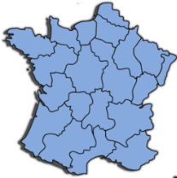
Phonétique
parler
économique
[economic]
contre
monde
[against]
formation
[course]
concentrer
nombreux
[plentiful]
comité
domaine
région
[committee]
[field/domain]
monter
promettre
[to go up]
omission
[to promise]
disponible
[oversight]
[available]
moment
dont
long
[of which]
Notes:
Timing: 5 minutes
Aim: applying awareness of the pronunciation rules governing SSCs [om], [on], and long and short [o] to the production of words containing these letter combinations.
Procedure:
1. Student read the words and decide based on the presence or absence of a vowel after letter ‘m’ or ‘n’ whether a nasal is needed or not.
2. Click to check.
3. Now, students are challenged to pronounce the words correctly. Students should work in pairs and monitor each other for this.
4. Students try to say the words out loud. Teacher corrects.
5. Click the words to hear pronunciation.
Word frequency (1 is the most frequent word in French): disponible [1205] domaine [539] comité [651] promettre [854] omission [>5000] moment [148] économique [261] concentrer [856] nombreux [366] monter [853] formation [831] dont [74] monde [77] contre [121] long [202] région [241]
Source: Londsale, D., & Le Bras, Y. (2009). A Frequency Dictionary of French: Core vocabulary for learners London: Routledge.

Slide 42
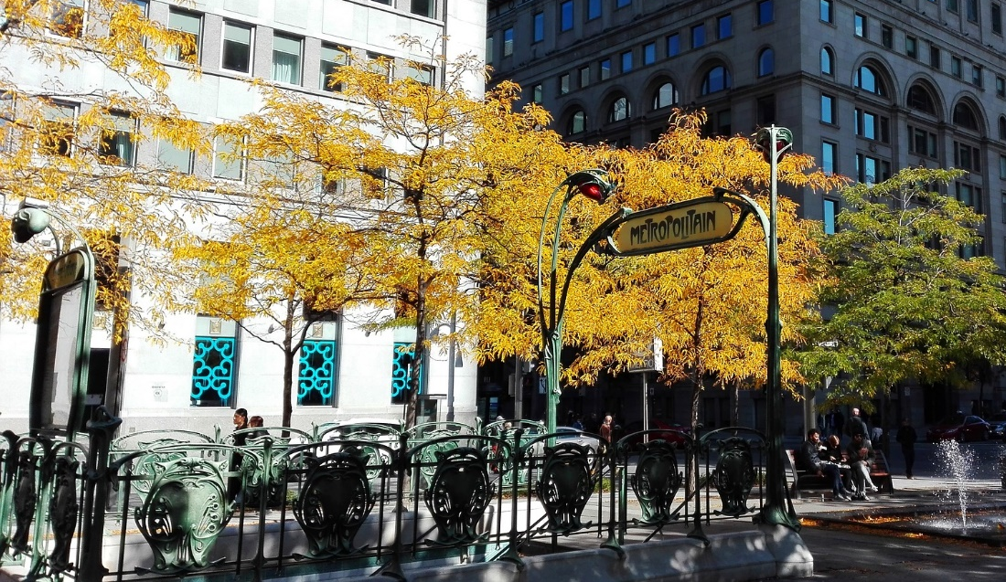
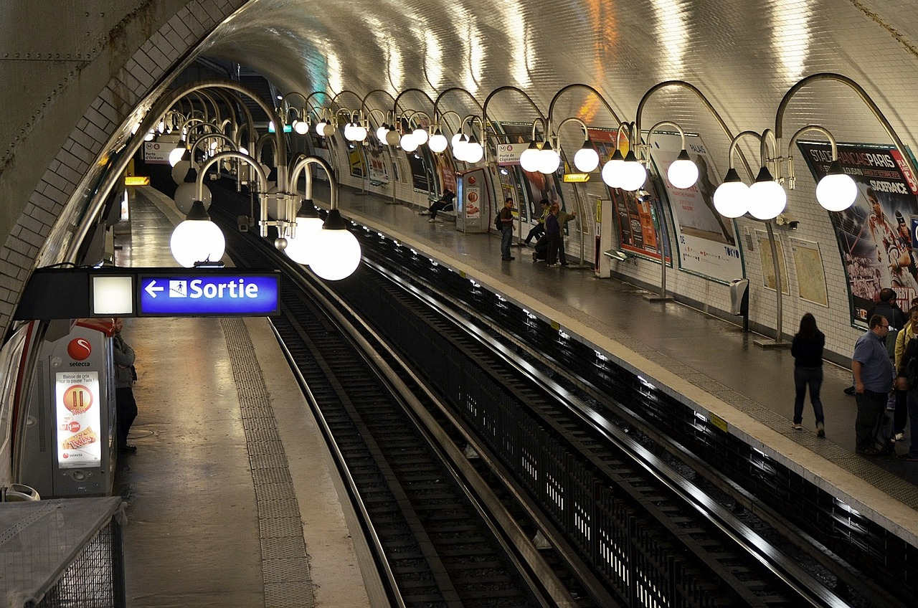
Phonétique
lire / parler
À Paris on peut prendre le métro pour vite se déplacer*.
Le métro est un train souterrain**.
* to get around
** underground
Notes:
Timing: 1 minute
Aim: To introduce students to the context of the phonics activity which follows.
Procedure:
1. Ask student to read the slide.
2. Ensure understanding by taking feedback.
Word frequency of unknown words used (1 is the most frequent word in French): se déplacer [714]; souterrain [4544]
Source: Londsale, D., & Le Bras, Y. (2009). A Frequency Dictionary of French: Core vocabulary for learners London: Routledge.
Word frequency of cognates used (1 is the most frequent word in French): métro [3227]
Source: Londsale, D., & Le Bras, Y. (2009). A Frequency Dictionary of French: Core vocabulary for learners London: Routledge.

Slide 43
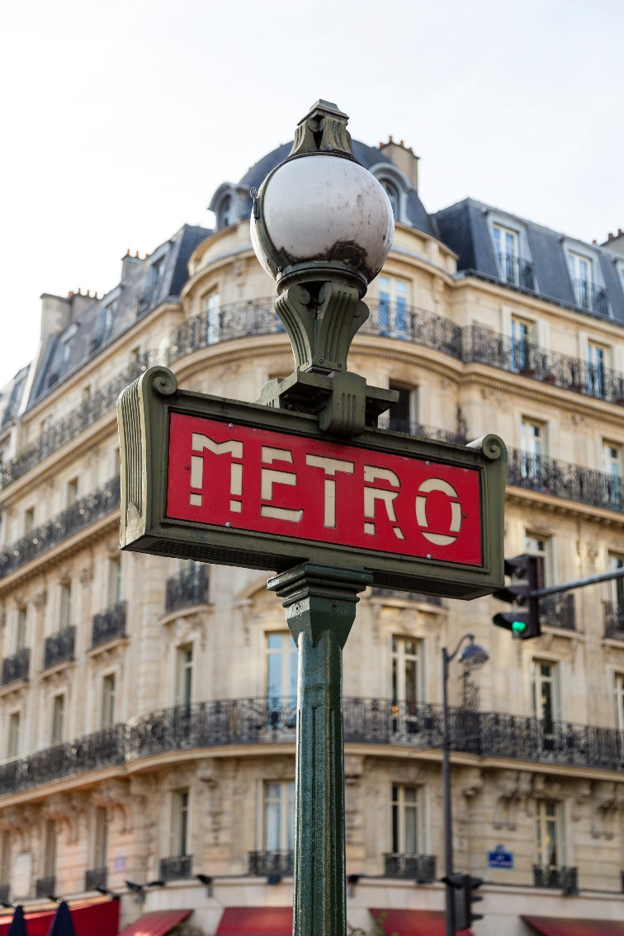
Phonétique
A→Z
Z→A
lire / parler
Des stations de métro à Paris.
Europe
Église d’Auteuil
Marie de Montreuil
Porte d’Auteuil
Pasteur
Pont-Neuf
Richelieu-Drouot
Notes:
Timing: 3 minutes
Aim: spoken practice of SSCs [eu] and [-euil/euill].
Procedure:
1. Partners take it in turns to say the station names in alphabetical order (A-Z). Partner A starts.
2. Partners take it in turns to say the station names in reverse alphabetical order (Z-A). Partner B starts.
3. Partners repeat to improve fluency of production.
4. Circulate to listen in to students’ pronunciation.

Slide 44
SSC [on]
phonétique
Consolidation [4]

Slide 45
on
non!
Notes:
Timing: 1 minute
Aim: To introduce/consolidate SSC [on]
Procedure: 1. Present the letter(s) and say the [on] sound first, on its own. Students repeat it with you. 2. Bring up the word ”non” on its own, say it, students repeat it, so that they have the opportunity to focus all of their attention on the connection between the written word and its sound.
3. A possible gesture for this would be to shake ones head whilst waggling one’s index finger, to indicate ‘no!’ 4. Roll back the animations and work through 1-3 again, but this time, dropping your voice completely to listen carefully to the students saying the [on] sound, pronouncing ”non” and, if using, doing the gesture.
Word frequency (1 is the most frequent word in French):
onze [2447]
Source: Londsale, D., & Le Bras, Y. (2009). A Frequency Dictionary of French: Core vocabulary for learners London: Routledge.

Slide 46
on
onze
continuer
[to continue]
non!
monde
au fond
montrer
[at the back]
[to show]
Notes:
Timing: 2 minutes
Aim: To introduce/consolidate SSC [on]
Procedure:
1. Introduce and elicit the pronunciation of the individual SSC [on] and then the source word again ‘non’ (with gesture, if using). 2. Then present and elicit the pronunciation of the five cluster words.
The cluster words have been chosen for their high-frequency, from a range of word classes, with the SSC (where possible) positioned within a variety of syllables within the words (e.g. initial, 2nd, final etc.). Additionally, we have tried to use words that build cumulatively on previously taught SSCs (see the Phonics Teaching Sequence document) and do not include new SSCs. Where new SSCs are used, they are often consonants which have a similar symbol-sound correspondence in English.
Word frequency (1 is the most frequent word in French): onze [2447]; continuer [113] monde [77]; montrer [108]; au fond [553]; non [72]. Source: Londsale, D., & Le Bras, Y. (2009). A Frequency Dictionary of French: Core vocabulary for learners London: Routledge.

Slide 47
‘mon’ ou ‘-ment’ ?
* répéter = to repeat
info
Écoute et répète.*
mon
il ment [he’s lying]
1
mon
normalement
3
mon
absolument
2
mon
rarement
4
mon
facilement
Notes:
Timing: 3 minutes
Aim: To distinguish aurally between SSCs [en/an] and accurately produce both sounds. This phonics focus prepares students to correctly pronounce -ment adverbs, which are this week’s word pattern feature.
Procedure:
1. Click to bring up the minima pair. Students listen to the pronunciation (click on the images to hear).
2. Explain that [on] and [en/an] are nasal vowels. [on] is a nasal [o], and [en/an] is a nasal [a]. Students practise saying [o] and [a], focusing on mouth position. The mouth should be wide in a square shape for [a], and almost closed like a kiss for [o].
3. Keeping the mouth position the same, students practise saying [on] and [en/an], and then [mon] and [il ment].
4. Click to bring up some known –ment adjectives juxtaposed with the word mon. Students listen and repeat.
Transcript:
mon – il ment
1. mon – normalement
2. mon – rarement
3. mon – absolument
4. mon – facilement

Slide 48
SSC [on]
phonétique
Consolidation [5]

Slide 49
on
non!
Notes:
Timing: 1 minute
Aim: To introduce/consolidate SSC [on]
Procedure: 1. Present the letter(s) and say the [on] sound first, on its own. Students repeat it with you. 2. Bring up the word ”non” on its own, say it, students repeat it, so that they have the opportunity to focus all of their attention on the connection between the written word and its sound.
3. A possible gesture for this would be to shake ones head whilst waggling one’s index finger, to indicate ‘no!’ 4. Roll back the animations and work through 1-3 again, but this time, dropping your voice completely to listen carefully to the students saying the [on] sound, pronouncing ”non” and, if using, doing the gesture.
Word frequency (1 is the most frequent word in French):
onze [2447]
Source: Londsale, D., & Le Bras, Y. (2009). A Frequency Dictionary of French: Core vocabulary for learners London: Routledge.

Slide 50
on
onze
continuer
[to continue]
non!
monde
au fond
montrer
[at the back]
[to show]
Notes:
Timing: 2 minutes
Aim: To introduce/consolidate SSC [on]
Procedure:
1. Introduce and elicit the pronunciation of the individual SSC [on] and then the source word again ‘non’ (with gesture, if using). 2. Then present and elicit the pronunciation of the five cluster words.
The cluster words have been chosen for their high-frequency, from a range of word classes, with the SSC (where possible) positioned within a variety of syllables within the words (e.g. initial, 2nd, final etc.). Additionally, we have tried to use words that build cumulatively on previously taught SSCs (see the Phonics Teaching Sequence document) and do not include new SSCs. Where new SSCs are used, they are often consonants which have a similar symbol-sound correspondence in English.
Word frequency (1 is the most frequent word in French): onze [2447]; continuer [113] monde [77]; montrer [108]; au fond [553]; non [72]. Source: Londsale, D., & Le Bras, Y. (2009). A Frequency Dictionary of French: Core vocabulary for learners London: Routledge.

Slide 51
SSC décollage*: [on], [ion], [tion] ou [sson] ?
*le décollage = take-off
écouter
1
s?dage
avia?
sondage
2
aviation
3
potir?
potiron
4
mou?
mousson
5
espion
esp?
[survey]
[aviation]
[pumpkin]
[monsoon]
[spy]
6
inonda?
fri?ner
torch?
inondation
7
sonder
s?der
8
frissonner
9
torchon
10
buisson
bui?
11
hérisson
héri?
[flood]
[probe]
[shiver]
[tea towel]
[bush]
[hedgehog]
12
sta?nement
stationnement
15
réun?
réunion
16
pioncer
jonction
p?cer
jonc?
camion
13
14
cam?
[parking]
[junction]
[lorry]
[meeting]
[snooze]
Notes:
Timing: 6 minutes
Aim: To practise distinguishing between sounds [on], [ion], [tion] and [sson]
Procedure:
Click on the number boxes to hear the full word.
Students must identify which sound they hear. This can be done using mini-whiteboards, either writing the sound or transcribing the full word.
The teacher clicks to reveal the correct spelling, and the aeroplane moves to the next word.
Transcript:
sondage
aviation
potiron
mousson
espion
inondation
sonder
frissonner
torchon
buisson
hérisson
stationnement [audio being re-recorded]
jonction
camion
réunion
pioncer
Word frequency of unknown words (1 is the most frequent word in French):
sondage [2232], potiron [>5000], mousson [>5000], inondation [4677], espion [>5000], torchon [>5000], frissonner [>5000], sonder [4930], buisson [>5000], stationnement [>5000], hérisson [>5000], camion [2542], pioncer [>5000]
Source: Lonsdale, D., & Le Bras, Y. (2009). A Frequency Dictionary of French: Core vocabulary for learners London: Routledge.
Word frequency of cognates used (1 is the most frequent word in French): aviation [4084], jonction [>5000], réunion [971]
Source: Lonsdale, D., & Le Bras, Y. (2009). A Frequency Dictionary of French: Core vocabulary for learners London: Routledge.

Slide 52
SSC [on]
phonétique
Consolidation [6]

Slide 53
on
non!
Notes:
Timing: 1 minute
Aim: To introduce/consolidate SSC [on]
Procedure: 1. Present the letter(s) and say the [on] sound first, on its own. Students repeat it with you. 2. Bring up the word ”non” on its own, say it, students repeat it, so that they have the opportunity to focus all of their attention on the connection between the written word and its sound.
3. A possible gesture for this would be to shake ones head whilst waggling one’s index finger, to indicate ‘no!’ 4. Roll back the animations and work through 1-3 again, but this time, dropping your voice completely to listen carefully to the students saying the [on] sound, pronouncing ”non” and, if using, doing the gesture.
Word frequency (1 is the most frequent word in French):
onze [2447]
Source: Londsale, D., & Le Bras, Y. (2009). A Frequency Dictionary of French: Core vocabulary for learners London: Routledge.

Slide 54
on
onze
continuer
[to continue]
non!
monde
au fond
montrer
[at the back]
[to show]
Notes:
Timing: 2 minutes
Aim: To introduce/consolidate SSC [on]
Procedure:
1. Introduce and elicit the pronunciation of the individual SSC [on] and then the source word again ‘non’ (with gesture, if using). 2. Then present and elicit the pronunciation of the five cluster words.
The cluster words have been chosen for their high-frequency, from a range of word classes, with the SSC (where possible) positioned within a variety of syllables within the words (e.g. initial, 2nd, final etc.). Additionally, we have tried to use words that build cumulatively on previously taught SSCs (see the Phonics Teaching Sequence document) and do not include new SSCs. Where new SSCs are used, they are often consonants which have a similar symbol-sound correspondence in English.
Word frequency (1 is the most frequent word in French): onze [2447]; continuer [113] monde [77]; montrer [108]; au fond [553]; non [72]. Source: Londsale, D., & Le Bras, Y. (2009). A Frequency Dictionary of French: Core vocabulary for learners London: Routledge.

Slide 55
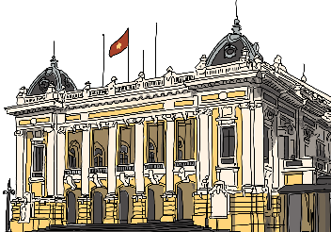
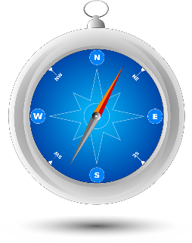
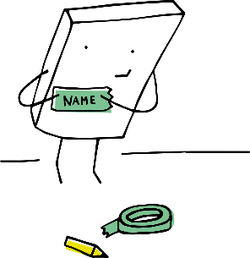
Les voyelles nasales
Are the vowels in bold nasal or non-nasal?
lire/parler
Remember that the nasal SSCs [on] and [om] become non-nasal sounds when they come before a vowel.
colonial [colonial]
tromper
[to deceive]
nomade
[nomadic]
compas
[compass]
rebondir
[to bounce back]
bâton
[stick]
escadron
[squadron]
prénom
[first name]
bonhomie
[friendliness]
comité
[committee]
monarchie
[monarchy]
complot
[plot]
Notes:
Timing: 3 minutes
Aim: Written recognition and oral production of nasal and non-nasal SSCs [on] and [om].
Procedure:
1. Use slides 2-7 to revise the sounds. Remind students that SSCs [on] and [om] sound identical.
2. Remind students that when [on] and [om] appear before a vowel, they are pronounced as non-nasal vowels + m/n. Nomade could be used as an example to illustrate this.
3. Working in pairs, students use the rules to sound out the words and decide whether the sounds in bold are nasal or non-nasal.
4. Click to reveal the answers. Click on the images to hear the words said aloud by a native speaker.
Transcript:
colonial, tromper, nomade, compas, rebondir, bâton, escadron, prénom, bonhomie, comité, monarchie, complot
Word frequency (1 is the most frequent word in French): tromper [1539], rebondir [>5000], bâton [3553], escadron [>5000], prénom [3543], bonhomie [>5000], complot [4569]
Source: Lonsdale, D., & Le Bras, Y. (2009). A Frequency Dictionary of French: Core vocabulary for learners London: Routledge.
Word frequency of cognates used (1 is the most frequent word in French): colonial [4143], nomade [>5000], compas [>5000], comité [651], monarchie [>5000]
Source: Lonsdale, D., & Le Bras, Y. (2009). A Frequency Dictionary of French: Core vocabulary for learners London: Routledge.

