Slide 1
French Phonics Collection
SSC [om]
Artwork by: Chloé Motard
Date updated: 30/08/22
Notes:
Artwork by Chloé Motard. All additional pictures selected are available under a Creative Commons license, no attribution required.

Slide 2
SSC [om]
phonétique
Introduction

Slide 3
om
Nathalie
Lefèvre
nom
Notes:
Timing: 1 minute
Aim: To introduce SSC [om]
Procedure: 1. Present the letter(s) and say the [om] sound first, on its own. Students repeat it with you. 2. Bring up the word ”nom” on its own, say it, students repeat it, so that they have the opportunity to focus all of their attention on the connection between the written word and its sound.
3. A possible gesture for this would be to point at yourself. 4. Roll back the animations and work through 1-3 again, but this time, dropping your voice completely to listen carefully to the students saying the [om] sound, pronouncing ”nom” and, if using, doing the gesture.
Word frequency (1 is the most frequent word in French):
nom [171]
Source: Londsale, D., & Le Bras, Y. (2009). A Frequency Dictionary of French: Core vocabulary for learners London: Routledge.

Slide 4
om
nom
Notes:
With sound and no pictures to focus all attention on the sound-symbol correspondence.

Slide 5
om
Nathalie
Lefèvre
nom
Notes:
Without sound to elicit pronunciation (without first hearing the teacher).
Teacher to elicit pronunciation by asking “Comment dit-on …”

Slide 6
om
ombre
combat
Nathalie
Lefèvre
nom
comprendre
tomber
[to understand]
compte
[fall]
[account]
Notes:
Timing: 2 minutes
Aim: To introduce/consolidate [delete as appropriate] SSC [om]
Procedure:
Introduce and elicit the pronunciation of the individual SSC [om] and then the source word again ‘nom’ (with gesture, if using). Then present and elicit the pronunciation of the five cluster words. The cluster words have been chosen for their high-frequency, from a range of word classes, with the SSC (where possible) positioned within a variety of syllables within the words (e.g. initial, 2nd, final etc.). Additionally, we have tried to use words that build cumulatively on previously taught SSCs (see the Phonics Teaching Sequence document) and do not include new SSCs. Where new SSCs are used, they are often consonants which have a similar symbol-sound correspondence in English.
Word frequency (1 is the most frequent word in French): nom [171]; comprendre [95]; compte [254]; tomber [547]; combat [1062]; ombre [2001]. Source: Londsale, D., & Le Bras, Y. (2009). A Frequency Dictionary of French: Core vocabulary for learners London: Routledge.

Slide 7
om
ombre
combat
Nathalie
Lefèvre
nom
comprendre
tomber
compte
Notes:
With sound and no pictures to focus all attention on the sound-symbol correspondence.

Slide 8
om
ombre
combat
Nathalie
Lefèvre
nom
comprendre
tomber
compte
Notes:
Without sound to elicit pronunciation (without first hearing the teacher).
Teacher to elicit pronunciation by asking “Comment dit-on …”

Slide 9
Phonétique
lire / parler
tomber
facile
45
nombre
compléter
combien
secondes
comble
comparer
nombreux
0
difficile
compagnie
DÉBUT
Notes:
Timing: 3 minutes for 3 slides.
Aim: Oral production of SSC [om/on] in words of varying degrees of complexity in decreasing amounts of time.
Procedure:
Students pair up.
Explain that students are going to work their way down the ‘ladder’ by correctly pronouncing cognates or previously taught words containing [om/on], starting with simple words and building up to more complex words. Starting with monde, Partner A works their way down the ladder. Partner B listens for correct pronunciation of [om/on]. If Partner A makes a mistake, e.g.tries to pronounce words the ‘English’ way by adding an ‘m’ after the vowel, they must return to the top of the ladder.
Students swap roles. Re-start the timer.
Whoever is furthest down the ladder when the timer stops is the winner!
Click on the words to hear them said aloud by a native speaker. Students repeat.
Move on to the next slide.
Word frequency (1 is the most frequent word in French): tomber [547]; nombre [249]; comble [4976]; combien [800]; comparer [1560]; compléter [2034]; nombreux [366]; compagnie [775]
Source: Londsale, D., & Le Bras, Y. (2009). A Frequency Dictionary of French: Core vocabulary for learners London: Routledge.

Slide 10
Phonétique
lire / parler
tomber
facile
30
nombre
completer
combien
secondes
comble
comparer
nombreux
0
difficile
compagnie
DÉBUT
Notes:
As previous but with 15 fewer seconds on the timer.

Slide 11
Phonétique
lire / parler
tomber
facile
15
nombre
completer
combien
secondes
comble
comparer
nombreux
0
difficile
compagnie
DÉBUT
Notes:
As previous but with 15 fewer seconds on the timer still.

Slide 12
[on] et [om]
écouter
What do you notice about these words?
Even though these words are spelled differently, they sound exactly the same!
Nathalie
non
nom
SSC [on] is the same sound as SSC [om], which you already know.
When this nasal sound appears in front of the letters p or b, it is spelled [om] instead of [on].
monde, montrer BUT tomber [to fall], une ombre [a shadow]
Notes:
Timing: 1 minute
Aim: Raising awareness of the identical sound in SSCs [ain/in], an [aim/im]
For a reminder of Year 7 SSC [ain/in], see the two slides that follow.

Slide 13
om/on
comparaison
Notes:
Timing: 1 minute
Aim: To demonstrate [om] and [on] in the same (highly appropriate!) word.
Word frequency (1 is the most frequent word in French):
comparaison [2244]
Source: Londsale, D., & Le Bras, Y. (2009). A Frequency Dictionary of French: Core vocabulary for learners London: Routledge.

Slide 14
[om] ou [on] ?
lire / écouter
 |  | [on] | [om]
 | tombe
 | trompe
 | concombre
j | confortable [comfortable]
 | pompier
 | bonbon
h | honte [shame]
 | interrompre [to interrupt]
 | combler [to fill]
Comment ça s'écrit ?
Avec [on] ou [om] ?
Complète et dis les mots !
1
_ _
2
_ _
3
_ _
_ _
4
_ _
5
_ _
6
_ _
7
_ _
8
_ _
9
_ _
Notes:
Timing: 5 minutes
Aim: Applying awareness of the spelling rules governing SSCs [on] and [om], and production of all four SSCs.
Procedure
Student read the words and decide based on the presence of absence of a ‘p’ or ‘b’ after the gap when [on] or [om] is needed.
Click to check.
Now, students are challenged to say all ten words and pronounce the SSCs in the same way each time. It will be tempting for students to add an ‘n’ or ‘m’ after the vowel! Students should work in pairs and monitor each other for this.
Students try to say the words out loud. Teacher corrects.
Transcript:
tombe
trompe
concombre
comfortable
pompier
bonbon
honte
interrompre
combler
Word frequency (1 is the most frequent word in French): tombe [3426], trompe [>5000] concombre [>5000], confortable [3964], pompier [3295], bonbon [>5000], honte [1943], interrompre [1479], combler [4976],
Source: Londsale, D., & Le Bras, Y. (2009). A Frequency Dictionary of French: Core vocabulary for learners London: Routledge.

Slide 15
Phonétique
parler
Dis les mots à ton/ta partenaire – attention à la prononciation !
1
1) non – nom
2) onze – ombre
3) continuer – comprendre
4) combat – montrer
5) compte – monde
6
6) tomber – au fond
7) correspondre – interrompre
8) accomplir – contenir
9) complet – confiance
1 construction – compagnie
[to fall]
[essentially]
2
7
[shadow]
[to correspond]
[to interrupt]
3
8
[to continue]
[to accomplish]
[to contain]
4
9
[fight]
[complete]
[trust]
5
10
[count]
[company]
Notes:
Timing: 5 minutes
Aim: To practice pronunciation of [om] and [on] in words, both familiar and unfamiliar
Procedure:
1. Students say the pairs of words to a partner, who closes his/her eyes and listens carefully.
2. Partners point out if they hear any difference between the pronunciation of the [om] and the [on] sounds – of course, there should not be any difference in these words.
3. Swap roles and repeat.
Word frequency (1 is the most frequent word in French): onze [2447]; continuer [113] monde [77]; montrer [108]; au fond [553]; non [72] nom [171]; comprendre [95]; compte [254]; tomber [547]; combat [1062]; ombre [2001] correspondre [1415] interrompre [1479] accomplir [1301] contenir [1033] confiance [435] complet [965] construction [976] compagnie [775]
Source: Londsale, D., & Le Bras, Y. (2009). A Frequency Dictionary of French: Core vocabulary for learners London: Routledge.

Slide 16
SSC [om]
phonétique
Consolidation [1]

Slide 17
om
Nathalie
Lefèvre
nom
Notes:
Timing: 1 minute
Aim: To consolidate SSC [om]
Procedure: 1. Present the letter(s) and say the [om] sound first, on its own. Students repeat it with you. 2. Bring up the word ”nom” on its own, say it, students repeat it, so that they have the opportunity to focus all of their attention on the connection between the written word and its sound.
3. A possible gesture for this would be to point at yourself. 4. Roll back the animations and work through 1-3 again, but this time, dropping your voice completely to listen carefully to the students saying the [om] sound, pronouncing ”nom” and, if using, doing the gesture.
Word frequency (1 is the most frequent word in French):
nom [171]
Source: Londsale, D., & Le Bras, Y. (2009). A Frequency Dictionary of French: Core vocabulary for learners London: Routledge.

Slide 18
om
ombre
combat
Nathalie
Lefèvre
nom
comprendre
tomber
[to understand]
compte
[fall]
[account]
Notes:
Timing: 1 minute
Aim: To consolidate SSC [om]
Procedure:
Introduce and elicit the pronunciation of the individual SSC [om] and then the source word again ‘nom’ (with gesture, if using). Then present and elicit the pronunciation of the five cluster words. The cluster words have been chosen for their high-frequency, from a range of word classes, with the SSC (where possible) positioned within a variety of syllables within the words (e.g. initial, 2nd, final etc.). Additionally, we have tried to use words that build cumulatively on previously taught SSCs (see the Phonics Teaching Sequence document) and do not include new SSCs. Where new SSCs are used, they are often consonants which have a similar symbol-sound correspondence in English.
Word frequency (1 is the most frequent word in French): nom [171]; comprendre [95]; compte [254]; tomber [547]; combat [1062]; ombre [2001]. Source: Londsale, D., & Le Bras, Y. (2009). A Frequency Dictionary of French: Core vocabulary for learners London: Routledge.

Slide 19
Phonétique
écouter
 |  | nasal | oral + m/n
 | plafond [roof]
 | promettre [to promise]
 | concentrer [to concentrate]
 | domaine [field/domain]
 | dont [of which]
 | raconter [to tell]
 | moment [time]
 | nombreux [plentiful]
1
2
3
Remember!
[om] and [on] are oral sounds before a vowel, and nasal sounds before a consonant.
4
5
6
7
8
Notes:
Timing: 5 minutes
Aim: Aural recognition of nasal and non-nasal vowels [om], [on], open [o] and closed [o] in unknown words.
Procedure:
1. Practise saying SSCs [om], [on], open [o] and closed [o] aloud, in isolation. Students should notice a vibration in the nose when they produce the nasal sounds, but not when they produce the oral sounds.
2. Click the numbers to play the audio.
3. Students write 1-8 and decide if the letters in bold represent a ‘nasal’ or ‘non-nasal’ vowel sound.
4. Click to reveal the answers.
5. Click to bring up the reminder about spelling rules introduced last week (8.2.2.1) and demonstrate its applicability here.
Transcript:
1. plafond
2. promettre
3. concentrer
4. domaine
5. dont
6. raconter
7. moment
8. nombreux
Word frequency (1 is the most frequent word in French): plafond [2823] promettre [854] concentrer [856] nombreux [366] formation [831] dont [74] raconter [890] moment [148]
Source: Londsale, D., & Le Bras, Y. (2009). A Frequency Dictionary of French: Core vocabulary for learners London: Routledge.

Slide 20
[om], [on]
écouter / écrire
Normally, SSCs [om] and [on] are nasal vowels.
However, [om] and [on] sound different before a vowel.
Can you think of any examples in words you already know?
before a consonant: before a vowel:
montrer national
contre une promenade
le monde fromage
comprendre le roman
(to show)
These sounds are nasal vowels [om], [on].
(national)
These sounds are oral vowels open [o] and closed [o] + m / n.
(against)
(a walk)
(world)
(cheese)
(to understand)
(novel)
Notes:
Timing: 2 minutes
Aim: revising the spelling rules governing pronunciation changes in SSCs which are normally nasal vowels, and applying these to [om] and [on].
Procedure: 1. Cycle through the information on the slide using the animation sequence.

Slide 21
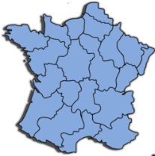
Phonétique
parler
économique
[economic]
contre
monde
[against]
formation
[course]
concentrer
nombreux
[plentiful]
comité
domaine
région
[committee]
[field/domain]
monter
promettre
[to go up]
omission
[to promise]
disponible
[oversight]
[available]
moment
dont
long
[of which]
Notes:
Timing: 5 minutes
Aim: applying awareness of the pronunciation rules governing SSCs [om], [on], and long and short [o] to the production of words containing these letter combinations.
Procedure:
1. Student read the words and decide based on the presence or absence of a vowel after letter ‘m’ or ‘n’ whether a nasal is needed or not.
2. Click to check.
3. Now, students are challenged to pronounce the words correctly. Students should work in pairs and monitor each other for this.
4. Students try to say the words out loud. Teacher corrects.
5. Click the words to hear pronunciation.
Word frequency (1 is the most frequent word in French): disponible [1205] domaine [539] comité [651] promettre [854] omission [>5000] moment [148] économique [261] concentrer [856] nombreux [366] monter [853] formation [831] dont [74] monde [77] contre [121] long [202] région [241]
Source: Londsale, D., & Le Bras, Y. (2009). A Frequency Dictionary of French: Core vocabulary for learners London: Routledge.

Slide 22
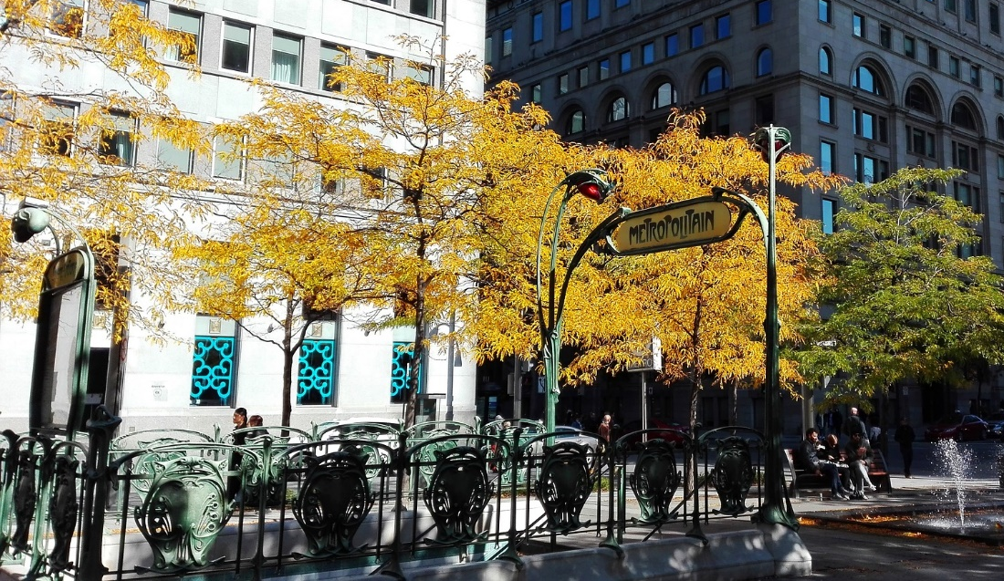
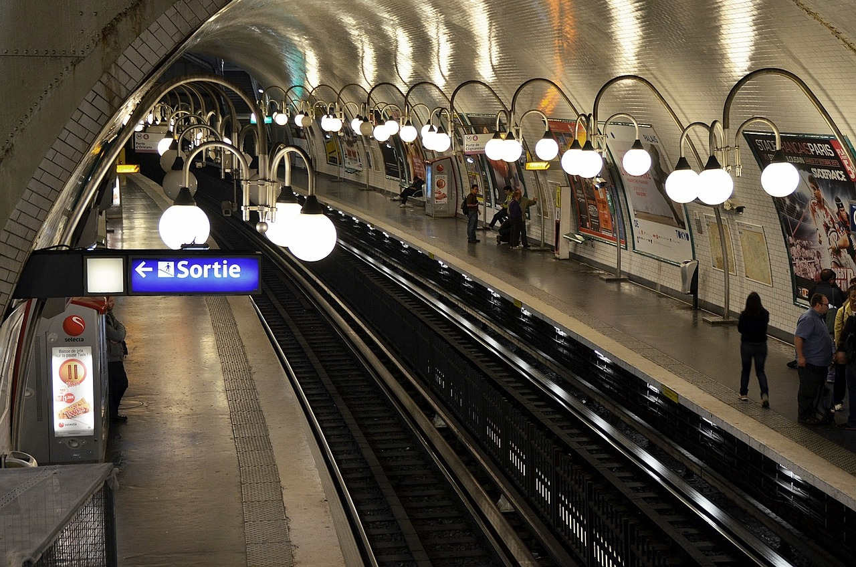
Phonétique
lire / parler
À Paris on peut prendre le métro pour vite se déplacer*.
Le métro est un train souterrain**.
* to get around
** underground
Notes:
Timing: 1 minute
Aim: To introduce students to the context of the phonics activity which follows.
Procedure:
1. Ask student to read the slide.
2. Ensure understanding by taking feedback.
Word frequency of unknown words used (1 is the most frequent word in French): se déplacer [714]; souterrain [4544]
Source: Londsale, D., & Le Bras, Y. (2009). A Frequency Dictionary of French: Core vocabulary for learners London: Routledge.
Word frequency of cognates used (1 is the most frequent word in French): métro [3227]
Source: Londsale, D., & Le Bras, Y. (2009). A Frequency Dictionary of French: Core vocabulary for learners London: Routledge.

Slide 23
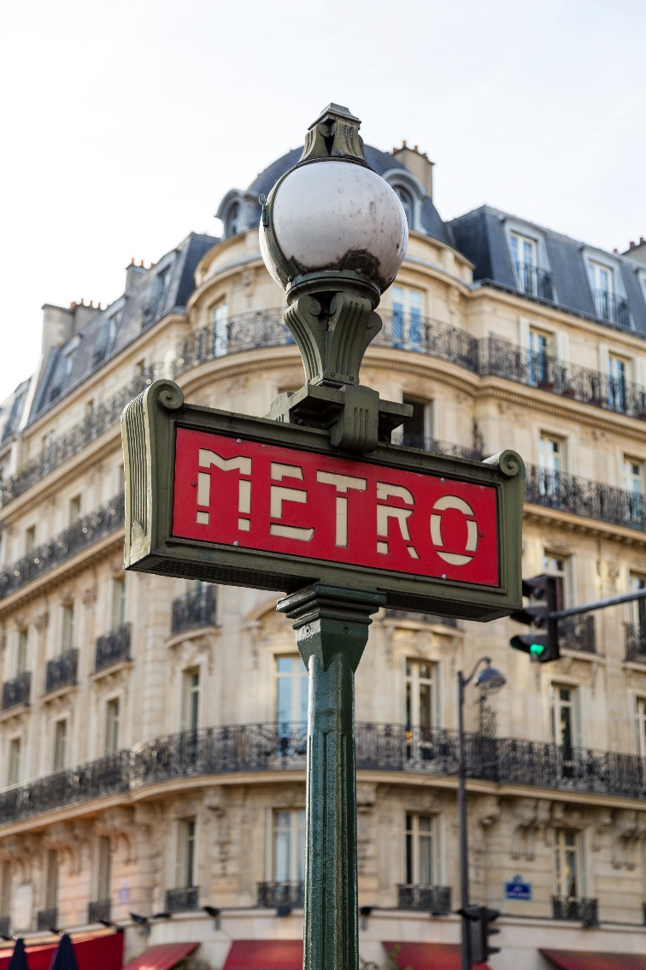
Phonétique
A→Z
Z→A
lire / parler
Des stations de métro à Paris.
Europe
Église d’Auteuil
Marie de Montreuil
Porte d’Auteuil
Pasteur
Pont-Neuf
Richelieu-Drouot
Notes:
Timing: 3 minutes
Aim: spoken practice of SSCs [eu] and [-euil/euill].
Procedure:
1. Partners take it in turns to say the station names in alphabetical order (A-Z). Partner A starts.
2. Partners take it in turns to say the station names in reverse alphabetical order (Z-A). Partner B starts.
3. Partners repeat to improve fluency of production.
4. Circulate to listen in to students’ pronunciation.

Slide 24
SSC [om]
phonétique
Consolidation [2]

Slide 25
om
Nathalie
Lefèvre
nom
Notes:
Timing: 1 minute
Aim: To consolidate SSC [om]
Procedure: 1. Present the letter(s) and say the [om] sound first, on its own. Students repeat it with you. 2. Bring up the word ”nom” on its own, say it, students repeat it, so that they have the opportunity to focus all of their attention on the connection between the written word and its sound.
3. A possible gesture for this would be to point at yourself. 4. Roll back the animations and work through 1-3 again, but this time, dropping your voice completely to listen carefully to the students saying the [om] sound, pronouncing ”nom” and, if using, doing the gesture.
Word frequency (1 is the most frequent word in French):
nom [171]
Source: Lonsdale, D., & Le Bras, Y. (2009). A Frequency Dictionary of French: Core vocabulary for learners London: Routledge.

Slide 26
om
ombre
combat
Nathalie
Lefèvre
nom
comprendre
tomber
[to understand]
compte
[fall]
[account]
Notes:
Timing: 2 minutes
Aim: To consolidate SSC [om]
Procedure:
Introduce and elicit the pronunciation of the individual SSC [om] and then the source word again ‘nom’ (with gesture, if using). Then present and elicit the pronunciation of the five cluster words. The cluster words have been chosen for their high-frequency, from a range of word classes, with the SSC (where possible) positioned within a variety of syllables within the words (e.g. initial, 2nd, final etc.). Additionally, we have tried to use words that build cumulatively on previously taught SSCs (see the Phonics Teaching Sequence document) and do not include new SSCs. Where new SSCs are used, they are often consonants which have a similar symbol-sound correspondence in English.
Word frequency (1 is the most frequent word in French): nom [171]; comprendre [95]; compte [254]; tomber [547]; combat [1062]; ombre [2001]. Source: Lonsdale, D., & Le Bras, Y. (2009). A Frequency Dictionary of French: Core vocabulary for learners London: Routledge.

Slide 27
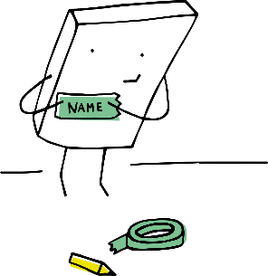
Les voyelles nasales
Are the vowels in bold nasal or non-nasal?
lire/parler
Remember that the nasal SSCs [on] and [om] become non-nasal sounds when they come before a vowel.
colonial [colonial]
tromper
[to deceive]
nomade
[nomadic]
compas
[compass]
rebondir
[to bounce back]
bâton
[stick]
escadron
[squadron]
prénom
[first name]
bonhomie
[friendliness]
comité
[committee]
monarchie
[monarchy]
complot
[plot]
Notes:
Timing: 3 minutes
Aim: Written recognition and oral production of nasal and non-nasal SSCs [on] and [om].
Procedure:
1. Use slides 2-7 to revise the sounds. Remind students that SSCs [on] and [om] sound identical.
2. Remind students that when [on] and [om] appear before a vowel, they are pronounced as non-nasal vowels + m/n. Nomade could be used as an example to illustrate this.
3. Working in pairs, students use the rules to sound out the words and decide whether the sounds in bold are nasal or non-nasal.
4. Click to reveal the answers. Click on the images to hear the words said aloud by a native speaker.
Transcript:
colonial, tromper, nomade, compas, rebondir, bâton, escadron, prénom, bonhomie, comité, monarchie, complot
Word frequency (1 is the most frequent word in French): tromper [1539], rebondir [>5000], bâton [3553], escadron [>5000], prénom [3543], bonhomie [>5000], complot [4569]
Source: Lonsdale, D., & Le Bras, Y. (2009). A Frequency Dictionary of French: Core vocabulary for learners London: Routledge.
Word frequency of cognates used (1 is the most frequent word in French): colonial [4143], nomade [>5000], compas [>5000], comité [651], monarchie [>5000]
Source: Lonsdale, D., & Le Bras, Y. (2009). A Frequency Dictionary of French: Core vocabulary for learners London: Routledge.

