Slide 1
French Phonics Collection
SSC [oin]
Artwork by: Chloé Motard
Date updated: 30/08/2022
Notes:
Artwork by Chloé Motard. All additional pictures selected are available under a Creative Commons license, no attribution required.

Slide 2
SSC [ay]
phonétique
Introduction

Slide 3
oin
besoin
[need]
Notes:
Timing: 1 minute
Aim: To introduce SSC [oin]
Procedure: 1. Present the letter(s) and say the [oin] sound first, on its own. Students repeat it with you. 2. Bring up the word ”besoin” on its own, say it, students repeat it, so that they have the opportunity to focus all of their attention on the connection between the written word and its sound.
3. A possible gesture for this would be [cuddling]. 4. Roll back the animations and work through 1-3 again, but this time, dropping your voice completely to listen carefully to the students saying the [oin] sound, pronouncing ”besoin” and, if using, doing the gesture.
Word frequency (1 is the most frequent word in French):
besoin [183]
Source: Londsale, D., & Le Bras, Y. (2009). A Frequency Dictionary of French: Core vocabulary for learners London: Routledge.

Slide 4
oin
besoin
Notes:
With sound and no pictures to focus all attention on the sound-symbol correspondence.

Slide 5
oin
besoin
Notes:
Without sound to elicit pronunciation (without first hearing the teacher).
Teacher to elicit pronunciation by asking “Comment dit-on …”

Slide 6
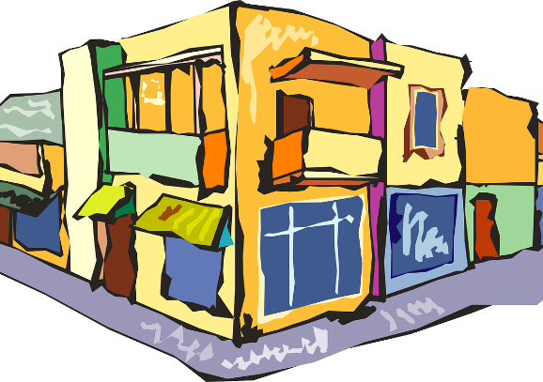
oin
coin
point
[corner]
[dot]
témoin
besoin
joindre
[witness]
[to join]
moins
[less]
Notes:
Timing: 2 minutes
Aim: To introduce SSC [oin]
Procedure:
1. Introduce and elicit the pronunciation of the individual SSC [oin] and then the source word again ‘besoin’ (with gesture, if using). 2. Then present and elicit the pronunciation of the five cluster words.
The cluster words have been chosen for their high-frequency, from a range of word classes, with the SSC (where possible) positioned within a variety of syllables within the words (e.g. initial, 2nd, final etc.). Additionally, we have tried to use words that build cumulatively on previously taught SSCs (see the Phonics Teaching Sequence document) and do not include new SSCs. Where new SSCs are used, they are often consonants which have a similar symbol-sound correspondence in English.
Word frequency (1 is the most frequent word in French): coin [341]; point [97]; témoin [1055]; joindre [1320]; moins [62]; Source: Londsale, D., & Le Bras, Y. (2009). A Frequency Dictionary of French: Core vocabulary for learners London: Routledge.

Slide 7
oin
coin
point
témoin
joindre
besoin
moins
Notes:
With sound and no pictures to focus all attention on the sound-symbol correspondence.

Slide 8
oin
coin
point
témoin
joindre
besoin
moins
Notes:
Without sound to elicit pronunciation (without first hearing the teacher).
Teacher to elicit pronunciation by asking “Comment dit-on …”

Slide 9
SSC [ay]
phonétique
Consolidation [1]

Slide 10
oin
besoin
[need]
Notes:
Timing: 1 minute
Aim: To introduce SSC [oin]
Procedure: 1. Present the letter(s) and say the [oin] sound first, on its own. Students repeat it with you. 2. Bring up the word ”besoin” on its own, say it, students repeat it, so that they have the opportunity to focus all of their attention on the connection between the written word and its sound.
3. A possible gesture for this would be [cuddling]. 4. Roll back the animations and work through 1-3 again, but this time, dropping your voice completely to listen carefully to the students saying the [oin] sound, pronouncing ”besoin” and, if using, doing the gesture.
Word frequency (1 is the most frequent word in French):
besoin [183]
Source: Londsale, D., & Le Bras, Y. (2009). A Frequency Dictionary of French: Core vocabulary for learners London: Routledge.

Slide 11
oin
coin
point
[corner]
[dot]
témoin
besoin
joindre
[witness]
[to join]
moins
[less]
Notes:
Timing: 2 minutes
Aim: To introduce SSC [oin]
Procedure:
1. Introduce and elicit the pronunciation of the individual SSC [oin] and then the source word again ‘besoin’ (with gesture, if using). 2. Then present and elicit the pronunciation of the five cluster words.
The cluster words have been chosen for their high-frequency, from a range of word classes, with the SSC (where possible) positioned within a variety of syllables within the words (e.g. initial, 2nd, final etc.). Additionally, we have tried to use words that build cumulatively on previously taught SSCs (see the Phonics Teaching Sequence document) and do not include new SSCs. Where new SSCs are used, they are often consonants which have a similar symbol-sound correspondence in English.
Word frequency (1 is the most frequent word in French): coin [341]; point [97]; témoin [1055]; joindre [1320]; moins [62]; Source: Londsale, D., & Le Bras, Y. (2009). A Frequency Dictionary of French: Core vocabulary for learners London: Routledge.

Slide 12
[oi] ou [-oin] ?
écouter / écrire
Écoute et coche le bon mot.
 | oi | -oin
 | mois | moins
 | joie | joint
 | pois | poing
 | loi | loin
 | fois | foin
 | soi | soin
1
2
3
4
5
6
Notes:
Timing: 4 minutes
Aim: Aural recognition of SSCs [oi] and [-oin]
Procedure:
1. Click the buttons to play the audio.
2. Students tick which word they hear.
3. Click to reveal answers.
Transcript:
moins
joie
pois
loin
fois
soin
Word frequency of unknown words used (1 is the most frequent word in French): joie [1984], joint [>5000], pois [>5000], poing [3889], loi [267], foin [>5000], soi [1365]
Source: Lonsdale, D., & Le Bras, Y. (2009). A Frequency Dictionary of French: Core vocabulary for learners London: Routledge.

Slide 13
[oi] ou [-oin] ?
lire / parler
The SSC [-oin] is a nasal sound, but only when it is followed by a consonant.
When it is followed by a vowel, it sounds like [oi] followed by [n].
moins
moine
[less]
[monk]
Notes:
Timing: 1 minute
Aim: Introduction of [-oin] before a vowel
Procedure:
1. Click to reveal examples and explanations.
2. Click the example words to hear a native speaker recording.
3. Ensure understanding.
Transcript:
moins
moine
Word frequency of unknown words used (1 is the most frequent word in French): moine [4339]
Source: Lonsdale, D., & Le Bras, Y. (2009). A Frequency Dictionary of French: Core vocabulary for learners London: Routledge.

Slide 14
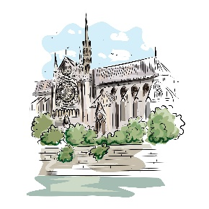
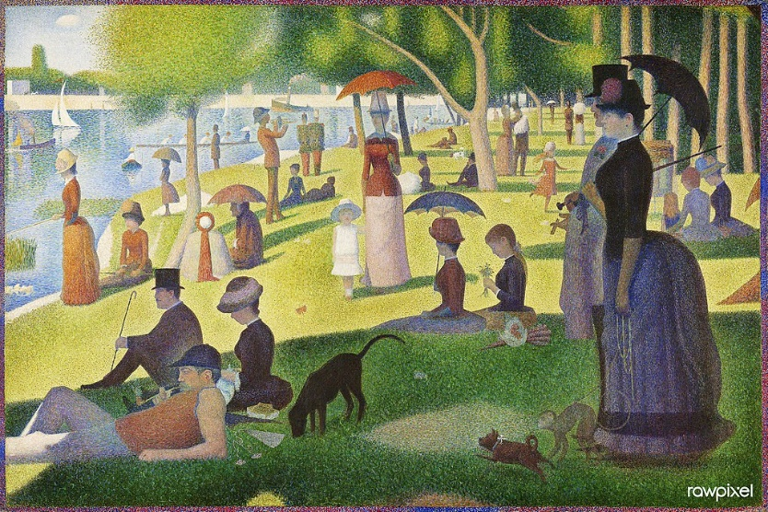
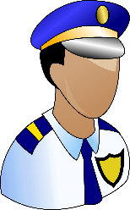
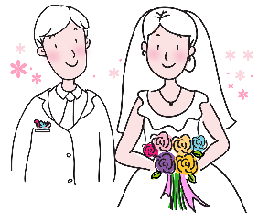
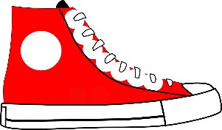
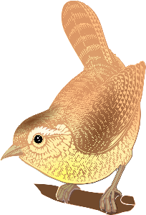
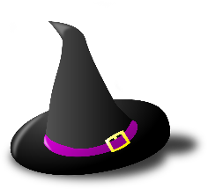
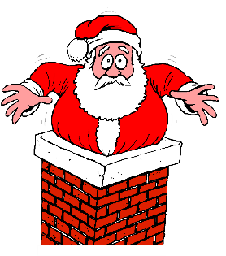
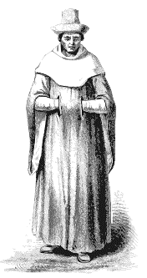
[oi] ou [-oin] ?
lire / parler
patrimoine
[heritage]
avoine
[oats]
rond-point
[roundabout]
néanmoins
[nevertheless]
60
Pointillism is a painting technique that uses dots to make a picture.
It was developed in France in the late 19th century by Georges Seurat and Paul Signac.
This is a painting of an island in the Seine by Georges Seurat.
pointure
[shoe size]
adjoint
[deputy]
conjoint
[spouse]
moine
[monk]
pointu
[pointed]
secondes
moineau
[sparrow]
shampooing
[shampoo]
lointain
[distant]
coincé
[stuck]
chanoine
[canon - religious person]
pointillisme
[pointillism]
0
Macédoine
[Macedonia]
DÉBUT
Notes:
Timing: 3 minutes
Aim: Oral practice of SSC [-oin] before consonants and vowels
Procedure:
1. Students try to say all the words before the timer ends.
2. Click on each word to hear native speaker pronunciation.
3. After clicking on pointillisme, click also on its image to bring up further information about this artistic style.
Transcript:
moine
pointu
avoine
coincé
moineau
adjoint
lointain
conjoint
chanoine
pointure
pointillisme
néanmoins
Macédoine
shampooing
patrimoine
rond-point
Word frequency of unknown words used (1 is the most frequent word in French): moine [4339], pointu [>5000], avoine [>5000], coincé (coincer) [3289], moineau [>5000], adjoint [2532], lointain [2933], conjoint [3317], chanoine [>5000], pointure [>5000], pointillisme [>5000], néanmoins [1271], Macédoine [>5000], shampooing [>5000], poinsettia [>5000], patrimoine [2530], rond-point [>5000]
Source: Lonsdale, D., & Le Bras, Y. (2009). A Frequency Dictionary of French: Core vocabulary for learners London: Routledge.
A Sunday on La Grande Jatte (1884) by Georges Seurat. Original from The Art Institute of Chicago. Digitally enhanced by rawpixel. (50434734621).jpg by Rawpixel Ltd is licensed under CC BY 2.0

