Slide 1
French Phonics Collection
SSC [oi]
Artwork by: Chloé Motard
Date updated: 31/08/22
Notes:
Artwork by Chloé Motard. All additional pictures selected are available under a Creative Commons license, no attribution required.

Slide 2
SSC [oi]
phonétique
Introduction

Slide 3
oi
[to see]
voir
Notes:
Timing: 1 minute
Aim: To introduce/consolidate SSC [oi]
Procedure: 1. Present the letter(s) and say the [oi] sound first, on its own. Students repeat it with you. 2. Bring up the word ”voir” on its own, say it, students repeat it, so that they have the opportunity to focus all of their attention on the connection between the written word and its sound.
3. A possible gesture for this would be to put one’s hand above one’s brow (as if to shade one’s view) and pretend to be seeing something far off. 4. Roll back the animations and work through 1-3 again, but this time, dropping your voice completely to listen carefully to the students saying the [oi] sound, pronouncing ”voir” and, if using, doing the gesture.
Word frequency (1 is the most frequent word in French):
voir [69].
Source: Londsale, D., & Le Bras, Y. (2009). A Frequency Dictionary of French: Core vocabulary for learners London: Routledge.

Slide 4
oi
voir
Notes:
With sound and no pictures to focus all attention on the sound-symbol correspondence.

Slide 5
oi
[to see]
voir
Notes:
Without sound to elicit pronunciation (without first hearing the teacher).
Teacher to elicit pronunciation by asking “Comment dit-on …"

Slide 6
oi
droite
avoir
[to have]
to see
voir
Au revoir !
trois
Pourquoi ?
[why?]
Notes:
Timing: 2 minutes
Aim: To introduce/consolidate SSC [oi]
Procedure:
1. Introduce and elicit the pronunciation of the individual SSC [oi] and then the source word again ‘voir’ (with gesture, if using). 2. Then present and elicit the pronunciation of the five cluster words.
The cluster words have been chosen for their high-frequency, from a range of word classes, with the SSC (where possible) positioned within a variety of syllables within the words (e.g. initial, 2nd, final etc.). Additionally, we have tried to use words that build cumulatively on previously taught SSCs (see the Phonics Teaching Sequence document) and do not include new SSCs. Where new SSCs are used, they are often consonants which have a similar symbol-sound correspondence in English.
Word frequency (1 is the most frequent word in French): droite [1293]; avoir [8] au revoir [n/a]; pourquoi[193]; trois[115]; voir [69]. Source: Londsale, D., & Le Bras, Y. (2009). A Frequency Dictionary of French: Core vocabulary for learners London: Routledge.

Slide 7
oi
droite
avoir
voir
Au revoir !
trois
Pourquoi ?
Notes:
With sound and no pictures to focus all attention on the sound-symbol correspondence.

Slide 8
oi
droite
avoir
voir
Au revoir !
trois
Pourquoi ?
Notes:
Without sound to elicit pronunciation (without first hearing the teacher).
Teacher to elicit pronunciation by asking “Comment dit-on …"

Slide 9
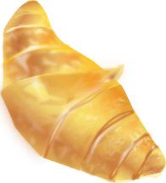
Phonétique
lire / parler
soi
facile
60
bois
[self]
étoile
espoir
voisin
[hope]
croissant
secondes
[neighbour]
victoire
laboratoire
accessoire
0
difficile
DÉBUT
[accessory]
Notes:
Timing: 2 minutes
Aim: Oral production of SSC [oi] in words of varying degrees of complexity in alphabetical order for one minute, helping automisation of production.
Procedure:
1. Students say the words in order of length out loud with a partner, building up speed, over 1 minute’s intensive practice. 2. Circulate during this activity to listen into learners’ SSC knowledge, giving feedback where necessary.
3. If the listening student notices a mistake in the pronunciation of [oi], their partner must go back to the top of the ladder and start again! Mispronunciations of SSCs other than [oi] should be noted and fed back to partners after the minute is up.
Word frequency (1 is the most frequent word in French): soi [1365], bois [1425], étoile [2776], espoir [717], voisin [979], croissant [2069], victoire [1373], laboratoire [2158], accessoire [2689]
Source: Londsale, D., & Le Bras, Y. (2009). A Frequency Dictionary of French: Core vocabulary for learners London: Routledge.

Slide 10
Phonétique
écouter / lire
C’est la SSC [oi] ?
Les trois chiens aboient à l’oie.
1
The three dogs bark at the goose.
Ils font la croix avec du bois chinois.
2
They are making the cross with Chinese wood.
Le chat noir a soif.
3
The black cat is thirsty.
C'est une histoire des rois et du poison.
4
It is a story about kings and poison.
Notes:
Timing: 4 minutes
Aim: Sentence level listening practise of the SSC [oi].
Procedure:
Play the audio by clicking on the number trigger.
Students tally the number of times they hear the SSC [oi].
Click to reveal the full sentence and English translation.
Transcript
1. Les trois chiens aboient à l’oie.
2. Ils font la croix avec du bois chinois.
3. Le chat noir a soif.
4. C'est une histoire des rois et du poison.

Slide 11
SSC [oi]
phonétique
Consolidation [1]

Slide 12
oi
[to see]
voir
Notes:
Timing: 1 minute
Aim: To introduce/consolidate SSC [oi]
Procedure: 1. Present the letter(s) and say the [oi] sound first, on its own. Students repeat it with you. 2. Bring up the word ”voir” on its own, say it, students repeat it, so that they have the opportunity to focus all of their attention on the connection between the written word and its sound.
3. A possible gesture for this would be to put one’s hand above one’s brow (as if to shade one’s view) and pretend to be seeing something far off. 4. Roll back the animations and work through 1-3 again, but this time, dropping your voice completely to listen carefully to the students saying the [oi] sound, pronouncing ”voir” and, if using, doing the gesture.
Word frequency (1 is the most frequent word in French):
voir [69].
Source: Londsale, D., & Le Bras, Y. (2009). A Frequency Dictionary of French: Core vocabulary for learners London: Routledge.

Slide 13
oi
voir
Notes:
With sound and no pictures to focus all attention on the sound-symbol correspondence.

Slide 14
oi
[to see]
voir
Notes:
Without sound to elicit pronunciation (without first hearing the teacher).
Teacher to elicit pronunciation by asking “Comment dit-on …"

Slide 15
oi
droite
avoir
[to have]
to see
voir
Au revoir !
trois
Pourquoi ?
[why?]
Notes:
Timing: 2 minutes
Aim: To introduce/consolidate SSC [oi]
Procedure:
1. Introduce and elicit the pronunciation of the individual SSC [oi] and then the source word again ‘voir’ (with gesture, if using). 2. Then present and elicit the pronunciation of the five cluster words.
The cluster words have been chosen for their high-frequency, from a range of word classes, with the SSC (where possible) positioned within a variety of syllables within the words (e.g. initial, 2nd, final etc.). Additionally, we have tried to use words that build cumulatively on previously taught SSCs (see the Phonics Teaching Sequence document) and do not include new SSCs. Where new SSCs are used, they are often consonants which have a similar symbol-sound correspondence in English.
Word frequency (1 is the most frequent word in French): droite [1293]; avoir [8] au revoir [n/a]; pourquoi[193]; trois[115]; voir [69]. Source: Londsale, D., & Le Bras, Y. (2009). A Frequency Dictionary of French: Core vocabulary for learners London: Routledge.

Slide 16
oi
droite
avoir
voir
Au revoir !
trois
Pourquoi ?
Notes:
With sound and no pictures to focus all attention on the sound-symbol correspondence.

Slide 17
oi
droite
avoir
voir
Au revoir !
trois
Pourquoi ?
Notes:
Without sound to elicit pronunciation (without first hearing the teacher).
Teacher to elicit pronunciation by asking “Comment dit-on …"

Slide 18
Phonétique
Phonétique
écouter / parler
(a)in
oi
bain
[bath]
drain
[drain]
droit
[straight]
voix
[voice]
crin
[horsehair]
croix
[cross]
nain
[dwarf]
soi
[oneself]
pain
[bread]
poids
[weight]
vin
[wine]
foi
[faith]
noix
[walnut]
main
[hand]
moi
[me/
myself]
fin
[end]
sain
[healthy]
bois
[wood]
Notes:
In-class version
Timing: 5 minutes
Aim: Production and recognition of SSCs [oi] and [ain/in].
Procedure:
Each student writes 1-10 in their workbooks and chooses 10 words to write down in order (this number can be increased or decreased to fit the time available).
Students then take turns to read their list aloud, while their partner notes down either [ain] or [oi] for each word. For a more challenging task, students could find the word on the board and write it down in full as they listen.
The partners then compare lists and work together to correct any words that were mispronounced or misheard.
The teacher circulates and listens for any areas of difficulty – in particular, students may need to be reminded about the SFC.
Word frequency (1 is the most frequent word in French):
bain [3458], pain [2808], crin [>5000], drain = cognate, vin [2309], nain [>5000], sain [1763], fin [111], droit [143], toi [510], voix [414], croix [3904], poids [1102], soi [1365], foi [1368], moi [131], noix [>5000], bois [1425]
Source: Londsale, D., & Le Bras, Y. (2009). A Frequency Dictionary of French: Core vocabulary for learners London: Routledge.

Slide 19
Phonétique 1 (self-study)
Phonétique 1 – self study
écouter / parler
Click on the arrow to listen to a list of nine of the words from below.
Write down whether you hear [oi] or [(a)in]. You can write the full word if you recognise it.
Once you have listened to nine words, click the space bar to see answers.
Practise saying [oi] and [(a)in] by playing the audio again and repeating the words.
(a)in
oi
drain
[drain]
bain
[bath]
droit
[straight]
voix
[voice]
crin
[horsehair]
croix
[cross]
soi
[oneself]
foi
[faith]
pain
[bread]
nain
[dwarf]
fin
[end]
vin
[wine]
poids
[weight]
Remember! Silent Final Consonants (SFC): none of the words on this slide has the final [n], [s] or [x] pronounced.
noix
[walnut]
sain
[healthy]
moi
[me/
myself]
main
[hand]
bois
[wood]
Notes:
Home learning version (NB: an in-class version of this activity can be found on slide 8).
Timing: 5 minutes for 3 slides
Aim: Production and recognition of SSCs [oi] and [ain/in].
Procedure:
Click on the play button to hear a list of nine words
Write down whether you hear [oi] or [ain/in]
Write the full word if you recognise it
Click the space bar to reveal the answers
Practise pronunciation along with the audio
Transcript
main
moi
sain
fin
foi
voix
vin
bain
bois

Slide 20
Phonétique 2 (self-study)
Phonétique 2 – self study
écouter / parler
Click on the arrow to listen to a second list of nine of the words from below.
Write down whether you hear [oi] or [(a)in]. You can write the full word if you recognise it.
Once you have listened to nine words, click the space bar to see answers.
Practise saying [oi] and [(a)in] by playing the audio again and repeating the words.
(a)in
oi
drain
[drain]
bain
[bath]
droit
[straight]
voix
[voice]
crin
[horsehair]
croix
[cross]
soi
[oneself]
pain
[bread]
nain
[dwarf]
foi
[faith]
vin
[wine]
poids
[weight]
fin
[end]
Remember! Silent Final Consonants (SFC): none of the words on this slide has the final [n], [s] or [x] pronounced.
noix
[walnut]
sain
[healthy]
moi
[me/
myself]
main
[hand]
bois
[wood]
Notes:
Home learning version (NB: an in-class version of this activity can be found on slide 8).
Transcript
soi
pain
poids
nain
croix
noix
droit
drain
crin

Slide 21
Phonétique 3 (self-study)
Phonétique 3 – self study
écouter / parler
Click on the arrow to listen to a third list of nine of the words from below.
Write down whether you hear [oi] or [(a)in]. You can write the full word if you recognise it.
Once you have listened to nine words, click the space bar to see answers.
Practise saying [oi] and [(a)in] by playing the audio again and repeating the words.
(a)in
oi
drain
[drain]
bain
[bath]
droit
[straight]
voix
[voice]
crin
[horsehair]
croix
[cross]
soi
[oneself]
pain
[bread]
nain
[dwarf]
foi
[faith]
vin
[wine]
poids
[weight]
fin
[end]
Remember! Silent Final Consonants (SFC): none of the words on this slide has the final [n], [s] or [x] pronounced.
noix
[walnut]
sain
[healthy]
moi
[me/
myself]
main
[hand]
bois
[wood]
Notes:
Home learning version (NB: an in-class version of this activity can be found on slide 8).
Transcript
voix
pain
croix
moi
crin
vin
nain
foi
drain

Slide 22
SSC [oi]
phonétique
Consolidation [2]

Slide 23
oi
[to see]
voir
Notes:
Timing: 1 minute
Aim: To introduce/consolidate SSC [oi]
Procedure: 1. Present the letter(s) and say the [oi] sound first, on its own. Students repeat it with you. 2. Bring up the word ”voir” on its own, say it, students repeat it, so that they have the opportunity to focus all of their attention on the connection between the written word and its sound.
3. A possible gesture for this would be to put one’s hand above one’s brow (as if to shade one’s view) and pretend to be seeing something far off. 4. Roll back the animations and work through 1-3 again, but this time, dropping your voice completely to listen carefully to the students saying the [oi] sound, pronouncing ”voir” and, if using, doing the gesture.
Word frequency (1 is the most frequent word in French):
voir [69].
Source: Londsale, D., & Le Bras, Y. (2009). A Frequency Dictionary of French: Core vocabulary for learners London: Routledge.

Slide 24
oi
droite
avoir
[to have]
to see
voir
Au revoir !
trois
Pourquoi ?
[why?]
Notes:
Timing: 2 minutes
Aim: To introduce/consolidate SSC [oi]
Procedure:
1. Introduce and elicit the pronunciation of the individual SSC [oi] and then the source word again ‘voir’ (with gesture, if using). 2. Then present and elicit the pronunciation of the five cluster words.
The cluster words have been chosen for their high-frequency, from a range of word classes, with the SSC (where possible) positioned within a variety of syllables within the words (e.g. initial, 2nd, final etc.). Additionally, we have tried to use words that build cumulatively on previously taught SSCs (see the Phonics Teaching Sequence document) and do not include new SSCs. Where new SSCs are used, they are often consonants which have a similar symbol-sound correspondence in English.
Word frequency (1 is the most frequent word in French): droite [1293]; avoir [8] au revoir [n/a]; pourquoi[193]; trois[115]; voir [69]. Source: Londsale, D., & Le Bras, Y. (2009). A Frequency Dictionary of French: Core vocabulary for learners London: Routledge.

Slide 25
Phonétique
écouter / écrire
Say these words:
SSC [oy]
sounds like a ‘yih’ sound after SSC [oi].
This is similar to the
[-ill-/ille] vs [i] and
[-aill-/-ail] vs [a] patterns.
fois
[time]
foyer
[home]
Notes:
Timing: 1 minute
Aim: Aural recognition and production of SSCs [oy] and [oi] to prime for the activity on the next slide.
Procedure:
1. Students try to say the words in the pair, foi and foyer.
2. Click to hear the words said by a native speaker. Students repeat.
3. Click to bring up the hint.
Transcript:
fois
foyer
Word frequency (1 is the most frequent word in French): ail [>5000]

Slide 26
Phonétique (1/2)
Hint
SSC [oy]
sounds like a ‘yih’ sound after SSC [oi].
écouter
Écoute ! Quel mot a la SSC [oy] ?
[to drown] | [black]
a) noyer | b) noir
[king] | [kingdom]
a) roi | b) royaume
1
3
__
_
__
__
[law] | [to use]
a) loi | b) employer
[happy] | [joy]
a) joyeux | b) joie
2
4
__
__
__
__
Notes:
Timing: 8 minutes (for two slides)
Aim: aural recognition of SSCs [oy] and [oi] in pairs. Awareness-raising exercise in pronunciation of [oy] (sounds like [oi] + ‘yih’.)
Procedure:
1. Click the numbers to play the audio.
2. Students write 1-8 and complete the word with [oi] or [oy].
3. Click to reveal the answers.
4. Students sound out the pairs of words. Draw attention to the SFC.
5. Move to the next slide and repeat steps 1-4 for four more pairs.
Transcript:
1. a) noyer b) noir
2. a) loi b) employer
3. a) roi b) royaume
4. a) joyeux b) joie
Word frequency of unknown words used (1 is the most frequent word in French): noyer [4060], noir [572], loi [267], employer [724], roi [1364], royaume [2620], joyeux [3987], joie [1984]
Source: Londsale, D., & Le Bras, Y. (2009). A Frequency Dictionary of French: Core vocabulary for learners London: Routledge.

Slide 27
Phonétique (2/2)
Hint
SSC [oy]
sounds like a ‘yih’ sound after SSC [oi].
écouter
Écoute ! Quel mot a le SSC [oy] ?
[believer] | [to believe]
a) croyant | b) croire
[nucleus] | [Chinese]
a) noyau | b) chinois
5
7
__
_
__
_
[citizen] | [roof]
a) citoyen | b) toit
3 | [to grant]
a) trois | b) octroyer
6
8
__
_
_
__
Notes:
This is the second part of the activity described on the previous slide.
Transcript:
5. a) croyant b) croire
6. a) citoyen b) toit
7. a) noyau b) chinois
8. a) trois b) octroyer
Word frequency of unknown words used (1 is the most frequent word in French): croyant [4332], croire [135], citoyen [1081], toit [roof], noyau [3832], chinois [1914], trois [115], octroyer [4232]
Source: Londsale, D., & Le Bras, Y. (2009). A Frequency Dictionary of French: Core vocabulary for learners London: Routledge.

Slide 28
SSC [oi]
phonétique
Consolidation [3]

Slide 29
oi
[to see]
voir
Notes:
Timing: 1 minute
Aim: To introduce/consolidate SSC [oi]
Procedure: 1. Present the letter(s) and say the [oi] sound first, on its own. Students repeat it with you. 2. Bring up the word ”voir” on its own, say it, students repeat it, so that they have the opportunity to focus all of their attention on the connection between the written word and its sound.
3. A possible gesture for this would be to put one’s hand above one’s brow (as if to shade one’s view) and pretend to be seeing something far off. 4. Roll back the animations and work through 1-3 again, but this time, dropping your voice completely to listen carefully to the students saying the [oi] sound, pronouncing ”voir” and, if using, doing the gesture.
Word frequency (1 is the most frequent word in French):
voir [69].
Source: Londsale, D., & Le Bras, Y. (2009). A Frequency Dictionary of French: Core vocabulary for learners London: Routledge.

Slide 30
oi
droite
avoir
[to have]
to see
voir
Au revoir !
trois
Pourquoi ?
[why?]
Notes:
Timing: 2 minutes
Aim: To introduce/consolidate SSC [oi]
Procedure:
1. Introduce and elicit the pronunciation of the individual SSC [oi] and then the source word again ‘voir’ (with gesture, if using). 2. Then present and elicit the pronunciation of the five cluster words.
The cluster words have been chosen for their high-frequency, from a range of word classes, with the SSC (where possible) positioned within a variety of syllables within the words (e.g. initial, 2nd, final etc.). Additionally, we have tried to use words that build cumulatively on previously taught SSCs (see the Phonics Teaching Sequence document) and do not include new SSCs. Where new SSCs are used, they are often consonants which have a similar symbol-sound correspondence in English.
Word frequency (1 is the most frequent word in French): droite [1293]; avoir [8] au revoir [n/a]; pourquoi[193]; trois[115]; voir [69]. Source: Londsale, D., & Le Bras, Y. (2009). A Frequency Dictionary of French: Core vocabulary for learners London: Routledge.

Slide 31
SSC [oi]
écouter
phrase | combien ?
1
2
3
Combien de fois entend-on SSC [oi] ?
1
On ne peut pas choisir ses voisins.
You cannot choose your neighbours.
2
François a deux mois pour écrire l'histoire.
Francois has two months to write the story.
3
Le roi voit pourquoi la reine a écrit la loi.
The king sees why the queen wrote the law.
Notes:
Timing: 3 minutes
Aim: Recognise SSC [oi] in spoken language
Procedure:
1. Click audio buttons to hear sentences in French
2. Students tally how many times they hear SSC [oi] in each sentence
3. Elicit answers one by one
4. Click to reveal sentences with [oi] highlighted (and English translations)
Transcript:
1. On ne peut pas choisir ses voisins.
2. François a deux mois pour écrire l'histoire.
3. Le roi voit pourquoi la reine a écrit la loi.
Word frequency (1 is the most frequent word in French): voisin [979], roi [1364], reine [2809], loi [267]
Source: Lonsdale, D., & Le Bras, Y. (2009). A Frequency Dictionary of French: Core vocabulary for learners London: Routledge.

Slide 32
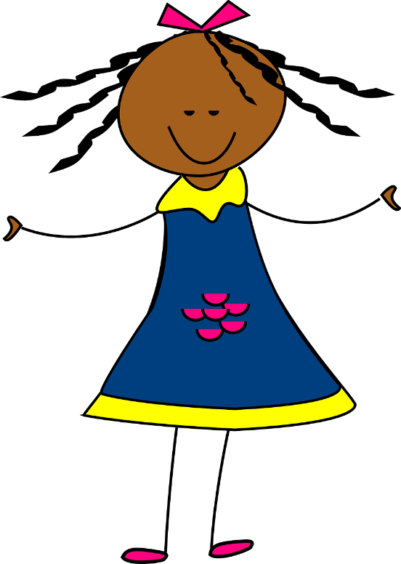
Des virelangues avec [oi]
lire / parler
Parle aussi vite que possible!
Excusez-moi mademoiselle,
éloignez le doigt de la framboise.
[Excuse me miss, move your finger
away from the raspberry.]
A
B
C
Notes:
Timing: 5 mins for 3 slides
Aim: Practise pronunciation of SSC [oi] in the form of tongue twisters
Procedure:
1. Students read the sentences aloud, aiming for accurate pronunciation as quickly as possible.
2. Click audio buttons to hear three different speeds (A = slowest, C = fastest)
3. Repeat on next three slides for three more tongue twisters
Transcript:
Excusez-moi mademoiselle, éloignez le doigt de la framboise.
Word frequency (1 is the most frequent word in French): excuser [1987], mademoiselle [3148], éloigner [1541], framboise [>5000]
Source: Londsale, D., & Le Bras, Y. (2009). A Frequency Dictionary of French: Core vocabulary for learners London: Routledge.

Slide 33
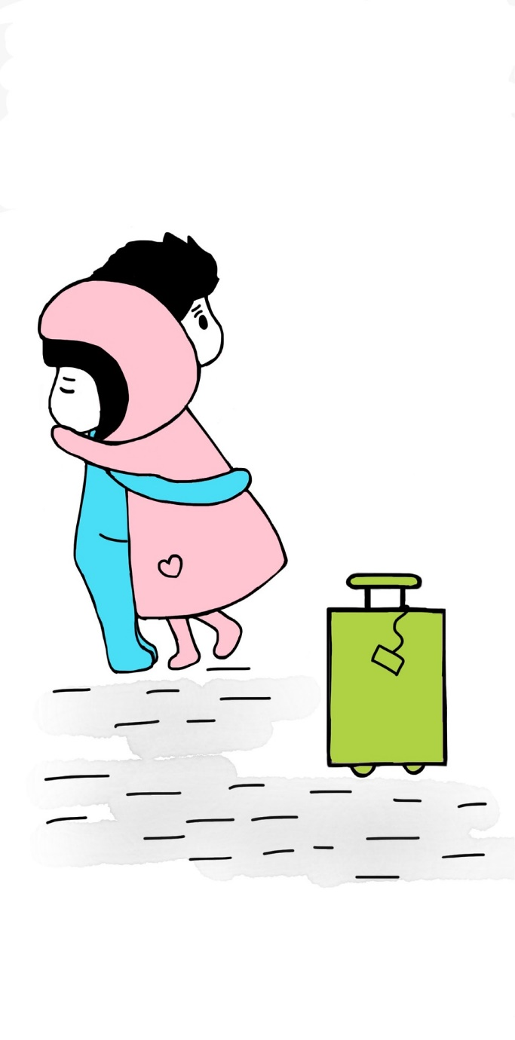
Des virelangues avec [oi]
lire / parler
Parle aussi vite que possible!
On se dit au revoir le soir, toutefois on va se revoir.
[We say goodbye in the evening,
nevertheless we will see each other again.]
A
B
C
Notes:
Slide 2/3
Aim: Practise pronunciation of SSC [oi] in the form of tongue twisters
Procedure:
1. Students read the sentences aloud, aiming for accurate pronunciation as quickly as possible.
2. Click audio buttons to hear three different speeds (A = slowest, C = fastest)
3. Repeat on next three slides for three more tongue twisters
Transcript:
On se dit au revoir le soir, toutefois on va se revoir.
Word frequency (1 is the most frequent word in French): se [17], toutefois [770], revoir [1274]
Source: Londsale, D., & Le Bras, Y. (2009). A Frequency Dictionary of French: Core vocabulary for learners London: Routledge.

Slide 34
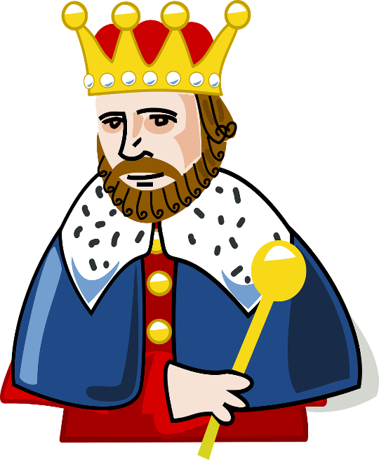
Des virelangues avec [oi]
lire / parler
Parle aussi vite que possible!
Il fait froid lorsqu’on s'assoit à la droite du roi.
[It is cold when you sit to the right of the king.]
A
B
C
Notes:
Slide 3/3
Aim: Practise pronunciation of SSC [oi] in the form of tongue twisters
Procedure:
1. Students read the sentences aloud, aiming for accurate pronunciation as quickly as possible.
2. Click audio buttons to hear three different speeds (A = slowest, C = fastest)
3. Repeat on next three slides for three more tongue twisters
Transcript:
Il fait froid lorsque on s'assoit à la droite du roi.
Word frequency (1 is the most frequent word in French): lorsque [256], se [17]. asseoir [1360], roi [1364]
Source: Londsale, D., & Le Bras, Y. (2009). A Frequency Dictionary of French: Core vocabulary for learners London: Routledge.

Slide 35
SSC [oi]
phonétique
Consolidation [4]

Slide 36
oi
[to see]
voir
Notes:
Timing: 1 minute
Aim: To introduce/consolidate SSC [oi]
Procedure: 1. Present the letter(s) and say the [oi] sound first, on its own. Students repeat it with you. 2. Bring up the word ”voir” on its own, say it, students repeat it, so that they have the opportunity to focus all of their attention on the connection between the written word and its sound.
3. A possible gesture for this would be to put one’s hand above one’s brow (as if to shade one’s view) and pretend to be seeing something far off. 4. Roll back the animations and work through 1-3 again, but this time, dropping your voice completely to listen carefully to the students saying the [oi] sound, pronouncing ”voir” and, if using, doing the gesture.
Word frequency (1 is the most frequent word in French):
voir [69].
Source: Londsale, D., & Le Bras, Y. (2009). A Frequency Dictionary of French: Core vocabulary for learners London: Routledge.

Slide 37
oi
droite
avoir
[to have]
to see
voir
Au revoir !
trois
Pourquoi ?
[why?]
Notes:
Timing: 2 minutes
Aim: To introduce/consolidate SSC [oi]
Procedure:
1. Introduce and elicit the pronunciation of the individual SSC [oi] and then the source word again ‘voir’ (with gesture, if using). 2. Then present and elicit the pronunciation of the five cluster words.
The cluster words have been chosen for their high-frequency, from a range of word classes, with the SSC (where possible) positioned within a variety of syllables within the words (e.g. initial, 2nd, final etc.). Additionally, we have tried to use words that build cumulatively on previously taught SSCs (see the Phonics Teaching Sequence document) and do not include new SSCs. Where new SSCs are used, they are often consonants which have a similar symbol-sound correspondence in English.
Word frequency (1 is the most frequent word in French): droite [1293]; avoir [8] au revoir [n/a]; pourquoi[193]; trois[115]; voir [69]. Source: Londsale, D., & Le Bras, Y. (2009). A Frequency Dictionary of French: Core vocabulary for learners London: Routledge.

Slide 38
[oi] ou [-oin] ?
écouter / écrire
Écoute et coche le bon mot.
 | oi | -oin
 | mois | moins
 | joie | joint
 | pois | poing
 | loi | loin
 | fois | foin
 | soi | soin
1
2
3
4
5
6
Notes:
Timing: 4 minutes
Aim: Aural recognition of SSCs [oi] and [-oin]
Procedure:
1. Click the buttons to play the audio.
2. Students tick which word they hear.
3. Click to reveal answers.
Transcript:
moins
joie
pois
loin
fois
soin
Word frequency of unknown words used (1 is the most frequent word in French): joie [1984], joint [>5000], pois [>5000], poing [3889], loi [267], foin [>5000], soi [1365]
Source: Lonsdale, D., & Le Bras, Y. (2009). A Frequency Dictionary of French: Core vocabulary for learners London: Routledge.

Slide 39
[oi] ou [-oin] ?
lire / parler
The SSC [-oin] is a nasal sound, but only when it is followed by a consonant.
When it is followed by a vowel, it sounds like [oi] followed by [n].
moins
moine
[less]
[monk]
Notes:
Timing: 1 minute
Aim: Introduction of [-oin] before a vowel
Procedure:
1. Click to reveal examples and explanations.
2. Click the example words to hear a native speaker recording.
3. Ensure understanding.
Transcript:
moins
moine
Word frequency of unknown words used (1 is the most frequent word in French): moine [4339]
Source: Lonsdale, D., & Le Bras, Y. (2009). A Frequency Dictionary of French: Core vocabulary for learners London: Routledge.

Slide 40
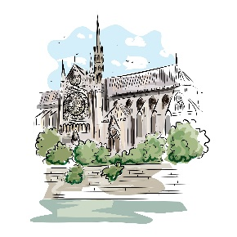
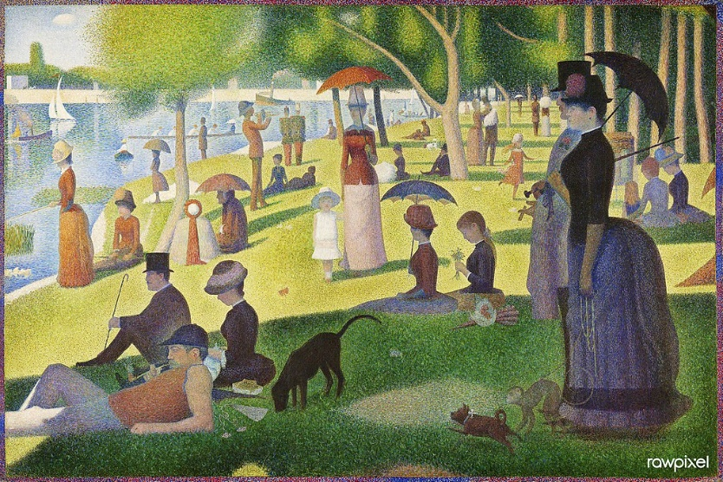
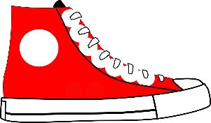
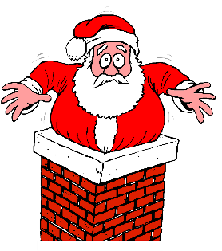
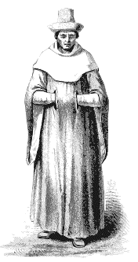
[oi] ou [-oin] ?
lire / parler
patrimoine
[heritage]
avoine
[oats]
rond-point
[roundabout]
néanmoins
[nevertheless]
60
Pointillism is a painting technique that uses dots to make a picture.
It was developed in France in the late 19th century by Georges Seurat and Paul Signac.
This is a painting of an island in the Seine by Georges Seurat.
pointure
[shoe size]
adjoint
[deputy]
conjoint
[spouse]
moine
[monk]
pointu
[pointed]
secondes
moineau
[sparrow]
shampooing
[shampoo]
lointain
[distant]
coincé
[stuck]
chanoine
[canon - religious person]
pointillisme
[pointillism]
0
Macédoine
[Macedonia]
DÉBUT
Notes:
Timing: 3 minutes
Aim: Oral practice of SSC [-oin] before consonants and vowels
Procedure:
1. Students try to say all the words before the timer ends.
2. Click on each word to hear native speaker pronunciation.
3. After clicking on pointillisme, click also on its image to bring up further information about this artistic style.
Transcript:
moine
pointu
avoine
coincé
moineau
adjoint
lointain
conjoint
chanoine
pointure
pointillisme
néanmoins
Macédoine
shampooing
patrimoine
rond-point
Word frequency of unknown words used (1 is the most frequent word in French): moine [4339], pointu [>5000], avoine [>5000], coincé (coincer) [3289], moineau [>5000], adjoint [2532], lointain [2933], conjoint [3317], chanoine [>5000], pointure [>5000], pointillisme [>5000], néanmoins [1271], Macédoine [>5000], shampooing [>5000], poinsettia [>5000], patrimoine [2530], rond-point [>5000]
Source: Lonsdale, D., & Le Bras, Y. (2009). A Frequency Dictionary of French: Core vocabulary for learners London: Routledge.
A Sunday on La Grande Jatte (1884) by Georges Seurat. Original from The Art Institute of Chicago. Digitally enhanced by rawpixel. (50434734621).jpg by Rawpixel Ltd is licensed under CC BY 2.0

