Slide 1
French Phonics Collection
SSC [j/soft g]
Artwork by: Chloé Motard
Date updated: 31/08/22
Notes:
Artwork by Chloé Motard. All additional pictures selected are available under a Creative Commons license, no attribution required.

Slide 2
SSC [j/soft g]
phonétique
Introduction

Slide 3
j/soft g
X
jour
Notes:
Timing: 1 minute
Aim: To introduce/consolidate SSC [j/soft g]
Procedure: 1. Present the letter(s) and say the [j/soft g] sound first, on its own. Students repeat it with you. 2. Bring up the word ”jour” on its own, say it, students repeat it, so that they have the opportunity to focus all of their attention on the connection between the written word and its sound.
3. A possible gesture for this would be to mime waking up at daybreak, by stretching out ones arms and yawning. 4. Roll back the animations and work through 1-3 again, but this time, dropping your voice completely to listen carefully to the students saying the [j/soft g] sound, pronouncing ”jour” and, if using, doing the gesture.
Word frequency (1 is the most frequent word in French):
jour [78].
Source: Londsale, D., & Le Bras, Y. (2009). A Frequency Dictionary of French: Core vocabulary for learners London: Routledge.

Slide 4
j/soft g
jour
Notes:
With sound and no pictures to focus all attention on the sound-symbol correspondence.

Slide 5
j/soft g
X
jour
Notes:
Without sound to elicit pronunciation (without first hearing the teacher).
Teacher to elicit pronunciation by asking “Comment dit-on …"

Slide 6
j/soft g
j’ai
génial
[I have]
X
jour
sujet
jamais
[subject]
[never]
déjà
[already]
Notes:
Timing: 2 minutes
Aim: To introduce/consolidate SSC [j/soft g]
Procedure:
1. Introduce and elicit the pronunciation of the individual SSC [j/soft g] and then the source word again ‘jour’ (with gesture, if using). 2. Then present and elicit the pronunciation of the five cluster words.
The cluster words have been chosen for their high-frequency, from a range of word classes, with the SSC (where possible) positioned within a variety of syllables within the words (e.g. initial, 2nd, final etc.). Additionally, we have tried to use words that build cumulatively on previously taught SSCs (see the Phonics Teaching Sequence document) and do not include new SSCs. Where new SSCs are used, they are often consonants which have a similar symbol-sound correspondence in English.
Word frequency (1 is the most frequent word in French): j’ai [8 - avoir]; génial [3872] sujet [353]; déjà [58]; jamais [179]; jour [78]. Source: Londsale, D., & Le Bras, Y. (2009). A Frequency Dictionary of French: Core vocabulary for learners London: Routledge.

Slide 7
j/soft g
j’ai
génial
jour
sujet
jamais
déjà
Notes:
With sound and no pictures to focus all attention on the sound-symbol correspondence.

Slide 8
j/soft g
j’ai
génial
jour
sujet
jamais
déjà
Notes:
Without sound to elicit pronunciation (without first hearing the teacher).
Teacher to elicit pronunciation by asking “Comment dit-on …"

Slide 9
Soft or hard g- ?
Soft or hard g- ?
phonétique
The French g- can be soft or hard.
It is soft in front of these sounds:
e (génial, intelligent, rouge, le ménage)
i (la girafe)
y (la gymnastique)
It is hard in front of other sounds:
la vague, grand, le magasin
You will meet lots of examples of soft g followed by e.
Notes:
Timing: 2 minutes
Aim: to explain spelling rules governing the pronunciation of soft and hard ‘[g]’.
Procedure:
Click to bring up the explanation.
Draw attention to the fact that students will not encounter ‘soft g’ followed by ‘i’ or ‘y’ very often, whereas ‘soft g’ followed by ‘e’ is very common.
Note: Students have encountered all words used as examples here with the exception of ‘gymnastique’. As no words containing ‘soft g’ followed by ‘y’ feature in the SOW for Year 7, a cognate is used as an example here.
Word frequency (1 is the most frequent word in French):
gymnastique [>5000].
Source: Londsale, D., & Le Bras, Y. (2009). A Frequency Dictionary of French: Core vocabulary for learners London: Routledge.

Slide 10
Soft or hard g- ?
Soft or hard g- ?
lire / parler
Soft or hard g- ?
Consider the words below.
Do you think the g- is soft or hard?
 | soft | hard |  | soft | hard
progrès (progress) |  |  | boulangerie (bakery)
nager (to swim) |  |  | plage (beach)
gare (station) |  |  | corriger (to correct)
étranger (abroad) |  |  | argent (money)
Angleterre (England) |  |  | agréable (pleasant)
a
f
b
g
c
h
d
i
e
j
Notes:
Timing: 5 minutes
Aim: to identify whether ‘g’ is soft or hard by putting into practise the rules on the previous slide.
Procedure:
Students read the word and decide based on spelling whether they think [g] is soft or hard.
Listen to check. Answers revealed on clicks.
Students try to pronounce the words.
Listen again to check pronunciation. Elicit whole class choral pronunciation. (Choral pronunciation practice is recommended as the words contain SSCs which have not yet been focussed on explicitly.)
Note: Unknown words have been chosen so that students must focus on the sound.
Word frequency (1 is the most frequent word in French):
progrès [919]; nager [>5000]; gare [2581]; étranger [305]; Angleterre [n/a]; boulangerie [>5000]; corriger [1639]; plage [2693]; argent [472]; agréable [2841]
Source: Londsale, D., & Le Bras, Y. (2009). A Frequency Dictionary of French: Core vocabulary for learners London: Routledge.

Slide 11
SSC [j/soft g]
phonétique
Consolidation [1]

Slide 12
j/soft g
X
jour
Notes:
Timing: 1 minute
Aim: To introduce/consolidate SSC [j/soft g]
Procedure: 1. Present the letter(s) and say the [j/soft g] sound first, on its own. Students repeat it with you. 2. Bring up the word ”jour” on its own, say it, students repeat it, so that they have the opportunity to focus all of their attention on the connection between the written word and its sound.
3. A possible gesture for this would be to mime waking up at daybreak, by stretching out ones arms and yawning. 4. Roll back the animations and work through 1-3 again, but this time, dropping your voice completely to listen carefully to the students saying the [j/soft g] sound, pronouncing ”jour” and, if using, doing the gesture.
Word frequency (1 is the most frequent word in French):
jour [78].
Source: Londsale, D., & Le Bras, Y. (2009). A Frequency Dictionary of French: Core vocabulary for learners London: Routledge.

Slide 13
j/soft g
jour
Notes:
With sound and no pictures to focus all attention on the sound-symbol correspondence.

Slide 14
j/soft g
X
jour
Notes:
Without sound to elicit pronunciation (without first hearing the teacher).
Teacher to elicit pronunciation by asking “Comment dit-on …"

Slide 15
j/soft g
j’ai
génial
[I have]
X
jour
sujet
jamais
[subject]
[never]
déjà
[already]
Notes:
Timing: 2 minutes
Aim: To introduce/consolidate SSC [j/soft g]
Procedure:
1. Introduce and elicit the pronunciation of the individual SSC [j/soft g] and then the source word again ‘jour’ (with gesture, if using). 2. Then present and elicit the pronunciation of the five cluster words.
The cluster words have been chosen for their high-frequency, from a range of word classes, with the SSC (where possible) positioned within a variety of syllables within the words (e.g. initial, 2nd, final etc.). Additionally, we have tried to use words that build cumulatively on previously taught SSCs (see the Phonics Teaching Sequence document) and do not include new SSCs. Where new SSCs are used, they are often consonants which have a similar symbol-sound correspondence in English.
Word frequency (1 is the most frequent word in French): j’ai [8 - avoir]; génial [3872] sujet [353]; déjà [58]; jamais [179]; jour [78]. Source: Londsale, D., & Le Bras, Y. (2009). A Frequency Dictionary of French: Core vocabulary for learners London: Routledge.

Slide 16
j/soft g
j’ai
génial
jour
sujet
jamais
déjà
Notes:
With sound and no pictures to focus all attention on the sound-symbol correspondence.

Slide 17
j/soft g
j’ai
génial
jour
sujet
jamais
déjà
Notes:
Without sound to elicit pronunciation (without first hearing the teacher).
Teacher to elicit pronunciation by asking “Comment dit-on …"

Slide 18
Phonétique
écouter / écrire
 | hard [g] | [j] / soft [g]
 | gagner
 |  | jaune
 | la vague
 | l’anglais
 |  | le déjeuner
 |  | jouer
 | le garçon
 |  | rouge
 |  | la plage
 |  | le ménage
 | le magasin
 |  | le jardin
Écoute les mots.
Contiennent-ils hard [g] ou [j]/soft [g] ?
Écris les mots dans les colonnes correctes.
1
2
3
4
5
Remember!
[g] is hard (like English golf) when it comes before the letters a, o, u or a consonant.
[g] is soft (like English jog) when it comes before the letters e, i or y.
6
7
8
9
10
11
12
Notes:
Timing: 5 minutes
Aim: To raise awareness of SSCs [j]/soft [g] and hard [g] by hearing these pronounced in known vocabulary items. Known words containing [j] and soft [g] are Grouped in the same column to strengthen the connection between these alternate spellings of the same sound. Students are then encouraged to consider the spelling differences which separate words containing hard [g] and [soft g].
Procedure:
1. Ensure students understand the task instructions – they may need some help with unknown near-cognates contenir [1033] and colonne [2931].
2. Click on the numbers to hear a known word.
3. Students decide whether the word they hear contains hard [g] or soft [g]. As students have met all words in the activity before, they are encouraged to try to write them out in full for additional spelling practice.
4. Answers revealed on clicks.
5. Recap the rules for triggering hard [g] and soft [g] by asking students what they notice about the spelling of words in the column.
6. Click to reveal the bubble summarising the hard vs soft distinction
Transcript:
1. gagner
2. jaune
3. la vague
4. l’anglais
5. le déjeuner
6. jouer
7. le garçon
8. rouge
9. la plage
10. le ménage
11. le magasin
12. le jardin

Slide 19
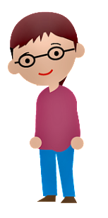
Phonétique
parler 1/8
lire / parler
Dis les noms.
Attention! C’est hard [g] ou [j]/soft [g] ?
Mon nom est …
1
Gérard
5
Gilles
9
Jacques
2
Gaelle
6
Julien
10
Jérôme
3
Angéline
7
Joséphine
11
Margaux
4
Agathe
8
Morgane
12
Georges
Notes:
Timing: 8 minutes
Aim: To raise awareness of [j]/soft [g] and hard [g] by using known spelling rules to pronounce these correctly in unknown vocabulary items.
Procedure:
1. Explain that these are popular French names that look like names students may recognise from English, but are pronounced differently.
2. Give students four minutes to work with a partner to decide how to pronounce [j] or [g], and to have a go at sounding out the names. All other SSCs in the words are either known or transferable from English, with the exception of the [ô] in Jérôme.
3. Click on the numbers to hear the names pronounced. The voices indicate whether the name is traditionally a male or female one. Students repeat chorally.
4. Now, teachers encourage students to read the names in increasing speed intervals (30 seconds, 20 seconds, 10 seconds … may vary according to the individual needs of the class) to work on fluency.
Transcript
1. Gérard
2. Gaelle
3. Angéline
4. Agathe
5. Gilles
6. Julien
7. Joséphine
8. Morgane
9. Jacques
10. Jérôme
11. Margaux
12. Georges

Slide 20
SSC [j/soft g]
phonétique
Consolidation [2]

Slide 21
j/soft g
X
jour
Notes:
Timing: 1 minute
Aim: To introduce/consolidate SSC [j/soft g]
Procedure: 1. Present the letter(s) and say the [j/soft g] sound first, on its own. Students repeat it with you. 2. Bring up the word ”jour” on its own, say it, students repeat it, so that they have the opportunity to focus all of their attention on the connection between the written word and its sound.
3. A possible gesture for this would be to mime waking up at daybreak, by stretching out ones arms and yawning. 4. Roll back the animations and work through 1-3 again, but this time, dropping your voice completely to listen carefully to the students saying the [j/soft g] sound, pronouncing ”jour” and, if using, doing the gesture.
Word frequency (1 is the most frequent word in French):
jour [78].
Source: Londsale, D., & Le Bras, Y. (2009). A Frequency Dictionary of French: Core vocabulary for learners London: Routledge.

Slide 22
j/soft g
j’ai
génial
[I have]
X
jour
sujet
jamais
[subject]
[never]
déjà
[already]
Notes:
Timing: 2 minutes
Aim: To introduce/consolidate SSC [j/soft g]
Procedure:
1. Introduce and elicit the pronunciation of the individual SSC [j/soft g] and then the source word again ‘jour’ (with gesture, if using). 2. Then present and elicit the pronunciation of the five cluster words.
The cluster words have been chosen for their high-frequency, from a range of word classes, with the SSC (where possible) positioned within a variety of syllables within the words (e.g. initial, 2nd, final etc.). Additionally, we have tried to use words that build cumulatively on previously taught SSCs (see the Phonics Teaching Sequence document) and do not include new SSCs. Where new SSCs are used, they are often consonants which have a similar symbol-sound correspondence in English.
Word frequency (1 is the most frequent word in French): j’ai [8 - avoir]; génial [3872] sujet [353]; déjà [58]; jamais [179]; jour [78]. Source: Londsale, D., & Le Bras, Y. (2009). A Frequency Dictionary of French: Core vocabulary for learners London: Routledge.

Slide 23
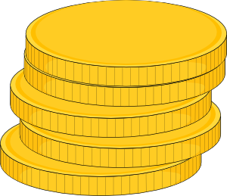
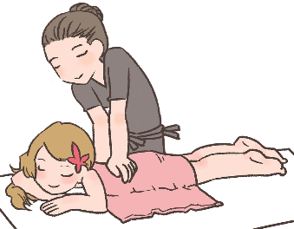
Hard and soft [g]/[j]
info
Hard [g] is pronounced like the g in ‘gold’.
[g] is hard when it comes before a, o, u or r, l, m.
Soft [g] and [j] are pronounced like the g in ‘massage’.
[g] is soft when it comes before e, i, or y.
la gare
[station]
le gilet
[cardigan]
nous plongeons
[we are diving]
la blague
[joke]
hard [g]
soft [g]/[j]
soft [g]/[j]
hard [g]
Notes:
Timing: 2 minutes
Aim: To revise spelling rules governing the pronunciation of hard and soft [g] in preparation for the listening activity that follows.
Procedure:
1. Click to bring up information.
2. Students predict the pronunciation of the four target words.
3. Click again to reveal answers one by one.
4. Click on words to hear them said aloud by a native speaker.
5. Students repeat.
Transcript:
la gare, le gilet, nous plongeons, la blague
Word frequency of unknown words used (1 is the most frequent word in French): gare [2581], gilet [>5000], plonger [1958], blague [4822]

Slide 24
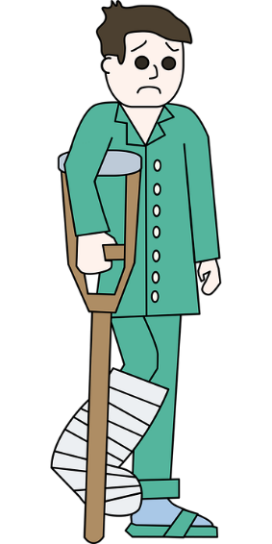
Phonétique
écouter
Romain est à l’hôpital! Qu’entendez-vous ? Hard [g], [soft g/j], ou [gn] ?
J’ai mal au genou !
[My knee hurts!]
__
1
Vous pouvez choisir un compagnon pour voir le médecin.
[You can choose a companion to see the doctor (with).]
2
__
Mon collè g ue vient avec moi.
[My colleague is coming with me.]
__
3
4
Re g ardez le rayon X.
[Look at the x-ray.]
Votre jambe est cassée.
[Your leg is broken.]
Nous devons aligner les os avec le plâtre.
[We have to align the bones with the cast.]
hard g
soft g
[gn]
__
5
__
6
__
Notes:
Timing: 4 minutes
Aim: Aural and written recognition of SSCs hard and soft [g], [j] and [gn] in longer sentences.
Procedure:
1. Click numbers to hear the sentences.
2. Students should note what the missing sound is. Remind them that they can distinguish between soft [g] and [j] by looking at the following vowel (if it is ‘a’, ‘o’ or ‘u’, it must be [j]).
3. Click to reveal answers one by one (plus tally of total SSCs).
Transcript:
1. J’ai mal au genou !
2. Vous pouvez choisir un compagnon pour voir le médecin.
3. Mon collègue vient avec moi.
4. Regardez le rayon X.
5. Votre jambe est cassée.
6. Nous devons aligner les os avec le plâtre.
Word frequency of unknown words used (1 is the most frequent word in French): genou [2967], compagnon [3023], collègue [1099], rayon [2926], jambe [2472], casser [2185], aligner [3021], os [4092], plâtre [>5000]
Source: Londsale, D., & Le Bras, Y. (2009). A Frequency Dictionary of French: Core vocabulary for learners London: Routledge.

Slide 25
Hard and soft [g]/[j]
info
Hard [g] is pronounced like the g in ‘gold’.
[g] is hard when it comes before a, o, u or r, l, m.
Soft [g] and [j] are pronounced like the g in ‘massage’.
[g] is soft when it comes before e, i, or y.
la gare
[station]
le gilet
[cardigan]
nous plongeons
[we are diving]
la blague
[joke]
hard [g]
soft [g]/[j]
soft [g]/[j]
hard [g]
Notes:
Timing: 1 minute
Aim: A reminder of spelling rules governing the pronunciation of hard and soft [g] in preparation for the spoken activity which follows.
Procedure:
1. Click to bring up information.
2. Students say the four target words.
Transcript:
la gare, le gilet, nous plongeons, la blague
Word frequency of unknown words used (1 is the most frequent word in French): gare [2581], gilet [>5000], plonger [1958], blague [4822]

Slide 26
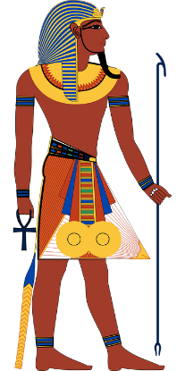
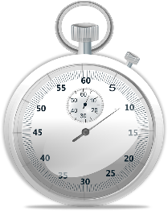
Phonétique
lire / parler
égyptien
60
chagrin
[sorrow]
englober
[to incorporate]
signature
blague
[joke]
dignité
signification
[meaning]
égalité
[equality]
secondes
fatigue
génocide
indigène
[indigenous]
analogue
langage
[language]
registre
consigne
[deposit]
0
embargo
DÉBUT
Notes:
Timing: 3 minutes for 2 slides. This is slide 1/2.
Aim: Oral pronunciation of words containing hard and soft [g] and [gn]. This is slide 1/2.
Procedure:
1. Students pair up.
2. Click début to start timer.
3. Partner A reads the words aloud.
4. Partner B listens to check pronunciation. If they spot a mispronunciation, they must stop student A who repeats the word correctly 3 times before moving on.
5. Click on words to hear them said aloud by a native speaker. Tally the total number of words said correctly within 60 seconds.
5. Partners swap roles and repeat with different words on the next slide. Whoever has pronounced the most words correctly wins!
Transcript:
Signature, égalité, analogue, embargo, chagrin, dignité, genocide, register, englober, signification, indigene, consigne, égyptien, blague, fatigue, langage
Word frequency (1 is the most frequent word in French): dignité [2171], signature [2187], signification [2798], analogue [4498], blague [4822], registre [2556], langage [1850], égalité [1898], chagrin [4560], égyptien [4137], genocide [4148], englober [4188], embargo [4450], indigene [4555], consigne [4583], fatigue [4595]
Source: Londsale, D., & Le Bras, Y. (2009). A Frequency Dictionary of French: Core vocabulary for learners London: Routledge.

Slide 27
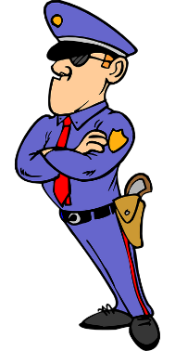
Phonétique
lire / parler
60
avantageux
gorge
[throat]
irrégulier
compagnie
[company]
gestionnaire
[managerial]
baigner
[to bathe]
ignorer
épargner
[to save money]
secondes
ligne
[line]
intégral
goutte
[drop]
significatif
[significant]
gendarme
[policeman]
engin
[gear]
0
magnifique
[magnificentl]
brigade
DÉBUT
Notes:
This is slide 1/2.
Word frequency (1 is the most frequent word in French): gorge [4194], compagnie [775], épargner [2354], ignorer [639], ligne [342], magnifique [2136], significative [2292], brigade [4224], engine [4269], goutte [4337], gestionnaire [4350], avantageux [4391], gendarme [4438], irrégulier [4606], baigner [4608], integral [4641]
Source: Londsale, D., & Le Bras, Y. (2009). A Frequency Dictionary of French: Core vocabulary for learners London: Routledge.

Slide 28
SSC [j/soft g]
phonétique
Consolidation [3]

Slide 29
j/soft g
X
jour
Notes:
Timing: 1 minute
Aim: To introduce/consolidate SSC [j/soft g]
Procedure: 1. Present the letter(s) and say the [j/soft g] sound first, on its own. Students repeat it with you. 2. Bring up the word ”jour” on its own, say it, students repeat it, so that they have the opportunity to focus all of their attention on the connection between the written word and its sound.
3. A possible gesture for this would be to mime waking up at daybreak, by stretching out ones arms and yawning. 4. Roll back the animations and work through 1-3 again, but this time, dropping your voice completely to listen carefully to the students saying the [j/soft g] sound, pronouncing ”jour” and, if using, doing the gesture.
Word frequency (1 is the most frequent word in French):
jour [78].
Source: Londsale, D., & Le Bras, Y. (2009). A Frequency Dictionary of French: Core vocabulary for learners London: Routledge.

Slide 30
j/soft g
j’ai
génial
[I have]
X
jour
sujet
jamais
[subject]
[never]
déjà
[already]
Notes:
Timing: 2 minutes
Aim: To introduce/consolidate SSC [j/soft g]
Procedure:
1. Introduce and elicit the pronunciation of the individual SSC [j/soft g] and then the source word again ‘jour’ (with gesture, if using). 2. Then present and elicit the pronunciation of the five cluster words.
The cluster words have been chosen for their high-frequency, from a range of word classes, with the SSC (where possible) positioned within a variety of syllables within the words (e.g. initial, 2nd, final etc.). Additionally, we have tried to use words that build cumulatively on previously taught SSCs (see the Phonics Teaching Sequence document) and do not include new SSCs. Where new SSCs are used, they are often consonants which have a similar symbol-sound correspondence in English.
Word frequency (1 is the most frequent word in French): j’ai [8 - avoir]; génial [3872] sujet [353]; déjà [58]; jamais [179]; jour [78]. Source: Londsale, D., & Le Bras, Y. (2009). A Frequency Dictionary of French: Core vocabulary for learners London: Routledge.

Slide 31
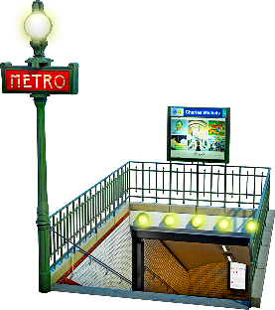
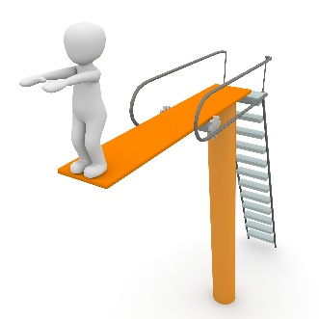
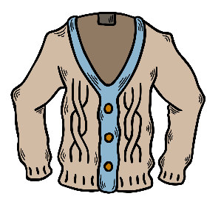
Hard [g] and soft [g]/[j]
info
Remember that hard [g] is pronounced like the [g] in ‘goldfish’.
[g] is hard when it comes before a, o, u or r, l, m.
Soft [g] and [j] are pronounced like the [g] in ‘massage’.
[g] is soft when it comes before e, i, or y.
la gare
[station]
le gilet
[cardigan]
nous plongeons
[we are diving]
la blague
[joke]
hard [g]
soft [g]/[j]
soft [g]/[j]
hard [g]
Notes:
Timing: 2 minutes
Aim: To revise spelling rules governing the pronunciation of hard and soft [g] in preparation for the listening activity that follows.
Procedure:
1. Click to bring up information.
2. Students predict the pronunciation of the four target words.
3. Click on pictures to hear words said aloud by a native speaker.
4. Students repeat.
Transcript:
la gare, le gilet, nous plongeons, la blague
Word frequency of unknown words used (1 is the most frequent word in French): gare [2581], gilet [>5000], plonger [1958], blague [4822]
Source: Lonsdale, D., & Le Bras, Y. (2009). A Frequency Dictionary of French: Core vocabulary for learners London: Routledge.

Slide 32
La crise des réfugiés*
*la crise des réfugiés = the refugee crisis
lire/parler
Lis les mots et pratique les SSC hard [g] et soft [g/j].
1
Un pays d’origine de beaucoup de réfugiés est l’Afghanistan.
[One country of origin of many refugees is Afghanistan.]
2
Les réfugiés se retrouvent dans des situations graves.
[The refugees find themselves in serious situations.]
Ils sont obligés de quitter leurs villages avec leurs bagages.
3
[They are obliged to leave their villages with their baggage.]
Les réfugiés doivent bien s’organiser pour rejoindre leurs familles.
4
[The refugees must organise themselves well to rejoin their families.]
5
Ils sont très fatigués et fragiles après des voyages dangereux.
[They are very tired and fragile after dangerous journeys.]
Notes:
Timing: 4 minutes
Aim: To practise identifying words with hard [g] or soft [g/j] through reading/speaking.
Procedure:
Click to reveal each sentence with its translation.
Ask individual students to read a sentence, focusing on the correct pronunciation of the hard [g] and soft [g/j]
Click on the numbers to hear the sentences spoken by a native speaker to verify pronunciation.
Transcript:
Un pays d’origine de beaucoup de réfugiés est l’Afghanistan.
Les réfugiés se retrouvent dans des situations graves.
Ils sont obligés de quitter leurs villages avec leurs bagages.
Les réfugiés doivent bien s’organiser pour rejoindre leurs familles.
Ils sont très fatigués et fragiles après des voyages dangereux.
Ils cherchent la justice contre ceux qui commettent le génocide.
Word frequency of unknown words (1 is the most frequent word in French): grave [443], rejoindre [1007], ceux [>5000], fatigué [>5000], commettre [1196] Source: Lonsdale, D., & Le Bras, Y. (2009). A Frequency Dictionary of French: Core vocabulary for learners London: Routledge.
Word frequency of cognates (1 is the most frequent word in French): origine [709], réfugié [>5000], Afghanistan [>5000], village [1295], bagage [3566], justice [637], obligé [2265], fragile [2107], génocide [4148]
Source: Lonsdale, D., & Le Bras, Y. (2009). A Frequency Dictionary of French: Core vocabulary for learners London: Routledge.

Slide 33
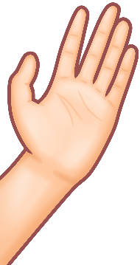
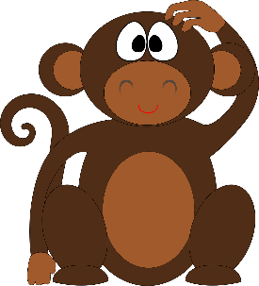
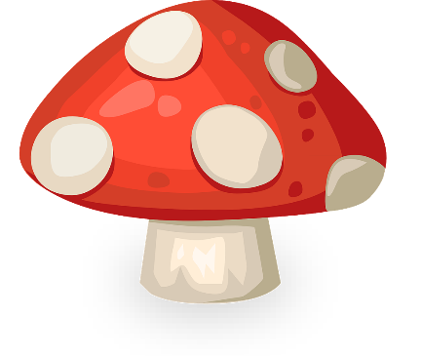
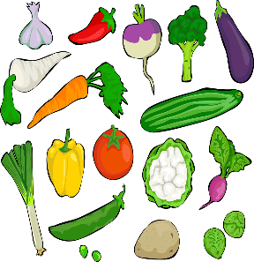
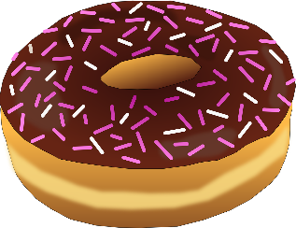
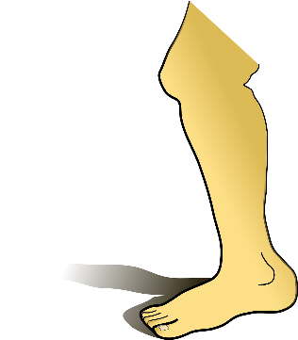
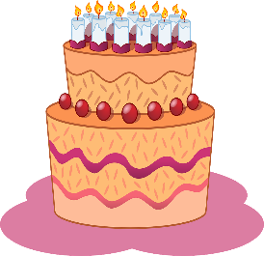
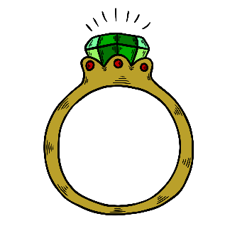
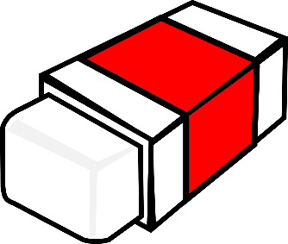
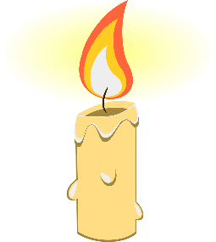
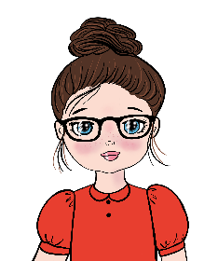
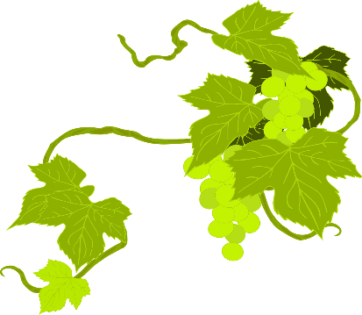
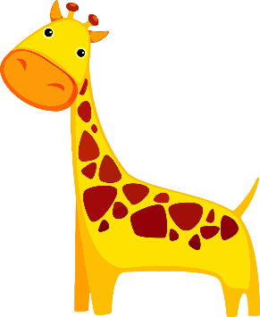
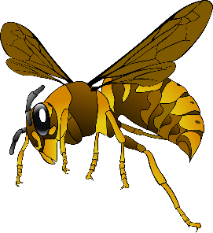
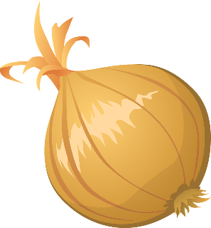
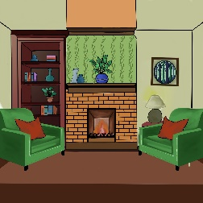
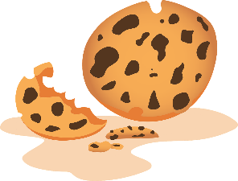
C’est hard [g], soft [g/j] ou [gn]?
écouter
beignet
[gn]
[donut]
singe
[j/soft g]
[monkey]
genou
[j/soft g]
[knee]
champignon
[gn]
[mushroom]
poignet
[gn]
[wrist]
légumes
[hard g]
[vegetables]
manège
[j/soft g]
[carousel]
gâteau
[hard g]
[cake]
bague
[hard g]
[ring]
gomme
[hard g]
[eraser]
joue
[j/soft g]
[cheek]
bougie
[j/soft g]
[candle]
magique
[j/soft g]
[magic]
chignon
[gn]
[hair bun]
justice
[j/soft g]
[justice]
vigne
[gn]
[vine]
gare
[hard g]
[station]
girafe
[j/soft g]
[giraffe]
guêpe
[hard g]
[wasp]
oignon
[gn]
[onion]
séjour
[j/soft g]
[lounge]
goûter
[hard g]
[snack]
châtaigne[gn]
[chestnut]
araignée
[gn]
[spider]
Notes:
Timing: 3 minutes
Aim: To consolidate aural recognition of [hard g], [j/soft g] and [gn]
Procedure:
Click on the pictures to hear the word spoken
Ask students to identify if they hear the SSC [hard g], [j/soft g] or [gn]
Click again to reveal the word, the correct SSC and the English translation.
Transcript:
beignet
gâteau
magique
girafe
guêpe
oignon
chignon
bague
singe
genou
champignon
gomme
justice
séjour
goûter
châtaigne
vigne
joue
poignet
légumes
manège
bougie
gare
araignée
Word frequency of unknown words (1 is the most frequent word in French): beignet [>5000], gâteau [4845], guêpe [>5000], chignon [>5000], bague >5000], singe [4739], genou [2967], champignon [>5000], gomme [>5000], séjour [2007], goûter [4441], châtaigne [>5000], vigne [>5000], joue [3932], poignet [>5000], légumes [>5000], manège [>5000], bougie [>5000], gare [2582], araignée [>5000] Source: Lonsdale, D., & Le Bras, Y. (2009). A Frequency Dictionary of French: Core vocabulary for learners London: Routledge.
Word frequency of cognates (1 is the most frequent word in French): magique [3530], girafe [>5000], oignon [>5000], justice [637] Source: Lonsdale, D., & Le Bras, Y. (2009). A Frequency Dictionary of French: Core vocabulary for learners London: Routledge.

