Slide 1
French Phonics Collection
SSC [ien]
Artwork by: Chloé Motard
Date updated: 31/08/22
Notes:
Artwork by Chloé Motard. All additional pictures selected are available under a Creative Commons license, no attribution required.

Slide 2
SSC [ien]
phonétique
Introduction

Slide 3
ien
bien
Notes:
Timing: 1 minute
Aim: To introduce/consolidate SSC [ien]
Procedure: 1. Present the letter(s) and say the [ien] sound first, on its own. Students repeat it with you. 2. Bring up the word ”bien” on its own, say it, students repeat it, so that they have the opportunity to focus all of their attention on the connection between the written word and its sound.
3. A possible gesture for this would be to give a thumbs up sign. 4. Roll back the animations and work through 1-3 again, but this time, dropping your voice completely to listen carefully to the students saying the [ien] sound, pronouncing ”bien” and, if using, doing the gesture.
Word frequency (1 is the most frequent word in French):
bien [47]
Source: Londsale, D., & Le Bras, Y. (2009). A Frequency Dictionary of French: Core vocabulary for learners London: Routledge.

Slide 4
ien
bien
Notes:
With sound and no pictures to focus all attention on the sound-symbol correspondence.

Slide 5
ien
bien
Notes:
Without sound to elicit pronunciation (without first hearing the teacher).
Teacher to elicit pronunciation by asking “Comment dit-on …"

Slide 6
ien
ancien
chien
rien
bien
combien ?
[nothing]
bientôt
€ ?
[soon]
Notes:
Timing: 2 minutes
Aim: To introduce/consolidate SSC [ien]
Procedure:
1. Introduce and elicit the pronunciation of the individual SSC [ien] and then the source word again ‘bien’ (with gesture, if using). 2. Then present and elicit the pronunciation of the five cluster words.
The cluster words have been chosen for their high-frequency, from a range of word classes, with the SSC (where possible) positioned within a variety of syllables within the words (e.g. initial, 2nd, final etc.). Additionally, we have tried to use words that build cumulatively on previously taught SSCs (see the Phonics Teaching Sequence document) and do not include new SSCs. Where new SSCs are used, they are often consonants which have a similar symbol-sound correspondence in English.
Word frequency (1 is the most frequent word in French): chien [1744]; rien [168] bientôt [1208]; ancien [392]; combien? [800]; bien [47]. Source: Londsale, D., & Le Bras, Y. (2009). A Frequency Dictionary of French: Core vocabulary for learners London: Routledge.

Slide 7
ien
ancien
chien
rien
bien
combien ?
bientôt
Notes:
With sound and no pictures to focus all attention on the sound-symbol correspondence.

Slide 8
ien
ancien
chien
rien
bien
combien ?
bientôt
Notes:
Without sound to elicit pronunciation (without first hearing the teacher).
Teacher to elicit pronunciation by asking “Comment dit-on …"

Slide 9
Phonétique
écouter
 |  | [ien] | [ain/in]
 | bain
 | lien
 | soutien
 | voisin
1
[bath]
2
 |  | [ien] | [ain/in]
 | quotidien
 | écrivain
 | historien
 | soudain
[link]
3
5
[support]
[daily]
4
6
[neighbour]
[writer]
7
[historian]
8
[sudden]
Notes:
Timing: 3 minutes
Aim: Identify SSC [ien] vs distraction SSC [ain/in]
Procedure:
1. Click numbers to play audio
2. Students tick which sound they think they hear
3. Answers revealed on clicks
Transcript:
bain
lien
soutien
voisin
quotidien
écrivain
historien
soudain
Word frequency (1 is the most frequent word in French): bain [3458], lien [880], soutien [1198], voisin [979], quotidien [1318], écrivain [1738]
Source: Londsale, D., & Le Bras, Y. (2009). A Frequency Dictionary of French: Core vocabulary for learners London: Routledge.

Slide 10
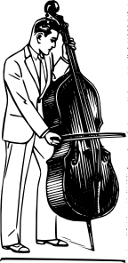
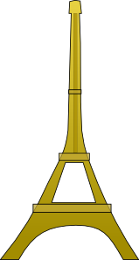
Phonétique
politicien
lire / parler
30
maintien
technicien
comédien
[maintenance]
comédien
entretien
chrétien
[interview]
secondes
musicien
bienvenu
[welcome]
gardien
[guardian]
chirurgien
égyptien
0
parisien
[surgeon]
DÉBUT
Notes:
Timing: 30 seconds (click début to begin timer)
Aim: Practise pronunciation of SSC [tion]
Procedure:
1. Click ‘début’ to start timer
2. Students have 30 seconds to accurately pronounce as many words as possible
3. Students can do this in pairs to check each others pronunciation
Word frequency (1 is the most frequent word in French): maintien [1819], technicien [2461], comédien [4253], chrétien [1895], gardien [1924], musicien [3100], politicien [3371], parisien [2549], entretien [1433], bienvenu [3714], égyptien [4137], comédien [4253], chirurgien [4787]
Source: Londsale, D., & Le Bras, Y. (2009). A Frequency Dictionary of French: Core vocabulary for learners London: Routledge.

Slide 11
SSC [ien]
phonétique
Consolidation [1]

Slide 12
ien
bien
Notes:
Timing: 1 minute
Aim: To introduce/consolidate SSC [ien]
Procedure: 1. Present the letter(s) and say the [ien] sound first, on its own. Students repeat it with you. 2. Bring up the word ”bien” on its own, say it, students repeat it, so that they have the opportunity to focus all of their attention on the connection between the written word and its sound.
3. A possible gesture for this would be to give a thumbs up sign. 4. Roll back the animations and work through 1-3 again, but this time, dropping your voice completely to listen carefully to the students saying the [ien] sound, pronouncing ”bien” and, if using, doing the gesture.
Word frequency (1 is the most frequent word in French):
bien [47]
Source: Londsale, D., & Le Bras, Y. (2009). A Frequency Dictionary of French: Core vocabulary for learners London: Routledge.

Slide 13
ien
bien
Notes:
With sound and no pictures to focus all attention on the sound-symbol correspondence.

Slide 14
ien
bien
Notes:
Without sound to elicit pronunciation (without first hearing the teacher).
Teacher to elicit pronunciation by asking “Comment dit-on …"

Slide 15
ien
ancien
chien
rien
bien
combien ?
[nothing]
bientôt
€ ?
[soon]
Notes:
Timing: 2 minutes
Aim: To introduce/consolidate SSC [ien]
Procedure:
1. Introduce and elicit the pronunciation of the individual SSC [ien] and then the source word again ‘bien’ (with gesture, if using). 2. Then present and elicit the pronunciation of the five cluster words.
The cluster words have been chosen for their high-frequency, from a range of word classes, with the SSC (where possible) positioned within a variety of syllables within the words (e.g. initial, 2nd, final etc.). Additionally, we have tried to use words that build cumulatively on previously taught SSCs (see the Phonics Teaching Sequence document) and do not include new SSCs. Where new SSCs are used, they are often consonants which have a similar symbol-sound correspondence in English.
Word frequency (1 is the most frequent word in French): chien [1744]; rien [168] bientôt [1208]; ancien [392]; combien? [800]; bien [47]. Source: Londsale, D., & Le Bras, Y. (2009). A Frequency Dictionary of French: Core vocabulary for learners London: Routledge.

Slide 16
ien
ancien
chien
rien
bien
combien ?
bientôt
Notes:
With sound and no pictures to focus all attention on the sound-symbol correspondence.

Slide 17
ien
ancien
chien
rien
bien
combien ?
bientôt
Notes:
Without sound to elicit pronunciation (without first hearing the teacher).
Teacher to elicit pronunciation by asking “Comment dit-on …"

Slide 18
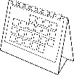
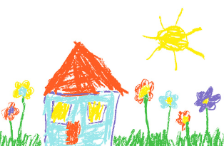
-ien ou –(a)in ?
écouter
Écoute les mots.
C’est quelle SSC ?
Coche.
 |  |  | -ien | -(a)in
 | end | fin
 | link | lien
 | path | chemin
 | support | soutien
 | daily | quotidien
 | interview | entretien
 | drawing | dessin
 | bread | pain
1
____
2
@ www.
____
3
____
4
____
5
____
6
____
7
____
8
____
Notes:
Timing: 5 minutes
Aim: Practice in observing the similarities and differences between [-ien] and [-(a)in]. Both SSCs contain the same nasal sound, preceded by /j/ in the former. Unknown vocabulary is used so that students are required to draw on their SSC knowledge rather than their vocabulary knowledge.
Procedure:
1. Students write 1-8 and copy the columns with headings –ien/-(a)in into their books. The partial French word is provided with the SSC missing to focus attention on this part, but students are not expected to transcribe (it is not possible to do this accurately when an SSC has multiple spellings).
2. Audio plays on number clicks.
3. Answers, full transcriptions and English definitions (for information only) appear on successive clicks.
Transcript and word frequency (1 is the most frequent word in French):
fin [111]
lien [880]
chemin [859]
soutien [1198]
quotidien [1318]
entretien [1433]
dessin [2624]
pain [2802]
Source: Londsale, D., & Le Bras, Y. (2009). A Frequency Dictionary of French: Core vocabulary for learners London: Routledge.

Slide 19
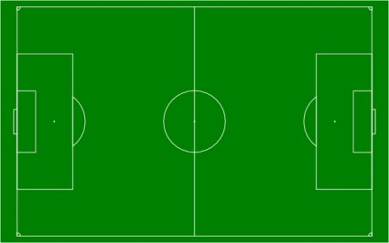
L’équipe d’Amir
parler
Adrien
Benjamin
Corentin
Amir
Julien
Aurélien
Martin
Sébastien
Lucien
Valentin
Fabien
Notes:
Timing: 5 minutes
Aim: Practice in producing [-ien] and [-(a)in]. Both SSCs contain the same nasal sound, preceded by /j/ in the former. Names are used so that students are required to draw on their SSC knowledge rather than their vocabulary knowledge, and to raise aware of popular French male names.
Procedure:
Click to pass the ball to a player.
Students commentate on the match by saying the name of the player who has the ball.
Click on the number next to the player to check pronunciation.
Students repeat.
Click to pass the ball to the next player.
Use the back button to “replay” any problematic names (e.g. those whose written form resembles the English).
Transcript
1. Aurélien
2. Valentin
3. Lucien
4. Julien
5. Corentin
6. Sébastien
7. Fabien
8. Adrien
9. Martin
10. Benjamin

Slide 20
SSC [ien]
phonétique
Consolidation [2]

Slide 21
ien
bien
Notes:
Timing: 1 minute
Aim: To introduce/consolidate SSC [ien]
Procedure: 1. Present the letter(s) and say the [ien] sound first, on its own. Students repeat it with you. 2. Bring up the word ”bien” on its own, say it, students repeat it, so that they have the opportunity to focus all of their attention on the connection between the written word and its sound.
3. A possible gesture for this would be to give a thumbs up sign. 4. Roll back the animations and work through 1-3 again, but this time, dropping your voice completely to listen carefully to the students saying the [ien] sound, pronouncing ”bien” and, if using, doing the gesture.
Word frequency (1 is the most frequent word in French):
bien [47]
Source: Londsale, D., & Le Bras, Y. (2009). A Frequency Dictionary of French: Core vocabulary for learners London: Routledge.

Slide 22
ien
ancien
chien
rien
bien
combien ?
[nothing]
bientôt
€ ?
[soon]
Notes:
Timing: 2 minutes
Aim: To introduce/consolidate SSC [ien]
Procedure:
1. Introduce and elicit the pronunciation of the individual SSC [ien] and then the source word again ‘bien’ (with gesture, if using). 2. Then present and elicit the pronunciation of the five cluster words.
The cluster words have been chosen for their high-frequency, from a range of word classes, with the SSC (where possible) positioned within a variety of syllables within the words (e.g. initial, 2nd, final etc.). Additionally, we have tried to use words that build cumulatively on previously taught SSCs (see the Phonics Teaching Sequence document) and do not include new SSCs. Where new SSCs are used, they are often consonants which have a similar symbol-sound correspondence in English.
Word frequency (1 is the most frequent word in French): chien [1744]; rien [168] bientôt [1208]; ancien [392]; combien? [800]; bien [47]. Source: Londsale, D., & Le Bras, Y. (2009). A Frequency Dictionary of French: Core vocabulary for learners London: Routledge.

Slide 23
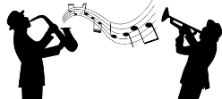
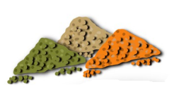
Phonétique
Les mots finissent-ils par [-ille] ou par [-ien] ? C’est quoi en anglais ?
en français | en anglais | [-ille] | [-ien]
un musicien | a musician
une lentille | a lentil
un dalmatien | a dalmatian
un martien | a Martian
un gorille | a gorilla
un comédien | a comedian
vanille | vanilla
1
2
3
4
5
6
7
Notes:
Timing: 5 minutes
Aim: Aural recognition of SSCs [-ille] and [-ien] at the end of words which are near-cognates in written but not spoken form; raising awareness of English equivalent spellings/pronunciation of [-ille] and [-ien].
Procedure:
1. Click on a number to play the audio.
2. Instruct students to play close attention to the end of the word, and decide which SSC they hear.
3. Click to reveal answers.
4. Click to play the words again. Students already know how the word ends, so they should now focus on the beginning. Ask them which English word it sounds like.
5. Click to bring up picture clues if necessary.
6. Click to reveal English translations.
7. Click to reveal French transcriptions.
8. Play the audio again. Students repeat.
Transcript:
1. un musicien
2. une lentille
3. un dalmatien
4. un martien
5. un gorille
6. un comédien
7. vanille
Word frequency of cognates (1 is the most frequent word in French):
lentille [>5000], dalmatien [>5000]; martien [>5000]; gorille [>5000]; comédien [4253], vanille [>5000]
Source: Londsale, D., & Le Bras, Y. (2009). A Frequency Dictionary of French: Core vocabulary for Léarners London: Routledge.

Slide 24
Des virelangues
lire / parler
1
2
3
Le comédien canadien pose une question à la famille de gorilles.
The Canadian comedian asks the family of gorillas a question.
Notes:
Timing: 4 minutes. This is slide 1/4.
Aim: Oral production of sentences with words containing a mix of SSCs containing [i] ([-ill-]/[-ille], [-ien], [-tion]).
Procedure:
1. Remind students which words containing [-ill-] are exceptions (mille, ville).
2. Students takes turns to say the tongue twisters, focussing on the SSCs in bold.
3. Click on the slowest speed (1) to check pronunciation.
4. Students repeat.
5. Repeat steps 203 at speeds (2) and (3) to improve fluency.
Transcript:
Le comédien canadien pose une question à la famille de gorilles.
Word frequency of cognates (1 is the most frequent word in French):
comédien [4253], poser [218], gorille [>5000]
Source: Londsale, D., & Le Bras, Y. (2009). A Frequency Dictionary of French: Core vocabulary for Léarners London: Routledge.

Slide 25
Des virelangues
lire / parler
1
2
3
Un grillon canadien vit avec une famille de chenilles dans une cabine.
A Canadian cricket lives with a family of caterpillars in a cabin.
Notes:
This is slide 2/4.
Transcript:
Un grillon canadien vit avec une famille de chenilles dans une cabine.
Word frequency of cognates (1 is the most frequent word in French):
cabine [3953]
Source: Londsale, D., & Le Bras, Y. (2009). A Frequency Dictionary of French: Core vocabulary for Léarners London: Routledge.
Word frequency of unknown words (1 is the most frequent word in French):
vivre [201], grillon [>5000], chenille [>5000]
Source: Londsale, D., & Le Bras, Y. (2009). A Frequency Dictionary of French: Core vocabulary for Léarners London: Routledge.

Slide 26
Des virelangues
lire / parler
1
2
3
Un dalmatien italien joue avec trois mille billes dans la ville.
An Italian dalmatian plays with three thousand marbles in the town.
Notes:
This is slide 3/4.
Transcript:
Un dalmatien italien joue avec trois mille billes dans la ville.
Word frequency of cognates (1 is the most frequent word in French):
dalmatien [>5000]
Source: Londsale, D., & Le Bras, Y. (2009). A Frequency Dictionary of French: Core vocabulary for Léarners London: Routledge.
Word frequency of unknown words (1 is the most frequent word in French):
mille [1008], bille [>5000]
Source: Londsale, D., & Le Bras, Y. (2009). A Frequency Dictionary of French: Core vocabulary for Léarners London: Routledge.

Slide 27
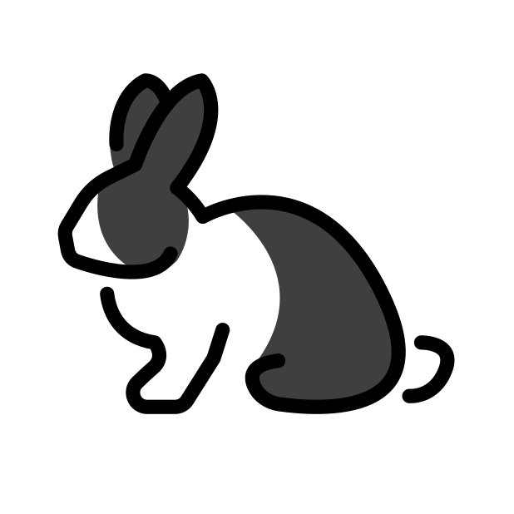
Des virelangues
lire / parler
1
2
3
Sa copine tient un grillon canadien et un lapin italien.
Her friend is holding a Canadian cricket and an Italian rabbit.
Notes:
This is slide 4/4.
Transcript:
Sa copine tient un grillon canadien et un lapin italien.
Word frequency of unknown words (1 is the most frequent word in French):
copain [3020], tenir [104], grillon [>5000], lapin [>5000]
Source: Londsale, D., & Le Bras, Y. (2009). A Frequency Dictionary of French: Core vocabulary for Léarners London: Routledge.

Slide 28
SSC [ien]
phonétique
Consolidation [3]

Slide 29
ien
bien
Notes:
Timing: 1 minute
Aim: To introduce/consolidate SSC [ien]
Procedure: 1. Present the letter(s) and say the [ien] sound first, on its own. Students repeat it with you. 2. Bring up the word ”bien” on its own, say it, students repeat it, so that they have the opportunity to focus all of their attention on the connection between the written word and its sound.
3. A possible gesture for this would be to give a thumbs up sign. 4. Roll back the animations and work through 1-3 again, but this time, dropping your voice completely to listen carefully to the students saying the [ien] sound, pronouncing ”bien” and, if using, doing the gesture.
Word frequency (1 is the most frequent word in French):
bien [47]
Source: Londsale, D., & Le Bras, Y. (2009). A Frequency Dictionary of French: Core vocabulary for learners London: Routledge.

Slide 30
ien
ancien
chien
rien
bien
combien ?
[nothing]
bientôt
€ ?
[soon]
Notes:
Timing: 2 minutes
Aim: To introduce/consolidate SSC [ien]
Procedure:
1. Introduce and elicit the pronunciation of the individual SSC [ien] and then the source word again ‘bien’ (with gesture, if using). 2. Then present and elicit the pronunciation of the five cluster words.
The cluster words have been chosen for their high-frequency, from a range of word classes, with the SSC (where possible) positioned within a variety of syllables within the words (e.g. initial, 2nd, final etc.). Additionally, we have tried to use words that build cumulatively on previously taught SSCs (see the Phonics Teaching Sequence document) and do not include new SSCs. Where new SSCs are used, they are often consonants which have a similar symbol-sound correspondence in English.
Word frequency (1 is the most frequent word in French): chien [1744]; rien [168] bientôt [1208]; ancien [392]; combien? [800]; bien [47]. Source: Londsale, D., & Le Bras, Y. (2009). A Frequency Dictionary of French: Core vocabulary for learners London: Routledge.

