Slide 1
French Phonics Collection
SSC [h]
Artwork by: Chloé Motard
Date updated: 30/08/2022
Notes:
Artwork by Chloé Motard. All additional pictures selected are available under a Creative Commons license, no attribution required.

Slide 2
SSC [h]
phonétique
Introduction

Slide 3
h
heure
Notes:
Timing: 1 minute
Aim: To introduce SSC [h]
Procedure: 1. Present the letter(s) and the [h] first, on its own. As there is no sound, put a finger to your lips instead. 2. Bring up the word ”heure” on its own, say it, students repeat it, so that they have the opportunity to focus all of their attention on the connection between the written word and its sound.
3. A possible gesture for this would be to tap a watch/wrist. 4. Roll back the animations and work through 1-3 again, but this time, dropping your voice completely to listen carefully to the students saying the [h] sound, pronouncing ”heure” and, if using, doing the gesture.
Word frequency (1 is the most frequent word in French):
heure [99]
Source: Londsale, D., & Le Bras, Y. (2009). A Frequency Dictionary of French: Core vocabulary for learners London: Routledge.

Slide 4
h
heure
Notes:
With sound and no pictures to focus all attention on the sound-symbol correspondence.

Slide 5
h
heure
Notes:
Without sound to elicit pronunciation (without first hearing the teacher).
Teacher to elicit pronunciation by asking “Comment dit-on …”

Slide 6
h
hôtel
huit
8
hôpital
hiver
heure
[winter]
histoire
[history, story]
Notes:
Timing: 2 minutes
Aim: To introduce SSC [h]
Procedure:
Introduce and elicit the pronunciation of the individual SSC [h] and then the source word again ‘heure’ (with gesture, if using). Then present and elicit the pronunciation of the five cluster words. The cluster words have been chosen for their high-frequency, from a range of word classes, with the SSC (where possible) positioned within a variety of syllables within the words (e.g. initial, 2nd, final etc.). Additionally, we have tried to use words that build cumulatively on previously taught SSCs (see the Phonics Teaching Sequence document) and do not include new SSCs. Where new SSCs are used, they are often consonants which have a similar symbol-sound correspondence in English.
Word frequency (1 is the most frequent word in French): histoire [263]; huit [877]; hôpital [1308]; hôtel [1774]; hiver [1586]; heure [99]. Source: Londsale, D., & Le Bras, Y. (2009). A Frequency Dictionary of French: Core vocabulary for learners London: Routledge.

Slide 7
h
hôtel
huit
hôpital
hiver
heure
histoire
Notes:
With sound and no pictures to focus all attention on the sound-symbol correspondence.

Slide 8
h
hôtel
huit
hôpital
hiver
heure
histoire
Notes:
Without sound to elicit pronunciation (without first hearing the teacher).
Teacher to elicit pronunciation by asking “Comment dit-on …”

Slide 9
Phonétique
parler
Remember! Although you will recognise these words from English, the h- is silent in French!
60
humanité
horreur
herbe
horizon
[grass]
secondes
honnête
ha ha
héros
hostile
historique
[hero]
0
honorable
hélicoptère
DÉBUT
Notes:
Timing: 5 minutes. This is slide 1/3.
Aim: To correctly pronounce unknown words containing [h-] in decreasing amounts of time, helping automisation of SSC production. Awareness raising of cross-linguistic pronunciation differences. The words chosen are cognates which otherwise contain sounds that are equivalent (or very similar) to English SSCs, as well as known SSCs, so that students can focus fully on [h-] (allowances are made for English pronunciation of [r], which is covered later in year 8).
Procedure:
1. Students pair up.
2. Teacher starts timer.
3. Student A tries to say the words without pronouncing [h-].
4. Student B listens and makes speaker pause for 3 seconds every time an English pronunciation creeps in!
5. Swap roles.
6. The student who says the most words correctly is the winner!
7. Click on the word to hear pronunciation by a native speaker. Students repeat.
8. Check understanding of words.
9. Move onto the next slide.
Transcript and word frequency (1 is the most frequent word in French): horreur [2565], herbe [3562], humanité [1525], honnête [2405], ha ha [>5000], horizon [2502], héros [1883], historique [902], hostile [3091], honorable [893], hélicoptère [2978]
Source: Londsale, D., & Le Bras, Y. (2009). A Frequency Dictionary of French: Core vocabulary for learners London: Routledge.

Slide 10
Phonétique
parler
Remember! Although you will recognise these words from English, the h- is silent in French!
45
humanité
horreur
herbe
horizon
[grass]
secondes
honnête
ha ha
héros
hostile
historique
[hero]
0
honorable
hélicoptère
DÉBUT
Notes:
This is slide 2/3.
As previous but with 15 fewer seconds on the timer.

Slide 11
Phonétique
parler
Remember! Although you will recognise these words from English, the h- is silent in French!
30
humanité
horreur
herbe
horizon
[grass]
secondes
honnête
ha ha
héros
hostile
historique
[hero]
0
honorable
hélicoptère
DÉBUT
Notes:
This is slide 3/3.
As previous but with 15 fewer seconds on the timer again.

Slide 12
SSC [h]
phonétique
Consolidation [1]

Slide 13
h
heure
Notes:
Timing: 1 minute [2 slides].
Aim: To consolidate SSC [h]
Procedure: 1. Present the letter(s) and the [h] first, on its own. As there is no sound, put a finger to your lips instead. 2. Bring up the word ”heure” on its own, say it, students repeat it, so that they have the opportunity to focus all of their attention on the connection between the written word and its sound.
3. A possible gesture for this would be to tap a watch/wrist. 4. Roll back the animations and work through 1-3 again, but this time, dropping your voice completely to listen carefully to the students saying the [h] sound, pronouncing ”heure” and, if using, doing the gesture.
Word frequency (1 is the most frequent word in French):
heure [99]
Source: Londsale, D., & Le Bras, Y. (2009). A Frequency Dictionary of French: Core vocabulary for learners London: Routledge.

Slide 14
h
hôtel
huit
8
hôpital
hiver
heure
[winter]
histoire
[history, story]
Notes:
Aim: To consolidate SSC [h]
Procedure:
Introduce and elicit the pronunciation of the individual SSC [h] and then the source word again ‘heure’ (with gesture, if using). Then present and elicit the pronunciation of the five cluster words. The cluster words have been chosen for their high-frequency, from a range of word classes, with the SSC (where possible) positioned within a variety of syllables within the words (e.g. initial, 2nd, final etc.). Additionally, we have tried to use words that build cumulatively on previously taught SSCs (see the Phonics Teaching Sequence document) and do not include new SSCs. Where new SSCs are used, they are often consonants which have a similar symbol-sound correspondence in English.
Word frequency (1 is the most frequent word in French): histoire [263]; huit [877]; hôpital [1308]; hôtel [1774]; hiver [1586]; heure [99]. Source: Londsale, D., & Le Bras, Y. (2009). A Frequency Dictionary of French: Core vocabulary for learners London: Routledge.

Slide 15
Phonétique
parler
60
Remember! Although some of these words look like English, the [h] is silent!
inhérent
cohérent
horrible
malheureusement
hostilité
[hostility]
secondes
[unfortunately]
envahir
habitation
hésitation
[to invade]
hôte
souhait
compréhension
0
[host]
[wish]
[understanding]
DÉBUT
Notes:
Timing: 2 minutes
Aim: Oral production of unknown words containing [h] in decreasing amounts of time (teacher to choose appropriately), helping automatisation of SSC production. Awareness raising of cross-linguistic pronunciation differences.
Procedure:
1. Students pair up.
2. Teacher starts timing.
3. Student A tries to say the words without pronouncing [h].
4. Student B listens for English pronunciation of [h] creeping in. Where this occurs, the listener asks the speaker to repeat the words three times.
5. Swap roles.
6. The student who says the most words correctly is the winner!
7. Click on the word to hear pronunciation by a native speaker. Students repeat.
8. Check understanding of words.
Transcript and word frequency (1 is the most frequent word in French): horrible [3190], hostilité [3436], envahir [2566], hôte [3780], malheureusement [1543], compréhension [2827], habitation [3616], cohérent [3274], hésitation [4323], inhérent [4672], souhait [3122]
Source: Londsale, D., & Le Bras, Y. (2009). A Frequency Dictionary of French: Core vocabulary for learners London: Routledge.

Slide 16
SSC [h]
phonétique
Consolidation [2]

Slide 17
h
heure
Notes:
Timing: 1 minute
Aim: To introduce SSC [h]
Procedure: 1. Present the letter(s) and the [h] first, on its own. As there is no sound, put a finger to your lips instead. 2. Bring up the word ”heure” on its own, say it, students repeat it, so that they have the opportunity to focus all of their attention on the connection between the written word and its sound.
3. A possible gesture for this would be to tap a watch/wrist. 4. Roll back the animations and work through 1-3 again, but this time, dropping your voice completely to listen carefully to the students saying the [h] sound, pronouncing ”heure” and, if using, doing the gesture.
Word frequency (1 is the most frequent word in French):
heure [99]
Source: Lonsdale, D., & Le Bras, Y. (2009). A Frequency Dictionary of French: Core vocabulary for learners London: Routledge.

Slide 18
h
hôtel
huit
8
hôpital
hiver
heure
[winter]
histoire
[history, story]
Notes:
Timing: 2 minutes
Aim: To introduce SSC [h]
Procedure:
Introduce and elicit the pronunciation of the individual SSC [h] and then the source word again ‘heure’ (with gesture, if using). Then present and elicit the pronunciation of the five cluster words. The cluster words have been chosen for their high-frequency, from a range of word classes, with the SSC (where possible) positioned within a variety of syllables within the words (e.g. initial, 2nd, final etc.). Additionally, we have tried to use words that build cumulatively on previously taught SSCs (see the Phonics Teaching Sequence document) and do not include new SSCs. Where new SSCs are used, they are often consonants which have a similar symbol-sound correspondence in English.
Word frequency (1 is the most frequent word in French): histoire [263]; huit [877]; hôpital [1308]; hôtel [1774]; hiver [1586]; heure [99]. Source: Lonsdale, D., & Le Bras, Y. (2009). A Frequency Dictionary of French: Core vocabulary for learners London: Routledge.

Slide 19
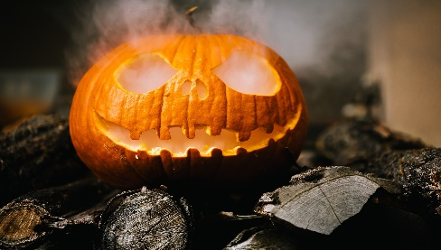
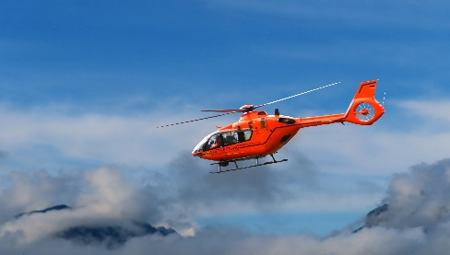
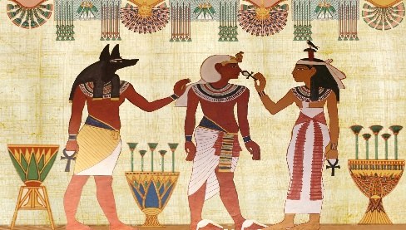
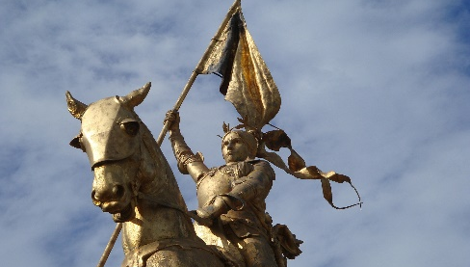
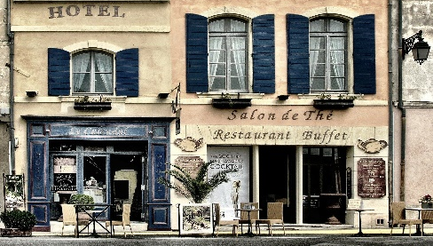
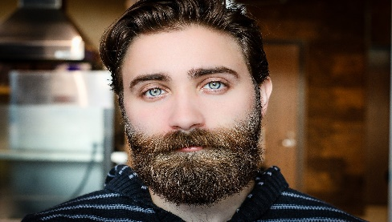
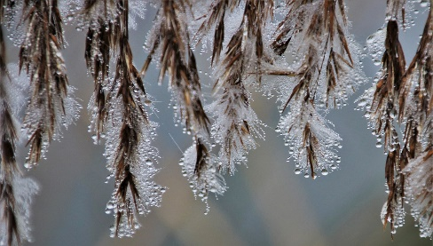
Phonétique [h-] muet
parler
Remember [h-] is normally silent.
This means it follows the pronunciation rules of the vowel that comes after it.
Practise this rule by saying these words.
hiver
herbe
halloween
hélicoptère
histoire
harmonie
héroïne
hôtel
horizon
homme
humidité
horloge
Notes:
Timing: 1 minute
Aim: To practise pronunciation of words beginning with silent [h].
Procedure:
1. Elicit pronunciation from students, reminding them of the silent [h].
2. Click on the pictures to hear the words said by a native speaker.
Transcript:
hiver
herbe
halloween
hélicoptère
histoire
harmonie
héroïne
hôtel
horizon
homme
humidité
horloge
Word frequency (1 is the most frequent word in French): herbe [3562], horloge [>50000], horreur [2565], histoire [263]
Source: Lonsdale, D., & Le Bras, Y. (2009). A Frequency Dictionary of French: Core vocabulary for learners London: Routledge.
Word frequency of cognates (1 is the most frequent word in French):
hélicoptère [2978], harmonie [4584], héroïne [3467], horizon [2502], humidité [>5000] Source: Lonsdale, D., & Le Bras, Y. (2009). A Frequency Dictionary of French: Core vocabulary for learners London: Routledge.

Slide 20
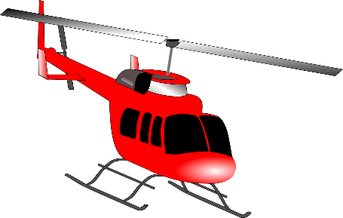
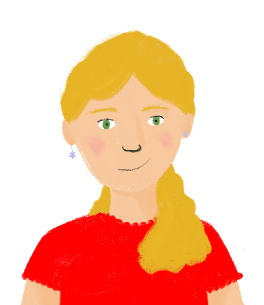
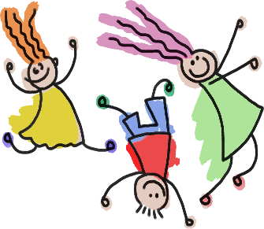
La liaison avec le [h-] muet
parler
Remember that when a word with a Silent Final Consonant
comes before a word beginning with [h-] muet, there is a liaison.
Look at the example. How is the last letter in c’est pronounced?
C’est triste !
C’est horrible !
C’est triste !
C’est horrible !
Tu voyages dans ton hélicoptère.
Il a acheté
mes horloges.
Tu voyages dans ton hélicoptère.
Il a acheté
mes horloges.
Now try saying these sentences…
Elles chantent en harmonie.
Les enfants
sont heureux.
Elles chantent
en harmonie.
Les enfants
sont heureux.
Notes:
Timing: 2 minutes
Aim: To practise pronouncing sentences with [h-] muet and liaisons.
Procedure:
Click through the example to hear the native speaker say the two sentences, one with a liaison, one without.
Ask students to say the sentences, following the pronunciation rules.
Click on the images to hear the native speaker.
Transcript:
C’est triste!
C’est horrible!
Tu voyages dans ton hélicoptère.
Il a acheté mes horloges.
Elles chantant en harmonie.
Les enfants sont heureux.

Slide 21
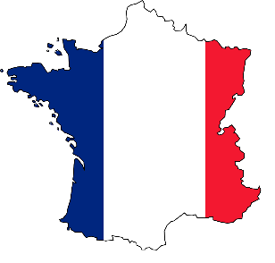
La liaison avec le [h-] muet
parler
Remember that words like le, la, je, de, ne and que replace their final letter with an apostrophe before a word beginning with [h]. This is called elision.
J’habite à Paris.
Il n’y a pas d’humains dans l’espace.
Hugo est plus grand qu’Henri.
Il n’y a pas d’humains dans l’espace.
Hugo est plus grand qu’Henri.
Now try saying these sentences…
Le soleil est sur l’horizon.
Le soleil est sur l’horizon.
Je n’habite pas en France.
Je n’habite pas en France.
Notes:
Timing: 2 minutes
Aim: To practise pronouncing sentences with [h-] muet and elision/liaison
Procedure:
Click through the example to hear the native speaker say the sentence with an elision and liaison.
Ask students to say the sentences, following the pronunciation rules.
Click on the images to hear the native speaker.
Transcript:
J’habite à Paris.
Il n’y a pas d’humains dans l’espace.
Hugo est plus grand qu’Henri.
Le soleil est sur l’horizon.
Je n’habite pas en France.
Word frequency of cognates (1 is the most frequent word in French):
humain [286] Source: Lonsdale, D., & Le Bras, Y. (2009). A Frequency Dictionary of French: Core vocabulary for learners London: Routledge.

