Slide 1
French Phonics Collection
SSC [é]
Artwork by: Chloé Motard
Date updated: 31/08/22
Notes:
Artwork by Chloé Motard. All additional pictures selected are available under a Creative Commons license, no attribution required.

Slide 2
SSC [é]
phonétique
Introduction

Slide 3
é/-er/-ez
écrire
Notes:
Timing: 1 minute
Aim: To introduce/consolidate SSC [é]
Procedure: 1. Present the letter(s) and say the [é] sound first, on its own. Students repeat it with you. 2. Bring up the word ”écrire” on its own, say it, students repeat it, so that they have the opportunity to focus all of their attention on the connection between the written word and its sound.
3. A possible gesture for this would be to mime the act of writing (onto the palm of the other hand perhaps). 4. Roll back the animations and work through 1-3 again, but this time, dropping your voice completely to listen carefully to the students saying the [é] sound, pronouncing ”écrire” and, if using, doing the gesture.
Word frequency (1 is the most frequent word in French):
écrire [382] Source: Londsale, D., & Le Bras, Y. (2009). A Frequency Dictionary of French: Core vocabulary for learners London: Routledge.

Slide 4
é/-er/-ez
écrire
Notes:
With sound and no pictures to focus all attention on the sound-symbol correspondence.

Slide 5
é/-er/-ez
écrire
Notes:
Without sound to elicit pronunciation (without first hearing the teacher).
Teacher to elicit pronunciation by asking “Comment dit-on …"

Slide 6
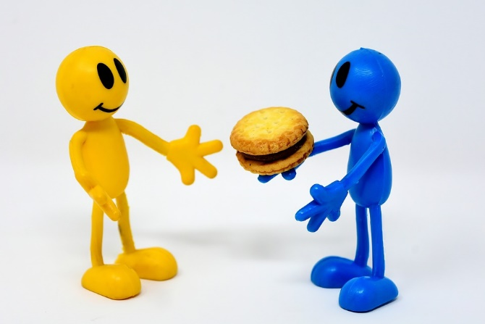
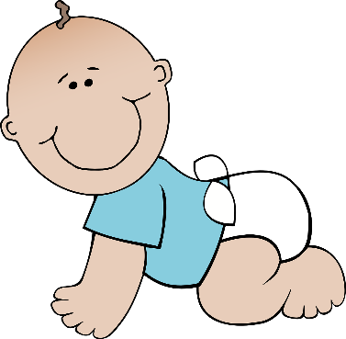
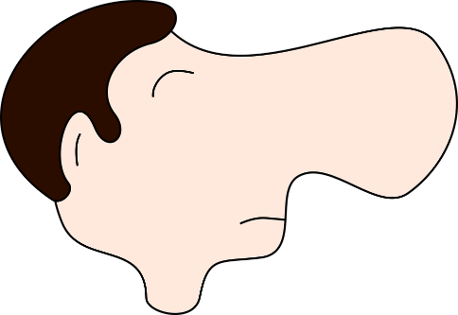
é/-er/-ez
bébé
donner
nez
parler
écrire
aller
[to go]
Notes:
Timing: 2 minutes
Aim: To introduce/consolidate SSC [é]
Procedure:
1. Introduce and elicit the pronunciation of the individual SSC [é] and then the source word again ‘écrire’ (with gesture, if using). 2. Then present and elicit the pronunciation of the five cluster words.
The cluster words have been chosen for their high-frequency, from a range of word classes, with the SSC (where possible) positioned within a variety of syllables within the words (e.g. initial, 2nd, final etc.). Additionally, we have tried to use words that build cumulatively on previously taught SSCs (see the Phonics Teaching Sequence document) and do not include new SSCs. Where new SSCs are used, they are often consonants which have a similar symbol-sound correspondence in English.
Word frequency (1 is the most frequent word in French): écrire [382]; bébé [>5000]; aller [55] donner [46]; nez [2661]; parler [106]. Source: Londsale, D., & Le Bras, Y. (2009). A Frequency Dictionary of French: Core vocabulary for learners London: Routledge.

Slide 7
é/-er-ez
donner
bébé
nez
parler
écrire
aller
Notes:
With sound and no pictures to focus all attention on the sound-symbol correspondence.

Slide 8
é/-er/-ez
donner
bébé
nez
parler
écrire
aller
Notes:
Without sound to elicit pronunciation (without first hearing the teacher).
Teacher to elicit pronunciation by asking “Comment dit-on …"

Slide 9
Phonétique
écouter
In which order do you hear the words? Write 1 or 2.
[SFe]
[é / -er / -ez]
__ vole (I fly)
__ volez (you fly)
1
2
a
__ porte (door)
__ porter (to wear)
2
1
b
__ marche (step)
__ marché (market)
2
1
c
__ ferme (farm)
__ fermer (to close)
d
1
2
__ tourne (spins)
__ tournée (tour)
e
1
2
Notes:
Timing: 4 minutes
Aim: aural recognition of SSCs [SFe] and [é / -er / -et]
Procedure:
1. Click the letters to play the audio.
2. Students write ‘1’ beside the first word they hear, and ‘2’ beside the second
3. Click to reveal the answers.

Slide 10
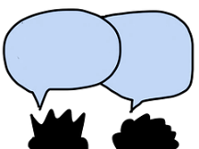
Phonétique
assez
parler
papier
quite
60
voler
réalité
bébé
to fly
secondes
éviter
médias
to avoid
médical
février
0
February
DÉBUT
Notes:
Timing: 1 minute
Aim: oral production of SSC [é / -er / -ez]
Procedure:
1. Students say the words alternately out loud with a partner, building up speed, over 1 minute’s intensive practice. They call in any order they like, students are not allowed to repeat the one they said in their last turn.
2. Teacher can circulate to listen into their SSC knowledge.
3. Click on début to start a one-minute timer on the screen.
4. Click on the words to hear them said by a native speaker. Students repeat.
Word frequency (1 is the most frequent word in French): assez [321], papier [951], réalité [532], bébé [2271], voler [1610], médical [1566], médias [1585], éviter [396], février [1136]
Source: Londsale, D., & Le Bras, Y. (2009). A Frequency Dictionary of French: Core vocabulary for learners London: Routledge.

Slide 11
Phonétique
assez
parler
papier
quite
60
voler
réalité
bébé
to fly
secondes
éviter
médias
to avoid
médical
février
0
February
DÉBUT
Notes:
Timing: 1 minute
Aim: oral production of SSC [é / -er / -ez]
Procedure:
1. Individually, students read out the words but in alphabetical order. They keep going for one minute.
2. Teacher can circulate to listen into their SSC knowledge.
Word frequency (1 is the most frequent word in French): assez [321], papier [951], réalité [532], bébé [2271], voler [1610], médical [1566], médias [1585], éviter [396], février [1136]
Source: Londsale, D., & Le Bras, Y. (2009). A Frequency Dictionary of French: Core vocabulary for learners London: Routledge.

Slide 12
SSC [é]
phonétique
Consolidation [1]

Slide 13
é/-er/-ez
écrire
Notes:
Timing: 1 minute
Aim: To introduce/consolidate SSC [é]
Procedure: 1. Present the letter(s) and say the [é] sound first, on its own. Students repeat it with you. 2. Bring up the word ”écrire” on its own, say it, students repeat it, so that they have the opportunity to focus all of their attention on the connection between the written word and its sound.
3. A possible gesture for this would be to mime the act of writing (onto the palm of the other hand perhaps). 4. Roll back the animations and work through 1-3 again, but this time, dropping your voice completely to listen carefully to the students saying the [é] sound, pronouncing ”écrire” and, if using, doing the gesture.
Word frequency (1 is the most frequent word in French):
écrire [382] Source: Londsale, D., & Le Bras, Y. (2009). A Frequency Dictionary of French: Core vocabulary for learners London: Routledge.

Slide 14
é/-er/-ez
écrire
Notes:
With sound and no pictures to focus all attention on the sound-symbol correspondence.

Slide 15
é/-er/-ez
écrire
Notes:
Without sound to elicit pronunciation (without first hearing the teacher).
Teacher to elicit pronunciation by asking “Comment dit-on …"

Slide 16
é/-er/-ez
bébé
donner
nez
parler
écrire
aller
[to go]
Notes:
Timing: 2 minutes
Aim: To introduce/consolidate SSC [é]
Procedure:
1. Introduce and elicit the pronunciation of the individual SSC [é] and then the source word again ‘écrire’ (with gesture, if using). 2. Then present and elicit the pronunciation of the five cluster words.
The cluster words have been chosen for their high-frequency, from a range of word classes, with the SSC (where possible) positioned within a variety of syllables within the words (e.g. initial, 2nd, final etc.). Additionally, we have tried to use words that build cumulatively on previously taught SSCs (see the Phonics Teaching Sequence document) and do not include new SSCs. Where new SSCs are used, they are often consonants which have a similar symbol-sound correspondence in English.
Word frequency (1 is the most frequent word in French): écrire [382]; bébé [>5000]; aller [55] donner [46]; nez [2661]; parler [106]. Source: Londsale, D., & Le Bras, Y. (2009). A Frequency Dictionary of French: Core vocabulary for learners London: Routledge.

Slide 17
é/-er-ez
donner
bébé
nez
parler
écrire
aller
Notes:
With sound and no pictures to focus all attention on the sound-symbol correspondence.

Slide 18
é/-er/-ez
donner
bébé
nez
parler
écrire
aller
Notes:
Without sound to elicit pronunciation (without first hearing the teacher).
Teacher to elicit pronunciation by asking “Comment dit-on …"

Slide 19
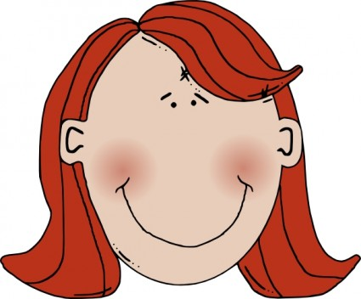
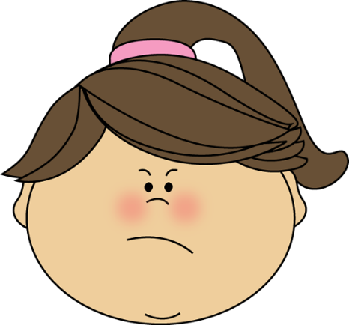
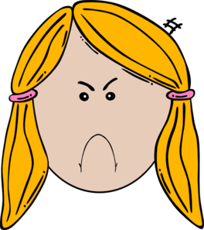
Amies ou ennemies ?
écouter
Elles ont une chose en commun:
1
Elles sont très différentes !
Agnès
é
è
e
et
Chloé
Notes:
Timing: 5 minutes (for 8 slides)
Aim: Aural recognition of SSC [è] in contrast to [é] and [e]. Names are used so that students focus on the SSCs rather than vocabulary knowledge.
Procedure:
1. Students write 1-8 in their workbooks, and for each write down either the SSC that is common to both names, or “[-]”.
2. Click the number to hear the pairs of names. This can be repeated as necessary depending on the level of the class.
3. The answers are animated to show first whether the two names have “something in common” (the SSC [e], [è] or [e]!) or if they are “very different” (no common SSC).
4. On a final click, the names in full including the SSC highlighted in blue.
Transcript:
1. Agnès et Chloé

Slide 20
Amies ou ennemies ?
écouter
Elles ont une chose en commun:
2
Elles sont très différentes !
Léa
é
è
e
et
Zoé
Notes:
Transcript:
2. Léa et Zoé

Slide 21
Amies ou ennemies ?
écouter
Elles ont une chose en commun:
3
Elles sont très différentes !
Madeleine
é
è
e
et
Renée
Notes:
Transcript:
3. Madeleine et Renée

Slide 22
Amies ou ennemies ?
écouter
Elles ont une chose en commun:
4
Elles sont très différentes !
Marylène
é
è
e
et
Émeline
Notes:
Transcript:
4. Marylène et Émeline

Slide 23
Amies ou ennemies ?
écouter
Elles ont une chose en commun:
5
Elles sont très différentes !
Solène
é
è
e
et
Cécile
Notes:
Transcript:
5. Solène et Cécile

Slide 24
Amies ou ennemies ?
écouter
Elles ont une chose en commun:
6
Elles sont très différentes !
Michèle
é
è
e
et
Mylène
Notes:
Transcript:
6. Michèle et Mylène

Slide 25
Amies ou ennemies ?
écouter
Elles ont une chose en commun:
7
Elles sont très différentes !
Ségolène
é
è
e
et
Aurélie
Notes:
Transcript:
7. Ségolène et Aurélie

Slide 26
Amies ou ennemies ?
écouter
Elles ont une chose en commun:
8
Elles sont très différentes !
Adèle
é
è
e
et
Hélène
Notes:
Transcript:
8. Adèle et Hélène

Slide 27
Phonétique
parler
C’est quoi le mot français avec la SSC é (-er, -ez) ?
ou
[together]
ch______
semble
anter
en_______
Notes:
Timing: 3 minutes for 5 slides
Aim: Oral production of SSC [é (-er, -ez)] and vocabulary from this week’s revisited sets.
Procedure:
1. Students call out the answers as a class.
2. Elicit both words before moving on.
3. The answers are animated to show the word with the SSC [é (-er, -ez)] first, followed by the other word.

Slide 28
Phonétique
parler
C’est quoi le mot français avec la SSC é (-er, -ez) ?
ou
é
ou
er
ruit
__c___t___
l__ f______
e

Slide 29
Phonétique
parler
C’est quoi le mot français avec la SSC é (-er, -ez) ?
[attention]
ou
l’a______
ttention
j______
ouer

Slide 30
Phonétique
parler
C’est quoi le mot français avec la SSC é (-er, -ez) ?
ou
[what]
é
u
__t___d___
ier
______oi
qu

Slide 31
Phonétique
parler
C’est quoi le mot français avec la SSC é (-er, -ez) ?
ou
[to eat]
a
adio
anger
l__ r______
m______

Slide 32
SSC [é]
phonétique
Consolidation [2]

Slide 33
é/-er/-ez
écrire
Notes:
Timing: 1 minute
Aim: To introduce/consolidate SSC [é]
Procedure: 1. Present the letter(s) and say the [é] sound first, on its own. Students repeat it with you. 2. Bring up the word ”écrire” on its own, say it, students repeat it, so that they have the opportunity to focus all of their attention on the connection between the written word and its sound.
3. A possible gesture for this would be to mime the act of writing (onto the palm of the other hand perhaps). 4. Roll back the animations and work through 1-3 again, but this time, dropping your voice completely to listen carefully to the students saying the [é] sound, pronouncing ”écrire” and, if using, doing the gesture.
Word frequency (1 is the most frequent word in French):
écrire [382] Source: Londsale, D., & Le Bras, Y. (2009). A Frequency Dictionary of French: Core vocabulary for learners London: Routledge.

Slide 34
SFE
Silent final -e
[shy]
timide
Notes:
Aim: To consolidate SSC [SFE]
Procedure: 1. Present the letter(s) and say the [SFE] sound first, on its own. Students repeat it with you. 2. Bring up the word ”timide” on its own, say it, students repeat it, so that they have the opportunity to focus all of their attention on the connection between the written word and its sound.
3. A possible gesture for this would be to cower and cover one’s face slightly, simulating shyness. 4. Roll back the animations and work through 1-3 again, but this time, dropping your voice completely to listen carefully to the students saying the [SFE] sound, pronouncing ”timide” and, if using, doing the gesture.
Word frequency (1 is the most frequent word in French):
timide [3835]
Source: Londsale, D., & Le Bras, Y. (2009). A Frequency Dictionary of French: Core vocabulary for learners London: Routledge.

Slide 35
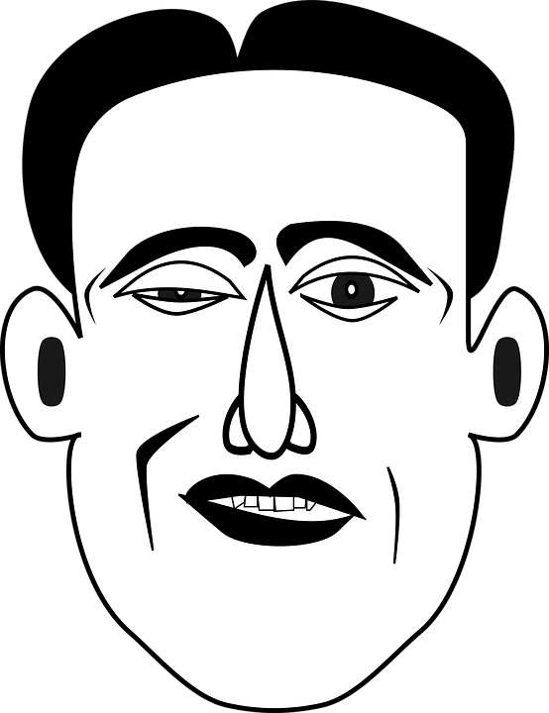
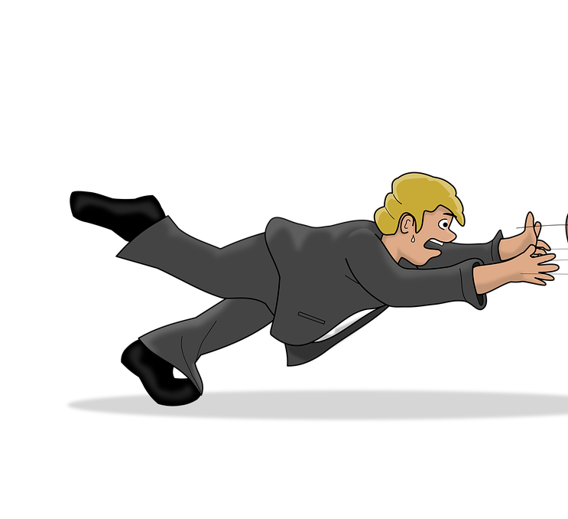
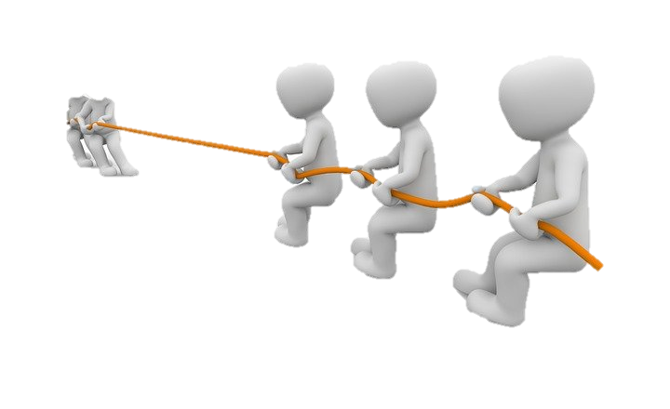
SSC [é] ou SFE ?
écouter
verb | infinitive meaning | infinitive (dictionary form) | short form (je/tu/il/elle)
cesser | to stop/quit
semble | to seem
illumine | to light up
encourager | to encourage
tirer | to pull
tomber | to fall
entre | to enter
garde | to keep
Listen out for the last SSC
in each word.
1
_
2
_
3
_
4
_
5
_
6
_
7
_
8
_
Notes:
Timing: 5 minutes
Aim: to practise aural recognition of SSCs [é/-er/-ez] and SFE and connect these with meaning (long or short form of verb).
NB: some of these unknown –ER verbs appear in the text students will work with in this lesson.
Procedure:
1. Click numbers to hear a verb.
2. Students tick whether they hear a long or short form, based on the ending they hear. Note that the options here are simply ‘long’ or ‘short’ as the singular forms (je/tu/il/elle) sound identical.
3. Click to reveal answers.
4. Listen again, this time drawing attention to stress patterns. As the last syllable in French words carries a slightly heavier stress, it is always the –er in the infinitive form that is stressed. Students repeat.
5. Students say the long and short form of each verb, focusing on the changing position of the stress (from base to ending).
Differentiation option for higher level students: Extend box to cover whole verb form. Students transcribe.
Transcript:
1. cesser
2. semble
3. illumine
4. encourager
5. tirer
6. tomber
7. entre
8. garde
Word frequency of unknown words used (1 is the most frequent word in French): sembler [180], cesser [462], garder [531], tomber [547], tirer [391]
Source: Londsale, D., & Le Bras, Y. (2009). A Frequency Dictionary of French: Core vocabulary for learners London: Routledge.
Word frequency of cognates used (1 is the most frequent word in French): encourager [1434], illuminer [>5000], entrer [337]
Source: Londsale, D., & Le Bras, Y. (2009). A Frequency Dictionary of French: Core vocabulary for learners London: Routledge.

Slide 36
é/-er/-ez
bébé
donner
nez
parler
écrire
aller
[to go]
Notes:
Timing: 2 minutes
Aim: To introduce/consolidate SSC [é]
Procedure:
1. Introduce and elicit the pronunciation of the individual SSC [é] and then the source word again ‘écrire’ (with gesture, if using). 2. Then present and elicit the pronunciation of the five cluster words.
The cluster words have been chosen for their high-frequency, from a range of word classes, with the SSC (where possible) positioned within a variety of syllables within the words (e.g. initial, 2nd, final etc.). Additionally, we have tried to use words that build cumulatively on previously taught SSCs (see the Phonics Teaching Sequence document) and do not include new SSCs. Where new SSCs are used, they are often consonants which have a similar symbol-sound correspondence in English.
Word frequency (1 is the most frequent word in French): écrire [382]; bébé [>5000]; aller [55] donner [46]; nez [2661]; parler [106]. Source: Londsale, D., & Le Bras, Y. (2009). A Frequency Dictionary of French: Core vocabulary for learners London: Routledge.

Slide 37
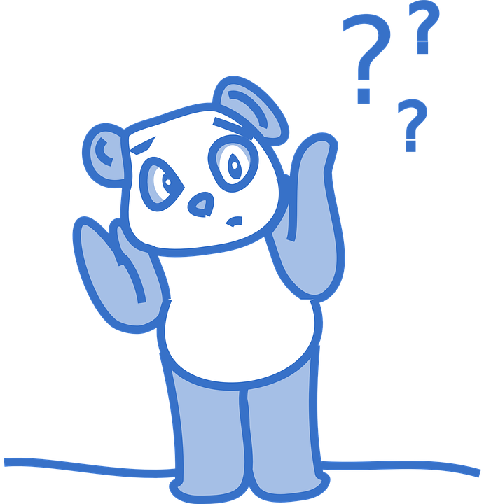
SSC [é] ou SFE ?
écouter
verb | infinitive meaning | infinitive OR ‘vous’ form | short form (ils/elles)
oublient | to forget
refuser/ez | to refuse
rencontrent | to meet
tentent | to try
ajouter/ez | to add
marquent | to mark
obliger/ez | to force
appuyer/ez | to press
Listen out for the last SSC
in each word.
1
_
2
_
3
_
4
_
5
_
6
_
7
_
8
_
Notes:
Timing: 5 minutes
Aim: Aural recognition of SSCs [é/-er/-ez] and SFE and to connecting these with meaning (long/2nd person plural vs 3rd person plural).
Procedure:
1. Click numbers to hear a verb in the long/2nd person plural or 3rd person plural.
2. Students tick whether they hear a long/2nd person plural or 3rd person plural, based on the ending they hear.
3. Click to reveal answers.
4. Listen again, this time drawing attention to stress patterns. As the last syllable in French words carries a slightly heavier stress, it is always the –er in the infinitive form that is stressed. Students repeat.
5. Students say the long and short form of each verb, focusing on the changing position of the stress (from base to ending).
Differentiation option for higher level students: extend box to cover whole verb form. Students transcribe.
Transcript:
oublient
refuser/refusez
rencontrent
tentent
ajouter/ajoutez
marquent
obliger/obligez
appuyer/apuyez
Word frequency of unknown words used (1 is the most frequent word in French): oublier [504], rencontrer [329], tenter [347], ajouter [359], obliger [499], appuyer [923]
Source: Londsale, D., & Le Bras, Y. (2009). A Frequency Dictionary of French: Core vocabulary for learners London: Routledge.
Word frequency of cognates (1 is the most frequent word in French): refuser [271], marquer [454]
Source: Londsale, D., & Le Bras, Y. (2009). A Frequency Dictionary of French: Core vocabulary for learners London: Routledge.

Slide 38
SSC [é]
phonétique
Consolidation [3]

Slide 39
é/-er/-ez
écrire
Notes:
Timing: 1 minute
Aim: To introduce/consolidate SSC [é]
Procedure: 1. Present the letter(s) and say the [é] sound first, on its own. Students repeat it with you. 2. Bring up the word ”écrire” on its own, say it, students repeat it, so that they have the opportunity to focus all of their attention on the connection between the written word and its sound.
3. A possible gesture for this would be to mime the act of writing (onto the palm of the other hand perhaps). 4. Roll back the animations and work through 1-3 again, but this time, dropping your voice completely to listen carefully to the students saying the [é] sound, pronouncing ”écrire” and, if using, doing the gesture.
Word frequency (1 is the most frequent word in French):
écrire [382] Source: Londsale, D., & Le Bras, Y. (2009). A Frequency Dictionary of French: Core vocabulary for learners London: Routledge.

Slide 40
SSCs: [ai] vs. [é]
When you make these sounds, notice how your lips are more relaxed in French than in English.
phonétique
The words below have a similar spelling and meaning in English and French.
This is because they are cognates.
Cognates are often pronounced differently in English and French.
In English, the letters in orange sound like the SSC [é]
English | French
In French, the letters in orange sound like the SSC [ai]
May
mai
e-mail
e-mail
mayonnaise
mayonnaise
Notes:
Timing: 3 minutes
Aim: To highlight the cross-linguistic differences between English and French pronunciations of SSC [ai].
Procedure:
1. Click to animate the explanation.
2. Students say the cognate words aloud in English and French. You can click on the words in orange to hear them read aloud in French by a native speaker.
3. Encourage students to compare the feel of their lips and mouth when saying the words in English and French. Because the French SSC [ai] is a more ‘lax’ vowel than the English SSC [ai], the lips and mouth should feel more relaxed when saying the French words.
Transcript:
mai, e-mail, mayonnaise
Word frequency of cognates used (1 is the most frequent word in French): e-mail [>5000], mayonnaise [>5000]
Source: Londsale, D., & Le Bras, Y. (2009). A Frequency Dictionary of French: Core vocabulary for learners London: Routledge.

Slide 41
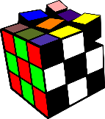
Adjectifs : Quelle SSC ?
écouter / écrire
Écoute ces adjectifs. Tu entends [ai] ou [é] ? Remplis les blancs.
 | French | English | [ai] | [é]
 | frais | fresh
 | étonnant | surprising
 | clair | clear
 | spécial | special
 | faible | weak
 | pénible | annoying
 | parfait | perfect
 | étrange | strange
1
_
2
_
3
_
4
_
5
_
6
_
7
_
8
_
Notes:
Timing: 5 minutes
Aim: To distinguish aurally between SSCs [ai] and [é].
Procedure:
1. Click on the number button to listen to the word read aloud.
2. Students fill in the gap with the missing SSC.
3. Click to reveal the answers.
4. Students listen to and repeat the word.
Transcript:
frais
étonnant
clair
spécial
faible
pénible
parfait
étrange
Word frequency (1 is the most frequent word in French): frais [691], étonnant [1627], clair [335], spécial [726], faible [723], pénible [3690], parfait [1600], étrange [2159]
Source: Londsale, D., & Le Bras, Y. (2009). A Frequency Dictionary of French: Core vocabulary for learners London: Routledge.

Slide 42
é/-er/-ez
bébé
donner
nez
parler
écrire
aller
[to go]
Notes:
Aim: To consolidate SSC [é]
Procedure:
1. Introduce and elicit the pronunciation of the individual SSC [é] and then the source word again ‘écrire’ (with gesture, if using). 2. Then present and elicit the pronunciation of the five cluster words.
The cluster words have been chosen for their high-frequency, from a range of word classes, with the SSC (where possible) positioned within a variety of syllables within the words (e.g. initial, 2nd, final etc.). Additionally, we have tried to use words that build cumulatively on previously taught SSCs (see the Phonics Teaching Sequence document) and do not include new SSCs. Where new SSCs are used, they are often consonants which have a similar symbol-sound correspondence in English.
Word frequency (1 is the most frequent word in French): écrire [382]; bébé [>5000]; aller [55] donner [46]; nez [2661]; parler [106]. Source: Londsale, D., & Le Bras, Y. (2009). A Frequency Dictionary of French: Core vocabulary for learners London: Routledge.

Slide 43
SSC [é]
phonétique
Consolidation [3]

Slide 44
é/-er/-ez
écrire
Notes:
[2/5]
Aim: To consolidate SSC [é]
Procedure: 1. Present the letter(s) and say the [é] sound first, on its own. Students repeat it with you. 2. Bring up the word ”écrire” on its own, say it, students repeat it, so that they have the opportunity to focus all of their attention on the connection between the written word and its sound.
3. A possible gesture for this would be to mime the act of writing (onto the palm of the other hand perhaps). 4. Roll back the animations and work through 1-3 again, but this time, dropping your voice completely to listen carefully to the students saying the [é] sound, pronouncing ”écrire” and, if using, doing the gesture.
Word frequency (1 is the most frequent word in French):
écrire [382] Source: Londsale, D., & Le Bras, Y. (2009). A Frequency Dictionary of French: Core vocabulary for learners London: Routledge.

Slide 45
é/-er/-ez
bébé
donner
nez
parler
écrire
aller
[to go]
Notes:
Aim: To consolidate SSC [é]
Procedure:
1. Introduce and elicit the pronunciation of the individual SSC [é] and then the source word again ‘écrire’ (with gesture, if using). 2. Then present and elicit the pronunciation of the five cluster words.
The cluster words have been chosen for their high-frequency, from a range of word classes, with the SSC (where possible) positioned within a variety of syllables within the words (e.g. initial, 2nd, final etc.). Additionally, we have tried to use words that build cumulatively on previously taught SSCs (see the Phonics Teaching Sequence document) and do not include new SSCs. Where new SSCs are used, they are often consonants which have a similar symbol-sound correspondence in English.
Word frequency (1 is the most frequent word in French): écrire [382]; bébé [>5000]; aller [55] donner [46]; nez [2661]; parler [106]. Source: Londsale, D., & Le Bras, Y. (2009). A Frequency Dictionary of French: Core vocabulary for learners London: Routledge.

Slide 46
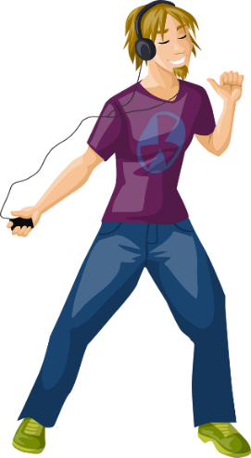
Imperfect forms and past participles: [é] vs [ai]
grammaire
Listen to these examples to hear the difference between the [é] of a past participle in the perfect tense, and the [ai] in the ending of the imperfect tense.
Perfect tense:
a one-off event in the past
On a parlé
[we talked]
J’ai chanté
[I sang]
Here, we see a ‘perfect’ example of the importance of phonics! The difference between the [é] and [ai] sounds may be subtle, but the change in meaning is significant.
Il a dansé
[he danced]
Je chantais
[I used to sing]
On parlait
[we used to talk]
Imperfect tense: something which used to happen all the time
Il dansait
[he used to dance]
Notes:
Timing: 5 minutes [1/2]
Aim: To recap the difference in usage between perfect tense (for one-off events in the past) and imperfect tense (for habitual actions in the past); to draw attention to the difference in pronunciation between -é at the end of a past participle and -ais/-ait at the end of the imperfect form; to highlight the link between phonics and meaning; to prepare students for the grammar point covered later in the lesson.
Procedure:
1. Click to reveal text and pictures.
2. Click on the French text to hear a native speaker say perfect and imperfect forms of the same verb. Note that the [ai] in j’ai is pronounced like [é].
3. Draw attention to the English definitions, and click to reveal reminder about the difference between in use between the perfect and imperfect tenses.
4. Click to reveal information on the importance of phonics in this case, where a slight sound change carries a significant meaning change.
Transcript:
1. on a parlé
2. on parlait
3. j’ai chanté
4. je chantais
5. il a dansé
6. il dansait

