Slide 1
French Phonics Collection
SSC [eu]
Artwork by: Chloé Motard
Date updated: 31/08/2022
Notes:
Artwork by Chloé Motard. All additional pictures selected are available under a Creative Commons license, no attribution required.

Slide 2
SSC [eu]
phonétique
Introduction

Slide 3
eu
deux
Notes:
Timing: 1 minute
Aim: To introduce/consolidate SSC [eu]
Procedure: 1. Present the letter(s) and say the [eu] sound first, on its own. Students repeat it with you. 2. Bring up the word ”deux” on its own, say it, students repeat it, so that they have the opportunity to focus all of their attention on the connection between the written word and its sound.
3. A possible gesture for this would be to hold up two fingers (N.B. palm of the hand facing the class!). 4. Roll back the animations and work through 1-3 again, but this time, dropping your voice completely to listen carefully to the students saying the [eu] sound, pronouncing ”deux” and, if using, doing the gesture.
Word frequency (1 is the most frequent word in French):
deux [41].
Source: Londsale, D., & Le Bras, Y. (2009). A Frequency Dictionary of French: Core vocabulary for learners London: Routledge.

Slide 4
eu
deux
Notes:
With sound and no pictures to focus all attention on the sound-symbol correspondence.

Slide 5
eu
deux
Notes:
Without sound to elicit pronunciation (without first hearing the teacher).
Teacher to elicit pronunciation by asking “Comment dit-on …"

Slide 6
eu
jeudi
lieu
[place]
deux
feu
jeu
un peu
[a little]
Notes:
Timing: 2 minutes
Aim: To introduce/consolidate SSC [eu]
Procedure:
1. Introduce and elicit the pronunciation of the individual SSC [eu] and then the source word again ‘deux’ (with gesture, if using). 2. Then present and elicit the pronunciation of the five cluster words.
The cluster words have been chosen for their high-frequency, from a range of word classes, with the SSC (where possible) positioned within a variety of syllables within the words (e.g. initial, 2nd, final etc.). Additionally, we have tried to use words that build cumulatively on previously taught SSCs (see the Phonics Teaching Sequence document) and do not include new SSCs. Where new SSCs are used, they are often consonants which have a similar symbol-sound correspondence in English.
Word frequency (1 is the most frequent word in French): deux {41]; jeudi[1112]; lieu [117] feu [786]; un peu [138/91]; jeu [291]. Source: Londsale, D., & Le Bras, Y. (2009). A Frequency Dictionary of French: Core vocabulary for learners London: Routledge.

Slide 7
eu
jeudi
lieu
deux
feu
jeu
un peu
Notes:
With sound and no pictures to focus all attention on the sound-symbol correspondence.

Slide 8
eu
jeudi
lieu
deux
feu
jeu
un peu
Notes:
Without sound to elicit pronunciation (without first hearing the teacher).
Teacher to elicit pronunciation by asking “Comment dit-on …"

Slide 9
Phonétique
écouter
Tally how many times you hear [eu] |  | Phrases
1
Nombreux animaux vivent à la ferme.
I
A lot of animals live at the farm.
2
IIII
Ceux qui font la queue sont heureux.
Those who queue are happy.
3
Il veut être courageux, mais c’est douteux.
III
He wants to be brave, but it’s doubtful.
Notes:
Timing: 2 minutes
Aim: practising recognition of SSC [eu]
Procedure:
1. Click the numbers to play the audio.
2. Students write 1-3 and tally how many times they hear the SSC [eu].
Transcript:
Nombreux animaux vivent à la ferme.
Ceux qui font la queue sont heureux.
Il veut être courageux, mais c’est douteux.
Word frequency (1 is the most frequent word in French): nombreux [366], animal [1002], celui [45], queue [3255], heureux [764], vouloir [57], courageux [2198], douteux [>5000]
Source: Londsale, D., & Le Bras, Y. (2009). A Frequency Dictionary of French: Core vocabulary for learners London: Routledge.

Slide 10
Phonétique
SFC
parler
bleu
creux
30
[blue]
[hollow]
eux
neutre
vieux
[them]
[neutral]
[old]
secondes
peut-être
nerveux
[maybe]
[nervous]
mieux
milieu
dieu
0
[better]
[middle]
DÉBUT
[god]
Notes:
Timing: 3 minutes for 3 slides
Aim: To correctly pronounce unknown words containing [eu] in decreasing amounts of time, helping automisation of SSC production. The words chosen otherwise contain sounds that are equivalent (or very similar) to English SSCs, as well as known SSCs, so that students can focus fully on the [eu] (allowances are made for English pronunciation of [r], which is covered in year 8).
Procedure:
Students pair up, and take turns trying to say all the words in 30 seconds (run the timer twice).
Ask students which words also contain the other SSC introduced this week [i].
Click on the words to hear them pronounced by a native speaker. Students repeat.
Move on to the next slide.
Word frequency (1 is the most frequent word in French): bleu [1216], creux [3508], eux [161], neutre [2785], vieux [671], peut-être [190], nerveux [3735], mieux [217], milieu [479], dieu [2262]
Source: Londsale, D., & Le Bras, Y. (2009). A Frequency Dictionary of French:], Core vocabulary for learners London: Routledge.

Slide 11
Phonétique
SFC
parler
bleu
creux
20
[blue]
[hollow]
eux
neutre
vieux
[them]
[neutral]
[old]
secondes
peut-être
nerveux
[maybe]
[nervous]
mieux
milieu
dieu
0
[better]
[middle]
DÉBUT
[god]
Notes:
As per previous slide, but with ten fewer seconds on the timer.

Slide 12
Phonétique
SFC
parler
bleu
creux
10
[blue]
[hollow]
eux
neutre
vieux
[them]
[neutral]
[old]
secondes
peut-être
nerveux
[maybe]
[nervous]
mieux
milieu
dieu
0
[better]
[middle]
DÉBUT
[god]
Notes:
As per previous slide, but with ten fewer seconds on the timer again.

Slide 13
SSC [eu]
phonétique
Consolidation [1]

Slide 14
eu
deux
Notes:
Timing: 1 minute
Aim: To introduce/consolidate SSC [eu]
Procedure: 1. Present the letter(s) and say the [eu] sound first, on its own. Students repeat it with you. 2. Bring up the word ”deux” on its own, say it, students repeat it, so that they have the opportunity to focus all of their attention on the connection between the written word and its sound.
3. A possible gesture for this would be to hold up two fingers (N.B. palm of the hand facing the class!). 4. Roll back the animations and work through 1-3 again, but this time, dropping your voice completely to listen carefully to the students saying the [eu] sound, pronouncing ”deux” and, if using, doing the gesture.
Word frequency (1 is the most frequent word in French):
deux [41].
Source: Londsale, D., & Le Bras, Y. (2009). A Frequency Dictionary of French: Core vocabulary for learners London: Routledge.

Slide 15
eu
deux
Notes:
With sound and no pictures to focus all attention on the sound-symbol correspondence.

Slide 16
eu
deux
Notes:
Without sound to elicit pronunciation (without first hearing the teacher).
Teacher to elicit pronunciation by asking “Comment dit-on …"

Slide 17
eu
jeudi
lieu
[place]
deux
feu
jeu
un peu
[a little]
Notes:
Timing: 2 minutes
Aim: To introduce/consolidate SSC [eu]
Procedure:
1. Introduce and elicit the pronunciation of the individual SSC [eu] and then the source word again ‘deux’ (with gesture, if using). 2. Then present and elicit the pronunciation of the five cluster words.
The cluster words have been chosen for their high-frequency, from a range of word classes, with the SSC (where possible) positioned within a variety of syllables within the words (e.g. initial, 2nd, final etc.). Additionally, we have tried to use words that build cumulatively on previously taught SSCs (see the Phonics Teaching Sequence document) and do not include new SSCs. Where new SSCs are used, they are often consonants which have a similar symbol-sound correspondence in English.
Word frequency (1 is the most frequent word in French): deux {41]; jeudi[1112]; lieu [117] feu [786]; un peu [138/91]; jeu [291]. Source: Londsale, D., & Le Bras, Y. (2009). A Frequency Dictionary of French: Core vocabulary for learners London: Routledge.

Slide 18
eu
jeudi
lieu
deux
feu
jeu
un peu
Notes:
With sound and no pictures to focus all attention on the sound-symbol correspondence.

Slide 19
eu
jeudi
lieu
deux
feu
jeu
un peu
Notes:
Without sound to elicit pronunciation (without first hearing the teacher).
Teacher to elicit pronunciation by asking “Comment dit-on …"

Slide 20
Phonétique
écouter
 | nerveux
 | certain
 | peureux
 | rigoureux
 | surprise
 | urgent
 | malheureux
 | merveilleux
 | respectueux
 | heureux
a
nervous
f
urgent
b
certain
g
unhappy
c
fearful
h
marvellous
d
thorough, strict
i
respectful
e
surprise
j
happy
Notes:
Timing: 5 minutes
Aim: Aural recognition of SSC [eu] from a pool of words containing carefully-chosen distractor vowels.
Procedure:
1. Click on a letter to play a word.
2. Students tally how many times they hear SSC [eu].
3. Answers revealed on clicks (first tally then corresponding word).
Transcript and word frequency (1 is the most frequent word in French): nerveux [3735], certain [110], peureux [>5000], rigoureux [2682], surprise [1815], urgent [2179], malheureux [2372], merveilleux [2209], respectueux [2296], heureux [764]
Source: Londsale, D., & Le Bras, Y. (2009). A Frequency Dictionary of French: Core vocabulary for learners London: Routledge.

Slide 21
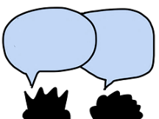
Phonétique
lire / parler
euro
vieux
30
[Euro]
affreux
[old]
fameux
[awful]
[famous]
pneu
secondes
sérieux
mieux
[tyre]
[serious]
[better]
Europe
feutre
0
[felt tip]
DÉBUT
[Europe]
Notes:
Timing: 1 minute
Aim: Oral production of SSC [eu].
Procedure:
1. Students say the words alternately out loud with a partner, building up speed, over 1 minute’s intensive practice.
2. They call in any order they like but cannot repeat a word.
3. Click on début to start a thirty second timer on the screen.
4. Teacher can circulate to listen into their SSC knowledge.
5. Click on a word to hear it said by a native speaker.
Word frequency (1 is the most frequent word in French): affreux [4369], sérieux [412], vieux [671], euro [1753], fameux [2060], pneu [4514], mieux [217], Europe [n/a], feutre [>5000]
Source: Londsale, D., & Le Bras, Y. (2009). A Frequency Dictionary of French: Core vocabulary for learners London: Routledge.

Slide 22
Phonétique
lire / parler
euro
vieux
30
[Euro]
affreux
[old]
fameux
[awful]
[famous]
pneu
secondes
sérieux
mieux
[tyre]
[serious]
[better]
Europe
feutre
0
DÉBUT
Notes:
Timing: 1 minute
Aim: Oral production of SSC [eu]. Automisation of SSC production through repetition.
Procedure:
1. Students read out the words but in alphabetical order (working either individually or in pairs).
2. They keep going for thirty seconds.
3. Teacher can circulate to listen into their SSC knowledge.
Word frequency (1 is the most frequent word in French): affreux [4369], sérieux [412], vieux [671], euro [1753], fameux [2060], pneu [4514], mieux [217], Europe [n/a], feutre [>5000]
Source: Londsale, D., & Le Bras, Y. (2009). A Frequency Dictionary of French: Core vocabulary for learners London: Routledge.

Slide 23
Phonétique
écouter
Words containing
[eu] | [u] | [è/ê] | [au]
a. neutre (neutral) | b. chute (a fall) | e. mère (mother) | c. chaud (hot)
d. eux (them) | g. mur (wall) | i. suprême (supreme) | f. daube (stew)
j. ceux (those) | k. zut ! (darn !) | l. scène (stage) | h. pause (pause)
a
b
c
d
e
f
g
h
i
j
k
l
Notes:
Timing: 5 minutes
Aim: Distinguish aurally between similar-sounding SSCs in monosyllabic words.
Procedure:
Students sketch the grid.
Click on a letter to play a word.
Students decide which vowel sound they hear and write the letter in the relevant column in their exercise books.
Answers and translations revealed on clicks in order of audio.
Transcript:
neutre
chute
chaud
eux
mère
daube
mur
pause
suprême
ceux
zut
scène
Word frequency (1 is the most frequent word in French): neutre [2785], chute [1761], chaud [1852], eux [161], mère [645], daube [>5000], mur [1335], pause [2647], suprême [2022], ceux [45], zut [>5000], scène [794]
Source: Londsale, D., & Le Bras, Y. (2009). A Frequency Dictionary of French: Core vocabulary for learners London: Routledge.

Slide 24
Phonétique
Lisez en français !
parler
3
peux
2
4
euh !
mieux
1
bleu
9
courageux
nombreux
8
eux
5
dangereux
yeux
7
6
Notes:
Timing: 4 minutes
Aim: Oral production of SSC [eu].
NB: Pupils have learnt the SSC [SFC] (silent final consonant) – here they get a reminder of the silent –X at the end of words.
Procedure:
1. The teacher should read out the title, so that students both hear and read the word ‘lisez’.
2. Explain (or elicit) that ‘lisez’ means ‘you - plural - read’ from the verb ‘lire – to read’.
3. Ask them to notice the ending of the verb – it’s the ‘-ez’ ending. Why might that be? (They have practised ‘ez’ verb inflections already so this is a recap).
4. Partner A reads out words 1-5 in French and Partner B says the English back. Partner A agrees or disagrees.
5. Swap roles - partner B reads words 6-9.
6. Students should then choose any of the words at random to read out, their partner saying the number of the word and then giving the English - this should be out of order, so they cannot just rely on the order here.
7. They should do six words each, alternating: A says French, B gives the number and then the English. B says French, A gives the number and then the English.
8. No timer this time. Some of these will be unfamiliar words and pupils will need to slow down to decode them more carefully.
9. Click on the words to hear their pronunciation.
Word frequency (1 is the most frequent word in French): bleu [1216]; euh [889]; peux [pouvoir - 20] mieux [217]; eux [161]; yeux [œil-474]; dangereux [713]; nombreux [366]; courageux [2198]
Source: Londsale, D., & Le Bras, Y. (2009). A Frequency Dictionary of French: Core vocabulary for learners London: Routledge.

Slide 25
SSC [eu]
phonétique
Consolidation [2]

Slide 26
Closed and open [eu/œu]
écouter
You have already met an [eu] sound in Year 7:
The long vowel sounds like the ‘ur’ in the English ‘hurt.’
[few]
[fear]
peu
peur
This is a closed vowel.
When you say this sound, your tongue is near the top of your mouth.
This is an open vowel.
When you say this sound, your tongue is near the bottom of your mouth.
Notes:
Timing: 2 minutes
Aim: To introduce the concept of open and closed vowel sounds.
Procedure:
1. Click to reveal ‘peu’. Students repeat it
2. Click to relevel the first info bubble. Students hear and say ‘peu’ again several time, noticing the position of the tongue in the mouth.
3. Click to reveal ‘peur’. Repeat steps one and two.
4. Click to play the words in quick succession.
5. Move to the following slides for a reminder of other words containing closed [eu].
Word frequency (1 is the most frequent word in French): peu [92], peur [755]

Slide 27
eu
deux
Notes:
Timing: 1 minute
Aim: To consolidate SSC [eu]
Procedure: 1. Present the letter(s) and say the [eu] sound first, on its own. Students repeat it with you. 2. Bring up the word ”deux” on its own, say it, students repeat it, so that they have the opportunity to focus all of their attention on the connection between the written word and its sound.
3. A possible gesture for this would be to hold up two fingers (N.B. palm of the hand facing the class!). 4. Roll back the animations and work through 1-3 again, but this time, dropping your voice completely to listen carefully to the students saying the [eu] sound, pronouncing ”deux” and, if using, doing the gesture.
Word frequency (1 is the most frequent word in French):
deux [41].
Source: Londsale, D., & Le Bras, Y. (2009). A Frequency Dictionary of French: Core vocabulary for learners London: Routledge.

Slide 28
eu
jeudi
lieu
[place]
deux
feu
jeu
un peu
[a little]
Notes:
Timing: 1 minute
Aim: To consolidate SSC [eu]
Procedure:
1. Introduce and elicit the pronunciation of the individual SSC [eu] and then the source word again ‘deux’ (with gesture, if using). 2. Then present and elicit the pronunciation of the five cluster words.
The cluster words have been chosen for their high-frequency, from a range of word classes, with the SSC (where possible) positioned within a variety of syllables within the words (e.g. initial, 2nd, final etc.). Additionally, we have tried to use words that build cumulatively on previously taught SSCs (see the Phonics Teaching Sequence document) and do not include new SSCs. Where new SSCs are used, they are often consonants which have a similar symbol-sound correspondence in English.
Word frequency (1 is the most frequent word in French): deux {41]; jeudi[1112]; lieu [117] feu [786]; un peu [138/91]; jeu [291]. Source: Londsale, D., & Le Bras, Y. (2009). A Frequency Dictionary of French: Core vocabulary for learners London: Routledge.

Slide 29
Closed or open [eu/œu]?
écouter / écrire
 |  | open | closed
 | bleu [blue]
 | deux
 | bœuf
 | ordinateur
 |  | open | closed
 | vœux [wishes]
 | rumeur [rumour]
 | adieu [farewell]
 | meuble [furniture]
1
5
2
6
3
7
4
8
What do you notice about the spelling of the words containing open [eu/œu] compared to those containing closed [eu/œu]?
If the vowel is followed by a pronounced consonant (not an SFC), it is open.
Notes:
Timing: 6 minutes
Aim: aural recognition of open and closed [eu/œu]. Raising awareness of spelling rules governing the pronoun.
Procedure:
1. Click on numbers to hear words. Student decide if [eu/œu] is open or closed.
2. Click to reveal answers.
3. Click again to reveal the question about spelling. Students consider in pairs. They might say things like ‘the words are longer’ or ‘the sound is in the middle of the word’. Encourage students to look at the letters they see after the SSC.
4. Click to reveal the answers and again to reveal the rule.
5. Students try to say the words.
Word frequency (1 is the most frequent word in French): bleu [1216], deux [41], bœuf [3914], ordinateur [2201], déjeuner [2724], vœu [2103], rumeur [2164], peuple [378], adieu [3968], meuble [3876], feu [786],
Source: Londsale, D., & Le Bras, Y. (2009). A Frequency Dictionary of French: Core vocabulary for learners London: Routledge.

Slide 30
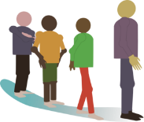
Open or closed [eu/œ]?
lire / parler
Remember!
What kind of sound follows an open vowel?
 |  |  | open | closed
 | fleur
 | queue
 | cheveu | [hair]
j | courageux | [brave]
 | beurre
 | nœud | [knot]
 | œuvre | [work, piece]
 | milieu | [environment]
1
2
3
4
5
6
7
8
Notes:
Timing: 5 minutes
Aim: Applying awareness of the spelling rules governing SSCs open and closed [eu/œu].
Procedure
Student read the words and decide based on the presence of absence of a pronounced consonant after [eu/œu] whether the vowel is open or closed.
Click on the numbers to check. Click to reveal answers.
Students say the words aloud.
Word frequency (1 is the most frequent word in French): fleur [2305], queue [3255], cheveu [2296], courageux [2198], beurre [4112], nœud [3551], œuvre [331], milieu [479]
Source: Londsale, D., & Le Bras, Y. (2009). A Frequency Dictionary of French: Core vocabulary for learners London: Routledge.

Slide 31
SSC [eu]
phonétique
Consolidation [3]

Slide 32
eu
deux
Notes:
Timing: 1 minute
Aim: To consolidate SSC [eu]
Procedure: 1. Present the letter(s) and say the [eu] sound first, on its own. Students repeat it with you. 2. Bring up the word ”deux” on its own, say it, students repeat it, so that they have the opportunity to focus all of their attention on the connection between the written word and its sound.
3. A possible gesture for this would be to hold up two fingers (N.B. palm of the hand facing the class!). 4. Roll back the animations and work through 1-3 again, but this time, dropping your voice completely to listen carefully to the students saying the [eu] sound, pronouncing ”deux” and, if using, doing the gesture.
Word frequency (1 is the most frequent word in French):
deux [41].
Source: Londsale, D., & Le Bras, Y. (2009). A Frequency Dictionary of French: Core vocabulary for learners London: Routledge.

Slide 33
eu
jeudi
lieu
[place]
deux
feu
jeu
un peu
[a little]
Notes:
Timing: 2 minutes
Aim: To consolidate SSC [eu]
Procedure:
1. Introduce and elicit the pronunciation of the individual SSC [eu] and then the source word again ‘deux’ (with gesture, if using). 2. Then present and elicit the pronunciation of the five cluster words.
The cluster words have been chosen for their high-frequency, from a range of word classes, with the SSC (where possible) positioned within a variety of syllables within the words (e.g. initial, 2nd, final etc.). Additionally, we have tried to use words that build cumulatively on previously taught SSCs (see the Phonics Teaching Sequence document) and do not include new SSCs. Where new SSCs are used, they are often consonants which have a similar symbol-sound correspondence in English.
Word frequency (1 is the most frequent word in French): deux {41]; jeudi[1112]; lieu [117] feu [786]; un peu [138/91]; jeu [291]. Source: Londsale, D., & Le Bras, Y. (2009). A Frequency Dictionary of French: Core vocabulary for learners London: Routledge.

Slide 34
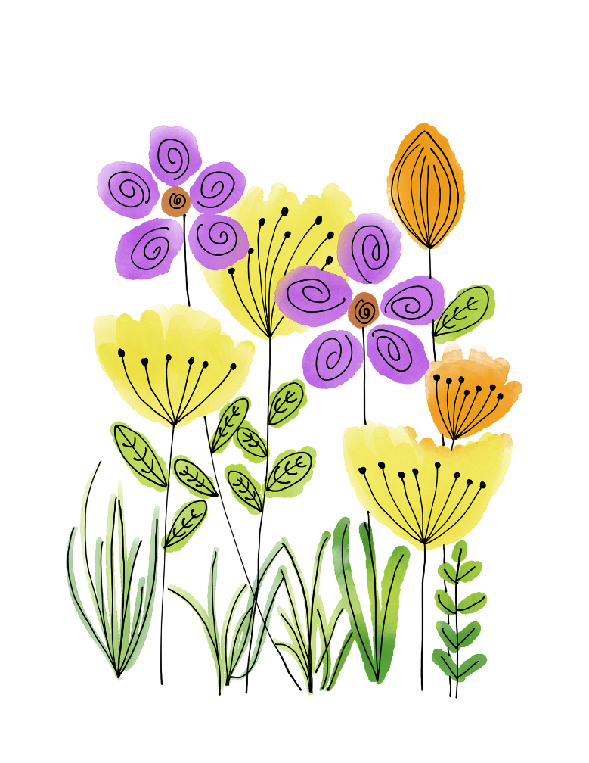
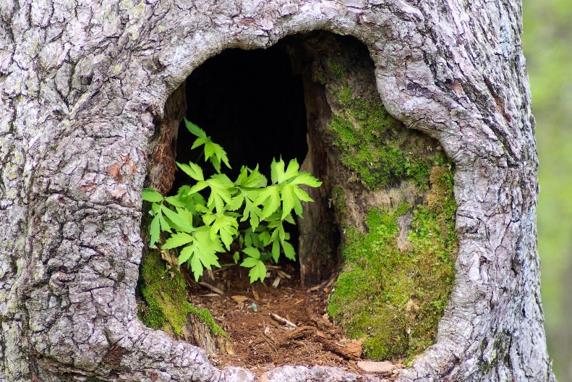
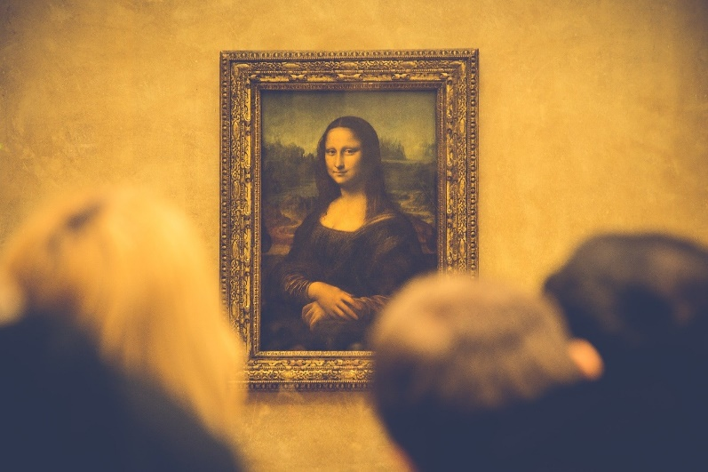
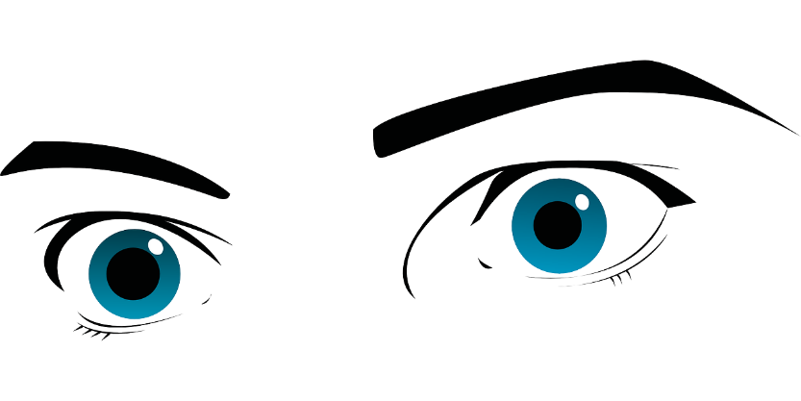
Phonétique
écouter
Écoute les mots et choisis la bonne SSC.
 | en français | en anglais | open [eu/œu] | [eu]
 | la peur | fear
 | adieu | goodbye
 | l’œuvre | work of art
 | le pneu | tyre
 | l’œuf | egg
 | les yeux | eyes
 | creux | hollow
 | la fleur | flower
1
__
2
___
3
___
4
___
5
___
6
__
7
__
8
__
Notes:
Timing: 5 minutes
Aim: Aural recognition of SSCs open [eu]/[œu] and [eu].
Procedure:
1. Click the number to play the audio.
2. Students choose which SSC the word contains.
3. Click to reveal answers.
Transcript:
la peur
adieu
l’œuvre
le pneu
l’œuf
les yeux
creux
la fleur
Word frequency of unknown words used (1 is the most frequent word in French): peur [755]; adieu [3968]; œuvre [331]; pneu [4514]; œuf [2685]; yeux [>5000]; creux [3508]; fleur [2305]
Source: Londsale, D., & Le Bras, Y. (2009). A Frequency Dictionary of French: Core vocabulary for learners London: Routledge.

Slide 35
Phonétique
parler
Partners say alternate sentences while the other counts the SSCs they hear.
 |  | open [eu/œu] | [eu]
 | Léa dit adieu à son vieux grand-père à deux heures. | 1 | 3
 | Antoine choisit une seule fleur bleue à neuf heures. | 4 | 1
 | Le chef travailleur donne un copieux déjeuner à la neuvième personne dans la queue. | 2 | 3
 | Le jeune pêcheur va au fleuve parce qu’il veut prendre plusieurs poissons. | 4 | 1
A
B
A
B
Notes:
Timing: 2 minutes
Aim: Oral production of sentences containing SSCs open [eu]/[œu] and [eu].
Procedure:
1. Student B turns away from the board.
2. Click to reveal partner A’s first sentence.
3. Partner A reads the sentence aloud while student B counts the total number of open [eu]/[œu] and [eu] they hear.
4. Click to reveal answer.
5. Student A then turns away from the board.
6. Repeat steps 2-4.
7. Repeat for the second pair of sentences.
8. The next slide contains English translations of the sentences with the SSC highlighted in different colours.
Word frequency of unknown words used (1 is the most frequent word in French): adieu [3968]; fleur [2305]; neuvième [>5000]; queue [3255]; pêcheur [2759]; fleuve [2893]; poisson [1616]
Source: Londsale, D., & Le Bras, Y. (2009). A Frequency Dictionary of French: Core vocabulary for learners London: Routledge.

Slide 36
Phonétique
parler
 |  | open [eu/œu] | [eu]
 | Léa dit adieu à son vieux grand-père à deux heures. (Léa says goodbye to her old grandad at two o’clock.) | 1 | 3
 | Antoine choisit une seule fleur bleue à neuf heures. (Antoine choses a single blue flower at nine o’clock.) | 4 | 1
 | Le chef travailleur donne un copieux déjeuner à la neuvième personne dans la queue. (The hard-working chef gives a generous lunch to the ninth person in the queue.) | 2 | 3
 | Le jeune pêcheur va au fleuve parce qu’il veut prendre plusieurs poissons. (The young fisherman goes to the river because he wants to take several fish.) | 4 | 1
A
B
A
B
Notes:
Answers to previous slide with translations and SSCs highlighted.

Slide 37
SSC [eu]
phonétique
Consolidation [4]

Slide 38
eu
deux
Notes:
Timing: 1 minute
Aim: To consolidate SSC [eu]
Procedure: 1. Present the letter(s) and say the [eu] sound first, on its own. Students repeat it with you. 2. Bring up the word ”deux” on its own, say it, students repeat it, so that they have the opportunity to focus all of their attention on the connection between the written word and its sound.
3. A possible gesture for this would be to hold up two fingers (N.B. palm of the hand facing the class!). 4. Roll back the animations and work through 1-3 again, but this time, dropping your voice completely to listen carefully to the students saying the [eu] sound, pronouncing ”deux” and, if using, doing the gesture.
Word frequency (1 is the most frequent word in French):
deux [41].
Source: Londsale, D., & Le Bras, Y. (2009). A Frequency Dictionary of French: Core vocabulary for learners London: Routledge.

Slide 39
eu
jeudi
lieu
[place]
deux
feu
jeu
un peu
[a little]
Notes:
Timing: 2 minutes
Aim: To consolidate SSC [eu]
Procedure:
1. Consolidate and elicit the pronunciation of the individual SSC [eu] and then the source word again ‘deux’ (with gesture, if using). 2. Then present and elicit the pronunciation of the five cluster words.
The cluster words have been chosen for their high-frequency, from a range of word classes, with the SSC (where possible) positioned within a variety of syllables within the words (e.g. initial, 2nd, final etc.). Additionally, we have tried to use words that build cumulatively on previously taught SSCs (see the Phonics Teaching Sequence document) and do not include new SSCs. Where new SSCs are used, they are often consonants which have a similar symbol-sound correspondence in English.
Word frequency (1 is the most frequent word in French): deux {41]; jeudi[1112]; lieu [117] feu [786]; un peu [138/91]; jeu [291]. Source: Londsale, D., & Le Bras, Y. (2009). A Frequency Dictionary of French: Core vocabulary for learners London: Routledge.

Slide 40
Les équipes de mots
écouter / écrire
Organise les mots en équipes : open eu/œu vs closed eu/œu.
1
2
3
4
5
6
7
8
9
10
1. mieux
2. peuple (people)
4. nombreux (plentiful)
open eu/oeu
5. deuxième
closed eu/oeu
3. heure
9. veuf (widower)
6. dangereux
7. sérieux (serious)
10. beurre (butter)
8. euro
Notes:
Timing: 3 minutes
Aim: Identify and transcribe open and closed SSC eu/oeu from heard words
Procedure:
1. Click numbers to hear audio.
2. Students tick whether SSC heard was open or closed and attempt to transcribe the word in French. [note: some words are unknown so all plausible spellings should be rewarded e.g. deusieme]
3. Click to bring up answers (they will appear on the side of the correct SSC kit)
Transcript:
mieux
peuple
heure
nombreux
deuxième
dangereux
sérieux
euro
veuf
beurre
Word frequency (1 is the most frequent word in French): peuple [378], nombreux [366], sérieux [412], veuf [3455], beurre [4112]
Source: Lonsdale, D., & Le Bras, Y. (2009). A Frequency Dictionary of French: Core vocabulary for learners London: Routledge.

Slide 41
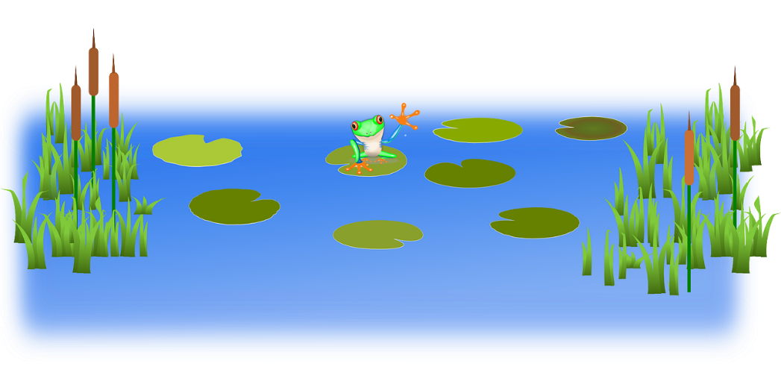
Virelangues 1/3
lire / parler
Il y a de nombreux docteurs dangereux au milieu du lac.
(There are many dangerous doctors in the middle of the lake.)
a
b
c
Notes:
Timing: 3 minutes for 3 slides
Aim: To practise pronunciation of open and closed SSC eu/oeu.
Procedure:
1. Students to say tongue twisters as quickly as possible with accurate pronunciation of SSCs.
2. Click buttons to hear slow, medium and fast pronunciation by native speaker.
Transcript:
1. Il y a de nombreux docteurs dangereux au milieu du lac.
2. Je ne veux pas pleurer, il est mieux d'être heureux que d'être sérieux.
3. L’entrepreneur est courageux, il fais la preuve de sa valeur chaque heure.
Word frequency (1 is the most frequent word in French): nombreux [366], docteur [2176], milieu [479], pleurer [2253], sérieux [412], entrepreneur [2377], courageux [2198], preuve [653], valeur [453]
Source: Lonsdale, D., & Le Bras, Y. (2009). A Frequency Dictionary of French: Core vocabulary for learners London: Routledge.

Slide 42
Virelangues 2/3
lire / parler
Je ne veux pas pleurer, il est mieux d'être heureux que d'être sérieux.
(I don’t want to cry, it is better to be
happy than to be serious.)
a
b
c
Notes:
Slide 2/3

Slide 43
Virelangues 3/3
lire / parler
L’entrepreneur est courageux,
il fait la preuve de sa valeur chaque heure.
(The entrepreneur is brave, he proves his worth every hour.)
a
b
c
Notes:
Slide 3/3

