Slide 1
French Phonics Collection
SSC [em/am]
Artwork by: Chloé Motard
Date updated: 30/08/22
Notes:
Artwork by Chloé Motard. All additional pictures selected are available under a Creative Commons license, no attribution required.

Slide 2
SSC [em/am]
phonétique
Introduction

Slide 3
em/am
[time]
temps
Notes:
Timing: 1 minute
Aim: To introduce SSC [em/am]
Procedure: 1. Present the letter(s) and say the [em/am] sound first, on its own. Students repeat it with you. 2. Bring up the word ”temps” on its own, say it, students repeat it, so that they have the opportunity to focus all of their attention on the connection between the written word and its sound.
3. A possible gesture for this would be to look at your wrist as though checking your watch. 4. Roll back the animations and work through 1-3 again, but this time, dropping your voice completely to listen carefully to the students saying the [em/am] sound, pronouncing ”temps” and, if using, doing the gesture.
Word frequency (1 is the most frequent word in French):
temps [65]
Source: Londsale, D., & Le Bras, Y. (2009). A Frequency Dictionary of French: Core vocabulary for learners London: Routledge.

Slide 4
em/am
temps
Notes:
With sound and no pictures to focus all attention on the sound-symbol correspondence.

Slide 5
em/am
[time]
temps
Notes:
Without sound to elicit pronunciation (without first hearing the teacher).
Teacher to elicit pronunciation by asking “Comment dit-on …”

Slide 6
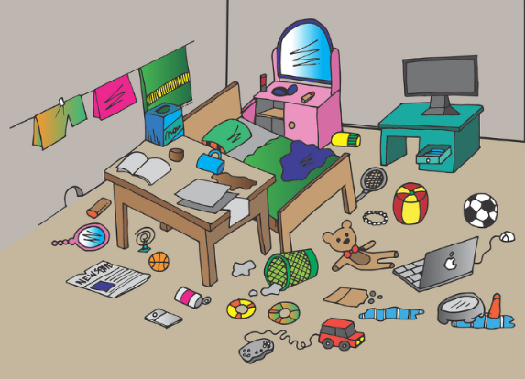
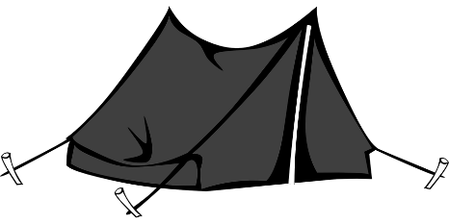
em/am
camp
chambre
ensemble
[time]
printemps
temps
[together]
[spring]
ressembler (à)
[to look like]
Notes:
Timing: 2 minutes
Aim: To introduce SSC [em/am]
Procedure:
Introduce and elicit the pronunciation of the individual SSC [em/am] and then the source word again ‘temps’ (with gesture, if using). Then present and elicit the pronunciation of the five cluster words. The cluster words have been chosen for their high-frequency, from a range of word classes, with the SSC (where possible) positioned within a variety of syllables within the words (e.g. initial, 2nd, final etc.). Additionally, we have tried to use words that build cumulatively on previously taught SSCs (see the Phonics Teaching Sequence document) and do not include new SSCs. Where new SSCs are used, they are often consonants which have a similar symbol-sound correspondence in English.
Word frequency (1 is the most frequent word in French): camps [1084]; chambre [633] ensemble [124]; printemps [1288]; temps [65]; ressembler [1398]. Source: Londsale, D., & Le Bras, Y. (2009). A Frequency Dictionary of French: Core vocabulary for learners London: Routledge.

Slide 7
em/am
camp
chambre
ensemble
[time]
printemps
temps
ressembler (à)
Notes:
With sound and no pictures to focus all attention on the sound-symbol correspondence.

Slide 8
em/am
camp
chambre
ensemble
[time]
printemps
temps
ressembler (à)
Notes:
Without sound to elicit pronunciation (without first hearing the teacher).
Teacher to elicit pronunciation by asking “Comment dit-on …”

Slide 9
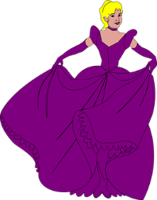
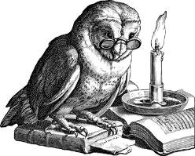
Phonétique
If there is an [m] after either of these vowels, it makes an identical nasal sound.
écouter
C’est quelle SSC ?
1
le champ
_
[a]
[am/em]
[e]
2
le carn a val
_
3
le ch e valier
_
le champ
le chevalier
4
les b a ls
_
le carnaval
rec e voir
5
_
l’emballage
recevoir
l’ emballage
6
_
[packaging]
[to receive]
les bals
7
la p e luche
_
la tempête
8
la s a gesse
_
la sagesse
la tempête
l‘ampoule
la peluche
9
_
10
l'ampoule
_
Notes:
Timing: 6 minutes
Aim: aural recognition of SSCs [a], [e] and [em/am]; raising awareness of the fact that although SSCs [a] and [e] sound different, [em] and [am] sound identical.
Procedure:
1. Students sketch the Venn diagram in their books.
2. Click on the numbers to hear the words said aloud.
3. Students decide whether the missing sound is [a], [am/em] or [e] and write the word in full in the correct section of the diagram.
4. Click to reveal missing sounds. As the missing letters are revealed, the words pop up in the appropriate places in the Venn diagram. Displaying the words in this way should help students visualise the crossover. On their own, letters [e] and [a] represent different SSCs. When followed by an ‘m’, [e] and [a] enter into an identical nasal sound.
5. Click to reveal pronunciation rule: [e]/[a] + m = nasal [em/am].
Transcript:
1. le champ
2. le carnaval
3. le chevalier
4. les bals
5. recevoir
6. l’emballage
7. la peluche
8. la sagesse
9. la tempête
10. l’ampoule
Word frequency (1 is the most frequent word in French): champ [847], carnaval [>5000], chevalier [>5000], bal [>5000], recevoir [199], emballage [>5000], peluche [>5000], sagesse [2998], tempête [2695], ampoule [>5000]
Source: Londsale, D., & Le Bras, Y. (2009). A Frequency Dictionary of French: Core vocabulary for learners London: Routledge.

Slide 10
Phonétique
écouter
What do you notice about these four sounds?
temps
chambre
penser
grand
SSC [em/am] is the same sound as SSC [en/am], which you already know.
When this nasal sound appears in front of the letters p or b, it is spelled [em/am] instead of [en/an].
Notes:
Timing: 2 minutes
Aim: Raising awareness of the identical sound in SSCs [em], [am], [en] and [an].
For a reminder of Year 7 SSC [en/an], see the two slides that follow.

Slide 11
Phonétique
lire / parler
facile
lampe
45
orange
champion
éléphant
secondes
ambition
amplifier
chimpanzee
ambassade
0
difficile
DÉBUT
Notes:
Timing: 3 minutes for 3 slides.
Aim: Oral production of SSC [an/am] in words of varying degrees of complexity in decreasing amounts of time.
Procedure:
Students pair up.
Explain that students are going to work their way down the ‘ladder’ by correctly pronouncing cognates containing [an/am], starting with simple words and building up to more complex words. Starting with lampe, Partner A works their way down the ladder. Partner B listens for correct pronunciation of [an/am]. If Partner A makes a mistake, e.g.tries to pronounce words the ‘English’ way by adding an ‘m’ after the vowel, they must return to the top of the ladder.
Students swap roles. Re-start the timer.
Whoever is furthest down the ladder when the timer stops is the winner!
Click on the words to hear them said aloud by a native speaker. Students repeat.
Move on to the next slide.
Transcript and word frequency (1 is the most frequent word in French):
orange [3912], lampe [4699], champion [2443], ambassade [3327], chimpanzee [>5000], éléphant [>5000], amplifier [4537], ambition [2280]

Slide 12
Phonétique
lire / parler
facile
lampe
30
orange
champion
éléphant
secondes
ambition
amplifier
chimpanzee
ambassade
0
difficile
DÉBUT
Notes:
As previous but with 15 fewer seconds on the timer.

Slide 13
Phonétique
lire / parler
facile
lampe
15
orange
champion
éléphant
secondes
ambition
amplifier
chimpanzee
ambassade
0
difficile
DÉBUT
Notes:
As previous but with 15 fewer seconds on the timer still.

Slide 14
Phonétique
lire / écouter
 |  | [en/em] | [an/am]
 | campagne [countryside]
 | serpent
 | vent [wind]
j | jambon
 | vendredi [Friday]
 | ampoule
 | pantalon
 | emmener [to take]
 | jambe
 | tempête [storm]
Comment ça s'écrit ?
Avec [en/an] ou [em/am] ?
Complète et dis les mots !
1
_ _
2
_ _
3
_ _
4
_ _
5
_ _
6
_ _
7
_ _
8
_ _
9
_ _
10
_ _
Notes:
Timing: 7 minutes
Aim: Applying awareness of the spelling rules governing SSCs [em], [am], [en] and [an], and production of all four SSCs.
Procedure
Student read the wordsand decide based on the presence of absence of a ‘p’ or ‘b’ after the gap when [en/em] or [an/am] is needed.
Click to check.
Now, students are challenged to say all ten words and pronounce the SSCs in the same way each time. It will be tempting for students to add an ‘n’ or ‘m’ after the vowel! Students should work in pairs and monitor each other for this.
Click to hear the words pronounced by a native speaker.
Word frequency of unknown words used (1 is the most frequent word in French): campagne [666], serpent [>5000], vent [1387], jambon [>5000], vendredi [1086], ampoule [>5000], pantalon [4670], emmener [2098], jambe [2472], tempête [2695]
Source: Londsale, D., & Le Bras, Y. (2009). A Frequency Dictionary of French: Core vocabulary for learners London: Routledge.
Word frequency of cognates used (1 is the most frequent word in French): compléter [2034]
Source: Londsale, D., & Le Bras, Y. (2009). A Frequency Dictionary of French: Core vocabulary for learners London: Routledge.

Slide 15
SSC [em/am]
phonétique
Consolidation [1]

Slide 16
em/am
[time]
temps
Notes:
Timing: 1 minute
Aim: To consolidate SSC [em/am]
Procedure: 1. Present the letter(s) and say the [em/am] sound first, on its own. Students repeat it with you. 2. Bring up the word ”temps” on its own, say it, students repeat it, so that they have the opportunity to focus all of their attention on the connection between the written word and its sound.
3. A possible gesture for this would be to look at your wrist as though checking your watch. 4. Roll back the animations and work through 1-3 again, but this time, dropping your voice completely to listen carefully to the students saying the [em/am] sound, pronouncing ”temps” and, if using, doing the gesture.
Word frequency (1 is the most frequent word in French):
temps [65]
Source: Londsale, D., & Le Bras, Y. (2009). A Frequency Dictionary of French: Core vocabulary for learners London: Routledge.

Slide 17
em/am
camp
chambre
ensemble
[time]
printemps
temps
[together]
[spring]
ressembler (à)
[to look like]
Notes:
Timing: 1 minute
Aim: To consolidate SSC [em/am]
Procedure:
Introduce and elicit the pronunciation of the individual SSC [em/am] and then the source word again ‘temps’ (with gesture, if using). Then present and elicit the pronunciation of the five cluster words. The cluster words have been chosen for their high-frequency, from a range of word classes, with the SSC (where possible) positioned within a variety of syllables within the words (e.g. initial, 2nd, final etc.). Additionally, we have tried to use words that build cumulatively on previously taught SSCs (see the Phonics Teaching Sequence document) and do not include new SSCs. Where new SSCs are used, they are often consonants which have a similar symbol-sound correspondence in English.
Word frequency (1 is the most frequent word in French): camps [1084]; chambre [633] ensemble [124]; printemps [1288]; temps [65]; ressembler [1398]. Source: Londsale, D., & Le Bras, Y. (2009). A Frequency Dictionary of French: Core vocabulary for learners London: Routledge.

Slide 18
Nasal and non-nasal vowels
écouter / écrire
Vowels can be nasal (like [am/em] and [an/an] or non-nasal [like [e] and [a].
When you say a nasal vowel, air passes through your nose as well as your mouth.
Écoute les mots. C’est [em/am] / [en/an] ou [e] / [a] ?
 |  | nasal vowel [em/am] [en/an] | non-nasal vowel [e] / [a]
 |  | nasal vowel [em/am] [en/an] | non-nasal vowel [e] / [a]
1
menu
5
centre
2
membre
6
remarque
3
dramatique
7
croissant
4
champion
8
organisation
Notes:
Timing: 5 minutes
Aim: to introduce the concept of nasal and non-nasal vowels. Aural recognition of nasal and non-nasal vowels [em/am], [en/an], [e] and [a] using cognates.
Procedure:
1. Practise saying SSCs [em/am] / [en/an] and [e] / [a] aloud, in isolation. Students should notice a vibration in the nose when they produce the nasal sounds, but not when they produce the oral sounds.
2. Click the numbers to play the audio.
3. Students write 1-8 and decide if the letters in bold represent a ‘nasal’ or ‘non-nasal’ vowel sound.
4. Click to reveal the answers. The word appears first, followed by the ticks in the appropriate columns.
Transcript:
menu
membre
dramatique
champion
centre
remarque
croissant
organisation
Word frequency of cognates (1 is the most frequent word in French): menu [3470], membre [390], dramatique [2918], champion [2443], centre [491], remarque [2019], croissant [2069], organisation [570]
Source: Londsale, D., & Le Bras, Y. (2009). A Frequency Dictionary of French: Core vocabulary for learners London: Routledge.

Slide 19
[em/am], [en/an]
écouter / écrire
Normally, SSCs [em/am] and [en/an] are nasal vowels.
However, [em/am] and [en/an] sound different before a vowel.
Can you think of any examples in words you already know?
before a consonant: before a vowel:
exemple semaine
chambre amusant
content promenade
grand animal
(example)
The sounds are nasal vowels [em/am], [en/an].
(week)
The sounds are oral vowels [e] / [a] + m / n.
(bedroom)
(funny)
(pleased)
(walk)
(big)
(animal)
Notes:
Timing: 2 minutes
Aim: to introducing spelling rules governing pronunciation changes in SSCs [em/am] and [en/an].

Slide 20
[nasal], [e] ou [a] ?
parler
Lis les mots et décide si c’est une voyelle nasale ou une voyelle orale.
Puis, dis les mots !
 |  | nasal vowel | non-nasal vowel
 | embaucher [to hire]
 | remonter [to go back up]
 | engendrer [to generate]
 | abandon [abandonment]
 | chemin [path]
 | menace [threat]
 | champ [field]
 | banal [ordinary]
1
2
3
4
nasal vowels
[em/am], [en/an]
5
6
7
oral vowels
[e], [a]
8
Notes:
Timing: 5 minutes
Aim: to apply awareness of spelling rules governing pronunciation changes in SSCs [em/am] and [en/an]. Oral production of words containing these letter combinations.
Procedure:
1. Recap the spelling rules governing pronunciation changes in SSCs [em/am] and [en/an] introduced in lesson 1 (see slide 7). 2. Students read the words and decide from the spelling alone whether they think the SSC in bold represents a nasal or non-nasal sound.
3. Click to reveal correct answer.
4. Students say the words.
5. Click on the numbers to check pronunciation.
Transcript:
1. embaucher
2. remonter
3. engendrer
4. abandon
5. chemin
6. menace
7. champ
8. banal
Word frequency (1 is the most frequent word in French): embaucher [3743], remonter [1020], engendrer [2286], abandon [2676], chemin [859,] menace [1607], champ [847], banal [4221]
Source: Londsale, D., & Le Bras, Y. (2009). A Frequency Dictionary of French: Core vocabulary for learners London: Routledge.
Word frequency of near-cognates used in task instructions (1 is the most frequent word in French): décider [165], voyelle [>5000], nasal [>5000], oral [4114]
Source: Londsale, D., & Le Bras, Y. (2009). A Frequency Dictionary of French: Core vocabulary for learners London: Routledge.

Slide 21
SSC [em/am]
phonétique
Consolidation [2]

Slide 22
em/am
[time]
temps
Notes:
[3/8]
Aim: To consolidate SSC [em/am]
Procedure: 1. Present the letter(s) and say the [em/am] sound first, on its own. Students repeat it with you. 2. Bring up the word ”temps” on its own, say it, students repeat it, so that they have the opportunity to focus all of their attention on the connection between the written word and its sound.
3. A possible gesture for this would be to look at your wrist as though checking your watch. 4. Roll back the animations and work through 1-3 again, but this time, dropping your voice completely to listen carefully to the students saying the [em/am] sound, pronouncing ”temps” and, if using, doing the gesture.
Word frequency (1 is the most frequent word in French):
temps [65]
Source: Londsale, D., & Le Bras, Y. (2009). A Frequency Dictionary of French: Core vocabulary for learners London: Routledge.

Slide 23
em/am
camp
chambre
ensemble
[time]
printemps
temps
[together]
[spring]
ressembler (à)
[to look like]
Notes:
[4/8]
Aim: To consolidate SSC [em/am]
Procedure:
Introduce and elicit the pronunciation of the individual SSC [em/am] and then the source word again ‘temps’ (with gesture, if using). Then present and elicit the pronunciation of the five cluster words. The cluster words have been chosen for their high-frequency, from a range of word classes, with the SSC (where possible) positioned within a variety of syllables within the words (e.g. initial, 2nd, final etc.). Additionally, we have tried to use words that build cumulatively on previously taught SSCs (see the Phonics Teaching Sequence document) and do not include new SSCs. Where new SSCs are used, they are often consonants which have a similar symbol-sound correspondence in English.
Word frequency (1 is the most frequent word in French): camps [1084]; chambre [633] ensemble [124]; printemps [1288]; temps [65]; ressembler [1398]. Source: Londsale, D., & Le Bras, Y. (2009). A Frequency Dictionary of French: Core vocabulary for learners London: Routledge.

Slide 24
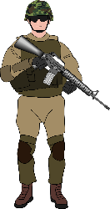
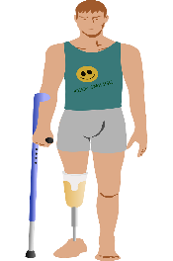
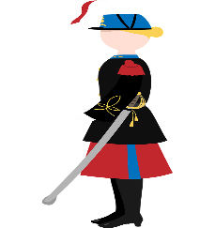
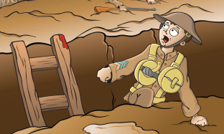
Les voyelles nasales
Are the vowels in bold nasal or non-nasal?
lire/parler
Remember that the nasal SSCs [em/am] and [en/an] become non-nasal sounds before a vowel.
bombardement [bombing]
ennemi
[enemy]
empire
[empire]
camion
[lorry]
amputé
[amputee]
grenade
[grenade]
combattant
[fighter]
super puissance
[super power]
vétérane
[veteran (f)]
vétéran
[veteran (m)]
tranchée
[trench]
Notes:
Timing: 5 minutes
Aim: Written recognition and oral production of nasal SSCs [em/am] and [en/an] and non-nasal SSCs [a]/[e] + m/n.
Procedure:
1. Use slides 24-31 to revise the sounds. Remind students that SSCs [em/am] and [en/an] sound identical.
2. Remind students that when [em/am] and [en/an] appear before a vowel, they are pronounced as non-nasal vowels + m/n. Grenade could be used as an example to illustrate this.
3. Working in pairs, students use the rules to sound out the words and decide whether the sounds in bold are nasal or non-nasal.
4. Click to reveal the answers. Click on the images to hear the words said aloud by a native speaker.
Transcript:
bombardement ennemi empire
amputé
camion tranchée combattant super puissance grenade vétérane vétéran
Word frequency of unknown words (1 is the most frequent word in French): camion [2542], super puissance [n/a], tranchée [2145]
Source: Londsale, D., & Le Bras, Y. (2009). A Frequency Dictionary of French: Core vocabulary for learners London: Routledge.
Word frequency of cognates used (1 is the most frequent word in French): bombardement ][3565], ennemi [1725], empire [3367], amputé [>5000], grenade [>5000], combattant [2374], vétérane [>5000], vétéran [>5000]
Source: Londsale, D., & Le Bras, Y. (2009). A Frequency Dictionary of French: Core vocabulary for learners London: Routledge.

