Slide 1
French Phonics Collection
SSC [e]
Artwork by: Chloé Motard
Date updated: 31/08/2022
Notes:
Artwork by Chloé Motard. All additional pictures selected are available under a Creative Commons license, no attribution required.

Slide 2
SSC [e]
phonétique
Introduction

Slide 3
e
je
Notes:
Timing: 1 minute
Aim: To introduce/consolidate SSC [e]
Procedure: 1. Present the letter(s) and say the [e] sound first, on its own. Students repeat it with you. 2. Bring up the word ”je” on its own, say it, students repeat it, so that they have the opportunity to focus all of their attention on the connection between the written word and its sound.
3. A possible gesture for this would be to point to oneself. 4. Roll back the animations and work through 1-3 again, but this time, dropping your voice completely to listen carefully to the students saying the [e] sound, pronouncing ”je” and, if using, doing the gesture.
Word frequency (1 is the most frequent word in French):
je [22]. Source: Londsale, D., & Le Bras, Y. (2009). A Frequency Dictionary of French: Core vocabulary for learners London: Routledge.

Slide 4
e
je
Notes:
With sound and no pictures to focus all attention on the sound-symbol correspondence.

Slide 5
e
je
Notes:
Without sound to elicit pronunciation (without first hearing the teacher).
Teacher to elicit pronunciation by asking “Comment dit-on …"

Slide 6
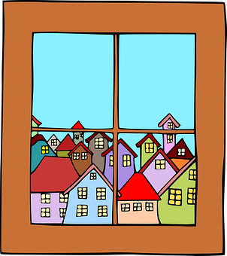
e
fenêtre
cela
[that]
je
second
cheval
devoir
[to have to]
Notes:
Timing: 2 minutes
Aim: To introduce/consolidate SSC [e]
Procedure:
1. Introduce and elicit the pronunciation of the individual SSC [e] and then the source word again ‘je’ (with gesture, if using). 2. Then present and elicit the pronunciation of the five cluster words.
The cluster words have been chosen for their high-frequency, from a range of word classes, with the SSC (where possible) positioned within a variety of syllables within the words (e.g. initial, 2nd, final etc.). Additionally, we have tried to use words that build cumulatively on previously taught SSCs (see the Phonics Teaching Sequence document) and do not include new SSCs. Where new SSCs are used, they are often consonants which have a similar symbol-sound correspondence in English.
Word frequency (1 is the most frequent word in French): fenêtre [1604]; cela [54] second [379]; devoir [39]; cheval [2220]; je [22]. Source: Londsale, D., & Le Bras, Y. (2009). A Frequency Dictionary of French: Core vocabulary for learners London: Routledge.

Slide 7
e
fenêtre
cela
je
second
cheval
devoir
Notes:
With sound and no pictures to focus all attention on the sound-symbol correspondence.

Slide 8
e
fenêtre
cela
je
second
cheval
devoir
Notes:
Without sound to elicit pronunciation (without first hearing the teacher).
Teacher to elicit pronunciation by asking “Comment dit-on …"

Slide 9
Phonétique
écouter
Which word has the SSC [e] ?
ou
au revoir
chanter
Notes:
Timing: 5 minutes for 5 slides
Aim: Aural recognition of SSC [e]
Procedure: 1. For the next five slides, click on the pictures to hear the words.
2. Decide which word contains SSC [e]. Remember that the [e] sound might not be obvious at first – it won’t be ‘stressed’ like some of the other vowels, so you might have to listen carefully to pick it up. For this reason, we are providing the beginning of the word so students know where to start listening!
3. Click to check.
4. Clarify the meaning of unknown vocabulary.
Transcript
au revoir, chanter
Word frequency of unknown vocabulary used (1 is the most frequent word in French):
chanter [1820] Source: Londsale, D., & Le Bras, Y. (2009). A Frequency Dictionary of French: Core vocabulary for learners London: Routledge.

Slide 10
Phonétique
écouter
Which word has the SSC [e] ?
[this, that]
ou
ce
chien
Notes:
Transcript
ce, chien

Slide 11
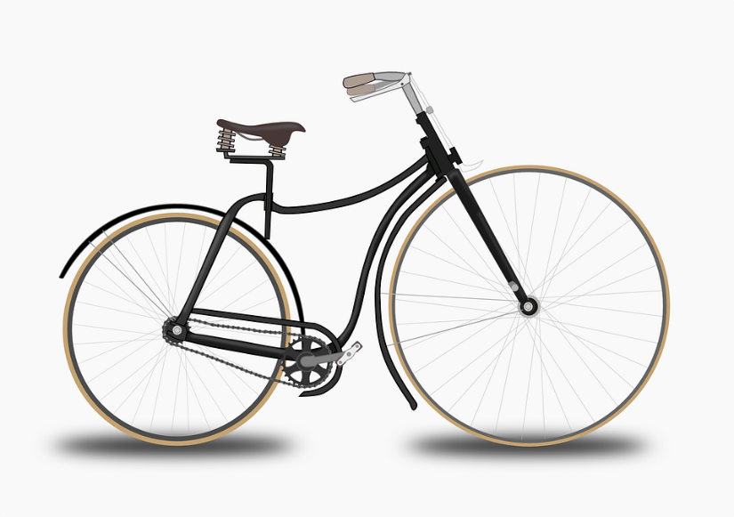
Phonétique
écouter
Which word has the SSC [e] ?
ou
the (m.)
vélo
le
Notes:
Transcript
vélo, le
Word frequency of unknown vocabulary used (1 is the most frequent word in French):
vélo [4594], le [1] Source: Londsale, D., & Le Bras, Y. (2009). A Frequency Dictionary of French: Core vocabulary for learners London: Routledge.

Slide 12
Phonétique
écouter
Which word has the SSC [e] ?
[partner]
ou
partenaire
personne
Notes:
Transcript
partenaire, personne
Word frequency of unknown vocabulary used (1 is the most frequent word in French):
partenaire [1077], personne [84] Source: Londsale, D., & Le Bras, Y. (2009). A Frequency Dictionary of French: Core vocabulary for learners London: Routledge.

Slide 13
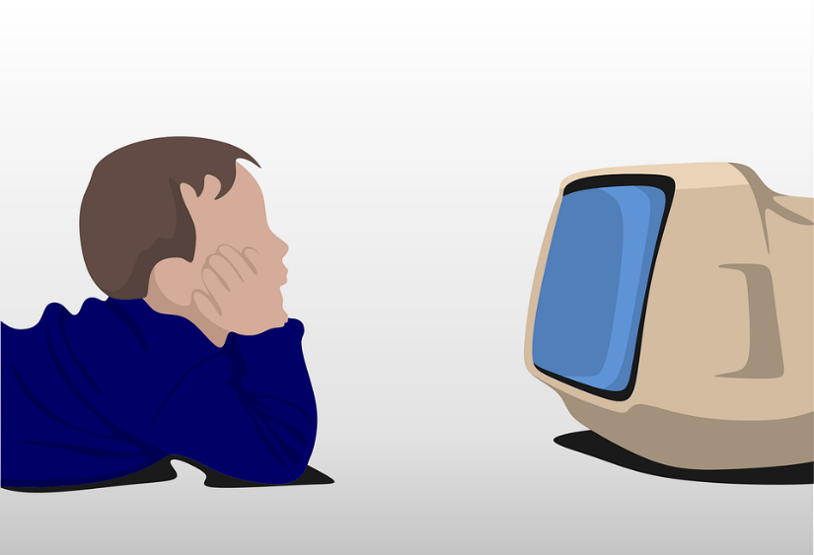
Phonétique
écouter
Which word has the SSC [e] ?
ou
regarder
télé
Notes:
Transcript
regarder, télé
Word frequency of unknown vocabulary used (1 is the most frequent word in French):
regarder [425], télé [2746] Source: Londsale, D., & Le Bras, Y. (2009). A Frequency Dictionary of French: Core vocabulary for learners London: Routledge.

Slide 14
Phonétique
SFC
parler
facile
de
45
le
[of]
[the (m)]
secret
[secret]
regard
dehors
[a glance]
secondes
rebelle
[outside]
[rebel]
fenêtre
mercredi
[window]
[Wednesday]
promenade
0
difficile
[a walk]
DÉBUT
Notes:
Timing: 3 minutes for 3 slides.
Aim: Oral production of SSC [e] in words of varying degrees of complexity in decreasing amounts of time.
Procedure:
Students pair up.
Explain that students are going to work their way down the ‘ladder’ by correctly pronouncing words containing [e], starting with simple words and building up to more complex words. Using their knowledge of English, students should be able to work out the meanings of facile and difficile form context – clarify. Explain that only the letters in bold are examples of [e] – the others are the ‘e’ sound they know from English.
Start the timer. Starting with de, Partner A works their way down the ladder. Partner B listens for correct pronunciation of [e]. If Partner A makes a mistake, they must go back to de and start again!
Students swap roles. Re-start the timer.
Whoever is furthest down the ladder when the timer stops is the winner!
Click on the words to hear them said aloud by a native speaker. Students repeat.
Move on to the next slide.
Transcript and word frequency (1 is the most frequent word in French):
de [2], le [1], secret [796], regard [1209], dehors [1217], rebelle [2621], fenêtre [1604], mercredi [1168], promenade [>5000]
Word frequencies of unknown words used in task instructions (1 is the most frequent word in French): facile [822], difficile [296]
Source: Londsale, D., & Le Bras, Y. (2009). A Frequency Dictionary of French: Core vocabulary for learners London: Routledge.

Slide 15
Phonétique
SFC
parler
facile
de
30
le
[of]
[the (m)]
secret
[secret]
regard
dehors
[a glance]
secondes
rebelle
[outside]
[rebel]
fenêtre
mercredi
[window]
[Wednesday]
promenade
0
difficile
[a walk]
DÉBUT
Notes:
As previous but with 15 fewer seconds on the timer.

Slide 16
Phonétique
SFC
parler
facile
de
15
le
[of]
[the (m)]
secret
[secret]
regard
dehors
[a glance]
secondes
rebelle
[outside]
[rebel]
fenêtre
mercredi
[window]
[Wednesday]
promenade
0
difficile
[a walk]
DÉBUT
Notes:
As previous but with 15 fewer seconds on the timer still.

Slide 17
SSC [e]
phonétique
Consolidation [1]

Slide 18
e
je
Notes:
Timing: 1 minute
Aim: To introduce/consolidate SSC [e]
Procedure: 1. Present the letter(s) and say the [e] sound first, on its own. Students repeat it with you. 2. Bring up the word ”je” on its own, say it, students repeat it, so that they have the opportunity to focus all of their attention on the connection between the written word and its sound.
3. A possible gesture for this would be to point to oneself. 4. Roll back the animations and work through 1-3 again, but this time, dropping your voice completely to listen carefully to the students saying the [e] sound, pronouncing ”je” and, if using, doing the gesture.
Word frequency (1 is the most frequent word in French):
je [22]. Source: Londsale, D., & Le Bras, Y. (2009). A Frequency Dictionary of French: Core vocabulary for learners London: Routledge.

Slide 19
e
je
Notes:
With sound and no pictures to focus all attention on the sound-symbol correspondence.

Slide 20
e
je
Notes:
Without sound to elicit pronunciation (without first hearing the teacher).
Teacher to elicit pronunciation by asking “Comment dit-on …"

Slide 21
e
fenêtre
cela
[that]
je
second
cheval
devoir
[to have to]
Notes:
Timing: 2 minutes
Aim: To introduce/consolidate SSC [e]
Procedure:
1. Introduce and elicit the pronunciation of the individual SSC [e] and then the source word again ‘je’ (with gesture, if using). 2. Then present and elicit the pronunciation of the five cluster words.
The cluster words have been chosen for their high-frequency, from a range of word classes, with the SSC (where possible) positioned within a variety of syllables within the words (e.g. initial, 2nd, final etc.). Additionally, we have tried to use words that build cumulatively on previously taught SSCs (see the Phonics Teaching Sequence document) and do not include new SSCs. Where new SSCs are used, they are often consonants which have a similar symbol-sound correspondence in English.
Word frequency (1 is the most frequent word in French): fenêtre [1604]; cela [54] second [379]; devoir [39]; cheval [2220]; je [22]. Source: Londsale, D., & Le Bras, Y. (2009). A Frequency Dictionary of French: Core vocabulary for learners London: Routledge.

Slide 22
e
fenêtre
cela
je
second
cheval
devoir
Notes:
With sound and no pictures to focus all attention on the sound-symbol correspondence.

Slide 23
e
fenêtre
cela
je
second
cheval
devoir
Notes:
Without sound to elicit pronunciation (without first hearing the teacher).
Teacher to elicit pronunciation by asking “Comment dit-on …"

Slide 24
Phonétique
parler
En français, quel mot a la SSC e ?
[to sing,
singing]
chemise
ch__nter
ch__mise
chanter
Notes:
Timing: 2 minutes for 3 slides
Aim: Aural recognition of SSC [e]
Procedure:
1. Students recall the French words that relate to the pictures on screen
2. Students decide which word contains the SSC [e]
3. Click to reveal first clue (French word with gap for SSC)
4. Click again to reveal answer

Slide 25
Phonétique
parler
En français, quel mot a la SSC e ?
[to close,
closing]
fermer
f__nêtre
f__mer
fenêtre

Slide 26
Phonétique
parler
En français, quel mot a la SSC e ?
2
deux
demander
de__x
de__mander

Slide 27
Phonétique
écouter / écrire
C’est [e] ou [ê/è] ?
rejet
gêner
bêche
nous ferons
1
elle sera
suprême
tête
cinquième
[she will be]
5
[rejection]
2
[supreme]
6
[to disturb]
3
[head]
7
[spade]
4
[fifth]
8
[we will do, make]
Notes:
Timing: 6 minutes
Aim: Aural recognition of SSCs [e] and [ê/è] in unknown words.
Procedure:
1. Click numbers to hear word pronunciation
2. Students fill in the blank
3. Answers revealed on clicks (allow EITHER [ê] or [è] for words with SSC [ê/è]).
Transcript and word frequency (1 is the most frequent word in French): sera [être-5], tête [343], suprême [2022], cinquième [2030], rejet [2455], gêner [2460], bêche [>5000], ferons [faire-25],
Source: Londsale, D., & Le Bras, Y. (2009). A Frequency Dictionary of French: Core vocabulary for learners London: Routledge.

Slide 28
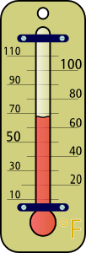
Phonétique
belette
parler
pelage
[weasel]
45
degré
[fur]
devenir
je serai
[to become]
dedans
[I will be]
celui
secondes
menace
[inside]
[the one]
il fera
[threat]
delà
0
[he will do, he will make]
[beyond]
DÉBUT
Notes:
Timing: 3 minutes
Aim: Oral production of SSC [e]
Procedure:
1. Students work in pairs pronouncing the words on the slide, taking it in turns, and making sure all words have been said at least once.
2. The teacher can circulate during this activity to listen into students’ SSC knowledge.
3. Click to hear words pronounced by a native speaker.
Frequency of unknown vocabulary (1 is the most frequent word in French): degré [1311], devenir [162], se [17], menace [1607], fera [faire-25], dedans [3058], pelage [>5000], serai [être-5], belette [>5000], delà [4367], celui [45]
Source: Londsale, D., & Le Bras, Y. (2009). A Frequency Dictionary of French: Core vocabulary for learners London: Routledge.

Slide 29
SSC [e]
phonétique
Consolidation [2]

Slide 30
Nasal and non-nasal vowels
écouter / écrire
Vowels can be nasal (like [am/em] and [an/an] or non-nasal [like [e] and [a].
When you say a nasal vowel, air passes through your nose as well as your mouth.
Écoute les mots. C’est [em/am] / [en/an] ou [e] / [a] ?
 |  | nasal vowel [em/am] [en/an] | non-nasal vowel [e] / [a]
 |  | nasal vowel [em/am] [en/an] | non-nasal vowel [e] / [a]
1
menu
5
centre
2
membre
6
remarque
3
dramatique
7
croissant
4
champion
8
organisation
Notes:
Timing: 5 minutes
Aim: to introduce the concept of nasal and non-nasal vowels. Aural recognition of nasal and non-nasal vowels [em/am], [en/an], [e] and [a] using cognates.
Procedure:
1. Practise saying SSCs [em/am] / [en/an] and [e] / [a] aloud, in isolation. Students should notice a vibration in the nose when they produce the nasal sounds, but not when they produce the oral sounds.
2. Click the numbers to play the audio.
3. Students write 1-8 and decide if the letters in bold represent a ‘nasal’ or ‘non-nasal’ vowel sound.
4. Click to reveal the answers. The word appears first, followed by the ticks in the appropriate columns.
Transcript:
menu
membre
dramatique
champion
centre
remarque
croissant
organisation
Word frequency of cognates (1 is the most frequent word in French): menu [3470], membre [390], dramatique [2918], champion [2443], centre [491], remarque [2019], croissant [2069], organisation [570]
Source: Londsale, D., & Le Bras, Y. (2009). A Frequency Dictionary of French: Core vocabulary for learners London: Routledge.

Slide 31
[em/am], [en/an]
écouter / écrire
Normally, SSCs [em/am] and [en/an] are nasal vowels.
However, [em/am] and [en/an] sound different before a vowel.
Can you think of any examples in words you already know?
before a consonant: before a vowel:
exemple semaine
chambre amusant
content promenade
grand animal
(example)
The sounds are nasal vowels [em/am], [en/an].
(week)
The sounds are oral vowels [e] / [a] + m / n.
(bedroom)
(funny)
(pleased)
(walk)
(big)
(animal)
Notes:
Timing: 2 minutes
Aim: to introducing spelling rules governing pronunciation changes in SSCs [em/am] and [en/an].

Slide 32
e
je
Notes:
Timing: 1 minute
Aim: To introduce/consolidate SSC [e]
Procedure: 1. Present the letter(s) and say the [e] sound first, on its own. Students repeat it with you. 2. Bring up the word ”je” on its own, say it, students repeat it, so that they have the opportunity to focus all of their attention on the connection between the written word and its sound.
3. A possible gesture for this would be to point to oneself. 4. Roll back the animations and work through 1-3 again, but this time, dropping your voice completely to listen carefully to the students saying the [e] sound, pronouncing ”je” and, if using, doing the gesture.
Word frequency (1 is the most frequent word in French):
je [22]. Source: Londsale, D., & Le Bras, Y. (2009). A Frequency Dictionary of French: Core vocabulary for learners London: Routledge.

Slide 33
e
fenêtre
cela
[that]
je
second
cheval
devoir
[to have to]
Notes:
Timing: 2 minutes
Aim: To introduce/consolidate SSC [e]
Procedure:
1. Introduce and elicit the pronunciation of the individual SSC [e] and then the source word again ‘je’ (with gesture, if using). 2. Then present and elicit the pronunciation of the five cluster words.
The cluster words have been chosen for their high-frequency, from a range of word classes, with the SSC (where possible) positioned within a variety of syllables within the words (e.g. initial, 2nd, final etc.). Additionally, we have tried to use words that build cumulatively on previously taught SSCs (see the Phonics Teaching Sequence document) and do not include new SSCs. Where new SSCs are used, they are often consonants which have a similar symbol-sound correspondence in English.
Word frequency (1 is the most frequent word in French): fenêtre [1604]; cela [54] second [379]; devoir [39]; cheval [2220]; je [22]. Source: Londsale, D., & Le Bras, Y. (2009). A Frequency Dictionary of French: Core vocabulary for learners London: Routledge.

Slide 34
[nasal], [e] ou [a] ?
parler
Lis les mots et décide si c’est une voyelle nasale ou une voyelle orale.
Puis, dis les mots !
 |  | nasal vowel | non-nasal vowel
 | embaucher [to hire]
 | remonter [to go back up]
 | engendrer [to generate]
 | abandon [abandonment]
 | chemin [path]
 | menace [threat]
 | champ [field]
 | banal [ordinary]
1
2
3
4
nasal vowels
[em/am], [en/an]
5
6
7
oral vowels
[e], [a]
8
Notes:
Timing: 5 minutes
Aim: to apply awareness of spelling rules governing pronunciation changes in SSCs [em/am] and [en/an]. Oral production of words containing these letter combinations.
Procedure:
1. Recap the spelling rules governing pronunciation changes in SSCs [em/am] and [en/an] introduced in lesson 1 (see slide 7). 2. Students read the words and decide from the spelling alone whether they think the SSC in bold represents a nasal or non-nasal sound.
3. Click to reveal correct answer.
4. Students say the words.
5. Click on the numbers to check pronunciation.
Transcript:
1. embaucher
2. remonter
3. engendrer
4. abandon
5. chemin
6. menace
7. champ
8. banal
Word frequency (1 is the most frequent word in French): embaucher [3743], remonter [1020], engendrer [2286], abandon [2676], chemin [859,] menace [1607], champ [847], banal [4221]
Source: Londsale, D., & Le Bras, Y. (2009). A Frequency Dictionary of French: Core vocabulary for learners London: Routledge.
Word frequency of near-cognates used in task instructions (1 is the most frequent word in French): décider [165], voyelle [>5000], nasal [>5000], oral [4114]
Source: Londsale, D., & Le Bras, Y. (2009). A Frequency Dictionary of French: Core vocabulary for learners London: Routledge.

Slide 35
SSC [e]
phonétique
Consolidation [3]

Slide 36
SSCs: [e] vs. [i]
Remember! In English, the SSC [i] sounds like ‘ih’. But in French, it sounds like ‘ee’.
écouter
Écoute ces mots et remplis les blancs avec la bonne SSC.
C’est quoi en anglais ?
 | French | English | [e] | [i]
 | mégabit | megabyte
 | rebelle | rebel
 | menu | menu
 | bip | beep
 | riche | rich
 | rejeté | rejected
 | fixé | fixed
 | degré | degree
1
_
2
_
3
_
4
_
5
_
6
_
7
_
8
_
Notes:
Timing: 5 minutes
Aim: Aural recognition of SSCs [e] and [i]; raising awareness of cross-linguistic differences in pronunciation between cognates and near-cognates; to ‘break’ the association between English SSC [i] and the sound ‘ih’ and to connect this sound with its nearest French equivalent, SSC [e].
Procedure:
1. Depending on the needs of the class, click to bring up the reminder about pronunciation.
2. Click the number button on the left to hear the French word read aloud.
3. Students fill in the gap with the correct SSC. Note that these words have specifically been chosen because they are near cognates.
4. Click to reveal the missing SSC and a tick in the correct column.
5. Click to reveal the next task instruction.
6. Students try to volunteer the English translation.
7. Students say the pairs of words, first in French and then in English.
Transcript:
1. mégabit
2. rebelle
3. menu
4. bip
5. riche
6. rejeté
7. fixé
8. degré
Word frequency of cognates used (1 is the most frequent word in French):
mégabit [>5000], rebelle [2621], menu [3470], bip [<5000], riche [599], rejeter [981], fixer [641], degré [1311]
Source: Londsale, D., & Le Bras, Y. (2009). A Frequency Dictionary of French: Core vocabulary for learners London: Routledge.

Slide 37
SSC [e]
phonétique
Consolidation [4]

Slide 38
e
je
Notes:
Timing: 1 minute
Aim: To introduce/consolidate SSC [e]
Procedure: 1. Present the letter(s) and say the [e] sound first, on its own. Students repeat it with you. 2. Bring up the word ”je” on its own, say it, students repeat it, so that they have the opportunity to focus all of their attention on the connection between the written word and its sound.
3. A possible gesture for this would be to point to oneself. 4. Roll back the animations and work through 1-3 again, but this time, dropping your voice completely to listen carefully to the students saying the [e] sound, pronouncing ”je” and, if using, doing the gesture.
Word frequency (1 is the most frequent word in French):
je [22]. Source: Londsale, D., & Le Bras, Y. (2009). A Frequency Dictionary of French: Core vocabulary for learners London: Routledge.

Slide 39
e
fenêtre
cela
[that]
je
second
cheval
devoir
[to have to]
Notes:
Timing: 2 minutes
Aim: To introduce/consolidate SSC [e]
Procedure:
1. Introduce and elicit the pronunciation of the individual SSC [e] and then the source word again ‘je’ (with gesture, if using). 2. Then present and elicit the pronunciation of the five cluster words.
The cluster words have been chosen for their high-frequency, from a range of word classes, with the SSC (where possible) positioned within a variety of syllables within the words (e.g. initial, 2nd, final etc.). Additionally, we have tried to use words that build cumulatively on previously taught SSCs (see the Phonics Teaching Sequence document) and do not include new SSCs. Where new SSCs are used, they are often consonants which have a similar symbol-sound correspondence in English.
Word frequency (1 is the most frequent word in French): fenêtre [1604]; cela [54] second [379]; devoir [39]; cheval [2220]; je [22]. Source: Londsale, D., & Le Bras, Y. (2009). A Frequency Dictionary of French: Core vocabulary for learners London: Routledge.

Slide 40
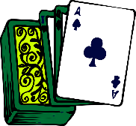
SSCs: [e] vs. [i]
Écoute ces mots et remplis les blancs avec la bonne SSC.
écouter
 | French | [e] | [i]
 | secours [aid]
 | menace [threat]
 | susciter [to provoke]
 | pari [bet]
 | regard [look]
 | bilan [outcome]
 | tenue [dress]
 | usine [factory]
1
8
_
2
_
3
_
4
_
5
_
6
_
7
_
8
_
Notes:
Timing: 5 minutes
Aim: To distinguish aurally between SSCs [e] and [i].
Procedure:
1. Click on the number button to listen to the word read aloud.
2. Students fill in the gap with the missing SSC.
3. Click to reveal the answers.
4. Students listen to and repeat the word.
Transcript:
secours
menace
susciter
pari
regard
bilan
tenue
usine
Word frequency (1 is the most frequent word in French): tenue [1899], regard [1206], menace [1607], secours [1857], susciter [1027], pari [1688], bilan [1758], usine [1482]
Source: Londsale, D., & Le Bras, Y. (2009). A Frequency Dictionary of French: Core vocabulary for learners London: Routledge.

Slide 41
SSC [e]
phonétique
Consolidation [5]

Slide 42
e
je
Notes:
Timing: 1 minute
Aim: To introduce/consolidate SSC [e]
Procedure: 1. Present the letter(s) and say the [e] sound first, on its own. Students repeat it with you. 2. Bring up the word ”je” on its own, say it, students repeat it, so that they have the opportunity to focus all of their attention on the connection between the written word and its sound.
3. A possible gesture for this would be to point to oneself. 4. Roll back the animations and work through 1-3 again, but this time, dropping your voice completely to listen carefully to the students saying the [e] sound, pronouncing ”je” and, if using, doing the gesture.
Word frequency (1 is the most frequent word in French):
je [22]. Source: Londsale, D., & Le Bras, Y. (2009). A Frequency Dictionary of French: Core vocabulary for learners London: Routledge.

Slide 43
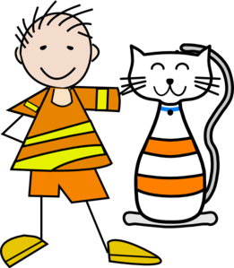
SSC [e] ou [ê/è] ?
phonétique
Je suis avec mon chat, Pacha
As you have already learned, some French words containing an unaccented ‘e’ are not pronounced like je.
Some sound like ê/è, such as in avec [with].
Listen to the difference here between the ‘e’ in je and the ‘e’ in avec.
Notes:
Timing: 1 minute
Aim: Raising awareness of different sounds represented by the SSC [e].
Procedure:
Explain that an e without an accent is not always pronounced like je, giving the example of avec.
Listen to the audio, and students repeat the sentence, emphasizing the pronunciation of je and avec.
Transcript:
Je suis avec mon chat, Pacha

Slide 44
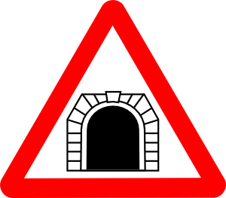
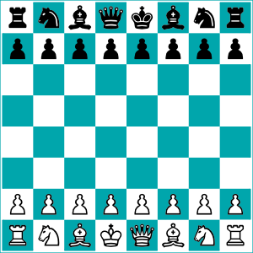
SSC [e] ou [ê/è] ?
Listen carefully to the pronunciation. Do you hear [e] or [ê/è]?
écouter
1
tunnel
2
chenille
[e] | [ê/è]
[e] | [ê/è]
3
melon
4
*échecs
[e] | [ê/è]
[e] | [ê/è]
*échecs = chess
Notes:
Timing: 8 minutes. Slide 1/3.
Aim: to practise aural recognition of SSCs [e/ê/è].
NB: unknown words
Procedure:
1. Click numbers to hear a word.
2. Students tick whether they hear the [e] or [ê/è] sound.
3. Click to reveal answers.
4. Listen again, this time drawing attention to the e sounds. Students repeat.
5. Students say the words one more time, emphasizing the correct e sound.
Transcript:
tunnel
chenille
melon
échecs
Word frequency of unknown words used (1 is the most frequent word in French):
chenille [>5000], échecs [>5000]
Source: Lonsdale, D., & Le Bras, Y. (2009). A Frequency Dictionary of French: Core vocabulary for learners London: Routledge.
Word frequency of cognates used (1 is the most frequent word in French): tunnel [3386], melon [>5000]
Source: Lonsdale, D., & Le Bras, Y. (2009). A Frequency Dictionary of French: Core vocabulary for learners London: Routledge.

Slide 45
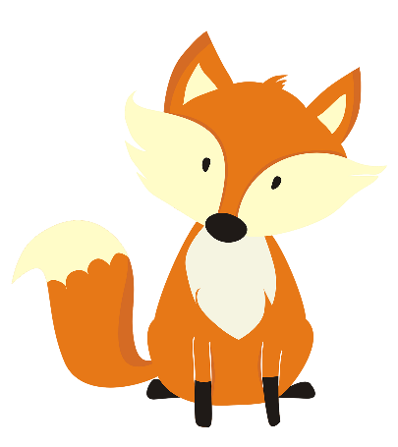
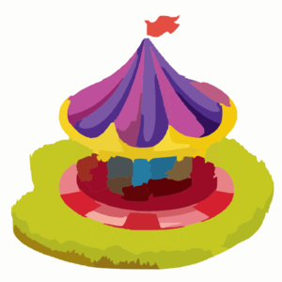
SSC [e] ou [ê/è] ?
Listen carefully to the pronunciation. Do you hear [e] or [ê/è]?
écouter
1
renard
2
cheval
[e] | [ê/è]
[e] | [ê/è]
3
*bec
4
carrousel
[e] | [ê/è]
[e] | [ê/è]
*bec = beak
Notes:
Slide 2/3
Transcript:
renard
cheval
bec
carrousel
Word frequency of unknown words used (1 is the most frequent word in French): renard [>5000], cheval [2220], bec [>5000]
Source: Lonsdale, D., & Le Bras, Y. (2009). A Frequency Dictionary of French: Core vocabulary for learners London: Routledge.
Word frequency of cognates used (1 is the most frequent word in French): carrousel [>5000]
Source: Lonsdale, D., & Le Bras, Y. (2009). A Frequency Dictionary of French: Core vocabulary for learners London: Routledge.

Slide 46
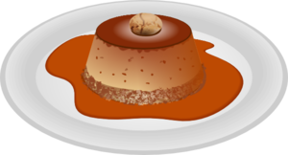
SSC [e] ou [ê/è] ?
Have you noticed any spelling patterns which could help you identify whether to use the [e] or [ê/è] sound?
Listen carefully to the pronunciation. Do you hear [e] or [ê/è]?
écouter
caramel
chaussette
1
2
[e] | [ê/è]
[e] | [ê/è]
peluche
3
*vitesse
4
[e] | [ê/è]
[e] | [ê/è]
*vitesse = speed
Notes:
Slide 3/3
Do you notice any patterns emerging for words containing an e which is not pronounced like je?
Point out there is a rule in French for this: This pronunciation comes before double consonants e.g. –ette, and when it is a closed syllable (a syllable ending in a consonant sound), e.g. caramel, bec. Teachers can use following slide for add-on activity.
Transcript:
caramel
chaussette
vitesse
peluche
Word frequency of unknown words used (1 is the most frequent word in French): chaussette [>5000], vitesse [1065], peluche [>5000]
Source: Lonsdale, D., & Le Bras, Y. (2009). A Frequency Dictionary of French: Core vocabulary for learners London: Routledge.
Word frequency of cognates used (1 is the most frequent word in French): caramel [>5000]
Source: Lonsdale, D., & Le Bras, Y. (2009). A Frequency Dictionary of French: Core vocabulary for learners London: Routledge.

Slide 47
SSC [e] ou [ê/è] ?
phonétique
In French, the e is usually pronounced as in avec [ê/è] when:
It comes before a double consonant, such as vitesse [speed]
It comes before a ‘c’ or ‘l’ in the last syllable, such as bec [beak]
Following this guide, decide whether the unaccented e makes the [e] or [ê/è] sound, and say the words. Check by listening to the native speaker.
1
assiette [plate]
repos [rest]
vaisselle [crockery]
verre [glass]
culturel [cultural]
première [first]
2
3
4
5
6
Notes:
[Optional] Timing: 3 minutes
Aim: Raising awareness of differences between different ‘e’ sounds.
Procedure:
In French, the e is usually pronounced as in avec [ê/è] when:
It comes before a double consonant, such as vitesse [speed]
It comes before a ‘c’ or ‘l’ in the last syllable, such as bec [beak]
Students say the words, applying the rule.
Listen to the native speaker to check.
Transcript:
assiette
verre
repos
culturel
vaisselle
première
Word frequency of unknown words used (1 is the most frequent word in French):
assiette [3756], verre [2174], repos [2731], vaisselle [>5000], première [56]
Source: Lonsdale, D., & Le Bras, Y. (2009). A Frequency Dictionary of French: Core vocabulary for learners London: Routledge.
Word frequency of cognates used (1 is the most frequent word in French): culturel [1495]
Source: Lonsdale, D., & Le Bras, Y. (2009). A Frequency Dictionary of French: Core vocabulary for learners London: Routledge.

Slide 48
SSC [e]
phonétique
Consolidation [6]

Slide 49
e
je
Notes:
Timing: 1 minute
Aim: To introduce/consolidate SSC [e]
Procedure: 1. Present the letter(s) and say the [e] sound first, on its own. Students repeat it with you. 2. Bring up the word ”je” on its own, say it, students repeat it, so that they have the opportunity to focus all of their attention on the connection between the written word and its sound.
3. A possible gesture for this would be to point to oneself. 4. Roll back the animations and work through 1-3 again, but this time, dropping your voice completely to listen carefully to the students saying the [e] sound, pronouncing ”je” and, if using, doing the gesture.
Word frequency (1 is the most frequent word in French):
je [22]. Source: Londsale, D., & Le Bras, Y. (2009). A Frequency Dictionary of French: Core vocabulary for learners London: Routledge.

Slide 50
e
fenêtre
cela
[that]
je
second
cheval
devoir
[to have to]
Notes:
[8/8]
Aim: To consolidate SSC [e]
Procedure:
1. Introduce and elicit the pronunciation of the individual SSC [e] and then the source word again ‘je’ (with gesture, if using). 2. Then present and elicit the pronunciation of the five cluster words.
The cluster words have been chosen for their high-frequency, from a range of word classes, with the SSC (where possible) positioned within a variety of syllables within the words (e.g. initial, 2nd, final etc.). Additionally, we have tried to use words that build cumulatively on previously taught SSCs (see the Phonics Teaching Sequence document) and do not include new SSCs. Where new SSCs are used, they are often consonants which have a similar symbol-sound correspondence in English.
Word frequency (1 is the most frequent word in French): fenêtre [1604]; cela [54] second [379]; devoir [39]; cheval [2220]; je [22]. Source: Londsale, D., & Le Bras, Y. (2009). A Frequency Dictionary of French: Core vocabulary for learners London: Routledge.

Slide 51
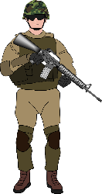
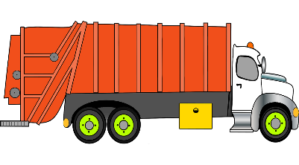
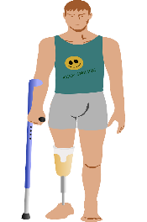
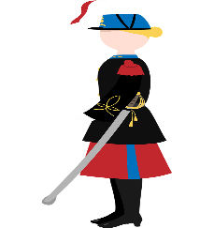
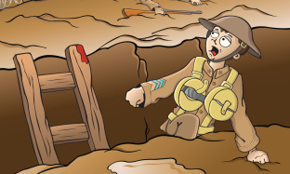
Les voyelles nasales
Are the vowels in bold nasal or non-nasal?
lire/parler
Remember that the nasal SSCs [em/am] and [en/an] become non-nasal sounds before a vowel.
bombardement [bombing]
ennemi
[enemy]
empire
[empire]
camion
[lorry]
amputé
[amputee]
grenade
[grenade]
combattant
[fighter]
super puissance
[super power]
vétérane
[veteran (f)]
vétéran
[veteran (m)]
tranchée
[trench]
Notes:
Timing: 5 minutes
Aim: Written recognition and oral production of nasal SSCs [em/am] and [en/an] and non-nasal SSCs [a]/[e] + m/n.
Procedure:
1. Use slides 24-31 to revise the sounds. Remind students that SSCs [em/am] and [en/an] sound identical.
2. Remind students that when [em/am] and [en/an] appear before a vowel, they are pronounced as non-nasal vowels + m/n. Grenade could be used as an example to illustrate this.
3. Working in pairs, students use the rules to sound out the words and decide whether the sounds in bold are nasal or non-nasal.
4. Click to reveal the answers. Click on the images to hear the words said aloud by a native speaker.
Transcript:
bombardement ennemi empire
amputé
camion tranchée combattant super puissance grenade vétérane vétéran
Word frequency of unknown words (1 is the most frequent word in French): camion [2542], super puissance [n/a], tranchée [2145]
Source: Londsale, D., & Le Bras, Y. (2009). A Frequency Dictionary of French: Core vocabulary for learners London: Routledge.
Word frequency of cognates used (1 is the most frequent word in French): bombardement ][3565], ennemi [1725], empire [3367], amputé [>5000], grenade [>5000], combattant [2374], vétérane [>5000], vétéran [>5000]
Source: Londsale, D., & Le Bras, Y. (2009). A Frequency Dictionary of French: Core vocabulary for learners London: Routledge.

