Slide 1
French Phonics Collection
SSC [ç/soft c]
Artwork by: Chloé Motard
Date updated: 31/07/2022
Notes:
Artwork by Chloé Motard. All additional pictures selected are available under a Creative Commons license, no attribution required.

Slide 2
SSC [ç/ soft c]
phonétique
Introduction

Slide 3
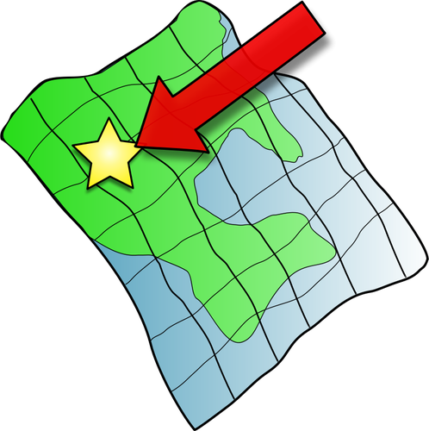
ç/c
ici
Notes:
Timing: 1 minute
Aim: To introduce/consolidate SSC [ç/c]
Procedure: 1. Present the letter(s) and say the [ç/c] sound first, on its own. Students repeat it with you. 2. Bring up the word ”ici” on its own, say it, students repeat it, so that they have the opportunity to focus all of their attention on the connection between the written word and its sound.
3. A possible gesture for this would be to point to the spot on which one is standing / indicate the room in which the lesson is taking place with a sweeping motion of one’s index finger. 4. Roll back the animations and work through 1-3 again, but this time, dropping your voice completely to listen carefully to the students saying the [ç/c] sound, pronouncing ”ici” and, if using, doing the gesture.
Word frequency (1 is the most frequent word in French):
ici [167]. Source: Londsale, D., & Le Bras, Y. (2009). A Frequency Dictionary of French: Core vocabulary for learners London: Routledge.

Slide 4
ç/c
ici
Notes:
With sound and no pictures to focus all attention on the sound-symbol correspondence.

Slide 5
ç/c
ici
Notes:
Without sound to elicit pronunciation (without first hearing the teacher).
Teacher to elicit pronunciation by asking “Comment dit-on …"

Slide 6
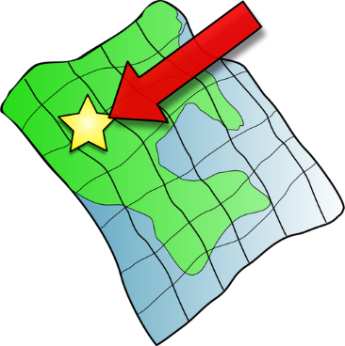
ç/c
français
garçon
ici
cinéma
cinq
décider
[to decide]
Notes:
Timing: 2 minutes
Aim: To introduce/consolidate SSC [ç/c]
Procedure:
1. Introduce and elicit the pronunciation of the individual SSC [ç/c] and then the source word again ‘ici’ (with gesture, if using). 2. Then present and elicit the pronunciation of the five cluster words.
The cluster words have been chosen for their high-frequency, from a range of word classes, with the SSC (where possible) positioned within a variety of syllables within the words (e.g. initial, 2nd, final etc.). Additionally, we have tried to use words that build cumulatively on previously taught SSCs (see the Phonics Teaching Sequence document) and do not include new SSCs. Where new SSCs are used, they are often consonants which have a similar symbol-sound correspondence in English.
Word frequency (1 is the most frequent word in French): français [251]; garçon [1599]; cinéma [1623]; décider [165]; cinq [288]; ici [167]. Source: Londsale, D., & Le Bras, Y. (2009). A Frequency Dictionary of French: Core vocabulary for learners London: Routledge.

Slide 7
ç/c
français
garçon
ici
cinéma
cinq
décider
Notes:
With sound and no pictures to focus all attention on the sound-symbol correspondence.

Slide 8
ç/c
français
garçon
ici
cinéma
cinq
décider
Notes:
Without sound to elicit pronunciation (without first hearing the teacher).
Teacher to elicit pronunciation by asking “Comment dit-on …"

Slide 9
Phonétique
ici
parler
déçevoir
ceci
45
cinq
cependant
ancien
secondes
façon
commerçant
spécial
insouciant
0
DÉBUT
Notes:
Timing: 5 minutes for three slides.
Aim: automatisation of oral production of SSCs soft [c] and [ç] at word level.
Procedure:
Tell students that they are going to take turns to say all the words within a given time, building up speed. They call in any order they like but are not allowed to repeat the one they said in their last turn.
Click on début to start the timer on the screen.
The listening students checks that the speaking student does not produce a hard [c]. If they do, they must repeat the words correctly three times.
Students swap roles. Restart the timer.
Click to check pronunciation of the words. [audio missing – recording in progress]
Word frequency (1 is the most frequent word in French):
ici [167], décevoir [1302], ceci [732], cinq [288], cependant [352], façon [248], ancien [392], commerçant [4167], spécial [726], insouciant [>5000] Source: Londsale, D., & Le Bras, Y. (2009). A Frequency Dictionary of French: Core vocabulary for learners London: Routledge.
Ask students what they notice about the vowels which follow soft [c] (always ‘i’ or ‘e’). This primes for the explanation on slide 36.

Slide 10
Phonétique
ici
parler
Phonétique
déçevoir
ceci
30
cinq
cependant
ancien
secondes
façon
commerçant
spécial
insouciant
0
DÉBUT
Notes:
As previous, but with 15 fewer seconds on the timer.

Slide 11
Phonétique
ici
parler
Phonétique
déçevoir
ceci
15
cinq
cependant
ancien
secondes
façon
commerçant
spécial
insouciant
0
DÉBUT
Notes:
As previous, but with 15 fewer seconds on the timer still.

Slide 12
Soft or hard [c/ç]?
In French, the letter c is soft (sounds like s) before e or i:
le cinéma c’est
The letter c is hard (sounds like k) before a, o or u:
calme content cuisine
We sometimes soften the c before a, o or u with a cedilla (ç):
le français le garçon le reçu (receipt)
Notes:
Timing: 2 minutes
Aim: to introduce spelling rules governing the pronunciation of [c] and explain when a cedilla is needed.
Procedure:
1. Click to bring up the explanation
2. Ask students to read the words in each category out loud.

Slide 13
Soft or hard [c/ç]?
lire / écouter / parler
 |  | [ç/c] | [hard c]
 | glaçon
 | compter [to count]
 | concombre
j | cible [aim]
 | Franco- [French-]
 | tronçon [section]
h | cabane
 | merci
Complète et dis les mots !
A
Sometimes, you will see the prefix Franco- used instead of français, e.g.:
Il est franco-italien
He is half-French, half-Italien.
B
C
D
E
F
G
H
Notes:
Timing: 5 minutes
Aim: Applying awareness of the spelling rules governing SSC [c/ç]
Procedure
Student read the words and decide based on the spelling of the word (vowel which follows/cedilla) whether the letter in bold is hard or soft.
Click to check.
Students try to say the words out loud.
Click to check.
Word frequency of unknown words and cognates (1 is the most frequent word in French): glaçon [>5000], compter [140], concombre [>5000], cible [2740], Franco- [n/a], tronçon [>5000], cabane [>5000]
Source: Londsale, D., & Le Bras, Y. (2009). A Frequency Dictionary of French: Core vocabulary for learners London: Routledge.

Slide 14
SSC [ç/ soft c]
phonétique
Consolidation [1]

Slide 15
ç/c
ici
Notes:
Timing: 1 minute
Aim: To introduce/consolidate SSC [ç/c]
Procedure: 1. Present the letter(s) and say the [ç/c] sound first, on its own. Students repeat it with you. 2. Bring up the word ”ici” on its own, say it, students repeat it, so that they have the opportunity to focus all of their attention on the connection between the written word and its sound.
3. A possible gesture for this would be to point to the spot on which one is standing / indicate the room in which the lesson is taking place with a sweeping motion of one’s index finger. 4. Roll back the animations and work through 1-3 again, but this time, dropping your voice completely to listen carefully to the students saying the [ç/c] sound, pronouncing ”ici” and, if using, doing the gesture.
Word frequency (1 is the most frequent word in French):
ici [167]. Source: Londsale, D., & Le Bras, Y. (2009). A Frequency Dictionary of French: Core vocabulary for learners London: Routledge.

Slide 16
ç/c
ici
Notes:
With sound and no pictures to focus all attention on the sound-symbol correspondence.

Slide 17
ç/c
ici
Notes:
Without sound to elicit pronunciation (without first hearing the teacher).
Teacher to elicit pronunciation by asking “Comment dit-on …"

Slide 18
ç/c
français
garçon
ici
cinéma
cinq
décider
[to decide]
Notes:
Timing: 2 minutes
Aim: To introduce/consolidate SSC [ç/c]
Procedure:
1. Introduce and elicit the pronunciation of the individual SSC [ç/c] and then the source word again ‘ici’ (with gesture, if using). 2. Then present and elicit the pronunciation of the five cluster words.
The cluster words have been chosen for their high-frequency, from a range of word classes, with the SSC (where possible) positioned within a variety of syllables within the words (e.g. initial, 2nd, final etc.). Additionally, we have tried to use words that build cumulatively on previously taught SSCs (see the Phonics Teaching Sequence document) and do not include new SSCs. Where new SSCs are used, they are often consonants which have a similar symbol-sound correspondence in English.
Word frequency (1 is the most frequent word in French): français [251]; garçon [1599]; cinéma [1623]; décider [165]; cinq [288]; ici [167]. Source: Londsale, D., & Le Bras, Y. (2009). A Frequency Dictionary of French: Core vocabulary for learners London: Routledge.

Slide 19
ç/c
français
garçon
ici
cinéma
cinq
décider
Notes:
With sound and no pictures to focus all attention on the sound-symbol correspondence.

Slide 20
ç/c
français
garçon
ici
cinéma
cinq
décider
Notes:
Without sound to elicit pronunciation (without first hearing the teacher).
Teacher to elicit pronunciation by asking “Comment dit-on …"

Slide 21
Hard and soft [c]
Hard and soft [c]
phonétique
Remember!
In French, the letter c is naturally soft (sounds like s) before e or i:
le cinéma c’est
However, the letter c is hard (sounds like k) before a, o or u:
calme content cuisine
We sometimes soften the c before a, o or u with a cedilla (ç):
le français le garçon le reçu (receipt)
Notes:
Timing: 2 minutes
Aim: To revise spelling rules governing the pronunciation of the letter ‘c’ before vowels and use of a cedilla..
Procedure:
1. Bring up the rules governing each category on clicks.
2. Teacher reads the words in each category out loud. Students repeat.

Slide 22
C ou Ç ?
Hard [c] or [ç] ?
écouter
Do you hear a hard or a soft sound?
 |  | hard [c] | ç
 | cas (case)
 | contre (against)
 | reçu (receipt)
 | commerçant (shopkeeper)
 | aucun (none)
 | façon (way)
1
_
2
_
3
_
4
_
_
5
_
6
_
Notes:
Timing: 3 minutes
Aim: Oral recognition of hard [c] and [ç]
Procedure:
1. Ask students to look at the vowel following each gap. What do they notice? Explain that as only the letters a, o and u follow the missing SSC, the missing letter can only be either hard [c] or [ç].
2. Click numbers to play audio.
3. Students tick whether they think they hear hard or soft ‘c’
4. Answers revealed on clicks
Transcript
1) cas
2) contre
3) reçu
4) commerçant
5) aucun
6) façon
Word frequency (1 is the most frequent word in French):
cas [137], contre [121], reçu [4226], commerçant [4167] aucun [63], façon [248]
Source: Londsale, D., & Le Bras, Y. (2009). A Frequency Dictionary of French: Core vocabulary for learners London: Routledge.

Slide 23
C ou Ç ?
Soft [c] or [ç] ?
écrire
These words all contain a soft sound. How is it written?
 |  | soft [c] | ç
 | cependant (however)
 | principe (principle)
 | soupçon (suspicion)
 | cesser (to stop, stopping)
 | façade (facade)
 | société (society)
1
_
2
_
3
_
4
_
5
_
6
_
Notes:
Timing: 3 minutes
Aim: Written production of hard [c] and [ç]
Procedure:
1. Remind students of spelling rules for the soft sound ([c] in front of e or i, [ç] in front of a, o and u).
2. Students read the words and decide which letter is missing based on the vowel which follows the gap.
3. Answers revealed on clicks.
4. Click to hear the words. Students repeat. This reinforces that the pronunciation is the same.
Transcript
1) cependant
2) principe
3) soupçon
4) cesser
5) façade
6) société
Word frequency (1 is the most frequent word in French):
cependant [352], principe [447], cesser [462], soupçon [3921], façade [4029], société [295]
Source: Londsale, D., & Le Bras, Y. (2009). A Frequency Dictionary of French: Core vocabulary for learners London: Routledge.

Slide 24
C ou Ç ?
Hard [c], soft [c] or [ç] ?
écouter / écrire
Do you hear a hard or a soft sound? If you hear a soft sound, how is it written?
 |  | hard [c] | soft [c] | ç
 | cent (hundred)
 | construire (to construct)
 | culture (culture)
 | civil (civilian)
 | leçon (lesson)
 | candidat (candidate)
1
_
2
_
3
_
4
_
5
_
6
_
Notes:
Timing: 3 minutes
Aim: Oral recognition and written production of hard [c], soft c and [ç] sounds.
Procedure:
1. Click numbers to play audio.
2. Students decide whether they hear a hard or soft sound. When they hear a soft sound, they decide whether to tick soft [c] or [ç] based on the vowel which follows the gap.
3. Answers revealed on clicks
Transcript
1) cent
2) construire
3) culture
4) civil
5) leçon
6) candidat
Word frequency (1 is the most frequent word in French):
cent [704] construire [794] culture [913] civil [929] leçon [1300] candidat [1328]
Source: Londsale, D., & Le Bras, Y. (2009). A Frequency Dictionary of French: Core vocabulary for learners London: Routledge.

Slide 25
Virelangue: c ou ç ?
Virelangue: c ou ç ?
écouter
Bonjour madame la saucissière, combien vendez-vous ces six saucisses-là ? Je les vends six sous, six sous ci , six sous ça, six sous ces six saucisses-là
Good day madam sausage-seller, For how much are you selling those six sausages?
I’m selling them for six sous (pennies) six sous for this one, six sous for that one, six sous for those sausages there.
Notes:
Timing: 5 minutes
Aim: Oral recognition and written production of hard [c], soft c and [ç] sounds.
Procedure:
1. Remind students of spelling rules: the cedilla is only needed to soften ‘c’ before letters ‘a’, ‘o’ and ‘u’, the letter ‘c’ being naturally soft before ‘e’ and ‘i’.
2. The teacher plays the tongue-twister (there are faster and slower options); students write in the missing letter – [c] or [ç] – in each gap.
3. The gaps are animated to disappear and reveal the answers.
Transcript
Bonjour madame la saucissière, combien vendez-vous ces six saucisses-là ? Je les vends six sous, six sous ci, six sous ça, six sous ces six saucisses-là.

Slide 26
SSC [ç/ soft c]
phonétique
Consolidation [2]

Slide 27
ç/c
ici
Notes:
Timing: 1 minute
Aim: To introduce/consolidate SSC [ç/c]
Procedure: 1. Present the letter(s) and say the [ç/c] sound first, on its own. Students repeat it with you. 2. Bring up the word ”ici” on its own, say it, students repeat it, so that they have the opportunity to focus all of their attention on the connection between the written word and its sound.
3. A possible gesture for this would be to point to the spot on which one is standing / indicate the room in which the lesson is taking place with a sweeping motion of one’s index finger. 4. Roll back the animations and work through 1-3 again, but this time, dropping your voice completely to listen carefully to the students saying the [ç/c] sound, pronouncing ”ici” and, if using, doing the gesture.
Word frequency (1 is the most frequent word in French):
ici [167]. Source: Londsale, D., & Le Bras, Y. (2009). A Frequency Dictionary of French: Core vocabulary for learners London: Routledge.

Slide 28
ç/c
français
garçon
ici
cinéma
cinq
décider
[to decide]
Notes:
Timing: 2 minutes
Aim: To introduce/consolidate SSC [ç/c]
Procedure:
1. Introduce and elicit the pronunciation of the individual SSC [ç/c] and then the source word again ‘ici’ (with gesture, if using). 2. Then present and elicit the pronunciation of the five cluster words.
The cluster words have been chosen for their high-frequency, from a range of word classes, with the SSC (where possible) positioned within a variety of syllables within the words (e.g. initial, 2nd, final etc.). Additionally, we have tried to use words that build cumulatively on previously taught SSCs (see the Phonics Teaching Sequence document) and do not include new SSCs. Where new SSCs are used, they are often consonants which have a similar symbol-sound correspondence in English.
Word frequency (1 is the most frequent word in French): français [251]; garçon [1599]; cinéma [1623]; décider [165]; cinq [288]; ici [167]. Source: Londsale, D., & Le Bras, Y. (2009). A Frequency Dictionary of French: Core vocabulary for learners London: Routledge.

Slide 29
Hard and soft [c]
Hard and soft [c]
phonétique
Remember!
In French, the letter c is naturally soft (sounds like s) before e or i:
le cinéma c’est
However, the letter c is hard (sounds like k) before a, o or u:
calme content cuisine
We sometimes soften the c before a, o or u with a cedilla (ç):
le français le garçon le reçu (receipt)
Notes:
Timing: 2 minutes
Aim: To revise spelling rules governing the pronunciation of the letter ‘c’ before vowels and use of a cedilla..
Procedure:
1. Bring up the rules governing each category on clicks.
2. Teacher reads the words in each category out loud. Students repeat.

Slide 30
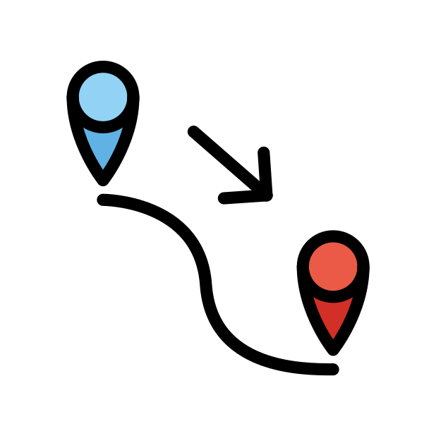
Hard and soft [c]
Some verbs must add a cedilla (ç) before the –ons ending in the nous form so that the sound is soft, like in the infinitive.
parler / écrire
Doit-on utiliser une cédille ? Lis et écoute les mots.
1
commencer | nous commençons
5
prononcer | vous prononcez
a
b
a
b
to start, starting | we start, we are starting
to pronounce| you _{[pl/forma]} pronounce
2
reculer | vous reculez
6
décaler | ils décalent
a
b
a
b
to move back| you_{[pl/formall]} move back
to postpone| they postpone
3
avancer | nous avançons
7
remplacer | nous remplaçons
a
b
a
b
to move forward| we move forward
to replace| we replace
4
raconter | elles racontent
8
renoncer | vous renoncez
a
b
a
b
to tell| they tell
to give up| you _{[pl/formal]} give up
Notes:
Timing: 4minutes
Aim: Oral recognition and transcription of hard [c] and soft [c]/[ç]. This slide also primes students for the spelling change in the 1st person plural form of commencer, which is introduced in this week’s vocabulary set.
Procedure:
1. Tell students that the letters a) and b) hide a cedilla in some cases, and nothing in others.
2. Click on the number buttons to play the audio.
3. Students listen to the pairs of verbs and decide whether the SSCs above a) and b) are hard or soft. With lower levels, you may wish to check that students have this part correct before moving on to 4).
4. Remind students of the spelling rules governing the spelling of soft [c]/[ç]. Students complete the spelling of each word accordingly (either by adding a cedilla, or not).
5. Click to reveal the answers.
6. Click again to reveal translations of the words.
7. Click to reveal the explanation about the spelling change before a 1st person plural ending. NB: This is not a grammar point that students are expected to produce at this stage and will not feature in any NCELP tests. It is showcased here for awareness and passive understanding only.
Transcript:
commencer nous commençons
reculer vous reculez
avancer nous avançons
raconter elles racontent
prononcer vous prononcez
décaler ils décalent
remplacer nous remplaçons
renoncer vous renoncez
Word frequency of unknown words used(1 is the most frequent word in French): commencer [139], reculer [1922], avancer [449], raconter [890], prononcer [706], décaler [>5000], remplacer [448], renoncer [1363]
Source: Londsale, D., & Le Bras, Y. (2009). A Frequency Dictionary of French: Core vocabulary for learners London: Routledge.

Slide 31
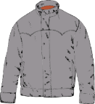
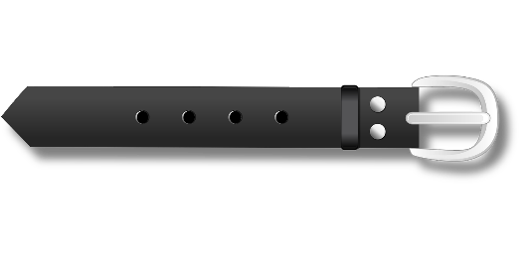
Au magasin de vêtements
Remember:
[-s-] is hard between two vowels.
[c] is hard before a/o/u.
lire / parler
Lisez les listes de mots. Attention aux SCCs en orange !
Ne dites pas l’intrus !
 | des chaussettes | un blouson | un bracelet
 | un pardessus | des lunettes de natation | une blouse
 | un tricot | une ceinture | une jupe plissée
 | un caleçon | des chaussures | une chemisette
 | des lunettes de protection | une vareuse | un chemisier
1
2
3
4
5
Notes:
Timing: 5 minutes
Aim: Pronunciation of words containing SSCs [-s-], [ss], [ç], soft [c], hard [c] and [-tion]. Raising awareness that [ss], [ç], soft [c] and the [t] in [-tion] sound identical.
Procedure:
1. Students read the sets of words, focusing on the SSCs in bold, and mentally eliminating the word containing an SSC which doesn’t match the others.
2. They take it in turns to read aloud the remaining pair of words.
3. Click to reveal the ‘odd one out’. Students say it aloud.
4. Click on the numbers to hear the full line of words said aloud by a native speaker. Students repeat.
Word frequency of cognates used (1 is the most frequent word in French):
protection [953]
Word frequency of unknown words used (1 is the most frequent word in French):
chaussette [>5000], blouson [>5000], jupe [>5000], plissé [>5000], pardessus [>5000], chaussure [3638], tricot [>5000], ceinture [4538], bracelet [>5000], blouse [>5000], caleçon [>5000], chemisette [>5000], lunette [4207], protection [953], vareuse [>5000], chemisier [>5000]
Source: Lonsdale, D., & Le Bras, Y. (2009). A Frequency Dictionary of French: Core vocabulary for learners London: Routledge.

Slide 32
SSC [ç/ soft c]
phonétique
Consolidation [3]

Slide 33
ç/c
ici
Notes:
Timing: 1 minute
Aim: To introduce/consolidate SSC [ç/c]
Procedure: 1. Present the letter(s) and say the [ç/c] sound first, on its own. Students repeat it with you. 2. Bring up the word ”ici” on its own, say it, students repeat it, so that they have the opportunity to focus all of their attention on the connection between the written word and its sound.
3. A possible gesture for this would be to point to the spot on which one is standing / indicate the room in which the lesson is taking place with a sweeping motion of one’s index finger. 4. Roll back the animations and work through 1-3 again, but this time, dropping your voice completely to listen carefully to the students saying the [ç/c] sound, pronouncing ”ici” and, if using, doing the gesture.
Word frequency (1 is the most frequent word in French):
ici [167]. Source: Londsale, D., & Le Bras, Y. (2009). A Frequency Dictionary of French: Core vocabulary for learners London: Routledge.

Slide 34
ç/c
français
garçon
ici
cinéma
cinq
décider
[to decide]
Notes:
Timing: 2 minutes
Aim: To introduce/consolidate SSC [ç/c]
Procedure:
1. Introduce and elicit the pronunciation of the individual SSC [ç/c] and then the source word again ‘ici’ (with gesture, if using). 2. Then present and elicit the pronunciation of the five cluster words.
The cluster words have been chosen for their high-frequency, from a range of word classes, with the SSC (where possible) positioned within a variety of syllables within the words (e.g. initial, 2nd, final etc.). Additionally, we have tried to use words that build cumulatively on previously taught SSCs (see the Phonics Teaching Sequence document) and do not include new SSCs. Where new SSCs are used, they are often consonants which have a similar symbol-sound correspondence in English.
Word frequency (1 is the most frequent word in French): français [251]; garçon [1599]; cinéma [1623]; décider [165]; cinq [288]; ici [167]. Source: Londsale, D., & Le Bras, Y. (2009). A Frequency Dictionary of French: Core vocabulary for learners London: Routledge.

Slide 35
SSC [ç/soft c]
Remember! ‘s’ at the start of a word sounds the same as soft [c]
écouter / écrire
1
Ce morceau de gâteau ici est une source de bonheur pour moi.
This piece of cake here is a source of happiness for me.
2
Certains Français vivent ici, à côté de la rivière courante.
Some French people live here, next to the running river
3
La présence de célébrités incite à la folie.
The presence of celebrities incites madness.
4
Voici la recette de cinquante gâteaux de célébration.
Here is the recipe for fifty celebration cakes.
5
La société peut influencer nos décisions et menacer notre bien-être.
Society can influence our decisions and threaten our well-being.
6
C'est difficile de financer un divorce.
It’s difficult to finance a divorce.
Notes:
Timing: 3 minutes
Aim: recognise SSC [ç/soft c] in sentences
Procedure:
Do number 1 first as an example.
Click audio button.
Students tally how many times they hear SSC [ç/soft c].
Optional – listen again and students attempt full transcription.
Click to reveal full sentences with each SSC [ç/soft c] highlighted.
Draw attention to the word ‘source’ as an example of ‘s’ at the front of a word sounding the same as soft [c].
Repeat steps 2-5 for the remaining sentences. Draw attention to ‘s’ again in sentence 5.
Transcript:
Ce morceau de gâteau ici est une source de bonheur pour moi.
Certains Français vivent ici, à côté de la rivière courante.
La présence de célébrités incite à la folie.
Voici la recette de cinquante gâteaux de célébration.
La société peut influencer nos décisions et menacer notre bien-être.
C'est difficile de financer un divorce.
Word frequency (1 is the most frequent word in French): ce [12], morceau [2118], ici [167], source [817], certain [110], Français [251], présence [365], célébrité [>5000], inciter [2212], voici [1103], cinquante [2273], célébration [>5000], société [1709], influencer [2498], décision [370], menacer [969], difficile [296], financer [1772], divorce [2561]
Source: Lonsdale, D., & Le Bras, Y. (2009). A Frequency Dictionary of French: Core vocabulary for learners London: Routledge.

Slide 36
Le tennis phonétique
parler
Fais attention aux lettres ‘c’
30
concevoir
to design
race
breed
centre
commencer
to start
cercle
efficacité
effectiveness
précisément
precisely
avance
prepayment
glace
cent
concerner
to concern
cellule
secondes
espèce
type
concurrence
competition
cible
océan
civil
recevoir
to receive
efficace
effective
concentrer
to concentrate
0
soupçonner
to suspect
confiance
trust
commercial
précision
DÉBUT
Notes:
Timing: 1 minutes
Aim: Recognise when to produce SSC [ç/soft c]
Procedure:
1. Students work in pairs and take it in turns to read a word off the board as quickly and accurately as possible.
2. Partners must listen for mistakes and correct each other.
3. Click début to start 30s timer.
4. Click on words to hear native pronunciation.
Transcript:
Cercle, commercial, concerner, efficace, concentrer, soupçonner, commencer, océan, cible, glace, race, précision, centre, cent, espèce, concevoir, avance, civil, cellule, confiance, précisément, recevoir, efficacité, concurrence
Word frequency (1 is the most frequent word in French): cercle [2258], commercial [908], concerner [324], efficace [1243], concentrer [856], soupçonner [2375], commencer [139], océan [2513], cible [2740], glace [2580], race [2490], précision [1756], centre [491], cent [704], espèce [1049], concevoir [1100], avance [1087], civil [927], cellule [2151], confiance [435], précisément [1197], recevoir [199], efficacité [1752], concurrence [1005]
Source: Lonsdale, D., & Le Bras, Y. (2009). A Frequency Dictionary of French: Core vocabulary for learners London: Routledge.

