Slide 1
French Phonics Collection
SSC [ch]
Artwork by: Chloé Motard
Date updated: 03/08/2022
Notes:
Artwork by Chloé Motard. All additional pictures selected are available under a Creative Commons license, no attribution required.

Slide 2
SSC [ch]
phonétique
Introduction

Slide 3
ch
chercher
Notes:
Timing: 1 minute
Aim: To introduce/consolidate SSC [ch]
Procedure: 1. Present the letter(s) and say the [ch] sound first, on its own. Students repeat it with you. 2. Bring up the word ”chercher” on its own, say it, students repeat it, so that they have the opportunity to focus all of their attention on the connection between the written word and its sound.
3. A possible gesture for this would be to mime looking for something everywhere. 4. Roll back the animations and work through 1-3 again, but this time, dropping your voice completely to listen carefully to the students saying the [ch] sound, pronouncing ”chercher” and, if using, doing the gesture.
Word frequency (1 is the most frequent word in French):
chercher [336]. Source: Londsale, D., & Le Bras, Y. (2009). A Frequency Dictionary of French: Core vocabulary for learners London: Routledge.

Slide 4
ch
chercher
Notes:
With sound and no pictures to focus all attention on the sound-symbol correspondence.

Slide 5
ch
chercher
Notes:
Without sound to elicit pronunciation (without first hearing the teacher).
Teacher to elicit pronunciation by asking “Comment dit-on …”/

Slide 6
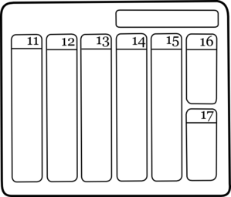
ch
dimanche
chanter
chercher
bouche
chat
champ
[field]
Notes:
Timing: 2 minutes
Aim: To introduce/consolidate SSC [ch]
Procedure:
1. Introduce and elicit the pronunciation of the individual SSC [ch] and then the source word again ‘chercher’ (with gesture, if using). 2. Then present and elicit the pronunciation of the five cluster words.
The cluster words have been chosen for their high-frequency, from a range of word classes, with the SSC (where possible) positioned within a variety of syllables within the words (e.g. initial, 2nd, final etc.). Additionally, we have tried to use words that build cumulatively on previously taught SSCs (see the Phonics Teaching Sequence document) and do not include new SSCs. Where new SSCs are used, they are often consonants which have a similar symbol-sound correspondence in English.
Word frequency (1 is the most frequent word in French): dimanche [1235]; chanter [1820] bouche [1838]; champ [847]; chat [3138]; chercher [336]. Source: Londsale, D., & Le Bras, Y. (2009). A Frequency Dictionary of French: Core vocabulary for learners London: Routledge.

Slide 7
ch
dimanche
chanter
chercher
bouche
chat
champ
Notes:
With sound and no pictures to focus all attention on the sound-symbol correspondence.

Slide 8
ch
dimanche
chanter
chercher
bouche
chat
champ
Notes:
Without sound to elicit pronunciation (without first hearing the teacher).
Teacher to elicit pronunciation by asking “Comment dit-on …”

Slide 9
Phonétique
écouter / écrire
C’est [ch] ou [s(s)] ?
broche brooch
brosse brush
1
2
3
4
5
6
a
b
a
mâche chews, is chewing
b
masse mass
a
sot silly
b
chaud hot
a
crasse grime
b
crache spits, is spitting
a
sait knows, is knowing
b
chez at
chut hush
su knew
a
b
Notes:
Timing: 5 minutes Aim: To differentiate between pairs of words that differ by one phoneme (one SSC that changes the meaning). These words are called minimal pairs. Procedure: 1. Click on the letter triggers (a then b for numbers 1-6) to play the audio. 2. Students write [ch] or [s(s)] for each pair.
3. Click to see the answers.
Transcript:
1a. broche - b. brosse
2a. mâche - b. masse
3a. sot - b. chaud
4a. crasse - b. crache
5a. sait - b. chez
6a. chut - b. su
Word frequency of unknown vocabulary (1 is the most frequent word in French): broche [>5000], brosse [>5000], mâcher [>5000], masse [1826], sot [>5000], chaud [1852], crasse [>5000], cracher [>5000], savoir [67], chez [206]
Source: Londsale, D., & Le Bras, Y. (2009). A Frequency Dictionary of French: Core vocabulary for learners London: Routledge.

Slide 10
Phonétique
Phonétique
écouter / parler
Le chat et la biche achètent des brioches.
1
The cat and the deer are buying brioche.
Le champion cache son chapeau.
2
The champion is hiding his hat.
La machine à gauche marche.
3
The machine on the left is working.
C’est la moustache du maréchal !
4
It’s the Marshall’s moustache!
Notes:
Timing: 8 minutes
Aim: to recognise and produce SSC [ch] within words at sentence level.
Procedure:
1. Click on the number trigger to play the audio.
2. Students tally the number of times they hear SSC [ch].
3. Click to reveal answers.
4. Students take turns to read the words containing [ch] only aloud (at more advanced levels, students may wish to try reading the whole sentence, paying special attention to the words containing [ch].) The listening partner ensures [ch] is not pronounced the English way. If it is, the speaking student must read it again three times.
5. Click to check pronunciation.
Transcript:
1) Le chat et la biche achètent des brioches.
2) Le champion cache son chapeau.
3) La machine à gauche marche.
4) C’est la moustache du Maréchal !
Word frequency of unknown vocabulary (1 is the most frequent word in French): chat [3138], biche [>5000], acheter [636], brioche [>5000], champion [2443], cacher [914], chapeau [2908], machine [1294], gauche [607], marcher [1532], moustache [>5000], maréchal [>5000]

Slide 11
SSC [ch]
phonétique
Consolidation [1]

Slide 12
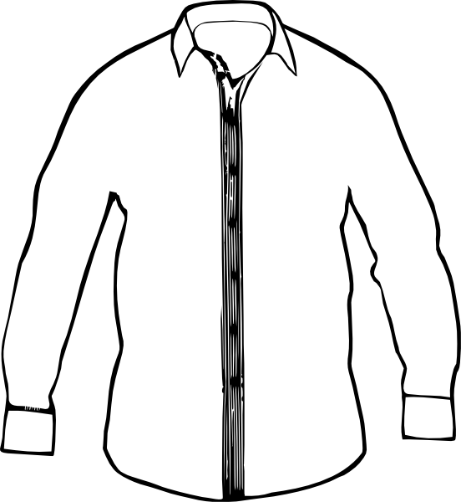
Phonétique
Dis les mots en français. Quelle est la SSC de la semaine ?
Notes:
Timing: 1 minute
Aim: To identify a shared SSC from a set of known vocabulary items.
Procedure:
Students work in pairs to say/write the words and identify the shared SSC.
First pair to put hands up have a go – must say all words correctly and work out the sound.
Click the image to play the audio.
Answers:
chien
cocher
chemise

Slide 13
ch
chercher
Notes:
Timing: 1 minute
Aim: To consolidate SSC [ch]
Procedure: 1. Present the letter(s) and say the [ch] sound first, on its own. Students repeat it with you. 2. Bring up the word ”chercher” on its own, say it, students repeat it, so that they have the opportunity to focus all of their attention on the connection between the written word and its sound.
3. A possible gesture for this would be to mime looking for something everywhere. 4. Roll back the animations and work through 1-3 again, but this time, dropping your voice completely to listen carefully to the students saying the [ch] sound, pronouncing ”chercher” and, if using, doing the gesture.
Word frequency (1 is the most frequent word in French):
chercher [336]. Source: Londsale, D., & Le Bras, Y. (2009). A Frequency Dictionary of French: Core vocabulary for learners London: Routledge.

Slide 14
ch
chercher
Notes:
With sound and no pictures to focus all attention on the sound-symbol correspondence.

Slide 15
ch
chercher
Notes:
Without sound to elicit pronunciation (without first hearing the teacher).
Teacher to elicit pronunciation by asking “Comment dit-on …"

Slide 16
ch
dimanche
chanter
chercher
bouche
chat
champ
[field]
Notes:
Timing: 2 minutes
Aim: To consolidate SSC [ch]
Procedure:
1. Introduce and elicit the pronunciation of the individual SSC [ch] and then the source word again ‘chercher’ (with gesture, if using). 2. Then present and elicit the pronunciation of the five cluster words.
The cluster words have been chosen for their high-frequency, from a range of word classes, with the SSC (where possible) positioned within a variety of syllables within the words (e.g. initial, 2nd, final etc.). Additionally, we have tried to use words that build cumulatively on previously taught SSCs (see the Phonics Teaching Sequence document) and do not include new SSCs. Where new SSCs are used, they are often consonants which have a similar symbol-sound correspondence in English.
Word frequency (1 is the most frequent word in French): dimanche [1235]; chanter [1820] bouche [1838]; champ [847]; chat [3138]; chercher [336]. Source: Londsale, D., & Le Bras, Y. (2009). A Frequency Dictionary of French: Core vocabulary for learners London: Routledge.

Slide 17
ch
dimanche
chanter
chercher
bouche
chat
champ
Notes:
With sound and no pictures to focus all attention on the sound-symbol correspondence.

Slide 18
ch
dimanche
chanter
chercher
bouche
chat
champ
Notes:
Without sound to elicit pronunciation (without first hearing the teacher).
Teacher to elicit pronunciation by asking “Comment dit-on …"

Slide 19
En anglais et en français
En anglaise et en français
lire / écouter
same [ch]
different [ch]
same [ch]
different [ch]
1
chef
6
champagne
2
avalanche
7
chocolat
3
touche
8
champion
4
brochure
9
moustache
5
charge
10
riche
Notes:
Timing: 5 minutes (6 slides)
Aim: Highlight similarities in and differences between the English and French pronunciation of the SSC [ch]
Procedure:
Students write 1-10 in their exercise books and decide whether they think SSC [ch] will sound the same as in English, or different from the English.
Click on the numbers to listen to the words. Students check their answers.
Teachers to highlight that, where the sound is ‘sh’ in English, these words are “borrowed” from French (chef, brochure, champagne, moustache).
TRANSCRIPT:
chef
avalanche
touche
brochure
charge
champagne
chocolat
champion
moustache
riche
Frequency rankings (1 is the most frequent word in French):
avalanche [4426], brochure [>5000], champagne [>5000], champion [2443], charge [849], chef [386], chocolat [4556], moustache [>5000], riche [599], touche [3775]
Source: Londsale, D., & Le Bras, Y. (2009). A Frequency Dictionary of French: Core vocabulary for learners London: Routledge

Slide 20
Phonétique
parler
Remember ! Two pronunciations in English, one pronunciation in French!
chef
champagne
avalanche
chocolat
touche
champion
brochure
moustache
charge
riche
Notes:
Timing: 5 minutes
Aim: Oral production of SSC [ch]. Consolidation of the idea that there is only on possible pronunciation of SSC [ch] in French, whereas there are two in English.
Procedure:
1. Students say the words (which featured in the listening task in lesson 1) in pairs, each choosing a word from a different side, then swapping sides.
2. Students check each others’ pronunciation, trying to get the longest ‘rally’ of correct pronunciations.
3. The teacher circulates to check that students are drawing on their existing knowledge of French SSCs to pronounce the words accurately and avoid L1 interference.
4. Before beginning the task, teacher to remind students: two pronunciations in English, one pronunciation in French.

Slide 21
SSC [ch]
phonétique
Consolidation [2]

Slide 22
ch
chercher
Notes:
Timing: 1 minute [2 slides]
Aim: To consolidate SSC [ch]
Procedure: 1. Present the letter(s) and say the [ch] sound first, on its own. Students repeat it with you. 2. Bring up the word ”chercher” on its own, say it, students repeat it, so that they have the opportunity to focus all of their attention on the connection between the written word and its sound.
3. A possible gesture for this would be to mime looking for something everywhere. 4. Roll back the animations and work through 1-3 again, but this time, dropping your voice completely to listen carefully to the students saying the [ch] sound, pronouncing ”chercher” and, if using, doing the gesture.
Word frequency (1 is the most frequent word in French):
chercher [336]. Source: Londsale, D., & Le Bras, Y. (2009). A Frequency Dictionary of French: Core vocabulary for learners London: Routledge.

Slide 23
ch
dimanche
chanter
chercher
bouche
chat
champ
[field]
Notes:
Aim: To consolidate SSC [ch]
Procedure:
1. Introduce and elicit the pronunciation of the individual SSC [ch] and then the source word again ‘chercher’ (with gesture, if using). 2. Then present and elicit the pronunciation of the five cluster words.
The cluster words have been chosen for their high-frequency, from a range of word classes, with the SSC (where possible) positioned within a variety of syllables within the words (e.g. initial, 2nd, final etc.). Additionally, we have tried to use words that build cumulatively on previously taught SSCs (see the Phonics Teaching Sequence document) and do not include new SSCs. Where new SSCs are used, they are often consonants which have a similar symbol-sound correspondence in English.
Word frequency (1 is the most frequent word in French): dimanche [1235]; chanter [1820] bouche [1838]; champ [847]; chat [3138]; chercher [336]. Source: Londsale, D., & Le Bras, Y. (2009). A Frequency Dictionary of French: Core vocabulary for learners London: Routledge.

Slide 24
Des groupes consonantiques
écouter / écrire
Coche chaque fois que tu entends une des SSCs [th], [ch] ou [qu].
 | th | ch | qu | phrase
 |  |  |  | Mathieu est athlète.
 |  |  |  | Il cherche des marathons au Québec…
 |  |  |  | …parce qu’il est enthousiaste.
 |  |  |  | Son chat, Thibaut, mâche du thon québécois.
 |  |  |  | Son chien, Véronique, est chez Monique.
1
Mathieu is an athlete.
Ma__ieu est a__lète.
He looks for/is looking for marathons in Quebec…
Il __er__e des mara__ons au __ébec…
2
3
…because he is enthusiastic.
…parce __’il est en__ousiaste.
His cat, Thibaut, chews/is chewing tuna from Quebec.
4
Son __at, __ibaut, mâ__e du __on __ébecois.
Son __ien, Véroni__e, est __ez Moni__e.
His dog, Véronique, is at Monique’s place.
5
Notes:
Timing: 8 minutes
Aim: Aural recognition of SSCs [th], [ch], [qu] in longer contexts. Raising awareness of cross-linguistic differences in the pronunciation of these consonant clusters through use of cognate words.
Procedure:
1. Click on the buttons to play the audio.
2. Students listen and tick or transcribe the target SSCs.
3. Click to reveal answers (with more advanced classes, skip this step and move to step 4 to challenge students to translate the sentences through listening alone).
4. Students use the answers to try to translate the sentences into English, noticing the cognate words that they have transcribed.
5. Click to reveal answers.
6. Ask students to identify other SSCs in the sentence that sound identical to [th] and [qu] ([t] and hard [c] in enthousiaste and Québec).
Transcript:
1. Mathieu est athlète.
2. Il cherche des marathons au Québec…
3. …parce qu’il est enthousiaste.
4. Son chat, Thibault, mâche du thon québécois.
5. Son chien, Véronique, est chez Monique.
Word frequency of cognates used (1 is the most frequent word in French):
athlète [4722], marathon [>5000], enthousiaste [4287], groupe [187], consonantique [<5000]
Word frequency of unknown words used (1 is the most frequent word in French):
mâcher [>5000], thon [>5000]
Source: Lonsdale, D., & Le Bras, Y. (2009). A Frequency Dictionary of French: Core vocabulary for learners London: Routledge.

Slide 25
Phonétique
écouter / écrire
Personne A lit la phrase. Personne B coche chaque fois qu’il/elle entend [th, [ch] ou [qu].
Charles va chez Thérèse chaque dimanche.
1
2
3
 | th | ch | qu | en anglais
1 |  |  |  | Charles goes to Thérèse’s place every Sunday.
2
3
4
Notes:
Timing: 8 minutes. This is slide 1/7.
Aim: Oral production and aural recognition of SSCs [th], [ch], [qu].
Procedure:
1. Students prepare for the activity by sketching the grid pictured on this slide. Use the sentence on this slide as an example to model steps 2-6 below.
2. Students work in pairs. Student A faces the board. Student B turns away.
3. Student A reads the sentence from the board. Student B has their back to the board and ticks the SSCs they hear.
4. Student B turns back to the board to check the answer, revealed on clicks.
5. Students use their knowledge of cognates to guess the English meaning of the sentence, revealed on a further click. At more advanced levels, the listening student could try to do this as part of step 3.
6. Both students practice saying the sentences at increasing speeds to increase fluency of production. Click on the numbers 1-3 to hear the sentences read aloud at different speeds. Students listen and repeat.
7. Repeat steps 2-7 for the remaining sentences.

Slide 26
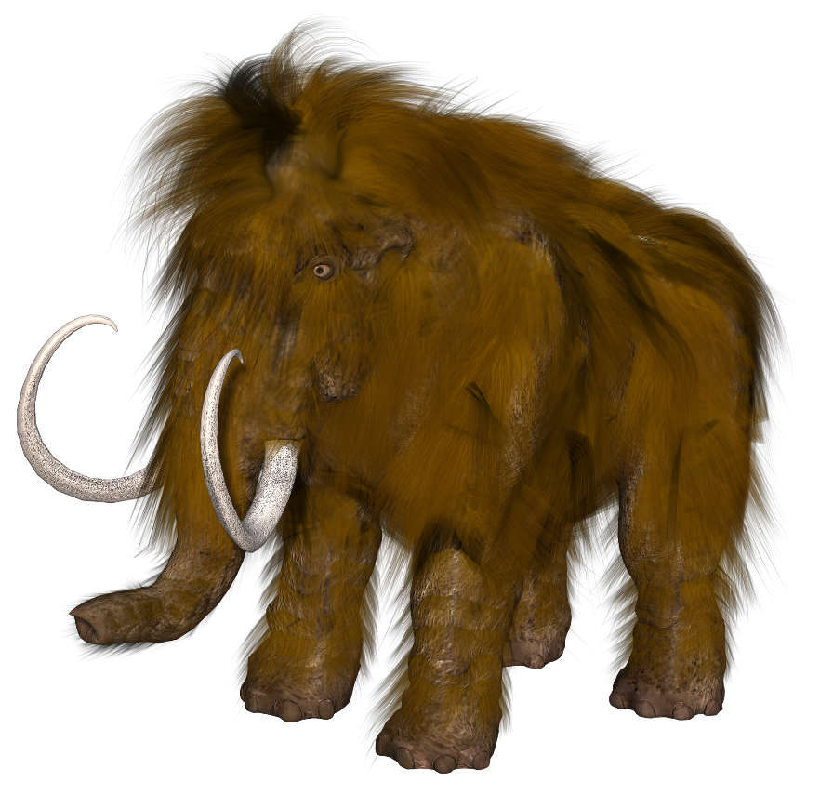
Phonétique
écouter / écrire
Michel le mammouth explique qu’il vient de Belgique.
Michel the mammoth explains that he comes from Belgium.
1
2
3
Notes:
This is slide 2/7
Word frequency of cognates used (1 is the most frequent word in French):
mammouth [<5000]
Source: Lonsdale, D., & Le Bras, Y. (2009). A Frequency Dictionary of French: Core vocabulary for learners London: Routledge.

Slide 27
Phonétique
écouter / écrire
Frédérique choisit la musique catholique.
Frédérique chooses Catholic music.
1
2
3
Notes:
This is slide 3/7
Word frequency of cognates used (1 is the most frequent word in French):
catholique [1578]
Source: Lonsdale, D., & Le Bras, Y. (2009). A Frequency Dictionary of French: Core vocabulary for learners London: Routledge.

Slide 28
Phonétique
écouter / écrire
Les quatre chats sympathiques cherchent quatre chaises chaudes.
The four nice cats are looking for four warm chairs.
1
2
3
Notes:
This is slide 4/7
Word frequency of unknown words used (1 is the most frequent word in French):
chaise [3419]
Source: Lonsdale, D., & Le Bras, Y. (2009). A Frequency Dictionary of French: Core vocabulary for learners London: Routledge.

Slide 29
Phonétique
écouter / écrire
Les dimanches, Agathe va au théâtre, aux champs, et à la bibliothèque.
On Sundays, Agathe goes to the theatre, to the fields, and to the library.
1
2
3
Notes:
This is slide 5/7
Word frequency of cognates used (1 is the most frequent word in French):
théâtre [1701]
Word frequency of unknown words used (1 is the most frequent word in French):
champ [847]
Source: Lonsdale, D., & Le Bras, Y. (2009). A Frequency Dictionary of French: Core vocabulary for learners London: Routledge.

Slide 30
Phonétique
écouter / écrire
Le chef fait des recherches sur le thé à la menthe.
The boss is doing research on mint tea.
1
2
3
Notes:
This is slide 6/7
Word frequency of unknown words used (1 is the most frequent word in French):
chef [386], recherche [357], menthe [>5000]
Source: Lonsdale, D., & Le Bras, Y. (2009). A Frequency Dictionary of French: Core vocabulary for learners London: Routledge.

Slide 31
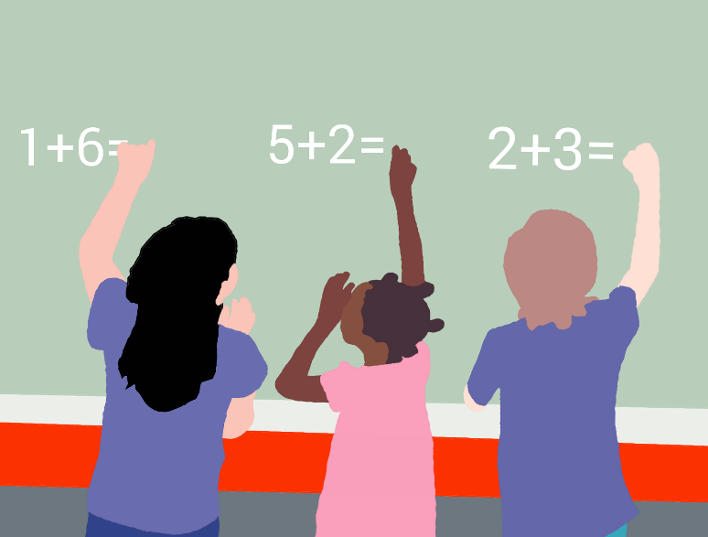
Phonétique
écouter / écrire
Dominique a des questions sur les méthodes chinoises de maths.
Dominique has some questions about Chinese maths methods.
1
2
3
Notes:
This is slide 7/7
Word frequency of cognates used (1 is the most frequent word in French):
méthode [1149], chinois [1914]
Source: Lonsdale, D., & Le Bras, Y. (2009). A Frequency Dictionary of French: Core vocabulary for learners London: Routledge.

Slide 32
SSC [ch]
phonétique
Consolidation [3]

Slide 33
ch
chercher
Notes:
Timing: 1 minute
Aim: To consolidate SSC [ch]
Procedure: 1. Present the letter(s) and say the [ch] sound first, on its own. Students repeat it with you. 2. Bring up the word ”chercher” on its own, say it, students repeat it, so that they have the opportunity to focus all of their attention on the connection between the written word and its sound.
3. A possible gesture for this would be to mime looking for something everywhere. 4. Roll back the animations and work through 1-3 again, but this time, dropping your voice completely to listen carefully to the students saying the [ch] sound, pronouncing ”chercher” and, if using, doing the gesture.
Word frequency (1 is the most frequent word in French):
chercher [336]. Source: Lonsdale, D., & Le Bras, Y. (2009). A Frequency Dictionary of French: Core vocabulary for learners London: Routledge.

Slide 34
ch
dimanche
chanter
chercher
bouche
chat
champ
[field]
Notes:
Timing: 2 minutes
Aim: To consolidate SSC [ch]
Procedure:
1. Introduce and elicit the pronunciation of the individual SSC [ch] and then the source word again ‘chercher’ (with gesture, if using). 2. Then present and elicit the pronunciation of the five cluster words.
The cluster words have been chosen for their high-frequency, from a range of word classes, with the SSC (where possible) positioned within a variety of syllables within the words (e.g. initial, 2nd, final etc.). Additionally, we have tried to use words that build cumulatively on previously taught SSCs (see the Phonics Teaching Sequence document) and do not include new SSCs. Where new SSCs are used, they are often consonants which have a similar symbol-sound correspondence in English.
Word frequency (1 is the most frequent word in French): dimanche [1235]; chanter [1820] bouche [1838]; champ [847]; chat [3138]; chercher [336]. Source: Lonsdale, D., & Le Bras, Y. (2009). A Frequency Dictionary of French: Core vocabulary for learners London: Routledge.

Slide 35
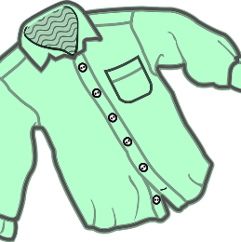
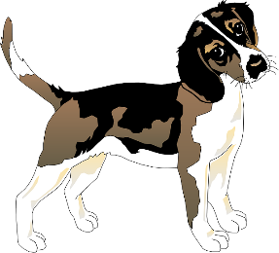
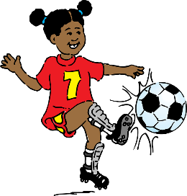
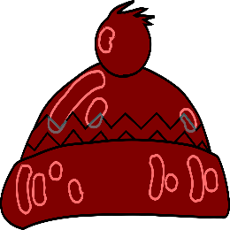
Phonétique: SSC [ch]
Qui va avec chaque phrase?
parler
Catherine
Mathéo
Nathalie
Théophile
Elizabeth
Nathan
Mathéo
1
Nathan
2
Nathalie
3
…cherche son chien, Charles
…. boit du chocolat chaud
… est la prochaine championne de foot
Théophile
4
Elizabeth
5
Catherine
6
…. va chez le boucher chaque dimanche.
… touche un chapeau en chenille
…choisit une chemise chère de Chanel
Notes:
Timing: 3 minutes
Aim: To consolidate pronunciation of SSC [th] and [ch]
Procedure:
Ask students to match each person to the correct sentence, using the picture clues.
Students read the complete matched sentences, paying close attention to the pronunciation of the SSC [th].
Click on the audio boxes to hear the sentences spoken by a native speaker to verify the answers.
Transcript:
Mathéo cherche son chien, Charles.
Nathan boit du chocolat chaud.
Nathalie est la prochaine championne de foot.
Théophile va chez le boucher chaque dimanche.
Élizabeth touche un chapeau en chenille.
Catherine choisit une chemise chère de Chanel.
Word frequency of cognates used (1 is the most frequent word in French): athlète [4722], mandarine [>5000], thérapie [4420], python [>5000], enthousiaste [4287]
Source: Lonsdale, D., & Le Bras, Y. (2009). A Frequency Dictionary of French: Core vocabulary for learners London: Routledge.
Word frequency (1 is the most frequent word in French): menthe [>5000], météo [4574]
Source: Londsale, D., & Le Bras, Y. (2009). A Frequency Dictionary of French: Core vocabulary for learners London: Routledge.

Slide 36
Des virelangues
Écoute. Combien de fois entends-tu les SSCs [th] et [ch] ?
écouter/parler
[th] and [t] sound the same, but in this task, if you hear a ‘t’ sound, it is written [th].
 |  | [th] | [ch]
 | Cinq chiens chassent six chats. |  | |||
 | Charlène cherche une chemise sans manches. |  | |||||
 | Édith est sympathique mais son chapeau est moche. | || | ||
 | Thierry marche sur chaque chemin sans changer de chaussures. | | | |||||
 | L'athénien charmant aime les bonbons à la menthe. | || | |
 | Sacha le professeur de chimie aime les maths et l'éthique. | || | ||
1
2
3
4
#
5
6
Notes:
Timing: 6 minutes
Aim: Consolidation of recognition of SSCs [th] and [ch]
Procedure:
Click the buttons to play audio.
Students tally how many times they hear [th] and [ch].
Click to reveal answers and sentences.
Transcript:
Cinq chiens chassent six chats.
Charlène cherche une chemise sans manches.
Édith est sympathique mais son chapeau est moche.
Thierry marche sur chaque chemin sans changer de chaussures.
L’athénien charmant aime les bonbons à la menthe.
Sacha le professeur de chimie aime les maths et l’éthique.
Word frequency of unknown words used (1 is the most frequent word in French): chaser [2364], manche [3437], moche [>5000], chaussure [3638], athénien [>5000], charmant [4030], bonbon [>5000], menthe [>5000], chimie [4073], éthique [2747]
Source: Lonsdale, D., & Le Bras, Y. (2009). A Frequency Dictionary of French: Core vocabulary for learners London: Routledge.

Slide 37
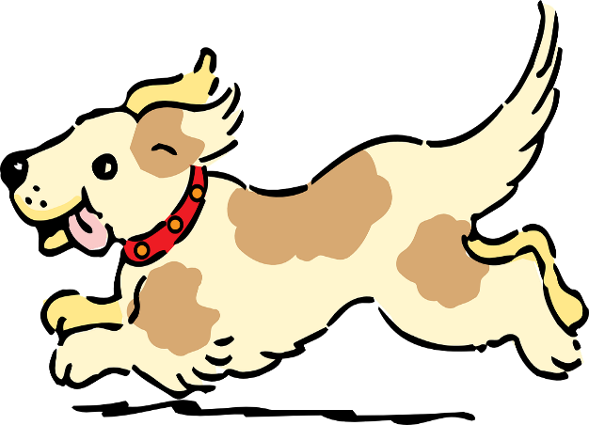
Des virelangues avec [ch] et [th]
lire / parler
Parle aussi vite que possible!
Cinq chiens chassent six chats.
[Five dogs chase six cats]
A
B
C
Notes:
Slide 1 of 6
Timing: 6 minutes for 6 slides
Aim: Practise pronunciation of SSC [ch] and [th] in the form of tongue twisters
Procedure:
1. Students read the sentences aloud, aiming for accurate pronunciation as quickly as possible.
2. Click audio buttons to hear three different speeds (A = slowest, C = fastest).
3. Repeat on next three slides for three more tongue twisters.
Transcript:
Cinq chiens chassent six chats.

Slide 38
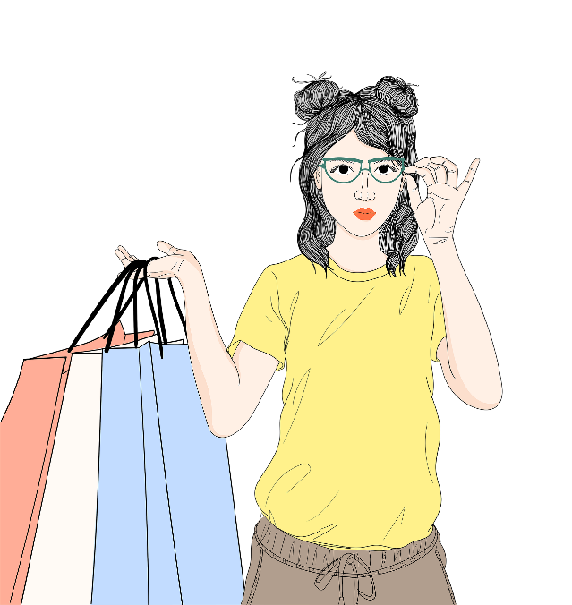
Des virelangues avec [ch] et [th]
lire / parler
Parle aussi vite que possible!
Charlène cherche une chemise sans manches.
[Charlène is looking for a blouse with no sleeves.]
A
B
C
Notes:
Slide 2 of 6
Transcript:
Charlène cherche une chemise sans manches.

Slide 39
Des virelangues avec [ch] et [th]
lire / parler
Parle aussi vite que possible!
Édith est sympathique mais son chapeau est moche.
[Édith is nice but her hat is ugly.]
A
B
C
Notes:
Slide 3 of 6
Transcript:
Édith est sympathique mais son chapeau est moche.

Slide 40
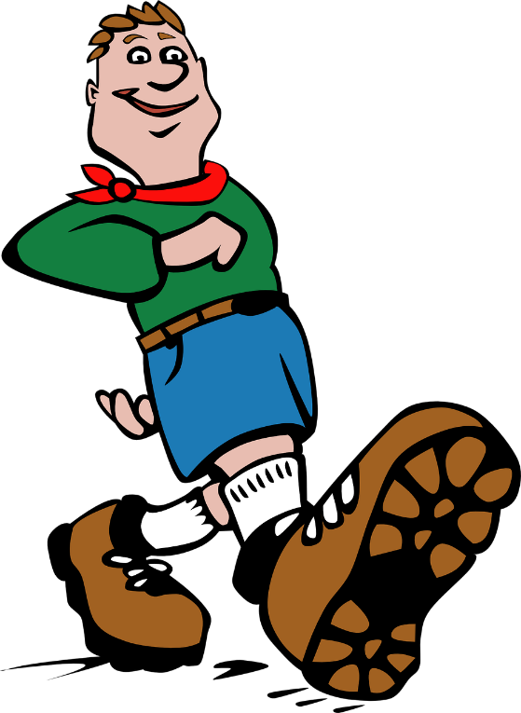
Des virelangues avec [ch] et [th]
lire / parler
Parle aussi vite que possible!
Thierry marche sur chaque chemin sans changer de chaussures.
[Thierry walks on every path without changing shoes.]
A
B
C
Notes:
Slide 4 of 6
Transcript:
Thierry marche sur chaque chemin sans changer de chaussures.

Slide 41
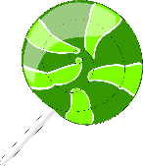
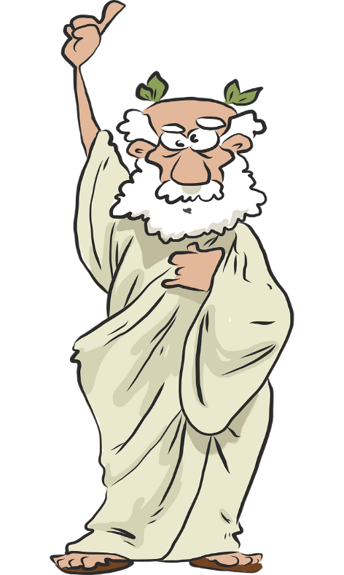
Des virelangues avec [ch] et [th]
lire / parler
Parle aussi vite que possible!
L’athénien charmant aime les bonbons à la menthe.
[The charming man from Athens likes mint sweets.]
A
B
C
Notes:
Slide 5 of 6
Transcript:
L’athénien charmant aime les bonbons à la menthe.

Slide 42
Des virelangues avec [ch] et [th]
lire / parler
Parle aussi vite que possible!
Sacha le professeur de chimie aime les maths et l’éthique.
[Sacha the chemistry teacher likes maths and ethics.]
A
B
C
Notes:
Slide 6 of 6
Transcript:
Sacha le professeur de chimie aime les maths et l’éthique.

