Slide 1
French Phonics Collection
SSC [au]
Artwork by: Chloé Motard
Date updated: 31/08/2022
Notes:
Artwork by Chloé Motard. All additional pictures selected are available under a Creative Commons license, no attribution required.

Slide 2
SSC [au]
phonétique
Introduction

Slide 3
au
[au/eau]
gauche
Notes:
Timing: 1 minute
Aim: To introduce/consolidate SSC [au]
Procedure: 1. Present the letter(s) and say the [au] sound first, on its own. Students repeat it with you. 2. Bring up the word ”gauche” on its own, say it, students repeat it, so that they have the opportunity to focus all of their attention on the connection between the written word and its sound.
3. A possible gesture for this would be to point to the students’ left (teacher’s right!) to indicate this direction. 4. Roll back the animations and work through 1-3 again, but this time, dropping your voice completely to listen carefully to the students saying the [au] sound, pronouncing ”gauche” and, if using, doing the gesture.
Word frequency (1 is the most frequent word in French):
gauche [607].
Source: Londsale, D., & Le Bras, Y. (2009). A Frequency Dictionary of French: Core vocabulary for learners London: Routledge.

Slide 4
au
[au/eau]
gauche
Notes:
With sound and no pictures to focus all attention on the sound-symbol correspondence.

Slide 5
au
[au/eau]
gauche
Notes:
Without sound to elicit pronunciation (without first hearing the teacher).
Teacher to elicit pronunciation by asking “Comment dit-on …"

Slide 6
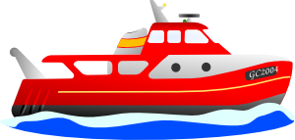
au
faux
bateau
[au/eau]
beau
eau
gauche
aussi
[also]
Notes:
Timing: 2 minutes
Aim: To introduce/consolidate SSC [au]
Procedure:
1. Introduce and elicit the pronunciation of the individual SSC [au] and then the source word again ‘gauche’ (with gesture, if using). 2. Then present and elicit the pronunciation of the five cluster words.
The cluster words have been chosen for their high-frequency, from a range of word classes, with the SSC (where possible) positioned within a variety of syllables within the words (e.g. initial, 2nd, final etc.). Additionally, we have tried to use words that build cumulatively on previously taught SSCs (see the Phonics Teaching Sequence document) and do not include new SSCs. Where new SSCs are used, they are often consonants which have a similar symbol-sound correspondence in English.
Word frequency (1 is the most frequent word in French): gauche [607]; aussi [44]; faux [555] bateau [1278]; beau [393]; eau [475] Source: Londsale, D., & Le Bras, Y. (2009). A Frequency Dictionary of French: Core vocabulary for learners London: Routledge.

Slide 7
au
faux
bateau
[au/eau]
beau
eau
gauche
aussi
Notes:
With sound and no pictures to focus all attention on the sound-symbol correspondence.

Slide 8
au
faux
bateau
[au/eau]
beau
eau
gauche
aussi
Notes:
Without sound to elicit pronunciation (without first hearing the teacher).
Teacher to elicit pronunciation by asking “Comment dit-on …"

Slide 9
Phonétique – c’est [au] ?
écouter / parler
restaurant
uniforme
piano
docteur
radio
poste
intéressant
professeur
[(e)au / o]
personne
[other sounds]
Notes:
Timing: 5 minutes
Aim: Aural recognition and production of SSC [au].
Procedure:
Click on a word to hear it said out loud.
Students allocate each word to either the left bucket, if they think the SCE in bold is [au] or the right bucket, if not. Tell students that even though these words look like English, English will not help them. Sometimes the SSCs sound the same as English, sometimes not.
Click to check and clarify the meaning of the words.
Once all the words have been assigned, reset the slide.
Students now try saying the words.
Click to check.
Transcript and word frequency (1 is the most frequent word in French):
restaurant [2336], uniforme [1801], piano [4967], docteur [2176], radio [1526], poste [489], intéressant [1244], professeur [1150], personne [84]

Slide 10
Phonétique – c’est [au] ?
écouter
Les faux animaux sont à gauche.
1
The fake animals are on the left.
Le bateau est sur l’eau.
2
The boat is on the water.
Ce nouveau tableau montre le problème.
3
This new chart shows the problem.
Il porte le cadeau jaune au bureau.
4
He is carrying the yellow present to the office.
Notes:
Timing: 3 minutes
Aim: Aural identification of SSC [au] in sentences.
Procedure:
Click on the numbers to play audio. Tel students they won’t understand the meaning of the sentences, they just need to listen out for the sound.
Students tally the number of times they hear the SSC [au].
On clicks, transcriptions of the sentences appear. Students use these to check their answers.
On a second round of clicks, the answers appear one by one.
On a final round of clicks, English translations appear.
Word frequency of unknown target words (1 is the most frequent word in French):
faux [555], animal [1002], gauche [607], bateau [1287], eau [475], nouveau [52], tableau [1456], cadeau [2298], jaune [2585], au [4, 1], bureau [273]

Slide 11
SSC [au]
phonétique
Consolidation [1]

Slide 12
au
[au/eau]
gauche
Notes:
Timing: 1 minute
Aim: To introduce/consolidate SSC [au]
Procedure: 1. Present the letter(s) and say the [au] sound first, on its own. Students repeat it with you. 2. Bring up the word ”gauche” on its own, say it, students repeat it, so that they have the opportunity to focus all of their attention on the connection between the written word and its sound.
3. A possible gesture for this would be to point to the students’ left (teacher’s right!) to indicate this direction. 4. Roll back the animations and work through 1-3 again, but this time, dropping your voice completely to listen carefully to the students saying the [au] sound, pronouncing ”gauche” and, if using, doing the gesture.
Word frequency (1 is the most frequent word in French):
gauche [607].
Source: Londsale, D., & Le Bras, Y. (2009). A Frequency Dictionary of French: Core vocabulary for learners London: Routledge.

Slide 13
au
[au/eau]
gauche
Notes:
With sound and no pictures to focus all attention on the sound-symbol correspondence.

Slide 14
au
[au/eau]
gauche
Notes:
Without sound to elicit pronunciation (without first hearing the teacher).
Teacher to elicit pronunciation by asking “Comment dit-on …"

Slide 15
au
faux
bateau
[au/eau]
beau
eau
gauche
aussi
[also]
Notes:
Timing: 2 minutes
Aim: To introduce/consolidate SSC [au]
Procedure:
1. Introduce and elicit the pronunciation of the individual SSC [au] and then the source word again ‘gauche’ (with gesture, if using). 2. Then present and elicit the pronunciation of the five cluster words.
The cluster words have been chosen for their high-frequency, from a range of word classes, with the SSC (where possible) positioned within a variety of syllables within the words (e.g. initial, 2nd, final etc.). Additionally, we have tried to use words that build cumulatively on previously taught SSCs (see the Phonics Teaching Sequence document) and do not include new SSCs. Where new SSCs are used, they are often consonants which have a similar symbol-sound correspondence in English.
Word frequency (1 is the most frequent word in French): gauche [607]; aussi [44]; faux [555] bateau [1278]; beau [393]; eau [475] Source: Londsale, D., & Le Bras, Y. (2009). A Frequency Dictionary of French: Core vocabulary for learners London: Routledge.

Slide 16
au
faux
bateau
[au/eau]
beau
eau
gauche
aussi
Notes:
With sound and no pictures to focus all attention on the sound-symbol correspondence.

Slide 17
au
faux
bateau
[au/eau]
beau
eau
gauche
aussi
Notes:
Without sound to elicit pronunciation (without first hearing the teacher).
Teacher to elicit pronunciation by asking “Comment dit-on …"

Slide 18
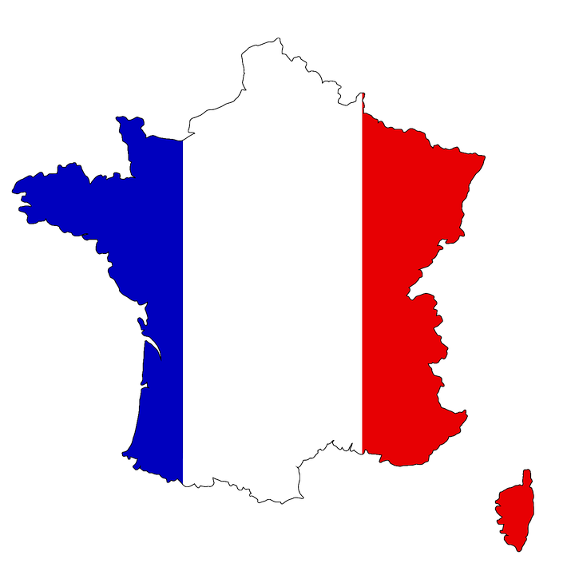
Phonétique
écouter / parler
Do these place names contain the sound [au]? Écoutez et cochez.
 |  | Oui | Non
 | Bordeaux
 | Gren o ble
 | C o rse
 | Beauvais
 | L au sanne
 | O rléans
 | Aix-en-Pr o vence
 | Monaco
1
____
2
____
3
____
4
____
The letter ‘o’ is sometimes (but not always!) pronounced like [au] too.
5
____
6
____
7
____
8
____
Notes:
Timing: 5 minutes
Aim: Oral recognition of SSC [au].
The exercise also provides an opportunity to review SFCs (Bordeaux, Beauvais, Orléans) and the previously studied SSCs [é] (Orléans), [en] (Aix-en-Provence) and [ai] (Beauvais, Aix-en-Provence).
Procedure:
1. The place names are heard on individual number clicks. To allow students to compare the sounds, it is recommended that the teacher cycles through the recordings (from 1-8) at least twice.
2. Teacher reveals answers on clicks. Teacher to highlights the fact that some place names, (Bordeaux, Monaco) contain both sounds, and that the letter ‘o’ is not always pronounced [au] (this will be explored further in Year 8). Teacher can illustrate this by giving examples of previously encountered words such as modèle, école, ordinateur …
3. Teacher elicits pronunciation by pointing at the word and asking ‘Comment dit-on numéro un, deux…’
4. Teacher plays each place name again, and students repeat chorally.
Transcript:
Bordeaux
Grenoble
Corse
Beauvais
Lausanne
Aix-en-Provence
Orléans
Monaco

Slide 19
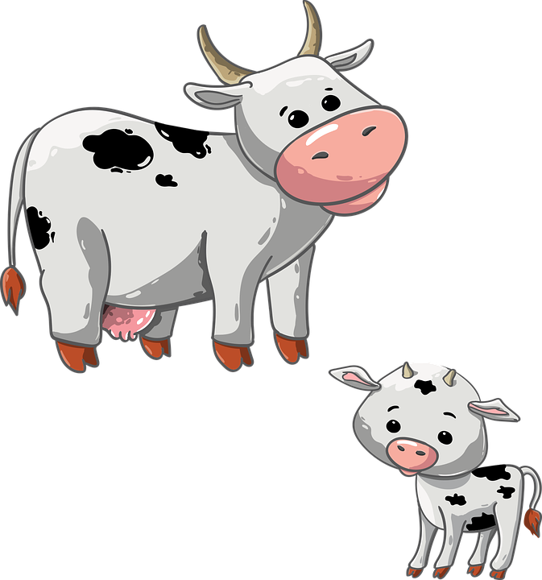
Phonétique
Partenaire A
écouter / écrire
1
3
A | beau | se | causer
B | beau | seau | caser
C | bas | seau | caser
A | peu | veau | poivron
B | peau | va | pauvre
C | peau | veau | poivron
[self]
[to cause]
[a little]
[to place]
[skin]
[goes]
[poor]
[bottom]
[to place]
[skin]
2
4
A | gâche | jaune | faux
B | gauche | jaune | feu
C | gauche | jeune | faux
A | soif | haute | eau
B | sauf | haute | eu
C | sauf | hâte | eau
[wastes]
[thirst]
[high]
[left]
[except]
[high]
[was]
[left]
[except]
[haste]
Notes:
Timing: 5 minutes
Aim: Oral production and recognition of SSC [au] in minimal pairs with SSCs [e], [a], [e] and [oi]
Procedure:
1. Print or sketch the role cards found on slide 36. These show the lines of words each partner needs to read.
2. Students word in pairs. Give each student a role card and tell them they need to read only the line of text indicated on their card.
3. Student A reads first. Bring up this slide (34). Starting with box 1, student A reads the line of words indicated by the letter on their rolecard.
4. Student B write whether they hear row A, B or C in each case.
5. Answers revealed on clicks.
6. Bring up the next slide (35). Students swap roles.
7. Repeat steps 1-5.
Word frequency of unknown words used (1 is the most frequent word in French): se [17], causer [1089], caser [>5000], bas [468], gâcher [4623], gauche [607], peu [91], veau [>5000], poivron [>5000], peau [2122], pauvre [699], soif [4659], sauf [476], haut [264], hâte [3460], eu [avoir-8]
Source: Londsale, D., & Le Bras, Y. (2009). A Frequency Dictionary of French: Core vocabulary for learners London: Routledge.

Slide 20
Phonétique
Partenaire B
écouter / écrire
1
3
A | beau | seau | caser
B | bas | seau | caser
C | beau | se | causer
A | peau | veau | pauvre
B | peu | veau | poivron
C | peau | va | pauvre
[to place]
[skin]
[poor]
[bottom]
[to place]
[a little]
[self]
[to cause]
[skin]
[goes]
[poor]
2
4
A | gauche | jeune | faux
B | gauche | jeune | feu
C | gâche | jaune | faux
A | sauf | hâte | eau
B | soif | haute | eu
C | soif | haute | eau
[left]
[except]
[haste]
[left]
[thirst]
[high]
[was]
[wastes]
[thirst]
[high]

Slide 21
Phonétique
Rolecards
écouter / écrire
Partner A: 1A, 2C, 3A, 4B
Partner A: 1A, 2C, 3A, 4B
Partner A: 1A, 2C, 3A, 4B
Partner A: 1A, 2C, 3A, 4B
Partner A: 1A, 2C, 3A, 4B
Partner A: 1A, 2C, 3A, 4B
Partner A: 1A, 2C, 3A, 4B
Partner A: 1A, 2C, 3A, 4B
Partner A: 1A, 2C, 3A, 4B
Partner A: 1A, 2C, 3A, 4B
Partner A: 1A, 2C, 3A, 4B
Partner A: 1A, 2C, 3A, 4B
Partner B: 1B, 2B, 3A, 4C
Partner B: 1B, 2B, 3A, 4C
Partner B: 1B, 2B, 3A, 4C
Partner B: 1B, 2B, 3A, 4C
Partner B: 1B, 2B, 3A, 4C
Partner B: 1B, 2B, 3A, 4C
Partner B: 1B, 2B, 3A, 4C
Partner B: 1B, 2B, 3A, 4C
Partner B: 1B, 2B, 3A, 4C
Partner B: 1B, 2B, 3A, 4C
Partner B: 1B, 2B, 3A, 4C
Partner B: 1B, 2B, 3A, 4C
Notes:
For printing: role cards for the activity on slides 34-36.

Slide 22
SSC [au]
phonétique
Consolidation [2]

Slide 23
Le poète en difficulté
Le poète en difficulté
écouter
Le poète fait des erreurs avec les SSC [on] et [au / eau / o].
Écoute le poème. La rime est bonne ou mauvaise ?
Je mange à Dijon
1
Menton
Tu manges à _______
La rime est bonne
La rime est mauvaise
Notes:
Timing: 5 minutes for 8 slides
Aim: oral recognition of this week’s SSC [on] in contrast to the similar-sounding SSC [au / eau / o]
Procedure:
First, check students’ understanding of the L2 instructions. Draw attention to the near-cognates “difficulté” and “erreurs”, which have not been previously encountered. “Poète” / “poème” and “rime” have been introduced previously, but may need some refreshing. The feminine “bonne” and “mauvaise” have not been encountered in this form, so encourage students to decode from the previously learnt “bon” and “mauvais”.
Students write 1-8 in their workbooks.
Click the number button to play the audio – the number of times may vary depending on the needs and level of the class.
Students draw a smiley face if the two lines rhyme (if the second line ends with [o]), or a sad face if they do not (if the second line ends with [au / eau / o] – no need to transcribe the missing word. Place names are used to limit reliance on vocabulary knowledge – the focus is simply on recognising the SSC.
The slides are animated so that the smiley or sad face is highlighted first, then the missing word appears on the next click. Pronunciation can be practised at this stage.
Transcript:
Je mange à Dijon. Tu manges à Menton.
Frequency information for non-SOW (near-)cognates:
difficulté [564], erreur [612], poème [3031], poète [2307], rime [>5000]
Source: Londsale, D., & Le Bras, Y. (2009). A Frequency Dictionary of French: Core vocabulary for learners London: Routledge.

Slide 24
Le poète en difficulté
Le poète en difficulté
écouter
Le poète fait des erreurs avec les SSC [on] et [au / eau / o].
Écoute le poème. La rime est bonne ou mauvaise ?
Je joue à Toulon
2
Bordeaux
Tu joues à _________
La rime est bonne
La rime est mauvaise
Notes:
Transcript:
2. Je joue à Toulon. Tu joues à Bordeaux.

Slide 25
Le poète en difficulté
Le poète en difficulté
écouter
Le poète fait des erreurs avec les SSC [on] et [au / eau / o].
Écoute le poème. La rime est bonne ou mauvaise ?
Je gagne à Soissons
3
Chaumont
Tu gagnes à __________
La rime est bonne
La rime est mauvaise
Notes:
Transcript:
3. Je parle à Soissons. Tu parles à Chaumont.

Slide 26
Le poète en difficulté
Le poète en difficulté
écouter
Le poète fait des erreurs avec les SSC [on] et [au / eau / o].
Écoute le poème. La rime est bonne ou mauvaise ?
Je marche à Mâcon
4
Tu marches à ______
Larrau
La rime est bonne
La rime est mauvaise
Notes:
Transcript:
4. Je marche à Mâcon. Tu marches à Larrau.

Slide 27
Le poète en difficulté
Le poète en difficulté
écouter
Le poète fait des erreurs avec les SSC [on] et [au / eau / o].
Écoute le poème. La rime est bonne ou mauvaise ?
Je reste à Montluçon
5
Tu restes à _________
Monaco
La rime est bonne
La rime est mauvaise
Notes:
Transcript:
5. Je reste à Montluçon. Tu restes à Monaco.

Slide 28
Le poète en difficulté
Le poète en difficulté
écouter
Le poète fait des erreurs avec les SSC [on] et [au / eau / o].
Écoute le poème. La rime est bonne ou mauvaise ?
Je chante à Avignon
6
Tu chantes à ________
Avallon
La rime est bonne
La rime est mauvaise
Notes:
Transcript:
6. Je chante à Avignon. Tu chantes à Avallon.

Slide 29
Le poète en difficulté
Le poète en difficulté
écouter
Le poète fait des erreurs avec les SSC [on] et [au / eau / o].
Écoute le poème. La rime est bonne ou mauvaise ?
Je pense à Briançon
7
Tu penses à __________
Besançon
La rime est bonne
La rime est mauvaise
Notes:
Transcript:
7. Je pense à Briançon. Tu penses à Besançon.

Slide 30
Le poète en difficulté
Le poète en difficulté
écouter
Le poète fait des erreurs avec les SSC [on] et [au / eau / o].
Écoute le poème. La rime est bonne ou mauvaise ?
Je travaille à Quiberon
8
Tu travailles à _____________
Concarneau
La rime est bonne
La rime est mauvaise
Notes:
Transcript:
8. Je travaille à Quiberon. Tu travailles à Concarneau.

Slide 31
SSC [au]
phonétique
Consolidation [3]

Slide 32
Phonétique
lire / parler
Pierre veut écrire un poème, mais il ne peut pas faire des rimes ! Écoute et coche « oui » ou « non » pour chaque rime.
 | English | French | Oui | Non
 | water - word | eau - mot
 | high - vote | haute - vote
 | sport - okay | sport - d’accord
 | bowl - sheet metal | bol - taule
 | thing - pause | chose - pause
 | clock - trough | horloge - auge
 | side - subtracted | côté - ôté
 | funny - willow | drôle - saule
1
2
3
4
5
6
7
8
Notes:
Timing: 5 minutes
Aim: Aural recognition of closed [o] and open [o].
Procedure:
1. Click on the numbers to play audio.
2. Students listen and tick “oui” if the two words rhyme, or “non” if they don’t.
3. Click to reveal French and allow students to check their answers by looking at the spellings.
4. Click to reveal answers. Draw attention to the different letter combinations representing the open [o] sound ([o], [ô], [au] and [eau].)
5. Students say the words aloud.
Transcript:
1) eau/mot
2) haute/vote
3) sport/d’accord
4) bol/taule
5) chose/pause
6) horloge/auge
7) côté/ôté
8) drôle/saule
Word frequency of unknown words used(1 is the most frequent word in French):
vote [1046], bol [>5000], taule [>5000], pause [2647], horloge [>5000], auge [>5000], ôté [>5000], saule [>5000], rime [>5000]
Source: Lonsdale, D., & Le Bras, Y. (2009). A Frequency Dictionary of French: Core vocabulary for learners London: Routledge.

Slide 33
Phonétique
lire / parler
Which lines from the poem contain the SSC closed [o]?
Read each one to your partner to help you decide.
Il a fait des ronds
Il a bu le café au lait
Dans le café au lait
Il a tourné
Son manteau de pluie
Son chapeau sur sa tête
Sous la pluie
Et il a reposé la tasse
Notes:
Timing: 5 minutes
Aim: Written recognition and oral production of SSC closed [o].
Procedure:
1. Students read the lines from the poem aloud out in pairs and decide which ones contain the SSC closed [o]. Partner A reads the phrase, Partner B says oui or non and Partner A says whether they agree. Partners swap roles each time.
2. Click to remove the phrases without closed [o] to check answers.

Slide 34
SSC [au]
phonétique
Consolidation [4]

Slide 35
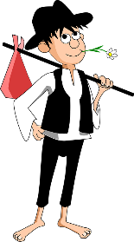
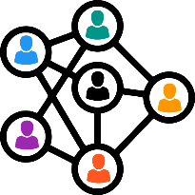
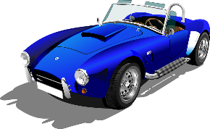
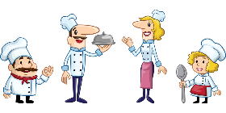
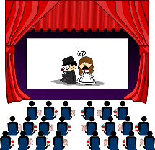
Les mots [au] en français
parler
chaud
pauvre
30
faux
communauté
gauche
automne
auteur
réseau
bateau
cerveau
SECONDES
tableau
peau
[skin]
hausse
automobile
épaule
[shoulder]
autonome
[independent]
restaurant
beauté
[beauty]
0
cadeau
sauvage
audience
DÉBUT
Notes:
Timing: 1 minute
Aim: Speaking practice of SSC [au]
Procedure:
1. Students work in pairs.
2. One at a time they have to say as many [au] words as possible in 30s.
3. The partner listens to make sure pronunciation is correct.
4. If they get one wrong, start again.
5. Swap roles.
6. Click on words to hear native pronunciation.
Transcript:
faux, communauté, gauche, chaud, pauvre, automne, reseau, auteur, bateau, cerveau, hausse, tableau, automobile, peau, épaule, restaurant, autonome, cadeau, beauté, sauvage, audience
Word frequency of cognates (1 is the most frequent word in French): communauté [558], auteur [762], automne [1503], audience [2071], autonome [2192], restaurant [2336], automobile [2407], beauté [2492]
Word frequency of unknown words (1 is the most frequent word in French): faux [555], gauche [607], pauvre [699], réseau [721], bateau [1287], tableau [1456], hausse [1572], chaud [1852], cerveau [1990], peau [2122], cadeau [2298], sauvage [2464], épaule [2494]
Source: Lonsdale, D., & Le Bras, Y. (2009). A Frequency Dictionary of French: Core vocabulary for learners London: Routledge.

Slide 36
SSC [au]
phonétique
Consolidation [5]

Slide 37
au
[au/eau]
gauche
Notes:
[2/4]
Aim: To consolidate SSC [au]
Procedure: 1. Present the letter(s) and say the [au] sound first, on its own. Students repeat it with you. 2. Bring up the word ”gauche” on its own, say it, students repeat it, so that they have the opportunity to focus all of their attention on the connection between the written word and its sound.
3. A possible gesture for this would be to point to the students’ left (teacher’s right!) to indicate this direction. 4. Roll back the animations and work through 1-3 again, but this time, dropping your voice completely to listen carefully to the students saying the [au] sound, pronouncing ”gauche” and, if using, doing the gesture.
Word frequency (1 is the most frequent word in French):
gauche [607].
Source: Londsale, D., & Le Bras, Y. (2009). A Frequency Dictionary of French: Core vocabulary for learners London: Routledge.

Slide 38
au
faux
bateau
[au/eau]
beau
eau
gauche
aussi
[also]
Notes:
[4/4]
Aim: To consolidate SSC [au]
Procedure:
1. Introduce and elicit the pronunciation of the individual SSC [au] and then the source word again ‘gauche’ (with gesture, if using). 2. Then present and elicit the pronunciation of the five cluster words.
The cluster words have been chosen for their high-frequency, from a range of word classes, with the SSC (where possible) positioned within a variety of syllables within the words (e.g. initial, 2nd, final etc.). Additionally, we have tried to use words that build cumulatively on previously taught SSCs (see the Phonics Teaching Sequence document) and do not include new SSCs. Where new SSCs are used, they are often consonants which have a similar symbol-sound correspondence in English.
Word frequency (1 is the most frequent word in French): gauche [607]; aussi [44]; faux [555] bateau [1278]; beau [393]; eau [475] Source: Londsale, D., & Le Bras, Y. (2009). A Frequency Dictionary of French: Core vocabulary for learners London: Routledge.

Slide 39
SSC [au]
phonétique
Consolidation [6]

Slide 40
au
[au/eau]
gauche
Notes:
Timing: 1 minute
Aim: To consolidate SSC [au]
Procedure: 1. Present the letter(s) and say the [au] sound first, on its own. Students repeat it with you. 2. Bring up the word ”gauche” on its own, say it, students repeat it, so that they have the opportunity to focus all of their attention on the connection between the written word and its sound.
3. A possible gesture for this would be to point to the students’ left (teacher’s right!) to indicate this direction. 4. Roll back the animations and work through 1-3 again, but this time, dropping your voice completely to listen carefully to the students saying the [au] sound, pronouncing ”gauche” and, if using, doing the gesture.
Word frequency (1 is the most frequent word in French):
gauche [607].
Source: Lonsdale, D., & Le Bras, Y. (2009). A Frequency Dictionary of French: Core vocabulary for learners London: Routledge.

Slide 41
au
faux
bateau
[au/eau]
beau
eau
gauche
aussi
[also]
Notes:
Timing: 1 minute
Aim: To consolidate SSC [au]
Procedure:
1. Introduce and elicit the pronunciation of the individual SSC [au] and then the source word again ‘gauche’ (with gesture, if using). 2. Then present and elicit the pronunciation of the five cluster words.
The cluster words have been chosen for their high-frequency, from a range of word classes, with the SSC (where possible) positioned within a variety of syllables within the words (e.g. initial, 2nd, final etc.). Additionally, we have tried to use words that build cumulatively on previously taught SSCs (see the Phonics Teaching Sequence document) and do not include new SSCs. Where new SSCs are used, they are often consonants which have a similar symbol-sound correspondence in English.
Word frequency (1 is the most frequent word in French): gauche [607]; aussi [44]; faux [555] bateau [1278]; beau [393]; eau [475] Source: Lonsdale, D., & Le Bras, Y. (2009). A Frequency Dictionary of French: Core vocabulary for learners London: Routledge.

Slide 42
Phonétique
Open [o] and closed [ô/o]/[au] are tricky for English speakers. Try saying the source words porte (open) and photo (closed) /gauche to match with the SSC you hear.
écouter
Écoute. Les mots ont-ils la SSC open [o] ou closed [ô/o]/[au] ?
Q | mot | en anglais | open [o] | closed [ô/o]/[au]
 | au cune | [none]
 | s o l | [ground]
 | fant ô me | [ghost]
 | c ô te | [coast]
 | c o lle | [glue]
 | v o leur | [thief]
 | pauvre | [poor]
 | r o be | [dress]
1
_
2
_
3
_
4
_
5
_
6
_
7
_
8
_
Notes:
Timing: 5 minutes
Aim: Aural recognition of SSCs [o], [ô] and [au] in single words
Procedure:
1. Click to play the audio.
2. Students tick whether they hear [o],[ô] or [au].
3. Click to reveal the answers.
Transcript:
1. aucune
2. sol
3 fantôme
4. côte
5. colle
6. voleur
7. pauvre
8. robe
Word frequency of unknown words used (1 is the most frequent word in French):
aucun [63], fantôme [4075], côte [1385], voleur [3163], robe [2864]
Source: Lonsdale, D., & Le Bras, Y. (2019). A Frequency Dictionary of French: Core vocabulary for learners London: Routledge.

Slide 43
La crise des réfugiés*
*la crise des réfugiés = the refugee crisis
lire/parler
Practise reading the open/closed [o/ô] and [au] sounds.
1
Le nombre de réfugiés augmente en raison de la guerre en cours .
[The number of refugees is increasing due to ongoing war.]
2
Leur réalité devient un cauchemar car leur vie change du jour au lendemain.
[Their reality becomes a nightmare as their life changes overnight.]
3
Les hôpitaux des zones de guerre offrent soins et protection même dans des circonstances difficiles.
[Hospitals in war zones offer care and protection even in difficult circumstances .]
4
Les réfugiés doivent parfois rester à long terme dans des logements temporaires.
[Refugees sometimes have to stay in temporary accommodation on a long term basis.]
Notes:
Timing: 4 minutes
Aim: To practise identifying words with open [o], closed [o/ô] [(e)au] through reading/speaking.
Procedure:
Click to reveal each sentence with its translation.
Ask individual students to read a sentence, focusing on the correct pronunciation of the closed [o/ô], open [o], [au]
Click on the numbers to hear the sentences spoken by a native speaker to verify pronunciation.
Transcript:
Le nombre de réfugiés augmente en raison de la guerre en cours
Leur réalité devient un cauchemar car leur vie change du jour au lendemain
3. Les hôpitaux des zones de guerre offrent soins et protection même dans des circonstances difficiles.
4. Les réfugiés doivent parfois rester à long terme dans des logements temporaires.
Word frequency of unknown words (1 is the most frequent word in French): nombre [249], augmenter [823], cauchemar [3689], car [176], lendemain [1258], offrir [224], circonstance [1054], logement [1849], temporaire [2885]
Word frequency of cognates (1 is the most frequent word in French): réfugié [>5000], réalité [532], zone [860], protection [953], terme [311]

