Slide 1
French Phonics Collection
SSC [ai]
Artwork by: Chloé Motard
Date updated: 31/08/2022
Notes:
Artwork by Chloé Motard. All additional pictures selected are available under a Creative Commons license, no attribution required.

Slide 2
SSC [ai]
phonétique
Introduction

Slide 3
ai
vrai
Notes:
Timing: 1 minute
Aim: To introduce/consolidate SSC [ai]
Procedure: 1. Present the letter(s) and say the [ai] sound first, on its own. Students repeat it with you. 2. Bring up the word ”vrai” on its own, say it, students repeat it, so that they have the opportunity to focus all of their attention on the connection between the written word and its sound.
3. A possible gesture for this would be to mime a ‘tick’.
4. Roll back the animations and work through 1-3 again, but this time, dropping your voice completely to listen carefully to the students saying the [ai] sound, pronouncing ”vrai” and, if using, doing the gesture.
Word frequency (1 is the most frequent word in French):
vrai [292].
Source: Londsale, D., & Le Bras, Y. (2009). A Frequency Dictionary of French: Core vocabulary for learners London: Routledge.

Slide 4
ai
vrai
Notes:
With sound and no pictures to focus all attention on the sound-symbol correspondence.

Slide 5
ai
vrai
Notes:
Without sound to elicit pronunciation (without first hearing the teacher).
Teacher to elicit pronunciation by asking “Comment dit-on …"

Slide 6
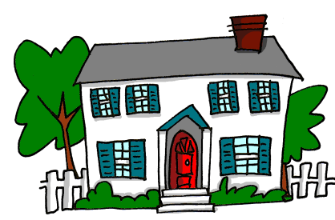
ai
maison
raison
[reason]
mauvais
vrai
faire
[bad]
semaine
[to do]
[week]
Notes:
Timing: 2 minutes
Aim: To introduce/consolidate SSC [ai]
Procedure:
1. Introduce and elicit the pronunciation of the individual SSC [ai] and then the source word again ‘vrai’ (with gesture, if using). 2. Then present and elicit the pronunciation of the five cluster words.
The cluster words have been chosen for their high-frequency, from a range of word classes, with the SSC (where possible) positioned within a variety of syllables within the words (e.g. initial, 2nd, final etc.). Additionally, we have tried to use words that build cumulatively on previously taught SSCs (see the Phonics Teaching Sequence document) and do not include new SSCs. Where new SSCs are used, they are often consonants which have a similar symbol-sound correspondence in English.
Word frequency (1 is the most frequent word in French): maison [325]; raison [72] mauvais [274]; faire [25]; semaine [245]; vrai [292]. Source: Londsale, D., & Le Bras, Y. (2009). A Frequency Dictionary of French: Core vocabulary for learners London: Routledge.

Slide 7
ai
maison
raison
mauvais
vrai
faire
semaine
Notes:
With sound and no pictures to focus all attention on the sound-symbol correspondence.

Slide 8
ai
maison
raison
mauvais
vrai
faire
semaine
Notes:
Without sound to elicit pronunciation (without first hearing the teacher).
Teacher to elicit pronunciation by asking “Comment dit-on …"

Slide 9
Phonétique
écouter
C’est la SSC [ai] ?
ou
__
le combat
portugais
__
Notes:
Timing: 5 minutes for 5 slides
Aim: Aural recognition of SSC [ai]
Procedure:
1. Click the images to play the audio.
2. Students choose which word has [ai],
3. Students could also complete the word with the correct spelling
4. Answers revealed on a click.
Word frequency (1 is the most frequent word in French): portugais [3684], combat [1062]
Source: Londsale, D., & Le Bras, Y. (2009). A Frequency Dictionary of French: Core vocabulary for learners London: Routledge.

Slide 10
Phonétique
écouter
C’est la SSC [ai] ?
ou
[she knows how to]
__
le camp
elle sait
__
Notes:
Word frequency (1 is the most frequent word in French): camp [1084], savoir [67]
Source: Londsale, D., & Le Bras, Y. (2009). A Frequency Dictionary of French: Core vocabulary for learners London: Routledge.

Slide 11
Phonétique
écouter
C’est la SSC [ai] ?
ou
[why]
pourquoi
__
[why?]
l’essai
__
Notes:
Word frequency (1 is the most frequent word in French): pourquoi [193], essai [1475]
Source: Londsale, D., & Le Bras, Y. (2009). A Frequency Dictionary of French: Core vocabulary for learners London: Routledge.

Slide 12
Phonétique
écouter
C’est la SSC [ai] ?
ou
[perfect]
parfait
__
__
la médaille
Notes:
Word frequency (1 is the most frequent word in French): parfait [1600], médaille [3361]
Source: Londsale, D., & Le Bras, Y. (2009). A Frequency Dictionary of French: Core vocabulary for learners London: Routledge.

Slide 13
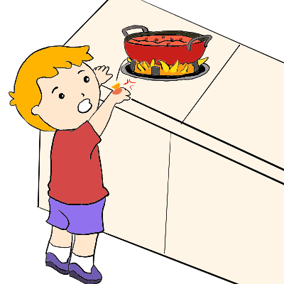
Phonétique
écouter
C’est la SSC [ai] ?
ou
l’oraison
__
__
il brûle
Notes:
Word frequency (1 is the most frequent word in French): oraison [>5000], brûler [1930]
Source: Londsale, D., & Le Bras, Y. (2009). A Frequency Dictionary of French: Core vocabulary for learners London: Routledge.

Slide 14
Phonétique
air
lire / parler
[air]
fait
facile
60
baie
[does]
fraise
[bay]
[strawberry]
distrait
clairon
[absent-minded]
faitout
secondes
[bugle]
[cooking pot]
japonais
[japanese]
raisonnable
[reasonable]
anniversaire
0
difficile
[birthday]
DÉBUT
Notes:
Timing: 2 minutes
Aim: Oral production of SSC [ai] in words of varying degrees of complexity in decreasing amounts of time.
Procedure:
Students pair up.
Explain that students are going to work their way down the ‘ladder’ by correctly pronouncing words containing [ai], starting with simple words and building up to more complex words. Using their knowledge of English, students should be able to work out the meanings of facile and difficile form context – clarify.
Start the timer. Starting with air, Partner A works their way down the ladder. Partner B listens for correct pronunciation of [e]. If Partner A makes a mistake, they must go back to air and start again!
Students swap roles. Re-start the timer.
Whoever is furthest down the ladder when the timer stops is the winner!
Click on the words to hear them said aloud by a native speaker. Students repeat.
Move on to the next slide.
Word frequencies of unknown words used (1 is the most frequent word in French): air [761], baie [3917], faire [25], fraise [>5000], distrait [>5000], clarion [>5000], faitout [>5000], japonais [2093], raisonnable [2021], anniversaire [2043]
Source: Londsale, D., & Le Bras, Y. (2009). A Frequency Dictionary of French: Core vocabulary for learners London: Routledge.

Slide 15
Phonétique
air
lire / parler
[air]
fait
60
baie
[does]
fraise
[bay]
[strawberry]
distrait
clairon
[absent-minded]
faitout
secondes
[bugle]
[cooking pot]
japonais
[japanese]
raisonnable
[reasonable]
anniversaire
0
[birthday]
DÉBUT
Notes:
Timing: 2 minutes
As previous, but in alphabetical order this time for an additional challenge, helping automisation of production.

Slide 16
SSC [ai]
phonétique
Consolidation [1]

Slide 17
ai
vrai
Notes:
Timing: 1 minute
Aim: To introduce/consolidate SSC [ai]
Procedure: 1. Present the letter(s) and say the [ai] sound first, on its own. Students repeat it with you. 2. Bring up the word ”vrai” on its own, say it, students repeat it, so that they have the opportunity to focus all of their attention on the connection between the written word and its sound.
3. A possible gesture for this would be to mime a ‘tick’.
4. Roll back the animations and work through 1-3 again, but this time, dropping your voice completely to listen carefully to the students saying the [ai] sound, pronouncing ”vrai” and, if using, doing the gesture.
Word frequency (1 is the most frequent word in French):
vrai [292].
Source: Londsale, D., & Le Bras, Y. (2009). A Frequency Dictionary of French: Core vocabulary for learners London: Routledge.

Slide 18
ai
vrai
Notes:
With sound and no pictures to focus all attention on the sound-symbol correspondence.

Slide 19
ai
vrai
Notes:
Without sound to elicit pronunciation (without first hearing the teacher).
Teacher to elicit pronunciation by asking “Comment dit-on …"

Slide 20
ai
maison
raison
[reason]
mauvais
vrai
faire
[bad]
semaine
[to do]
[week]
Notes:
Timing: 2 minutes
Aim: To introduce/consolidate SSC [ai]
Procedure:
1. Introduce and elicit the pronunciation of the individual SSC [ai] and then the source word again ‘vrai’ (with gesture, if using). 2. Then present and elicit the pronunciation of the five cluster words.
The cluster words have been chosen for their high-frequency, from a range of word classes, with the SSC (where possible) positioned within a variety of syllables within the words (e.g. initial, 2nd, final etc.). Additionally, we have tried to use words that build cumulatively on previously taught SSCs (see the Phonics Teaching Sequence document) and do not include new SSCs. Where new SSCs are used, they are often consonants which have a similar symbol-sound correspondence in English.
Word frequency (1 is the most frequent word in French): maison [325]; raison [72] mauvais [274]; faire [25]; semaine [245]; vrai [292]. Source: Londsale, D., & Le Bras, Y. (2009). A Frequency Dictionary of French: Core vocabulary for learners London: Routledge.

Slide 21
ai
maison
raison
mauvais
vrai
faire
semaine
Notes:
With sound and no pictures to focus all attention on the sound-symbol correspondence.

Slide 22
ai
maison
raison
mauvais
vrai
faire
semaine
Notes:
Without sound to elicit pronunciation (without first hearing the teacher).
Teacher to elicit pronunciation by asking “Comment dit-on …"

Slide 23
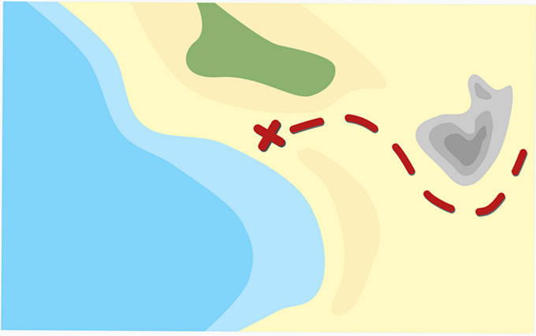
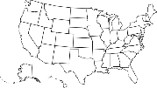
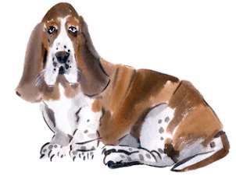
[ai] ou [a]?
[ai] ou [a] ?
écouter
ai
a
1
✔
mais [but]
ma [my]
2
baie
✔
bas [low]
3
✔
faire [do/make]
phare
4
✔
paire
par [by]
5
vais [I go]
✔
vas [you go]
6
✔
caisse
casse
[he/she breaks]
7
étais [was]
✔
état
8
maire [mayor]
✔
marre
[he/she laughs]
9
baisser [to lower]
✔
basset
10
✔
extrait [extract]
extra [amazing, fab]
Notes:
Timing: 5 minutes
Aim: Aural distinction between SSCs [a] and [ai]. The SCCs are presented in minimal pairs, highlighting the link between SSC and meaning and drawing students’ attention to the fact that the mispronunciation of one sound can change the meaning of a whole word.
Procedure:
1. Click on the numbers to play the audio.
2. Students write 1-8 and [a] or [ai].
3. Teacher elicits answers by pointing to a number and saying e.g. ‘numéro 1 - [ai] ou [a]’?
4. Students say the words. Teacher draws attention to the difference in mouth position when saying the two sounds ([ai] = mid-open; [a] = low, wide open).
Transcript
mais, ma
baie ,bas
faire, phare
paire, par
vais, vas
caisse, case
étais, état
maire, marre
baisser, basset
extrait, extra
Word frequency (1 is the most frequent word in French): ma [60], baie [3719], bas [468], phare [3884], paire [3926], par [21], caisse [1881], case [2185], étais [5], maire [1876], marre [>5000], baisser [911], basset [>5000] , extrait [4283], extra [>5000]
Source: Londsale, D., & Le Bras, Y. (2009). A Frequency Dictionary of French: Core vocabulary for learners London: Routledge.

Slide 24
[ai] et [ê/è]
écouter
What do you notice about these words?
SSC [ai] is the same sound as SSC [ê/è], which you already know.
Even though these words are spelled differently, they sound exactly the same!
père
paire
Notes:
Timing: 1 minutes
Aim: Raising awareness of the identical sound in SSCs [ai] and [ê/è].
For a reminder of [ê/è], see the two slides that follow.

Slide 25
Phonétique
Phonétique
parler
Say only the words containing this week’s target sound!
A | clair | honnête | pétition | collègue | plastique
B | défense | ancêtre | signature | raisonnable | légal
A | secondaire | air | sincère | économiste | sphère
B | armée | portrait | barrière | forêt | péril
A | kilomètre | sincère | japonais | réunion | parallèle
B | secrétaire | satellite | suprême | capitaine | courageux
Notes:
Timing: 5 minutes
Aim: Oral production of SSCs [ai] and [ê/è]. Cognates are chosen to also practise ‘unlearning’ English pronunciation.
Procedure:
1. Students partner up and label themselves A and B.
2. They then treat the table as a script, but have to make sure they only pronounce the words containing SSCs [ai] and [è/ê].
3. The listening student notes any errors (illegal word said or SSC pronounced incorrectly) and gives their partner a score out of 5 for each round.
4. The student with the most points at the end is the winner!
5. ‘Legal’ words revealed on clicks.
6. Clarify meaning of the cognate words.
7. A challenge could be to get through the table as fast as possible without making a mistake.
Word frequency (1 is the most frequent word in French): clair [335], raisonnable [2021], secondaire [2027], japonais [2097], capitaine [2518], portrait [2666], air [761], secrétaire [920], pétition [2920], défense [938], économiste [2943], réaction [947], péril [2969], réunion [971], majorité [988], procédure [933], armée [1011], collègue [1099], sincère [3910], kilomètre [1435], sphere [4209], parallèle [2196], honnête [2405], ancêtre [3067], forêt [1724], suprême [2022], plastique [2191], signature [2187], courageux [2198], satellite [2200], legal [2247]
Source: Londsale, D., & Le Bras, Y. (2009). A Frequency Dictionary of French: Core vocabulary for learners London: Routledge.

Slide 26
SSC [ai]
phonétique
Consolidation [2]

Slide 27
ai
vrai
Notes:
Timing: 1 minute
Aim: To introduce/consolidate SSC [ai]
Procedure: 1. Present the letter(s) and say the [ai] sound first, on its own. Students repeat it with you. 2. Bring up the word ”vrai” on its own, say it, students repeat it, so that they have the opportunity to focus all of their attention on the connection between the written word and its sound.
3. A possible gesture for this would be to mime a ‘tick’.
4. Roll back the animations and work through 1-3 again, but this time, dropping your voice completely to listen carefully to the students saying the [ai] sound, pronouncing ”vrai” and, if using, doing the gesture.
Word frequency (1 is the most frequent word in French):
vrai [292].
Source: Londsale, D., & Le Bras, Y. (2009). A Frequency Dictionary of French: Core vocabulary for learners London: Routledge.

Slide 28
ai
maison
raison
[reason]
mauvais
vrai
faire
[bad]
semaine
[to do]
[week]
Notes:
Timing: 2 minutes
Aim: To introduce/consolidate SSC [ai]
Procedure:
1. Introduce and elicit the pronunciation of the individual SSC [ai] and then the source word again ‘vrai’ (with gesture, if using). 2. Then present and elicit the pronunciation of the five cluster words.
The cluster words have been chosen for their high-frequency, from a range of word classes, with the SSC (where possible) positioned within a variety of syllables within the words (e.g. initial, 2nd, final etc.). Additionally, we have tried to use words that build cumulatively on previously taught SSCs (see the Phonics Teaching Sequence document) and do not include new SSCs. Where new SSCs are used, they are often consonants which have a similar symbol-sound correspondence in English.
Word frequency (1 is the most frequent word in French): maison [325]; raison [72] mauvais [274]; faire [25]; semaine [245]; vrai [292]. Source: Londsale, D., & Le Bras, Y. (2009). A Frequency Dictionary of French: Core vocabulary for learners London: Routledge.

Slide 29
Nasal or oral vowels?
écouter
 |  | nasal | oral + m/n
 | diminuer [decrease]
 | interroger [to interrogate]
 | grimper [to climb]
 | aimable [likeable]
 | contraindre [to force]
 | chimique [chemical]
 | minorité [minority]
 | crainte [fear]
 | vraiment [really]
 | centaine [hundred]
1
2
3
4
5
Remember!
[aim/im] and [ain/in] are nasal sounds before a consonant, and oral sounds before a vowel.
6
7
8
9
10
Notes:
Timing: 6 minutes
Aim: Aural recognition of nasal and non-nasal vowels [aim/im], [ain/in], [ai] and [i] in unknown words.
Procedure:
1. Practise saying SSCs [aim/im], [ain/in], [ai] and [i] aloud, in isolation. Students should notice a vibration in the nose when they produce the nasal sounds, but not when they produce the oral sounds.
2. Click the numbers to play the audio.
3. Students write 1-8 and decide if the letters in bold represent a ‘nasal’ or ‘non-nasal’ vowel sound.
4. Click to reveal the answers. The word appears first, followed by the ticks in the appropriate columns.
5. Click to bring up the reminder about spelling rules introduced last week (8.2.2.3) and demonstrate its applicability here.
Procedure:
1. Students listen to the words and tick the appropriate column.
2. Click to reveal the words one by one, together with the correct tick for each.
Transcript:
1. diminuer
2. interroger
3. grimper
4. aimable
5. contraindre
6. chimique
7. minorité
8. crainte
9. vraiment
10. centaine
Word frequency (1 is the most frequent word in French): diminuer [1507], interroger [1093], grimper [2646], aimable [4668], plaindre [137], chimique [2650,] minorité [>5000], crainte [1195], vraiment [361], centaine [1417]
Source: Londsale, D., & Le Bras, Y. (2009). A Frequency Dictionary of French: Core vocabulary for learners London: Routledge.

Slide 30
[aim/im], [ain/in]
écouter / écrire
Normally, SSCs [aim/im] and [ain/in] are nasal vowels.
However, [aim/im] and [ain/in] sound different before a vowel.
Can you think of any examples in words you already know?
before a consonant: before a vowel:
important aimer
simple animal
prochain semaine
intéressant ordinateur
(important)
These sounds are nasal vowels [aim/im], [ain/in].
(to like)
These sounds are oral vowels [ai] / [i] + m / n.
(simple)
(animal)
(next)
(week)
(interesting)
(computer)
Notes:
Timing: 2 minutes
Aim: revising the spelling rules governing pronunciation changes in SSCs which are normally nasal vowels, and applying these to [aim/im] and [ain/in].
Procedure: 1. Cycle through the information on the slide using the animation sequence.

Slide 31
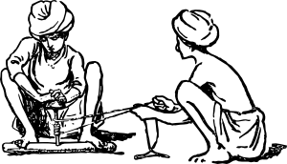
[nasal], [ai] ou [i] ?
lire / parler
 |  | [nasal] | [ai] + n | [i] + m/n
 | primitif [primitive]
 | intimider [to intimidate]
 | haine [hate]
j | crainte [fear]
 | timbre [to stamp]
 | prochainement [shortly, soon]
h | inondation [flood]
 | minimiser [to minimise]
 | capitaine [captain]
 | plaindre [to complain]
Lis les mots et décide si c’est une voyelle nasale ou une voyelle orale.
Puis, dis les mots !
1
2
3
4
5
6
nasal vowels
[aim/im], [ain/in]
7
8
oral vowels
[ai], [i]
9
10
Notes:
Timing: 5 minutes
Aim: applying awareness of the pronunciation rules governing SSCs [aim/ain], [ai] and [i] to the oral production of words containing these letter combinations.
Procedure
Student read the words and decide based on the presence of absence of a vowel after letter ‘m’ or ‘n’ whether a nasal is needed or not..
Click to check.
Now, students are challenged to pronounce the words correctly. Students should work in pairs and monitor each other for this.
Students try to say the words out loud. Teacher corrects.
Click the numbers to hear pronunciation
Transcript:
primitif
intimider
haine
crainte
timbre
prochainement
inondation
minimiser
capitaine
plaindre
Word frequency (1 is the most frequent word in French): primitif [3345], intimider [4777], haine [2277], crainte [1195], timbre [4138], prochainement [4417], inondation [4677], minimiser [4725], capitaine [2518], plaindre [1370]
Source: Londsale, D., & Le Bras, Y. (2009). A Frequency Dictionary of French: Core vocabulary for learners London: Routledge.
Word frequency of near-cognates used in task instructions (1 is the most frequent word in French): décider [165], voyelle [>5000], nasal [>5000], oral [4114]
Source: Londsale, D., & Le Bras, Y. (2009). A Frequency Dictionary of French: Core vocabulary for learners London: Routledge.

Slide 32
SSC [ai]
phonétique
Consolidation [3]

Slide 33
ai
vrai
Notes:
Timing: 1 minute
Aim: To introduce/consolidate SSC [ai]
Procedure: 1. Present the letter(s) and say the [ai] sound first, on its own. Students repeat it with you. 2. Bring up the word ”vrai” on its own, say it, students repeat it, so that they have the opportunity to focus all of their attention on the connection between the written word and its sound.
3. A possible gesture for this would be to mime a ‘tick’.
4. Roll back the animations and work through 1-3 again, but this time, dropping your voice completely to listen carefully to the students saying the [ai] sound, pronouncing ”vrai” and, if using, doing the gesture.
Word frequency (1 is the most frequent word in French):
vrai [292].
Source: Londsale, D., & Le Bras, Y. (2009). A Frequency Dictionary of French: Core vocabulary for learners London: Routledge.

Slide 34
ai
maison
raison
[reason]
mauvais
vrai
faire
[bad]
semaine
[to do]
[week]
Notes:
Timing: 2 minutes
Aim: To introduce/consolidate SSC [ai]
Procedure:
1. Introduce and elicit the pronunciation of the individual SSC [ai] and then the source word again ‘vrai’ (with gesture, if using). 2. Then present and elicit the pronunciation of the five cluster words.
The cluster words have been chosen for their high-frequency, from a range of word classes, with the SSC (where possible) positioned within a variety of syllables within the words (e.g. initial, 2nd, final etc.). Additionally, we have tried to use words that build cumulatively on previously taught SSCs (see the Phonics Teaching Sequence document) and do not include new SSCs. Where new SSCs are used, they are often consonants which have a similar symbol-sound correspondence in English.
Word frequency (1 is the most frequent word in French): maison [325]; raison [72] mauvais [274]; faire [25]; semaine [245]; vrai [292]. Source: Londsale, D., & Le Bras, Y. (2009). A Frequency Dictionary of French: Core vocabulary for learners London: Routledge.

Slide 35
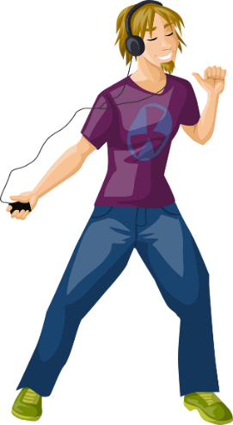
Imperfect forms and past participles: [é] vs [ai]
grammaire
Listen to these examples to hear the difference between the [é] of a past participle in the perfect tense, and the [ai] in the ending of the imperfect tense.
Perfect tense:
a one-off event in the past
On a parlé
[we talked]
J’ai chanté
[I sang]
Here, we see a ‘perfect’ example of the importance of phonics! The difference between the [é] and [ai] sounds may be subtle, but the change in meaning is significant.
Il a dansé
[he danced]
Je chantais
[I used to sing]
On parlait
[we used to talk]
Imperfect tense: something which used to happen all the time
Il dansait
[he used to dance]
Notes:
Timing: 5 minutes [1/2]
Aim: To recap the difference in usage between perfect tense (for one-off events in the past) and imperfect tense (for habitual actions in the past); to draw attention to the difference in pronunciation between -é at the end of a past participle and -ais/-ait at the end of the imperfect form; to highlight the link between phonics and meaning; to prepare students for the grammar point covered later in the lesson.
Procedure:
1. Click to reveal text and pictures.
2. Click on the French text to hear a native speaker say perfect and imperfect forms of the same verb. Note that the [ai] in j’ai is pronounced like [é].
3. Draw attention to the English definitions, and click to reveal reminder about the difference between in use between the perfect and imperfect tenses.
4. Click to reveal information on the importance of phonics in this case, where a slight sound change carries a significant meaning change.
Transcript:
1. on a parlé
2. on parlait
3. j’ai chanté
4. je chantais
5. il a dansé
6. il dansait

