Slide 1
French Phonics Collection
SSC [a]
Artwork by: Chloé Motard
Date updated: 31/08/2022
Notes:
Artwork by Chloé Motard. All additional pictures selected are available under a Creative Commons license, no attribution required.

Slide 2
SSC [a]
phonétique
Introduction

Slide 3
a
animal
Notes:
Timing: 1 minute
Aim: To introduce/consolidate SSC [a]
Procedure: 1. Present the letter(s) and say the [a] sound first, on its own. Students repeat it with you. 2. Bring up the word ”animal” on its own, say it, students repeat it, so that they have the opportunity to focus all of their attention on the connection between the written word and its sound.
3. A possible gesture for this would be to mimic an animal’s motion, perhaps holding ones arms and hands close to the chest as ‘paws’. 4. Roll back the animations and work through 1-3 again, but this time, dropping your voice completely to listen carefully to the students saying the [a] sound, pronouncing ”animal” and, if using, doing the gesture.
Word frequency (1 is the most frequent word in French):
animal [1002]
Source: Londsale, D., & Le Bras, Y. (2009). A Frequency Dictionary of French: Core vocabulary for learners London: Routledge.

Slide 4
a
animal
Notes:
With sound and no pictures to focus all attention on the sound-symbol correspondence.

Slide 5
a
animal
Notes:
Without sound to elicit pronunciation (without first hearing the teacher).
Teacher to elicit pronunciation by asking “Comment dit-on …"

Slide 6
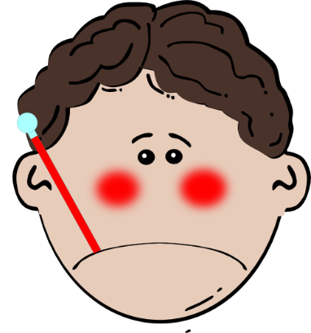
a
ça va ?
table
animal
malade
sac
mal
[badly]
Notes:
Timing: 2 minutes
Aim: To introduce/consolidate SSC [a]
Procedure:
1. Introduce and elicit the pronunciation of the individual SSC [a] and then the source word again ‘animal’ (with gesture, if using). 2. Then present and elicit the pronunciation of the five cluster words.
The cluster words have been chosen for their high-frequency, from a range of word classes, with the SSC (where possible) positioned within a variety of syllables within the words (e.g. initial, 2nd, final etc.). Additionally, we have tried to use words that build cumulatively on previously taught SSCs (see the Phonics Teaching Sequence document) and do not include new SSCs. Where new SSCs are used, they are often consonants which have a similar symbol-sound correspondence in English.
Word frequency (1 is the most frequent word in French): animal [1002]; ça va? [54 (cela), 53 (aller)]; malade [1066] mal [277]; table [1019]; sac [2343] Source: Londsale, D., & Le Bras, Y. (2009). A Frequency Dictionary of French: Core vocabulary for learners London: Routledge.

Slide 7
a
ça va ?
table
animal
malade
sac
mal
Notes:
With sound and no pictures to focus all attention on the sound-symbol correspondence.

Slide 8
a
ça va ?
table
animal
malade
sac
mal
Notes:
Without sound to elicit pronunciation (without first hearing the teacher).
Teacher to elicit pronunciation by asking “Comment dit-on …"

Slide 9
Phonétique
lire / parler
dame
rare
table
phase
trace
radio
place
favorable
grave
date
Notes:
Timing: 3 minutes
Aim: to practise production of SSC [a]
Procedure:
1. Students work in pairs, alternately saying one of the words and listening to spot errors in their partner’s pronunciation.
2. Students get one point for each correct French pronunciation of the SSC and lose a point if they say the English equivalent!
3. Click on the words to check pronunciation. Students repeat.
4. Go over the meaning of the words. These are all cognates or near-cognates, purposefully chosen for unlearning the connection between the SSC and the English sound. In some cases the words may have multiple meanings in English (e.g. grave) so these should be clarified. Students will find it rewarding in the first lesson to be able to recognise ten new words! Explain that lots of words are shared between the languages and they will encounter more of these across the year.
Word frequency (1 is the most frequent word in French): table [1019], rare [1233], dame [1983], radio [1526], phase [1754], trace [1848], place [129], favorable [1443], grave [443], date [660]
Source: Londsale, D., & Le Bras, Y. (2009). A Frequency Dictionary of French: Core vocabulary for learners London: Routledge.

Slide 10
SSC [a]
phonétique
Consolidation [1]

Slide 11
a
animal
Notes:
Timing: 1 minute
Aim: To introduce/consolidate SSC [a]
Procedure: 1. Present the letter(s) and say the [a] sound first, on its own. Students repeat it with you. 2. Bring up the word ”animal” on its own, say it, students repeat it, so that they have the opportunity to focus all of their attention on the connection between the written word and its sound.
3. A possible gesture for this would be to mimic an animal’s motion, perhaps holding ones arms and hands close to the chest as ‘paws’. 4. Roll back the animations and work through 1-3 again, but this time, dropping your voice completely to listen carefully to the students saying the [a] sound, pronouncing ”animal” and, if using, doing the gesture.
Word frequency (1 is the most frequent word in French):
animal [1002]
Source: Londsale, D., & Le Bras, Y. (2009). A Frequency Dictionary of French: Core vocabulary for learners London: Routledge.

Slide 12
a
animal
Notes:
With sound and no pictures to focus all attention on the sound-symbol correspondence.

Slide 13
a
animal
Notes:
Without sound to elicit pronunciation (without first hearing the teacher).
Teacher to elicit pronunciation by asking “Comment dit-on …"

Slide 14
a
ça va ?
table
animal
malade
sac
mal
[badly]
Notes:
Timing: 2 minutes
Aim: To introduce/consolidate SSC [a]
Procedure:
1. Introduce and elicit the pronunciation of the individual SSC [a] and then the source word again ‘animal’ (with gesture, if using). 2. Then present and elicit the pronunciation of the five cluster words.
The cluster words have been chosen for their high-frequency, from a range of word classes, with the SSC (where possible) positioned within a variety of syllables within the words (e.g. initial, 2nd, final etc.). Additionally, we have tried to use words that build cumulatively on previously taught SSCs (see the Phonics Teaching Sequence document) and do not include new SSCs. Where new SSCs are used, they are often consonants which have a similar symbol-sound correspondence in English.
Word frequency (1 is the most frequent word in French): animal [1002]; ça va? [54 (cela), 53 (aller)]; malade [1066] mal [277]; table [1019]; sac [2343] Source: Londsale, D., & Le Bras, Y. (2009). A Frequency Dictionary of French: Core vocabulary for learners London: Routledge.

Slide 15
a
ça va ?
table
animal
malade
sac
mal
Notes:
With sound and no pictures to focus all attention on the sound-symbol correspondence.

Slide 16
a
ça va ?
table
animal
malade
sac
mal
Notes:
Without sound to elicit pronunciation (without first hearing the teacher).
Teacher to elicit pronunciation by asking “Comment dit-on …"

Slide 17
Phonétique
Phonétique
écouter / lire
How many [a] ?
La rame freine rapidement.
1
The carriage brakes quickly.
L’étoile attire son attention.
2
The star attracts his attention.
Il n’est jamais là.
3
He’s never there.
Le chat va de Paris en Andorre.
4
The cat is going from Paris to Andorra.
Notes:
Timing: 4 minutes
Aim: Oral recognition of the target SSC [a] at sentence level.
Procedure:
1. Click the number trigger to play the audio.
2. Students listen and tally the number of times they hear the SSC [a].
3. Click to bring up: a) the sentence in French b) its translation into English c) the number of tallies for each [a] within the sentence.
Transcript:
La rame freine rapidement.
L’étoile attire son attention.
Il n’est jamais là.
Le chat va de Paris en Andorre.

Slide 18
Phonétique
écouter / écrire / parler
1
Tu as un animal.
2
Elle a un cadeau.
3
Il a un animal malade.
4
Tu as un ami sympa.
5
L’acteur a une classe calme.
6
Elle a un ami amusant.
Notes:
Timing: 5 minutes
Aim: to further practise applying knowledge of the target SSC [a] at sentence level.
Procedure:
There are several ways to use this slide:
Transcription
Click the number trigger to play the audio.
Students transcribe what is heard.
Click to reveal the French sentence in full.
Read aloud sentences
Click to bring up the French.
Students read out the sentence either as choral class work or pairs reading to each other.
Click the number trigger to play the audio to reinforce correct pronunciation.
Bi-modal input
The teacher reads out the sentence, pausing at the end of one of the words, just before one begins.
Students read the sentence as they are listening and say aloud the next word after the teacher’s pause.
The teacher can then choose to play the recording in full.
This helps students to link the sound to the written form, and helps them “segment” the input into words. When listening gets faster, students need to be really good at this – chopping up the input into words from one continuous stream.
Teachers may wish to elicit translations in English before moving on.
Transcript:
1. Tu as un animal.
2. Elle a un cadeau.
3. Il a un animal malade.
4. Tu as un ami sympa.
5. L’acteur a une classe calme.
6. Elle a un ami amusant.

Slide 19
SSC [a]
phonétique
Consolidation [2]

Slide 20
a
animal
Notes:
Timing: 1 minute
Aim: To consolidate SSC [a]
Procedure: 1. Present the letter(s) and say the [a] sound first, on its own. Students repeat it with you. 2. Bring up the word ”animal” on its own, say it, students repeat it, so that they have the opportunity to focus all of their attention on the connection between the written word and its sound.
3. A possible gesture for this would be to mimic an animal’s motion, perhaps holding ones arms and hands close to the chest as ‘paws’. 4. Roll back the animations and work through 1-3 again, but this time, dropping your voice completely to listen carefully to the students saying the [a] sound, pronouncing ”animal” and, if using, doing the gesture.
Word frequency (1 is the most frequent word in French):
animal [1002]
Source: Londsale, D., & Le Bras, Y. (2009). A Frequency Dictionary of French: Core vocabulary for learners London: Routledge.

Slide 21
a
ça va ?
table
animal
malade
sac
mal
[badly]
Notes:
Timing: 2 minutes
Aim: To consolidate SSC [a]
Procedure:
1. Introduce and elicit the pronunciation of the individual SSC [a] and then the source word again ‘animal’ (with gesture, if using). 2. Then present and elicit the pronunciation of the five cluster words.
The cluster words have been chosen for their high-frequency, from a range of word classes, with the SSC (where possible) positioned within a variety of syllables within the words (e.g. initial, 2nd, final etc.). Additionally, we have tried to use words that build cumulatively on previously taught SSCs (see the Phonics Teaching Sequence document) and do not include new SSCs. Where new SSCs are used, they are often consonants which have a similar symbol-sound correspondence in English.
Word frequency (1 is the most frequent word in French): animal [1002]; ça va? [54 (cela), 53 (aller)]; malade [1066] mal [277]; table [1019]; sac [2343] Source: Londsale, D., & Le Bras, Y. (2009). A Frequency Dictionary of French: Core vocabulary for learners London: Routledge.

Slide 22
SSC [a]
phonétique
Consolidation [3]

Slide 23
La vue de la fenêtre
La vue de la fenêtre
écouter / écrire
2
À Toulon, il y a des …
phares
_
Notes:
SSC: [a]
Transcript
phares
Word frequency (1 is the most frequent word in French): phare [3884]
Source: Londsale, D., & Le Bras, Y. (2009). A Frequency Dictionary of French: Core vocabulary for learners London: Routledge.

Slide 24
SSC [a]
phonétique
Consolidation [4]

Slide 25
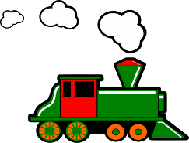
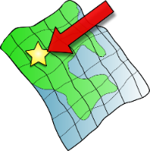
SFC
a
i
eu
e
au
X
midi
je
gauche
dans
animal
deux
u
ou
SFE
é
en/an
on
tu
nous
timide
écrire
X
enfant
Non!
ain/in
ê/è
ai
oi
ch
ç/soft c
train
tête
vrai
voir
chercher
ici
qu
-tion
ien
?
j/soft g
X
question
jour
Attention!
bien
Notes:
Timing: 5 minutes Aim: To revise all SSCs learned in Y7. Procedure: 1. Click to hear SSCs and source words to said aloud. Students repeat.
2. Point at SSCs at random. Ask ‘Comment dit-on la SSC?’ Students say it aloud.
3. Ask ‘Comment dit-on le mot?’ Students say the source word aloud. Click to check pronunciation.

Slide 26
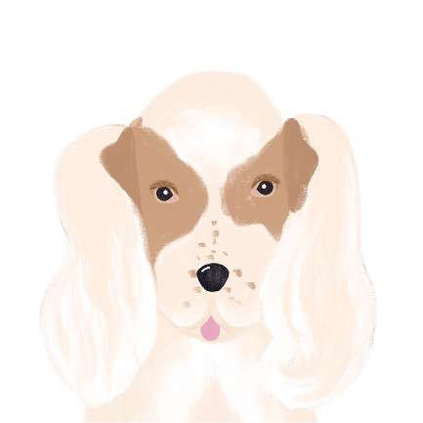
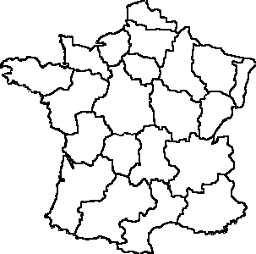
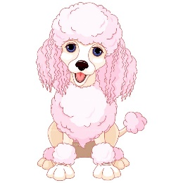
Les vacances à Nice
écouter / écrire
Ils font quoi ? Écoute les phrases et complète le mot final.
glaces
bijoux
5
7
_
_
Amir
Noura
région
amoureux
6
8
_
_ _
Océane
Apollon
Notes:
Transcript:
Je mange des glaces.
Je visite la region.
Je fais des bijoux.
Je suis amoureux.
Word frequency of unknown vocabulary (1 is the most frequent word in French): glace [2580], région [241], bijou [4301], amoureux [2495]
Source: Londsale, D., & Le Bras, Y. (2009). A Frequency Dictionary of French: Core vocabulary for learners London: Routledge.

Slide 27
SSC [a]
phonétique
Consolidation [5]

Slide 28
a
animal
Notes:
Timing: 1 minute
Aim: To consolidate SSC [a]
Procedure: 1. Present the letter(s) and say the [a] sound first, on its own. Students repeat it with you. 2. Bring up the word ”animal” on its own, say it, students repeat it, so that they have the opportunity to focus all of their attention on the connection between the written word and its sound.
3. A possible gesture for this would be to mimic an animal’s motion, perhaps holding ones arms and hands close to the chest as ‘paws’. 4. Roll back the animations and work through 1-3 again, but this time, dropping your voice completely to listen carefully to the students saying the [a] sound, pronouncing ”animal” and, if using, doing the gesture.
Word frequency (1 is the most frequent word in French):
animal [1002]
Source: Londsale, D., & Le Bras, Y. (2009). A Frequency Dictionary of French: Core vocabulary for learners London: Routledge.

Slide 29
a
ça va ?
table
animal
malade
sac
mal
[badly]
Notes:
Timing: 2 minutes
Aim: To consolidate SSC [a]
Procedure:
1. Introduce and elicit the pronunciation of the individual SSC [a] and then the source word again ‘animal’ (with gesture, if using). 2. Then present and elicit the pronunciation of the five cluster words.
The cluster words have been chosen for their high-frequency, from a range of word classes, with the SSC (where possible) positioned within a variety of syllables within the words (e.g. initial, 2nd, final etc.). Additionally, we have tried to use words that build cumulatively on previously taught SSCs (see the Phonics Teaching Sequence document) and do not include new SSCs. Where new SSCs are used, they are often consonants which have a similar symbol-sound correspondence in English.
Word frequency (1 is the most frequent word in French): animal [1002]; ça va? [54 (cela), 53 (aller)]; malade [1066] mal [277]; table [1019]; sac [2343] Source: Londsale, D., & Le Bras, Y. (2009). A Frequency Dictionary of French: Core vocabulary for learners London: Routledge.

Slide 30
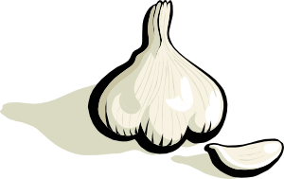
Phonétique
écouter / écrire
Say these words:
SSC [-ail-/aille]
sounds like a ‘yih’ sound after SSC [a].
This is similar to the [-ill-/ille] vs [i] pattern we practised last week.
à
[at, to, in]
ail
[garlic]
Notes:
Timing: 1 minute
Aim: aural recognition and production of SSCs [-ail-/aille] and [a] to prime for the activity on the next slide.
Procedure:
1. Students try to say the words in the minimal pair, à and ail.
2. Click to hear the words said by a native speaker. Students repeat.
3. Click to bring up the hint.
Transcript:
à
ail
Word frequency (1 is the most frequent word in French): ail [>5000]

Slide 31
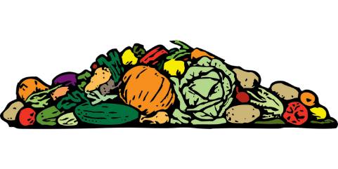
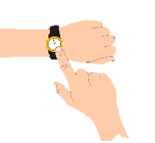
Phonétique (1/2)
Hint
SSC [-ail-/aille]
sounds like a ‘yih’ sound after SSC [a].
écouter
Écoute ! Quel mot a la SSC [-ail-/aille] ?
a) tas | b) taille
a) pas | b) paille
1
3
[pile]
[size]
[step]
[straw]
___
___
___
___
a) il a | b) il aille
a) ailleurs | b) à l’heure
2
4
[he has]
[he may go]
[elsewhere]
[on time]
___
___
_
_
Notes:
Timing: 5 minutes (for two slides)
Aim: aural recognition of SSCs [-ail-/aille] and [a] in minimal pairs. Awareness-raising exercise in pronunciation of [-il(le)-] (sounds like the preceding vowel + ‘yih’.)
Procedure:
1. Click the numbers to play the audio.
2. Students write 1-8 and complete the word with [a] or
3. Click to reveal the answers. Draw attention to the SFC on many of the distractors.
4. Students sound out the pairs of words.
5. Move to the next slide and repeat steps 1-4.
Transcript:
1. a) tas b) taille
2. a) il a b) il aille
3. a) pas b) paille
4. a) ailleurs b) à l’heure
Word frequency (1 is the most frequent word in French): tas [2723], taille [1500], il [13], avoir [8], aller [53], pas [18], paille [>5000], ailleurs [360], heure [99]
Source: Londsale, D., & Le Bras, Y. (2009). A Frequency Dictionary of French: Core vocabulary for learners London: Routledge.

Slide 32
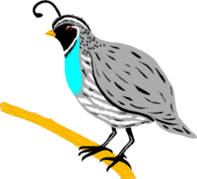
Phonétique (2/2)
Hint
SSC [-ail-/aille]
sounds like a ‘yih’ sound after SSC [a].
écouter
Écoute ! Quel mot a le SSC [-ail-/aille] ?
a) bail | b) bas
a) d’État | b) détail
5
7
[of the state]
[detail]
[lease]
[bottom]
___
___
___
___
a) rat | b) rail
a) caille | b) cas
6
8
[scenario]
[rail]
[quail]
___
___
___
___
Notes:
This is the second part of the activity described on the previous slide.
Transcript:
5. a) bail, b) bas
6. a) rat, b) rail
7. a) d’ État, détail
8. a) caille, cas
Word frequency (1 is the most frequent word in French): bâille [>5000], bas [468], rat [4290], rail [4697], état [1840], détail [53], caille [>5000], cas [137]
Source: Londsale, D., & Le Bras, Y. (2009). A Frequency Dictionary of French: Core vocabulary for learners London: Routledge.

Slide 33
Phonétique
Hint
Is there a letter ‘i’ before the -ll- ?
parler
balle
60
allumer
[to turn on]
broussaille [bush / thicket]
bétail [cattle]
ballon
chaleur
[heat]
défaillance [failure]
cheval
secondes
détailler [to describe]
intervalle [interval]
également [also / as well]
parallèle [parallel]
éventail [range / variety]
taille-crayon
tailler
[to trim]
installer [to install]
0
DÉBUT
Notes:
Timing: 5 minutes
Aim: Oral production of words containing ‘l/ll’ after ‘a’ and ‘ai’
Procedure:
1. Start the timer.
2. Students have one minute to try to say all the words correctly to a partner.
3. Teacher circulates to listen in to pronunciation and correct if necessary.
4. Click on the words to hear them said by a native speaker.
5. Click to move on to a more challenging versions of this activity with an increase in speed to aid automisation of the sounds.
Word frequency (1 is the most frequent word in French): allumer [3169], balle [2311], ballon [3692], bétail [4842], broussaille [>5000], chaleur [2773], cheval [2220], défaillance [3951], détailler [2667], également [246], éventail [4621], intervalle [3226], parallèle [2196], taille-crayon [>5000], tailler [3802], installer [821]

Slide 34
SSC [a]
phonétique
Consolidation [6]

Slide 35
a
animal
Notes:
Timing: 1 minute
Aim: To consolidate SSC [a]
Procedure: 1. Present the letter(s) and say the [a] sound first, on its own. Students repeat it with you. 2. Bring up the word ”animal” on its own, say it, students repeat it, so that they have the opportunity to focus all of their attention on the connection between the written word and its sound.
3. A possible gesture for this would be to mimic an animal’s motion, perhaps holding ones arms and hands close to the chest as ‘paws’. 4. Roll back the animations and work through 1-3 again, but this time, dropping your voice completely to listen carefully to the students saying the [a] sound, pronouncing ”animal” and, if using, doing the gesture.
Word frequency (1 is the most frequent word in French):
animal [1002]
Source: Londsale, D., & Le Bras, Y. (2009). A Frequency Dictionary of French: Core vocabulary for learners London: Routledge.

Slide 36
a
ça va ?
table
animal
malade
sac
mal
[badly]
Notes:
Timing: 2 minutes
Aim: To consolidate SSC [a]
Procedure:
1. Introduce and elicit the pronunciation of the individual SSC [a] and then the source word again ‘animal’ (with gesture, if using). 2. Then present and elicit the pronunciation of the five cluster words.
The cluster words have been chosen for their high-frequency, from a range of word classes, with the SSC (where possible) positioned within a variety of syllables within the words (e.g. initial, 2nd, final etc.). Additionally, we have tried to use words that build cumulatively on previously taught SSCs (see the Phonics Teaching Sequence document) and do not include new SSCs. Where new SSCs are used, they are often consonants which have a similar symbol-sound correspondence in English.
Word frequency (1 is the most frequent word in French): animal [1002]; ça va? [54 (cela), 53 (aller)]; malade [1066] mal [277]; table [1019]; sac [2343] Source: Londsale, D., & Le Bras, Y. (2009). A Frequency Dictionary of French: Core vocabulary for learners London: Routledge.

Slide 37
Nasal and non-nasal vowels
écouter / écrire
Vowels can be nasal (like [am/em] and [an/an] or non-nasal [like [e] and [a].
When you say a nasal vowel, air passes through your nose as well as your mouth.
Écoute les mots. C’est [em/am] / [en/an] ou [e] / [a] ?
 |  | nasal vowel [em/am] [en/an] | non-nasal vowel [e] / [a]
 |  | nasal vowel [em/am] [en/an] | non-nasal vowel [e] / [a]
1
menu
5
centre
2
membre
6
remarque
3
dramatique
7
croissant
4
champion
8
organisation
Notes:
Timing: 5 minutes
Aim: to introduce the concept of nasal and non-nasal vowels. Aural recognition of nasal and non-nasal vowels [em/am], [en/an], [e] and [a] using cognates.
Procedure:
1. Practise saying SSCs [em/am] / [en/an] and [e] / [a] aloud, in isolation. Students should notice a vibration in the nose when they produce the nasal sounds, but not when they produce the oral sounds.
2. Click the numbers to play the audio.
3. Students write 1-8 and decide if the letters in bold represent a ‘nasal’ or ‘non-nasal’ vowel sound.
4. Click to reveal the answers. The word appears first, followed by the ticks in the appropriate columns.
Transcript:
menu
membre
dramatique
champion
centre
remarque
croissant
organisation
Word frequency of cognates (1 is the most frequent word in French): menu [3470], membre [390], dramatique [2918], champion [2443], centre [491], remarque [2019], croissant [2069], organisation [570]
Source: Londsale, D., & Le Bras, Y. (2009). A Frequency Dictionary of French: Core vocabulary for learners London: Routledge.

Slide 38
[nasal], [e] ou [a] ?
parler
Lis les mots et décide si c’est une voyelle nasale ou une voyelle orale.
Puis, dis les mots !
 |  | nasal vowel | non-nasal vowel
 | embaucher [to hire]
 | remonter [to go back up]
 | engendrer [to generate]
 | abandon [abandonment]
 | chemin [path]
 | menace [threat]
 | champ [field]
 | banal [ordinary]
1
2
3
4
nasal vowels
[em/am], [en/an]
5
6
7
oral vowels
[e], [a]
8
Notes:
Timing: 5 minutes
Aim: to apply awareness of spelling rules governing pronunciation changes in SSCs [em/am] and [en/an]. Oral production of words containing these letter combinations.
Procedure:
1. Recap the spelling rules governing pronunciation changes in SSCs [em/am] and [en/an] introduced in lesson 1 (see slide 7). 2. Students read the words and decide from the spelling alone whether they think the SSC in bold represents a nasal or non-nasal sound.
3. Click to reveal correct answer.
4. Students say the words.
5. Click on the numbers to check pronunciation.
Transcript:
1. embaucher
2. remonter
3. engendrer
4. abandon
5. chemin
6. menace
7. champ
8. banal
Word frequency (1 is the most frequent word in French): embaucher [3743], remonter [1020], engendrer [2286], abandon [2676], chemin [859,] menace [1607], champ [847], banal [4221]
Source: Londsale, D., & Le Bras, Y. (2009). A Frequency Dictionary of French: Core vocabulary for learners London: Routledge.
Word frequency of near-cognates used in task instructions (1 is the most frequent word in French): décider [165], voyelle [>5000], nasal [>5000], oral [4114]
Source: Londsale, D., & Le Bras, Y. (2009). A Frequency Dictionary of French: Core vocabulary for learners London: Routledge.

Slide 39
SSC [a]
phonétique
Consolidation [7]

Slide 40
a
animal
Notes:
Timing: 1 minute
Aim: To introduce/consolidate SSC [a]
Procedure: 1. Present the letter(s) and say the [a] sound first, on its own. Students repeat it with you. 2. Bring up the word ”animal” on its own, say it, students repeat it, so that they have the opportunity to focus all of their attention on the connection between the written word and its sound.
3. A possible gesture for this would be to mimic an animal’s motion, perhaps holding ones arms and hands close to the chest as ‘paws’. 4. Roll back the animations and work through 1-3 again, but this time, dropping your voice completely to listen carefully to the students saying the [a] sound, pronouncing ”animal” and, if using, doing the gesture.
Word frequency (1 is the most frequent word in French):
animal [1002]
Source: Londsale, D., & Le Bras, Y. (2009). A Frequency Dictionary of French: Core vocabulary for learners London: Routledge.

Slide 41
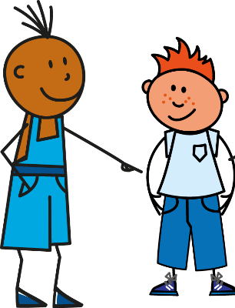
SSC [a] ou [ê/è] ?
phonétique
Listen carefully, then practise saying these words:
1
Tu as [you have]
2
Il/elle/on a [he/she/one has]
3
Tu es [you are]
4
Il/elle/on est [he/she/one is]
Notes:
Timing: 1 minute
Aim: To differentiate between the [a] or [ê/è] sounds
Procedure:
Click on the numbers to hear the native speaker, then students repeat.
Transcript:
Tu as
Il/elle/on a
Tu es
Il/elle/on est

Slide 42
SSC [a] ou [ê/è] ?
phonétique
Listen to Amir and Océane’s words and thoughts.
Do you hear the [a] or [ê/è] sound before the beep?
Choose the correct option for the missing sentence ending.
2
1
Il est ennuyeux*!
_____
Tu es belle
___________
________________
1
belle | un chat
2
un chien | ennuyeux
*ennuyeux = annoying
Notes:
Timing: 5 minutes. Slide 1/4
Aim: To differentiate between the [a] or [ê/è] sounds
Procedure:
Explain that students will hear complete sentences, which include either a, as, es or est, and that the final part of each sentence is beeped out.
Click on the numbers above the images to hear the beeped out sentences.
Students decide whether they hear the [a] or [ê/è] sound for each one.
Students then decide which sentence ending best fits with the [a] or [ê/è] sound that they heard.
Click to reveal if their answer is correct
Click on the number next to the option boxes to hear the complete sentences, asking students to repeat what they hear.
Transcript:
Tu es belle.
Il est ennuyeux.
Word frequency of unknown words used (1 is the most frequent word in French):
ennuyer [3480],
Source: Lonsdale, D., & Le Bras, Y. (2009). A Frequency Dictionary of French: Core vocabulary for learners London: Routledge.

Slide 43
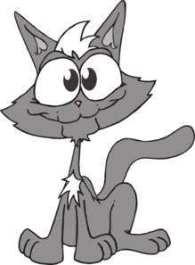
SSC [a] ou [ê/è] ?
*souris = mouse
phonétique
Listen to Amir and Océane’s words and thoughts.
Do you hear the [a] or [ê/è] sound before the beep?
Choose the correct option for the missing sentence ending.
1
2
Elle a un chat
Mon chat est gentil
____
______________
_______________
1
gentille | un chat
2
une souris* | gentil
Notes:
Slide 2/4
Transcript:
Elle a un chat.
Mon chat est gentil.
Word frequency of unknown words used (1 is the most frequent word in French):
souris [4328],
Source: Lonsdale, D., & Le Bras, Y. (2009). A Frequency Dictionary of French: Core vocabulary for learners London: Routledge.

Slide 44
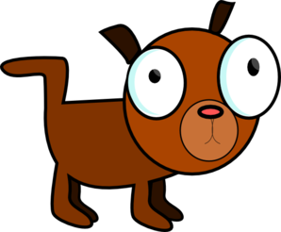
SSC [a] ou [ê/è] ?
*amusée = amused
*amusant =amusing
*nez = nose
phonétique
Listen to Amir and Océane’s words and thoughts.
Do you hear the [a] or [ê/è] sound before the beep?
Choose the correct option for the missing sentence ending.
2
1
Oui, il est amusant!
Tu as un chien?
____
________
______________
__________
1
un chien | amusée?
2
amusant | un nez rouge
Notes:
Slide 3/4
Transcript:
Tu as un chien?
Oui, il est amusant.
Word frequency of unknown words used (1 is the most frequent word in French): nez [2661]
Source: Lonsdale, D., & Le Bras, Y. (2009). A Frequency Dictionary of French: Core vocabulary for learners London: Routledge.
Word frequency of cognates used (1 is the most frequent word in French): amuser [2538]
Source: Lonsdale, D., & Le Bras, Y. (2009). A Frequency Dictionary of French: Core vocabulary for learners London: Routledge.

Slide 45
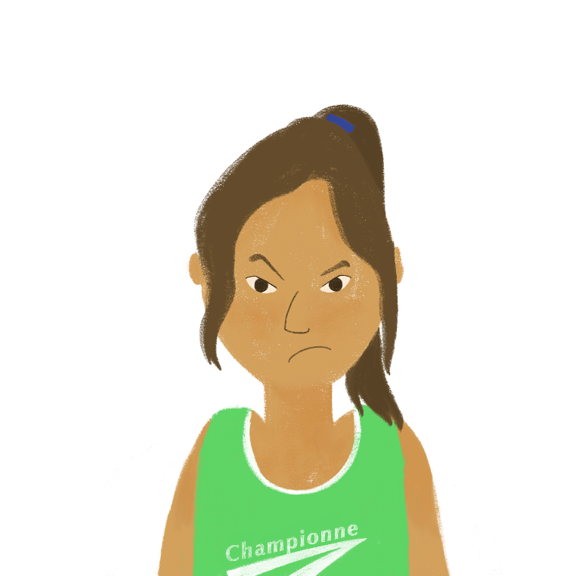
SSC [a] ou [ê/è] ?
phonétique
2
Listen to Amir and Océane’s words and thoughts.
Do you hear the [a] or [ê/è] sound before the beep?
Choose the correct option for the missing sentence ending.
Non, on n’est pas ensemble!
1
___________
On est ensemble
________
_____________
_________________
1
deux chiens | ensemble
2
pas ensemble | pas deux chiens
Notes:
Slide 4/4
Transcript:
On est ensemble
Non, on n’est pas ensemble!

Slide 46
SSC [a]
phonétique
Consolidation [8]

Slide 47
a
animal
Notes:
Timing: 1 minute [1/4]
Aim: To consolidate SSC [a]
Procedure: 1. Present the letter(s) and say the [a] sound first, on its own. Students repeat it with you. 2. Bring up the word ”animal” on its own, say it, students repeat it, so that they have the opportunity to focus all of their attention on the connection between the written word and its sound.
3. A possible gesture for this would be to mimic an animal’s motion, perhaps holding ones arms and hands close to the chest as ‘paws’. 4. Roll back the animations and work through 1-3 again, but this time, dropping your voice completely to listen carefully to the students saying the [a] sound, pronouncing ”animal” and, if using, doing the gesture.
Word frequency (1 is the most frequent word in French):
animal [1002]
Source: Londsale, D., & Le Bras, Y. (2009). A Frequency Dictionary of French: Core vocabulary for learners London: Routledge.

Slide 48
a
ça va ?
table
animal
malade
sac
mal
[badly]
Notes:
[3/4]
Aim: To consolidate SSC [a]
Procedure:
1. Introduce and elicit the pronunciation of the individual SSC [a] and then the source word again ‘animal’ (with gesture, if using). 2. Then present and elicit the pronunciation of the five cluster words.
The cluster words have been chosen for their high-frequency, from a range of word classes, with the SSC (where possible) positioned within a variety of syllables within the words (e.g. initial, 2nd, final etc.). Additionally, we have tried to use words that build cumulatively on previously taught SSCs (see the Phonics Teaching Sequence document) and do not include new SSCs. Where new SSCs are used, they are often consonants which have a similar symbol-sound correspondence in English.
Word frequency (1 is the most frequent word in French): animal [1002]; ça va? [54 (cela), 53 (aller)]; malade [1066] mal [277]; table [1019]; sac [2343] Source: Londsale, D., & Le Bras, Y. (2009). A Frequency Dictionary of French: Core vocabulary for learners London: Routledge.

Slide 49
SSC [a]
phonétique
Consolidation [9]

Slide 50
a
animal
Notes:
[5/8]
Aim: To consolidate SSC [a]
Procedure: 1. Present the letter(s) and say the [a] sound first, on its own. Students repeat it with you. 2. Bring up the word ”animal” on its own, say it, students repeat it, so that they have the opportunity to focus all of their attention on the connection between the written word and its sound.
3. A possible gesture for this would be to mimic an animal’s motion, perhaps holding ones arms and hands close to the chest as ‘paws’. 4. Roll back the animations and work through 1-3 again, but this time, dropping your voice completely to listen carefully to the students saying the [a] sound, pronouncing ”animal” and, if using, doing the gesture.
Word frequency (1 is the most frequent word in French):
animal [1002]
Source: Londsale, D., & Le Bras, Y. (2009). A Frequency Dictionary of French: Core vocabulary for learners London: Routledge.

Slide 51
a
ça va ?
table
animal
malade
sac
mal
[badly]
Notes:
[6/8]
Aim: To consolidate SSC [a]
Procedure:
1. Introduce and elicit the pronunciation of the individual SSC [a] and then the source word again ‘animal’ (with gesture, if using). 2. Then present and elicit the pronunciation of the five cluster words.
The cluster words have been chosen for their high-frequency, from a range of word classes, with the SSC (where possible) positioned within a variety of syllables within the words (e.g. initial, 2nd, final etc.). Additionally, we have tried to use words that build cumulatively on previously taught SSCs (see the Phonics Teaching Sequence document) and do not include new SSCs. Where new SSCs are used, they are often consonants which have a similar symbol-sound correspondence in English.
Word frequency (1 is the most frequent word in French): animal [1002]; ça va? [54 (cela), 53 (aller)]; malade [1066] mal [277]; table [1019]; sac [2343] Source: Londsale, D., & Le Bras, Y. (2009). A Frequency Dictionary of French: Core vocabulary for learners London: Routledge.

