Slide 1
French Phonics Collection
SSC [-s-]
Artwork by: Chloé Motard
Date updated: 30/08/2022
Notes:
Artwork by Chloé Motard. All additional pictures selected are available under a Creative Commons license, no attribution required.

Slide 2
SSC [-s-]
phonétique
Introduction

Slide 3
-s-
maison
Notes:
Timing: 1 minute
Aim: To introduce SSC [-s-]
Procedure: 1. Present the letter(s) and say the [-s-] sound first, on its own. Students repeat it with you. 2. Bring up the word ”maison” on its own, say it, students repeat it, so that they have the opportunity to focus all of their attention on the connection between the written word and its sound.
3. A possible gesture for this would be to trace the outline of a house in the air with two fingers. 4. Roll back the animations and work through 1-3 again, but this time, dropping your voice completely to listen carefully to the students saying the [-s- between vowels] sound, pronouncing ”maison” and, if using, doing the gesture.
Word frequency (1 is the most frequent word in French):
maison [325]
Source: Londsale, D., & Le Bras, Y. (2009). A Frequency Dictionary of French: Core vocabulary for learners London: Routledge.

Slide 4
-s-
maison
Notes:
With sound and no pictures to focus all attention on the sound-symbol correspondence.

Slide 5
-s-
maison
Notes:
Without sound to elicit pronunciation (without first hearing the teacher).
Teacher to elicit pronunciation by asking “Comment dit-on …”

Slide 6
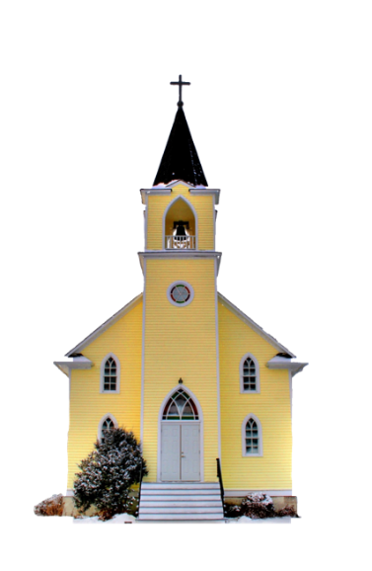
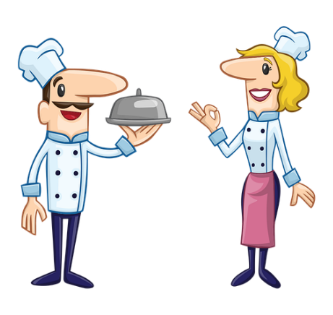
-s-
magasin
église
désolé
maison
cuisine
[sorry]
chose
[thing]
Notes:
Timing: 2 minutes
Aim: To introduce SSC [-s-]
Procedure:
Introduce and elicit the pronunciation of the individual SSC [-s-] and then the source word again ‘maison’ (with gesture, if using). Then present and elicit the pronunciation of the five cluster words. The cluster words have been chosen for their high-frequency, from a range of word classes, with the SSC (where possible) positioned within a variety of syllables within the words (e.g. initial, 2nd, final etc.). Additionally, we have tried to use words that build cumulatively on previously taught SSCs (see the Phonics Teaching Sequence document) and do not include new SSCs. Where new SSCs are used, they are often consonants which have a similar symbol-sound correspondence in English.
Word frequency (1 is the most frequent word in French): maison [325]; chose [125]; magasin [1736]; église [1782]; désolé [2081]; cuisine [2618]. Source: Londsale, D., & Le Bras, Y. (2009). A Frequency Dictionary of French: Core vocabulary for learners London: Routledge.

Slide 7
-s-
magasin
église
désolé
maison
cuisine
chose
Notes:
With sound and no pictures to focus all attention on the sound-symbol correspondence.

Slide 8
-s-
magasin
église
désolé
maison
cuisine
chose
Notes:
Without sound to elicit pronunciation (without first hearing the teacher).
Teacher to elicit pronunciation by asking “Comment dit-on …”

Slide 9
Hard or soft [-s-]?
écouter
 |  | hard (chose) | soft (suis)
 | soupe
 | fils
 | ils ont
 | poisson
 | visage
 |  | hard (chose) | soft (suis)
 | monsieur
 | quasi
 | passer
 | personne
 | usine
1
6
2
7
3
8
4
9
5
10
What do you notice about the spelling of the words containing hard [s] compared to those containing soft [s]?
Notes:
Timing: 5 minutes
Aim: aural recognition between hard and soft [s]. Awareness of spelling rules governing the pronunciation of these SSCs.
Procedure:
1. Click on numbers to hear words. Student decide if [s] is hard or soft.
2. Click to reveal answers.
3. Students try to say the words.
4. Click again to reveal the question about spelling. Students consider in pairs. They might say things like ‘the sound occurs at the beginning’ or ‘when there is a double s’ or ‘between two vowels’. You could guide the students by explaining that there are three rules in total to spot.
4. Rules are summarized on the following slide.
Word frequency (1 is the most frequent word in French): soupe [4563], fils [735], ils ont [13/8], poisson [1616], visage [1292], monsieur [79], quasi [2778], passer [90], personne [84], usine [1482]
Source: Londsale, D., & Le Bras, Y. (2009). A Frequency Dictionary of French: Core vocabulary for learners London: Routledge.

Slide 10
Closed or open [o] ?
Hard or soft [-s-]?
Hard [s] sounds like ‘z’ as in English ‘cousin’
Soft [s] sounds like ‘s’ as in English ‘sister’
phonétique
The French s can be hard or soft.
[-s-] is hard when it:
is between two vowels, including in a liaison (oser, les amis)
[-s-] is soft when:
it is at the beginning of a word or syllable (soupe)
it is before or after a consonant (insister)
there is a double [s] (poisson)
it is at the end of a word (fils)
This is rare as word final consonants are usually SFCs
Notes:
Timing: 2 minutes
Aim: to recap spelling rules governing SSC [-s-]

Slide 11
Closed or open [o] ?
Hard [s] sounds like ‘z’ as in English ‘cousin’
Soft [s] sounds like ‘s’ as in English ‘sister’
Hard or soft [-s-]?
phonétique
The French s can be hard or soft. What are the rules?
[-s-] is hard when it:
is between two vowels, including in a liaison (oser, les amis)
[-s-] is soft when:
it is at the beginning of a word or syllable (soupe)
it is before or after a consonant (insister)
there is a double [s] (poisson)
it is at the end of a word (fils)
Rule 1
Rule 2
Rule 3
Rule 4
Rule 5
This is rare as word final consonants are usually SFCs
Notes:
Timing: 1 minute
Aim: to recap spelling rules governing SSC [-s-]. In this version of slide 9, students are invited to recall the rules they learned in lesson 1. Here, the example words are given as cues, but these can be covered for an additional challenge!
Procedure
Click to reveal a cue. Student look at the cue words and try to remember the rule.
Answers revealed on clicks.

Slide 12
Phonétique
parler
hard [s] | soft [s]
hausse (an increase)
sale (dirty)
épisode
baisse (drop)
esclave (slave)
vision
besoin (need)
préciser (to specify)
ouest
excuse
Notes:
Timing: 5 minutes
Aim: written recognition and oral production of hard and soft [s]
Procedure:
1. Students sketch the grid and assign words to each based on their spelling. It might be helpful to tell students that their knowledge of English pronunciation won’t help them here!
2. Click to move each word to the right column.
3. Now, students practise saying the word. First, they read from top to bottom within the columns, so that words with the same sounds are pronounced together.
4. Click to check pronunciation.
5. Now, students read from left to right across columns, alternating between the [-s-] sounds.
Word frequency (1 is the most frequent word in French): hausse [1572], sale [2906], épisode [3238], baisse [1466], esclave [3468], vision [1505], besoin [183], préciser [745], ouest [1690], excuse [1839]
Source: Londsale, D., & Le Bras, Y. (2009). A Frequency Dictionary of French: Core vocabulary for learners London: Routledge.

Slide 13
SSC [-s-]
phonétique
Consolidation [1]

Slide 14
-s-
maison
Notes:
Timing: 1 minute (2 SSC slides).
Aim: To consolidate SSC [-s-]
Procedure: 1. Present the letter(s) and say the [-s-] sound first, on its own. Students repeat it with you. 2. Bring up the word ”maison” on its own, say it, students repeat it, so that they have the opportunity to focus all of their attention on the connection between the written word and its sound.
3. A possible gesture for this would be to trace the outline of a house in the air with two fingers. 4. Roll back the animations and work through 1-3 again, but this time, dropping your voice completely to listen carefully to the students saying the [-s- between vowels] sound, pronouncing ”maison” and, if using, doing the gesture.
Word frequency (1 is the most frequent word in French):
maison [325]
Source: Londsale, D., & Le Bras, Y. (2009). A Frequency Dictionary of French: Core vocabulary for learners London: Routledge.

Slide 15
-s-
magasin
église
désolé
maison
cuisine
[sorry]
chose
[thing]
Notes:
Aim: To consolidate SSC [-s-]
Procedure:
Introduce and elicit the pronunciation of the individual SSC [-s-] and then the source word again ‘maison’ (with gesture, if using). Then present and elicit the pronunciation of the five cluster words. The cluster words have been chosen for their high-frequency, from a range of word classes, with the SSC (where possible) positioned within a variety of syllables within the words (e.g. initial, 2nd, final etc.). Additionally, we have tried to use words that build cumulatively on previously taught SSCs (see the Phonics Teaching Sequence document) and do not include new SSCs. Where new SSCs are used, they are often consonants which have a similar symbol-sound correspondence in English.
Word frequency (1 is the most frequent word in French): maison [325]; chose [125]; magasin [1736]; église [1782]; désolé [2081]; cuisine [2618]. Source: Londsale, D., & Le Bras, Y. (2009). A Frequency Dictionary of French: Core vocabulary for learners London: Routledge.

Slide 16
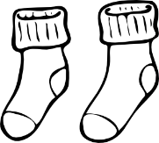
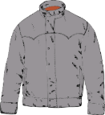
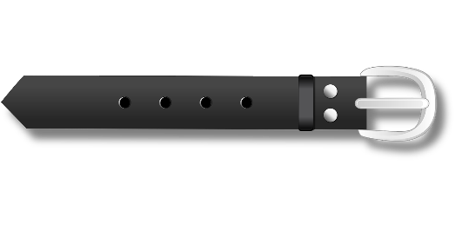
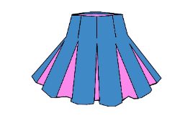
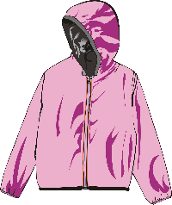
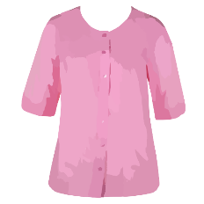
Au magasin de vêtements
Remember:
[-s-] is hard between two vowels.
[c] is hard before a/o/u.
lire / parler
Lisez les listes de mots. Attention aux SCCs en orange !
Ne dites pas l’intrus !
 | des chaussettes | un blouson | un bracelet
 | un pardessus | des lunettes de natation | une blouse
 | un tricot | une ceinture | une jupe plissée
 | un caleçon | des chaussures | une chemisette
 | des lunettes de protection | une vareuse | un chemisier
1
2
3
4
5
Notes:
Timing: 5 minutes
Aim: Pronunciation of words containing SSCs [-s-], [ss], [ç], soft [c], hard [c] and [-tion]. Raising awareness that [ss], [ç], soft [c] and the [t] in [-tion] sound identical.
Procedure:
1. Students read the sets of words, focusing on the SSCs in bold, and mentally eliminating the word containing an SSC which doesn’t match the others.
2. They take it in turns to read aloud the remaining pair of words.
3. Click to reveal the ‘odd one out’. Students say it aloud.
4. Click on the numbers to hear the full line of words said aloud by a native speaker. Students repeat.
Word frequency of cognates used (1 is the most frequent word in French):
protection [953]
Word frequency of unknown words used (1 is the most frequent word in French):
chaussette [>5000], blouson [>5000], jupe [>5000], plissé [>5000], pardessus [>5000], chaussure [3638], tricot [>5000], ceinture [4538], bracelet [>5000], blouse [>5000], caleçon [>5000], chemisette [>5000], lunette [4207], protection [953], vareuse [>5000], chemisier [>5000]
Source: Lonsdale, D., & Le Bras, Y. (2009). A Frequency Dictionary of French: Core vocabulary for learners London: Routledge.

Slide 17
SSC [-s-]
phonétique
Consolidation [2]

Slide 18
-s-
maison
Notes:
Timing: 1 minute [2 slides]
Aim: To consolidate SSC [-s-]
Procedure: 1. Present the letter(s) and say the [-s-] sound first, on its own. Students repeat it with you. 2. Bring up the word ”maison” on its own, say it, students repeat it, so that they have the opportunity to focus all of their attention on the connection between the written word and its sound.
3. A possible gesture for this would be to trace the outline of a house in the air with two fingers. 4. Roll back the animations and work through 1-3 again, but this time, dropping your voice completely to listen carefully to the students saying the [-s- between vowels] sound, pronouncing ”maison” and, if using, doing the gesture.
Word frequency (1 is the most frequent word in French):
maison [325]
Source: Lonsdale, D., & Le Bras, Y. (2009). A Frequency Dictionary of French: Core vocabulary for learners London: Routledge.

Slide 19
-s-
magasin
église
désolé
maison
cuisine
[sorry]
chose
[thing]
Notes:
Aim: To consolidate SSC [-s-]
Procedure:
Introduce and elicit the pronunciation of the individual SSC [-s-] and then the source word again ‘maison’ (with gesture, if using). Then present and elicit the pronunciation of the five cluster words. The cluster words have been chosen for their high-frequency, from a range of word classes, with the SSC (where possible) positioned within a variety of syllables within the words (e.g. initial, 2nd, final etc.). Additionally, we have tried to use words that build cumulatively on previously taught SSCs (see the Phonics Teaching Sequence document) and do not include new SSCs. Where new SSCs are used, they are often consonants which have a similar symbol-sound correspondence in English.
Word frequency (1 is the most frequent word in French): maison [325]; chose [125]; magasin [1736]; église [1782]; désolé [2081]; cuisine [2618]. Source: Lonsdale, D., & Le Bras, Y. (2009). A Frequency Dictionary of French: Core vocabulary for learners London: Routledge.

Slide 20
Phonétique: Hard or soft [s]?
info
Hard [s] sounds like ‘z’ as in English ‘cousin’.
Soft [s] sounds like ‘s’ as in English ‘sister’.
As you know, the French [s] can be hard or soft. To help you say and spell unknown words containing [s] correctly, there are some simple rules:
If there is a soft sound at the beginning of a word, it must be spelled [s-]
soupe
If there is a soft sound between two vowels, it must be spelled [-ss-]
poisson
If there is a hard sound between two vowels, including in a liaison, it must be spelled [-s-]
utiliser
les amis
Notes:
Timing: 2 minutes
Aim: To recap spelling rules governing the pronunciation of SSC [-s-].
Procedure
1. Click to reveal spelling rules. Remind students of the difference between hard and soft [-s-].
2. Click on words in brackets to hear pronunciation of the [s] sounds.
Transcript
soupe
poisson
utiliser
les amis
Word frequency of unknown words used (1 is the most frequent word in French):
soupe [4563]
Source: Lonsdale, D., & Le Bras, Y. (2009). A Frequency Dictionary of French: Core vocabulary for learners London: Routledge.

Slide 21
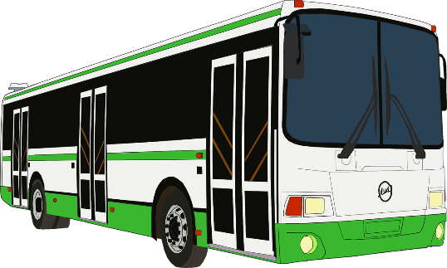
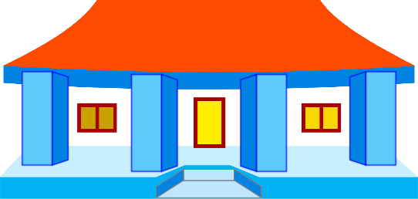
Soft [s], soft [ss] or hard [s]?
écouter
Écoute. Est-ce que tu entends soft [s], soft [ss] ou hard [s]?
sortie
[trip]
kermesse
[school fête]
1
?
2
?
soft [s-]
soft [-ss-]
dessiner
[to draw]
ci s eaux
[scissors]
ciseaux
[scissors]
3
?
4
?
soft [-ss-]
hard [-s-]
Notes:
Timing: 5 minutes [slide 1 of 3]
Aim: Aural recognition of hard [s], soft [ss] and soft [s] in unknown words related to school.
Procedure:
Click the numbers to hear the words.
Students transcribe what they hear (could be done with mini whiteboards). Remind students that if they hear a soft sound, they will have to consider the position of the SSC in the word to spell it correctly.
Click to reveal answers.
Transcript:
sortie
kermesse
dessiner
ciseaux
Word frequency of unknown words used (1 is the most frequent word in French):
sortie [1174], kermesse [>5000], dessiner [2086], ciseaux [>5000]
Source: Lonsdale, D., & Le Bras, Y. (2009). A Frequency Dictionary of French: Core vocabulary for learners London: Routledge.

Slide 22
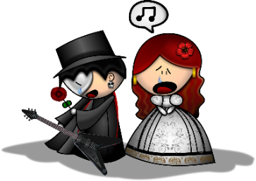
Soft [s], soft [ss] or hard [s]?
écouter
Écoute. Est-ce que tu entends soft [s], soft [ss] ou hard [s]?
maîtresse
[primary teacher, f]
spectacle
[show]
5
?
6
?
soft [-ss-]
soft [s-]
stylo
[pen]
excuse
[excuse]
?
excu s e
[excuse]
?
7
8
soft [s-]
hard [-s-]
Notes:
[slide 2 of 3]
Transcript:
maîtresse
spectacle
stylo
excuse
Word frequency of unknown words used (1 is the most frequent word in French):
maîtresse (maître) [1092], spectacle [1687], stylo [>5000]
Source: Lonsdale, D., & Le Bras, Y. (2009). A Frequency Dictionary of French: Core vocabulary for learners London: Routledge.
Word frequency of cognates used (1 is the most frequent word in French): excuse [1839],
Source: Lonsdale, D., & Le Bras, Y. (2009). A Frequency Dictionary of French: Core vocabulary for learners London: Routledge.

Slide 23
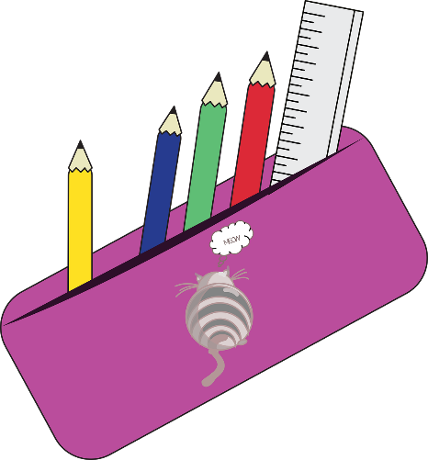
Soft [s], soft [ss] or hard [s]?
écouter
Écoute. Est-ce que tu entends soft [s], soft [ss] ou hard [s]?
trousse
[pencil case]
maîtrise
[master’s degree]
?
maîtri s e
[master’s degree]
9
10
?
soft [-ss-]
hard [-s-]
classeur
[ring binder]
chaise
[chair]
?
chai s e
[chair]
?
11
12
soft [-ss-]
hard [-s-]
Notes:
[slide 3 of 3]
Transcript:
trousse
maîtrise
classeur
chaise
Word frequency of unknown words used (1 is the most frequent word in French):
trousse [>5000], maîtrise [3442], classeur [>5000], chaise [3419]
Source: Lonsdale, D., & Le Bras, Y. (2009). A Frequency Dictionary of French: Core vocabulary for learners London: Routledge.

Slide 24
Phonétique
écouter / écrire
Listen carefully. Do you hear hard [s] or soft [s]?
1
Nous sommes
soft [s]
Vous êtes
hard [s]
Remember, hard [s] before a vowel is pronounced with a liaison.
2
3
Ils sont
soft [s]
4
Elles sont
soft [s]
Notes:
Timing: 1 minute
Aim: Recap of SSCs hard [s] and soft [s] with examples from the present tense of être
Procedure:
1. Click to reveal examples and play audio.
2. Pupils repeat each example to practise.
3. Remind pupils of liaison with hard [s].
Transcript:
Nous sommes
Vous êtes
Ils sont
Elles sont

Slide 25
Phonétique
écouter / écrire
Dis les phrases avec ton/ta partenaire. C’est hard [s] ou soft [s] ?
 |  | hard [s] | soft [s]
 | Je suis allé
 | Nous avons mangé
 | Tu es arrivée
 | Vous avez réservé
 | Ils ont travaillé
 | Elles sont restées
 | Ils sont tombés
 | Elles ont commandé
 | Ils ont appris
 | Elles sont montées
1
2
Hard [s]?
3
4
5
6
Soft [s]?
7
8
9
10
Notes:
Timing: 5 minutes
Aim: Production of SSCs hard [s] and soft [s]
Procedure:
1. Students take turns to say phrases in pairs.
2. Students write down whether they hear hard [s] or soft [s].
3. Click the numbers to listen to native speaker recording.
4. Click to reveal answers.
Transcript:
Je suis allé
Nous avons mangé
Tu es arrivé
Vous avez réservé
Ils ont travaillé
Elles sont restées
Ils sont tombés
Elles ont commandé
Ils ont appris
Elles sont montées
Word frequency (1 is the most frequent word in French):
Source: Lonsdale, D., & Le Bras, Y. (2009). A Frequency Dictionary of French: Core vocabulary for learners London: Routledge.

