Slide 1
French Phonics Collection
SSC [-ouill-/ouil]
Artwork by: Chloé Motard
Date updated: 20/04/21
Notes:
Artwork by Chloé Motard. All additional pictures selected are available under a Creative Commons license, no attribution required.

Slide 2
SSC [-ouill-/ouil]
phonétique
Introduction

Slide 3
Phonétique
phonétique
We know that [-ill/ille] and [-ail/aill] sound like a vowel + ‘yih’:
[-ill/ille]
= i + ‘yih’
[-ail/aill]
= a + ‘yih’
Using this pattern, we can work out how these new SSCs sound:
[-eil/eill]
= è + ‘yih’
e.g. oreille
[-ouil/ouill]
= ou + ‘yih’
e.g. brouillard
[-euil/euill]
= long eu/œ + ‘yih’
e.g. feuille
Notes:
Timing: 2 minutes
Aim: Introduction of SSCs [-eil/eill], [-euil/euill], and [-ouil/ouill]. Introducing the idea of vowel + [-il/ill] to help students break down these less frequent SSCs.
Procedure:
1. Click to remind students of SSCs [-ill/ille] and [-ail/aill], drawing attention to the fact that they can be broken down into SSCs [i]/[a] + yih.
2. Click to bring up the first new SSC. Students say SSC [-eil/eill] following the pronunciation tips given.
3. Click to reveal ‘decoded’ pronunciation and example word (click picture to hear pronunciation).
4. Repeat for [-ouil/ouill] and [-euil/euill].
Word frequency of unknown words (1 is the most frequent word in French):
oreille [1884], feuille [2440], brouillard [4452]
Source: Londsale, D., & Le Bras, Y. (2009). A Frequency Dictionary of French: Core vocabulary for learners London: Routledge.

Slide 4
-ouil/ouill
brouillard
Notes:
Timing: 1 minute
Aim: To introduce SSC [-ouil/ouill]
Procedure: 1. Present the letter(s) and say the [-ouil/ouill] sound first, on its own. Students repeat it with you. 2. Bring up the word ”brouillard” on its own, say it, students repeat it, so that they have the opportunity to focus all of their attention on the connection between the written word and its sound.
3. A possible gesture for this would be [to squint and wiggle fingers in front of face miming being unable to see through fog]. 4. Roll back the animations and work through 1-3 again, but this time, dropping your voice completely to listen carefully to the students saying the [-ouil/ouill] sound, pronouncing ”brouillard” and, if using, doing the gesture.
Word frequency (1 is the most frequent word in French):
brouillard [4452]
Source: Londsale, D., & Le Bras, Y. (2009). A Frequency Dictionary of French: Core vocabulary for learners London: Routledge.
Word frequency (1 is the most frequent word in French):
brouiller [4682]
Source: Londsale, D., & Le Bras, Y. (2009). A Frequency Dictionary of French: Core vocabulary for learners London: Routledge.

Slide 5
-ouil/ouill
brouillard
Notes:
With sound and no pictures to focus all attention on the sound-symbol correspondence.

Slide 6
-ouil/ouill
brouillard
Notes:
Without sound to elicit pronunciation (without first hearing the teacher).
Teacher to elicit pronunciation by asking “Comment dit-on …”

Slide 7
Phonétique
écouter / écrire
 |  | [-eil/eill] | [è]
 | sommeil
 | grès
 | conseil
 | bouteille
 |  | [-ouil/ouill] | [ou]
 | fouiller
0 | rouille
 | bouton
 | nouer
1
__
[sleep]
5
__
[to search]
2
__
[sandstone]
6
__
[rust]
3
__
[advice]
7
__
[button]
4
__
[bottle]
8
__
[to tie]
 |  | [-euil/euill] | [long eu/œ]
 | bonheur
 | seuil
 | deuil
 | œuvre
9
___
[joy]
10
___
[doorstep]
11
___
[grief]
12
___
[work]
Notes:
Timing: 7 minutes
Aim: aural recognition of SSCs [-eil/eill], [è], [ouil/ouill], [ou], [-euil/euill] and long [eu/oe]
Procedure:
1. Click the numbers to play the audio.
2. Students write 1-12 and choose which SSC they think is missing.
3. Click to reveal the answers.
Transcript:
1. sommeil
2. grès
3. conseil
4. bouteille
5. fouiller
6. rouille
7. bouton
8. nouer
9. bonheur
10. seuil
11. deuil
12. oeuvre
Word frequency (1 is the most frequent word in French): sommeil [3393], grès [>5000], conseil [577], bouteille [2979], fouiller [3431], rouille [>5000], bouton [4462], nouer [4489], bonheur [1948], seuil [2068], deuil [3540], œuvre [331]
Source: Londsale, D., & Le Bras, Y. (2009). A Frequency Dictionary of French: Core vocabulary for learners London: Routledge.

Slide 8
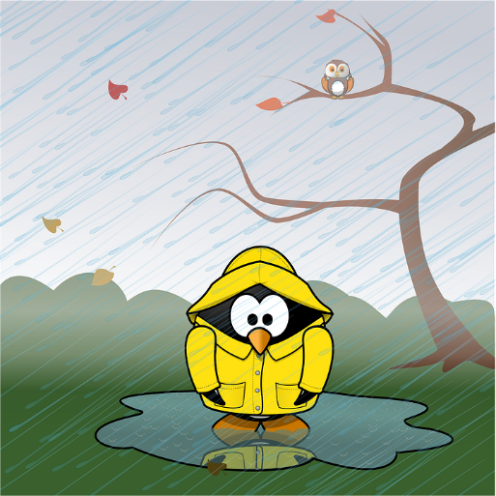
-ouil/ouill
fouiller
grenouille
[to rummage]
brouillard
débrouiller
[wet]
brouiller
mouillé
[disentangle]
[to scramble]
Notes:
Timing: 2 minutes
Aim: To introduce SSC [-ouil/ouill]
Procedure:
1. Introduce and elicit the pronunciation of the individual SSC [-ouil/ouill] and then the source word again ‘brouiller’ (with gesture, if using). 2. Then present and elicit the pronunciation of the four cluster words.
The cluster words have been chosen for their high-frequency, from a range of word classes, with the SSC (where possible) positioned within a variety of syllables within the words (e.g. initial, 2nd, final etc.). Additionally, we have tried to use words that build cumulatively on previously taught SSCs (see the Phonics Teaching Sequence document) and do not include new SSCs. Where new SSCs are used, they are often consonants which have a similar symbol-sound correspondence in English.
Word frequency (1 is the most frequent word in French): fouiller [3431]; brouiller [4682] débrouiller [3618]; grenouille [>5000], mouillé [>5000] Source: Londsale, D., & Le Bras, Y. (2009). A Frequency Dictionary of French: Core vocabulary for learners London: Routledge.

Slide 9
-ouil/ouill
fouiller
grenouille
brouillard
mouillé
débrouiller
brouiller
Notes:
With sound and no pictures to focus all attention on the sound-symbol correspondence.

Slide 10
-ouil/ouill
fouiller
grenouille
[to rummage]
brouillard
débrouiller
[wet]
brouiller
mouillé
[disentangle]
[to scramble]
Notes:
Without sound to elicit pronunciation (without first hearing the teacher).
Teacher to elicit pronunciation by asking “Comment dit-on …”

Slide 11
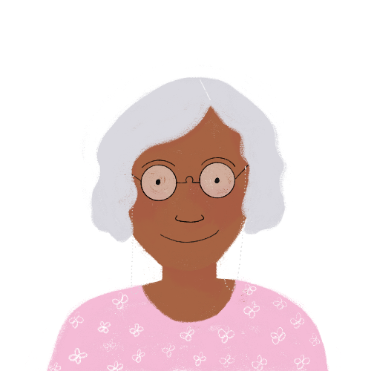
Phonétique
lire / parler
Remember that each SSC is made up of a vowel + ‘yih’
nouille
[noodle]
Notes:
Transcript:
nouille
Word frequency (1 is the most frequent word in French): nouille [>5000]
Source: Londsale, D., & Le Bras, Y. (2009). A Frequency Dictionary of French: Core vocabulary for learners London: Routledge.

Slide 12
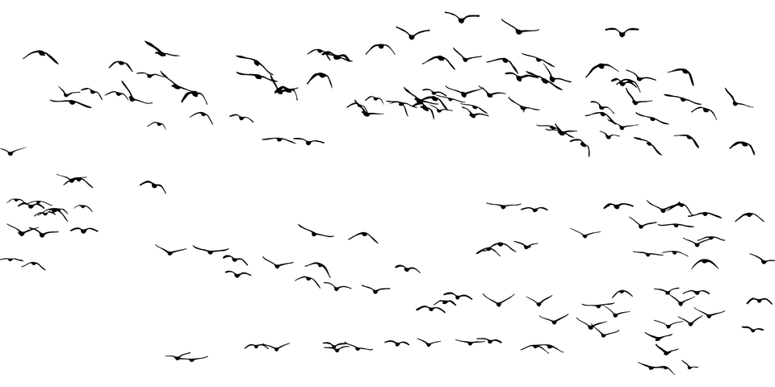
Phonétique
lire / parler
Remember that each SSC is made up of a vowel + ‘yih’
grouiller
[to swarm]
Notes:
Transcript:
grouiller
Word frequency (1 is the most frequent word in French): grouiller [>5000]
Source: Londsale, D., & Le Bras, Y. (2009). A Frequency Dictionary of French: Core vocabulary for learners London: Routledge.

Slide 13
Phonétique
lire / parler
Remember that each SSC is made up of a vowel + ‘yih’
chatouiller
[to tickle]
Notes:
Transcript:
chatouiller
Word frequency (1 is the most frequent word in French): chatouiller [>5000]
Source: Londsale, D., & Le Bras, Y. (2009). A Frequency Dictionary of French: Core vocabulary for learners London: Routledge.

Slide 14
SSC [-eill-/eil]
phonétique
Consolidation [1]

Slide 15
-ouill-/-ouil
brouillard
Notes:
Aim: To consolidate SSC [-ouill-/-ouil]
Procedure: 1. Present the letter(s) and say the [-ouill-/-ouil] sound first, on its own. Students repeat it with you. 2. Bring up the word ”brouillard” on its own, say it, students repeat it, so that they have the opportunity to focus all of their attention on the connection between the written word and its sound.
3. A possible gesture for this would be [to squint and wiggle fingers in front of face miming being unable to see through fog]. 4. Roll back the animations and work through 1-3 again, but this time, dropping your voice completely to listen carefully to the students saying the [-ouill-/-ouil] sound, pronouncing ”brouillard” and, if using, doing the gesture.
Word frequency (1 is the most frequent word in French):
brouillard [4452]
Source: Londsale, D., & Le Bras, Y. (2009). A Frequency Dictionary of French: Core vocabulary for learners London: Routledge.
Word frequency (1 is the most frequent word in French):
brouiller [4682]
Source: Londsale, D., & Le Bras, Y. (2009). A Frequency Dictionary of French: Core vocabulary for learners London: Routledge.

Slide 16
Phonétique
phonétique
Remember! These SSCs sound like a vowel + ‘yih’:
[-ail/aill]
= a + ‘yih’
e.g. taille
[-eil/eill]
= è + ‘yih’
e.g. oreille
[-ouil/ouill]
= ou + ‘yih’
e.g. brouillard
[-euil/euill]
= long eu/œ + ‘yih’
e.g. feuille
Notes:
Timing: 2 minutes
Aim: Revising the breakdown of SSCs [-aill-/-ail], [-eill-/-eil], [-ouill-/-ouil] and [-euill-/-euil].
Procedure:
1. Click to remind students of the SSCs, drawing attention to the fact that they can be broken down into vowels + yih.
2. Click to reveal ‘decoded’ pronunciation and example word. Students repeat.
Word frequency of unknown words (1 is the most frequent word in French):
oreille [1884], feuille [2440], brouillard [4452], taille [1500]
Source: Londsale, D., & Le Bras, Y. (2009). A Frequency Dictionary of French: Core vocabulary for learners London: Routledge.

Slide 17
Phonétique
écouter
Écoute les mots et choisis la bonne SSC.
 |  |  | [-aill-/-ail] | [-eill-/-eil] | [-ouill-/-ouil] | [-euill-/-euil]
 | la pagaille | chaos
 | l’œillade | wink
 | l’orteil | toe
 | le deuil | grief
 | mouiller | to wet
 | conseiller | to advise
 | la maille | stitch
 | ouille ! | ouch !
1
__
2
__
3
__
4
__
5
__
6
__
7
__
8
__
Notes:
Timing: 5 minutes
Aim: Aural recognition of SSCs [-aill-/-ail], [-eill-/-eil], [-ouill-/-ouil] and [-euill-/-euil] in isolated words.
Procedure:
1. Click on the number to play the audio. Remind students that they should focus on the part of the word which is covered, and listen for ‘vowel+ yih’.
2. Students choose which of the SSCs the word contains.
3. Click to reveal answers.
4. Play the words again. Students repeat.
Transcript:
1. la pagaille
2. l’œillade
3. l’orteil
4. le deuil
5. mouiller
6. conseiller
7. la maille
8. ouille !
Word frequency of unknown words used (1 is the most frequent word in French):
pagaille [>5000], œillade [>5000], orteil [>5000], deuil [3540], mouiller [>5000], conseiller [970], maille [>5000], ouille [>5000]
Source: Londsale, D., & Le Bras, Y. (2009). A Frequency Dictionary of French: Core vocabulary for learners London: Routledge.

Slide 18
Rolecards for printing
Partenaire A
1. L’écur___ recu___e un évent___ de c___oux. 2. Un épouvant___ assis dans un faut___ surv___ des citr___es.
Partenaire B
3. Les filles merv___euses pi___ent au cons___er à l’acc___.
4. Les ab___es et les bouvr___s débr___ent les tas de p___.
Partenaire A
1. L’écur___ recu___e un évent___ de c___oux. 2. Un épouvant___ assis dans un faut___ surv___ des citr___es.
Partenaire B
3. Les filles merv___euses pi___ent au cons___er à l’acc___.
4. Les ab___es et les bouvr___s débr___ent les tas de p___.
Partenaire A
1. L’écur___ recu___e un évent___ de c___oux. 2. Un épouvant___ assis dans un faut___ surv___ des citr___es.
Partenaire B
3. Les filles merv___euses pi___ent au cons___er à l’acc___.
4. Les ab___es et les bouvr___s débr___ent les tas de p___.
Notes:
Timing: 6 minutes. This is slide 1/5.
Aim: Oral production of sentences containing SSCs [-aill-/-ail], [-eill-/-eil], [-euill-/-euil], and [-ouill-/-ouil]; fluency of production.
Procedure:
1. Print and distribute the role cards on this slide.
2. Student B faces the board, Student A turns away. Display slide 31.
3. Students B reads the sentences aloud, two or three times depending on the needs of the class. Student A listens and fills in the gaps in sentence 1 of the rolecard.
4. Click on the audio button to hear the sentence said aloud by a native speaker. Student A uses this to check their writing.
5. Student A turns back to the board to self-correct.
6. Display slide 32 and repeat steps 2-5.
7. Students swap roles. Repeat steps 2-5 with slides 33 and 34.
Word frequency of unknown words used (1 is the most frequent word in French):
abeille [>5000], accueil [2541], bafouiller [>5000], bain [3458], bouiller [>5000], caillou [>5000], cocktail [4992], conseiller [577], écureuil [>5000], éventail [4621], feuilleter [>5000], leur [35], maillot [>5000], mail [>5000], médaille [3361], merveilleux [2209], paille [>5000], piaille [>5000], portail [>5000], recueillir [>1230]
Source: Londsale, D., & Le Bras, Y. (2009). A Frequency Dictionary of French: Core vocabulary for learners London: Routledge.

Slide 19
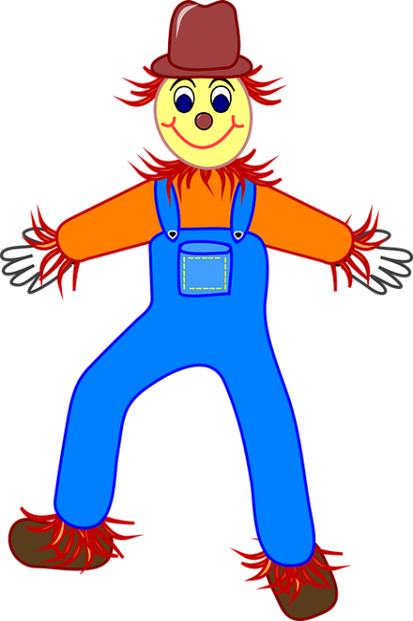
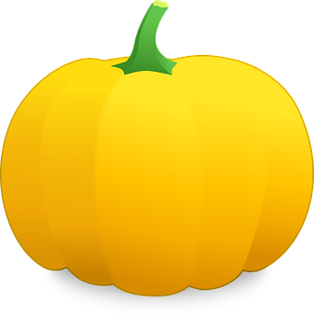
Réponses
écouter / parler
Un épouvantail assis dans un fauteuil surveille des citrouilles. A scarecrow sitting in an armchair is keeping an eye on the pumpkins.
2
Notes:
This is slide 3/5.

Slide 20
Réponses
écouter / parler
Les abeilles et les bouvreuils débrouillent les tas de paille. The bees and the bullfinches are arranging the piles of straw.
4
Notes:
This is slide 5/5.

