Slide 1
French Phonics Collection
SSC [-ill-/ille]
Artwork by: Chloé Motard
Date updated: 30/08/2022
Notes:
Artwork by Chloé Motard. All additional pictures selected are available under a Creative Commons license, no attribution required.

Slide 2
SSC [-ill-/ille]
phonétique
Introduction

Slide 3
-ill-/-ille
fille
Notes:
Timing: 1 minute
Aim: To introduce SSC [-ill-/-ille]
Procedure: 1. Present the letter(s) and say the [-ill-/ille] sound first, on its own. Students repeat it with you. 2. Bring up the word ”fille” on its own, say it, students repeat it, so that they have the opportunity to focus all of their attention on the connection between the written word and its sound.
3. A possible gesture for this would be to gesture at some of the girls in the class. 4. Roll back the animations and work through 1-3 again, but this time, dropping your voice completely to listen carefully to the students saying the [-ill-/-ille] sound, pronouncing ”fille” and, if using, doing the gesture.
Word frequency (1 is the most frequent word in French):
fille [629]
Source: Londsale, D., & Le Bras, Y. (2009). A Frequency Dictionary of French: Core vocabulary for learners London: Routledge.

Slide 4
-ill-/-ille
fille
Notes:
With sound and no pictures to focus all attention on the sound-symbol correspondence.

Slide 5
-ill-/ille
fille
Notes:
Without sound to elicit pronunciation (without first hearing the teacher).
Teacher to elicit pronunciation by asking “Comment dit-on …”

Slide 6
-ill-/-ille
brillant
juillet
[shiny]
habiller
fille
pavillon
[to dress]
famille
[family]
Notes:
Timing: 2 minutes
Aim: To introduce SSC [-ill-/-ille]
Procedure:
Introduce and elicit the pronunciation of the individual SSC [-ill-/-ille] and then the source word again ‘fille’ (with gesture, if using). Then present and elicit the pronunciation of the five cluster words. The cluster words have been chosen for their high-frequency, from a range of word classes, with the SSC (where possible) positioned within a variety of syllables within the words (e.g. initial, 2nd, final etc.). Additionally, we have tried to use words that build cumulatively on previously taught SSCs (see the Phonics Teaching Sequence document) and do not include new SSCs. Where new SSCs are used, they are often consonants which have a similar symbol-sound correspondence in English.
Word frequency (1 is the most frequent word in French): brillant [2569]; juillet [1326]; habiller [3576]; famille [172]; pavillon [3412]. Source: Londsale, D., & Le Bras, Y. (2009). A Frequency Dictionary of French: Core vocabulary for learners London: Routledge.

Slide 7
-ill-/ille
brillant
juillet
habiller
fille
pavillon
famille
Notes:
With sound and no pictures to focus all attention on the sound-symbol correspondence.

Slide 8
-ill-/ille
brillant
juillet
habiller
fille
pavillon
famille
Notes:
Without sound to elicit pronunciation (without first hearing the teacher).
Teacher to elicit pronunciation by asking “Comment dit-on …”

Slide 9
Phonétique
écouter / écrire
Say these words:
 |  | SSC [-ill-/ille] | SSC [i]
 | gentil
 | briller
 | grille
 | fils
 | billet
 | fillette
 | outil
 | subtil
fi !
[yuck]
fille
[girl]
1
[nice]
2
[to shine]
Attention!
The last letters of gentil and outil are SFCs. These are exceptions to the CRFL rule.
3
_
[railings]
4
[son]
Hint
SSC [-ill-/ille] sounds like SSC [i] followed by a ‘yih’ sound.
5
[ticket]
6
_
[little girl]
7
[tool]
8
[subtle]
Notes:
Timing: 5 minutes
Aim: aural recognition of SSCs [-ill-/ille] and [i]
Procedure:
1. Students try to say the words in the minimal pair, fi and fille. Click to hear the words said by a native speaker. Students repeat.
2. Click to bring up the hint.
3. Click the numbers to play the audio.
4. Students write 1-8 and choose [-ill-] or [i] for each.
5. Click to reveal the answers.
6. Click to highlight exceptions to the CRLF rule.
Transcript:
1. gentil
2. briller
3. grille
4. fils
5. billet
6. fillette
7. outil
8. subtil
Word frequency (1 is the most frequent word in French): gentil [2832] fils [735] outil [1725] briller [2904], billard [>5000], fillette [4737] grille [3341] subtil [4345]
Source: Londsale, D., & Le Bras, Y. (2009). A Frequency Dictionary of French: Core vocabulary for learners London: Routledge.

Slide 10
Phonétique
Quels mots sont différents ?
écouter / écrire
Il y a mille villes tranquilles comme Lille.
 |  | différent ?
 | famille [family]
 | ville [town]
 | coquillage [shell]
 | mille [thousand]
 | billes [marbles]
 | tranquille [quiet]
 | Lille [a French city]
 | camomille
1
These four words are different – the letter ‘l’ in [ille] is pronounced as normal.
There are not many of these exceptions, but some are important, high-frequency words.
You just have to learn them by heart!
2
3
4
5
6
7
8
Notes:
Timing: 5 minutes
Aim: To raise awareness of exceptions to the [-ill-/-ille] pronunciation rule
Procedure:
1. Explain to students that there are four important exceptions to the pronunciation rule they have practiced, and they are going to spot them in this exercise.
2. Click on the audio buttons to play the words.
3. Students tick in the column for the words in which they hear the difference.
4. Click to animate the answers (the words which are not exceptions disappear following the fifth click of the mouse).
5. Click once more to bring up the speech bubble explanation and the mnemonic. Students try to say the mnemonic. Teacher demonstrates, students repeat.
Transcript:
1. famille
2. ville
3. coquillage
4. mille
5. bille
6. tranquille
7. Lille
8. camomille
Word frequency (1 is the most frequent word in French): famille [172], ville [260], coquillage [>5000], mille [1008], bille [>5000], tranquille [2555], Lille [n/a], camomille [>5000]
Source: Londsale, D., & Le Bras, Y. (2009). A Frequency Dictionary of French: Core vocabulary for learners London: Routledge.

Slide 11
LL
écouter / écrire
You have learned that ll is pronounced like the English ‘y’ when it follows the letter i (famille, juillet, travailler).
Remember there are a handful of exceptions to this rule (ville, tranquille, mille, Lille). In these words, ll is pronounced like the English L.
After other vowels, ll is always pronounced like English L, (salle, belle, collège).
Challenge: on the next slide you will see a set of words in French containing ll.
Can you read them out to your partner before the timer runs out?
Notes:
Timing: 2 minutes
Aim: To introduce spelling rules governing the pronunciation of ‘ll’ and cross-linguistic comparison with English.

Slide 12
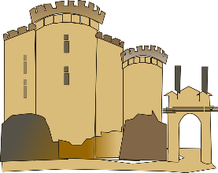
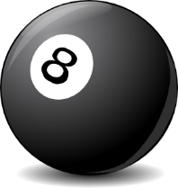
LL
parler
milllion
Lille
cédille
tellement
60
folle
[cedilla]
cheville
[so much]
[crazy]
vanille
collectif
actuellement
elle
[collective]
[at the moment]
[she]
secondes
syllabe
la Bastille
collègue
pull
[colleague]
[syllable]
installer
excellent
[to install]
dollar
vallée
0
salle
[valley]
DÉBUT
balle
Notes:
Timing: 5 minutes for 3 slides
Aim: Oral production (speaking) practice with the ‘ll’ sound after various vowels
Procedure:
1. Click to start the timer.
2. Students have one minute to try to say all the words correctly to a partner.
3. If the LL sound is pronounced incorrectly, the listening students stops the speaker and has them pronounce the word correctly three times before moving on (any pronunciation errors noticed in other parts of the word should not be penalised, but noted by the listener and given as feedback once the timer stops.
4. The student who pronounces the most words correctly in 30 seconds is the winner.
5. Move on to the following slides to repeat the task in fewer seconds, helping automisation.
Word frequency (1 is the most frequent word in French): dollar [432], collègue [1099], collectif [1224], salle [812], installer [821], actuellement [728], vallée [2856], folle [fou 1357], syllabe [>5000], elle [38], cédille [>5000], tellement [869], excellent [1225], vanille [>5000], la Bastille [n/a], cheville [>5000], pull [>5000], balle [2311], Lille [n/a], million [307]
Source: Londsale, D., & Le Bras, Y. (2009). A Frequency Dictionary of French: Core vocabulary for learners London: Routledge.

Slide 13
LL
parler
milllion
Lille
cédille
tellement
45
folle
[cedilla]
cheville
[so much]
[crazy]
vanille
collectif
actuellement
elle
[collective]
[at the moment]
[she]
secondes
syllabe
la Bastille
collègue
pull
[colleague]
[syllable]
installer
excellent
[to install]
dollar
vallée
0
salle
[valley]
DÉBUT
balle
Notes:
As previous with 15 fewer seconds on the timer.

Slide 14
LL
parler
milllion
Lille
cédille
tellement
30
folle
[cedilla]
cheville
[so much]
[crazy]
vanille
collectif
actuellement
elle
[collective]
[at the moment]
[she]
secondes
syllabe
la Bastille
collègue
pull
[colleague]
[syllable]
installer
excellent
[to install]
dollar
vallée
0
salle
[valley]
DÉBUT
balle
Notes:
As previous with 15 fewer seconds on the timer still.

Slide 15
SSC [-ill-/ille]
phonétique
Consolidation [1]

Slide 16
-ill-/-ille
fille
Notes:
Timing: 1 minute
Aim: To consolidate SSC [-ill-/-ille]
Procedure: 1. Present the letter(s) and say the [-ill-/ille] sound first, on its own. Students repeat it with you. 2. Bring up the word ”fille” on its own, say it, students repeat it, so that they have the opportunity to focus all of their attention on the connection between the written word and its sound.
3. A possible gesture for this would be to gesture at some of the girls in the class. 4. Roll back the animations and work through 1-3 again, but this time, dropping your voice completely to listen carefully to the students saying the [-ill-/-ille] sound, pronouncing ”fille” and, if using, doing the gesture.
Word frequency (1 is the most frequent word in French):
fille [629]
Source: Londsale, D., & Le Bras, Y. (2009). A Frequency Dictionary of French: Core vocabulary for learners London: Routledge.

Slide 17
-ill-/-ille
brillant
juillet
[shiny]
habiller
fille
pavillon
[to dress]
famille
[family]
Notes:
Timing: 1 minute
Aim: To consolidate SSC [-ill-/-ille]
Procedure:
Introduce and elicit the pronunciation of the individual SSC [-ill-/-ille] and then the source word again ‘fille’ (with gesture, if using). Then present and elicit the pronunciation of the five cluster words. The cluster words have been chosen for their high-frequency, from a range of word classes, with the SSC (where possible) positioned within a variety of syllables within the words (e.g. initial, 2nd, final etc.). Additionally, we have tried to use words that build cumulatively on previously taught SSCs (see the Phonics Teaching Sequence document) and do not include new SSCs. Where new SSCs are used, they are often consonants which have a similar symbol-sound correspondence in English.
Word frequency (1 is the most frequent word in French): brillant [2569]; juillet [1326]; habiller [3576]; famille [172]; pavillon [3412]. Source: Londsale, D., & Le Bras, Y. (2009). A Frequency Dictionary of French: Core vocabulary for learners London: Routledge.

Slide 18
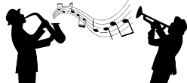
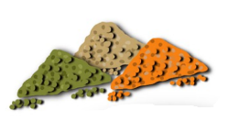
Phonétique
Les mots finissent-ils par [-ille] ou par [-ien] ? C’est quoi en anglais ?
en français | en anglais | [-ille] | [-ien]
un musicien | a musician
une lentille | a lentil
un dalmatien | a dalmatian
un martien | a Martian
un gorille | a gorilla
un comédien | a comedian
vanille | vanilla
1
2
3
4
5
6
7
Notes:
Timing: 5 minutes
Aim: Aural recognition of SSCs [-ille] and [-ien] at the end of words which are near-cognates in written but not spoken form; raising awareness of English equivalent spellings/pronunciation of [-ille] and [-ien].
Procedure:
1. Click on a number to play the audio.
2. Instruct students to play close attention to the end of the word, and decide which SSC they hear.
3. Click to reveal answers.
4. Click to play the words again. Students already know how the word ends, so they should now focus on the beginning. Ask them which English word it sounds like.
5. Click to bring up picture clues if necessary.
6. Click to reveal English translations.
7. Click to reveal French transcriptions.
8. Play the audio again. Students repeat.
Transcript:
1. un musicien
2. une lentille
3. un dalmatien
4. un martien
5. un gorille
6. un comédien
7. vanille
Word frequency of cognates (1 is the most frequent word in French):
lentille [>5000], dalmatien [>5000]; martien [>5000]; gorille [>5000]; comédien [4253], vanille [>5000]
Source: Londsale, D., & Le Bras, Y. (2009). A Frequency Dictionary of French: Core vocabulary for Léarners London: Routledge.

Slide 19
Des virelangues
lire / parler
1
2
3
Le comédien canadien pose une question à la famille de gorilles.
The Canadian comedian asks the family of gorillas a question.
Notes:
Timing: 4 minutes. This is slide 1/4.
Aim: Oral production of sentences with words containing a mix of SSCs containing [i] ([-ill-]/[-ille], [-ien], [-tion]).
Procedure:
1. Remind students which words containing [-ill-] are exceptions (mille, ville).
2. Students takes turns to say the tongue twisters, focussing on the SSCs in bold.
3. Click on the slowest speed (1) to check pronunciation.
4. Students repeat.
5. Repeat steps 203 at speeds (2) and (3) to improve fluency.
Transcript:
Le comédien canadien pose une question à la famille de gorilles.
Word frequency of cognates (1 is the most frequent word in French):
comédien [4253], poser [218], gorille [>5000]
Source: Londsale, D., & Le Bras, Y. (2009). A Frequency Dictionary of French: Core vocabulary for Léarners London: Routledge.

Slide 20
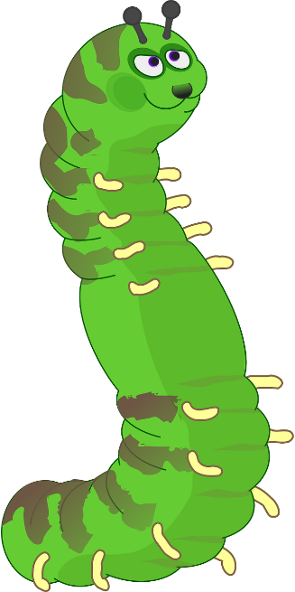
Des virelangues
lire / parler
1
2
3
Un grillon canadien vit avec une famille de chenilles dans une cabine.
A Canadian cricket lives with a family of caterpillars in a cabin.
Notes:
This is slide 2/4.
Transcript:
Un grillon canadien vit avec une famille de chenilles dans une cabine.
Word frequency of cognates (1 is the most frequent word in French):
cabine [3953]
Source: Londsale, D., & Le Bras, Y. (2009). A Frequency Dictionary of French: Core vocabulary for Léarners London: Routledge.
Word frequency of unknown words (1 is the most frequent word in French):
vivre [201], grillon [>5000], chenille [>5000]
Source: Londsale, D., & Le Bras, Y. (2009). A Frequency Dictionary of French: Core vocabulary for Léarners London: Routledge.

Slide 21
Des virelangues
lire / parler
1
2
3
Un dalmatien italien joue avec trois mille billes dans la ville.
An Italian dalmatian plays with three thousand marbles in the town.
Notes:
This is slide 3/4.
Transcript:
Un dalmatien italien joue avec trois mille billes dans la ville.
Word frequency of cognates (1 is the most frequent word in French):
dalmatien [>5000]
Source: Londsale, D., & Le Bras, Y. (2009). A Frequency Dictionary of French: Core vocabulary for Léarners London: Routledge.
Word frequency of unknown words (1 is the most frequent word in French):
mille [1008], bille [>5000]
Source: Londsale, D., & Le Bras, Y. (2009). A Frequency Dictionary of French: Core vocabulary for Léarners London: Routledge.

Slide 22
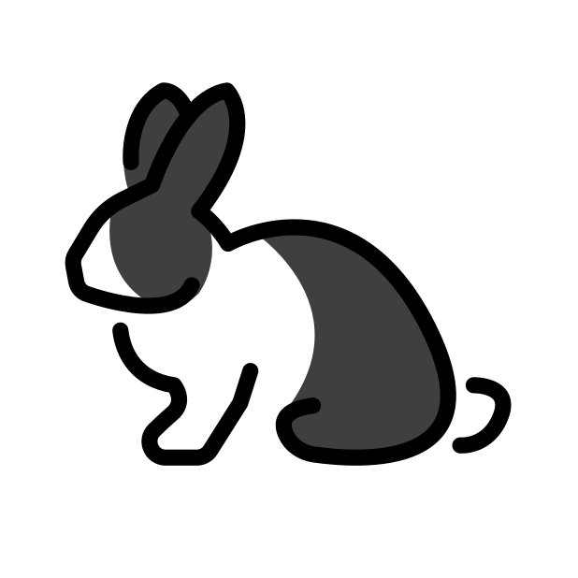
Des virelangues
lire / parler
1
2
3
Sa copine tient un grillon canadien et un lapin italien.
Her friend is holding a Canadian cricket and an Italian rabbit.
Notes:
This is slide 4/4.
Transcript:
Sa copine tient un grillon canadien et un lapin italien.
Word frequency of unknown words (1 is the most frequent word in French):
copain [3020], tenir [104], grillon [>5000], lapin [>5000]
Source: Londsale, D., & Le Bras, Y. (2009). A Frequency Dictionary of French: Core vocabulary for Léarners London: Routledge.

Slide 23
SSC [-ill-/ille]
phonétique
Consolidation [2]

Slide 24
-ill-/-ille
fille
Notes:
Timing: 1 minute
Aim: To consolidate SSC [-ill-/-ille]
Procedure: 1. Present the letter(s) and say the [-ill-/ille] sound first, on its own. Students repeat it with you. 2. Bring up the word ”fille” on its own, say it, students repeat it, so that they have the opportunity to focus all of their attention on the connection between the written word and its sound.
3. A possible gesture for this would be to gesture at some of the girls in the class. 4. Roll back the animations and work through 1-3 again, but this time, dropping your voice completely to listen carefully to the students saying the [-ill-/-ille] sound, pronouncing ”fille” and, if using, doing the gesture.
Word frequency (1 is the most frequent word in French):
fille [629]
Source: Lonsdale, D., & Le Bras, Y. (2009). A Frequency Dictionary of French: Core vocabulary for learners London: Routledge.

Slide 25
-ill-/-ille
brillant
juillet
[shiny]
habiller
fille
pavillon
[to dress]
famille
[family]
Notes:
Timing: 1 minute
Aim: To consolidate SSC [-ill-/-ille]
Procedure:
Introduce and elicit the pronunciation of the individual SSC [-ill-/-ille] and then the source word again ‘fille’ (with gesture, if using). Then present and elicit the pronunciation of the five cluster words. The cluster words have been chosen for their high-frequency, from a range of word classes, with the SSC (where possible) positioned within a variety of syllables within the words (e.g. initial, 2nd, final etc.). Additionally, we have tried to use words that build cumulatively on previously taught SSCs (see the Phonics Teaching Sequence document) and do not include new SSCs. Where new SSCs are used, they are often consonants which have a similar symbol-sound correspondence in English.
Word frequency (1 is the most frequent word in French): brillant [2569]; juillet [1326]; habiller [3576]; famille [172]; pavillon [3412]. Source: Lonsdale, D., & Le Bras, Y. (2009). A Frequency Dictionary of French: Core vocabulary for learners London: Routledge.

Slide 26
Phonétique
phonétique
As you know, [-ill/ille] and [-ail/aill] sound like a vowel + ‘yih’:
[-ill/ille]
= i + ‘yih’
[-ail/aill]
= a + ‘yih’
Using this pattern, we have also learned how these SSCs sound:
[-eil/eill]
= è + ‘yih’
e.g. oreille
[-ouil/ouill]
= ou + ‘yih’
e.g. brouillard
[-euil/euill]
= long eu/œ + ‘yih’
e.g. feuille
Notes:
Timing: 2 minutes
Aim: Consolidation of SSCs [-eil/eill], [-euil/euill], and [-ouil/ouill] and the idea of vowel + [-il/ill] to help students break down these less frequent SSCs.
Procedure:
1. Click to remind students of SSCs [-ill/ille] and [-ail/aill], drawing attention to the fact that they can be broken down into SSCs [i]/[a] + yih.
2. Click to bring up further SSC consolidation. Students say SSC [-eil/eill] following the pronunciation tips given.
3. Click to reveal ‘decoded’ pronunciation and example word (click picture to hear pronunciation).
4. Repeat for [-ouil/ouill] and [-euil/euill].
Word frequency of unknown words (1 is the most frequent word in French):
oreille [1884], feuille [2440], brouillard [4452]
Source: Lonsdale, D., & Le Bras, Y. (2009). A Frequency Dictionary of French: Core vocabulary for learners London: Routledge.

Slide 27
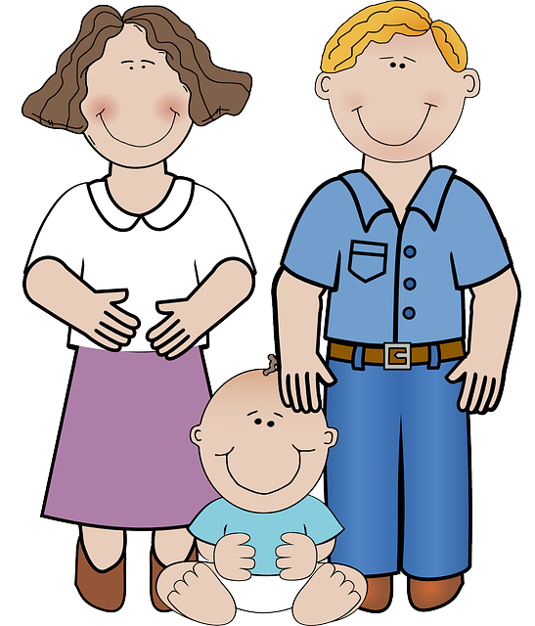
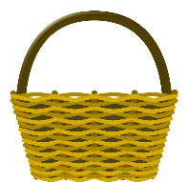
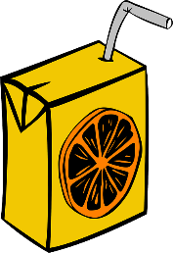
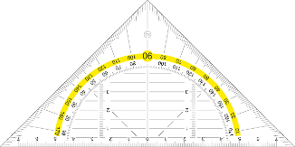
ill-/-ille, -ail/-aille, -eil/-eille, -ouil/-ouille
parler
brouillard
30
Marseille
famille
lentille
bouteille
médaille
oreille
travail
vitrail
paille
corbeille
SECONDES
éventail
chandail
soleil
feuille
cheville
grenouille
0
appareil
écureuil
fauteuil
détail
DÉBUT
Notes:
Timing: 3 minutes
Aim: Speaking practice of SSCs
Procedure:
1. Students work in pairs.
2. One at a time they have to say as many [ill-/-ille. -ail-/-aille, -eil/-eille, -euil/-euille, ouil/ouille.] words as possible in 30s.
3. The partner listens to make sure pronunciation is correct.
4. If they get one wrong, start again.
5. Swap roles.
6. Click on words to hear native pronunciation.
Transcript:
lentille
brouillard
Marseille
famille
travail
bouteille
vitrail
médaille
oreille
paille
corbeille
éventail
chandail
soleil
feuille
cheville
grenouille
appareil
écureuil
fauteuil
détail
Word frequency of cognates (1 is the most frequent word in French): lentille [>5000], brouillard [4452], famille [172], travail [153], bouteille [2979], vitrail [>5000], médaille [3361], oreille [1884], paille [>5000], ville [260], corbeille [>5000], éventail [4621], chandail [>5000], soleil [1713], feuille [2440], cheville [>5000], grenouille [>5000], appareil [1420], écureuil [>5000], fauteuil [2743], détail [318]
Source: Lonsdale, D., & Le Bras, Y. (2009). A Frequency Dictionary of French: Core vocabulary for learners London: Routledge.

Slide 28
Phonétique
écouter / écrire
Écoute et complète les mots avec le bon SSC
 |  | [-ill-/-ille] | [-ail-/aille] | [-eil/-eille] | [-euil/-euille] | [ouil/ouille]
 | bouillon
 | portefeuille
 | cons eil
 | pastille
 | acc ueill ir
 | orteil
 | trouvaille
 | bille s
1
___
[broth]
2
_____
[wallet]
3
___
[advice]
4
__
[tablet]
5
___
[to welcome]
6
__
[toe]
7
____
[discovery]
8
__
[marbles]
Notes:
Timing: 7 minutes
Aim: aural recognition of SSCs [ill-/-ille. -ail-/aille, -eil/-eille, -euil/-euille, ouil/ouille]
Procedure:
1. Click the numbers to play the audio.
2. Students write 1-12 and choose which SSC they think is missing.
3. Click to reveal the answers.
Transcript:
1. bouillon
2. portefeuille
3. conseil
4. pastille
5. accueilir
6. orteil
7. trouvaille
8. billes
Word frequency (1 is the most frequent word in French): bouillon [>5000],portefeuille [>5000], conseil [577], pastille [>5000], accueillir [1189], orteil [>5000], trouvaille [>5000], billes [>5000]
Source: Lonsdale, D., & Le Bras, Y. (2009). A Frequency Dictionary of French: Core vocabulary for learners London: Routledge.

