Slide 1
French Phonics Collection
SSC [-gn-]
Artwork by: Chloé Motard
Date updated: 30/08/2022
Notes:
Artwork by Chloé Motard. All additional pictures selected are available under a Creative Commons license, no attribution required.

Slide 2
SSC [-gn-]
phonétique
Introduction

Slide 3
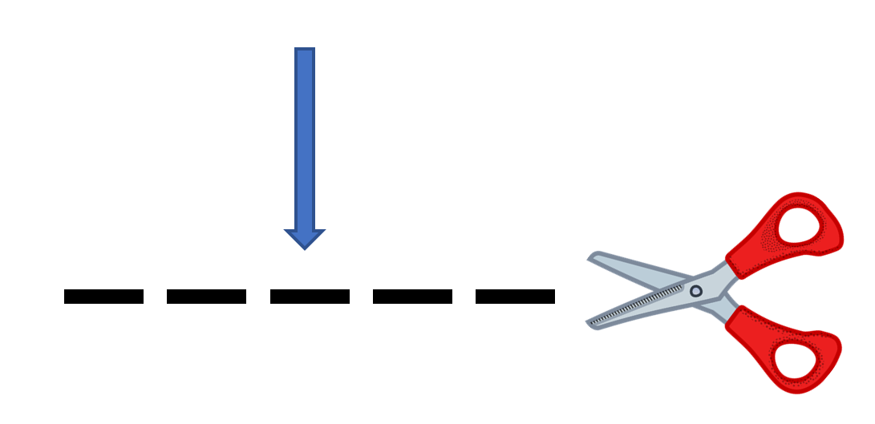
-gn-
ligne
Notes:
Timing: 1 minute
Aim: To introduce SSC [-gn-]
Procedure: 1. Present the letter(s) and say the [-gn-] sound first, on its own. Students repeat it with you. 2. Bring up the word ”ligne” on its own, say it, students repeat it, so that they have the opportunity to focus all of their attention on the connection between the written word and its sound.
3. A possible gesture for this would be to draw a line in the air with your finger, 4. Roll back the animations and work through 1-3 again, but this time, dropping your voice completely to listen carefully to the students saying the [-gn-] sound, pronouncing ”ligne” and, if using, doing the gesture.
Word frequency (1 is the most frequent word in French):
ligne [342]
Source: Londsale, D., & Le Bras, Y. (2009). A Frequency Dictionary of French: Core vocabulary for learners London: Routledge.

Slide 4
-gn-
ligne
Notes:
With sound and no pictures to focus all attention on the sound-symbol correspondence.

Slide 5
-gn-
ligne
Notes:
Without sound to elicit pronunciation (without first hearing the teacher).
Teacher to elicit pronunciation by asking “Comment dit-on …”

Slide 6
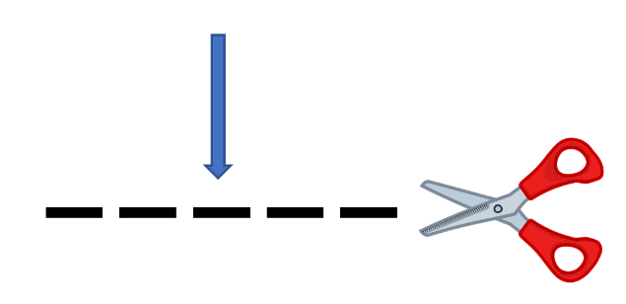
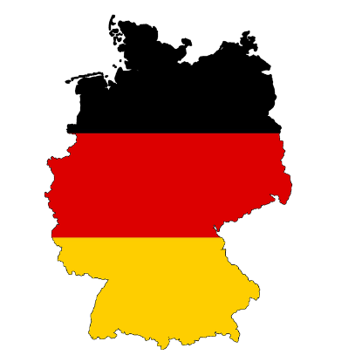
-gn-
gagner
montagne
[to win]
espagnol
ligne
Allemagne
ignorer
[to not know]
Notes:
Timing: 2 minutes
Aim: To introduce SSC [-gn-]
Procedure:
Introduce and elicit the pronunciation of the individual SSC [-gn-] and then the source word again ‘ligne’ (with gesture, if using). Then present and elicit the pronunciation of the five cluster words. The cluster words have been chosen for their high-frequency, from a range of word classes, with the SSC (where possible) positioned within a variety of syllables within the words (e.g. initial, 2nd, final etc.). Additionally, we have tried to use words that build cumulatively on previously taught SSCs (see the Phonics Teaching Sequence document) and do not include new SSCs. Where new SSCs are used, they are often consonants which have a similar symbol-sound correspondence in English.
Word frequency (1 is the most frequent word in French): ligne [342]; gagner [258]; ignorer [639]; espagnol [1666]; montagne [1734]; Allemagne [N/A]. Source: Londsale, D., & Le Bras, Y. (2009). A Frequency Dictionary of French: Core vocabulary for learners London: Routledge.

Slide 7
-gn-
gagner
montagne
espagnol
ligne
Allemagne
ignorer
Notes:
With sound and no pictures to focus all attention on the sound-symbol correspondence.

Slide 8
-gn-
gagner
montagne
espagnol
ligne
Allemagne
ignorer
Notes:
Without sound to elicit pronunciation (without first hearing the teacher).
Teacher to elicit pronunciation by asking “Comment dit-on …”

Slide 9
Phonétique
écouter / écrire
 | What do you hear? | [gn] | [n]/[nn]
 | poignée
 | accompagne
 | innocent
 | éloigner
 | anniversaire
 | baigner
 | What do you hear? | [gn] | [n]/[nn]
 | me n er
 | dessi n er
 | souligner
 | campagne
 | gouver n er
6
_
1
_
[to lead]
7
_
2
_
[to accompany]
8
_
3
_
[to underline]
9
_
4
_
[to take away]
[countryside]
10
_
[birthday]
5
_
[to rule]
11
_
[to bathe]
Notes:
Timing: 5 minutes
Aim: Aural differentiation between [gn] and [n].
Procedure:
1. Click numbers to hear words.
2. Students tick whether they think the word needs [gn] or [n]/[n] to fill the gap.
3. On clicks the answers are revealed.
Transcript:
mener
dessiner
souligner
campagne
gouverner
poignée
accompagne
innocent
éloigner
anniversaire
baigner
Word frequency (1 is the most frequent word in French): mener [4040], dessiner [2086], souligner [816], campagne [666], gouverner [2063], poignée [3208], accompagne [727], innocent [2059], éloigner [1541], anniversaire [2043], baigner [4608],
Source: Londsale, D., & Le Bras, Y. (2009). A Frequency Dictionary of French: Core vocabulary for learners London: Routledge.

Slide 10
Phonétique
lire / parler
chinois
signe
60
ministre
règne
significatif
[reign]
[significant]
compagnie
signal
[company]
témoignage
[testimony]
secondes
minime
généreux
[minimal]
raisonnable
signature
détenir
0
dignité
ignorance
Canada
DÉBUT
Notes:
Timing: 5 minutes for three slides
Aim: Written recognition and oral production of SSC [gn] in cognate or near-cognate words.
Procedure:
1. Click début to start timer
2. Students pronounce all words (mixture of [gn] and [n]/[nn]). Students work in pairs and listen to each other’s attempts. If a student mispronounces [gn] (they may pronounce it the English way and say a ‘g’ or ‘n’ sound) or [n] (they may overapply the rule and say [gn]) they must repeat the word three times before moving on.
3. Following slides have shorter timer to increase challenge
Word frequency (1 is the most frequent word in French): généreux [2015], raisonnable [2021], dignité [2171], signe [707], compagnie [775], signal [978], témoignage [1548], règne [3649], significatif [2292], minime [2030], détenir [2056], Canada [n/a], ministre [204], chinois [1914], signature [2187], ignorance [4055]
Source: Londsale, D., & Le Bras, Y. (2009). A Frequency Dictionary of French: Core vocabulary for learners London: Routledge.

Slide 11
Phonétique
lire / parler
chinois
signe
45
ministre
règne
significatif
[reign]
[significant]
compagnie
signal
[company]
témoignage
[testimony]
secondes
minime
généreux
[minimal]
raisonnable
signature
détenir
0
dignité
ignorance
Canada
DÉBUT
Notes:
45 seconds

Slide 12
Phonétique
lire / parler
chinois
signe
30
ministre
règne
significatif
[reign]
[significant]
compagnie
signal
[company]
témoignage
[testimony]
secondes
minime
généreux
[minimal]
raisonnable
signature
détenir
0
dignité
ignorance
Canada
DÉBUT
Notes:
30 seconds

Slide 13
SSC [-gn-]
phonétique
Consolidation [1]

Slide 14
-gn-
ligne
Notes:
Timing: 1 minute
Aim: To consolidate SSC [-gn-]
Procedure: 1. Present the letter(s) and say the [-gn-] sound first, on its own. Students repeat it with you. 2. Bring up the word ”ligne” on its own, say it, students repeat it, so that they have the opportunity to focus all of their attention on the connection between the written word and its sound.
3. A possible gesture for this would be to draw a line in the air with your finger, 4. Roll back the animations and work through 1-3 again, but this time, dropping your voice completely to listen carefully to the students saying the [-gn-] sound, pronouncing ”ligne” and, if using, doing the gesture.
Word frequency (1 is the most frequent word in French):
ligne [342]
Source: Londsale, D., & Le Bras, Y. (2009). A Frequency Dictionary of French: Core vocabulary for learners London: Routledge.

Slide 15
-gn-
gagner
montagne
[to win]
espagnol
ligne
Allemagne
ignorer
[to not know]
Notes:
Timing: 2 minutes
Aim: To consolidate SSC [-gn-]
Procedure:
Introduce and elicit the pronunciation of the individual SSC [-gn-] and then the source word again ‘ligne’ (with gesture, if using). Then present and elicit the pronunciation of the five cluster words. The cluster words have been chosen for their high-frequency, from a range of word classes, with the SSC (where possible) positioned within a variety of syllables within the words (e.g. initial, 2nd, final etc.). Additionally, we have tried to use words that build cumulatively on previously taught SSCs (see the Phonics Teaching Sequence document) and do not include new SSCs. Where new SSCs are used, they are often consonants which have a similar symbol-sound correspondence in English.
Word frequency (1 is the most frequent word in French): ligne [342]; gagner [258]; ignorer [639]; espagnol [1666]; montagne [1734]; Allemagne [N/A]. Source: Londsale, D., & Le Bras, Y. (2009). A Frequency Dictionary of French: Core vocabulary for learners London: Routledge.

Slide 16
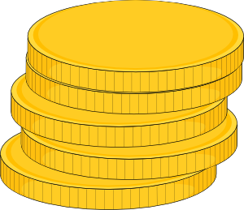
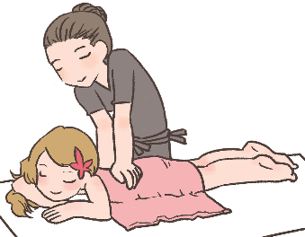
Hard and soft [g]/[j]
info
Hard [g] is pronounced like the g in ‘gold’.
[g] is hard when it comes before a, o, u or r, l, m.
Soft [g] and [j] are pronounced like the g in ‘massage’.
[g] is soft when it comes before e, i, or y.
la gare
[station]
le gilet
[cardigan]
nous plongeons
[we are diving]
la blague
[joke]
hard [g]
soft [g]/[j]
soft [g]/[j]
hard [g]
Notes:
Timing: 2 minutes
Aim: To revise spelling rules governing the pronunciation of hard and soft [g] in preparation for the listening activity that follows.
Procedure:
1. Click to bring up information.
2. Students predict the pronunciation of the four target words.
3. Click again to reveal answers one by one.
4. Click on words to hear them said aloud by a native speaker.
5. Students repeat.
Transcript:
la gare, le gilet, nous plongeons, la blague
Word frequency of unknown words used (1 is the most frequent word in French): gare [2581], gilet [>5000], plonger [1958], blague [4822]

Slide 17
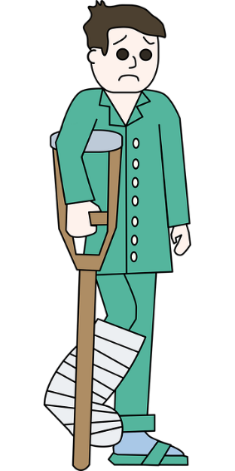
Phonétique
écouter
Romain est à l’hôpital! Qu’entendez-vous ? Hard [g], [soft g/j], ou [gn] ?
J’ai mal au genou !
[My knee hurts!]
__
1
Vous pouvez choisir un compagnon pour voir le médecin.
[You can choose a companion to see the doctor (with).]
2
__
Mon collè g ue vient avec moi.
[My colleague is coming with me.]
__
3
4
Re g ardez le rayon X.
[Look at the x-ray.]
Votre jambe est cassée.
[Your leg is broken.]
Nous devons aligner les os avec le plâtre.
[We have to align the bones with the cast.]
hard g
soft g
[gn]
__
5
__
6
__
Notes:
Timing: 4 minutes
Aim: Aural and written recognition of SSCs hard and soft [g], [j] and [gn] in longer sentences.
Procedure:
1. Click numbers to hear the sentences.
2. Students should note what the missing sound is. Remind them that they can distinguish between soft [g] and [j] by looking at the following vowel (if it is ‘a’, ‘o’ or ‘u’, it must be [j]).
3. Click to reveal answers one by one (plus tally of total SSCs).
Transcript:
1. J’ai mal au genou !
2. Vous pouvez choisir un compagnon pour voir le médecin.
3. Mon collègue vient avec moi.
4. Regardez le rayon X.
5. Votre jambe est cassée.
6. Nous devons aligner les os avec le plâtre.
Word frequency of unknown words used (1 is the most frequent word in French): genou [2967], compagnon [3023], collègue [1099], rayon [2926], jambe [2472], casser [2185], aligner [3021], os [4092], plâtre [>5000]
Source: Londsale, D., & Le Bras, Y. (2009). A Frequency Dictionary of French: Core vocabulary for learners London: Routledge.

Slide 18
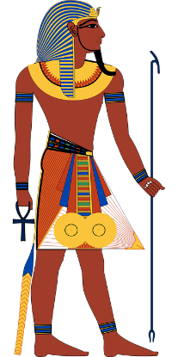
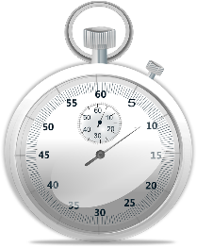
Phonétique
lire / parler
égyptien
60
chagrin
[sorrow]
englober
[to incorporate]
signature
blague
[joke]
dignité
signification
[meaning]
égalité
[equality]
secondes
fatigue
génocide
indigène
[indigenous]
analogue
langage
[language]
registre
consigne
[deposit]
0
embargo
DÉBUT
Notes:
Timing: 3 minutes for 2 slides. This is slide 1/2.
Aim: Oral pronunciation of words containing hard and soft [g] and [gn]. This is slide 1/2.
Procedure:
1. Students pair up.
2. Click début to start timer.
3. Partner A reads the words aloud.
4. Partner B listens to check pronunciation. If they spot a mispronunciation, they must stop student A who repeats the word correctly 3 times before moving on.
5. Click on words to hear them said aloud by a native speaker. Tally the total number of words said correctly within 60 seconds.
5. Partners swap roles and repeat with different words on the next slide. Whoever has pronounced the most words correctly wins!
Transcript:
Signature, égalité, analogue, embargo, chagrin, dignité, genocide, register, englober, signification, indigene, consigne, égyptien, blague, fatigue, langage
Word frequency (1 is the most frequent word in French): dignité [2171], signature [2187], signification [2798], analogue [4498], blague [4822], registre [2556], langage [1850], égalité [1898], chagrin [4560], égyptien [4137], genocide [4148], englober [4188], embargo [4450], indigene [4555], consigne [4583], fatigue [4595]
Source: Londsale, D., & Le Bras, Y. (2009). A Frequency Dictionary of French: Core vocabulary for learners London: Routledge.

Slide 19
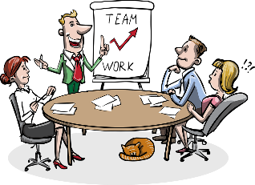
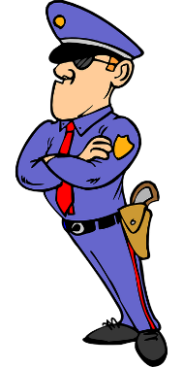
Phonétique
lire / parler
60
avantageux
gorge
[throat]
irrégulier
compagnie
[company]
gestionnaire
[managerial]
baigner
[to bathe]
ignorer
épargner
[to save money]
secondes
ligne
[line]
intégral
goutte
[drop]
significatif
[significant]
gendarme
[policeman]
engin
[gear]
0
magnifique
[magnificentl]
brigade
DÉBUT
Notes:
This is slide 1/2.
Word frequency (1 is the most frequent word in French): gorge [4194], compagnie [775], épargner [2354], ignorer [639], ligne [342], magnifique [2136], significative [2292], brigade [4224], engine [4269], goutte [4337], gestionnaire [4350], avantageux [4391], gendarme [4438], irrégulier [4606], baigner [4608], integral [4641]
Source: Londsale, D., & Le Bras, Y. (2009). A Frequency Dictionary of French: Core vocabulary for learners London: Routledge.

Slide 20
SSC [-gn-]
phonétique
Consolidation [2]

Slide 21
-gn-
ligne
Notes:
Timing: 1 minute
Aim: To consolidate SSC [-gn-]
Procedure: 1. Present the letter(s) and say the [-gn-] sound first, on its own. Students repeat it with you. 2. Bring up the word ”ligne” on its own, say it, students repeat it, so that they have the opportunity to focus all of their attention on the connection between the written word and its sound.
3. A possible gesture for this would be to draw a line in the air with your finger, 4. Roll back the animations and work through 1-3 again, but this time, dropping your voice completely to listen carefully to the students saying the [-gn-] sound, pronouncing ”ligne” and, if using, doing the gesture.
Word frequency (1 is the most frequent word in French):
ligne [342]
Source: Londsale, D., & Le Bras, Y. (2009). A Frequency Dictionary of French: Core vocabulary for learners London: Routledge.

Slide 22
-gn-
gagner
montagne
[to win]
espagnol
ligne
Allemagne
ignorer
[to not know]
Notes:
Timing: 2 minutes
Aim: To consolidate SSC [-gn-]
Procedure:
Introduce and elicit the pronunciation of the individual SSC [-gn-] and then the source word again ‘ligne’ (with gesture, if using). Then present and elicit the pronunciation of the five cluster words. The cluster words have been chosen for their high-frequency, from a range of word classes, with the SSC (where possible) positioned within a variety of syllables within the words (e.g. initial, 2nd, final etc.). Additionally, we have tried to use words that build cumulatively on previously taught SSCs (see the Phonics Teaching Sequence document) and do not include new SSCs. Where new SSCs are used, they are often consonants which have a similar symbol-sound correspondence in English.
Word frequency (1 is the most frequent word in French): ligne [342]; gagner [258]; ignorer [639]; espagnol [1666]; montagne [1734]; Allemagne [N/A]. Source: Londsale, D., & Le Bras, Y. (2009). A Frequency Dictionary of French: Core vocabulary for learners London: Routledge.

Slide 23
j/soft g
X
jour
Notes:
Timing: 1 minute
Aim: To consolidate SSC [j/soft g]
Procedure: 1. Present the letter(s) and say the [j/soft g] sound first, on its own. Students repeat it with you. 2. Bring up the word ”jour” on its own, say it, students repeat it, so that they have the opportunity to focus all of their attention on the connection between the written word and its sound.
3. A possible gesture for this would be to mime waking up at daybreak, by stretching out ones arms and yawning. 4. Roll back the animations and work through 1-3 again, but this time, dropping your voice completely to listen carefully to the students saying the [j/soft g] sound, pronouncing ”jour” and, if using, doing the gesture.
Word frequency (1 is the most frequent word in French):
jour [78].
Source: Londsale, D., & Le Bras, Y. (2009). A Frequency Dictionary of French: Core vocabulary for learners London: Routledge.

Slide 24
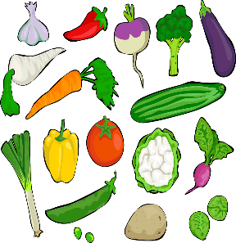
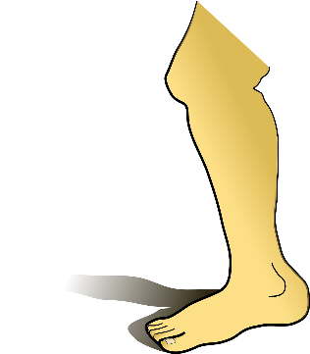
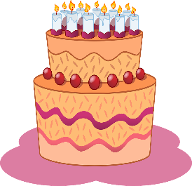
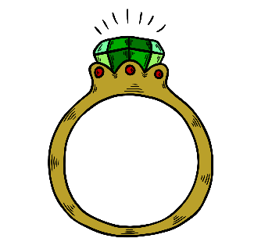
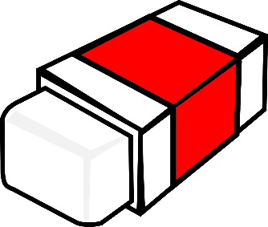
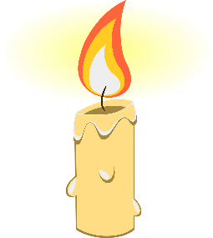
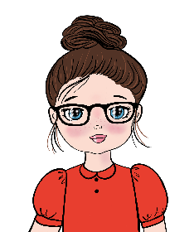
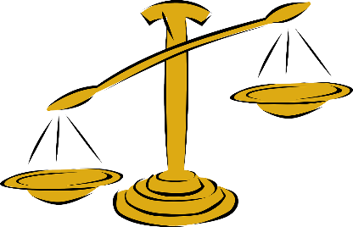
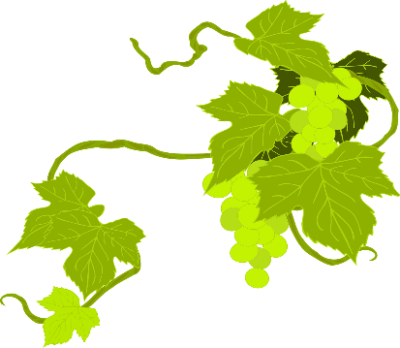
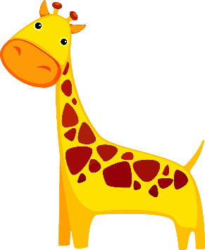
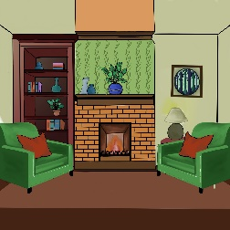
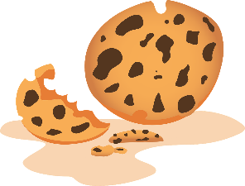
C’est hard [g], soft [g/j] ou [gn]?
écouter
beignet
[gn]
[donut]
singe
[j/soft g]
[monkey]
genou
[j/soft g]
[knee]
champignon
[gn]
[mushroom]
poignet
[gn]
[wrist]
légumes
[hard g]
[vegetables]
manège
[j/soft g]
[carousel]
gâteau
[hard g]
[cake]
bague
[hard g]
[ring]
gomme
[hard g]
[eraser]
joue
[j/soft g]
[cheek]
bougie
[j/soft g]
[candle]
magique
[j/soft g]
[magic]
chignon
[gn]
[hair bun]
justice
[j/soft g]
[justice]
vigne
[gn]
[vine]
gare
[hard g]
[station]
girafe
[j/soft g]
[giraffe]
guêpe
[hard g]
[wasp]
oignon
[gn]
[onion]
séjour
[j/soft g]
[lounge]
goûter
[hard g]
[snack]
châtaigne[gn]
[chestnut]
araignée
[gn]
[spider]
Notes:
Timing: 3 minutes
Aim: To consolidate aural recognition of [hard g], [j/soft g] and [gn]
Procedure:
Click on the pictures to hear the word spoken
Ask students to identify if they hear the SSC [hard g], [j/soft g] or [gn]
Click again to reveal the word, the correct SSC and the English translation.
Transcript:
beignet
gâteau
magique
girafe
guêpe
oignon
chignon
bague
singe
genou
champignon
gomme
justice
séjour
goûter
châtaigne
vigne
joue
poignet
légumes
manège
bougie
gare
araignée
Word frequency of unknown words (1 is the most frequent word in French): beignet [>5000], gâteau [4845], guêpe [>5000], chignon [>5000], bague >5000], singe [4739], genou [2967], champignon [>5000], gomme [>5000], séjour [2007], goûter [4441], châtaigne [>5000], vigne [>5000], joue [3932], poignet [>5000], légumes [>5000], manège [>5000], bougie [>5000], gare [2582], araignée [>5000] Source: Lonsdale, D., & Le Bras, Y. (2009). A Frequency Dictionary of French: Core vocabulary for learners London: Routledge.
Word frequency of cognates (1 is the most frequent word in French): magique [3530], girafe [>5000], oignon [>5000], justice [637] Source: Lonsdale, D., & Le Bras, Y. (2009). A Frequency Dictionary of French: Core vocabulary for learners London: Routledge.

