Slide 1
French Phonics Collection
SSC [-euill-/euil]
Artwork by: Chloé Motard
Date updated: 30/08/2022
Notes:
Artwork by Chloé Motard. All additional pictures selected are available under a Creative Commons license, no attribution required.

Slide 2
SSC [-euill-/euil]
phonétique
Introduction

Slide 3
Phonétique
phonétique
We know that [-ill/ille] and [-ail/aill] sound like a vowel + ‘yih’:
[-ill/ille]
= i + ‘yih’
[-ail/aill]
= a + ‘yih’
Using this pattern, we can work out how these new SSCs sound:
[-eil/eill]
= è + ‘yih’
e.g. oreille
[-ouil/ouill]
= ou + ‘yih’
e.g. brouillard
[-euil/euill]
= long eu/œ + ‘yih’
e.g. feuille
Notes:
Timing: 2 minutes
Aim: Introduction of SSCs [-eil/eill], [-euil/euill], and [-ouil/ouill]. Introducing the idea of vowel + [-il/ill] to help students break down these less frequent SSCs.
Procedure:
1. Click to remind students of SSCs [-ill/ille] and [-ail/aill], drawing attention to the fact that they can be broken down into SSCs [i]/[a] + yih.
2. Click to bring up the first new SSC. Students say SSC [-eil/eill] following the pronunciation tips given.
3. Click to reveal ‘decoded’ pronunciation and example word (click picture to hear pronunciation).
4. Repeat for [-ouil/ouill] and [-euil/euill].
Word frequency of unknown words (1 is the most frequent word in French):
oreille [1884], feuille [2440], brouillard [4452]
Source: Londsale, D., & Le Bras, Y. (2009). A Frequency Dictionary of French: Core vocabulary for learners London: Routledge.

Slide 4
-euill-/-euil
[-ueill-/-ueill, -œill-/-œil]
feuille
Notes:
Timing: 1 minute
Aim: To introduce SSC [-euill-/-euil]
Procedure: 1. Present the letter(s) and say the [-euill-/-euil] sound first, on its own. Students repeat it with you. 2. Bring up the word ”feuille” on its own, say it, students repeat it, so that they have the opportunity to focus all of their attention on the connection between the written word and its sound.
3. A possible gesture for this would be [to stroke the back of one hand]. 4. Roll back the animations and work through 1-3 again, but this time, dropping your voice completely to listen carefully to the students saying the [-euill-/-euil] sound, pronouncing ”feuille” and, if using, doing the gesture.
Word frequency (1 is the most frequent word in French):
feuille [2440]
Source: Londsale, D., & Le Bras, Y. (2009). A Frequency Dictionary of French: Core vocabulary for learners London: Routledge.

Slide 5
-euill-/-euil
[-ueill-/-ueill, -œill-/-œil]
feuille
Notes:
With sound and no pictures to focus all attention on the sound-symbol correspondence.

Slide 6
-euill-/-euil
[-ueill-/-ueill, -œill-/-œil]
feuille
Notes:
Without sound to elicit pronunciation (without first hearing the teacher).
Teacher to elicit pronunciation by asking “Comment dit-on …”

Slide 7
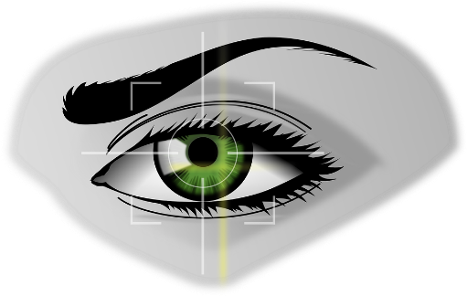
-euill-/-euil
fauteuil
[-ueill-/-ueill, -œill-/-œil]
recueillir
[to collect]
feuille
accueil
[welcome]
œil
écureuil
Notes:
Timing: 2 minutes
Aim: To consolidate SSC [-euill-/-euil]
Procedure:
1. Introduce and elicit the pronunciation of the individual SSC [-euill-/-euil] and then the source word again ‘feuille’ (with gesture, if using). 2. Then present and elicit the pronunciation of the four cluster words.
The cluster words have been chosen for their high-frequency, from a range of word classes, with the SSC (where possible) positioned within a variety of syllables within the words (e.g. initial, 2nd, final etc.). Additionally, we have tried to use words that build cumulatively on previously taught SSCs (see the Phonics Teaching Sequence document) and do not include new SSCs. Where new SSCs are used, they are often consonants which have a similar symbol-sound correspondence in English.
Word frequency (1 is the most frequent word in French): fauteuil [2743]; feuille [2440] recueillir [1230]; accueil [2541], écureuil [>5000], oeil [474] Source: Londsale, D., & Le Bras, Y. (2009). A Frequency Dictionary of French: Core vocabulary for learners London: Routledge.

Slide 8
-euill-/-euil
fauteuil
[-ueill-/-ueill, -œill-/-œil]
recueillir
feuille
accueil
écureuil
œil
Notes:
With sound and no pictures to focus all attention on the sound-symbol correspondence.

Slide 9
-euill-/-euil
fauteuil
[-ueill-/-ueill, -œill-/-œil]
recueillir
feuille
accueil
écureuil
œil
Notes:
Without sound to elicit pronunciation (without first hearing the teacher).
Teacher to elicit pronunciation by asking “Comment dit-on …”

Slide 10
Phonétique
écouter / écrire
 |  | [-eil/eill] | [è]
 | sommeil
 | grès
 | conseil
 | bouteille
 |  | [-ouil/ouill] | [ou]
 | fouiller
0 | rouille
 | bouton
 | nouer
1
__
[sleep]
5
__
[to search]
2
__
[sandstone]
6
__
[rust]
3
__
[advice]
7
__
[button]
4
__
[bottle]
8
__
[to tie]
 |  | [-euil/euill] | [long eu/œ]
 | bonheur
 | seuil
 | deuil
 | œuvre
9
___
[joy]
10
___
[doorstep]
11
___
[grief]
12
___
[work]
Notes:
Timing: 7 minutes
Aim: aural recognition of SSCs [-eil/eill], [è], [ouil/ouill], [ou], [-euil/euill] and long [eu/oe]
Procedure:
1. Click the numbers to play the audio.
2. Students write 1-12 and choose which SSC they think is missing.
3. Click to reveal the answers.
Transcript:
1. sommeil
2. grès
3. conseil
4. bouteille
5. fouiller
6. rouille
7. bouton
8. nouer
9. bonheur
10. seuil
11. deuil
12. oeuvre
Word frequency (1 is the most frequent word in French): sommeil [3393], grès [>5000], conseil [577], bouteille [2979], fouiller [3431], rouille [>5000], bouton [4462], nouer [4489], bonheur [1948], seuil [2068], deuil [3540], œuvre [331]
Source: Londsale, D., & Le Bras, Y. (2009). A Frequency Dictionary of French: Core vocabulary for learners London: Routledge.

Slide 11
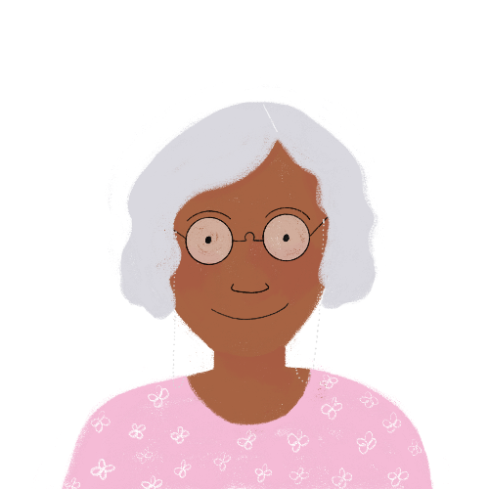
Phonétique
lire / parler
Remember that each SSC is made up of a vowel + ‘yih’
feuillu
[leafy]
Notes:
Transcript:
feuillu
Word frequency (1 is the most frequent word in French): feuillu [>5000]
Source: Londsale, D., & Le Bras, Y. (2009). A Frequency Dictionary of French: Core vocabulary for learners London: Routledge.

Slide 12
Phonétique
lire / parler
Remember that each SSC is made up of a vowel + ‘yih’
treuiller
[to winch]
Notes:
Transcript:
treuiller
Word frequency (1 is the most frequent word in French): treuiller [>5000]
Source: Londsale, D., & Le Bras, Y. (2009). A Frequency Dictionary of French: Core vocabulary for learners London: Routledge.

Slide 13
Phonétique
lire / parler
Remember that each SSC is made up of a vowel + ‘yih’
défeuiller
[to strip the leaves from]
Notes:
Transcript:
défeuiller
Word frequency (1 is the most frequent word in French): défeuiller [>5000]
Source: Londsale, D., & Le Bras, Y. (2009). A Frequency Dictionary of French: Core vocabulary for learners London: Routledge.

Slide 14
SSC [-eill-/eil]
phonétique
Consolidation [1]

Slide 15
-euill-/-euil
[-ueill-/-ueill, -œill-/-œil]
feuille
Notes:
Aim: To consolidate SSC [-euill-/-euil]
Procedure: 1. Present the letter(s) and say the [-euill-/-euil] sound first, on its own. Students repeat it with you. 2. Bring up the word ”feuille” on its own, say it, students repeat it, so that they have the opportunity to focus all of their attention on the connection between the written word and its sound.
3. A possible gesture for this would be [to stroke the back of one hand]. 4. Roll back the animations and work through 1-3 again, but this time, dropping your voice completely to listen carefully to the students saying the [-euill-/-euil] sound, pronouncing ”feuille” and, if using, doing the gesture.
Word frequency (1 is the most frequent word in French):
feuille [2440]
Source: Londsale, D., & Le Bras, Y. (2009). A Frequency Dictionary of French: Core vocabulary for learners London: Routledge.

Slide 16
-euill-/-euil
fauteuil
[-ueill-/-ueill, -œill-/-œil]
recueillir
[to collect]
feuille
accueil
[welcome]
œil
écureuil
Notes:
Aim: To consolidate SSC [-euill-/-euil]
Procedure:
1. Introduce and elicit the pronunciation of the individual SSC [-euill-/-euil] and then the source word again ‘feuille’ (with gesture, if using). 2. Then present and elicit the pronunciation of the four cluster words.
The cluster words have been chosen for their high-frequency, from a range of word classes, with the SSC (where possible) positioned within a variety of syllables within the words (e.g. initial, second, final etc.). Additionally, we have tried to use words that build cumulatively on previously taught SSCs (see the Phonics Teaching Sequence document) and do not include new SSCs. Where new SSCs are used, they are often consonants which have a similar symbol-sound correspondence in English.
Word frequency (1 is the most frequent word in French): fauteuil [2743]; feuille [2440] recueillir [1230]; accueil [2541], écureuil [>5000], oeil [474] Source: Londsale, D., & Le Bras, Y. (2009). A Frequency Dictionary of French: Core vocabulary for learners London: Routledge.

Slide 17
Phonétique
phonétique
Remember! These SSCs sound like a vowel + ‘yih’:
[-ail/aill]
= a + ‘yih’
e.g. taille
[-eil/eill]
= è + ‘yih’
e.g. oreille
[-ouil/ouill]
= ou + ‘yih’
e.g. brouillard
[-euil/euill]
= long eu/œ + ‘yih’
e.g. feuille
Notes:
Timing: 2 minutes
Aim: Revising the breakdown of SSCs [-aill-/-ail], [-eill-/-eil], [-ouill-/-ouil] and [-euill-/-euil].
Procedure:
1. Click to remind students of the SSCs, drawing attention to the fact that they can be broken down into vowels + yih.
2. Click to reveal ‘decoded’ pronunciation and example word. Students repeat.
Word frequency of unknown words (1 is the most frequent word in French):
oreille [1884], feuille [2440], brouillard [4452], taille [1500]
Source: Londsale, D., & Le Bras, Y. (2009). A Frequency Dictionary of French: Core vocabulary for learners London: Routledge.

Slide 18
Phonétique
écouter
Écoute les mots et choisis la bonne SSC.
 |  |  | [-aill-/-ail] | [-eill-/-eil] | [-ouill-/-ouil] | [-euill-/-euil]
 | la pagaille | chaos
 | l’œillade | wink
 | l’orteil | toe
 | le deuil | grief
 | mouiller | to wet
 | conseiller | to advise
 | la maille | stitch
 | ouille ! | ouch !
1
__
2
__
3
__
4
__
5
__
6
__
7
__
8
__
Notes:
Timing: 5 minutes
Aim: Aural recognition of SSCs [-aill-/-ail], [-eill-/-eil], [-ouill-/-ouil] and [-euill-/-euil] in isolated words.
Procedure:
1. Click on the number to play the audio. Remind students that they should focus on the part of the word which is covered, and listen for ‘vowel+ yih’.
2. Students choose which of the SSCs the word contains.
3. Click to reveal answers.
4. Play the words again. Students repeat.
Transcript:
1. la pagaille
2. l’œillade
3. l’orteil
4. le deuil
5. mouiller
6. conseiller
7. la maille
8. ouille !
Word frequency of unknown words used (1 is the most frequent word in French):
pagaille [>5000], œillade [>5000], orteil [>5000], deuil [3540], mouiller [>5000], conseiller [970], maille [>5000], ouille [>5000]
Source: Londsale, D., & Le Bras, Y. (2009). A Frequency Dictionary of French: Core vocabulary for learners London: Routledge.

Slide 19
Rolecards for printing
Partenaire A
1. L’écur___ recu___e un évent___ de c___oux. 2. Un épouvant___ assis dans un faut___ surv___ des citr___es.
Partenaire B
3. Les filles merv___euses pi___ent au cons___er à l’acc___.
4. Les ab___es et les bouvr___s débr___ent les tas de p___.
Partenaire A
1. L’écur___ recu___e un évent___ de c___oux. 2. Un épouvant___ assis dans un faut___ surv___ des citr___es.
Partenaire B
3. Les filles merv___euses pi___ent au cons___er à l’acc___.
4. Les ab___es et les bouvr___s débr___ent les tas de p___.
Partenaire A
1. L’écur___ recu___e un évent___ de c___oux. 2. Un épouvant___ assis dans un faut___ surv___ des citr___es.
Partenaire B
3. Les filles merv___euses pi___ent au cons___er à l’acc___.
4. Les ab___es et les bouvr___s débr___ent les tas de p___.
Notes:
Timing: 6 minutes. This is slide 1/5.
Aim: Oral production of sentences containing SSCs [-aill-/-ail], [-eill-/-eil], [-euill-/-euil], and [-ouill-/-ouil]; fluency of production.
Procedure:
1. Print and distribute the role cards on this slide.
2. Student B faces the board, Student A turns away. Display slide 31.
3. Students B reads the sentences aloud, two or three times depending on the needs of the class. Student A listens and fills in the gaps in sentence 1 of the rolecard.
4. Click on the audio button to hear the sentence said aloud by a native speaker. Student A uses this to check their writing.
5. Student A turns back to the board to self-correct.
6. Display slide 32 and repeat steps 2-5.
7. Students swap roles. Repeat steps 2-5 with slides 33 and 34.
Word frequency of unknown words used (1 is the most frequent word in French):
abeille [>5000], accueil [2541], bafouiller [>5000], bain [3458], bouiller [>5000], caillou [>5000], cocktail [4992], conseiller [577], écureuil [>5000], éventail [4621], feuilleter [>5000], leur [35], maillot [>5000], mail [>5000], médaille [3361], merveilleux [2209], paille [>5000], piaille [>5000], portail [>5000], recueillir [>1230]
Source: Londsale, D., & Le Bras, Y. (2009). A Frequency Dictionary of French: Core vocabulary for learners London: Routledge.

Slide 20
Réponses
écouter / parler
L’écureuil recueille un éventail de cailloux. The squirrel is collecting a range of stones.
1
Notes:
This is slide 2/5.

Slide 21
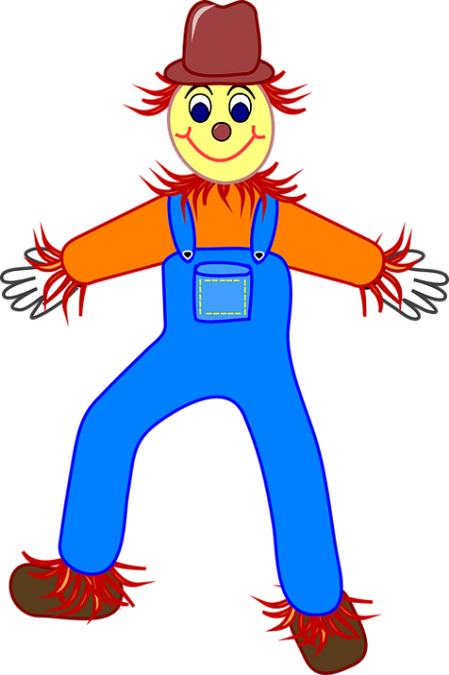
Réponses
écouter / parler
Un épouvantail assis dans un fauteuil surveille des citrouilles. A scarecrow sitting in an armchair is keeping an eye on the pumpkins.
2
Notes:
This is slide 3/5.

Slide 22
Réponses
écouter / parler
Les filles merveilleuses piaillent au conseiller à l'accueil. The brilliant girls are complaining to the advisor at the reception.
3
Notes:
This is slide 4/5.

Slide 23
Réponses
écouter / parler
Les abeilles et les bouvreuils débrouillent les tas de paille. The bees and the bullfinches are arranging the piles of straw.
4
Notes:
This is slide 5/5.

Slide 24
SSC [-eill-/eil]
phonétique
Consolidation [2]

Slide 25
-euill-/-euil
[-ueill-/-ueill, -œill-/-œil]
feuille
Notes:
Timing: 1 minute
Aim: To consolidate SSC [-euill-/-euil]
Procedure: 1. Present the letter(s) and say the [-euill-/-euil] sound first, on its own. Students repeat it with you. 2. Bring up the word ”feuille” on its own, say it, students repeat it, so that they have the opportunity to focus all of their attention on the connection between the written word and its sound.
3. A possible gesture for this would be [to stroke the back of one hand]. 4. Roll back the animations and work through 1-3 again, but this time, dropping your voice completely to listen carefully to the students saying the [-euill-/-euil] sound, pronouncing ”feuille” and, if using, doing the gesture.
Word frequency (1 is the most frequent word in French):
feuille [2440]
Source: Lonsdale, D., & Le Bras, Y. (2009). A Frequency Dictionary of French: Core vocabulary for learners London: Routledge.

Slide 26
-euill-/-euil
fauteuil
[-ueill-/-ueill, -œill-/-œil]
recueillir
[to collect]
feuille
accueil
[welcome]
œil
écureuil
Notes:
Timing: 1 minute
Aim: To consolidate SSC [-euill-/-euil]
Procedure:
1. Introduce and elicit the pronunciation of the individual SSC [-euill-/-euil] and then the source word again ‘feuille’ (with gesture, if using). 2. Then present and elicit the pronunciation of the four cluster words.
The cluster words have been chosen for their high-frequency, from a range of word classes, with the SSC (where possible) positioned within a variety of syllables within the words (e.g. initial, 2nd, final etc.). Additionally, we have tried to use words that build cumulatively on previously taught SSCs (see the Phonics Teaching Sequence document) and do not include new SSCs. Where new SSCs are used, they are often consonants which have a similar symbol-sound correspondence in English.
Word frequency (1 is the most frequent word in French): fauteuil [2743]; feuille [2440] recueillir [1230]; accueil [2541], écureuil [>5000], oeil [474] Source: Lonsdale, D., & Le Bras, Y. (2009). A Frequency Dictionary of French: Core vocabulary for learners London: Routledge.

Slide 27
Phonétique
phonétique
As you know, [-ill/ille] and [-ail/aill] sound like a vowel + ‘yih’:
[-ill/ille]
= i + ‘yih’
[-ail/aill]
= a + ‘yih’
Using this pattern, we have also learned how these SSCs sound:
[-eil/eill]
= è + ‘yih’
e.g. oreille
[-ouil/ouill]
= ou + ‘yih’
e.g. brouillard
[-euil/euill]
= long eu/œ + ‘yih’
e.g. feuille
Notes:
Timing: 2 minutes
Aim: Consolidation of SSCs [-eil/eill], [-euil/euill], and [-ouil/ouill] and the idea of vowel + [-il/ill] to help students break down these less frequent SSCs.
Procedure:
1. Click to remind students of SSCs [-ill/ille] and [-ail/aill], drawing attention to the fact that they can be broken down into SSCs [i]/[a] + yih.
2. Click to bring up further SSC consolidation. Students say SSC [-eil/eill] following the pronunciation tips given.
3. Click to reveal ‘decoded’ pronunciation and example word (click picture to hear pronunciation).
4. Repeat for [-ouil/ouill] and [-euil/euill].
Word frequency of unknown words (1 is the most frequent word in French):
oreille [1884], feuille [2440], brouillard [4452]
Source: Lonsdale, D., & Le Bras, Y. (2009). A Frequency Dictionary of French: Core vocabulary for learners London: Routledge.

Slide 28
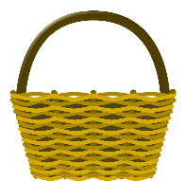
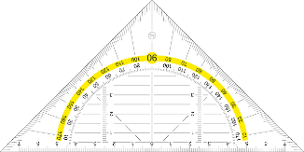
ill-/-ille, -ail/-aille, -eil/-eille, -ouil/-ouille
parler
brouillard
30
Marseille
famille
lentille
bouteille
médaille
oreille
travail
vitrail
paille
corbeille
SECONDES
éventail
chandail
soleil
feuille
cheville
grenouille
0
appareil
écureuil
fauteuil
détail
DÉBUT
Notes:
Timing: 3 minutes
Aim: Speaking practice of SSCs
Procedure:
1. Students work in pairs.
2. One at a time they have to say as many [ill-/-ille. -ail-/-aille, -eil/-eille, -euil/-euille, ouil/ouille.] words as possible in 30s.
3. The partner listens to make sure pronunciation is correct.
4. If they get one wrong, start again.
5. Swap roles.
6. Click on words to hear native pronunciation.
Transcript:
lentille
brouillard
Marseille
famille
travail
bouteille
vitrail
médaille
oreille
paille
corbeille
éventail
chandail
soleil
feuille
cheville
grenouille
appareil
écureuil
fauteuil
détail
Word frequency of cognates (1 is the most frequent word in French): lentille [>5000], brouillard [4452], famille [172], travail [153], bouteille [2979], vitrail [>5000], médaille [3361], oreille [1884], paille [>5000], ville [260], corbeille [>5000], éventail [4621], chandail [>5000], soleil [1713], feuille [2440], cheville [>5000], grenouille [>5000], appareil [1420], écureuil [>5000], fauteuil [2743], détail [318]
Source: Lonsdale, D., & Le Bras, Y. (2009). A Frequency Dictionary of French: Core vocabulary for learners London: Routledge.

Slide 29
Phonétique
écouter / écrire
Écoute et complète les mots avec le bon SSC
 |  | [-ill-/-ille] | [-ail-/aille] | [-eil/-eille] | [-euil/-euille] | [ouil/ouille]
 | bouillon
 | portefeuille
 | cons eil
 | pastille
 | acc ueill ir
 | orteil
 | trouvaille
 | bille s
1
___
[broth]
2
_____
[wallet]
3
___
[advice]
4
__
[tablet]
5
___
[to welcome]
6
__
[toe]
7
____
[discovery]
8
__
[marbles]
Notes:
Timing: 7 minutes
Aim: aural recognition of SSCs [ill-/-ille. -ail-/aille, -eil/-eille, -euil/-euille, ouil/ouille]
Procedure:
1. Click the numbers to play the audio.
2. Students write 1-12 and choose which SSC they think is missing.
3. Click to reveal the answers.
Transcript:
1. bouillon
2. portefeuille
3. conseil
4. pastille
5. accueilir
6. orteil
7. trouvaille
8. billes
Word frequency (1 is the most frequent word in French): bouillon [>5000],portefeuille [>5000], conseil [577], pastille [>5000], accueillir [1189], orteil [>5000], trouvaille [>5000], billes [>5000]
Source: Lonsdale, D., & Le Bras, Y. (2009). A Frequency Dictionary of French: Core vocabulary for learners London: Routledge.

