Slide 1
French Phonics Collection
SSC [-aill-/ail]
Artwork by: Chloé Motard
Date updated: 30/08/2022
Notes:
Artwork by Chloé Motard. All additional pictures selected are available under a Creative Commons license, no attribution required.

Slide 2
SSC [-aill-/ail]
phonétique
Introduction

Slide 3
-aill-/-ail
taille
Notes:
Timing: 1 minute
Aim: To introduce SSC [-aill-/-ail]
Procedure: 1. Present the letter(s) and say the [-aill-/-ail] sound first, on its own. Students repeat it with you. 2. Bring up the word ”taille” on its own, say it, students repeat it, so that they have the opportunity to focus all of their attention on the connection between the written word and its sound.
3. A possible gesture for this would be to start with hands together and move them apart, representing varying size. 4. Roll back the animations and work through 1-3 again, but this time, dropping your voice completely to listen carefully to the students saying the [-aill-/-ail] sound, pronouncing ”taille” and, if using, doing the gesture.
Word frequency (1 is the most frequent word in French):
taille [1500]
Source: Londsale, D., & Le Bras, Y. (2009). A Frequency Dictionary of French: Core vocabulary for learners London: Routledge.

Slide 4
-aill-/-ail
taille
Notes:
With sound and no pictures to focus all attention on the sound-symbol correspondence.

Slide 5
-aill-/-ail
taille
Notes:
Without sound to elicit pronunciation (without first hearing the teacher).
Teacher to elicit pronunciation by asking “Comment dit-on …”

Slide 6
-aill-/-ail
[garlic]
détail
ail
[detail]
taille
medaille
ailleurs
travailler
[elsewhere]
[to work]
Notes:
Timing: 2 minutes
Aim: To introduce SSC [-aill-/-ail]
Procedure:
Introduce and elicit the pronunciation of the individual SSC [-aill-/-ail] and then the source word again ‘taille’ (with gesture, if using). Then present and elicit the pronunciation of the five cluster words. The cluster words have been chosen for their high-frequency, from a range of word classes, with the SSC (where possible) positioned within a variety of syllables within the words (e.g. initial, 2nd, final etc.). Additionally, we have tried to use words that build cumulatively on previously taught SSCs (see the Phonics Teaching Sequence document) and do not include new SSCs. Where new SSCs are used, they are often consonants which have a similar symbol-sound correspondence in English.
Word frequency (1 is the most frequent word in French): taille [1500]; ail [>5000]; détail[318]; médaille [3361] travailler [290]; ailleurs [360]. Source: Londsale, D., & Le Bras, Y. (2009). A Frequency Dictionary of French: Core vocabulary for learners London: Routledge.

Slide 7
-aill-/-ail
ail
détail
taille
medaille
ailleurs
travailler
Notes:
With sound and no pictures to focus all attention on the sound-symbol correspondence.

Slide 8
-aill-/-ail
ail
détail
taille
medaille
ailleurs
travailler
Notes:
Without sound to elicit pronunciation (without first hearing the teacher).
Teacher to elicit pronunciation by asking “Comment dit-on …”

Slide 9
Phonétique
écouter / écrire
Say these words:
SSC [-ail-/aille]
sounds like a ‘yih’ sound after SSC [a].
This is similar to the [-ill-/ille] vs [i] pattern we practised last week.
à
[at, to, in]
ail
[garlic]
Notes:
Timing: 1 minute
Aim: aural recognition and production of SSCs [-ail-/aille] and [a] to prime for the activity on the next slide.
Procedure:
1. Students try to say the words in the minimal pair, à and ail.
2. Click to hear the words said by a native speaker. Students repeat.
3. Click to bring up the hint.
Transcript:
à
ail
Word frequency (1 is the most frequent word in French): ail [>5000]

Slide 10
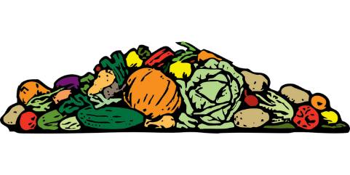
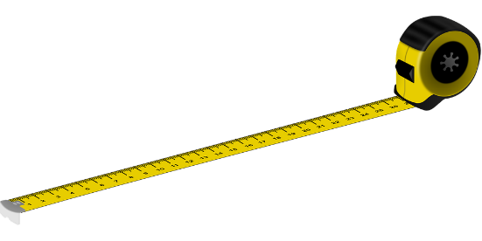
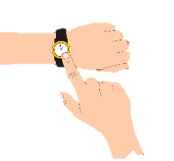
Phonétique (1/2)
Hint
SSC [-ail-/aille]
sounds like a ‘yih’ sound after SSC [a].
écouter
Écoute ! Quel mot a la SSC [-ail-/aille] ?
a) tas | b) taille
a) pas | b) paille
1
3
[pile]
[size]
[step]
[straw]
___
___
___
___
a) il a | b) il aille
a) ailleurs | b) à l’heure
2
4
[he has]
[he may go]
[elsewhere]
[on time]
___
___
_
_
Notes:
Timing: 5 minutes (for two slides)
Aim: aural recognition of SSCs [-ail-/aille] and [a] in minimal pairs. Awareness-raising exercise in pronunciation of [-il(le)-] (sounds like the preceding vowel + ‘yih’.)
Procedure:
1. Click the numbers to play the audio.
2. Students write 1-8 and complete the word with [a] or
3. Click to reveal the answers. Draw attention to the SFC on many of the distractors.
4. Students sound out the pairs of words.
5. Move to the next slide and repeat steps 1-4.
Transcript:
1. a) tas b) taille
2. a) il a b) il aille
3. a) pas b) paille
4. a) ailleurs b) à l’heure
Word frequency (1 is the most frequent word in French): tas [2723], taille [1500], il [13], avoir [8], aller [53], pas [18], paille [>5000], ailleurs [360], heure [99]
Source: Londsale, D., & Le Bras, Y. (2009). A Frequency Dictionary of French: Core vocabulary for learners London: Routledge.

Slide 11
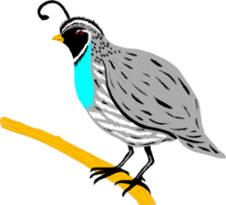
Phonétique (2/2)
Hint
SSC [-ail-/aille]
sounds like a ‘yih’ sound after SSC [a].
écouter
Écoute ! Quel mot a le SSC [-ail-/aille] ?
a) bail | b) bas
a) d’État | b) détail
5
7
[of the state]
[detail]
[lease]
[bottom]
___
___
___
___
a) rat | b) rail
a) caille | b) cas
6
8
[scenario]
[rail]
[quail]
___
___
___
___
Notes:
This is the second part of the activity described on the previous slide.
Transcript:
5. a) bail, b) bas
6. a) rat, b) rail
7. a) d’ État, détail
8. a) caille, cas
Word frequency (1 is the most frequent word in French): bâille [>5000], bas [468], rat [4290], rail [4697], état [1840], détail [53], caille [>5000], cas [137]
Source: Londsale, D., & Le Bras, Y. (2009). A Frequency Dictionary of French: Core vocabulary for learners London: Routledge.

Slide 12
Phonétique
Hint
Is there a letter ‘i’ before the -ll- ?
parler
balle
60
allumer
[to turn on]
broussaille [bush / thicket]
bétail [cattle]
ballon
chaleur
[heat]
défaillance [failure]
cheval
secondes
détailler [to describe]
intervalle [interval]
également [also / as well]
parallèle [parallel]
éventail [range / variety]
taille-crayon
tailler
[to trim]
installer [to install]
0
DÉBUT
Notes:
Timing: 5 minutes
Aim: Oral production of words containing ‘l/ll’ after ‘a’ and ‘ai’
Procedure:
1. Start the timer.
2. Students have one minute to try to say all the words correctly to a partner.
3. Teacher circulates to listen in to pronunciation and correct if necessary.
4. Click on the words to hear them said by a native speaker.
5. Click to move on to a more challenging versions of this activity with an increase in speed to aid automisation of the sounds.
Word frequency (1 is the most frequent word in French): allumer [3169], balle [2311], ballon [3692], bétail [4842], broussaille [>5000], chaleur [2773], cheval [2220], défaillance [3951], détailler [2667], également [246], éventail [4621], intervalle [3226], parallèle [2196], taille-crayon [>5000], tailler [3802], installer [821]

Slide 13
SSC [-aill-/ail]
phonétique
Consolidation [1]

Slide 14
-aill-/-ail
taille
Notes:
Timing: 2 minutes for four SSC slides.
Aim: To consolidate SSC [-aill-/-ail]
Procedure: 1. Present the letter(s) and say the [-aill-/-ail] sound first, on its own. Students repeat it with you. 2. Bring up the word ”taille” on its own, say it, students repeat it, so that they have the opportunity to focus all of their attention on the connection between the written word and its sound.
3. A possible gesture for this would be to start with hands together and move them apart, representing varying size. 4. Roll back the animations and work through 1-3 again, but this time, dropping your voice completely to listen carefully to the students saying the [-aill-/-ail] sound, pronouncing ”taille” and, if using, doing the gesture.
Word frequency (1 is the most frequent word in French):
taille [1500]
Source: Londsale, D., & Le Bras, Y. (2009). A Frequency Dictionary of French: Core vocabulary for learners London: Routledge.

Slide 15
-aill-/-ail
[garlic]
détail
ail
[detail]
taille
medaille
ailleurs
travailler
[elsewhere]
[to work]
Notes:
Timing: 2 minutes
Aim: To introduce SSC [-aill-/-ail]
Procedure:
Introduce and elicit the pronunciation of the individual SSC [-aill-/-ail] and then the source word again ‘taille’ (with gesture, if using). Then present and elicit the pronunciation of the five cluster words. The cluster words have been chosen for their high-frequency, from a range of word classes, with the SSC (where possible) positioned within a variety of syllables within the words (e.g. initial, 2nd, final etc.). Additionally, we have tried to use words that build cumulatively on previously taught SSCs (see the Phonics Teaching Sequence document) and do not include new SSCs. Where new SSCs are used, they are often consonants which have a similar symbol-sound correspondence in English.
Word frequency (1 is the most frequent word in French): taille [1500]; ail [>5000]; détail[318]; médaille [3361] travailler [290]; ailleurs [360]. Source: Londsale, D., & Le Bras, Y. (2009). A Frequency Dictionary of French: Core vocabulary for learners London: Routledge.

Slide 16
Phonétique
phonétique
Remember! These SSCs sound like a vowel + ‘yih’:
[-ail/aill]
= a + ‘yih’
e.g. taille
[-eil/eill]
= è + ‘yih’
e.g. oreille
[-ouil/ouill]
= ou + ‘yih’
e.g. brouillard
[-euil/euill]
= long eu/œ + ‘yih’
e.g. feuille
Notes:
Timing: 2 minutes
Aim: Revising the breakdown of SSCs [-aill-/-ail], [-eill-/-eil], [-ouill-/-ouil] and [-euill-/-euil].
Procedure:
1. Click to remind students of the SSCs, drawing attention to the fact that they can be broken down into vowels + yih.
2. Click to reveal ‘decoded’ pronunciation and example word. Students repeat.
Word frequency of unknown words (1 is the most frequent word in French):
oreille [1884], feuille [2440], brouillard [4452], taille [1500]
Source: Londsale, D., & Le Bras, Y. (2009). A Frequency Dictionary of French: Core vocabulary for learners London: Routledge.

Slide 17
Phonétique
écouter
Écoute les mots et choisis la bonne SSC.
 |  |  | [-aill-/-ail] | [-eill-/-eil] | [-ouill-/-ouil] | [-euill-/-euil]
 | la pagaille | chaos
 | l’œillade | wink
 | l’orteil | toe
 | le deuil | grief
 | mouiller | to wet
 | conseiller | to advise
 | la maille | stitch
 | ouille ! | ouch !
1
__
2
__
3
__
4
__
5
__
6
__
7
__
8
__
Notes:
Timing: 5 minutes
Aim: Aural recognition of SSCs [-aill-/-ail], [-eill-/-eil], [-ouill-/-ouil] and [-euill-/-euil] in isolated words.
Procedure:
1. Click on the number to play the audio. Remind students that they should focus on the part of the word which is covered, and listen for ‘vowel+ yih’.
2. Students choose which of the SSCs the word contains.
3. Click to reveal answers.
4. Play the words again. Students repeat.
Transcript:
1. la pagaille
2. l’œillade
3. l’orteil
4. le deuil
5. mouiller
6. conseiller
7. la maille
8. ouille !
Word frequency of unknown words used (1 is the most frequent word in French):
pagaille [>5000], œillade [>5000], orteil [>5000], deuil [3540], mouiller [>5000], conseiller [970], maille [>5000], ouille [>5000]
Source: Londsale, D., & Le Bras, Y. (2009). A Frequency Dictionary of French: Core vocabulary for learners London: Routledge.

Slide 18
Rolecards for printing
Partenaire A
1. L’écur___ recu___e un évent___ de c___oux. 2. Un épouvant___ assis dans un faut___ surv___ des citr___es.
Partenaire B
3. Les filles merv___euses pi___ent au cons___er à l’acc___.
4. Les ab___es et les bouvr___s débr___ent les tas de p___.
Partenaire A
1. L’écur___ recu___e un évent___ de c___oux. 2. Un épouvant___ assis dans un faut___ surv___ des citr___es.
Partenaire B
3. Les filles merv___euses pi___ent au cons___er à l’acc___.
4. Les ab___es et les bouvr___s débr___ent les tas de p___.
Partenaire A
1. L’écur___ recu___e un évent___ de c___oux. 2. Un épouvant___ assis dans un faut___ surv___ des citr___es.
Partenaire B
3. Les filles merv___euses pi___ent au cons___er à l’acc___.
4. Les ab___es et les bouvr___s débr___ent les tas de p___.
Notes:
Timing: 6 minutes. This is slide 1/5.
Aim: Oral production of sentences containing SSCs [-aill-/-ail], [-eill-/-eil], [-euill-/-euil], and [-ouill-/-ouil]; fluency of production.
Procedure:
1. Print and distribute the role cards on this slide.
2. Student B faces the board, Student A turns away. Display slide 31.
3. Students B reads the sentences aloud, two or three times depending on the needs of the class. Student A listens and fills in the gaps in sentence 1 of the rolecard.
4. Click on the audio button to hear the sentence said aloud by a native speaker. Student A uses this to check their writing.
5. Student A turns back to the board to self-correct.
6. Display slide 32 and repeat steps 2-5.
7. Students swap roles. Repeat steps 2-5 with slides 33 and 34.
Word frequency of unknown words used (1 is the most frequent word in French):
abeille [>5000], accueil [2541], bafouiller [>5000], bain [3458], bouiller [>5000], caillou [>5000], cocktail [4992], conseiller [577], écureuil [>5000], éventail [4621], feuilleter [>5000], leur [35], maillot [>5000], mail [>5000], médaille [3361], merveilleux [2209], paille [>5000], piaille [>5000], portail [>5000], recueillir [>1230]
Source: Londsale, D., & Le Bras, Y. (2009). A Frequency Dictionary of French: Core vocabulary for learners London: Routledge.

Slide 19
Réponses
écouter / parler
L’écureuil recueille un éventail de cailloux. The squirrel is collecting a range of stones.
1
Notes:
This is slide 2/5.

Slide 20
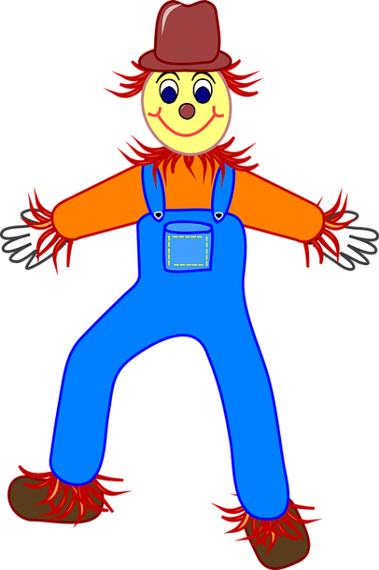
Réponses
écouter / parler
Un épouvantail assis dans un fauteuil surveille des citrouilles. A scarecrow sitting in an armchair is keeping an eye on the pumpkins.
2
Notes:
This is slide 3/5.

Slide 21
Réponses
écouter / parler
Les filles merveilleuses piaillent au conseiller à l'accueil. The brilliant girls are complaining to the advisor at the reception.
3
Notes:
This is slide 4/5.

Slide 22
Réponses
écouter / parler
Les abeilles et les bouvreuils débrouillent les tas de paille. The bees and the bullfinches are arranging the piles of straw.
4
Notes:
This is slide 5/5.

Slide 23
SSC [-aill-/ail]
phonétique
Consolidation [2]

Slide 24
-aill-/-ail
taille
Notes:
Timing: 1 minute
Aim: To consolidate SSC [-aill-/-ail]
Procedure: 1. Present the letter(s) and say the [-aill-/-ail] sound first, on its own. Students repeat it with you. 2. Bring up the word ”taille” on its own, say it, students repeat it, so that they have the opportunity to focus all of their attention on the connection between the written word and its sound.
3. A possible gesture for this would be to start with hands together and move them apart, representing varying size. 4. Roll back the animations and work through 1-3 again, but this time, dropping your voice completely to listen carefully to the students saying the [-aill-/-ail] sound, pronouncing ”taille” and, if using, doing the gesture.
Word frequency (1 is the most frequent word in French):
taille [1500]
Source: Lonsdale, D., & Le Bras, Y. (2009). A Frequency Dictionary of French: Core vocabulary for learners London: Routledge.

Slide 25
-aill-/-ail
[garlic]
détail
ail
[detail]
taille
medaille
ailleurs
travailler
[elsewhere]
[to work]
Notes:
Timing: 2 minutes
Aim: To introduce SSC [-aill-/-ail]
Procedure:
Introduce and elicit the pronunciation of the individual SSC [-aill-/-ail] and then the source word again ‘taille’ (with gesture, if using). Then present and elicit the pronunciation of the five cluster words. The cluster words have been chosen for their high-frequency, from a range of word classes, with the SSC (where possible) positioned within a variety of syllables within the words (e.g. initial, 2nd, final etc.). Additionally, we have tried to use words that build cumulatively on previously taught SSCs (see the Phonics Teaching Sequence document) and do not include new SSCs. Where new SSCs are used, they are often consonants which have a similar symbol-sound correspondence in English.
Word frequency (1 is the most frequent word in French): taille [1500]; ail [>5000]; détail[318]; médaille [3361] travailler [290]; ailleurs [360]. Source: Londsale, D., & Le Bras, Y. (2009). A Frequency Dictionary of French: Core vocabulary for learners London: Routledge.

Slide 26
Phonétique
phonétique
As you know, [-ill/ille] and [-ail/aill] sound like a vowel + ‘yih’:
[-ill/ille]
= i + ‘yih’
[-ail/aill]
= a + ‘yih’
Using this pattern, we have also learned how these SSCs sound:
[-eil/eill]
= è + ‘yih’
e.g. oreille
[-ouil/ouill]
= ou + ‘yih’
e.g. brouillard
[-euil/euill]
= long eu/œ + ‘yih’
e.g. feuille
Notes:
Timing: 2 minutes
Aim: Consolidation of SSCs [-eil/eill], [-euil/euill], and [-ouil/ouill] and the idea of vowel + [-il/ill] to help students break down these less frequent SSCs.
Procedure:
1. Click to remind students of SSCs [-ill/ille] and [-ail/aill], drawing attention to the fact that they can be broken down into SSCs [i]/[a] + yih.
2. Click to bring up further SSC consolidation. Students say SSC [-eil/eill] following the pronunciation tips given.
3. Click to reveal ‘decoded’ pronunciation and example word (click picture to hear pronunciation).
4. Repeat for [-ouil/ouill] and [-euil/euill].
Word frequency of unknown words (1 is the most frequent word in French):
oreille [1884], feuille [2440], brouillard [4452]
Source: Lonsdale, D., & Le Bras, Y. (2009). A Frequency Dictionary of French: Core vocabulary for learners London: Routledge.

Slide 27
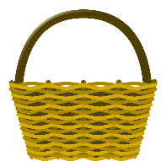
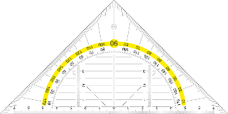
ill-/-ille, -ail/-aille, -eil/-eille, -ouil/-ouille
parler
brouillard
30
Marseille
famille
lentille
bouteille
médaille
oreille
travail
vitrail
paille
corbeille
SECONDES
éventail
chandail
soleil
feuille
cheville
grenouille
0
appareil
écureuil
fauteuil
détail
DÉBUT
Notes:
Timing: 3 minutes
Aim: Speaking practice of SSCs
Procedure:
1. Students work in pairs.
2. One at a time they have to say as many [ill-/-ille. -ail-/-aille, -eil/-eille, -euil/-euille, ouil/ouille.] words as possible in 30s.
3. The partner listens to make sure pronunciation is correct.
4. If they get one wrong, start again.
5. Swap roles.
6. Click on words to hear native pronunciation.
Transcript:
lentille
brouillard
Marseille
famille
travail
bouteille
vitrail
médaille
oreille
paille
corbeille
éventail
chandail
soleil
feuille
cheville
grenouille
appareil
écureuil
fauteuil
détail
Word frequency of cognates (1 is the most frequent word in French): lentille [>5000], brouillard [4452], famille [172], travail [153], bouteille [2979], vitrail [>5000], médaille [3361], oreille [1884], paille [>5000], ville [260], corbeille [>5000], éventail [4621], chandail [>5000], soleil [1713], feuille [2440], cheville [>5000], grenouille [>5000], appareil [1420], écureuil [>5000], fauteuil [2743], détail [318]
Source: Lonsdale, D., & Le Bras, Y. (2009). A Frequency Dictionary of French: Core vocabulary for learners London: Routledge.

Slide 28
Phonétique
écouter / écrire
Écoute et complète les mots avec le bon SSC
 |  | [-ill-/-ille] | [-ail-/aille] | [-eil/-eille] | [-euil/-euille] | [ouil/ouille]
 | bouillon
 | portefeuille
 | cons eil
 | pastille
 | acc ueill ir
 | orteil
 | trouvaille
 | bille s
1
___
[broth]
2
_____
[wallet]
3
___
[advice]
4
__
[tablet]
5
___
[to welcome]
6
__
[toe]
7
____
[discovery]
8
__
[marbles]
Notes:
Timing: 7 minutes
Aim: aural recognition of SSCs [ill-/-ille. -ail-/aille, -eil/-eille, -euil/-euille, ouil/ouille]
Procedure:
1. Click the numbers to play the audio.
2. Students write 1-12 and choose which SSC they think is missing.
3. Click to reveal the answers.
Transcript:
1. bouillon
2. portefeuille
3. conseil
4. pastille
5. accueilir
6. orteil
7. trouvaille
8. billes
Word frequency (1 is the most frequent word in French): bouillon [>5000],portefeuille [>5000], conseil [577], pastille [>5000], accueillir [1189], orteil [>5000], trouvaille [>5000], billes [>5000]
Source: Lonsdale, D., & Le Bras, Y. (2009). A Frequency Dictionary of French: Core vocabulary for learners London: Routledge.

