Slide 1
French Phonics Collection
Silent Final -e [SFe]
Artwork by: Chloé Motard
Date updated: 31/08/2022
Notes:
Artwork by Chloé Motard. All additional pictures selected are available under a Creative Commons license, no attribution required.

Slide 2
SFe
phonétique
Introduction

Slide 3
SFE
Silent final -e
[shy]
timide
Notes:
Timing: 1 minute
Aim: To introduce/consolidate SSC [SFE]
Procedure: 1. Present the letter(s) and say the [SFE] sound first, on its own. Students repeat it with you. 2. Bring up the word ”timide” on its own, say it, students repeat it, so that they have the opportunity to focus all of their attention on the connection between the written word and its sound.
3. A possible gesture for this would be to cower and cover one’s face slightly, simulating shyness. 4. Roll back the animations and work through 1-3 again, but this time, dropping your voice completely to listen carefully to the students saying the [SFE] sound, pronouncing ”timide” and, if using, doing the gesture.
Word frequency (1 is the most frequent word in French):
timide [3835]
Source: Londsale, D., & Le Bras, Y. (2009). A Frequency Dictionary of French: Core vocabulary for learners London: Routledge.

Slide 4
SFE
Silent final -e
timide
Notes:
With sound and no pictures to focus all attention on the sound-symbol correspondence.

Slide 5
SFE
Silent final -e
[shy]
timide
Notes:
Without sound to elicit pronunciation (without first hearing the teacher).
Teacher to elicit pronunciation by asking “Comment dit-on …"

Slide 6
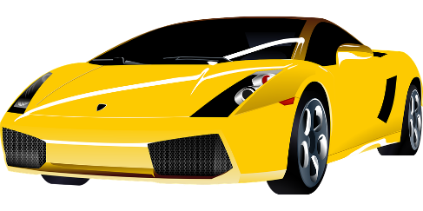
SFE
monde
moderne
[silent final –e]
[shy]
centre
timide
douze
vie
[life]
Notes:
Timing: 2 minutes
Aim: To introduce/consolidate SSC [SFE]
Procedure:
1. Introduce and elicit the pronunciation of the individual SSC [SFE] and then the source word again ‘timide’ (with gesture, if using). 2. Then present and elicit the pronunciation of the five cluster words.
The cluster words have been chosen for their high-frequency, from a range of word classes, with the SSC (where possible) positioned within a variety of syllables within the words (e.g. initial, 2nd, final etc.). Additionally, we have tried to use words that build cumulatively on previously taught SSCs (see the Phonics Teaching Sequence document) and do not include new SSCs. Where new SSCs are used, they are often consonants which have a similar symbol-sound correspondence in English.
Word frequency (1 is the most frequent word in French): monde [77]; moderne [1239] centre [491]; vie [132]; douze [1664]; timide [3835]. Source: Londsale, D., & Le Bras, Y. (2009). A Frequency Dictionary of French: Core vocabulary for learners London: Routledge.

Slide 7
SFE
monde
moderne
[silent final –e]
[shy]
centre
timide
douze
vie
Notes:
With sound and no pictures to focus all attention on the sound-symbol correspondence.

Slide 8
SFE
monde
moderne
[silent final –e]
[shy]
centre
timide
douze
vie
Notes:
Without sound to elicit pronunciation (without first hearing the teacher).
Teacher to elicit pronunciation by asking “Comment dit-on …"

Slide 9
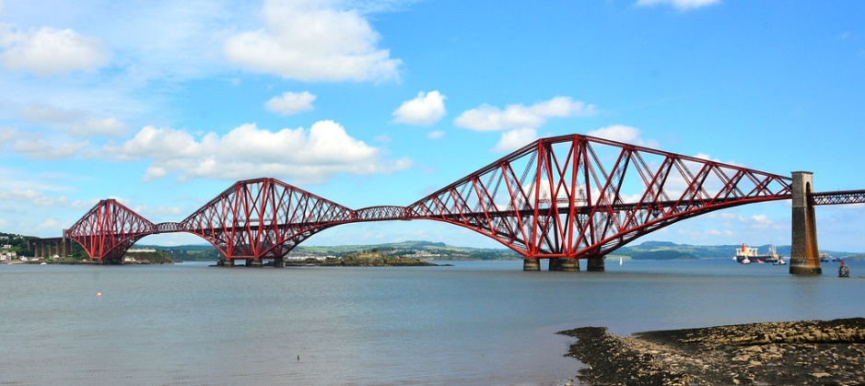
Phonétique
écouter
C’est la SSC [SFe] ?
[lawn]
[bridge]
pelouse
pont
Notes:
Timing: 3 minutes for 6 slides
Aim: aural recognition of SSC [SFe]
Procedure:
1. Click the words to play the audio.
2. Students choose which word has an SFe.
Word frequency (1 is the most frequent word in French): pelouse [>5000], pont [1889]
Source: Londsale, D., & Le Bras, Y. (2009). A Frequency Dictionary of French: Core vocabulary for learners London: Routledge.

Slide 10
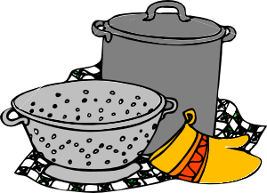
Phonétique
écouter
C’est la SSC [SFe] ?
[cooking]
[wolf]
cuisine
loup
Notes:
Word frequency (1 is the most frequent word in French): cuisine [2618], loup [3927]
Source: Londsale, D., & Le Bras, Y. (2009). A Frequency Dictionary of French: Core vocabulary for learners London: Routledge.

Slide 11
Phonétique
écouter
C’est la SSC [SFe] ?
froid
[cold]
trente
Notes:
Word frequency (1 is the most frequent word in French): trente [1646], froid [1307]
Source: Londsale, D., & Le Bras, Y. (2009). A Frequency Dictionary of French: Core vocabulary for learners London: Routledge.

Slide 12
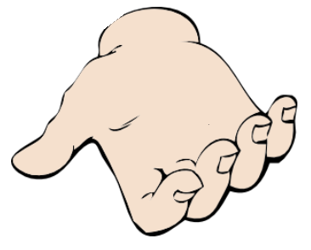
Phonétique
écouter
C’est la SSC [SFe] ?
[hand]
[shy]
main
timide
Notes:
Word frequency (1 is the most frequent word in French): main [418], timide [3835]
Source: Londsale, D., & Le Bras, Y. (2009). A Frequency Dictionary of French: Core vocabulary for learners London: Routledge.

Slide 13
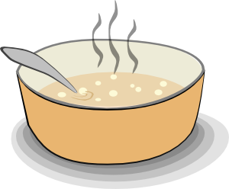
Phonétique
écouter
C’est la SSC [SFe] ?
riz
soupe
Notes:
Word frequency (1 is the most frequent word in French): riz [>5000], soupe [4563]
Source: Londsale, D., & Le Bras, Y. (2009). A Frequency Dictionary of French: Core vocabulary for learners London: Routledge.

Slide 14
Phonétique
écouter
C’est la SSC [SFe] ?
[dawn]
prix
[prize]
aube
Notes:
Word frequency (1 is the most frequent word in French): aube [2728], prix [310]
Source: Londsale, D., & Le Bras, Y. (2009). A Frequency Dictionary of French: Core vocabulary for learners London: Routledge.

Slide 15
Phonétique
parler
pilote
malade
45
lettre
texte
belle
secondes
coupe
beautiful (f)
phrase
trophy
capable
usine
0
DÉBUT
factory
Notes:
Timing: 1 minute
Aim: oral production of SSC [SFe]
Procedure:
1. Individually pupils read out the words but in alphabetical order. They keep going for one minute.
2. Teacher can circulate to listen into their SSC knowledge.
3. Click on words to check pronunciation. Students repeat.
4. Clarify meanings of cognate words.
Word frequency (1 is the most frequent word in French): rapide [672], portable [4002], elle [38], triste [1843], prime [2094], coupe [2925], phrase [2074], belle [393]
Source: Londsale, D., & Le Bras, Y. (2009). A Frequency Dictionary of French: Core vocabulary for learners London: Routledge.

Slide 16
SFe
phonétique
Consolidation [1]

Slide 17
SFE
Silent final -e
[shy]
timide
Notes:
Timing: 1 minute
Aim: To introduce/consolidate SSC [SFE]
Procedure: 1. Present the letter(s) and say the [SFE] sound first, on its own. Students repeat it with you. 2. Bring up the word ”timide” on its own, say it, students repeat it, so that they have the opportunity to focus all of their attention on the connection between the written word and its sound.
3. A possible gesture for this would be to cower and cover one’s face slightly, simulating shyness. 4. Roll back the animations and work through 1-3 again, but this time, dropping your voice completely to listen carefully to the students saying the [SFE] sound, pronouncing ”timide” and, if using, doing the gesture.
Word frequency (1 is the most frequent word in French):
timide [3835]
Source: Londsale, D., & Le Bras, Y. (2009). A Frequency Dictionary of French: Core vocabulary for learners London: Routledge.

Slide 18
SFE
Silent final -e
timide
Notes:
With sound and no pictures to focus all attention on the sound-symbol correspondence.

Slide 19
SFE
Silent final -e
[shy]
timide
Notes:
Without sound to elicit pronunciation (without first hearing the teacher).
Teacher to elicit pronunciation by asking “Comment dit-on …"

Slide 20
SFE
monde
moderne
[silent final –e]
[shy]
centre
timide
douze
vie
[life]
Notes:
Timing: 2 minutes
Aim: To introduce/consolidate SSC [SFE]
Procedure:
1. Introduce and elicit the pronunciation of the individual SSC [SFE] and then the source word again ‘timide’ (with gesture, if using). 2. Then present and elicit the pronunciation of the five cluster words.
The cluster words have been chosen for their high-frequency, from a range of word classes, with the SSC (where possible) positioned within a variety of syllables within the words (e.g. initial, 2nd, final etc.). Additionally, we have tried to use words that build cumulatively on previously taught SSCs (see the Phonics Teaching Sequence document) and do not include new SSCs. Where new SSCs are used, they are often consonants which have a similar symbol-sound correspondence in English.
Word frequency (1 is the most frequent word in French): monde [77]; moderne [1239] centre [491]; vie [132]; douze [1664]; timide [3835]. Source: Londsale, D., & Le Bras, Y. (2009). A Frequency Dictionary of French: Core vocabulary for learners London: Routledge.

Slide 21
SFE
monde
moderne
[silent final –e]
[shy]
centre
timide
douze
vie
Notes:
With sound and no pictures to focus all attention on the sound-symbol correspondence.

Slide 22
SFE
monde
moderne
[silent final –e]
[shy]
centre
timide
douze
vie
Notes:
Without sound to elicit pronunciation (without first hearing the teacher).
Teacher to elicit pronunciation by asking “Comment dit-on …"

Slide 23
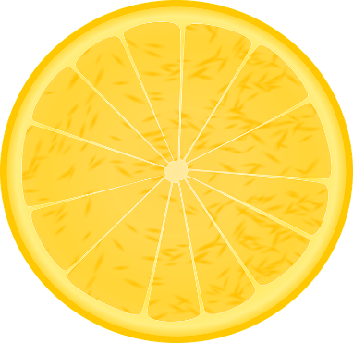
Phonétique
écouter
Phonétique
The ends of these words are hidden.
C’est la SSC [SFe] ?
[sour]
[degree]
aigre
degré
Notes:
Timing: 4 minutes for 6 slides
Aim: Aural recognition of SSC [SFe]
Procedure:
1. Click the images to play the audio.
2. Students choose which word has an SFe.
Word frequency (1 is the most frequent word in French):
aigre [>5000], degré [1311] Source: Londsale, D., & Le Bras, Y. (2009). A Frequency Dictionary of French: Core vocabulary for learners London: Routledge.

Slide 24
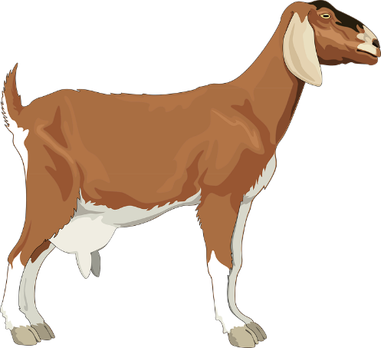
Phonétique
écouter
The ends of these words are hidden.
C’est la SSC [SFe] ?
[billy goat]
[sweet (f)]
bouc
douce
Notes:
Word frequency (1 is the most frequent word in French):
bouc [>5000], douce [>5000] Source: Londsale, D., & Le Bras, Y. (2009). A Frequency Dictionary of French: Core vocabulary for learners London: Routledge.

Slide 25
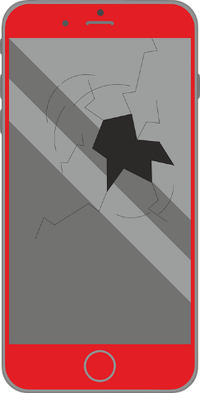
Phonétique
écouter
The ends of these words are hidden.
C’est la SSC [SFe] ?
[defect]
[jumps]
défaut
il saute
Notes:
Word frequency (1 is the most frequent word in French):
défaut [1276], sauter [2114] Source: Londsale, D., & Le Bras, Y. (2009). A Frequency Dictionary of French: Core vocabulary for learners London: Routledge.

Slide 26
Phonétique
écouter
The ends of these words are hidden.
C’est la SSC [SFe] ?
[besides]
[outraged]
outré
outre
Notes:
Word frequency (1 is the most frequent word in French):
outré [>5000], outre [974] Source: Londsale, D., & Le Bras, Y. (2009). A Frequency Dictionary of French: Core vocabulary for learners London: Routledge.

Slide 27
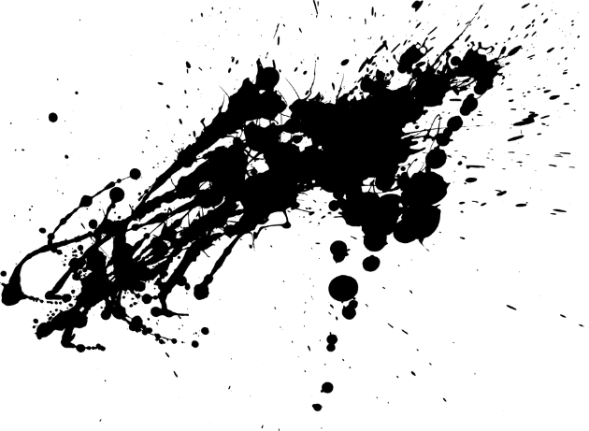
Phonétique
écouter
The ends of these words are hidden.
C’est la SSC [SFe] ?
[ink]
[to anchor]
encre
ancrer
Notes:
Word frequency (1 is the most frequent word in French):
encre [>5000], ancrer [4951] Source: Londsale, D., & Le Bras, Y. (2009). A Frequency Dictionary of French: Core vocabulary for learners London: Routledge.

Slide 28
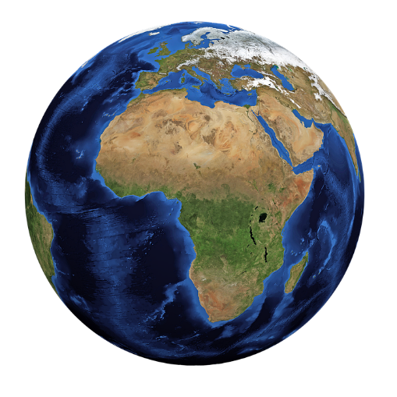
Phonétique
écouter
The ends of these words are hidden.
C’est la SSC [SFe] ?
[global]
[likable]
global
aimable
Notes:
Word frequency (1 is the most frequent word in French):
global [1155], aimable [4668] Source: Londsale, D., & Le Bras, Y. (2009). A Frequency Dictionary of French: Core vocabulary for learners London: Routledge.

Slide 29
Phonétique
écouter
The ends of these words are hidden.
C’est la SSC [SFe] ?
[useful]
[tool]
utile
outil
Notes:
Word frequency (1 is the most frequent word in French):
outil [1725], utile [1003] Source: Londsale, D., & Le Bras, Y. (2009). A Frequency Dictionary of French: Core vocabulary for learners London: Routledge.

Slide 30
Phonétique
parler
adulte
brise
45
ancêtre
breeze
aigle
ancestor
prendre
secondes
viable
eagle
to take
cible
attendre
0
to wait for
DÉBUT
target
Notes:
Timing: 5 minutes for 3 slides.
Aim: Oral production of SSC [SFe] in a limited time.
Procedure:
1. In pairs, pupils read out the words to one another in alphabetical order. They keep going for one minute.
2. The listening student pays close attention to their partner’s pronunciation of the last sound in each word. If they hear ‘-e’, they must ask their partner to repeat the word three times.
3. Click on words to check pronunciation. Students repeat.
4. Clarify meanings of cognate words.
5. Move on to the follow slide to repeat the activity in a shorter space of time, increasing automisation.
Word frequency (1 is the most frequent word in French):
brise [>5000], adulte [1580], ancêtre [3067], aigle [>5000], prendre [43], viable [4946], attendre [155], cible [2740] Source: Londsale, D., & Le Bras, Y. (2009). A Frequency Dictionary of French: Core vocabulary for learners London: Routledge.

Slide 31
Phonétique
parler
adulte
brise
30
ancêtre
breeze
aigle
ancestor
prendre
secondes
viable
eagle
to take
cible
attendre
0
to wait for
DÉBUT
target
Notes:
As previous, but with 15 fewer seconds on the timer.

Slide 32
Phonétique
parler
adulte
brise
15
ancêtre
breeze
aigle
ancestor
prendre
secondes
viable
eagle
to take
cible
attendre
0
to wait for
DÉBUT
target
Notes:
As previous, but with 15 fewer seconds on the timer still.

Slide 33
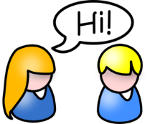
On écoute
Elle fait quoi ?
écouter / écrire
Écoute et écris les phrases.
Salut!
La femme
L’amie
1
Elle parle à l’homme.
3
Elle porte une chemise bleue.
Elle étudie l’histoire.
4
Elle aime l’uniforme moderne.
2
Notes:
Timing: 5 minutes
Aim: Transcription of known vocabulary containing SFe in short sentences.
Procedure:
1. Students listen to the sentences and transcribe what they hear. This activity moves students on from the cluster words, asking them to recall previously taught vocabulary which illustrates the SFe. Though they should, in theory, know the spellings of these words, the short time frame in addition to lack of an aural hint poses challenges.
2. The answers are revealed on clicks.
3. Teachers should ask students for meanings in English to reinforce vocabulary knowledge.
Transcript
Elle parle à l’homme.
Elle étudie l’histoire.
Elle porte une chemise bleue.
Elle aime l’uniforme moderne.

Slide 34
On parle !
On parle !
parler
Partenaire A
drôle | intéressante | timide
grande | la femme | sage
stricte | calme | triste
 | l’amie
Rachel Hawkes
Notes:
Timing: 5 minutes for 3 slides
Aim: Oral production of known words containing SFe.
Procedure:
1. Students take it in turns to say full sentences to their partner, starting with the adjective in the top left. E.g. partner A says to partner B: ‘La femme est drôle’
2. Partner B then writes down the adjective in the top left box. The order should then go round clockwise. This will allow students to easily check their answers against the master which will be displayed during the feedback.
3. Point out to students that all the adjectives are in the feminine form. This will can be further explored at the end of the activity, should teachers find it helpful.

Slide 35
On parle !
On parle !
parler
Partenaire B
 | la femme
petite | méchante | amusante
intelligente | l’amie | malade
excellente | contente | drôle
Notes:
Partner B’s sheet.

Slide 36
On parle !
On parle !
parler
drôle | intéressante | timide
grande | la femme | sage
stricte | calme | triste
petite | méchante | amusante
intelligente | l’amie | malade
excellente | contente | drôle
funny
interesting
shy
big
well-behaved
strict
calm
sad
Rachel Hawkes
Notes:
Answers to the activity on the previous slide.
Procedure:
1. The teacher can display this slide to close the activity as a way for students to check their answers.
2. The teacher could also choose to elicit meanings in English from students to maximise vocabulary consolidation. (English translations appear on clicks.)
3. Finally: a circle appears on a final click around the adjectives where the feminine version has changed spelling. Ask students what these adjectives have in common. This is a way to make quick reference to the pronunciation change in the feminine form which illustrates the Sfe, while reminding students that these adjectives also have a masculine form and the loss of the –e will change the pronunciation to SFC. If teachers want to practise this particular SSC at a future date to revise the differences between pronunciations of masculine and feminine forms, then the activity could be repeated with: l’homme and l’ami as the middle words.
Note:
Differentiation option (for lower ability levels): teachers could use this slide as a student worksheet. Partner A gives sentences (in a random order) starting ‘La femme est…’ / Partner B gives sentences starting ‘L’amie est…’
The partner listening would highlight/tick off/number the adjectives as they are heard (and translate into English). Partner A could keep a record of the order so as not to repeat a word and have something to compare with their partner at the end of the activity. Partner A could write the English as they go.

Slide 37
SFe
phonétique
Consolidation [2]

Slide 38
Phonétique
écrire
En français, c’est … ?
they (m)
ils
SFC
SFe
Notes:
Timing: 6 minutes for 10 slides
Aim: Written production of words containing SSCs [SFC] and [SFe], which feature heavily in the poem.
Procedure:
1. Students write the words in exercise books or on mini whiteboards.
2. Pronunciation can be checked when eliciting answers.
3. The answers are animated to show the full word in French first, then the correct SSC.

Slide 39
Phonétique
écrire
En français, c’est … ?
(we) do
(nous) faisons
SFC
SFe

Slide 40
Phonétique
écrire
En français, c’est … ?
history
histoire
SFC
SFe

Slide 41
Phonétique
écrire
En français, c’est … ?
history
histoire
SFC
SFe

Slide 42
Phonétique
écrire
En français, c’est … ?
effort
effort
SFC
SFe

Slide 43
Phonétique
écrire
En français, c’est … ?
they (f)
elles
SFC
SFe

Slide 44
Phonétique
écrire
En français, c’est … ?
(you (pl)) do
(vous) faites
SFC
SFe

Slide 45
Phonétique
écrire
En français, c’est … ?
party
fête
SFC
SFe

Slide 46
Phonétique
écrire
En français, c’est … ?
exercise
exercice
SFC
SFe

Slide 47
Phonétique
écrire
En français, c’est … ?
(they) do
(ils / elles) font
SFC
SFe

Slide 48
SFe
phonétique
Consolidation [3]

Slide 49
SFE
Silent final -e
[shy]
timide
Notes:
Timing: 1 minute
Aim: To introduce/consolidate SSC [SFE]
Procedure: 1. Present the letter(s) and say the [SFE] sound first, on its own. Students repeat it with you. 2. Bring up the word ”timide” on its own, say it, students repeat it, so that they have the opportunity to focus all of their attention on the connection between the written word and its sound.
3. A possible gesture for this would be to cower and cover one’s face slightly, simulating shyness. 4. Roll back the animations and work through 1-3 again, but this time, dropping your voice completely to listen carefully to the students saying the [SFE] sound, pronouncing ”timide” and, if using, doing the gesture.
Word frequency (1 is the most frequent word in French):
timide [3835]
Source: Londsale, D., & Le Bras, Y. (2009). A Frequency Dictionary of French: Core vocabulary for learners London: Routledge.

Slide 50
SFE
monde
moderne
[silent final –e]
[shy]
centre
timide
douze
vie
[life]
Notes:
Timing: 2 minutes
Aim: To introduce/consolidate SSC [SFE]
Procedure:
1. Introduce and elicit the pronunciation of the individual SSC [SFE] and then the source word again ‘timide’ (with gesture, if using). 2. Then present and elicit the pronunciation of the five cluster words.
The cluster words have been chosen for their high-frequency, from a range of word classes, with the SSC (where possible) positioned within a variety of syllables within the words (e.g. initial, 2nd, final etc.). Additionally, we have tried to use words that build cumulatively on previously taught SSCs (see the Phonics Teaching Sequence document) and do not include new SSCs. Where new SSCs are used, they are often consonants which have a similar symbol-sound correspondence in English.
Word frequency (1 is the most frequent word in French): monde [77]; moderne [1239] centre [491]; vie [132]; douze [1664]; timide [3835]. Source: Londsale, D., & Le Bras, Y. (2009). A Frequency Dictionary of French: Core vocabulary for learners London: Routledge.

Slide 51
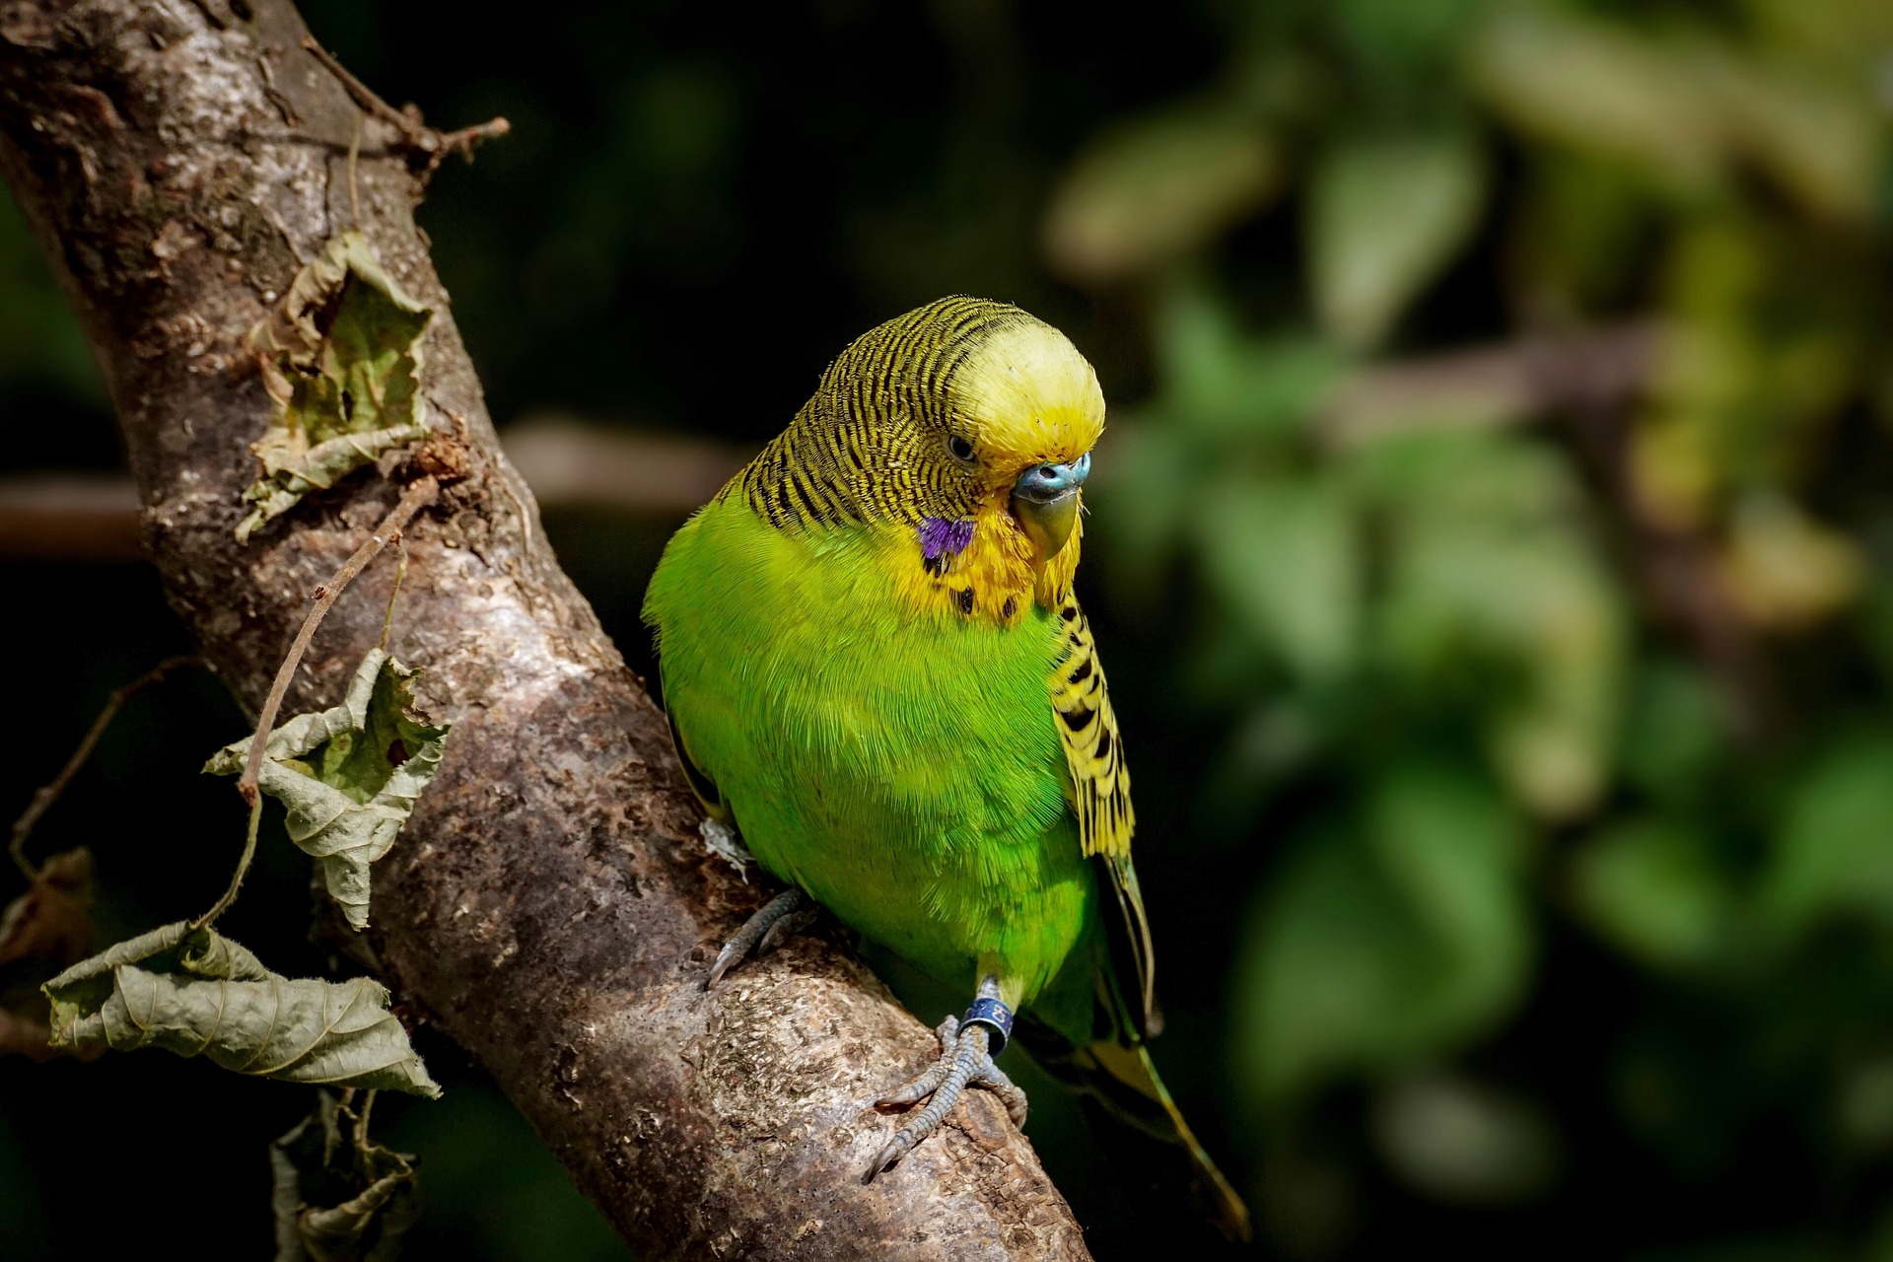
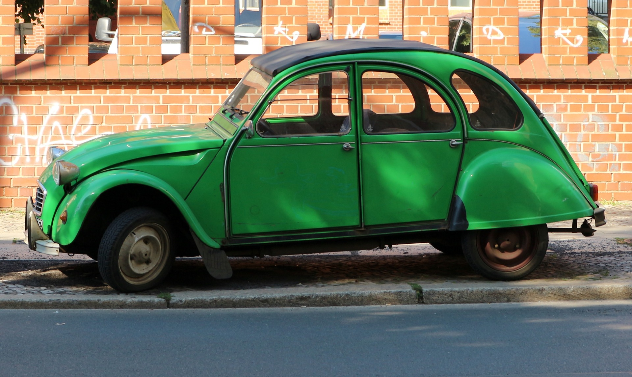
La féminisation des adjectifs
grammaire
Remember that adjectives change when they describe a feminine noun.
The most common change is to add ‘e’ to the end of the adjective.
un oiseau vert
a green bird
une voiture verte
a green car
When we add ‘e’, the SFC is no longer silent, and the ending is SFe instead.
Notes:
Timing: 3 minutes
Aim: Revision of feminine adjective agreement rule 1: add –e
Procedure:
1. Click through explanations and examples, eliciting knowledge where possible.
2. Ensure understanding of rule.
3. Click pictures to hear audio.
Transcript:
un oiseau vert une voiture verte
Word frequency of cognates used (1 is the most frequent word in French):
féminisation [>5000], adjectif [>5000]
Source: Lonsdale, D., & Le Bras, Y. (2009). A Frequency Dictionary of French: Core vocabulary for learners London: Routledge.

Slide 52
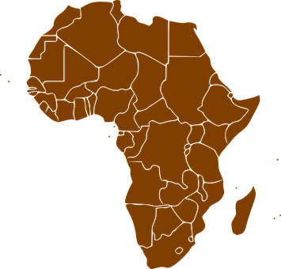
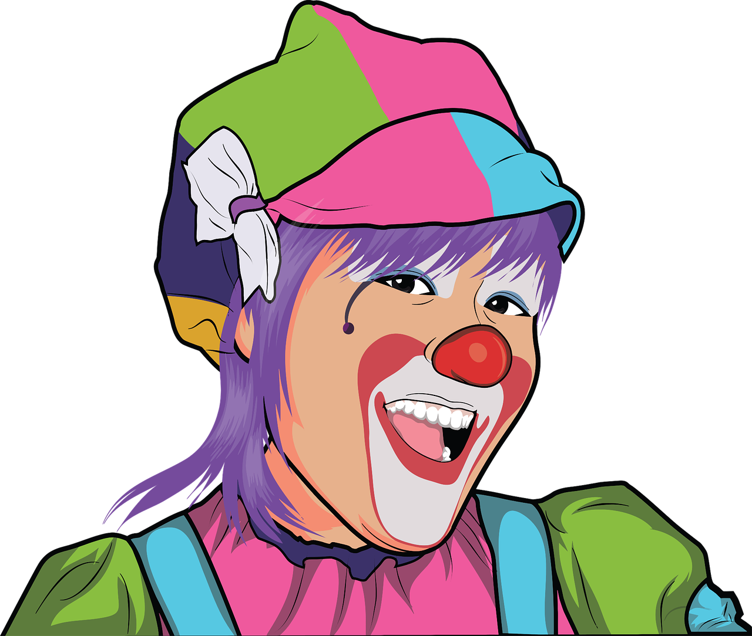
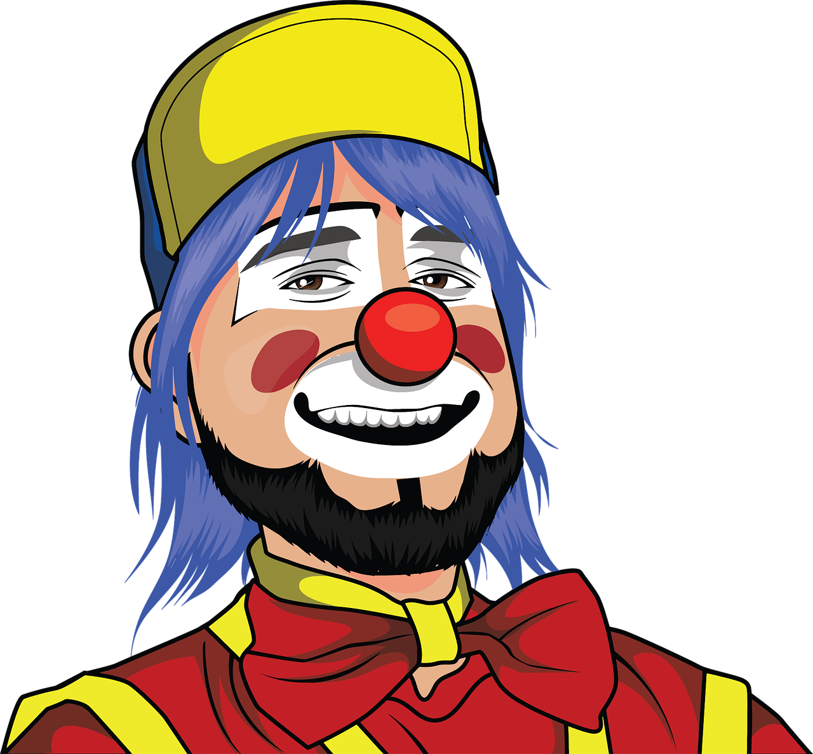
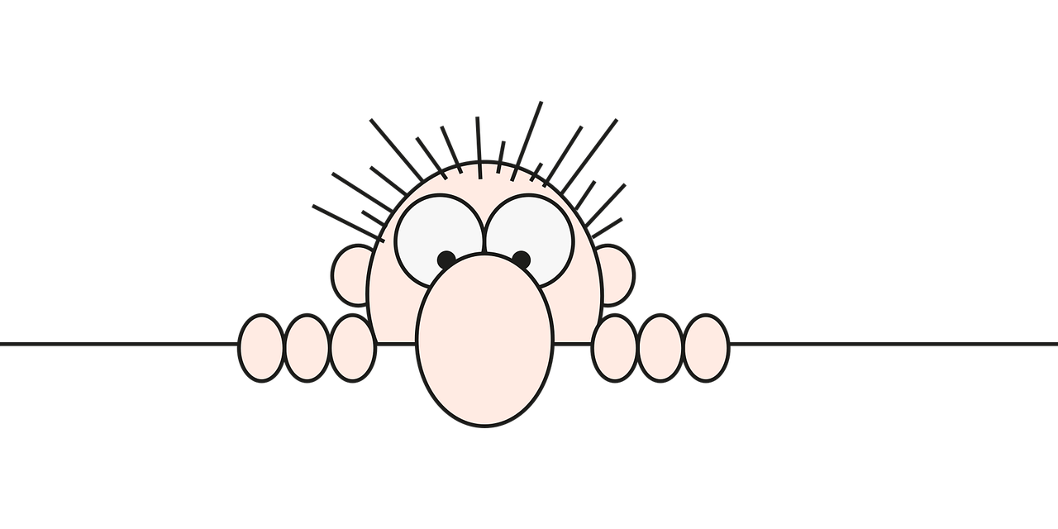
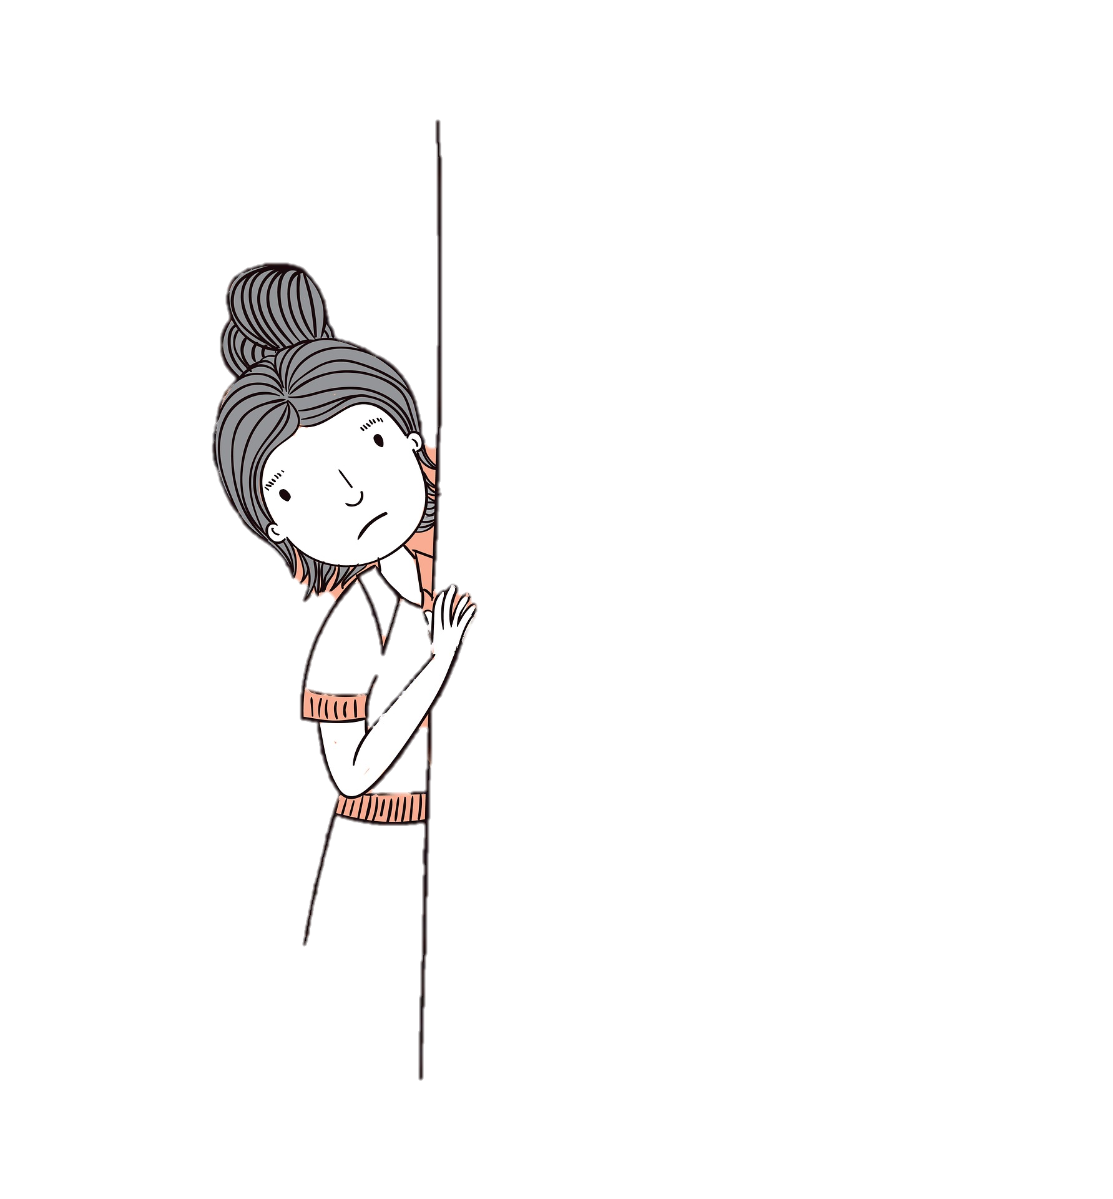
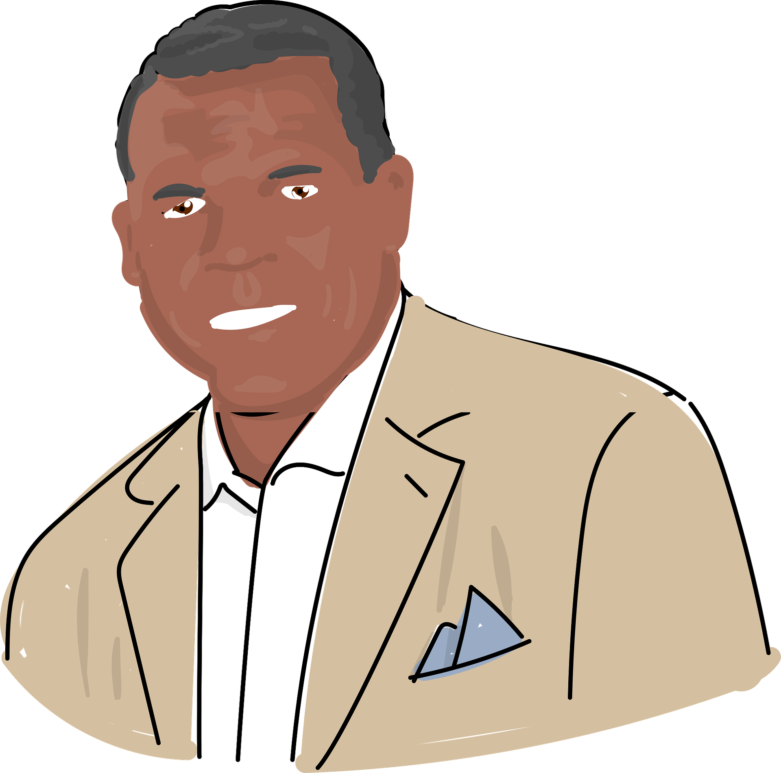
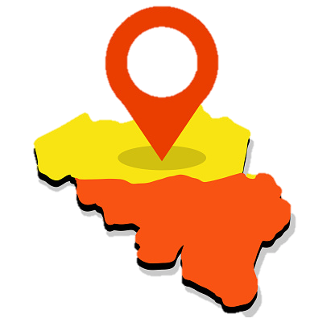
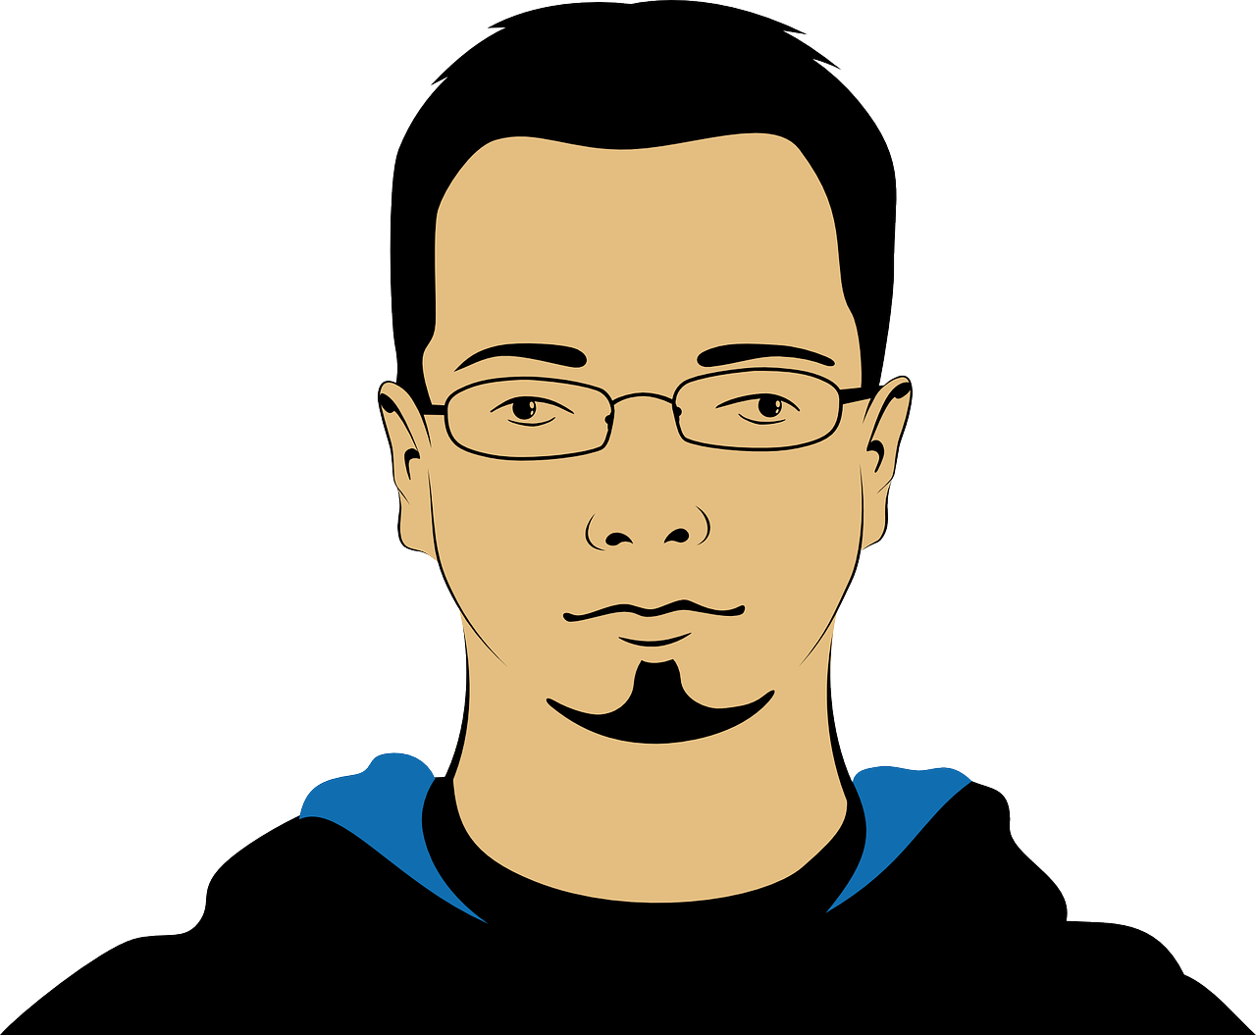
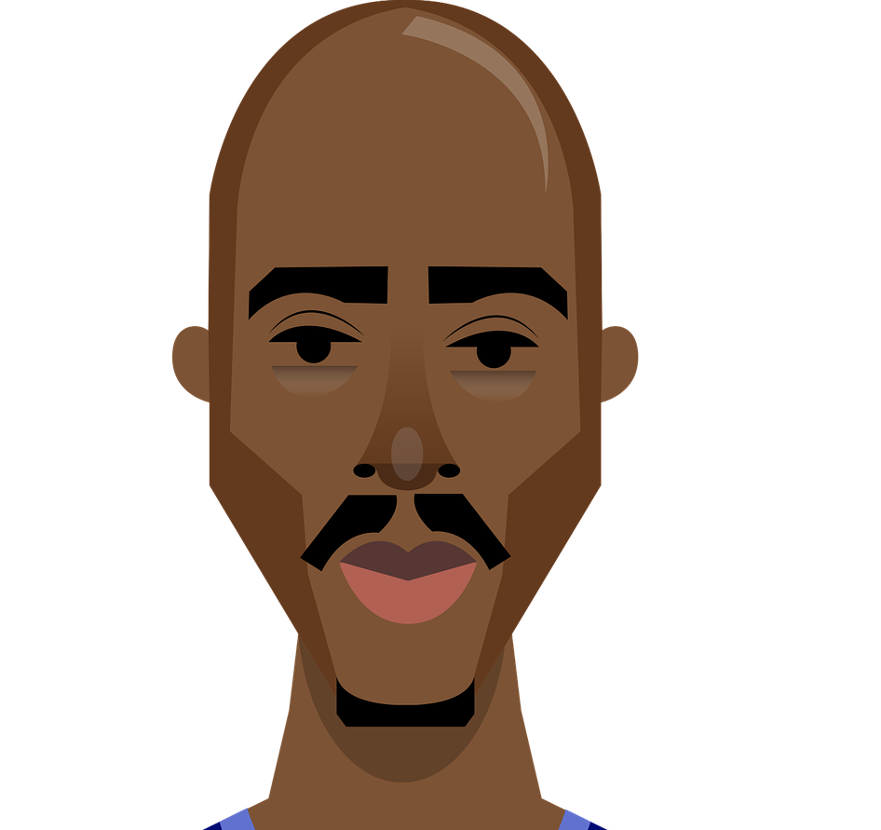
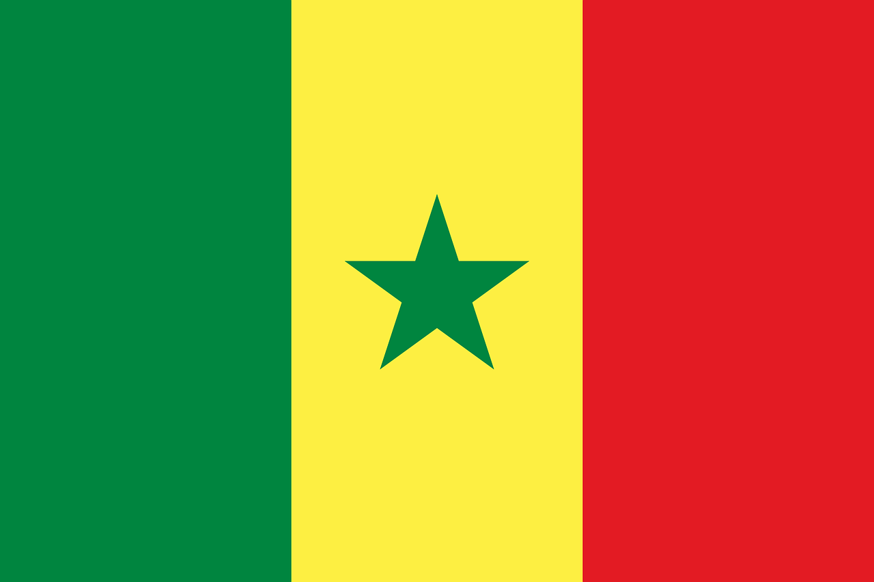
C’est qui ?
Écoute. On décrit qui ? La dernière lettre de l'adjectif, c’est SFC ou SFE ?
écouter
Le Rwanda est un pays en Afrique. On parle français au Rwanda.
Q | il | elle | Q | il | elle
 | gourmand (fond of food) |  |  | marrant (funny)
 | rwandais (Rwandan) |  |  | méfiant (wary, distrustful)
 | fort (strong) |  |  | flamand (Flemish)
 | sénégalais (Senegalese) |  |  | bavard (talkative)
1
5
La Flandre est une région de Belgique. On parle flamand en Flandre.
2
6
Le Sénégal est un pays en Afrique. On parle français au Sénégal.
3
7
4
8
Notes:
Timing: 5 minutes
Aim: Aural recognition of masculine (SFC) and feminine (SFe) forms of adjectives (following pattern 1).
Procedure:
1. Remind students of the association between SFC and masculine adjectives, and SFe and feminine adjectives.
2. Click to play audio.
3. Students write 1-8 and il or elle, depending on whether they hear a masculine or feminine form of the (unknown) adjective given.
4. Click to reveal answers. Hear full audio by clicking on tick.
5. Click to bring up some cultural information about the places mentioned. Explain that la Flandre is called ‘Flanders’ and it is the northern part of Belgium which borders the Netherlands. Explain that flamand is called ‘Flemish’ in English and that it is a language similar to Dutch.
Transcript:
1. [Elle] est gourmande.
2. [Il] est rwandais.
3. [Il] est fort.
4. [Elle] est sénégalaise.
5. [Il] est marrant.
6. [Elle] est méfiante.
7. [Elle] est flamande.
8. [Il] est bavard.
Word frequency of unknown words used (1 is the most frequent word in French):
gourmand [>5000], rwandais [>5000], fort [107], sénégalais [>5000], marrant [>5000], méfiant [>5000], flamand [>5000], bavard [>5000] Source: Lonsdale, D., & Le Bras, Y. (2009). A Frequency Dictionary of French: Core vocabulary for learners London: Routledge.
Word frequency of cognates used (1 is the most frequent word in French):
adjectif [>5000], lettre [480] Source: Lonsdale, D., & Le Bras, Y. (2009). A Frequency Dictionary of French: Core vocabulary for learners London: Routledge.

Slide 53
Des mots apparentés
parler
Some French nouns and adjectives look the same as the English, but with SFe added to the end. This spelling change sometimes means that we are forced to pronounce the consonant in the same way as in English.
Say the phrases below. In which words is the last consonant pronounced like English? In which words is it pronounced differently?
une adresse moderne un journaliste calme
un concert secret un film normal
un adulte modeste un incident dans la prison
une bombe nucléaire une demande de groupe
Notes:
Timing: 5 minutes
Aim: Raising awareness of a En-Fr word pattern (adding –e to English nouns and adjectives) and how this affects pronunciation.
Procedure:
1. Discuss the possible meaning of the activity title (the French translation may in fact be more transparent than the English translation ‘cognate!’) Explain that a cognate is a word that looks and/or sounds very similar in two different languages, normally because it has been absorbed into one language from the other.
2. Ensure understanding of the explanation.
3. Students say example phrases to practice pronunciation of SFe and SFC.
Word frequency of unknown words used (1 is the most frequent word in French): apparenté [>5000]
Source: Lonsdale, D., & Le Bras, Y. (2009). A Frequency Dictionary of French: Core vocabulary for learners London: Routledge.
Word frequency of cognates used (1 is the most frequent word in French): artiste [1797], groupe [187], journaliste [1337], concert [1697], secret [796], normal [833], adulte [1580], modeste [1540], incident [1885], prison [1010], bombe [1751], nucléaire [1130], demande [490]
Source: Lonsdale, D., & Le Bras, Y. (2009). A Frequency Dictionary of French: Core vocabulary for learners London: Routledge.

Slide 54
SFe
phonétique
Consolidation [4]

Slide 55
SFE
Silent final -e
[shy]
timide
Notes:
Timing: 1 minute
Aim: To introduce/consolidate SSC [SFE]
Procedure: 1. Present the letter(s) and say the [SFE] sound first, on its own. Students repeat it with you. 2. Bring up the word ”timide” on its own, say it, students repeat it, so that they have the opportunity to focus all of their attention on the connection between the written word and its sound.
3. A possible gesture for this would be to cower and cover one’s face slightly, simulating shyness. 4. Roll back the animations and work through 1-3 again, but this time, dropping your voice completely to listen carefully to the students saying the [SFE] sound, pronouncing ”timide” and, if using, doing the gesture.
Word frequency (1 is the most frequent word in French):
timide [3835]
Source: Londsale, D., & Le Bras, Y. (2009). A Frequency Dictionary of French: Core vocabulary for learners London: Routledge.

Slide 56
SFE
monde
moderne
[silent final –e]
[shy]
centre
timide
douze
vie
[life]
Notes:
Timing: 2 minutes
Aim: To introduce/consolidate SSC [SFE]
Procedure:
1. Introduce and elicit the pronunciation of the individual SSC [SFE] and then the source word again ‘timide’ (with gesture, if using). 2. Then present and elicit the pronunciation of the five cluster words.
The cluster words have been chosen for their high-frequency, from a range of word classes, with the SSC (where possible) positioned within a variety of syllables within the words (e.g. initial, 2nd, final etc.). Additionally, we have tried to use words that build cumulatively on previously taught SSCs (see the Phonics Teaching Sequence document) and do not include new SSCs. Where new SSCs are used, they are often consonants which have a similar symbol-sound correspondence in English.
Word frequency (1 is the most frequent word in French): monde [77]; moderne [1239] centre [491]; vie [132]; douze [1664]; timide [3835]. Source: Londsale, D., & Le Bras, Y. (2009). A Frequency Dictionary of French: Core vocabulary for learners London: Routledge.

Slide 57
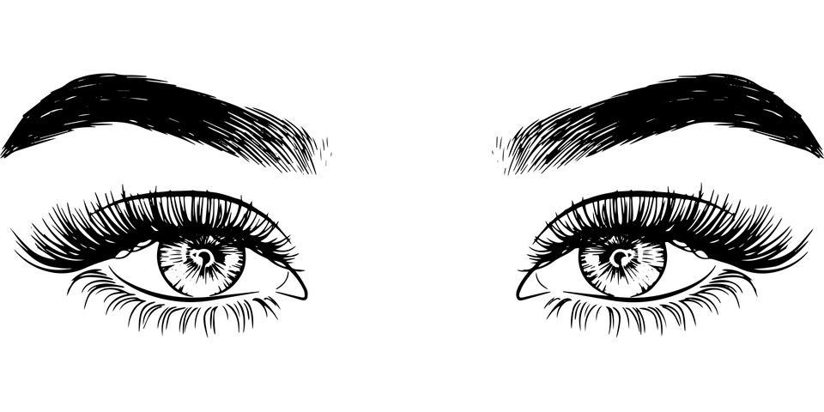
Les terminaisons de verbes
grammaire
Comment former les verbes au present ?
long form = infinitive /dictionary form
short form = forms that go with pronouns
remove -er add -e
Long form: regarder
Singular short forms: je regarde
remove -er add -es
tu regardes
il/elle regarde
remove -er add -e
Say the verb forms out loud. What is the last SSC in each word?
regarder regarde, regardes
SSC [é]
SFe
SFe + SFC
The SFE forces the consonant before it to be pronounced.
Notes:
Timing: 2 minutes
Aim: To revise long and singular short forms of –ER verbs and connect the endings with SSCs.
Procedure:
1. Remind students how to form singular short forms of –ER verbs.
2. Ask students to pronounce the verb forms, focusing on the final sound in each word (click on the names of the SSCs to hear audio).
3. Remind students that all three short forms sound the same.
4. Click to bring up the note about SFE and forced consonant production.
Word frequency of unknown words used (1 is the most frequent word in French): terminaison [>5000]
Source: Londsale, D., & Le Bras, Y. (2009). A Frequency Dictionary of French: Core vocabulary for learners London: Routledge.
Word frequency of cognates (1 is the most frequent word in French): verbe [>5000], former [486]
Source: Londsale, D., & Le Bras, Y. (2009). A Frequency Dictionary of French: Core vocabulary for learners London: Routledge.

Slide 58
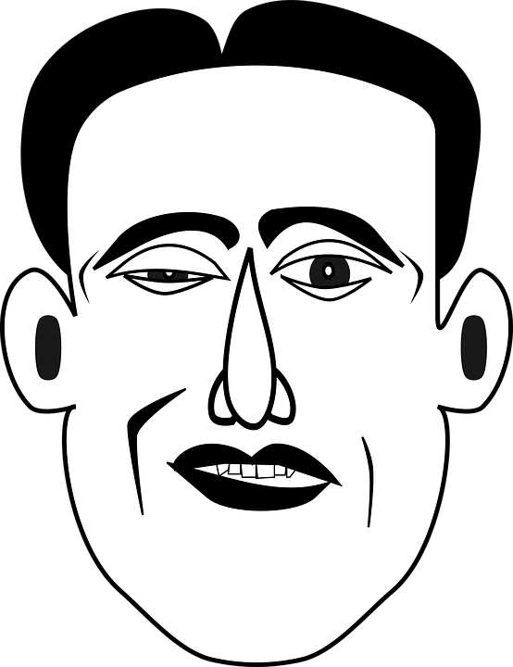
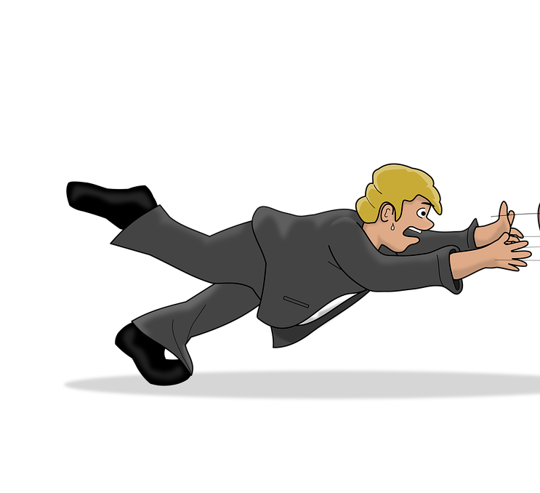
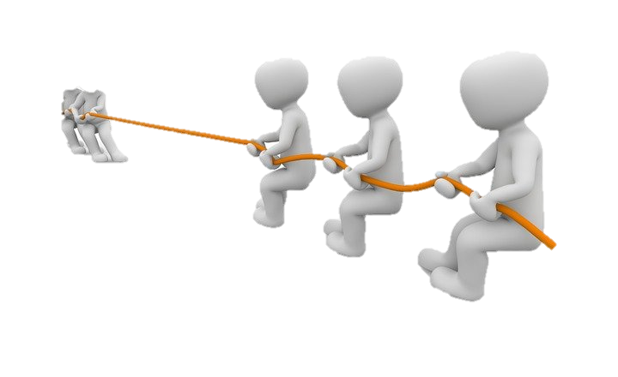
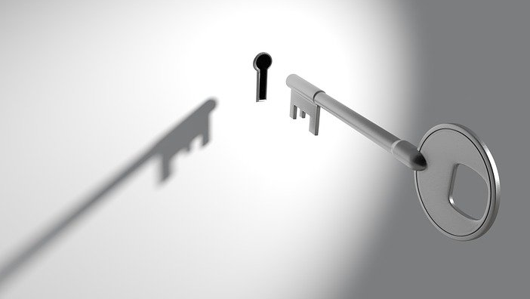
SSC [é] ou SFE ?
écouter
verb | infinitive meaning | infinitive (dictionary form) | short form (je/tu/il/elle)
cesser | to stop/quit
semble | to seem
illumine | to light up
encourager | to encourage
tirer | to pull
tomber | to fall
entre | to enter
garde | to keep
Listen out for the last SSC
in each word.
1
_
2
_
3
_
4
_
5
_
6
_
7
_
8
_
Notes:
Timing: 5 minutes
Aim: to practise aural recognition of SSCs [é/-er/-ez] and SFE and connect these with meaning (long or short form of verb).
NB: some of these unknown –ER verbs appear in the text students will work with in this lesson.
Procedure:
1. Click numbers to hear a verb.
2. Students tick whether they hear a long or short form, based on the ending they hear. Note that the options here are simply ‘long’ or ‘short’ as the singular forms (je/tu/il/elle) sound identical.
3. Click to reveal answers.
4. Listen again, this time drawing attention to stress patterns. As the last syllable in French words carries a slightly heavier stress, it is always the –er in the infinitive form that is stressed. Students repeat.
5. Students say the long and short form of each verb, focusing on the changing position of the stress (from base to ending).
Differentiation option for higher level students: Extend box to cover whole verb form. Students transcribe.
Transcript:
1. cesser
2. semble
3. illumine
4. encourager
5. tirer
6. tomber
7. entre
8. garde
Word frequency of unknown words used (1 is the most frequent word in French): sembler [180], cesser [462], garder [531], tomber [547], tirer [391]
Source: Londsale, D., & Le Bras, Y. (2009). A Frequency Dictionary of French: Core vocabulary for learners London: Routledge.
Word frequency of cognates used (1 is the most frequent word in French): encourager [1434], illuminer [>5000], entrer [337]
Source: Londsale, D., & Le Bras, Y. (2009). A Frequency Dictionary of French: Core vocabulary for learners London: Routledge.

Slide 59
Les terminaisons de verbes
grammaire
Comment former les verbes au present ?
long form = infinitive /dictionary form
short form = forms that go with pronouns
remove -er add -ons
Long form: regarder
Plural short forms: nous regardons
remove -er add -ez
vous regardez
ils/elles regardent
remove -er add -ent
Say the verb forms out loud. What is the last SSC in each word?
regarder regardons, regardez, regardent
SSC [é]
SFC
SSC [é]
SFE + SFC
The vous form sounds the same as the infinitive
Notes:
Timing: 2 minutes
Aim: To revise long and plural short forms of –ER verbs, and connect the endings with SSCs.
Procedure:
1. Remind students how to form plural short forms of –ER verbs.
2. Ask students to pronounce the verb forms, focusing on the final sound in each word (click on the names of the SSCs to hear audio).
ick and ask students to pronounce the verb forms, focusing on the final sound in each word.
3. Click to remind students that the infinitive and the vous form sound the same.
Word frequency of unknown words used (1 is the most frequent word in French): terminaison [>5000]
Source: Londsale, D., & Le Bras, Y. (2009). A Frequency Dictionary of French: Core vocabulary for learners London: Routledge.
Word frequency of cognates (1 is the most frequent word in French): verbe [>5000], former [486]
Source: Londsale, D., & Le Bras, Y. (2009). A Frequency Dictionary of French: Core vocabulary for learners London: Routledge.

Slide 60
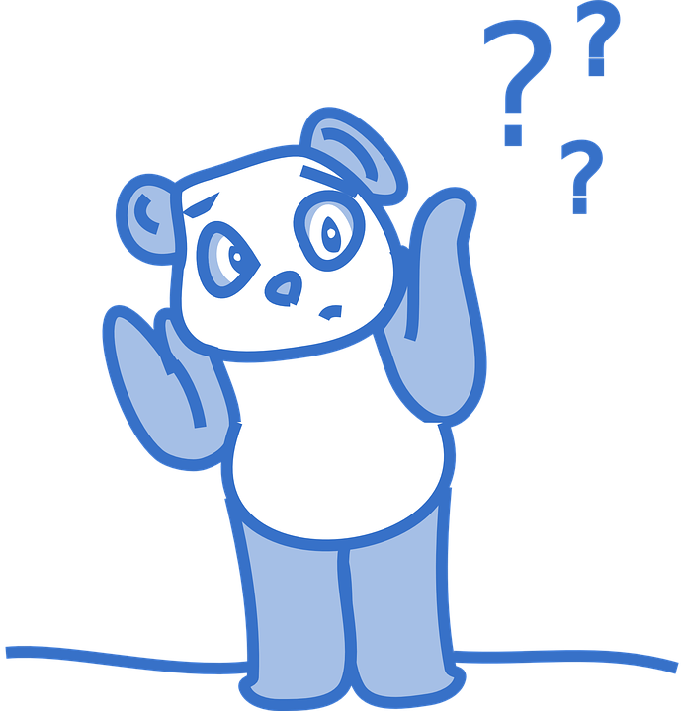
SSC [é] ou SFE ?
écouter
verb | infinitive meaning | infinitive OR ‘vous’ form | short form (ils/elles)
oublient | to forget
refuser/ez | to refuse
rencontrent | to meet
tentent | to try
ajouter/ez | to add
marquent | to mark
obliger/ez | to force
appuyer/ez | to press
Listen out for the last SSC
in each word.
1
_
2
_
3
_
4
_
5
_
6
_
7
_
8
_
Notes:
Timing: 5 minutes
Aim: Aural recognition of SSCs [é/-er/-ez] and SFE and to connecting these with meaning (long/2nd person plural vs 3rd person plural).
Procedure:
1. Click numbers to hear a verb in the long/2nd person plural or 3rd person plural.
2. Students tick whether they hear a long/2nd person plural or 3rd person plural, based on the ending they hear.
3. Click to reveal answers.
4. Listen again, this time drawing attention to stress patterns. As the last syllable in French words carries a slightly heavier stress, it is always the –er in the infinitive form that is stressed. Students repeat.
5. Students say the long and short form of each verb, focusing on the changing position of the stress (from base to ending).
Differentiation option for higher level students: extend box to cover whole verb form. Students transcribe.
Transcript:
oublient
refuser/refusez
rencontrent
tentent
ajouter/ajoutez
marquent
obliger/obligez
appuyer/apuyez
Word frequency of unknown words used (1 is the most frequent word in French): oublier [504], rencontrer [329], tenter [347], ajouter [359], obliger [499], appuyer [923]
Source: Londsale, D., & Le Bras, Y. (2009). A Frequency Dictionary of French: Core vocabulary for learners London: Routledge.
Word frequency of cognates (1 is the most frequent word in French): refuser [271], marquer [454]
Source: Londsale, D., & Le Bras, Y. (2009). A Frequency Dictionary of French: Core vocabulary for learners London: Routledge.

Slide 61
SFe
phonétique
Consolidation [5]

Slide 62
SFE
Silent final -e
[shy]
timide
Notes:
Timing: 1 minute
Aim: To introduce/consolidate SSC [SFE]
Procedure: 1. Present the letter(s) and say the [SFE] sound first, on its own. Students repeat it with you. 2. Bring up the word ”timide” on its own, say it, students repeat it, so that they have the opportunity to focus all of their attention on the connection between the written word and its sound.
3. A possible gesture for this would be to cower and cover one’s face slightly, simulating shyness. 4. Roll back the animations and work through 1-3 again, but this time, dropping your voice completely to listen carefully to the students saying the [SFE] sound, pronouncing ”timide” and, if using, doing the gesture.
Word frequency (1 is the most frequent word in French):
timide [3835]
Source: Londsale, D., & Le Bras, Y. (2009). A Frequency Dictionary of French: Core vocabulary for learners London: Routledge.

Slide 63
SFE
monde
moderne
[silent final –e]
[shy]
centre
timide
douze
vie
[life]
Notes:
Timing: 2 minutes
Aim: To introduce/consolidate SSC [SFE]
Procedure:
1. Introduce and elicit the pronunciation of the individual SSC [SFE] and then the source word again ‘timide’ (with gesture, if using). 2. Then present and elicit the pronunciation of the five cluster words.
The cluster words have been chosen for their high-frequency, from a range of word classes, with the SSC (where possible) positioned within a variety of syllables within the words (e.g. initial, 2nd, final etc.). Additionally, we have tried to use words that build cumulatively on previously taught SSCs (see the Phonics Teaching Sequence document) and do not include new SSCs. Where new SSCs are used, they are often consonants which have a similar symbol-sound correspondence in English.
Word frequency (1 is the most frequent word in French): monde [77]; moderne [1239] centre [491]; vie [132]; douze [1664]; timide [3835]. Source: Londsale, D., & Le Bras, Y. (2009). A Frequency Dictionary of French: Core vocabulary for learners London: Routledge.

Slide 64
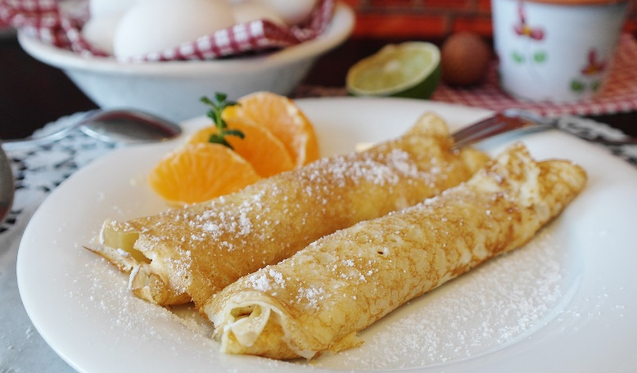
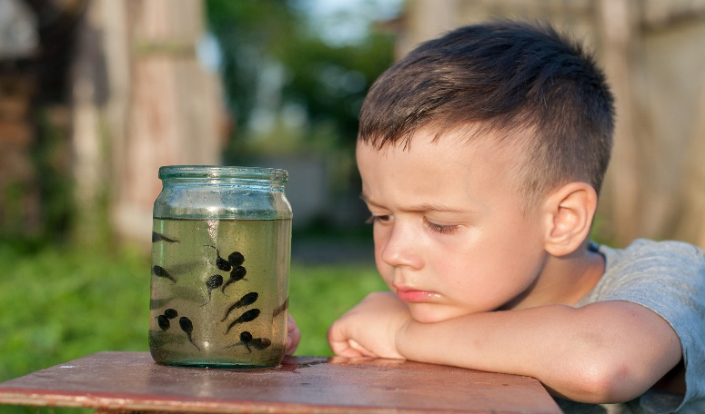
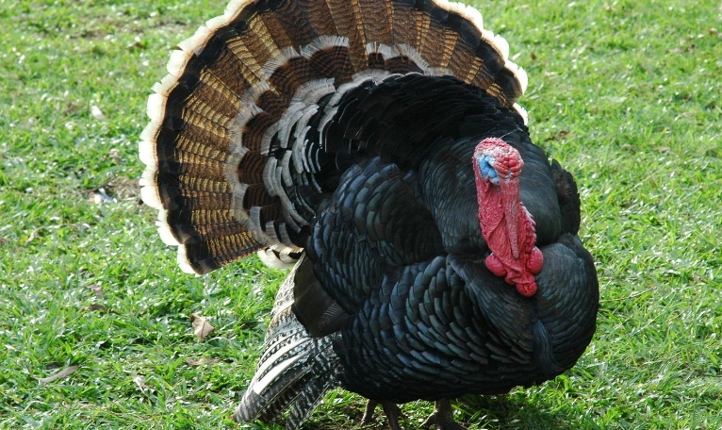
Phonétique
C’est la SSC [SFe] ou [--]?
écouter
1
2
crêpe
[pancake]
faux
[false]
[SFe]
[--]
3
4
têtard
[tadpole]
dinde
[turkey]
[--]
[SFe]
Notes:
Slide 1 of 2
Timing: 3 minutes for 2 slides
Aim: aural recognition of SSC [SFE]
Procedure:
1. Click the numbers to play the audio.
2. Students choose whether the words have a silent final e [SFE] or not [--].
Word frequency (1 is the most frequent word in French): crêpe [>5000], gâteaux [4845], têtard [>5000], dinde [>5000], sirop [>5000], fraise [>5000], escargot [>5000], crabe [>5000]
Source: Lonsdale, D., & Le Bras, Y. (2009). A Frequency Dictionary of French: Core vocabulary for learners London: Routledge.

Slide 65
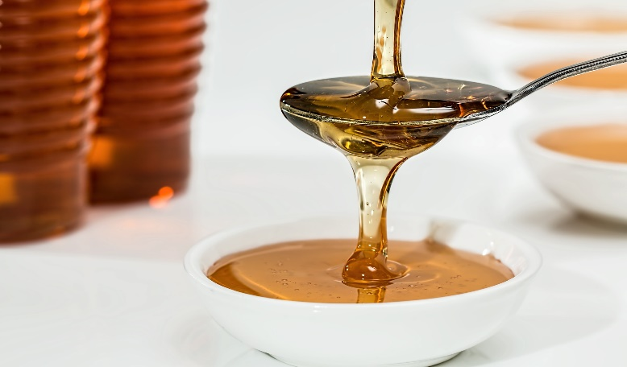
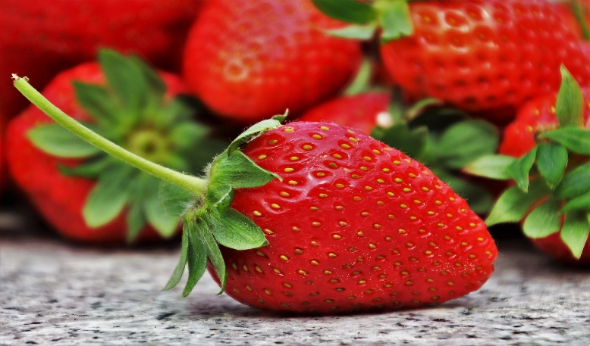
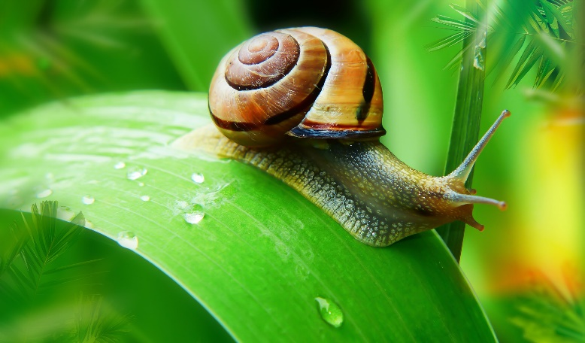
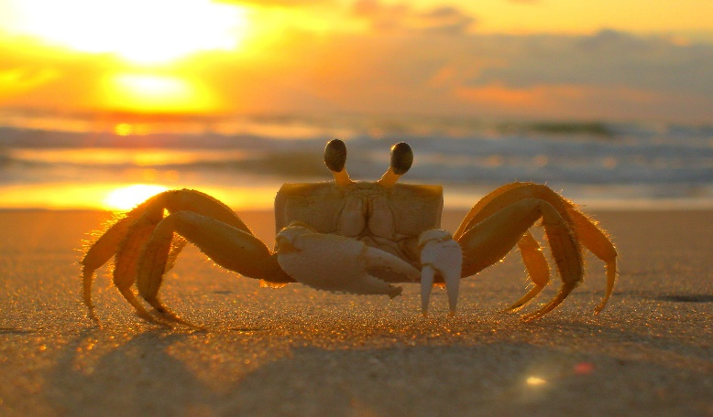
Phonétique
C’est la SSC [SFe] ou [--]?
écouter
1
2
sirop
[syrup]
fraise
[strawberry]
[--]
[SFe]
3
4
escargot
[snail]
crabe
[crab]
[--]
[SFe]
Notes:
Slide 2 of 2

