Slide 1
French Phonics Collection
Silent Final Consonant (SFC)
Artwork by: Chloé Motard
Date updated: 31/08/22
Notes:
Artwork by Chloé Motard. All additional pictures selected are available under a Creative Commons license, no attribution required.

Slide 2
SFC
phonétique
Introduction

Slide 3
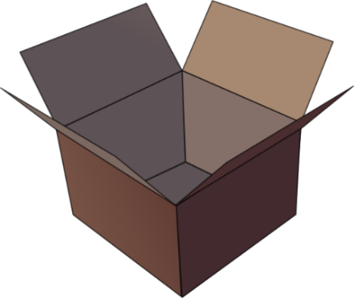
SFC
Silent final consonant
dans
X
Notes:
Timing: 1 minute
Aim: To introduce SSC [SFC]
Explanation in English, if desired: Something that makes French sounds very different from English is that some consonants at the ends of words are silent. This means you don’t pronounce/sound them out at all. As in the word ‘dans’ in French.
Procedure: 1. Bring up the word ”dans” on its own, say it, students repeat it, so that they have the opportunity to focus all of their attention on the connection between the written word and its sound.
3. A possible gesture for this would be to hold ones finger to ones lips to indicate ‘Shhhh!’. 4. Roll back the animations and work through 1-3 again, but this time, dropping your voice completely to listen carefully to the students saying the [SFC] sound, pronouncing ”dans” and, if using, doing the gesture.
Word frequency (1 is the most frequent word in French):
dans [11] Source: Londsale, D., & Le Bras, Y. (2009). A Frequency Dictionary of French: Core vocabulary for learners London: Routledge.

Slide 4
SFC
Silent final consonant
dans
X
Notes:
With sound and no pictures to focus all attention on the sound-symbol correspondence.

Slide 5
SFC
Silent final consonant
dans
X
Notes:
Without sound to elicit pronunciation (without first hearing the teacher).
Teacher to elicit pronunciation by asking “Comment dit-on …”/

Slide 6
SFC
petit
prix
€15.95
grand
mot
dans
X
mais
[but]
Notes:
Timing: 2 minutes
Aim: To introduce SSC [SFC]
Procedure:
1. Introduce and elicit the pronunciation of the individual SSC [SFC] (in this case is [SFC] – silent final consonant so nothing to pronounce as an individual sound!) and then the source word again ‘dans’ (with gesture, if using). 2. Then present and elicit the pronunciation of the five cluster words.
The cluster words have been chosen for their high-frequency, from a range of word classes, with the SSC (where possible) positioned within a variety of syllables within the words (e.g. initial, 2nd, final etc.). Additionally, we have tried to use words that build cumulatively on previously taught SSCs (see the Phonics Teaching Sequence document) and do not include new SSCs. Where new SSCs are used, they are often consonants which have a similar symbol-sound correspondence in English.
Word frequency (1 is the most frequent word in French): dans [11]; petit [138] prix [310]; mot [220]; mais [30]; grand [59]. Source: Londsale, D., & Le Bras, Y. (2009). A Frequency Dictionary of French: Core vocabulary for learners London: Routledge.

Slide 7
SFC
petit
prix
grand
mot
dans
X
mais
Notes:
With sound and no pictures to focus all attention on the sound-symbol correspondence.

Slide 8
SFC
petit
prix
grand
mot
dans
X
mais
Notes:
Without sound to elicit pronunciation (without first hearing the teacher).
Teacher to elicit pronunciation by asking “Comment dit-on …”

Slide 9
… except for
c r f l
Be c a r e f u l with these!

Slide 10
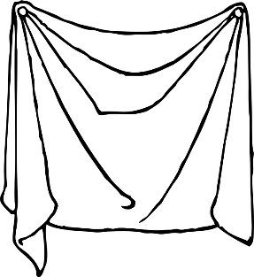
Phonétique (1/3)
lire / parler
drap
d’accord
vert
20
[sheet]
[okay]
[green]
estomac
secondes
canard
bras
[stomach]
0
DÉBUT
DÉBUT
Notes:
Timing: 3 minutes for 3 slides
NB: A more challenging version of this activity, which does not have the SSC scored out, can be found on slides 12-14.
Aim: To correctly pronounce unknown words containing [SFC] in decreasing amounts of time, helping automisation of SSC production. The words chosen otherwise contain sounds that are equivalent (or very similar) to English SSCs, so that students can focus fully on the [SFC] (allowances are made for English pronunciation of [r], which is covered in year 8).
Procedure:
1. Students pair up.
2. Teacher starts 20 second timer.
3. Student A tries to say the words without pronouncing the [SFC].
4. Student B makes speaker pause for 3 seconds every time an [SFC] is pronounced.
5. Complete before 20 seconds runs out.
6. Swap roles.
7. Click on the word to hear pronunciation by a native speaker. Students repeat.
7. Move onto the next slide.
Word frequency (1 is the most frequent word in French): drap [>5000], d’accord [736], vert [1060], canard [>5000], estomac [>5000], bras [1253]
Source: Londsale, D., & Le Bras, Y. (2009). A Frequency Dictionary of French: Core vocabulary for learners London: Routledge.

Slide 11
Phonétique (2/3)
lire / parler
drap
d’accord
vert
10
[sheet]
[okay]
[green]
secondes
canard
estomac
bras
[stomach]
0
DÉBUT
Notes:
As per previous slide, but with the time halved.

Slide 12
Phonétique (3/3)
lire / parler
drap
d’accord
vert
5
[sheet]
[okay]
[green]
secondes
secondes
canard
estomac
bras
[stomach]
0
DÉBUT
Notes:
As previous slide, but with the time halved again.

Slide 13
Phonétique (1/3)
lire / parler
drap
d’accord
vert
20
[sheet]
[okay]
[green]
estomac
secondes
canard
bras
[stomach]
0
DÉBUT
DÉBUT
Notes:
Timing: 3 minutes for 3 slides
NB: A less challenging version of this activity, which does has the SSC scored out, can be found on slides 9-11.
Aim: To correctly pronounce unknown words containing [SFC] in decreasing amounts of time, helping automisation of SSC production. The words chosen otherwise contain sounds that are equivalent (or very similar) to English SSCs, to that students can focus fully on the [SFC] (allowances are made for English pronunciation of [r], which is covered in year 8).
Procedure:
1. Students pair up.
2. Teacher starts 20 second timer.
3. Student A tries to say the words without pronouncing the [SFC].
4. Student B makes speaker pause for 3 seconds every time an [SFC] is pronounced.
5. Complete before 20 seconds runs out.
6. Swap roles.
7. Click on the loudspeaker icons to check pronunciation. Students repeat.
7. Move onto the next slide.
Word frequency (1 is the most frequent word in French): drap [>5000], d’accord [736], vert [1060], canard [>5000], estomac [>5000], bras [1253]
Source: Londsale, D., & Le Bras, Y. (2009). A Frequency Dictionary of French: Core vocabulary for learners London: Routledge.

Slide 14
Phonétique (2/3)
lire / parler
drap
d’accord
vert
10
[sheet]
[okay]
[green]
secondes
secondes
canard
estomac
bras
[stomach]
0
DÉBUT
Notes:
As per previous slide, but with the time halved.

Slide 15
Phonétique (3/3)
lire / parler
drap
d’accord
vert
5
[sheet]
[okay]
[green]
secondes
canard
estomac
bras
[stomach]
0
DÉBUT
Notes:
As previous slide, but with the time halved again.

Slide 16
SFC
phonétique
Consolidation [1]

Slide 17
SFC
Silent final consonant
dans
X
Notes:
Timing: 1 minute
Aim: To consolidate SSC [SFC]
Explanation in English, if desired: Something that makes French sounds very different from English is that some consonants at the ends of words are silent. This means you don’t pronounce/sound them out at all. As in the word ‘dans’ in French.
Procedure: 1. Present the letter(s) and say the [SFC] sound first, on its own. Students repeat it with you. 2. Bring up the word ”dans” on its own, say it, students repeat it, so that they have the opportunity to focus all of their attention on the connection between the written word and its sound.
3. A possible gesture for this would be to hold ones finger to ones lips to indicate ‘Shhhh!’. 4. Roll back the animations and work through 1-3 again, but this time, dropping your voice completely to listen carefully to the students saying the [SFC] sound, pronouncing ”dans” and, if using, doing the gesture.
Word frequency (1 is the most frequent word in French):
dans [11] Source: Londsale, D., & Le Bras, Y. (2009). A Frequency Dictionary of French: Core vocabulary for learners London: Routledge.

Slide 18
SFC
Silent final consonant
dans
X
Notes:
With sound and no pictures to focus all attention on the sound-symbol correspondence.

Slide 19
SFC
Silent final consonant
dans
X
Notes:
Without sound to elicit pronunciation (without first hearing the teacher).
Teacher to elicit pronunciation by asking “Comment dit-on …"

Slide 20
SFC
petit
prix
€15.95
grand
mot
dans
X
mais
[but]
Notes:
Timing: 2 minutes
Aim: To consolidate SSC [SFC]
Procedure:
1. Introduce and elicit the pronunciation of the individual SSC [SFC] (in this case is SFC – silent final consonant so nothing to pronounce as an individual sound!) and then the source word again ‘dans’ (with gesture, if using). 2. Then present and elicit the pronunciation of the five cluster words.
The cluster words have been chosen for their high-frequency, from a range of word classes, with the SSC (where possible) positioned within a variety of syllables within the words (e.g. initial, 2nd, final etc.). Additionally, we have tried to use words that build cumulatively on previously taught SSCs (see the Phonics Teaching Sequence document) and do not include new SSCs. Where new SSCs are used, they are often consonants which have a similar symbol-sound correspondence in English.
Word frequency (1 is the most frequent word in French): dans [11]; petit [138] prix [310]; mot [220]; mais [30]; grand [59]. Source: Londsale, D., & Le Bras, Y. (2009). A Frequency Dictionary of French: Core vocabulary for learners London: Routledge.

Slide 21
SFC
petit
prix
grand
mot
dans
X
mais
Notes:
With sound and no pictures to focus all attention on the sound-symbol correspondence.

Slide 22
SFC
petit
prix
grand
mot
dans
X
mais
Notes:
Without sound to elicit pronunciation (without first hearing the teacher).
Teacher to elicit pronunciation by asking “Comment dit-on …"

Slide 23
… except for
c r f l
Be c a r e f u l with these!

Slide 24
Phonétique
écouter
[SFe] ou [SFC] ?
[lawn]
pelouse
Notes:
Timing: 4 minutes for 12 slides
Aim: aural recognition of SSC [SFe] and [SFC]
Procedure:
1. Click the word to play the audio.
2. Students choose if the word ends in SFe or SFC.
Word frequency (1 is the most frequent word in French): pelouse [>5000]
Source: Londsale, D., & Le Bras, Y. (2009). A Frequency Dictionary of French: Core vocabulary for learners London: Routledge.

Slide 25
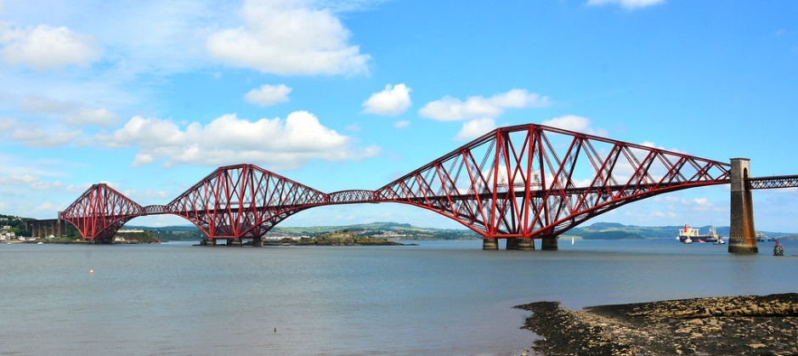
Phonétique
écouter
[SFe] ou [SFC] ?
[bridge]
pont
Notes:
Word frequency (1 is the most frequent word in French): pont [1889]
Source: Londsale, D., & Le Bras, Y. (2009). A Frequency Dictionary of French: Core vocabulary for learners London: Routledge.

Slide 26
Phonétique
écouter
[SFe] ou [SFC] ?
[wolf]
loup
Notes:
Word frequency (1 is the most frequent word in French): loup [3927]
Source: Londsale, D., & Le Bras, Y. (2009). A Frequency Dictionary of French: Core vocabulary for learners London: Routledge.

Slide 27
Phonétique
écouter
[SFe] ou [SFC] ?
froid
[cold]
Notes:
Word frequency (1 is the most frequent word in French): froid [1307]
Source: Londsale, D., & Le Bras, Y. (2009). A Frequency Dictionary of French: Core vocabulary for learners London: Routledge.

Slide 28
Phonétique
écouter
[SFe] ou [SFC] ?
trente
Notes:
Word frequency (1 is the most frequent word in French): trente [1646]
Source: Londsale, D., & Le Bras, Y. (2009). A Frequency Dictionary of French: Core vocabulary for learners London: Routledge.

Slide 29
Phonétique
écouter
[SFe] ou [SFC] ?
[hand]
main
Notes:
Word frequency (1 is the most frequent word in French): main [418]
Source: Londsale, D., & Le Bras, Y. (2009). A Frequency Dictionary of French: Core vocabulary for learners London: Routledge.

Slide 30
Phonétique
écouter
[SFe] ou [SFC] ?
[shy]
timide
Notes:
Word frequency (1 is the most frequent word in French): timide [3835]
Source: Londsale, D., & Le Bras, Y. (2009). A Frequency Dictionary of French: Core vocabulary for learners London: Routledge.

Slide 31
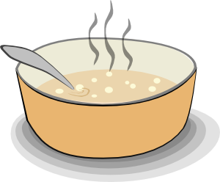
Phonétique
écouter
[SFe] ou [SFC] ?
soupe
Notes:
Word frequency (1 is the most frequent word in French): soupe [4563]
Source: Londsale, D., & Le Bras, Y. (2009). A Frequency Dictionary of French: Core vocabulary for learners London: Routledge.

Slide 32
Phonétique
écouter
[SFe] ou [SFC] ?
riz
Notes:
Word frequency (1 is the most frequent word in French): riz [>5000]
Source: Londsale, D., & Le Bras, Y. (2009). A Frequency Dictionary of French: Core vocabulary for learners London: Routledge.

Slide 33
Phonétique
écouter
[SFe] ou [SFC] ?
[prize]
prix
Notes:
Word frequency (1 is the most frequent word in French): prix [310]
Source: Londsale, D., & Le Bras, Y. (2009). A Frequency Dictionary of French: Core vocabulary for learners London: Routledge.

Slide 34
Phonétique
écouter
[SFe] ou [SFC] ?
[dawn]
aube
Notes:
Word frequency (1 is the most frequent word in French): aube [2728]
Source: Londsale, D., & Le Bras, Y. (2009). A Frequency Dictionary of French: Core vocabulary for learners London: Routledge.

Slide 35
Phonétique
*le chat = cat
*dans = in
*retourner = to return
lire / parler
1
Le chat* est méchant.
2
Nous trouvons le professeur amusant.
3
Je suis petit mais Nicolas, mon frère, est grand.
4
Il fait les courses et je fais les magasins.
5
Gaspard fait du sport et Clément regarde les films.
6
Nous restons à Paris mais dans* deux semaines
nous retournons* à Londres.
Notes:
Timing: 5 minutes
Aim: Oral production of SFC.
Procedure:
1. Students read sentences aloud to practice SFC
2. Including a few words that are unfamiliar, is the way to assess if pupils are applying their SSC knowledge, as opposed to recalling the pronunciations of whole words that they already know. A way to include unknown words without affecting pupils’ ability to understand the language is to use proper nouns, place or people names, as done here.
3. Sentence six offers an opportunity to stretch students with a sentence that includes a verb they have not previously met [retourner 999]. Teachers should use their judgement as to whether they wish to include this in the SFC practice here.
Word frequency of unknown words and cognates used (1 is the most frequent word in French): chat [3138], retourner [999], sport [2011], dans [11],
Source: Londsale, D., & Le Bras, Y. (2009). A Frequency Dictionary of French: Core vocabulary for learners London: Routledge.

Slide 36
SFC
phonétique
Consolidation [2]

Slide 37
Phonétique
écrire
En français, c’est … ?
they (m)
ils
SFC
SFe
Notes:
Timing: 6 minutes for 10 slides
Aim: Written production of words containing SSCs [SFC] and [SFe], which feature heavily in the poem.
Procedure:
1. Students write the words in exercise books or on mini whiteboards.
2. Pronunciation can be checked when eliciting answers.
3. The answers are animated to show the full word in French first, then the correct SSC.

Slide 38
Phonétique
écrire
En français, c’est … ?
(we) do
(nous) faisons
SFC
SFe

Slide 39
Phonétique
écrire
En français, c’est … ?
history
histoire
SFC
SFe

Slide 40
Phonétique
écrire
En français, c’est … ?
history
histoire
SFC
SFe

Slide 41
Phonétique
écrire
En français, c’est … ?
effort
effort
SFC
SFe

Slide 42
Phonétique
écrire
En français, c’est … ?
they (f)
elles
SFC
SFe

Slide 43
Phonétique
écrire
En français, c’est … ?
(you (pl)) do
(vous) faites
SFC
SFe

Slide 44
Phonétique
écrire
En français, c’est … ?
party
fête
SFC
SFe

Slide 45
Phonétique
écrire
En français, c’est … ?
exercise
exercice
SFC
SFe

Slide 46
Phonétique
écrire
En français, c’est … ?
(they) do
(ils / elles) font
SFC
SFe

Slide 47
SFC
phonétique
Consolidation [3]

Slide 48
SFC
Silent final consonant
dans
X
Notes:
Timing: 2 minutes for 4 SSC slides.
Aim: To consolidate SSC [SFC]
Explanation in English, if desired: Something that makes French sounds very different from English is that some consonants at the ends of words are silent. This means you don’t pronounce/sound them out at all. As in the word ‘dans’ in French.
Procedure: 1. Present the letter(s) and say the [SFC] sound first, on its own. Students repeat it with you. 2. Bring up the word ”dans” on its own, say it, students repeat it, so that they have the opportunity to focus all of their attention on the connection between the written word and its sound.
3. A possible gesture for this would be to hold ones finger to ones lips to indicate ‘Shhhh!’. 4. Roll back the animations and work through 1-3 again, but this time, dropping your voice completely to listen carefully to the students saying the [SFC] sound, pronouncing ”dans” and, if using, doing the gesture.
Word frequency (1 is the most frequent word in French):
dans [11] Source: Londsale, D., & Le Bras, Y. (2009). A Frequency Dictionary of French: Core vocabulary for learners London: Routledge.

Slide 49
SFC
petit
prix
€15.95
grand
mot
dans
X
mais
[but]
Notes:
Aim: To consolidate SSC [SFC]
Procedure:
1. Introduce and elicit the pronunciation of the individual SSC [SFC] (in this case is SFC – silent final consonant so nothing to pronounce as an individual sound!) and then the source word again ‘dans’ (with gesture, if using). 2. Then present and elicit the pronunciation of the five cluster words.
The cluster words have been chosen for their high-frequency, from a range of word classes, with the SSC (where possible) positioned within a variety of syllables within the words (e.g. initial, 2nd, final etc.). Additionally, we have tried to use words that build cumulatively on previously taught SSCs (see the Phonics Teaching Sequence document) and do not include new SSCs. Where new SSCs are used, they are often consonants which have a similar symbol-sound correspondence in English.
Word frequency (1 is the most frequent word in French): dans [11]; petit [138] prix [310]; mot [220]; mais [30]; grand [59]. Source: Londsale, D., & Le Bras, Y. (2009). A Frequency Dictionary of French: Core vocabulary for learners London: Routledge.

Slide 50
SFC
phonétique
Consolidation [4]

Slide 51
SFC
Silent final consonant
dans
X
Notes:
Without sound to elicit pronunciation (without first hearing the teacher).
Teacher to elicit pronunciation by asking “Comment dit-on …”

Slide 52
SFC
petit
prix
€15.95
grand
mot
dans
X
mais
[but]
Notes:
Introduce and elicit the pronunciation of the individual SSC (in this case is SFC – silent final consonant so nothing to pronounce as an individual sound!) and then the source word ‘dans’ again (with gesture, if using). Then present and elicit the pronunciation of the five cluster words. The cluster words have been chosen for their high-frequency, from a range of word classes, with the SSC (where possible) positioned within a variety of syllables within the words (e.g. initial, 2nd, final etc., although not, of course with SFC!). Additionally, we have tried to use words that build cumulatively on previously taught SSCs (see the Phonics Teaching Sequence document) and do not include new SSCs. Where new SSCs are used, they are often consonants which have a similar symbol-sound correspondence in English.
Ensure that pupils are clear about the meaning of each of these high-frequency words. NB: pictures can, at best, only suggest meaning. Many high-frequency words are less concrete than other words, and less easy to communicate unequivocally in pictures. Therefore, teachers should not shy away from giving the English meaning to students, to prevent any erroneous representations taking root in memory. Lead class repetition of the five CLUSTER words. Word frequency rankings (1 is the most common word in French): dans [11]; petit [138] prix [310]; mot [220]; mais [30]; grand [59]. Source: Londsale, D., & Le Bras, Y. (2009). A Frequency Dictionary of French: Core vocabulary for learners London: Routledge.

Slide 53
SFC
petit
prix
grand
mot
dans
X
mais
Notes:
With sound and no pictures to focus all attention on the sound-symbol correspondence.

Slide 54
SFC
petit
prix
€15.95
grand
mot
dans
X
mais
[but]
Notes:
Without sound to elicit pronunciation (without first hearing the teacher).
Teacher to elicit pronunciation by asking “Comment dit-on …”

Slide 55
… except for
c r f l
Be c a r e f u l with these!
Notes:
Highlight the most common consonants which are typically not silent at the end of a word.

Slide 56
C’est un SFC ?
écrire
En français, c’est … ?
heart
cœur
Notes:
Timing (including introduction): 10 minutes approx.
This activity practises the [SFC] rules (and exceptions), whilst revising relevant vocabulary from this week’s sets.
Students write the words in exercise books or on mini whiteboards. Pronunciation can be checked when eliciting answers. The answers are animated to show the full word in French first, then the answer.

Slide 57
C’est un SFC ?
écrire
En français, c’est … ?
maths
maths

Slide 58
C’est un SFC ?
écrire
En français, c’est … ?
time
temps

Slide 59
C’est un SFC ?
écrire
En français, c’est … ?
German
allemand

Slide 60
C’est un SFC ?
écrire
En français, c’est … ?
different
différent

Slide 61
C’est un SFC ?
écrire
En français, c’est … ?
black
noir

Slide 62
C’est un SFC ?
écrire
En français, c’est … ?
which (m)
quel

Slide 63
C’est un SFC ?
écrire
En français, c’est … ?
soon
bientôt

Slide 64
C’est un SFC ?
écrire
En français, c’est … ?
for, in order to
pour

Slide 65
C’est un SFC ?
écrire
En français, c’est … ?
This is an exception!
In most French words, a final c is not silent (eg. avec).
white (m.)
blanc

Slide 66
C’est un SFC ?
écrire
En français, c’est … ?
This is an irregular femine form.
white (f.)
blanche

Slide 67
SFC
phonétique
Consolidation [4]

Slide 68
SFC
Silent final consonant
dans
X
Notes:
2 minutes [5 slides]
Aim: To consolidate SSC [SFC]
Explanation in English, if desired: Something that makes French sounds very different from English is that some consonants at the ends of words are silent. This means you don’t pronounce/sound them out at all. As in the word ‘dans’ in French.
Procedure: 1. Present the letter(s) and say the [SFC] sound first, on its own. Students repeat it with you. 2. Bring up the word ”dans” on its own, say it, students repeat it, so that they have the opportunity to focus all of their attention on the connection between the written word and its sound.
3. A possible gesture for this would be to hold ones finger to ones lips to indicate ‘Shhhh!’. 4. Roll back the animations and work through 1-3 again, but this time, dropping your voice completely to listen carefully to the students saying the [SFC] sound, pronouncing ”dans” and, if using, doing the gesture.
Word frequency (1 is the most frequent word in French):
dans [11] Source: Londsale, D., & Le Bras, Y. (2009). A Frequency Dictionary of French: Core vocabulary for learners London: Routledge.

Slide 69
SFC
petit
prix
€15.95
grand
mot
dans
X
mais
[but]
Notes:
Aim: To consolidate SSC [SFC]
Procedure:
1. Introduce and elicit the pronunciation of the individual SSC [SFC] (in this case is SFC – silent final consonant so nothing to pronounce as an individual sound!) and then the source word again ‘dans’ (with gesture, if using). 2. Then present and elicit the pronunciation of the five cluster words.
The cluster words have been chosen for their high-frequency, from a range of word classes, with the SSC (where possible) positioned within a variety of syllables within the words (e.g. initial, 2nd, final etc.). Additionally, we have tried to use words that build cumulatively on previously taught SSCs (see the Phonics Teaching Sequence document) and do not include new SSCs. Where new SSCs are used, they are often consonants which have a similar symbol-sound correspondence in English.
Word frequency (1 is the most frequent word in French): dans [11]; petit [138] prix [310]; mot [220]; mais [30]; grand [59]. Source: Londsale, D., & Le Bras, Y. (2009). A Frequency Dictionary of French: Core vocabulary for learners London: Routledge.

Slide 70
… except for
c r f l
Be c a r e f u l with these!

Slide 71
Phonétique
The SFe means that the final consonant has to be pronounced in the words in this column!
écouter / lire
Écoute et choisis le bon mot.
tu | elles | meaning
conduis | conduisent | conduire [to drive]
perds | perdent | perdre [to lose]
apport | apportent | apporter [to bring]
lis | lisent | lire [to read]
1
2
3
4
il est | elle est | meaning
polonais | polonaise | Polish nationality (m/f)
blond | blonde | blond (m/f)
mort | morte | dead [m/f]
japonais | japonaise | Japanese nationality (m/f)
5
6
7
8
Notes:
Timing: 5 minutes
Aim: Aural recognition of SFC and SFe. Raising awareness of the function of these SSCs in a grammatical context.
Procedure:
1. Click numbers to hear word.
2. Students choose a word from the pairs of options.
3. Click to reveal answers one by one. Ensure understanding of the importance of SFC and SFe in distinguishing between singular and plural verb forms, and masculine and feminine adjective forms.
4. Click on the audio again. Students repeat.
5. Students say the other word in the pair, paying close attention to the effect of SFe in forcing pronunciation of SFC>
Transcript:
1. conduis
2. perdent
3. apport
4. lisent
5. polonais
6. blond
7. morte
8. japonaise
Word frequency (1 is the most frequent word in French): conduire [487], attendre [155], polonais [3660], apporter [339], lire [278], mort [276], blond [4585], japonais [2097]
Source: Londsale, D., & Le Bras, Y. (2009). A Frequency Dictionary of French: Core vocabulary for learners London: Routledge.

Slide 72
Phonétique
lire / parler
1
pris | bas | prise | dos | base | dose
tonne | prêt | lourd | ton | lourde | prête
étroite | sain | adéquate | saine | étroit | adéquat
confiante | confiant | opportun | décent | opportune | décente
manuscrit | grosse | manuscrite | flagrant | flagrante | gros
imminent | romaine | fréquente | romain | imminente | fréquent
[taken (f)]
[low]
[taken (m)]
[back]
[basis]
[dose]
2
[tonne]
[ready (m)]
[heavy (m)]
[tone]
[heavy (f)]
[ready (f)]
3
[tight (f)]
[healthy (m)]
[adequate (m)]
[healthy (f)]
[tight (m)]
[adequate (f)]
4
[confident (f)]
[confident (m)]
[timely (m)]
[decent (m)]
[timely (f)]
[decent (f)]
5
[handwritten (m)]
[fat (f)]
[handwritten (f)]
[obvious (m)]
[obvious (f)]
[fat (m)]
6
[imminent (m)]
[Roman (f)]
[frequent (f)]
[Roman (m)]
[imminent (f)]
[frequent (m)]
Notes:
Timing: 5 minutes
Aim: Oral production of minimal pairs containing SFC and SFe. Fluency development.
Procedure:
1. Students read the lines of words as quickly as they can while maintaining accuracy. Students may wish to time each other and challenge themselves to read at increasing speeds.
2. Teacher can circulate to check / encourage.
3, Click to hear the lines of words read by a native speaker. Students repeat.
Transcript:
1. pris, bas, prise, dos, base, dose
2. tonne, prêt, lourd, ton, lourde, prête
3. étroite, sain, adéquate, saine, étroit, adéquat
4. confiante, confiant, opportun, décent, opportune, décente
5. manuscrit, grosse, manuscrite, flagrant, flagrante, gros
6. imminent, romaine, fréquente, romain, imminente, fréquent
Word frequency (1 is the most frequent word in French): pris [prendre 43], bas [468], base [416], dos [1672], dose [4229], ton [330], tonne [2261], lourd [1026], prêt [422], étroit [1828], sain [1763], adéquat [3525], confiant [4359], opportun [4485], décent [4628], manuscrit [4460], gros [419], flagrant [3925], imminent [3466], romain [3144], fréquent [2684]
Source: Londsale, D., & Le Bras, Y. (2009). A Frequency Dictionary of French: Core vocabulary for learners London: Routledge.

Slide 73
SFC
phonétique
Consolidation [5]

Slide 74
SFC
Silent final consonant
dans
X
Notes:
Timing: 1 minute
Aim: To consolidate SSC [SFC]
Explanation in English, if desired: Something that makes French sounds very different from English is that some consonants at the ends of words are silent. This means you don’t pronounce/sound them out at all. As in the word ‘dans’ in French.
Procedure: 1. Present the letter(s) and say the [SFC] sound first, on its own. Students repeat it with you. 2. Bring up the word ”dans” on its own, say it, students repeat it, so that they have the opportunity to focus all of their attention on the connection between the written word and its sound.
3. A possible gesture for this would be to hold ones finger to ones lips to indicate ‘Shhhh!’. 4. Roll back the animations and work through 1-3 again, but this time, dropping your voice completely to listen carefully to the students saying the [SFC] sound, pronouncing ”dans” and, if using, doing the gesture.
Word frequency (1 is the most frequent word in French):
dans [11] Source: Lonsdale, D., & Le Bras, Y. (2009). A Frequency Dictionary of French: Core vocabulary for learners London: Routledge.

Slide 75
SFC
petit
prix
€15.95
grand
mot
dans
X
mais
[but]
Notes:
Timing: 2 minutes
Aim: To consolidate SSC [SFC]
Procedure:
1. Introduce and elicit the pronunciation of the individual SSC [SFC] (in this case is SFC – silent final consonant so nothing to pronounce as an individual sound!) and then the source word again ‘dans’ (with gesture, if using). 2. Then present and elicit the pronunciation of the five cluster words.
The cluster words have been chosen for their high-frequency, from a range of word classes, with the SSC (where possible) positioned within a variety of syllables within the words (e.g. initial, 2nd, final etc.). Additionally, we have tried to use words that build cumulatively on previously taught SSCs (see the Phonics Teaching Sequence document) and do not include new SSCs. Where new SSCs are used, they are often consonants which have a similar symbol-sound correspondence in English.
Word frequency (1 is the most frequent word in French): dans [11]; petit [138] prix [310]; mot [220]; mais [30]; grand [59]. Source: Lonsdale, D., & Le Bras, Y. (2009). A Frequency Dictionary of French: Core vocabulary for learners London: Routledge.

Slide 76
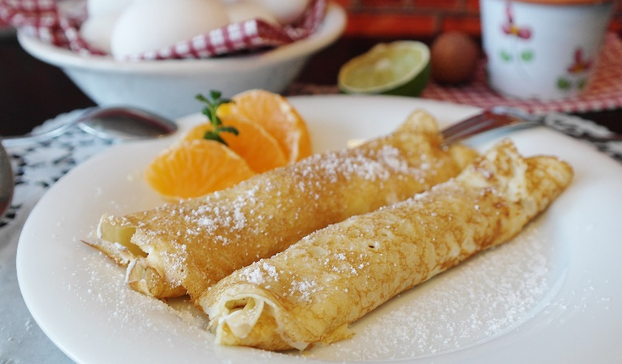
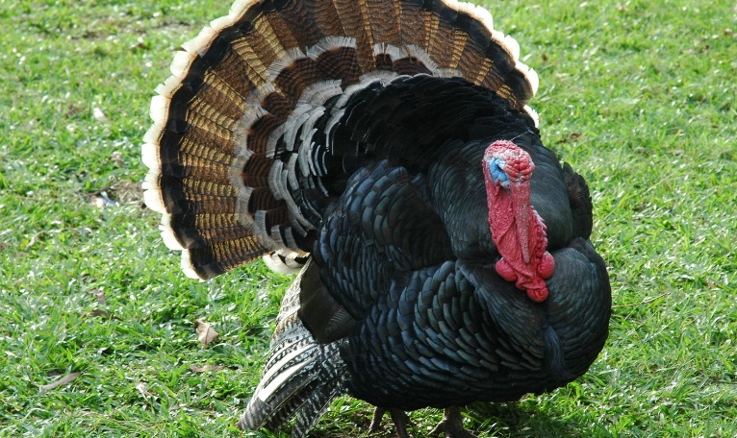
Phonétique
C’est la SSC [SFe] ou [--]?
écouter
1
2
crêpe
[pancake]
faux
[false]
[SFe]
[--]
3
4
têtard
[tadpole]
dinde
[turkey]
[--]
[SFe]
Notes:
Slide 1 of 2
Timing: 3 minutes for 2 slides
Aim: aural recognition of SSC [SFE]
Procedure:
1. Click the numbers to play the audio.
2. Students choose whether the words have a silent final e [SFE] or not [--].
Word frequency (1 is the most frequent word in French): crêpe [>5000], gâteaux [4845], têtard [>5000], dinde [>5000], sirop [>5000], fraise [>5000], escargot [>5000], crabe [>5000]
Source: Lonsdale, D., & Le Bras, Y. (2009). A Frequency Dictionary of French: Core vocabulary for learners London: Routledge.

Slide 77
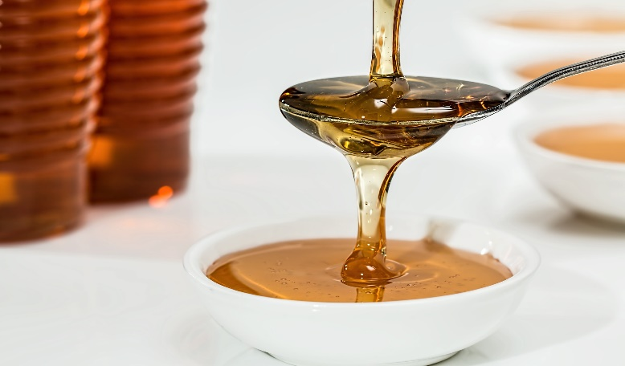
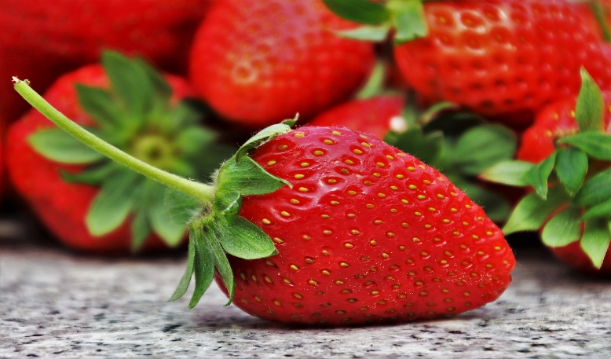
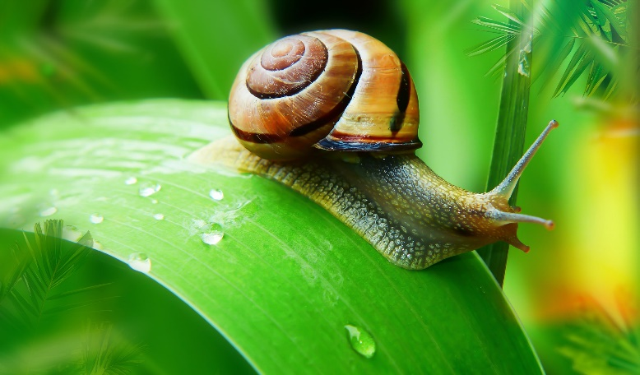
Phonétique
C’est la SSC [SFe] ou [--]?
écouter
1
2
sirop
[syrup]
fraise
[strawberry]
[--]
[SFe]
3
4
escargot
[snail]
crabe
[crab]
[--]
[SFe]
Notes:
Slide 2 of 2

