Slide 1
Talking about giving
Using ‘dar’ in infinitive and singular persons
Nick Avery / Rachel Hawkes
Date updated: 09/12/2019

Slide 2
dar
[to give | giving]
da
[gives | s/he gives]
Notes:
Dar is one of the NCELP 25 most frequent verbs in Spanish. Both the infinitive and 3rd person singular are introduced in order to familiarise students over the next few slides.
Bring up the word ‘dar’ on its own, say it, students repeat it, and remind them of the phonics.
Try to elicit the meaning from the students.
Then bring up the English translations. Emphasise the two meanings for the infinitive.
Bring up the 3rd person singular ‘da’, say it, students repeat it.
Try to elicit the meanings from the students. Emphasise the two meanings for ‘da’.

Slide 3
dar
[to give | giving]
da
[gives | s/he gives]
Notes:
Cycle through the infinitive and 3rd person singular again.

Slide 4
da
[gives]
Da mucho a un amigo.
[S/he gives a lot to a friend.]
Notes:
Introduce the 3rd person singular in a sentence.

Slide 5
dar
[to give | giving]
Dar mucho es bueno.
[Giving a lot is good.]
Notes:
Introduce the infinitive in a sentence.

Slide 6
da
[gives]
Da
___ mucho a un amigo.
[S/he gives a lot to a friend.]
Notes:
Cycle through the 3rd person singular in context again.

Slide 7
dar
[to give | giving]
____ mucho es bueno.
Dar
[Giving a lot is good.]
Notes:
Cycle through the infinitive in context again.

Slide 8
These sentences are from an article about what to give at Christmas.
leer
Lee. Completa la frase con la opción correcta.
…un libro es una buena idea.
1
Dar
…un libro.
…dinero a un amigo no es necesario.
Da
2
…dinero a un amigo.
…una película a un amigo.
3
Dar
…una película es una mala idea.
…tres regalos es normal.
4
Dar
…tres regalos.
…una revista.
5
Da
…una revista es importante.
Notes:
Sentence completion task. Students are provided with ‘dar’ or ‘da’ and have to finish the sentence with the correct ending. Sentences beginning with ‘dar’ make a verb phrase, e.g. ‘giving a book’, ‘giving three presents’ which then needs a complement (e.g. is a good idea, is normal).

Slide 9
leer
…arte a un amigo es una buena idea.
Navidad
6
Da
…arte a un amigo.
…mucho.
Da
7
…mucho no es necesario.
…vasos.
8
Dar
…vasos es una opción.
…flores es romántico.
9
Da
…flores.
…una moneda a un amigo no es mucho.
10
Dar
…una moneda a un amigo.

Slide 10
¿Cómo se dice en inglés?
1. Giving a lot isn’t necessary.
Dar mucho no es necesario.
2. S/he gives money to a friend.
Da dinero a un amigo.
3. Giving flowers is romantic.
Dar flores es romántico.
4. S/he gives some magazines.
Da unas revistas.
5. Giving a book to a friend is a good idea.
Dar un libro a un amigo es una buena idea.
Notes:
OPTIONAL
Students can opt to produce the sentences in any order. The shapes are triggered to reveal the English translation when the shape itself is clicked.

Slide 11
doy
[I give]
Notes:
This is a brief run-through of the 1st person singular.

Slide 12
doy
[I give]
Doy mucho a un amigo.
[I give a lot to a friend.]
Notes:
Introduce ‘doy’ in a sentence.

Slide 13
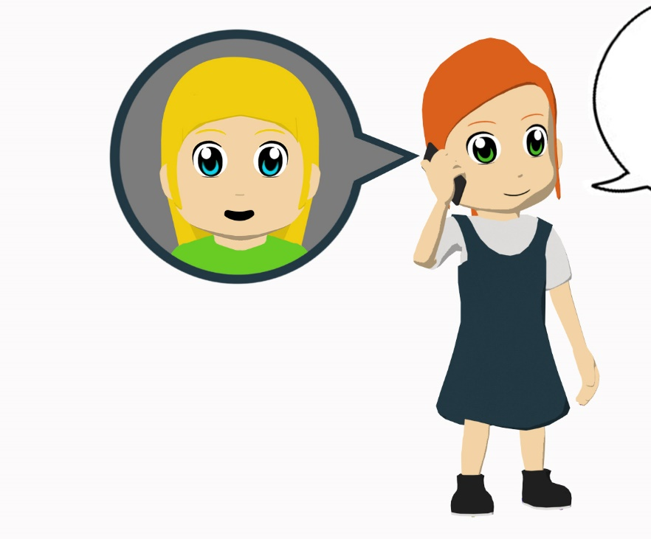
Amanda is telling a friend what presents she gives to people for Christmas.
She also says what her brother gives.
Lee y completa la tabla en español.
Da una bicicleta a mi madre.
Doy unos bolígrafos a mi hermana.
Doy dinero a mi padre.
Da unas camisas a mi hermano.
Doy una camisa a un amigo.
Da una revista de música a un amigo.
Doy un libro a mi profesor de inglés.
Da productos de España a una chica.
Amanda (‘I give’)
El hermano (‘he gives’)
Who receives…
unos bolígrafos
una bicicleta
the bike?
mother
dinero
unas monedas
the pens?
sister
una camisas
una revista de música
the money?
father
un libro
unos productos de España
the shirts?
brother
Notes:
The ‘who receives’ table requires students to pay attention to the meaning of the nouns taught this week and others that are revisited.
Mi’ hasn’t yet been taught in NCELP Y7 Spanish SoW, so make sure that the meaning of this word is clear (it can be mistakenly understood to be the English ‘me’).

Slide 14
das
[you give]
Notes:
This is a brief run-through of the 2nd person singular.

Slide 15
das
[You give]
Das mucho a un amigo.
[You give a lot to a friend.]
Notes:
Introduce ‘das’ in a sentence.

Slide 16
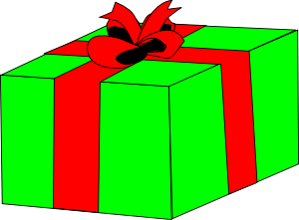
escuchar/escribir
¡Inventa el regalo! Completa la frase.
Make sure the noun agrees in gender and number with the article (‘un’, ‘una’ etc.).
Escucha. Es ‘doy’ o ‘das’?
Escucha otra vez. Escribe el artículo.
‘I give’
‘You give’
un/una/unos/unas
una
Un ejemplo: ‘mesa’
(Es feminino y singular.)
1
2
unos
Un ejemplo: ‘zapatos’
(Es masculino y plural.)
3
unas
4
un
5
unos
6
una
7
un
escuchar
8
unos
Notes:
Transcript 1. Doy una [beep]; 2. Das unos [beep]; 3. Das unas [beep]; 4. Doy un [beep]; 5, Doy unos [beep]; 6. Das una [beep]; 7. Doy un [beep]; 8. Das unos [beep].
Students first listen to see if they can hear ‘doy’ or ‘das’. They then listen again and write down the indefinite article that they hear. [Note: some classes may complete both steps in one listening.]
Finally, they think of a noun to complete the sentence. Encourage students to pay attention to the preceding article here, which determines the gender and number of the noun.
Students could then practise reading these aloud to each other in pairs.

Slide 17
Una tarea escrita
Escribe diez frases.
Include
a) what you want for Christmas.
b) what you give for Christmas.
c) what your friend / family member wants for Christmas.
d) what your friend / family member gives for Christmas.
Usa un diccionario.
Usa la forma correcta de ‘dar’ o ‘querer’.
Notes:
In this writing activity students can be more imaginative about giving. The task also revisits ‘querer’, but could be adapted to focus only on ‘dar’.
Dictionaries would be useful for this task, since students may wish to use previously untaught vocabulary.
If students need to recap the different forms of ‘dar’ and ‘querer’ before starting, refer to the accompanying help slide (see next slide).
Students could also say who they give to, using ‘a’. This could either require use of indefinite article (…a un amigo) or the use of ‘mi’ (…a mi madre).

Slide 18
¿Necesitas ayuda?
quiero
I give
s/he wants
I want
da
s/he gives
doy
quiere
el padre
father
mother
la madre
brother
sister
el hermano
la hermana
Notes:
This help slide can be used to do a quick recap of the different forms of dar and querer. Click once on any box to reveal the Spanish translation. The boxes can be clicked in any order.

