Slide 1
Saying what people do
-ar verbs - infinitive and 3rd person singular
The infinitive form of a verb is the form you see in a dictionary.
In English, this is often written ‘to + verb’.
In Spanish, the infinitive of the verb often ends in –ar.
For example:
Es importante escuchar.
It’s important to listen.
You can also begin a sentence with the infinitive:
Escuchar es importante.
Listening is important.
So, the infinitive often describes the general meaning of the verb.
Nick Avery / Emma Marsden
Notes:
Escuchar is included here as it was previously practised with week 5 phonics.

Slide 2
To mean ‘s/he’ or ‘it’ with a verb, the verb ending changes to –a.
For example:
Escucha música.
S/he listens to music.
In English, we say ‘he’ or ‘she’ to say who does the action.
In Spanish, the verb ending tells us this. There is usually no need for the word ‘s/he’.
Nick Avery / Emma Marsden

Slide 3
The dog ate your Spanish homework! What do the text pieces talk about?
the action in general | someone does the action
1
habla con un amigo
2
llega tarde
3
bailar salsa
compra un libro
4
5
escuchar en clase
6
comprar una casa
7
olvida una palabra
8
hablar con José
9
llega tarde
10
baila con Alejandra
leer
Nick Avery

Slide 4
You find four more pieces!
Which of the text fragments could these have gone with?
1
habla con un amigo
es importante
es excelente
2
llega tarde
es fantástico
es normal
3
bailar salsa
4
compra un libro
Write four sentences combining the new pieces with four of the old ones!
Then translate them into English.
5
escuchar en clase
6
comprar un barco
7
olvida una palabra
8
hablar con José
9
llega tarde
10
baila con Alejandra
leer / escribir
Nick Avery
Notes:
There are 4 matching sentence fragments. To make students think about meaning of the infinitives and the adjectives, ask them which combinations seem most and least likely. Then, they should write the full sentence (bearing in mind it could start or end with ‘es importante’) and then translate it into English. They could be asked to write two sensible ones and two silly ones!
The four adjectives were chosen as they are all (near) cognates.

Slide 5
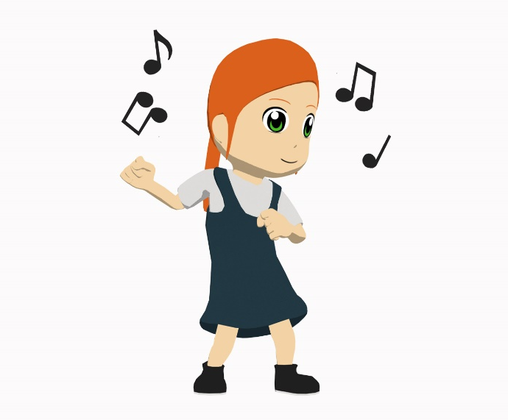
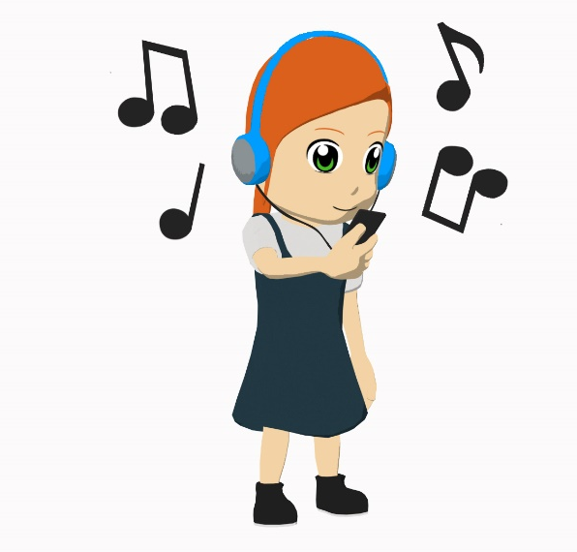
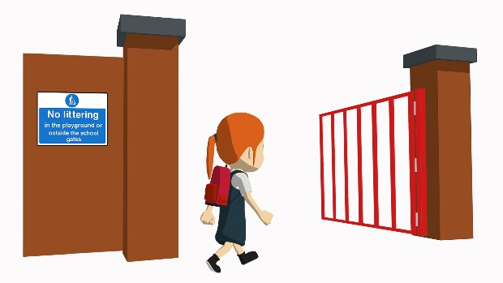
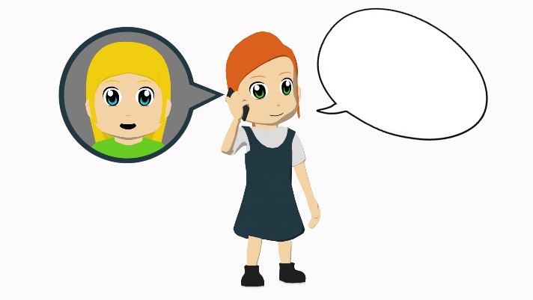
Carmen says what her friend Monica (in the pictures) does. Write 1 – 5.
Listen and match the action verb you hear to the picture.
C
1
A
A
B
2
C
3
D
4
E
B
E
5
D
[arrives]
¡Hola!
escuchar
Nick Avery
Notes:
This is a two-part listening activity focusing on new vocabulary.
1 – this slide: students listen to the individual verbs and match them to the action in the picture
2 – next slide: students listen to the same verbs in sentence constructions. They have to transcribe & translate them.
Students will hear the –a ending and need to translate it in [2], but this is not the main focus of the activity. Other activities in the sequence focus on the –a vs –ar endings together.
Transcript: 1. Escucha; 2. Compra; 3. Llega; 4. Habla; 5. Baila.

Slide 6
escuchar / escribir
Now listen to Carmen’s whole sentence about Monica.
Write down what you hear. Afterwards, translate the sentences.
Baila en un barco.
Escucha en clase.
1
6
She dances in a boat.
She listens in class.
Compra una revista.
Llega temprano.
2
She buys a magazine.
7
She arrives early.
Escucha música.
Habla con una amiga.
3
8
She speaks with a (female) friend.
She listens to music.
Llega tarde.
Baila en una casa.
4
She arrives late.
9
She dances in a house.
Habla con un amigo.
Compra un libro.
5
She speaks with a (male) friend.
10
She buys a book.
Nick Avery
Notes:
Two options:
1) transcribe the sentence endings, then translate into English. Learners will be able to read the written sentence before translating.
2) listen and translate straight into English (more challenging)

Slide 7
You tell a friend about your younger brother.
Student A: tell your friend what your brother does & what is important for him to do.
Student B: listen and write in English:
what your friend’s brother does.
what your friend thinks is important for him to do.
Then swap roles. Your cards are different.
hablar / escuchar
Nick Avery
Notes:
Since it is not essential to correctly use the infinitive and 3rd person singular to complete the task, the listener should be encouraged to correct the speaker if s/he notices mistakes in use of –ar vs –a ending.

Slide 8
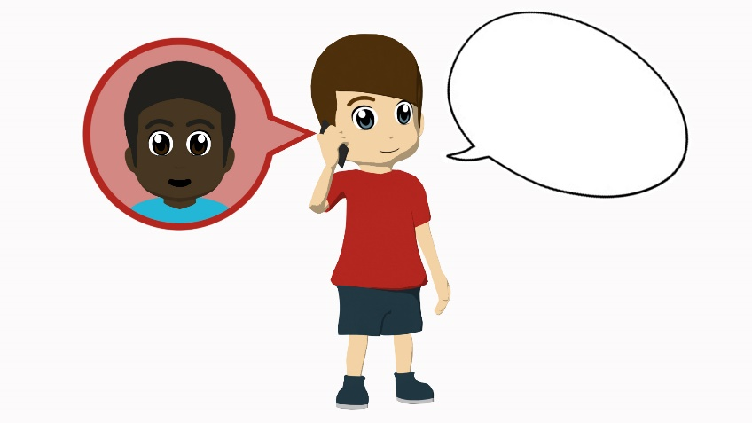
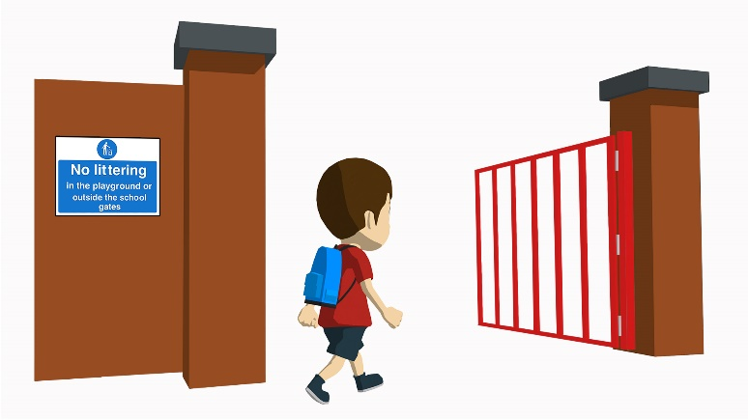
Student A
Brother already does it
It’s important to…
¡Hola!
¡Hola!
[with a female friend]
[a magazine]
[salsa]
[with a male friend]
[arrives early]
[in class]
[arrives late]
[music]
Nick Avery
Notes:
Student A speaking cards (these are also available in Word format)

Slide 9
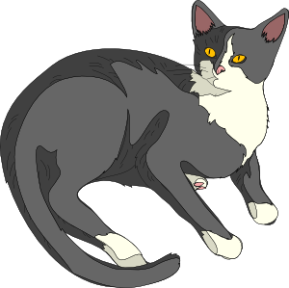
Student B
Brother already does it
It’s important to…
¡Hola!
¡Hola!
[a newspaper]
[with a female friend]
[with a male friend]
[a house]
[in a boat]
[arrives early]
[music]
[a cat]
Nick Avery
Notes:
Student A speaking cards (these are also available in Word format)

Slide 10
Student B answers
her brother does it | it’s important to… (talking in general)
dances salsa
speak with a (female) friend
listens to music
dance in class
speaks with a (male) friend
buy a magazine
arrives late
arrive early
Nick Avery
Notes:
Student B answer slide

Slide 11
Student A answers
her brother does it | it’s important (talking in general)
buys a newspaper
speak with a (male) friend
dances in a boat
buy a cat
speaks with a (female) friend
buy a house
arrives early
listen to music
Nick Avery
Notes:
Student B answer slide

Slide 12
…salsa es fantástico.
…salsa.
…música es importante.
…música.
…con Elena.
…con Elena es maravilloso.
…tarde con Pepe es normal.
…tarde con Pepe.
…una casa.
…una casa es importante.
1
Monica is recording her Spanish homework, but her device has problems!
2
You hear her first word. Which ending must be missing?
3
4
Hint: listen for the –a or –ar verb endings.
5
escuchar / leer
Nick Avery
Notes:
Transcript: 1. Bailar; 2. Escucha; 3. Hablar; 4. Llega; 5. Comprar
Check answers 1-5 before continuing with 6-10.

Slide 13
…un periódico es normal.
…un periódico.
…temprano es difícil.
…temprano.
…con un amigo.
…con un amigo es maravilloso.
…en clase.
…en clase es importante.
…en una escuela.
…en una escuela es normal.
6
7
8
9
10
escuchar / leer
Nick Avery
Notes:
Transcript: 6. Compra; 7. Llegar; 8. Habla; 9. Escuchar; 10. Baila.

Slide 14
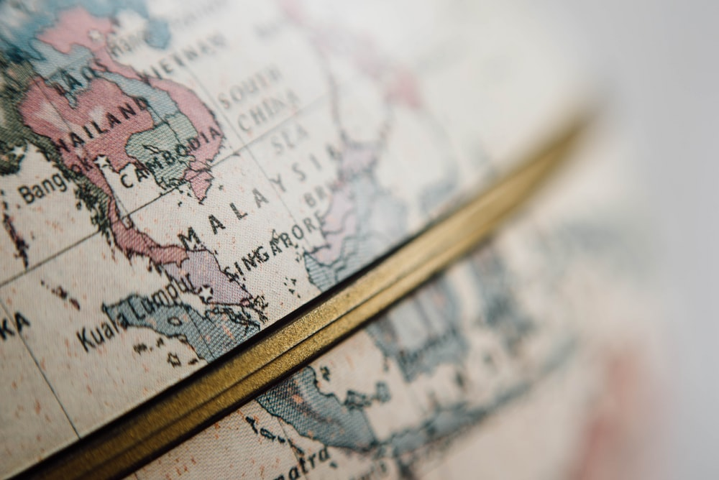
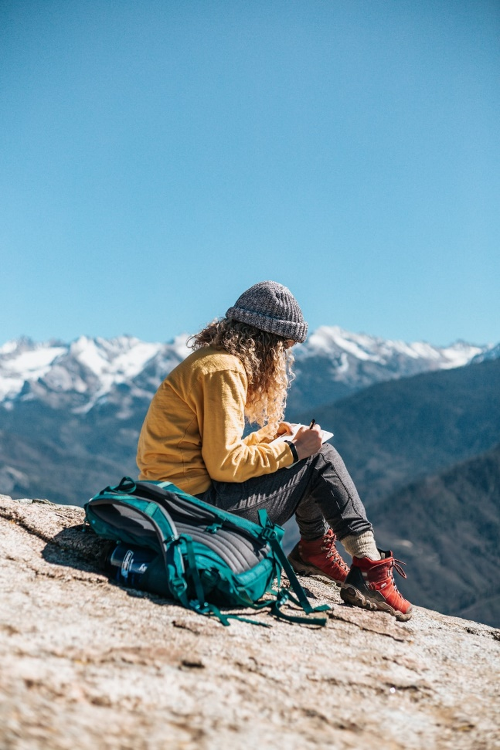
La gran aventura de Paula
Nick Avery
Notes:
Pictures from https://unsplash.com/ (freely usable images)

Slide 15
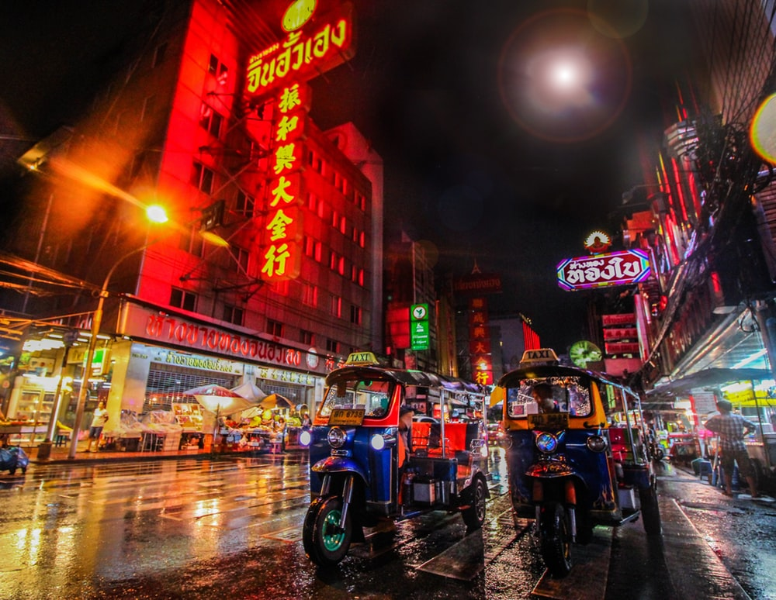
¿Dónde está…?
Bangkok
Tailandía
Malasia
China
Nick Avery
Notes:
This mini-quiz activates world knowledge before the main narration.
Encourage students to answer in full sentences here – ‘Bangkok está en Tailandía’
Note: these three destinations have either previously-taught SSC OR SSC which are similar to English, therefore we can simply ask the question here and students apply their SSC knowledge when reading their answer aloud.

Slide 16
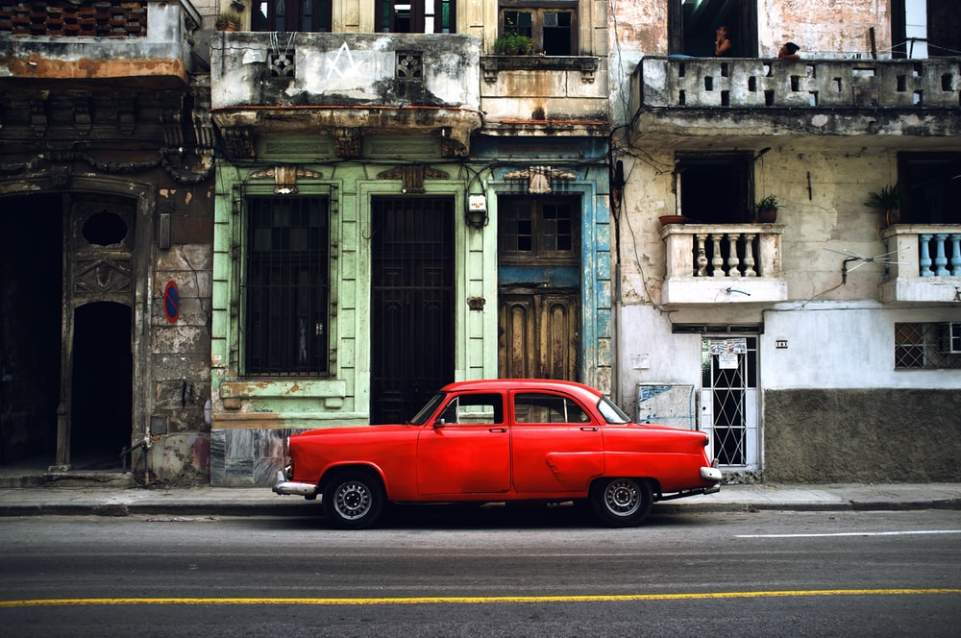
¿Dónde está…?
La Habana
El Salvador
Cuba
Guatemala
Nick Avery
Notes:
Note: these three destinations have either previously-taught SSC OR SSC which are similar to English, therefore we can simply ask the question here and students apply their SSC knowledge when reading their answer aloud.

Slide 17
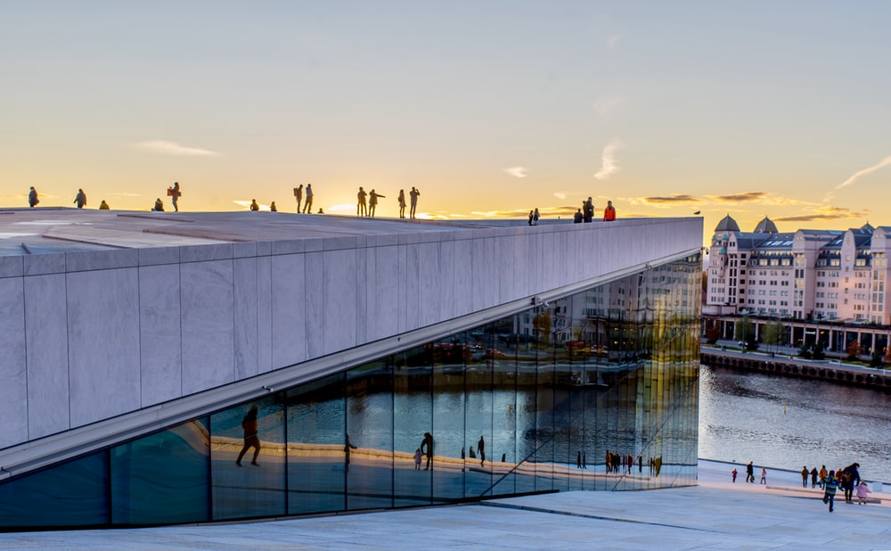
¿Dónde está…?
Oslo
Noruega
Polonia
Finlandia
Nick Avery
Notes:
Note: these three destinations have either previously-taught SSC OR SSC which are similar to English, therefore we can simply ask the question here and students apply their SSC knowledge when reading their answer aloud.

Slide 18
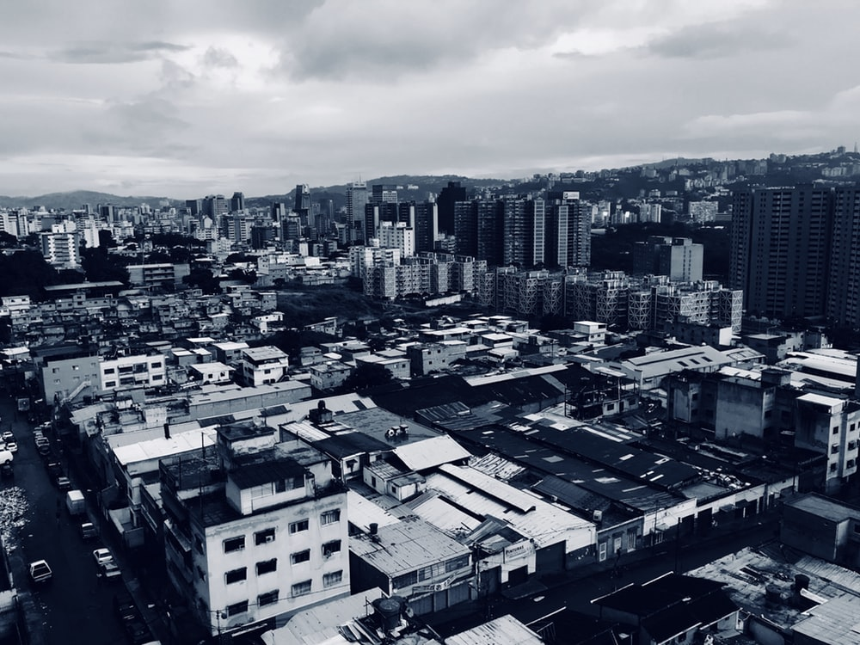
¿Dónde está…?
Caracas
Brasil
Venezuela
Chile
Nick Avery
Notes:
Note: There are some new SSC included in the destinations, so we will want to give options to students, so that they can hear a strong model in the input, before selecting and repeating the word in their answer.
E.g. ¿Dónde está Caracas…? Brasil, Venezuela o Chile?

Slide 19
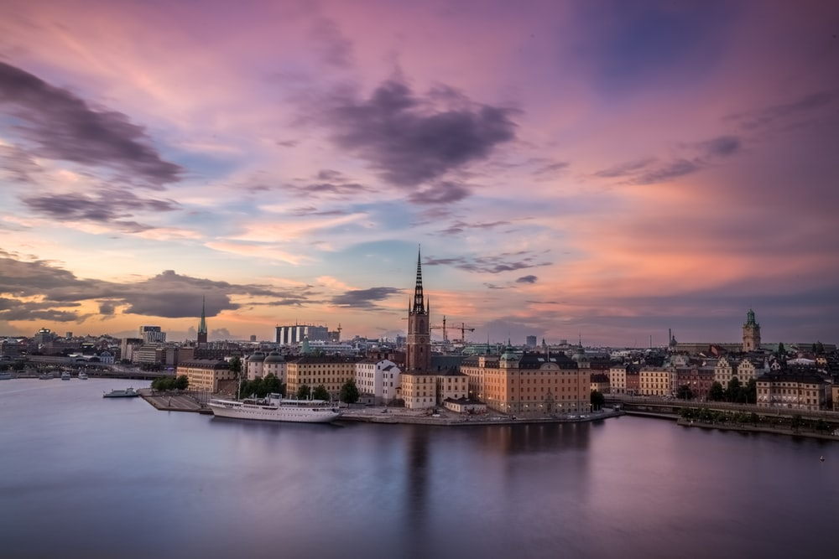
¿Dónde está…?
Estocolmo
Finlandia
Suecia
Francia
Nick Avery
Notes:
Note: There are some new SSC included in the destinations, so we will want to give options to students, so that they can hear a strong model in the input, before selecting and repeating the word in their answer.
E.g. ¿Dónde está Estocolmo…? Finlandia, Suecia or Francia?

Slide 20
¿Dónde está…?
Tokio
Inglaterra
Francia
Japón
Nick Avery
Notes:
Note: There are some new SSC included in the destinations, so we will want to give options to students, so that they can hear a strong model in the input, before selecting and repeating the word in their answer.
E.g. ¿Dónde está Tokio…? Inglaterra, Francia o Japón?

Slide 21
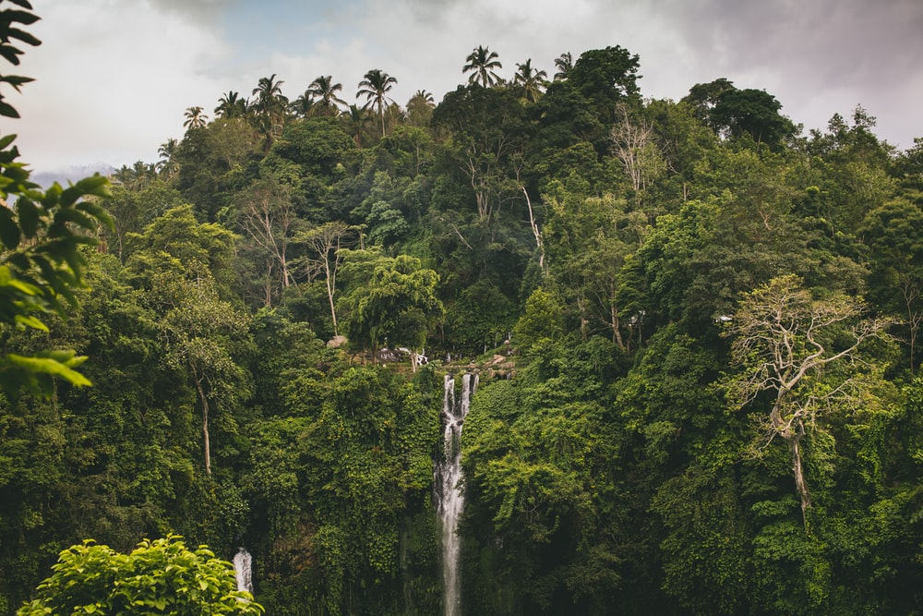
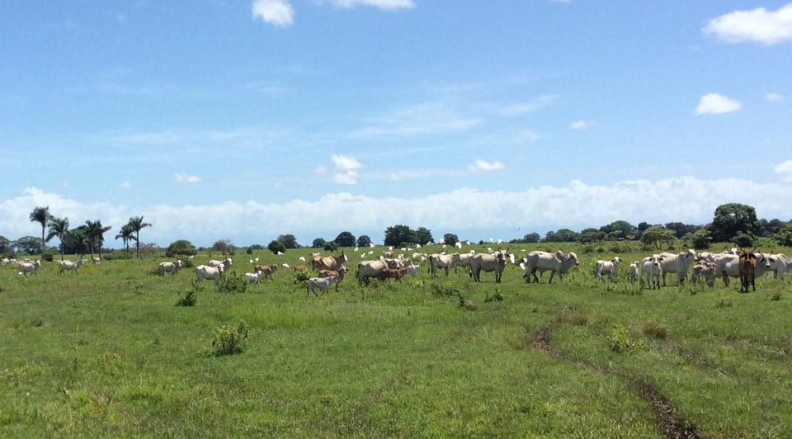
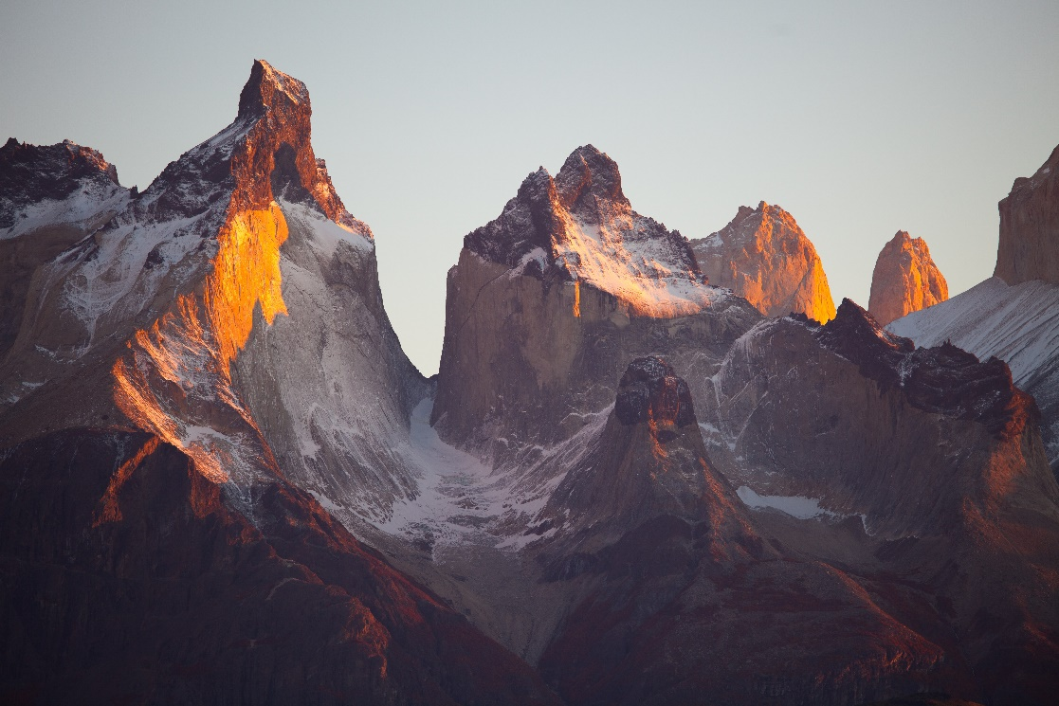
B
¿Los Llanos?
A
C
Es una parte de Colombia y Venezuela.
Nick Avery
Notes:
Ask students to guess if it’s picture A, B, or C. There aren’t many cities beginning with LL, so we chose a region instead. It’s a huge area of flat grassland between the Andes and the Amazon in Colombia and Venezuela.
Picture 1 by author and 2,3 from https://unsplash.com/ (freely usable images)

Slide 22
What does she do?
escuchar
In La Habana she
1
speaks with a (female) friend.
In Bangkok she
2
dances with a (male) friend.
buys a house.
3
In Caracas she
In Stockholm she
4
listens to music.
In Los Llanos she
5
arrives late.
In Tokio she
6
has a party.
In Oslo she
7
forgets a book
In California she
8
buys a boat
Nick Avery
Notes:
Make sure that students are aware that, when referring to a destination, Spanish uses ‘llegar A’ (‘en’ would refer to the means of arriving).
Transcript: 1. Habla con una amiga en La Habana; 2. Baila con un amigo en Bangkok; 3. Compra una casa en Caracas; 4. Escucha música en Estocolmo; 5. Llega tarde a Los Llanos. 6. Tiene una fiesta en Toledo. 7. Olvida un libro en Oslo. 8. Compra un barco en California.

Slide 23
Paula’s trip was so good that she does it again! This time she goes to the places in a different order.
Student A: Tell the story on your prompt cards!
Student B: Listen and take notes
What happens and in what order?
Then swap roles. Student B has a different set of cards.
hablar / escuchar / escribir
Nick Avery
Notes:
Ask students to compare their answers in terms of 1) Where her journey starts; 2) Where it ends; 3) Which order of places to visit would be better.
To challenge stronger students, you could change the nouns on the speaking cards to others seen in previous weeks (e.g. compra una cámara, un caballo etc.)

Slide 24
A
B
C
D
Forgets a book
Listens to music
Buys a house
Arrives late
Oslo
Estocolmo
Caracas
Los Llanos
E
F
G
H
Dances with a (male) friend
Speaks with a (female) friend
Has a party
Buys a boat
Bangkok
Tokio
California
La Habana
Persona A
Nick Avery
Notes:
Student A speaking cards Note: Cards are labelled with letters for additional alphabet practice.

Slide 25
A
B
C
D
Dances with a (male) friend
Speaks with a (female) friend
Buys a boat
Has a party
Bangkok
California
Tokio
La Habana
E
F
G
H
Forgets a book
Buys a house
Listens to music
Arrives late
Oslo
Caracas
Estocolmo
Los Llanos
Persona B
Nick Avery
Notes:
Student B speaking cards Note: Cards are labelled with letters for additional alphabet practice.

Slide 26
Deberes: una tarea escrita
escribir
Write the story of someone’s world trip. Use the present tense.
Use the verbs hablar, bailar, comprar, escuchar, olvidar, llegar.
Remember to use the –a verb ending for s/he.
City and country names are sometimes different in Spanish! Check this in a dictionary.
Nick Avery
Notes:
This could also be a writing task in class if there is time

Slide 27
Una gran aventura
Habla con una amiga en La Habana.
Baila con un amigo en Bangkok.
Compra una casa en Caracas.
Escucha música en Estocolmo.
Llega tarde a Los Llanos.
Tiene una fiesta en Tokio.
Olvida un libro en Oslo.
Compra un barco en California.
Nick Avery
Notes:
Full text – original

