Slide 1
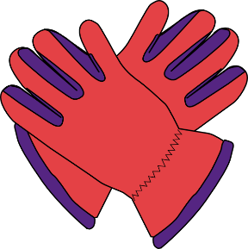
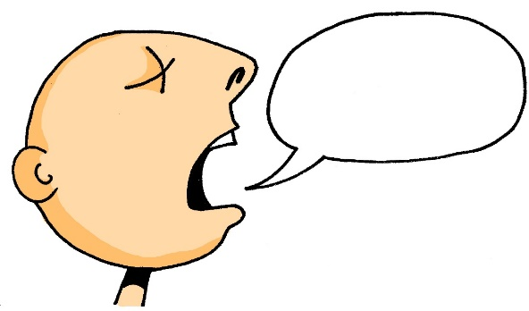
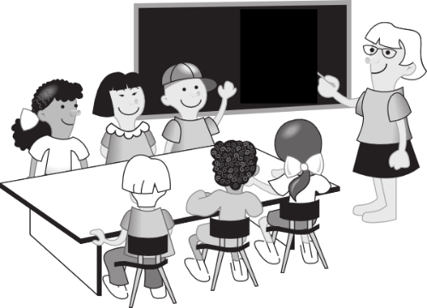
A
d__ P___
E
f_____
60
r______
B
F
d__ M___
Sekunden
s______
C
D
d__ K___
G
0
d__ T__
ANFANG
Notes:
Starter slide: revisit words from Week 2. Give students 60 seconds to fill in correct words. Note: Students are likely to be clear about the meanings these pictures represent, but make it clear to students that they can ask about any they are not sure about: ‘Was ist ‘E’ auf Englisch? This also offers the opportunity for them to re-visit some alphabet letters from last week.
sagen [46] sagt [46] der Tag [108] der Mann [131] das Paar [284] die Klasse [619] richtig [211] falsch [638] nicht [12]
Notes:
ja [27], nein [120], and oder [30] will be incorporated in the next exercise
Was? [39] will be revisited in the activity on Question words

Slide 2
A
das Paar
E
falsch
richtig
B
F
der Mann
sagen
C
D
die Klasse
G
der Tag
Notes:
ANSWERS SLIDE Answers animated to facilitate oral elicitation – students read their own answers aloud, which reinforces their SSC knowledge. Suggested classroom language routine:
Teacher: Was ist A? Student(s): A ist das Paar. This could be done with teacher nomination of individuals OR with whole class responses, as it is designed to be a low stakes revisiting of taught vocabulary.

Slide 3
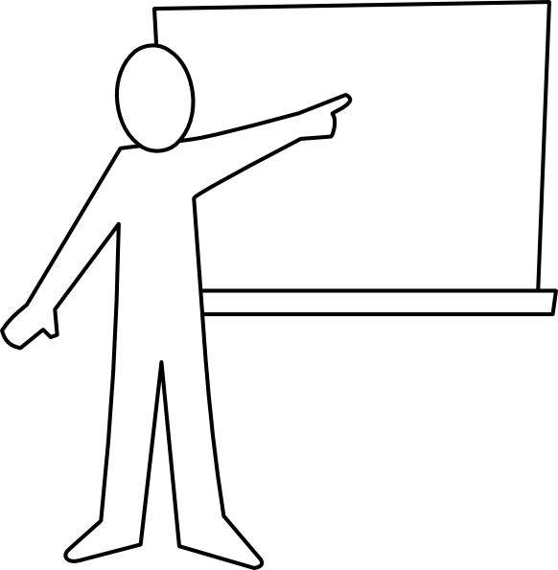
der Lehrer
Notes:
Present new vocabulary for this week - der Lehrer [433] der Fußball [1497] der Freund [326] das Wasser [297] die Welt [190] das Wort [243]
Der Lehrer [433] – teacher
These words (should) have been pre-learned using Quizlet and so the teacher could go through these fairly quickly. https://quizlet.com/gb/427138563/year-7-german-term-11-week-5-flash-cards/
The words are animated to allow teachers to elicit prior knowledge from students, but there will obviously (as always) be different levels of knowledge in the room, particularly as their first encounters with these words were self-access via Quizlet. Teachers can use these slides flexibly to move students to more secure knowledge of the words.

Slide 4
der Fußball
Notes:
der Fußball [1497] – football

Slide 5
der Freund
Notes:
der Freund [326] – friend Note: students need to be clear that ‘der Freund’ indicates a ‘male friend’ or a ‘boyfriend’ but not a friend that is a girl or a girlfriend. Students may then ask how to say ‘girl friend’ – Encourage ‘wie sagt man ‘girl friend’ auf Deutsch? as they have learnt this. As students will explicitly meet the pattern ‘Lehrer / Lehrerin’ and ‘Sänger/Sängerin’ in Week 7, providing ‘Freundin’ is useful priming, particularly if the communicative impetus comes spontaneously from students.

Slide 6
das Wasser
Notes:
das Wasser [297] - water

Slide 7
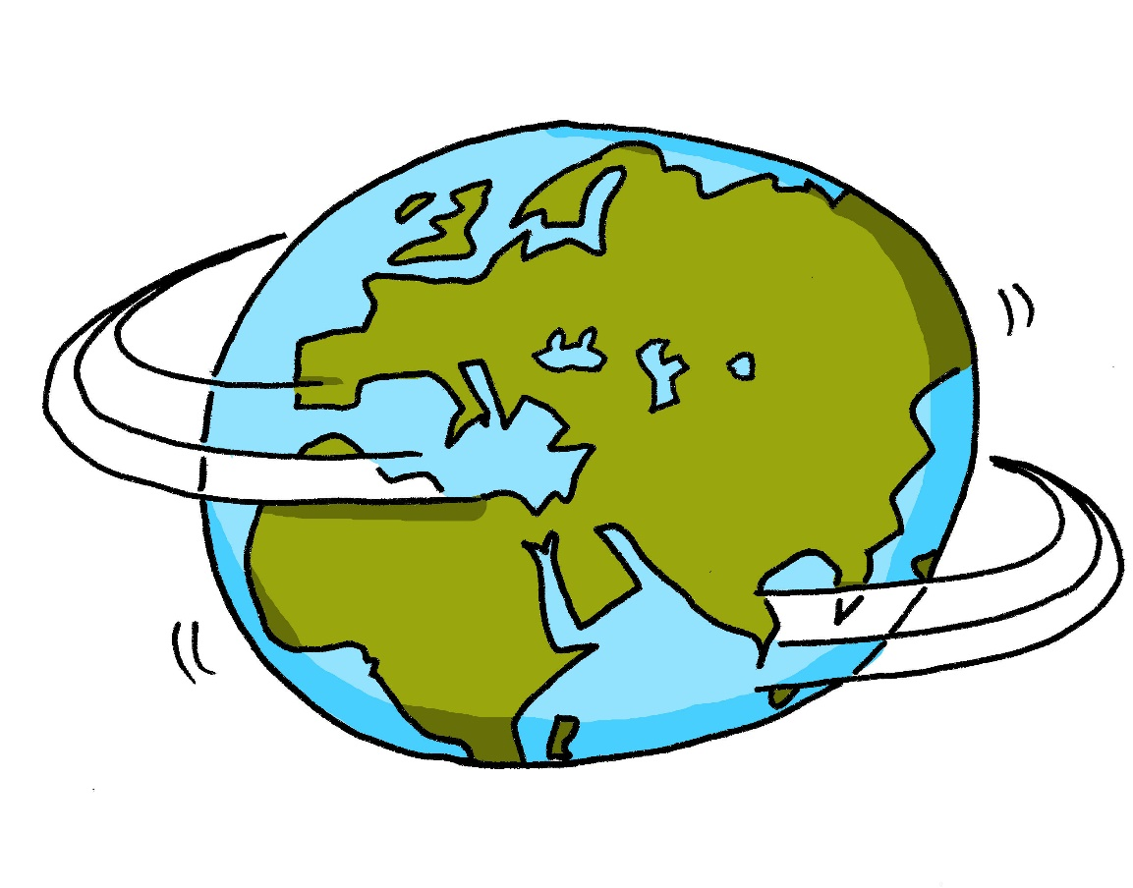
die Welt
Notes:
die Welt [190] - world

Slide 8
das Wort
Notes:
das Wort [243] - word

Slide 9
die Welt
der Freund
der Lehrer
das Wort
der Fußball
das Wasser
N
J
L
K
I
M
Notes:
Teacher elicits the vocabulary from students. Suggested routine: Teacher: Was ist ‘I’? Students: die Welt. Teacher: Was ist ‘L’? Students: der Lehrer. The letter prompts are the trigger (i.e. click on the letter) for the lines to connect the word to the picture. This means that students are practising their understanding of another set of alphabet letters at the same time. The teacher chooses which order to ask the letters in – clearly, it would be easy to ask in alphabetical order, but this would be what students would naturally expect, so it reduces the need for them to listen attentively to them.

Slide 10
6. der Lehrer
1. der Fußball
5. die Welt
4. das Wort
3. das Wasser
2. der Freund
Notes:
1. Students write 1-6 in books.
2. Ask students to write down the English translation before the word has faded away. 3. Click to bring up each option
4. Check answers by eliciting the German from students, with definite article. (i.e. so that they are translating back from their written English into spoken German). Note: Students have not yet done numbers but will be taught them explicitly in Week 9. However, in the next few weeks, certain activities will prime for them. Here the teacher can say the number when eliciting the answers, but support understanding by holding up the appropriate number of fingers each time. Obviously, the items proceed in number order in any case, so the finger gesture is more to draw learners attention to the sound – meaning connection of the number with the German word for that number. ANSWERS 1. der Fußball 2. der Freund 3. das Wasser 4. das Wort 5. die Welt 6. der Lehrer Pay particular attention to the pronunciation of ‘W’, our SSC for this week, and also to the correct recall of the genders. It’s all too easy for students to lose the connection between the gender and the noun.

Slide 11
der
die
das
Notes:
Ask students to predict which pacman will eat the word based on the word’s gender.
We continue to emphasise the importance of knowing the gender of a word in German.

