Slide 1
Describing events in the past (holidays)
-ar verbs in the preterite [revisited]
subject pronouns ‘yo’ and ‘ella’ [revisited]
Y9 Spanish
Term 1.1 - Week 1 - Lesson 1
Pete Watson / Louise Caruso / Nick Avery
Artwork: Mark Davies
Date updated: 09.07.21
Notes:
Artwork by Mark Davies. All additional pictures selected are available under a Creative Commons license, no attribution required.
Native teacher feedback provided by Blanca Román.
Learning outcomes (lesson 1)
Consolidation of the following:
-ar verbs in 1st person singular preterite (-é)
-ar verbs in 3rd person singular preterite (-ó)
subject pronouns ‘yo’ and ‘tú’
basic Spanish syllable structure
a subset of Y7 and Y8 vocabulary (see below)
Frequency rankings of vocabulary revisited this week (1 is the most common word in Spanish):
pasar³ [68]; aprovechar [885]; quedar [100]; verano [1139]; pasado (adj.); cantar [717]; precioso [1777]; viaje [519]; mientras que [mientras-127]; entonces [74]; fiesta [796]; canción [982]; país [109]; costa [896]; yo [28]; tú [184] él [9]; ella [72]; encontrar [102]; celebrar [886]; ¿de verdad? [176]; porque [40];]; largo [300]; bicicleta [3684]; cámara [903]; caballo [907]; también [49]; comprar [361]; bailar [1323]; llegar [75]; caminar [514]; antiguo [446]; museo [1114]; ciudad [178]; mar [480]; durante [139]; lugar [144]; descansar [1749]; preparar [570]; participar [593]; viajar (a) [902]; disfrutar [939]; montar [1446]; vacaciones [2641]; montaña [1464]; vista [408]; agosto [931]
Source: Davies, M. & Davies, K. (2018). A frequency dictionary of Spanish: Core vocabulary for learners (2nd ed.). Routledge: London
The frequency rankings for words that occur in this PowerPoint which have been previously introduced in NCELP resources are given in the NCELP SOW and in the resources that first introduced and formally re-visited those words. For any other words that occur incidentally in this PowerPoint, frequency rankings will be provided in the notes field wherever possible.

Slide 2
Hoy vamos a hablar sobre…
leer / hablar
v
__iaje
a
v
cab__llo
__ista
l
__ugar
e
c
bici__leta
mus__o
a
__ntiguo
d
r
a
__ónde
p__eparar
c__ntar
s
pa__ado
e
a
c
__lla
m__r
can__ión
l
a
s
n
i
e__tonces
jun__o
o
v
a
c
a
c
i
o
n
e
s
o
ag__sto
y__
n
mo__taña
d
e
e
porqu__
v
e
r
a
n
o
s
fie__ta
Notes:
Starter
Timing: 3 minutes
Aim: to work out which letters are missing and to share the context for the next activity.
Procedure:
1. Students look at the words individually or with a partner and try to identify the missing letters.
2. Each vertical column of words will create a single word in Spanish. Together, these create ‘las vacaciones de verano’, the context for the next activity.
3. Elicit the English translations of these words from students to ensure that they understand them.
Notes:
Some words could be given upfront to support students here, if helpful.
Vocabulary here is taken from both Year 7 and Year 8.
Pictures from https://openmoji.org/ under a CC BY-SA 4.0 license.

Slide 3
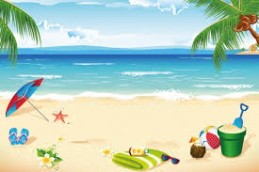
Diego habla con Ana sobre las vacaciones
escribir
Diego tiene unas ideas para actividades en las vacaciones.
Escribe las palabras en español en la frase correcta.
Opciones
antiguo
trip
she
1. Este edificio es muy __________. Parece interesante.
ciudad
holidays
old, ancient
2. El museo está en el centro de la _________.
encontrar
June
party
3. Primero ¡necesito ____________ mi cámara!
durante
vacaciones
4. ¿Quieres ir a Sevilla __________ las ______________ ?
songs
coast
canciones
5. Podemos escuchar _____________ de Shakira.
to find
during
fiesta
Ella
6. Yo quiero ir a una __________ pero Lucía no. ______ quiere pasar tiempo con sus amigos en la playa.
city
to meet up
costa
junio
7. Me gusta visitar la _________ en ________ porque no hay mucha gente.
quedar
viaje
8. Voy a __________ con mi amigo Javi para organizar un ________ en bici.
Notes:
Vocabulary recall activity
Timing: 6 mins
Aim: to recall previously taught vocabulary and use it in the correct sentence.
Procedure:
Students read each sentence and consider which option in the box on the right could correspond to the missing Spanish word. To prompt productive recall, answer options are given in English.
Elicit translations of sentences as part of feedback. It is worth checking understanding of ‘pero Lucía no’ in item 6, as this translates as ‘but Lucía doesn’t’.
Notes:
The activity could be adapted for a lower-level group by giving the first letter of the Spanish word.
The word ‘durante’ (one of the words in the options box) could be used to substitute ‘en’ in the phrase ‘en las vacaciones’. It would also be possible to say ‘las actividades’. This could be pointed out, if useful.
Frequency of unknown words/cognates:
idea [248]

Slide 4
Describing completed events in the past -ar verbs in the preterite
gramática
As you know, many verbs in Spanish end in –ar.
To mean ‘I’ with an action completed in the past, remove the ‘ar’ and add __.
é
Ejemplo
I travelled to the coast.
Viajé a la costa.
To mean ‘s/he’ or ‘it’ with an action completed in the past, remove the ‘ar’ and add __.
ó
Ejemplo
She celebrated her birthday in August.
Celebró su cumpleaños en agosto.
Notes:
Timing: 2 mins
Aim: to recap the formation of the 1st and 3rd person singular endings of the preterite tense of –ar verbs.
Procedure:
Click to go through the explanation and examples.
Gaps are left to allow teachers to elicit the verb endings and Spanish sentences from students.

Slide 5
Comparing what different people did Subject pronouns [revisited]
gramática
Remember to use subject pronouns when comparing what different people do or did, and to add emphasis.
Ejemplo:
I sang and she danced.
Yo
ella
____ canté y ____ bailó.
Ejemplo:
She walked, whereas I went horse-riding (literally, ‘rode a horse’).
Ella
yo
____ caminó, mientras que ____ monté a caballo.
Notes:
Timing: 2 mins
Aim: to recap how subject pronouns are used when comparing one person’s actions with another.
Procedure:
Click to go through the sentences and examples.
Gaps are left for teachers to elicit answers from students.
Note: the animation order allows for the full sentence in Spanish to be elicited from students before clicking to reveal the gapped sentences. This may suit a higher-level group.

Slide 6
Las vacaciones de Lucía y Daniel
leer
leer
Daniel habla con Hugo. Daniel describe las vacaciones del verano pasado.
Who… | Daniel (‘I’) | Lucía (‘she’)
1. walked along the coast?
2. went horse-riding?
3. prepared a meal?
4. bought a camera?
5. organized a party?
6. arrived late?
Completa la tabla. Escribe los pronombres (‘yo’ o ‘ella’) en español.
yo
1. “Un día _____ caminé por la costa y _____ montó a caballo en la montaña.”
ella
Ella
2. _____ preparó una comida allí mientras que _____ compré una cámara nueva.”
yo
Ella
3. “_____ organizó una fiesta para el cumpleaños de Mamá pero _____ llegué tarde.”
yo
Notes:
Timing: 6 minutes
Aim: to practise connecting the subject pronouns ‘yo’ and ‘ella’ with 1st and 3rd person singular endings in the preterite of –ar verbs.
Procedure:
Students read the extracts in order to fill in the table, ticking the column for the person who did each action. If working in their exercise books, they can just write, e.g., 1. Daniel (I).
Click to reveal the answers in the table, and then in the speech bubble.
Notes:
The activity could easily be adapted for a higher-achieving group by changing the order of the questions, which currently appear in the same order as in the text.
The text has been slightly adapted to facilitate grammar practice (e.g. by removing pronouns).
Note: It is worth reminding students of the fact that verbs ending in –gar change in spelling in the 1st person singular of the preterite, using ‘llegar’ as an example.

Slide 7
¿Qué pasó durante las vacaciones?
Lucía (‘she’)
leer / escuchar
made the most of
4. prepared a meal
______________
__________________
the good weather
Escucha y completa el texto.
5. organised a party
Luego escribe las actividades de cada persona en inglés.
2. went horseriding
didn’t forgive Daniel
6. _________________
____________________
rested at home
3. _________________
(for arriving late)
“El verano pasado yo __________ muchas cosas y ella también ____________ el buen clima. Un día yo caminé por la costa y ella montó a caballo en la montaña. El 23 de julio yo _________ con mis amigos en Vitoria, la capital del País Vasco, pero ella ___________ en casa. Ella preparó una comida allí mientras que yo compré una cámara nueva y después ________ el museo. Ella organizó una fiesta para el cumpleaños de Mamá pero yo llegué muy tarde. ¡Qué vergüenza! ¡Lucía no me ___________*!
disfruté
Daniel (‘I’)
aprovechó
enjoyed many things
1. ____________________
quedé
2. walked along the coast
met up with friends
3. ____________________
descansó
4. bought a camera
visited the museum
5. ____________________
visité
6. arrived late at the party
perdonó
*perdonar = to forgive
Notes:
Timing: 8 mins
Aim: to accurately transcribe the six missing –ar verbs and to understand the text in its entirety.
Procedure:
Begin by eliciting the meaning of the title in English. Pasar (with meaning #3, ‘to happen’) is one of this week’s revisited vocabulary items.
Students begin by reading the text and thinking of possible words for the gaps. In giving suggestions, they can also be encouraged say whether the verb ending would be –ó or –é. This will be indicated by the subject pronoun, which is given.
They then listen and fill in the gaps with the missing words. The gaps in the text are all the verbs that were not seen on the previous slide. Click the audio button to the right of the text bubble.
Finally, they write the activities that each person did in their books in English. The answers are shown one by one on each click, starting with Lucía. Note that those that were shown on the previous slide are not included in order to avoid repetition.
Click to reveal answers.
On the next slide, a factual explanation is given about the term ‘País Vasco’, which appears in this text.
Notes:
1. The expression ‘qué vergüenza’ was seen in an earlier Y8 lesson. It is worth drawing attention to it once again here, as the translation ‘how embarrassing’ is not literal.
2. To challenge stronger groups, remove more of the words in the transcription part of the task.
3. Disfrutar may either be transitive or intransitive (in which case it is commonly followed by ‘de’). https://www.rae.es/dpd/disfrutar
4. If desired, words already seen on the previous slide could be included for additional transcription practice (i.e., caminé, organizó, montó, preparó, compré, llegué).
Frequency of unknown words/cognates:
perdonar [1506]

Slide 8
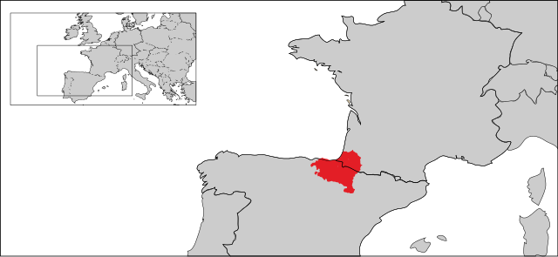
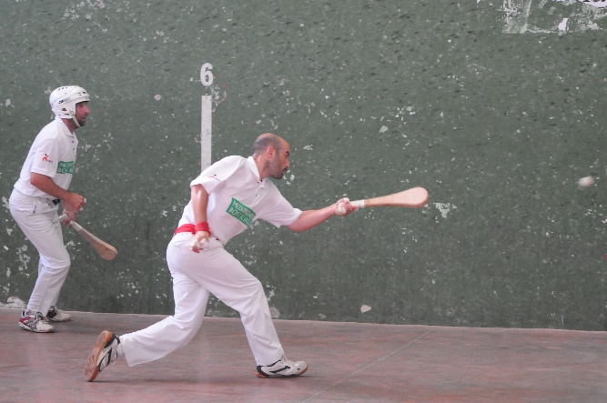
El País Vasco (the Basque Country)
hablar
Remember that in Spanish, syllables often include consonant-vowel pairs.
E.g. sá-ba-do
El País Vasco (Euskadi) es una zona muy natural en el norte de España y el suroeste de Francia. Tiene costa y montañas. La capital se llama Vitoria-Gasteiz. La zona tiene su propio idioma, el vasco (Euskera). 650,000 personas hablan vasco, incluso los jóvenes, así que no es un idioma inferior.
En el País Vasco la gente juega a la pelota vasca, un deporte similar al squash. Debes ser flexible para jugar bien. También hay un festival de cine anual en la ciudad de San Sebastián. Muchos actores famosos participan cada año.
¿Cuántas sílabas tiene la palabra en español?
(3)
natural
(3)
capital
particular
(4)
inferior
(4)
similar
(3)
flexible
(3)
festival
(3)
anual
(3)
*el/la joven = young person
Notes:
Timing: 7 mins
Aim: to learn about the Basque Country; to develop awareness of phonological differences between near-cognates in Spanish and English.
Procedure:
Students read the text about the Basque Country that contains some unknown words that are cognates. Then click to show a list of those cognates. Ask what they think the words mean.
Students then work with a partner to decide how many syllables the Spanish word has. When checking the answers, the teacher can ask students whether each word has the same or a different number of syllables in English. This may lead to some debate! For example, in informal speech, ‘natural’ is two syllables in English (‘na-trul’) but would be three syllables if pronounced slowly.
It is also worth highlighting how Spanish tends to group syllables into pairs of consonants and vowels, which must be pronounced fully (unlike in English, where there are contractions). There will also be differences in the vowel sounds used in English and Spanish, e.g., SSCs [a] and [i] in Spanish.
Notes: it may also be of interest to point out that although these words are cognates, they all have stress on a later syllable in the Spanish word than the English word. All Spanish words except for ‘flexible’ have stress on the final syllable (and do not have a written accent because they end in consonants other than ‘n’ or ‘s’).
The following information could also be given about the Basque Country (it was not included here due to space constraints):
Most Basque speakers are on the Spanish side of the France-Spain border. They are almost all bilingual (they are also Spanish speakers).
The Basque country in Spain is made up of two autonomous communities (autonomías), el País Vasco and Navarra. Like Scotland or Wales, it can make some of its own laws.
Some Basques want to be independent from Spain.
The Basque language is one of the oldest languages in Europe, and its origins are unknown. It is very different to Spanish!
The number of Basque speakers is in fact growing, partly due to the language being taught at school. There was a time in recent Spanish history when efforts were made to end the use of the language – its use in public was prohibited on the street during the time of General Franco.
Frequency of unknown words/cognates:
natural [520]; capital [581]; particular [1013]; conclusión [1538]; inferior [2013]; similar [1059]; flexible [4286]; festival [3194]; anual [1952]
Source: Davies, M. & Davies, K. (2018). A frequency dictionary of Spanish: Core vocabulary for learners (2nd ed.). Routledge: London
Map image free from Eddo from https://commons.wikimedia.org/wiki/File:Basque_Country_Location_Map.svg. This file is licensed under the Creative Commons Attribution-Share Alike 3.0 Unported license
Basque flag image free from clipart-library.com
Picture of pelota vasca free Carlos Octavio Uranga from https://www.flickr.com/photos/carlos_octavio/4257045534

Slide 9
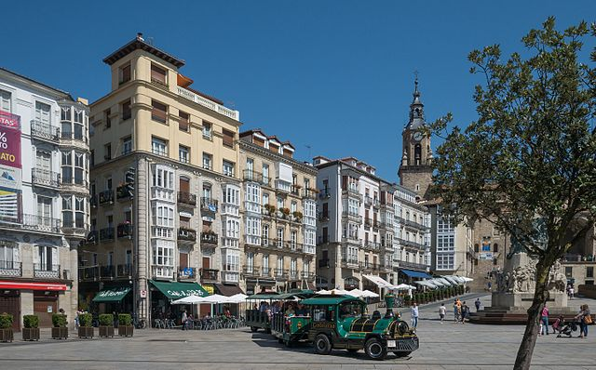
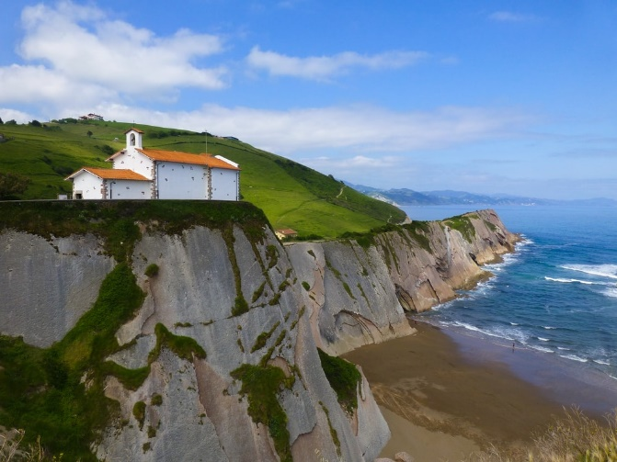
Ahora tú eres Daniel. Escribe unas frases sobre las vacaciones. Usa la forma correcta del verbo (‘–é’ o ‘–ó’), según la frase.
escribir
1. I made the most of the film festival. She took part/participated too!
Yo aproveché el festival de cine. ¡Ella participó también!
?
2. She walked along the coast to see the sea views (‘views of the sea’), whereas I rested on the beach.
Ella caminó por la costa para ver las vistas del mar,
mientras que yo descansé en la playa.
?
3. She bought the drinks and I prepared the food.
Vitoria-Gasteiz
Ella compró las bebidas y yo preparé la comida.
?
4. She met with Nadia and I met with Hugo in the same place.
Ella quedó con Nadia y yo quedé con Hugo en el mismo lugar.
?
5. I travelled to Vitoria and she played a game of pelota vasca.
Yo viajé a Vitoria y ella jugó un partido de pelota vasca.
?
6. She organised a party but I arrived late after a long trip.
Ella organizó una fiesta pero yo llegué tarde después de un viaje largo.
?
la costa del País Vasco
Notes:
Timing: 10 minutes
Aim: to produce six written sentences with examples of the –é and –ó verb endings, pronouns ‘yo’ and ‘ella’, and revisited vocabulary.
Procedure:
Students read the English sentences, paying particular attention to whether the verb refers to ‘I’ or ‘she’.
They write the sentence in Spanish.
Notes:
1. On the previous slide, students saw ‘festival de cine’ but may need a reminder to use ‘cine’. Accept ‘festival de películas’ if this is given.
2. The picture of the Basque coast was taken in Zumaia, about 15 kilometres from San Sebastián. It is the site of a famous rock formation. The chapel on the cliff edge was the scene of the wedding in the famous Spanish film Ocho appellidos vascos.
Picture of Vitoria free from Basotxerri, from https://commons.wikimedia.org/wiki/File:Vitoria_-_Gasteiztxo_01.jpg. This file is licensed under the Creative Commons Attribution-Share Alike 4.0 International license

Slide 10
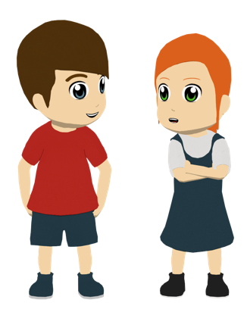
Las vacaciones de verano en el País Vasco
hablar
Traduce las actividades de Lucía y Daniel durante las vacaciones.
Usa ‘yo’ o ‘ella’ con la parte correcta de los verbos en pasado.
Notes:
Timing: 6 minutes
Aim: to successfully say sentences using 1st and 3rd person singular endings of –ar verbs in the preterite tense with the correct subject pronouns for the eight slides that follow.
Procedure:
Students say the sentence in Spanish as indicated by the text/images.
Clicking will then show the correct sentence in Spanish
Teachers can choose how best to conduct this exercise. Students could be asked to work in pairs to either produce the whole sentence together or come up with a part of the sentence each, and then feed back. This will ensure all students are working on the task.
Note:
The final sentence involved a spelling change with ‘llegar’ in the 1st person singular. Teachers could ask how this verb would be spelled before revealing the answer. The –gué ending was covered in Year 8.

Slide 11
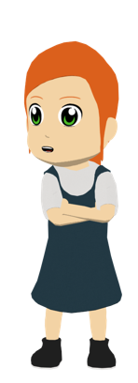
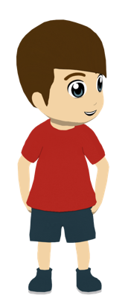
Las vacaciones de verano en el País Vasco
hablar
bought a bike
Ella compró una bici y yo compré una cámara.
she
and
bought a new camera
I

Slide 12
Las vacaciones de verano en el País Vasco
hablar
met up with her friends in Vitoria
Ella quedó con sus amigos en Vitoria pero yo no viajé a la ciudad.
she
but
did not travel to the city
I
Notes:
Note: the possessive adjective ‘su’ has been taught (both in singular and plural form) in the Y8 SOW, but some students may need a reminder here. Alternatively, if this is likely to cause difficulty, ‘her’ could be replaced with ‘some’ to prompt ‘unos/unas’.

Slide 13
Las vacaciones de verano en el País Vasco
hablar
prepared all the food for the party
Ella preparó toda la comida para la fiesta mientras que yo llegué muy tarde.
she
whereas
arrived very late.
I

Slide 14
Las vacaciones de verano en el País Vasco
hablar
participated in a class at the film festival
Yo participé en una clase en el festival de cine, sin embargo ella descansó en casa.
I
however
rested at home
she

Slide 15
Las vacaciones de verano en el País Vasco
hablar
walked along the coast
Ella caminó por la costa pero yo no pasé tiempo allí.
she
but
didn’t spend time there
I

Slide 16
Las vacaciones de verano en el País Vasco
hablar
celebrated my birthday in July
Yo celebré mi cumpleaños en julio entonces ella organizó una fiesta.
I
so
organised a party
she
Notes:
Note: ‘así que’ could also be given for ‘so’.

Slide 17
Las vacaciones de verano en el País Vasco
hablar
found a beautiful shop in the city of Vitoria
Ella encontró una tienda preciosa en la ciudad de Vitoria mientras que yo disfruté de la vista de las montañas.
she
whereas
I enjoyed the view of the mountains .
I
Notes:
Note: ‘hermosa’ could also be given for ‘beautiful’. Alternatively, students have also learnt the word ‘bonito’ with the translation ‘pretty’.

Slide 18
Las vacaciones de verano en el País Vasco
hablar
arrived by bike
Yo llegué en bici pero ella llegó a caballo.
I
but
she arrived by horse
she

Slide 19
Daniel y su viaje a Vitoria
hablar
Remember that in Spanish, syllables often come in single consonant-vowel pairs.
E.g. Sá-ba-do
¿Cuántas sílabas tiene la palabra en español?
capital
perfumes
central
cultural
hospital
particular
inferior
error
decisión
(3)
En Vitoria, la capital del País Vasco, hay una tienda de perfumes preciosa. Lucía siempre va a esta tienda. Está en un lugar central de la ciudad, en una zona bastante cultural, cerca del hospital. Daniel quiere comprar un regalo para su hermana. A Lucía le gusta una marca particular, pero Daniel compró una marca inferior. ¡Qué error! Tomó una decision incorrecta.
(3)
(2)
(3)
(3)
(4)
(4)
(2)
(3)
Notes:
OPTIONAL
This text could be used for additional practice in ‘sounding out’ unknown words in Spanish. It is very similar in design to the factual text on the Basque Country on slide 8.
Procedure:
Students first read the text. Then bring up the list of near-cognates.
Check understanding of the cognates/near-cognates.
Students then work with a partner to decide how many syllables the Spanish word has.
When checking the answers, ask students to also say the word and focus on the position of the stress. All words have final syllable stress, except ‘perfumes’ (penultimate syllable stress). In the English equivalent, the stress is always on the first or second syllable.
Frequency of unknown words/cognates:
capital [581], perfume [2895], central [618], cultural [714], hospital [1050], particular [1013], inferior [2013], error [887], decisión [590]
Source: Davies, M. & Davies, K. (2018). A frequency dictionary of Spanish: Core vocabulary for learners (2nd ed.). Routledge: London

Slide 20
Asking questions about events in the past (holidays)
-ar verbs in the preterite [revisited]
subject pronouns [revisited]
Y9 Spanish
Term 1.1 - Week 1 - Lesson 2
Pete Watson / Amanda Izquierdo / Nick Avery
Artwork: Mark Davies
Date updated: 30.06.21
Notes:
Artwork by Mark Davies. All additional pictures selected are available under a Creative Commons license, no attribution required.
Native teacher feedback provided by Blanca Román.
Learning outcomes (lesson 2)
Consolidation of the following:
-ar verbs in 1st, 2nd and 3rd person singular preterite (-é, -aste, -ó)
subject pronouns ‘yo’, ‘tú’, ‘él’, ‘ella’
a subset of Y7 and Y8 vocabulary (see below)
Frequency rankings of vocabulary revisited this week (1 is the most common word in Spanish):
pasar³ [68]; aprovechar [885]; quedar [100]; verano [1139]; pasado (adj.); cantar [717]; precioso [1777]; viaje [519]; mientras que [mientras-127]; entonces [74]; fiesta [796]; canción [982]; país [109]; costa [896]; yo [28]; tú [184] él [9]; ella [72]; encontrar [102]; celebrar [886]; ¿de verdad? [176]; porque [40];]; largo [300]; bicicleta [3684]; cámara [903]; caballo [907]; también [49]; comprar [361]; bailar [1323]; llegar [75]; caminar [514]; antiguo [446]; museo [1114]; ¿dónde? [161]; ciudad [178]; ¿cuándo? [57]; (por) ¿qué? [50]; ¿quién? [289]; mar [480]; durante [139]; lugar [144]; descansar [1749]; preparar [570]; participar [593]; viajar (a) [902]; disfrutar [939]; montar [1446]; vacaciones [2641]; montaña [1464]; vista [408]; agosto [931]
Source: Davies, M. & Davies, K. (2018). A frequency dictionary of Spanish: Core vocabulary for learners (2nd ed.). Routledge: London
The frequency rankings for words that occur in this PowerPoint which have been previously introduced in NCELP resources are given in the NCELP SOW and in the resources that first introduced and formally re-visited those words. For any other words that occur incidentally in this PowerPoint, frequency rankings will be provided in the notes field wherever possible.

Slide 21
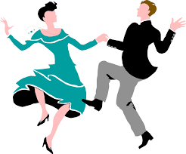
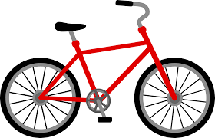
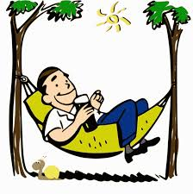
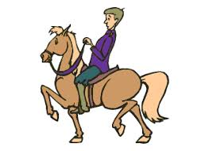
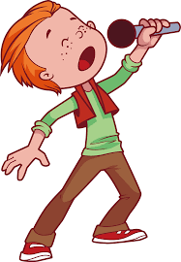
leer / hablar
Escribe la letra correcta para cada palabra en español.
Después, las palabras van a desaparecer. Debes decir una letra en español. Tu compañero debe decir la palabra en español. ¡Toma turnos!
 | Palabras | ¿Qué letra?
1 | pasar
2 | caminar
3 | la bici
4 | cantar
5 | el mar
6 | ¿De verdad?
7 | montar
8 | viajar
9 | el museo
10 | el agosto
11 | descansar
12 | bailar
a)
b)
c)
d)
h
[Really?]
j
a
[to travel]
[to dance]
k
e)
f)
g)
h)
l (L)
[to pass,
to spend (time), to happen]
b
f
[to rest]
[to ride]
[museum]
c
j)
k)
l)
i)
g
i
[August]
e
[to walk]
[to sing]
[sea]
d
Notes:
Timing: 4 minutes
Aim: to revisit Y7 and Y8 vocabulary in both receptive and productive modes of language use.
Procedure 1. Students either work by themselves or in pairs, matching up words with the corresponding picture (1 minute) 2. Then the teacher shows the answers one by one (1 minute).
3. After one more click, the Spanish words are covered up.
4. Students work in pairs. One says a random letter and the other says the word in Spanish as fast as possible. Students take turns (2 minutes).
Notes: Teachers could remind students to produce the articles with the nouns in the active recall phase.
To increase the level of difficulty for a higher-ability group, students could pass steps 1-3 and go straight to step 4 (production).
Images free from clipart-library.com

Slide 22
Describing completed events in the past -ar verbs in the preterite
gramática
As you know, many verbs in Spanish end in –ar.
When talking about completed events in the past, the verb ending changes.
é
To mean ‘I’, remove the ‘ar’ and add __.
I found the camera.
Encontré la cámara.
aste
To mean ‘you’, remove the ‘ar’ and add _____.
You travelled to the mountains.
Viajaste a las montañas.
ó
To mean ‘s/he’ or ‘it’, remove the ‘ar’ and add __.
He walked to the museum.
Caminó al museo.
Notes:
Timing: 2 minutes
Aim: to recap the 1st, 2nd and 3rd person singular endings for –ar verbs in the preterite tense.
Procedure:
1. Click to go through the rules for each verb ending. Gaps are left for teachers to elicit answers from students for the endings and translated sentences.

Slide 23
How to ask questions in Spanish Using verbs in questions
gramática
When asking questions in English, we often use ‘do’ (or ‘did’) before the subject.
Example:
Did you buy a watch?
Spanish doesn’t have a word for ‘do’ or ‘did’ in questions. Only the main verb is used.
Ejemplos:
1
¿Llegaste por la mañana?
¿Preparó estas bebidas?
2
Did you arrive in the morning?
Did s/he prepare these drinks?
Notes:
Timing: 2 minutes
Aim: to help students prepare for the productive elements of the next task by recapping Spanish question formation. Students often find it difficult to construct questions by translating from English prompts, as the translation is often not literal.
Procedure:
Click to go through this slide’s explanation and examples.
Audio is provided to model the intonation (see note below).
Note: the teacher could also highlight the fact that Spanish questions have raised intonation at the end. This distinguishes them from statements.

Slide 24
Daniel pregunta en clase sobre las vacaciones. Lee las frases. ¿Pregunta sobre las vacaciones de una amiga (‘did you’) o de la profesora (‘did she’)? Elige la opción correcta y escribe la frase en inglés.
leer
 | Did you…? | Did she…?
En inglés
1. ¿Caminaste por los parques?
Did you walk around the parks?
2. ¿Preparaste comida rica en casa?
Did you prepare/make tasty food at home?
3. ¿Visitó un lugar con vistas del mar?
Did she visit a place with views of the sea?
4. ¿Encontró una bici?
Did she find a bike?
5. ¿Aprovechó el día en el museo?
Did she make the most of the day in/at the museum?
6. ¿Quedaste con una amiga?
Did you meet up with a friend (f)?
Notes:
Timing: 6 minutes.
Aim: to consolidate understanding of the difference between 2nd person singular (-aste) and 3rd person singular (-ó) of the preterite through reading. To consolidate understanding of vocabulary through translation.
Procedure:
Students read each sentence and decide whether it refers to the 2nd or 3rd person singular of the preterite.
Students write each sentence in English. Alternatively, they could give the meaning orally when checking answers to part 1.
Answers are shown by clicking and appear row by row.
Note: picture from https://openmoji.org/ under a CC BY-SA 4.0 license.

Slide 25
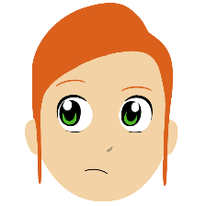
Ahora Lucía pregunta sobre las vacaciones. Escucha las frases. Marca la opción correcta. También escribe el verbo en español y completa la pregunta en inglés.
escuchar
¿Necesita una tilde?
 | “Did you…?” | “Did s/he…?”
El verbo en español
Completa la pregunta
______________ a city in Mexico?
_____________ something at the market?
____________________ in many activities?
___________________ Nadia’s birthday in July?
______________ in the afternoons?
______________ by car?
_____________ the history museum?
___________________________the holidays?
1
visitó
Did s/he visit
2
compraste
Did you buy
3
participó
Did s/he participate
4
celebraste
Did you celebrate
5
descansaste
Did you rest
6
llegaste
Did you arrive
7
encontró
Did s/he find
8
aprovechó
Did s/he make the most of
Notes:
Timing: 8 minutes
Aim: 1) to consolidate understanding of the difference between 2rd person singular (-aste) and 3rd person singular of the preterite (-ó) through listening; 2) to focus on the position of the stress and how this affects the use of the written accent.
Procedure:
Students listen to each recording.
They tick the correct column depending on whether the sentence refers to the present or to a completed action in the past.
Students listen again. This time, they write the verb in Spanish and the activity in English.
Note:
Some students may be able to complete the different parts in one go, rather than as separate steps.
The activity could also be adapted for a higher level group by requiring full sentence translation in the final column.
Pictures from https://openmoji.org/ under a CC BY-SA 4.0 license.
Transcript
¿Visitó una ciudad en México?
¿Compraste algo en el mercado?
¿Participó en muchas actividades?
¿Celebraste el cumpleaños de Nadia en julio?
¿Descansaste por las tardes?
¿Llegaste en coche?
¿Encontró el museo de historia?
¿Aprovechó las vacaciones?

Slide 26
Comparing what different people do Subject pronouns [revisited]
gramática
Remember to use subject pronouns when comparing what different people do or did, or to add emphasis.
Ejemplo:
I rested at home but you spent time with your friends.
Yo
tú
____ descansé en (la) casa, pero ___ pasaste tiempo con tus amigos.
Ejemplo:
She participated in many sports, whereas he sang and danced.
Ella
él
____ participó en muchos deportes, mientras que ____ cantó y bailó.
The verb ending is the same for ‘he’ and ‘she’, so sometimes we need the pronoun to say who does what!
Notes:
Timing: 2 mins
Aim: to recap how subject pronouns are used when comparing one person’s actions with another’s.
Procedure:
Click to go through the sentences and examples. Gaps are left for teachers to elicit answers from students.

Slide 27
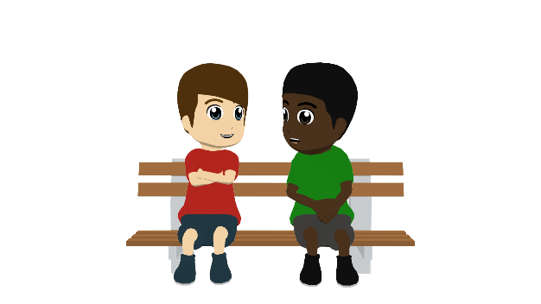
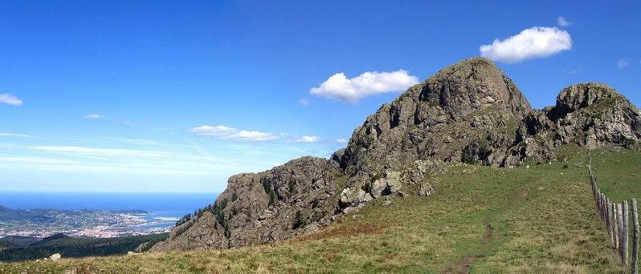
Daniel habla con Hugo sobre las vacaciones de verano. Lee y elige el verbo correcto. Después escucha y comprueba.
leer / escuchar
D: ¡Hola Hugo! ¿Tú viajaste el verano pasado?
H: Yo no, pero Nadia sí. Ella (1) viajé /viajó / viajaste a Inglaterra para visitar a un primo mientras que yo (2) pasó / pasé / pasaste las vacaciones aquí en San Sebastián en la playa de La Concha. ¿Y tú? (3) ¿Quedaste / Quedó / Quedé con otros amigos?
D: ¡Sí, pero sin Lucía! Ella (4) caminé / caminaste / caminó en las montañas cerca de la frontera con Francia para ver las vistas preciosas. Yo (5) participó / participé / participaste en un festival de música en Vitoria con Pablo y Alba.
H: ¿De verdad? ¿Tú (6) cantaste / cantó / canté en el festival?
D: Ja, ja, ja. No, solo fui para escuchar a unos grupos, pero *tuve suerte porque (7) ganaste / gané / ganó un premio en el festival. En cambio Lucía no (8) pasaste / pasó / pasé un buen día. ¡Ella lloró porque olvidó la cámara!
La playa principal de
San Sebastián (La Concha)
Las montañas cerca de San Sebastián (Las Peñas de Aia)
*tuve suerte – I was lucky
Notes:
Timing: 8 minutes
Aim: to consolidate understanding of –ar verbs in the preterite for all singular persons.
Procedure:
Students write 1-8 in their books. They first read and the choose the verb in the correct form, depending on the subject pronoun or name preceding it.
Check students’ answers. Audio is provided (click the speaker button between the two pictures) to allow for an optional ‘listen and check’.
Use a preferred method to check understanding of the text. This may include phrase by oral translation into English or direct questions such as 1) Where did Hugo spend the holidays? 2) And Nadia? 3) What different things did Daniel and Lucía do? 4) What does Daniel say about his experience of the festival? 5) Why did Lucía cry?
Draw attention to two previously taught features: (1) the use of ‘para’ + infinitive (‘para visitar a un primo’ and ‘para ver las vistas’); and (2) the way that pronouns are used in place of auxiliaries (‘yo no, pero Nadia sí’ for ‘I didn’t, but Nadia did’). Both of these will feature in later activities.
Notes:
1. ‘Pasar un buen día’ will be new to students. They have so far seen pasar as ‘spend (time)’, so attention could be drawn to the non-literal translation ‘have a good day’.
2. Images free to use from the following sources:
https://unsplash.com/photos/8KCquMrFEPg
https://es.wikipedia.org/wiki/Parque_natural_de_las_Pe%C3%B1as_de_Aya#/media/Archivo:Aiako_harria.jpg

Slide 28
Escucha y lee el texto al mismo tiempo para pensar en opciones diferentes:
leer / escuchar
1
5
D: ¡Hola Hugo! ¿Tú viajaste el verano pasado?
H: Yo no, pero Nadia sí. Ella viajó a Inglaterra para visitar a un primo mientras que yo pasé las vacaciones aquí en San Sebastián en la playa de La Concha. ¿Y tú? ¿Quedaste con otros amigos?
D: ¡Sí, pero sin Lucía! Ella caminó en las montañas cerca de la frontera con Francia para ver las vistas preciosas. Yo participé en un festival de música en Vitoria con Pablo y Alba.
H: ¿De verdad? ¿Tú cantaste en el festival?
D: Ja, ja, ja. No, solo fui para escuchar a unos grupos, pero tuve suerte porque gané un premio en el festival. En cambio Lucía no pasó un buen día. ¡Ella lloró porque olvidó la cámara!
2
6
3
7
4
8
*tuve suerte – I was lucky
Notes:
Timing: 8 minutes
Aim: to help students to connect the spoken and written forms of the language more securely; to consolidate vocabulary and grammar knowledge by eliciting suggested changes to the text.
Procedure: Click on the audio button to play the text. Read and listen.
Note: There is a full version of the audio top right with a player. Alternatively the audio is in 8 sections with a pause just after the words 1-7 below, to facilitate easy stop/start.
To support segmentation (identifying boundaries between words), stop the audio and ask students to say: a) the next word b) the previous word
In addition, to develop understanding, vocabulary and grammar knowledge, pause at key points and ask students to suggest an alternative word that could replace the next word. This is a chance to draw on previously taught grammar and vocabulary knowledge. Students will need to think about the kinds of words they can use in context, depending on where the audio stops. Words in bold below are those after which the audio stops.
I: ¡Hola Hugo! ¿Tú viajaste…. [a + name of a city, región or country; feminine noun – a la costa, a las montañas; ‘al’ + singular masculine noun; time markers – e.g. en julio, en agosto]
II: … el verano pasado? Yo no, pero Nadia sí. Ella viajó a Inglaterra para … [any infinitive that works in context, e.g, ver un partido de fútbol, conocer el país, pasar tiempo con una amiga, aprender inglés]
III: …visitar a un primo mientras que yo.... [any verb in 1st person singular preterite]
IV: … pasé las vacaciones aquí en San Sebastián en la playa de La Concha. ¿Y tú? ¿Quedaste con otros amigos? ¡Sí, pero sin Lucía! Ella… [any verb in 3rd person singular preterite]
V: … caminó en las montañas cerca de la frontera con Francia para ver las vistas preciosas. Yo participé en… [e.g., una clase, un concierto, un partido, un baile]
VI: … un festival de música en Vitoria con Pablo y Alba. ¿De verdad? ¿Tú cantaste en el festival? Ja, ja, ja. No, solo fui para… [any infinitive that works in context]
VII: … escuchar a unos grupos, pero tuve suerte porque… [any verb in 1st person singular preterit or a change in subject + verb, e.g., un chico me regaló…]
VIII: gané un premio en el festival. En cambio Lucía no pasó un buen día. ¡Ella lloró porque olvidó la cámara!

Slide 29
Las vacaciones de verano
La playa de La Concha
escribir
Lee el texto en inglés y completa el texto en español.
D: ¡Hola Hugo! (1) ¿ Tú _________ el verano pasado?
H: Yo no, pero Nadia sí. (2) _________ a Inglaterra para visitar a un primo mientras que (3) ___________________________ en San Sebastián en la playa de La Concha. (4) ¿ ________________ con otros amigos?
D: ¡Sí, pero (5) ____ Lucía! (6) ____________ en las montañas cerca de la frontera con Francia para ver (7) ___________________. (8) _____________ en un festival de música en Vitoria con Pablo y Alba.
Viajaste
D: Hi Hugo! (1) Did you travel last summer?
H: I didn’t, but Nadia did. (2) She travelled to England (in order) to visit a cousin whereas (3) I spent the holidays here in San Sebastián on the Concha beach. (4) And you? Did you meet up with other friends?
D: Yes, but (5) without Lucía! (6) She walked in the mountains near the border with France to see (7) the beautiful views. (8) I participated in a music festival in Vitoria with Pablo and Alba.
Ella viajó
yo pasé las vacaciones aquí
Y tú? ¿Quedaste
sin
Ella caminó
las vistas preciosas
Yo participé
Notes:
Timing: 5 minutes (either do this slide or the activity on the next slide)
Aim: Scaffolded writing exercise using the same text as the previous two exercises.
OPTION 1 – scaffolded text completion
Procedure:
Students write 1-8 in their books.
They will need to look at the English text and use the prompts in bold to fill in the missing words in the Spanish text on the right hand side. These include the target grammar features worked on this week, including subject pronouns and -ar verbs in the preterite, as well as vocabulary.
Click to show the missing Spanish words one by one.
Note:
Image free to use from the following source:
https://unsplash.com/photos/8KCquMrFEPg

Slide 30
Las vacaciones de verano
La playa de La Concha
escribir
Lee el texto en inglés y escribe el texto en español.
D: Hi Hugo! Did you travel last summer?
H: I didn’t, but Nadia did. She travelled to England (in order) to visit a cousin whereas I spent the holidays here
in San Sebastián on the Concha beach. Did you meet up with other friends?
D: Yes, but without Lucía!
¡Hola Hugo! ¿Tú viajaste el verano pasado?
Yo no, pero Nadia sí. Ella viajó a
Inglaterra para visitar a un primo
mientras que yo pasé las vacaciones aquí
en San Sebastián en la playa de La Concha.
¿Tú quedaste con otros amigos?
¡Sí, pero sin Lucía!
Notes:
OPTION 2 – translation of a passage of the text
The Spanish translation of each line of the text is revealed on a mouse click.
Note: option 2 may take a couple of minutes longer than option 1. Lesson timings total 52 minutes if option 2 is chosen, and 50 minutes if option 1 is chosen.

Slide 31
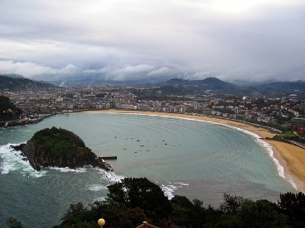
Lee el texto con tu compañero/a de clase. Traduce los verbos y los pronombres al español.
hablar
D: ¡Hola Hugo! ¿[Did you travel] el verano pasado?
H: Yo no, pero Nadia sí. [She travelled] a Inglaterra para visitar a un primo mientras que [I spent] las vacaciones aquí en San Sebastián en la playa de La Concha. ¿[Did you meet up] con otros amigos?
D: ¡Sí, pero sin Lucía! [She walked] en las montañas cerca de la frontera con Francia para ver las vistas preciosas. [I participated] en un festival de música en Vitoria con Pablo y Alba.
H: ¿De verdad? ¿[Did you sing] en el festival?
D: Ja, ja, ja. No, solo fui para escuchar a unos grupos, pero tuve suerte porque gané un premio en el festival. En cambio Lucía no pasó un buen día. ¡[She cried] porque olvidó la cámara!
Tú viajaste
Ella viajó
yo pasé
Tú quedaste
Ella caminó
Yo participé
Tú cantaste
Ella lloró
Notes:
Timing: 5 mins
Aim: to automatise knowledge of subject pronouns and –ar verbs in the preterite in oral production.
Procedure: 1. Students read the text aloud with a partner, translating the English prompts into Spanish as they go. After reading through it once, they can swap roles (the person reading as Daniel becoming Hugo and visa-versa).
2. The teacher may wish to do the first one together with the class to ensure understanding that two words (pronoun and verb) are needed for each prompt.
Note: to challenge a higher-level group, more words in the text could be given as prompts. At present the activity just focuses on verbs and pronouns as this is the main focus for this week’s teaching.

Slide 32
Ahora vamos a decir unas palabras en español. Usa la palabra para ‘the’ si es un nombre.
hablar
?
1
?
el país
to happen
pasar
7
country
2
?
comprar
8
preparar
to buy, buying
to prepare, preparing
?
3
?
9
el verano
disfrutar
summer
to enjoy
?
aprovechar
4
?
10
?
to make the most of
place
el lugar
5
¿de verdad?
?
11
also, too
también
Really?
?
?
6
largo
agosto
long (m)
12
August
?
Notes:
OPTIONAL
Aim: to recall previously taught vocabulary
Procedure:
Say the item number in Spanish. This can be done in any order, so can be useful for additional practice with numbers.
Students say the target Spanish word in chorus, with definite article if referring to a noun.
Click on the pink text box to reveal the answer.
Further rounds could be done as a class or in pairs, with one partner saying a number and the other then saying the word. This could be done under time pressure to help automaticity (e.g. number of words that can be achieved in one minute by partner/team A vs partner/team B).

Slide 33
Gaming Grammar
Gaming Grammar
Gaming Grammar mini-game Verbs: 1st and 3rd person past tense in the ‘Verb agreement (past)’ menu practices aspects of this week’s lessons.
Notes:
This slide links to Gaming Grammar login screen. The appropriate mission can then be selected from the menu page.
Students will progress through the game at their own rate; teachers should use the teacher interface to check progress. This will help to inform future lesson planning.

Slide 34
Deberes
Vocabulary Learning Homework (Y9, Term 1.1, Week 2)
Student worksheet
Quizlet link
Quizlet QR code
Notes:
This week’s vocabulary learning homework revisits vocabulary from Year 7 and Year 8.
The answer sheet can be found here: https://resources.ncelp.org/concern/resources/3x816n59k?locale=en

