Slide 1
Saying what someone is like (at the moment)
ESTAR – estoy / estás / está for STATE/MOOD
SSC [e]
Y7 Spanish
Term 1.1 - Week 2 - Lesson 3
Victoria Hobson / Nick Avery
Date updated: 09/08/2021
Notes:
Learning outcomes (lesson 1):
Introduction of SSC [e]
Introduction of ‘estoy’, ‘estás’ and ‘está for state/mood
Note: these three verb forms were seen in 1.1.1 (with ‘estar’ for location)
Word frequency (1 is the most frequent word in Spanish):
1.1.2.3 (introduce) nervioso [1521]; tranquilo [1073]; serio [856]; raro¹ [1005]; tonto [2379]; blanco [372]; ¿cómo? [151]; muy [43]; hoy [167]; ¿Cómo se dice […] en inglés/español?; ¿Cómo se escribe?; seguro [407]; listo [1684]; sí [45]; no [11]
Source: Davies, M. & Davies, K. (2018). A frequency dictionary of Spanish: Core vocabulary for learners (2nd ed.). Routledge: London

Slide 2
e
papel
en
espalda
tener
elefante
[to have]
estar
[to be]
Nick Avery
Notes:
Introduce and elicit the pronunciation of the individual SSC ‘e’ and then the source word again (with gesture, if using). Then present and elicit the pronunciation of the five cluster words.
The cluster words have been chosen for their high-frequency, from a range of word classes, with the SSC (where possible) positioned within a variety of syllables within the words(e.g. initial, 2nd, final etc..) and additionally, we have tried to use words that build cumulatively on previously taught SSCs (see the Phonics Teaching Sequence document) and do not include new SSCs. Where new SSCs are used, they are often consonants which have a similar symbol-sound correspondence in English.
Word frequency rankings: elefante [>5000]; papel [393]; espalda [942]; estar [21]; en [5]; tener [19] Source: Davies, M. & Davies, K. (2018). A Frequency Dictionary of Spanish: Core vocabulary for learners (2nd ed.) London: Routledge.

Slide 3
e
papel
en
espalda
tener
elefante
estar
Nick Avery
Notes:
Introduce and elicit the pronunciation of the individual SSC ‘e’ and then the source word again (with gesture, if using). Then present and elicit the pronunciation of the five cluster words.
The cluster words have been chosen for their high-frequency, from a range of word classes, with the SSC (where possible) positioned within a variety of syllables within the words(e.g. initial, 2nd, final etc..) and additionally, we have tried to use words that build cumulatively on previously taught SSCs (see the Phonics Teaching Sequence document) and do not include new SSCs. Where new SSCs are used, they are often consonants which have a similar symbol-sound correspondence in English.
Word frequency rankings: elefante [>5000]; papel [393]; espalda [942]; estar [21]; en [5]; tener [19] Source: Davies, M. & Davies, K. (2018). A Frequency Dictionary of Spanish: Core vocabulary for learners (2nd ed.) London: Routledge.

Slide 4
e
papel
en
espalda
elefante
tener
estar
Nick Avery
Notes:
Without the images or sound, students have to pronounce the words themselves.

Slide 5
Fonética
escuchar
Listen and write the missing letter(s).
¿Is it [a], [e] or [o]?
e
a
a
_sp_ld_
_l_f_nt_
e
e
a
e
1
6
c_m_
a
a
p_p_l
a
e
2
7
a
a
e
c_s_
t_n_r
e
3
8
_g_st_
a
o
a
o
o
4
_lt_
9
_st_r
e
o
e
a
p_r_
5
10
Notes:
Phonics Timing: 4 minutes Aim: To differentiate between SSC that are similar, phonetically and/or orthographically.
Note: [a] and [o] were introduced in 1.1.1 Procedure: 1. Click to listen. Write the SSC and/or write the whole word. 2. Click to see the answers.
TRANSCRIPT
Espalda
Cama
Tener
Alto
Pero
Elefante
Papel
Casa
Agosto
Estar

Slide 6
Vocabulario
 | Word | English meaning
1 | ¿Cómo? | How? Sorry?
2 | hoy | today
3 | nervioso | nervous
4 | tranquilo | calm
5 | serio | serious
6 | raro | strange
7 | tonto | silly
8 | blanco | white, pale
9 | listo | ready
10 | seguro | sure, certain
11 | muy | very
60
Segundos
0
INICIO
Notes:
Vocabulario
Timing: 2-4 minutes Aim: To reactivate and strengthen vocabulary knowledge. Note: Students in Y7 pre-learn their vocabulary on Quizlet. This task assists recall of the new vocabulary. Procedure: Round 1: Look at the Spanish, recall the English meanings, saying them aloud. [1 minute] Round 2: Look at the English, recall the Spanish meanings, saying them aloud. [1 minute] Repeat for two further minutes, to speed up recall.
Word frequencies:
cómo [151]; hoy [167]; nervioso [1521]; tranquilo [1073]; serio [856]; raro [1005]; tonto [2379-in AQA]; blanco [372]; muy [43]; seguro [407]; listo [1684]
Note:
Phonics: students will need a little support with the pronunciation of 1] ‘qui’ in ‘tranquilo 2] silent ‘h’ in hoy, and 3] the word-initial ‘r’ in ‘raro’, which is pronounced like a ‘rr’. This can juxtaposed with the ‘r’ in ‘serio’, which is much less pronounced, but still produced with the tongue inside the mouth and no change of shape in the lips (as with English ‘r’). Students will focus on all of these sounds more explicitly, later, so they only need to be addressed briefly here.
Target language (purple words in scheme of work): use ‘¿Estás seguro/a?’ to prompt self-correction and ‘¿Estás listo/a?’ to check students are ready. Encourage responses ‘sí or ‘no’. Also try to incorporate use of ‘¿Cómo se dice en inglés/español? This is a target language phrase of high communicative value that will regularly be used in task instructions and classroom interaction.

Slide 7
Estar for state/mood
Remember, in Spanish the verb estar means ‘to be’ when describing ___________.
a location
‘Estar’ also means ‘to be’ when describing a mood or temporary state.
In English, we often use a verb with ‘-ing’ to talk about a temporary state (‘right now’).
For example:
I am feeling nervous.
You are being silly.
He is acting strange.
Estoy nervioso.
I am nervous.
Estás tonto.
You are silly.
Está raro.
He is strange.
Notes:
Grammar recap and presentation slide
Timing: 2 minutes
Aim: to recap the function of ‘estar’ introduced last week and to introduce a new one (use of estar for state/mood)
Procedure:
Click to reveal each part of the explanation/recap
Where appropriate, elicit rules and translations from students
Notes:
1. we are focusing on masculine forms of adjectives for now and will introduce feminine forms later.

Slide 8
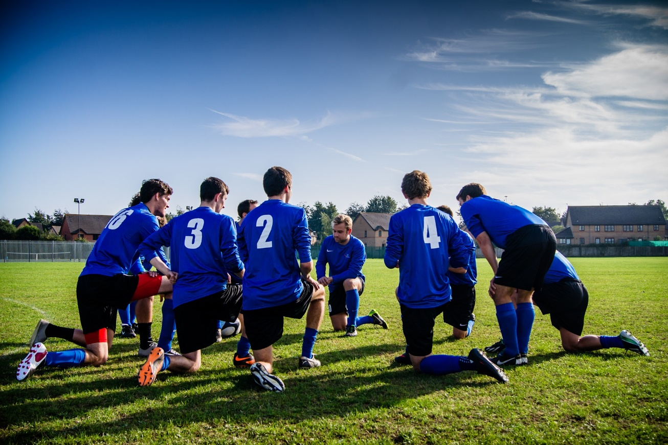
¿Cómo estás?
leer
It’s an important football game. These sentences describe how you are and how your brother (‘he’) is before the match. Write 1-8, ‘you’ or ‘he’ and the adjective in English.
Leer
1) Estás listo.
2) Está nervioso.
[‘you’]
[‘he’]
3) Está tranquilo
4) Estás muy blanco.
[‘you’]
[‘he’]
5) Estás muy tonto.
6) Está raro.
[‘he’]
[‘you’]
‘you’ | your brother (‘he’)
(feeling) ready
(feeling) nervous
(looking) very pale
(feeling) calm
7) Está serio.
8) Estás muy serio.
(acting) silly
(acting) strange
[‘he’]
[‘you’]
(being) very serious
(being) serious
Notes:
Grammar practice activity (reading)
Timing: 7 minutes
Aim: to distinguish between ‘estás’ and ‘está’ and their meanings; to consolidate understanding of new vocabulary
Procedure:
1. Students write 1-8.
2. Read the sentences and write ‘you’ or ‘he’ with the adjective
3. Students could also write a suitable English verb with –ing with their answer, or it could be shown during feedback. This will help to reinforce the sense of temporary state.
Note:
Answers are animated to first appear for person agreement, then for the adjective. However, some groups may be able to give both answers together.
In checking the answers in English, use the new target language item ‘¿Cómo se dice en inglés?’.

Slide 9
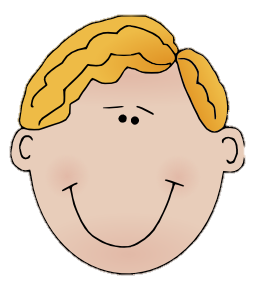
Gramática
escuchar
loco = crazy
enfermo = ill
Gonzalo and Raúl are at the Haunted House ride at a theme park. Is Gonzalo talking about himself (‘I am’) or Raúl (‘you are’). Who is the most scared?
‘I am’
‘You are’
 |  | Gonzalo | Raúl
1
Estás blanco.
✔
2
Estoy tranquilo.
✔
3
Estoy listo.
✔
4
Estás muy nervioso.
✔
5
Estoy serio.
✔
6
Estoy muy tonto.
✔
7
Estás raro.
✔
8
Estás loco.
✔
Notes:
Grammar practice activity (listening)
Timing: 8 minutes
Aim: to practice distinguishing between ‘estoy’ and ‘estás’ and their meanings while listneing
Procedure:
1. Students write 1-8.
2. They listen and write ‘Gonzalo’ or ‘Rául’
OR
They first listen and write the sentence before deciding who is referred to. This intermediate step may suit some students as it allows more time for reflection. The full sentences in Spanish appear with the answers.
3. Review the meanings of adjectives with students (ask ‘¿Cómo se dice en inglés?’). This may mean playing the audio once again.
Note: ‘loco’ [846] is not formally included in the set for this week but is a frequent adjective that will be taught later in Year 7. Its meaning is provided in a gloss. Remember the focus here is on the verb. These additional adjectives may be picked up incidentally.
Transcript:
Estás blanco.
Estoy tranquilo.
Estoy listo.
Estás muy nervioso.
Estoy serio.
Estoy muy tonto.
Estás raro.
Estás loco.
Word frequency (1 is the most frequent word in Spanish): nervioso [1521]; tranquilo [1073]; serio [856]; raro [1005]; tonto [2379-in AQA]; blanco [372]; muy [43]
Source: Davies, M. & Davies, K. (2018). A frequency dictionary of Spanish: Core vocabulary for learners (2nd ed.). Routledge: London

Slide 10
¿Cómo se dice en español?
nervous
hablar
silly
pale
[he is]
serious
[I am]
[you are]
calm
strange
Notes:
Speaking activity
Timing: 5 minutes
Aim: to produce the verbs ‘estoy’, ‘estás’ and ‘está’ and vocabulary from picture/word prompts under time pressure
Procedure:
1. Explain (or elicit) meaning of the title.
2. Students work with a partner and take it in turns to give the complete sentence in Spanish before the images stop spinning (after 5 seconds).
2. Students could aim to give the translation before the images stop spinning.
3. This activity could be repeated with the animation speeded up to further improve students’ fluency.
Note:
Here, all three parts of estar that students have seen so far are worked on. It is anticipated that by now, students are secure enough with these verbs for this to be a success.
Speed of retrieval is an important part of language proficiency and are useful to include after students have had plenty of receptive practice with the vocabulary and grammar.

Slide 11
Grámatica / vocabulario
escribir
nervous
today
Está nervioso hoy.
Notes:
Writing activity
Timing: 5 minutes (slides 13-19)
Aim: to productively use the target vocabulary and grammar in the written modality
Procedure:
1. In this final activity, students write the sentences generated by the combinations of images and English words.

Slide 12
Vocabulario
escribir
calm
today
Estoy tranquilo hoy.

Slide 13
Vocabulario
escribir
very nervous
today
Estás muy nervioso hoy.

Slide 14
Vocabulario
escribir
serious
today
Está serio hoy.

Slide 15
Vocabulario
escribir
very strange
today
Estoy muy raro hoy.

Slide 16
Vocabulario
escribir
pale
today
Estás blanco hoy.

Slide 17
Vocabulario
escribir
silly
today
Estoy tonto hoy.

Slide 18
Saying what someone is like (at the moment) [2]
ESTAR – estoy / estás / está for STATE/MOOD
gender agreement on adjectives (-o, -a)
SSC [i]
Y7 Spanish
Term 1.1 - Week 2 - Lesson 4
Victoria Hobson / Nick Avery
Date updated: 09/08/2021
Notes:
Learning outcomes (lesson 2):
Introduction of SSC [i] Introduction of gender agreement (-o, -a) where adjectives are a complement to the verb
Note: gender agreement can be a difficult feature to learn. To reduce complexity, it is initially introduced here only for biological gender and in sentences where the adjective is a complement to the verb (e.g. está rara) because this word order is used in both English and Spanish. Later, students will learn about post-nominal adjectives (e.g. un chico serio).
Word frequency (1 is the most frequent word in Spanish):
1.1.2.3 (revisit) nervioso [1521]; tranquilo [1073]; serio [856]; raro¹ [1005]; tonto [2379]; blanco [372]; ¿cómo? [151]; muy [43]; hoy [167]; ¿Cómo se dice […] en inglés/español?; ¿Cómo se escribe?; seguro [407]; listo [1684]; sí [45]; no [11]
Source: Davies, M. & Davies, K. (2018). A frequency dictionary of Spanish: Core vocabulary for learners (2nd ed.). Routledge: London

Slide 19
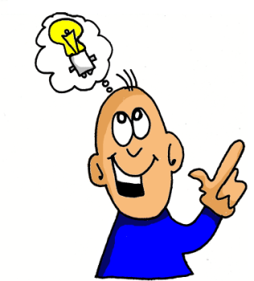
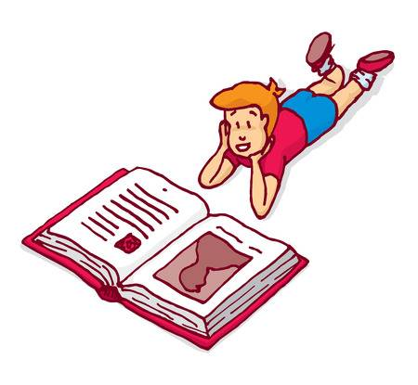
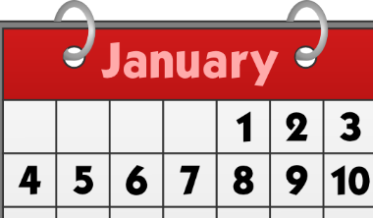
i
i
lista
ir
[to go]
idea
interesante
sin
primero
[without]
Notes:
Timing: 2 minutes
Aim: To introduce SSC [i]
Procedure:
Introduce and elicit the pronunciation of the individual SSC [i] and then the source word again ‘idea’ (with gesture, if using).
Then present and elicit the pronunciation of the five cluster words.
The cluster words have been chosen for their high-frequency, from a range of word classes, with the SSC (where possible) positioned within a variety of syllables within the words (e.g. initial, 2nd, final etc.). Additionally, we have tried to use words that build cumulatively on previously taught SSCs (see the Phonics Teaching Sequence document) and do not include new SSCs. Where new SSCs are used, they are often consonants which have a similar symbol-sound correspondence in English.
Word frequency (1 is the most frequent word in Spanish): idea [248]; lista [1189]; ir [33]; interesante [617]; primero [82]; sin [54] Source: Davies, M. & Davies, K. (2018). A frequency dictionary of Spanish: Core vocabulary for learners (2nd ed.). Routledge: London

Slide 20
i
i
lista
ir
idea
interesante
sin
primero
Notes:
Without the images, students focus this time again closely on the SSC and the cluster words.

Slide 21
i
i
lista
ir
idea
interesante
sin
primero
Notes:
Without the cluster word images or sound, students have to pronounce the words themselves.

Slide 22
escuchar
Listen to the words. Tick the SSCs you hear.
[a] | [e] | [i]
español
inglés
✔
✔
1
lista
list
✔
2
sin
without
✔
✔
✔
interesante
3
interesting
✔
✔
espalda
4
back
✔
✔
primero
first
5
✔
✔
✔
idea
6
idea
Notes:
Phonics – SSC recognition/transcription activity
Timing: 5 minutes Aim: To differentiate between similar SSCs in the oral modality. Procedure: 1. Click 1-6 to listen. Tally each time the SSC is heard. 2. Write the words with the SSC
3. Click for answers.
Note: the Spanish [i] is often confused with the English [e]. This may need attention before/after the activity.
TRANSCRIPT
lista
sin
interesante
espalda
primero
idea

Slide 23
Adjective agreement
In Spanish, adjectives that end in ‘o’ change to an ‘a’ when the person being described is female.
Masculine
Está nervioso.
He is nervous.
Feminine
Está nerviosa.
She is nervous.
Notes:
Grammar introduction slide
Timing: 3 minutes (slides 25-6)
Aim: to introduce gender agreement (for biological gender only and as complement to a verb)
Word frequency:
nervioso [1521]; tranquilo [1073]; serio [856]; raro [1005]; tonto [2379-in AQA]; blanco [372]; muy [43]

Slide 24
Masculine
Feminine
¿Cómo se dice en inglés?
blanco
blanca
white, pale
nervioso
nerviosa
nervous
raro
rara
strange
serio
seria
serious
tonto
tonta
silly
tranquilo
tranquila
calm
seguro
segura
sure, certain
loco
loca
crazy
Notes:
Grammar introduction slide [part 2]
This slide can be used to:
reinforce and practise pronunciation changes for masculine vs feminine forms (e.g. in a listen and repeat style). This will prepare students for the speaking later.
check students’ understanding of the vocab
Whole class – the teacher asks individuals to give the correct answer.
or:
Pairwork: when the adjective disappears in the animation, ask students to turn to their partner and say the adjective out loud. This could be then be practised a few times, with a competition element added by shortening the time sequence on the animation. Challenge pairs to complete within the new speeded up time.
Notes:
1. If desired, the slide could be used as a help-sheet which can be printed out for reference at any point during the activities for those students who need it. (Duplicate the slide and select print 2 to a page for A5 size)
2. although not included for teaching until later in the Y7 scheme of work, loco has been used in some of the listening and reading activities as it supports practice of ‘estar’ and gender agreement. However, if teachers do not wish to practise these words, they can be deleted from the bottom of the list.

Slide 25
Gramática
leer
@ ????????
Read the Twitter posts.
It’s an important exam! How are they?
Who is talking? A boy or a girl?
Notes:
Context and instructions for the grammar activity (reading) on the following slide

Slide 26
leer
1)
estoy muy blanca y nerviosa
@fortnightmegafan
5)
estoy loco y raro
@booboo456
leer
María
Paulo
Sara
Hugo
estoy muy tonta y rara
@moviestar
estoy loca y muy tonta
@flamencoazul
2)
6)
Isabel
Victor
Rebeca
Martín
estoy serio y tranquilo @coolkat
estoy serio y listo
@ganasdeirdecompras
3)
7)
Diego
Clara
Jacinta
Edu
4)
estoy tranquila y rara
@sportster91
estoy blanco y enfermo*
@crazeeTee
8)
Arturo
Alana
Teo
Talia
*enfermo = ill
Notes:
Grammar practice activity (reading)
Timing: 7 minutes
Aim: to practise attending to adjective endings in order to determine the gender of the speaker
Procedure:
1. Students write 1-8 in books.
2. They write the correct name (boy or girl)
Note: loco [846] and enfermo [1092] are not from the set for this week but are frequent adjectives that will be taught in the KS3 scheme of work. Remember, here the main focus is the spelling change.

Slide 27
Gramática
escuchar
The exam is tomorrow! María’s mum and Paulo’s mum are talking.
Who is being talked about each time? (-o for masculine and –a for feminine). Who seems most worried?
 |  | María | Paulo
1
Está blanco.
✔
2
Está tranquila.
✔
3
Está loca.
✔
4
Está muy nervioso.
✔
5
Está listo.
✔
6
Está muy tonta.
✔
7
Está rara.
✔
loco = crazy
8
Está enfermo.
✔
enfermo = ill
Notes:
Grammar practice activity (listening)
Timing: 8 minutes
Aim: to practise distinguishing between masculine and feminine adjective endings and their meanings
Procedure:
1. Write 1-8.
2. Listen and write María or Paulo, depending on whether the adjective is masculine or feminine.
3. Translate sentences afterwards. This has two benefits: 1) to reinforce the fact that one verb form (está) is used for both ‘he is’ and ‘she is’ and 2) to strengthen understanding of vocabulary.
Transcript:
Está blanco.
Está tranquila.
Está loca.
Está muy nervioso.
Está listo.
Está muy tonta.
Está rara.
Está enfermo.
Word frequency (1 is the most frequent word in Spanish): nervioso [1521]; tranquilo [1073]; serio [856]; raro¹ [1005]; tonto [2379]; blanco [372]; loco [846]; enfermo [1092]
Source: Davies, M. & Davies, K. (2018). A frequency dictionary of Spanish: Core vocabulary for learners (2nd ed.). Routledge: London

Slide 28
Gramática
hablar / escuchar
Partner A
Partner B
Estoy (+ adjective)
(Name!)
İSí! / İNo!
Notes:
Grammar speaking activity (speaking)
Timing: 10-12 mins (slides 29-31)
Aim: to practise, the use of ‘estar’ for temporary states and adjective gender agreement in speaking and listening
Procedure:
Display slide 31 for the whole class
Give students time to individually choose and write down 8 names. These are the characters that they will then describe.
Players take it in turns describe a person using adjectives, whilst the other player has to identify who is being described from the adjective (-o, -a used)
Note:
1. The person describing who they are must not say the name of the person as this gives away the answer! The idea here is to make the gender agreement on the adjective essential to completion of the task.

Slide 29
Gramática
hablar / escuchar
Marco
Helena
Clara
Felipe
(nervous)
(nervous)
(pale)
(pale)
Lucía
Paulo
Emilio
Ema
(serious)
(serious)
(strange)
(strange)
Chloe
Oscar
Ela
Chloe
Luca
(calm)
(calm)
(silly)
(silly)
Diego
Ana
María
Félix
(ready)
(ready)
(ill)
(ill)
enfermo = ill
Notes:
PROMPT CARDS – DISPLAY FOR WHOLE CLASS DURING ACTIVITY
An alternative model for carrying out the activity is provided on the next slide.

Slide 30
Gramática
hablar / escuchar
(nervous)
Marco
Clara
(pale)
(serious)
Lucía
Ema
(strange)
(calm)
Luca
Ela
(silly)
(crazy)
Diego
Félix
(ready)
Notes:
The activity can either be done using the previous slide only (displayed for the whole class) OR you can print this and the next slide (32-33) and follow the instructions below:
Partner A prompt cards
Procedure:
1. Bring up the main master slide (31)
2. Cut up these cards into 8 separate cards and put them into a small envelope/bag.
3. Partner A picks out a card and gives a sentence to describe it (WITHOUT using the name!)
e.g. ‘Está rara’
4. Partner B would then look at the board and give the correct name, in this case ’Ema’
Partner A would reply ‘Sí ‘ if correct or ‘No’ if incorrect. For each correct identification players could tally their scores.
The same procedure will apply for the speaking cards on the next slide. These will be the cards for Partner B to pick out.

Slide 31
Gramática
hablar / escuchar
Helena
(nervous)
Felipe
(pale)
Paulo
(serious)
Emilio
(strange)
Chloe
(calm)
Oscar
(silly)
Ana
(crazy)
María
(ill)
Notes:
Partner B prompt cards
Cut up these cards into 8 separate cards and put them into a small envelope/plastic bag.
Partner B picks out a card and gives a sentence to describe the card (WITHOUT using the name!)
e.g. ‘Está raro’
Partner A would then look at the master and give the correct name, in this case ‘Emilio’
Partner B would reply ‘Sí ‘ if correct or ‘No’ if incorrect. For each correct identification players could tally their scores.

Slide 32
Gramática
escribir
The students have two more exams!
Write how they feel now.
1 | Jacinta
2 | Sara
3 | Diego
4 | Hugo
5 | Rebeca
6 | Paulo
e.g. 1) Está muy nerviosa y blanca.
Notes:
Writing activity
Timing: 6 minutes
Aim: to practise writing using gender agreement and the new adjectives taught this week
Procedure:
Students imagine how these people are feeling and write ‘Está + adjective’.
Note: there is no correct answer – but encourage them to use a range of adjectives, perhaps set a target of at least 6 different adjectives.

Slide 33
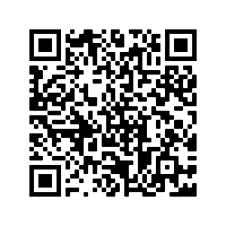
Deberes
Vocabulary Learning Homework (Term 1.1, Week 3)
Audio file
Audio file QR code:
Student worksheet
Quizlet link

